Slide 1
Fundamentals of Inventory Management
Daniel Kaszubowski

Slide 2
Road Transportation Systems Engineering Development in the Sub-Saharan Africa – Modern EU Master Programme & Capacity Building

Slide 4
Learning Objectives
Understand the purpose of inventory and four types (raw materials, WIP, finished goods, safety stock)
Identify four categories of inventory costs and their trade-offs
Calculate key inventory performance metrics (turnover, days of inventory, fill rate)
Analyze the balance between inventory investment and service level
Apply inventory concepts to real business scenarios

Slide 5
Section 1
Purpose and Types of Inventory

Slide 6
Why Companies Hold Inventory
Decouple supply and demand: Production/supply schedules don't match customer demand patterns. Inventory bridges the gap.
Protect against uncertainty: Demand fluctuates. Lead times vary. Suppliers fail. Inventory provides buffer.
Enable economies of scale: Buy/make in bulk (lower per-unit cost) but sell gradually. Inventory absorbs difference.
Reduce customer wait time: Customers want products NOW. Finished goods inventory enables fast delivery.

Slide 7
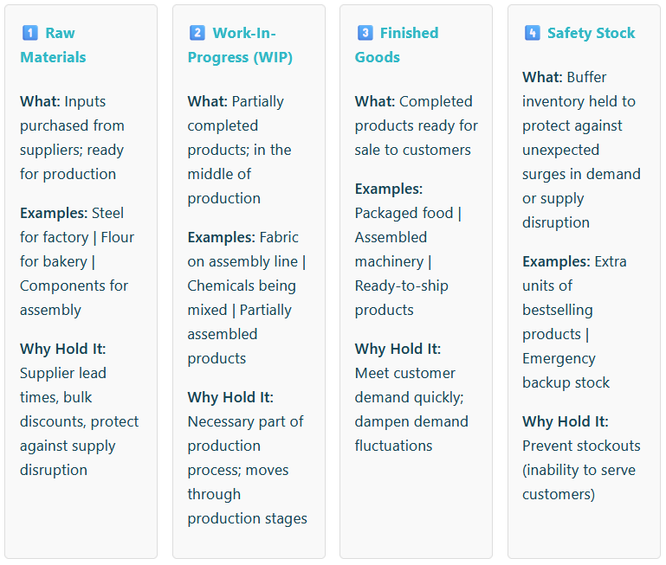
Four Types of Inventory

Slide 8
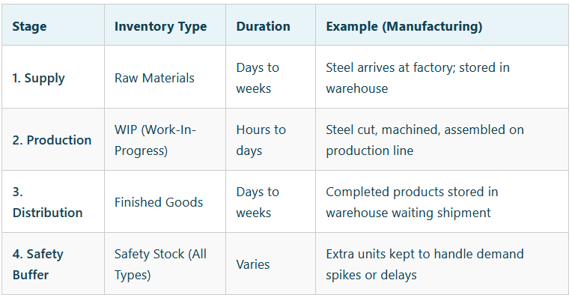
How inventory flows through a company

Slide 9
Section 2
Inventory Costs
- The Four Cost Categories

Slide 10
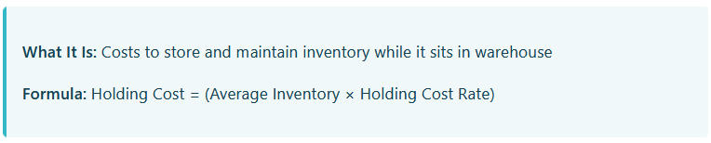
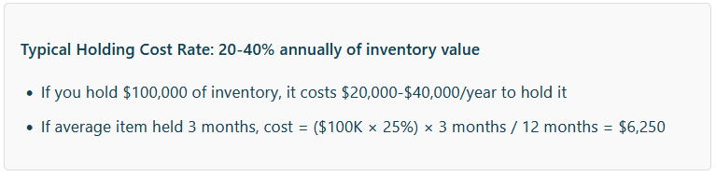
Cost Category 1:
Holding (Carrying) Costs

Slide 11
Components of Holding Cost
Storage Space: Warehouse rent/depreciation for space occupied by inventory
Handling & Movement: Labor to move, organize, manage inventory
Insurance: Insurance on inventory value (protection against theft, damage)
Obsolescence/Spoilage: Products expire, spoil, become outdated, or are damaged
Shrinkage: Loss to theft, damage, or miscount
Working Capital Cost: Cost of capital tied up in inventory (money could be invested elsewhere)

Slide 12
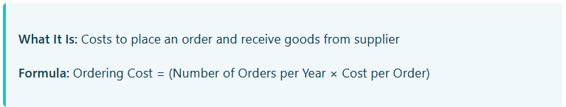
Cost Category 2: Ordering Costs
The Ordering Cost Trade-Off:
Order frequently (small quantities): High ordering costs (many orders)
Order infrequently (large quantities): Low ordering costs (few orders) but high holding costs (big inventory)

Slide 13
Components of Ordering Cost
Procurement Time: Buyer time to requisition, negotiate, process PO
Receiving Time: Receiving dock labor to unload, inspect, log goods
Quality Inspection: Testing and verification of incoming goods
Processing/Approval: Accounting to match invoice to PO to receipt
Transportation: Sometimes company pays for shipping from supplier

Slide 14
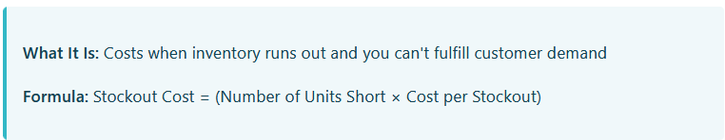
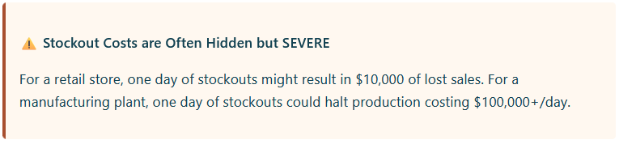
Cost Category 3: Stockout Costs

Slide 15
Components of Stockout Cost
Lost Sales: Customer buys from competitor instead
Lost Profit: Revenue and margin lost on that sale
Customer Dissatisfaction: Customer may not return; lifetime value lost
Emergency Ordering Costs: Have to expedite supplies at premium prices to recover
Backorder Costs: Customer orders but has to wait; may cancel
Brand Damage: Reputation hurt if customers experience stockouts

Slide 16
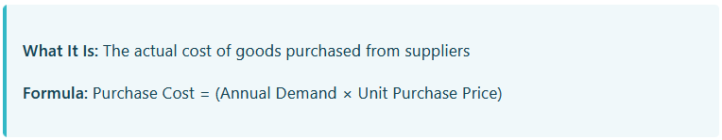
Cost Category 4: Purchase Cost
Why It Matters:
Bulk purchases = lower per-unit price (volume discounts)
Small purchases = higher per-unit price (pay premium for small orders)
Inventory decisions affect purchase price paid

Slide 17
Section 3
Inventory
Performance Metrics

Slide 18
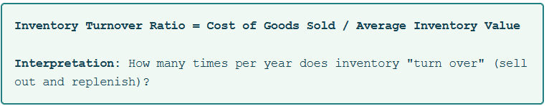
Metric 1: Inventory Turnover Ratio
What It Means:
High turnover (e.g., 12x/year): Inventory sells quickly; company doesn't hold much stock; efficient
Low turnover (e.g., 2x/year): Inventory sits for long periods; slow-moving; may indicate demand problem or overstocking

Slide 19
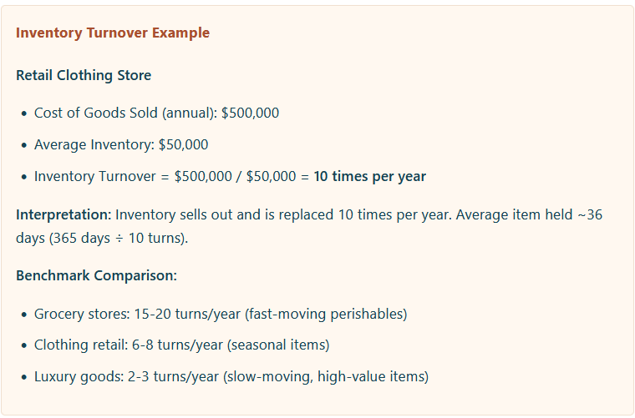

Slide 20
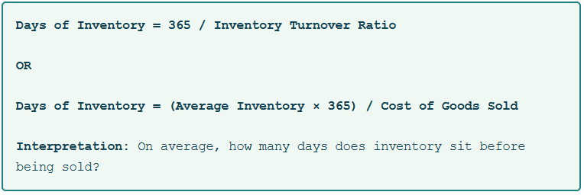
Metric 2: Days of Inventory
What It Means:
Low days (e.g., 20 days): Inventory moves quickly; good cash flow; minimal holding costs
High days (e.g., 180 days): Inventory sits a long time; ties up capital; high holding costs

Slide 21
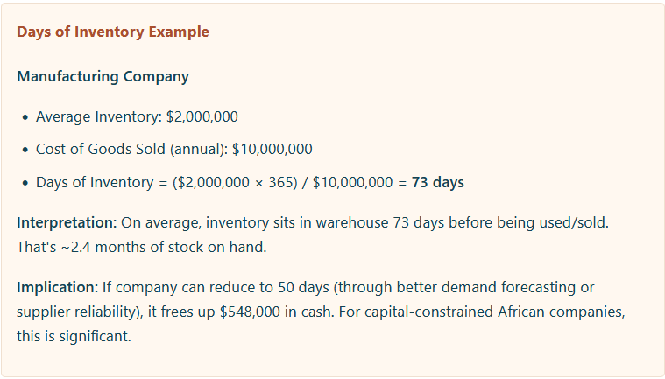

Slide 22
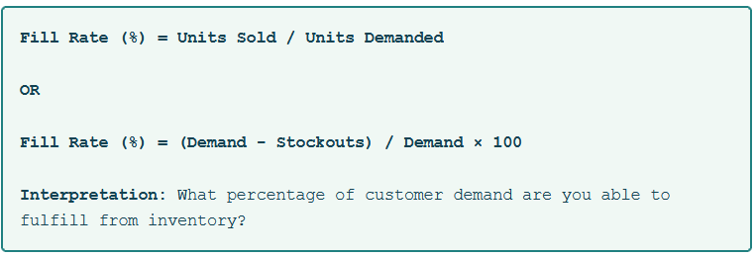
Metric 3: Fill Rate / Service Level
What It Means:
100% Fill Rate: Never stockout; always have what customers want
95% Fill Rate: 95% of customer orders fulfilled; 5% result in stockout/backorder
90% Fill Rate: 10% of customers can't get what they want; lose to competition

Slide 23
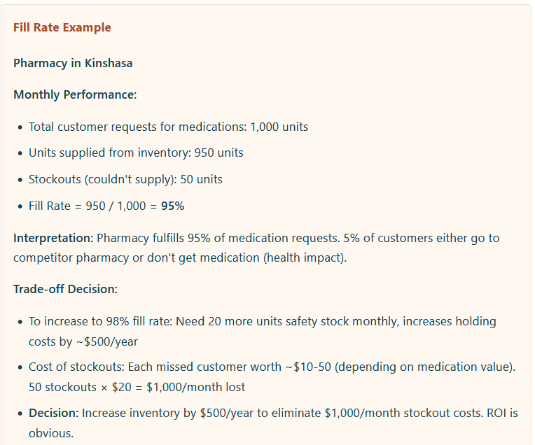

Slide 24
Key Takeaways
Four Types of Inventory: Raw materials | WIP | Finished goods | Safety stock. Each serves strategic purpose.
Four Cost Categories: Holding (storage), Ordering (procurement), Stockout (lost sales), Purchase (goods cost). They compete and require balance.
Inventory Turnover: Measures how fast inventory moves. Higher is better (faster cash conversion).
Days of Inventory: Measures how long inventory sits. Lower is better (less cash tied up, lower holding costs).
Fill Rate: Measures ability to meet customer demand from inventory. Target is typically 95-99% depending on industry.
The Balance: Optimal inventory minimizes TOTAL cost (holding + ordering + stockout), not just one category.

