Slide 1
Inventory Control
Daniel Kaszubowski

Slide 2
Road Transportation Systems Engineering Development in the Sub-Saharan Africa – Modern EU Master Programme & Capacity Building

Slide 4
Learning Objectives
Classify items into A, B and C groups using the Pareto principle.
Calculate a simple Economic Order Quantity (EOQ) and interpret what it means.
Compute a basic Reorder Point (ROP) under constant and variable demand/lead time.
Estimate safety stock for a chosen service level using a simple z-value.
Understand additional concepts such as review systems and service level.

Slide 5
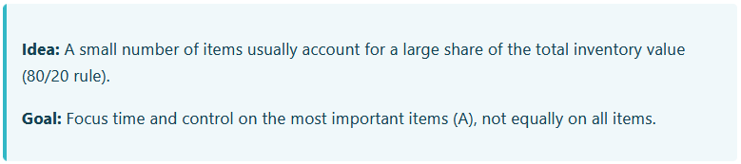
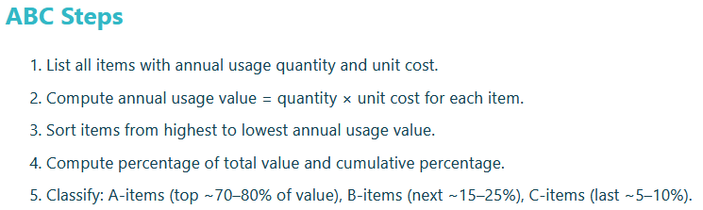
ABC Analysis (Pareto Principle)

Slide 6
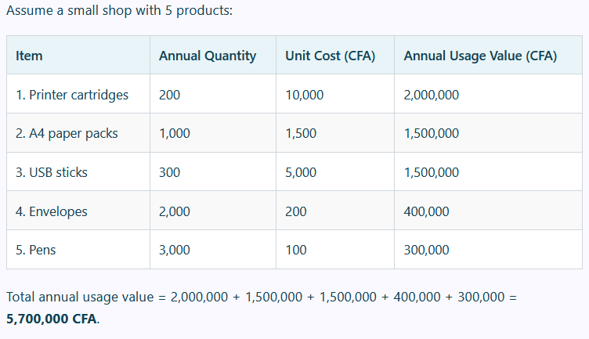
Example – Simple ABC Classification

Slide 7
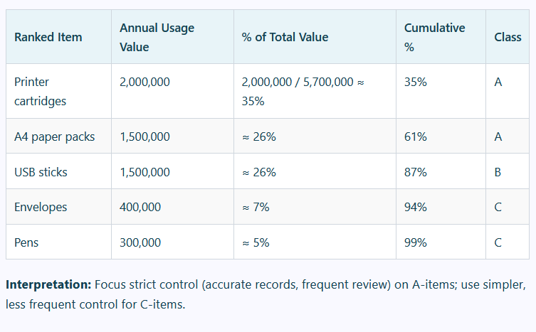
Example – Simple ABC Classification

Slide 8
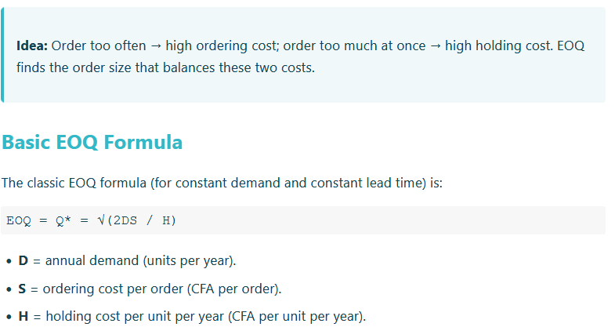
Economic Order Quantity (EOQ)

Slide 9
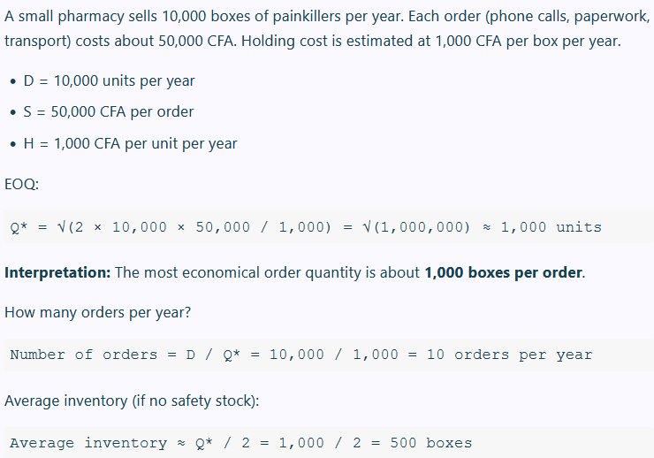
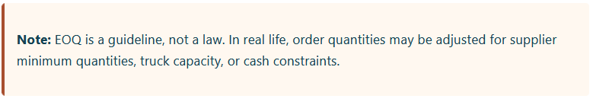
Example – Simple EOQ Calculation

Slide 10
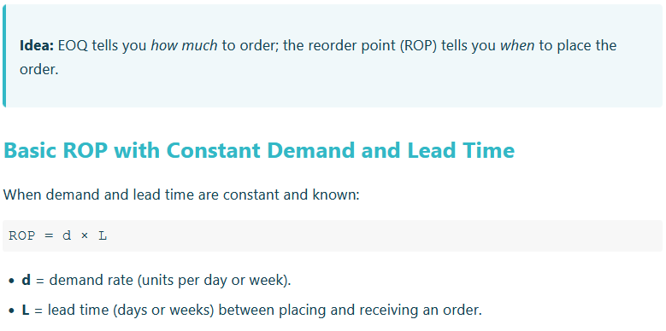
Reorder Point (ROP) Systems

Slide 11
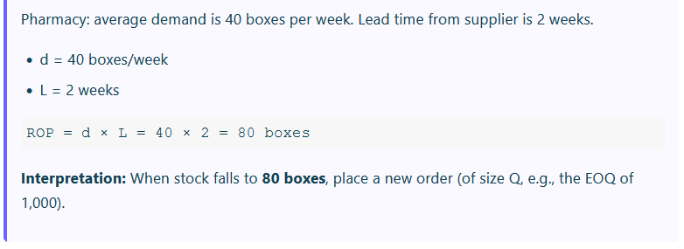
Example – Simple ROP

Slide 12
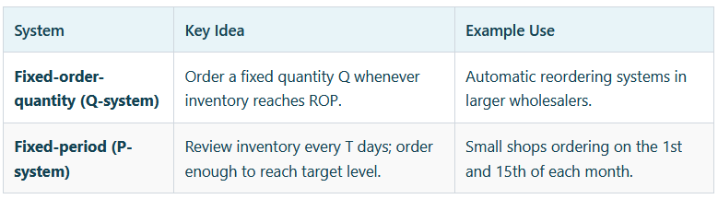
Fixed-Order-Quantity vs Fixed-Period Systems

Slide 13
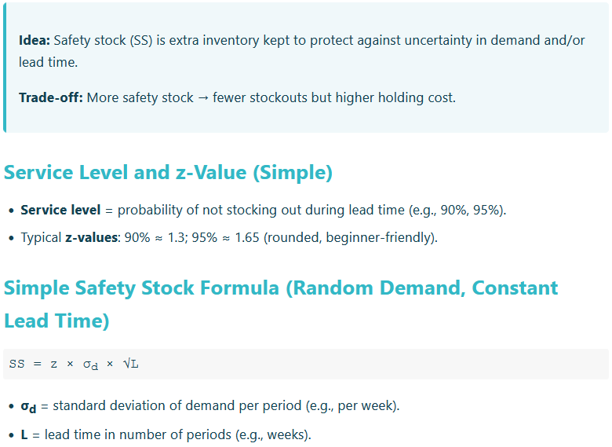
Safety Stock Calculation

Slide 14
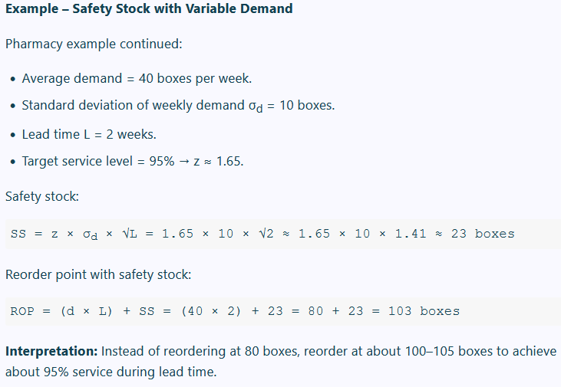
Example – Safety Stock with Variable Demand

Slide 15
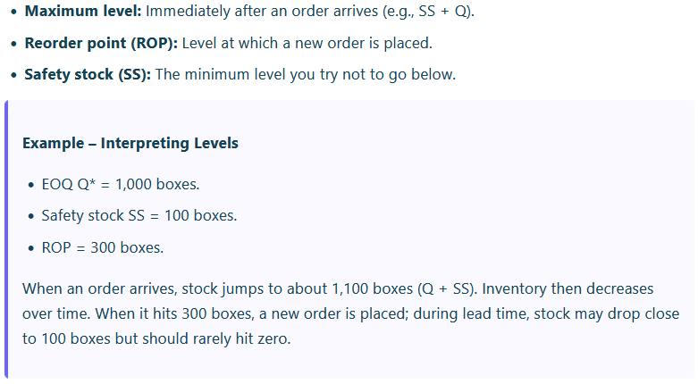
Inventory Levels: Visualizing the System

Slide 16
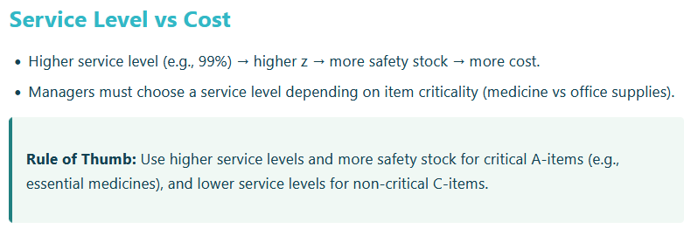
Service Level vs Cost

