Slide 1
Supply Chain Strategy and Network Design
Daniel Kaszubowski

Slide 2
Road Transportation Systems Engineering Development in the Sub-Saharan Africa – Modern EU Master Programme & Capacity Building

Slide 4
Learning Objectives
Explain the link between business strategy and supply chain network design.
Describe supply base management strategies and strategic purchasing planning.
Distinguish between supply chain and supply network concepts.
Compare centralization vs. decentralization and global vs. local-for-local strategies.
Recognize the role of network orchestration, extended enterprise, and virtual supply chains.

Slide 5
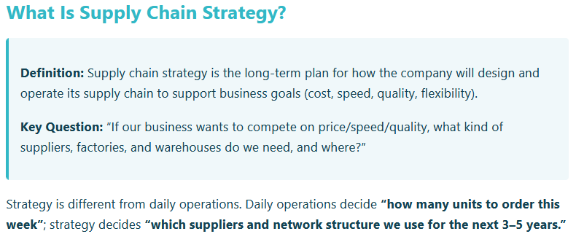
Supply Chain Strategy & Supply Base Management

Slide 6
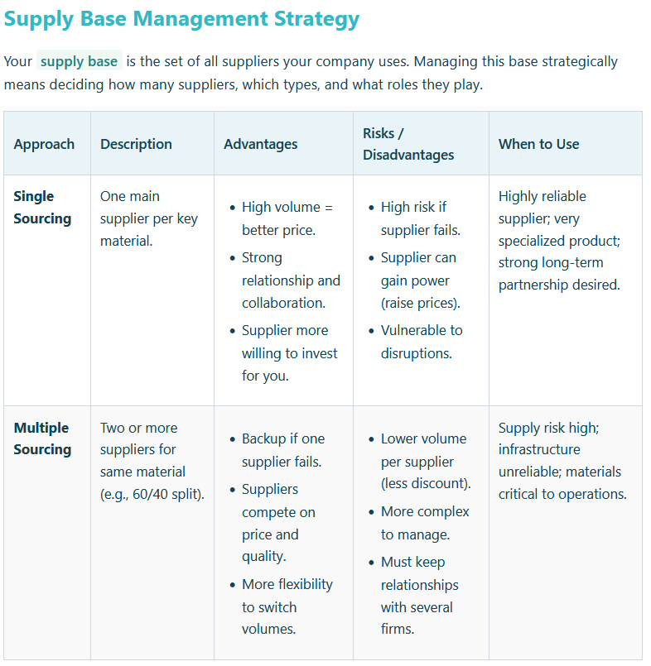
Supply Chain Strategy & Supply Base Management

Slide 7
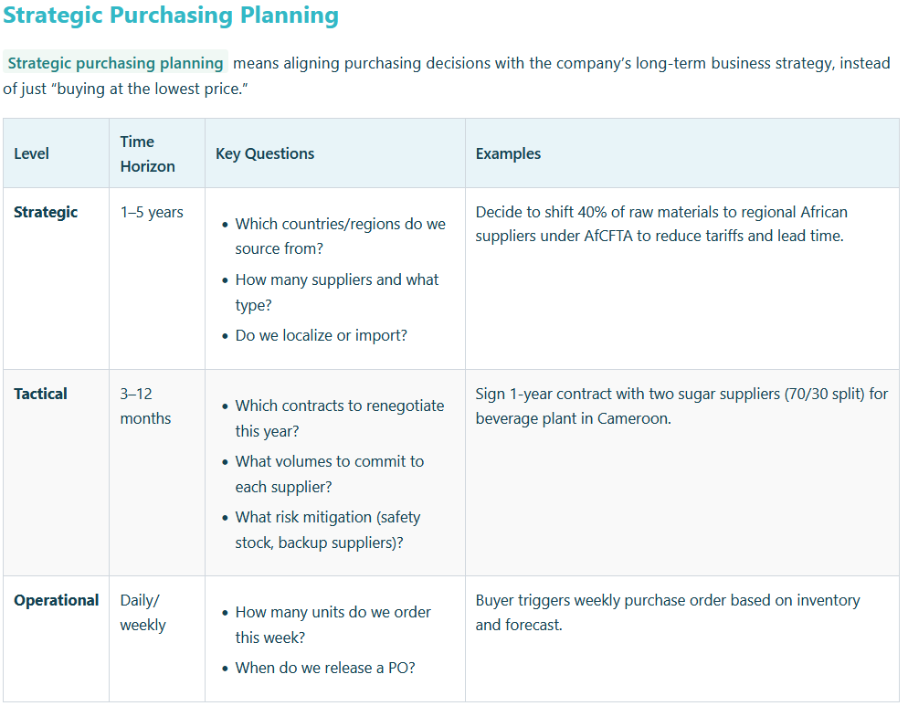

Slide 8
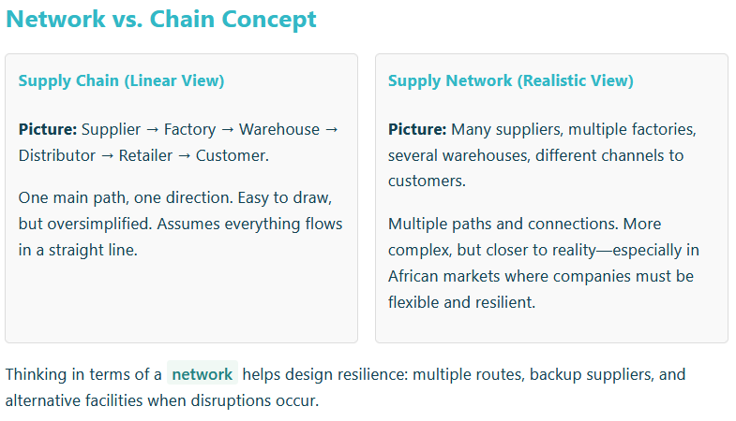
From Chain to Network & Centralization Decisions

Slide 9
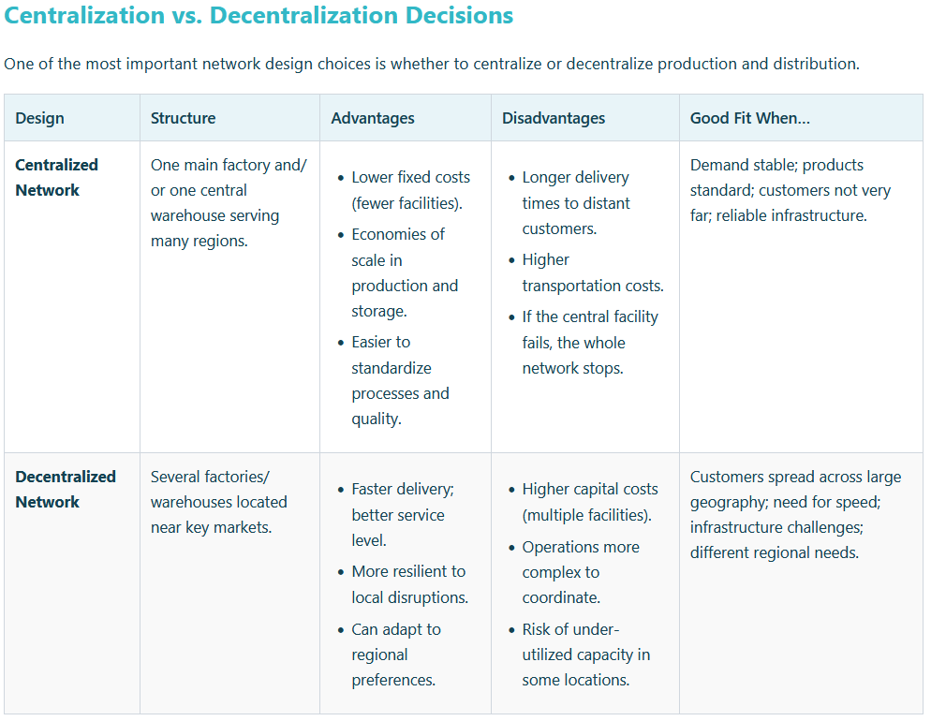

Slide 10
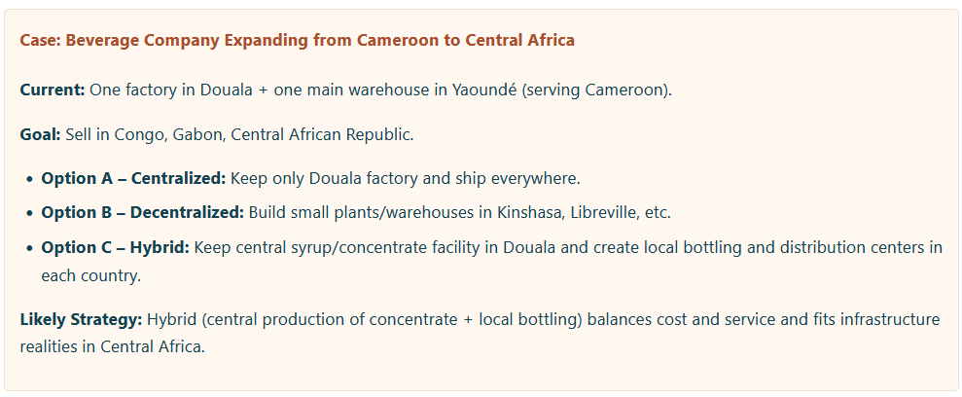
From Chain to Network & Centralization Decisions

Slide 11
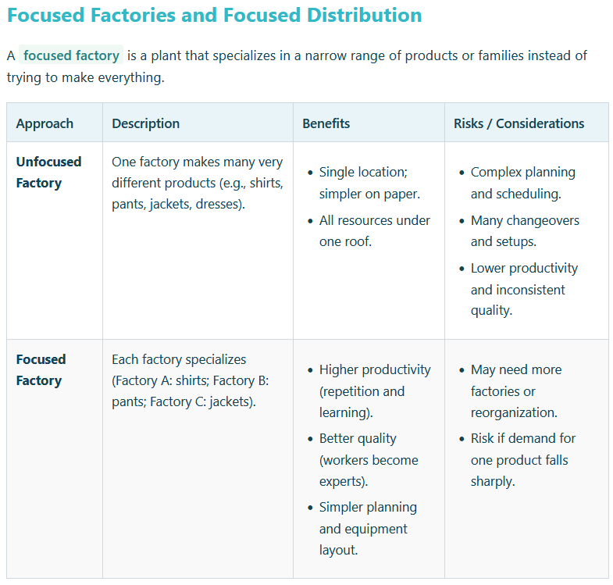
Focused Factories, Distribution Strategies, and Global vs. Local-for-Local

Slide 12
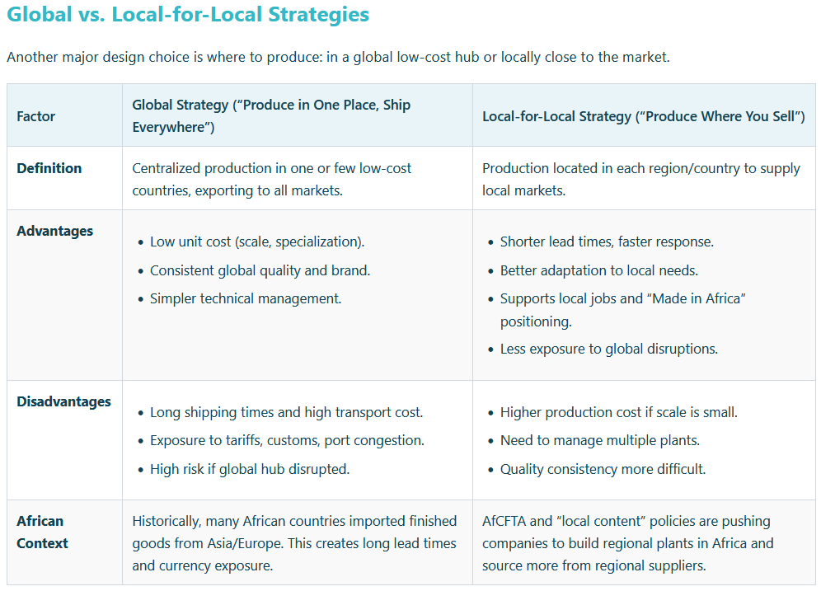

Slide 13
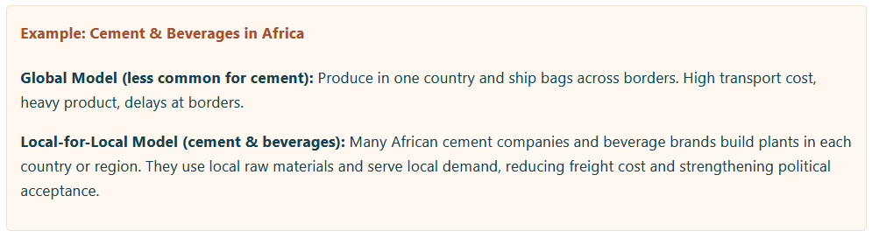
Focused Factories, Distribution Strategies, and Global vs. Local-for-Local

Slide 14
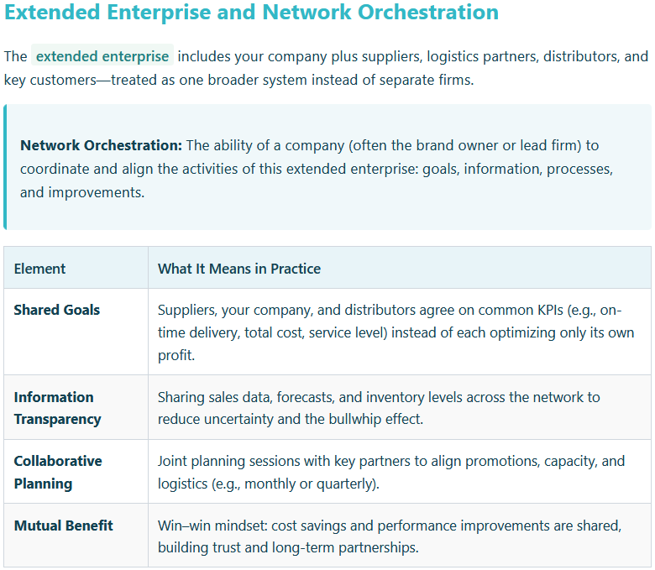
Network Orchestration, Extended Enterprise
& Virtual Supply Chains

Slide 15
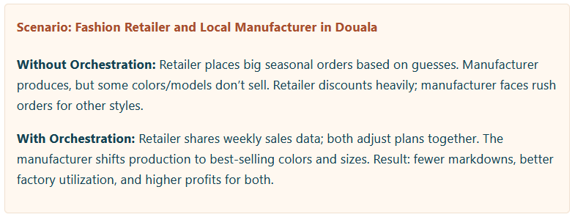
Network Orchestration, Extended Enterprise & Virtual Supply Chains

Slide 16
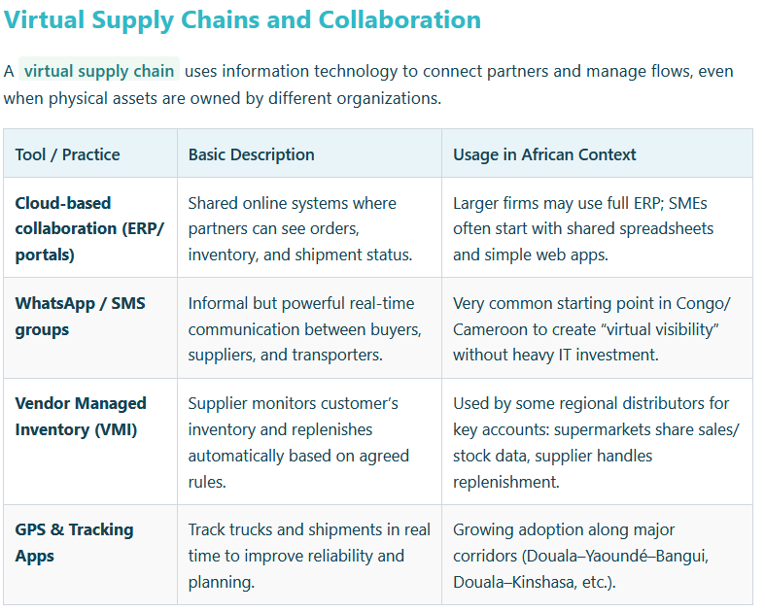
Virtual Supply Chains
and Collaboration

Slide 17
Key Takeaways
Supply chain strategy must align with business goals and drives decisions on supply base, facilities, and network structure.
Supply base management (single vs. multiple sourcing) and strategic purchasing planning are core long-term levers.
Modern supply chains are networks, not simple chains; centralization vs. decentralization is a crucial design choice.
Focused factories and distribution, and the choice between global and local-for-local, shape cost, speed, and resilience—especially under AfCFTA and African infrastructure realities.
Network orchestration, extended enterprise, and virtual supply chains emphasize collaboration, shared information, and coordination across all partners.

