Slide 1
Agile vs. Lean Supply Chains
Daniel Kaszubowski

Slide 2
Road Transportation Systems Engineering Development in the Sub-Saharan Africa – Modern EU Master Programme & Capacity Building

Slide 4
Learning Objectives
Explain core lean principles (waste elimination, Just-In-Time) and agile principles (flexibility, responsiveness).
Compare when to use lean vs. agile supply chain strategies.
Describe the decoupling point and postponement strategies.
Recognize hybrid “leagile” approaches that combine lean and agile.
Assess responsiveness requirements for market-sensitive supply chains in Central Africa.

Slide 5
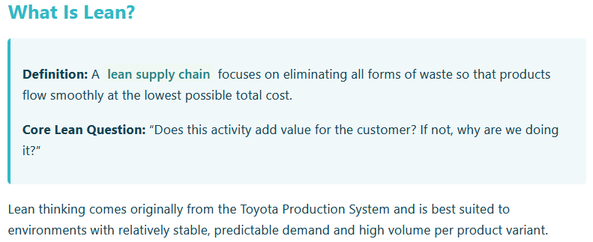
Lean Supply Chains: Efficiency and Waste Elimination

Slide 6
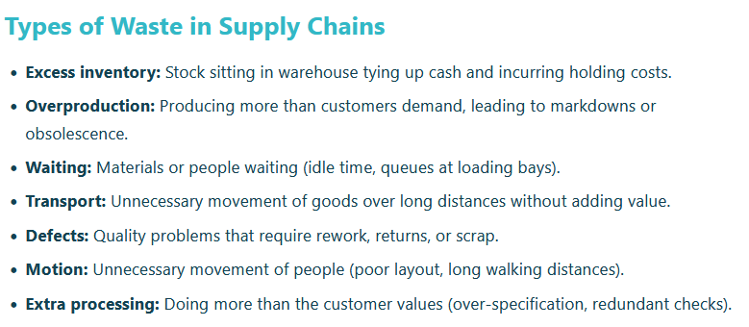
Lean Supply Chains: Efficiency and Waste Elimination

Slide 7
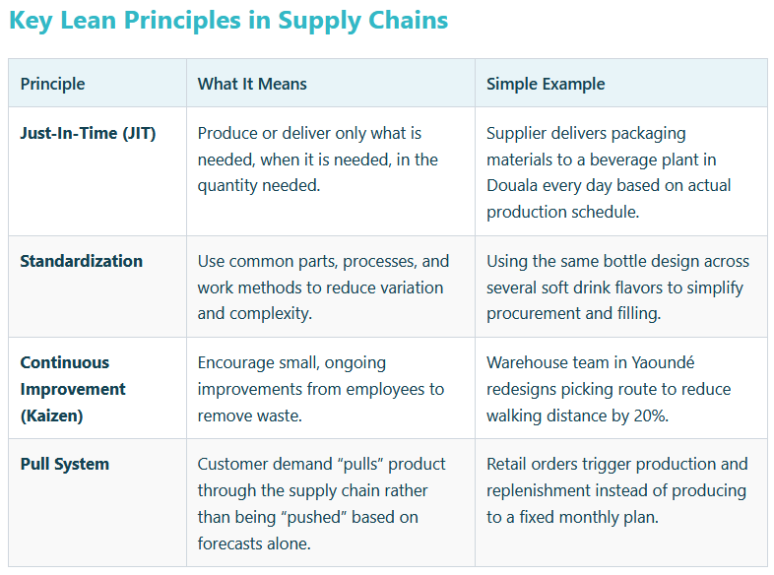
Lean Supply Chains: Efficiency and Waste Elimination

Slide 8
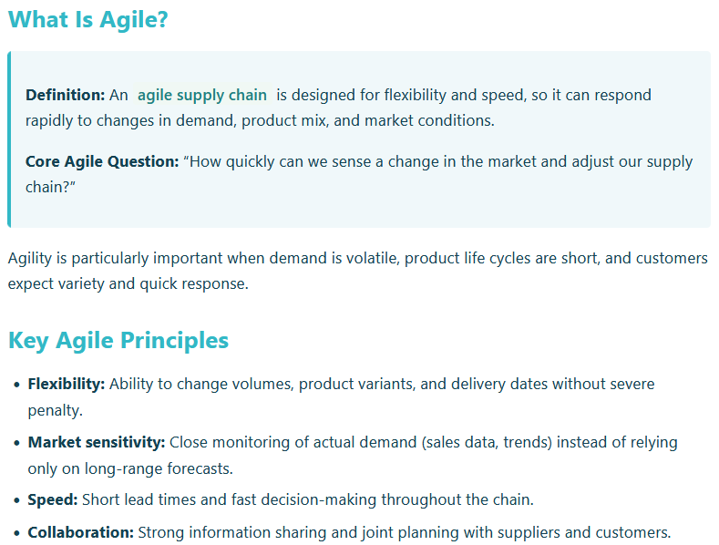
Agile Supply Chains: Flexibility and Responsiveness

Slide 9
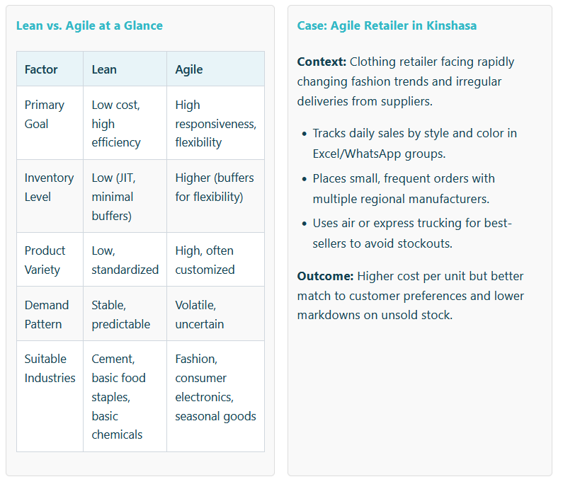
Agile Supply Chains:
Flexibility and Responsiveness

Slide 10
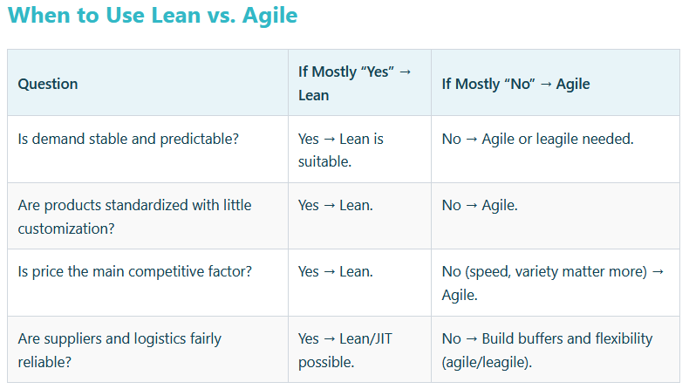
When to Use Lean vs. Agile, Decoupling Point & Postponement

Slide 11
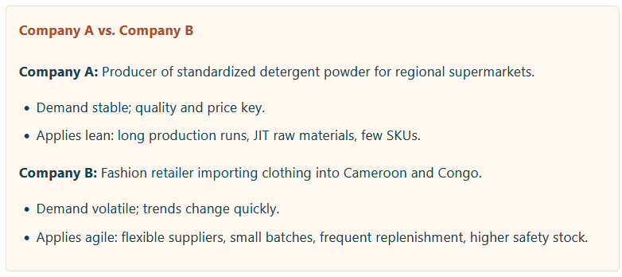
When to Use Lean vs. Agile, Decoupling Point & Postponement

Slide 12
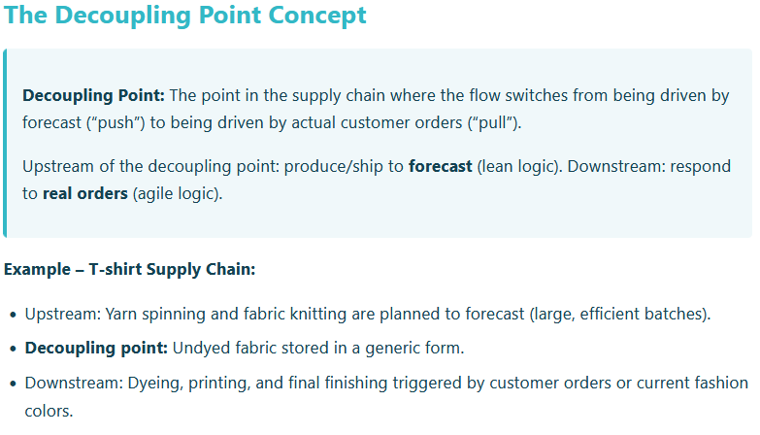
When to Use Lean vs. Agile, Decoupling Point & Postponement

Slide 13
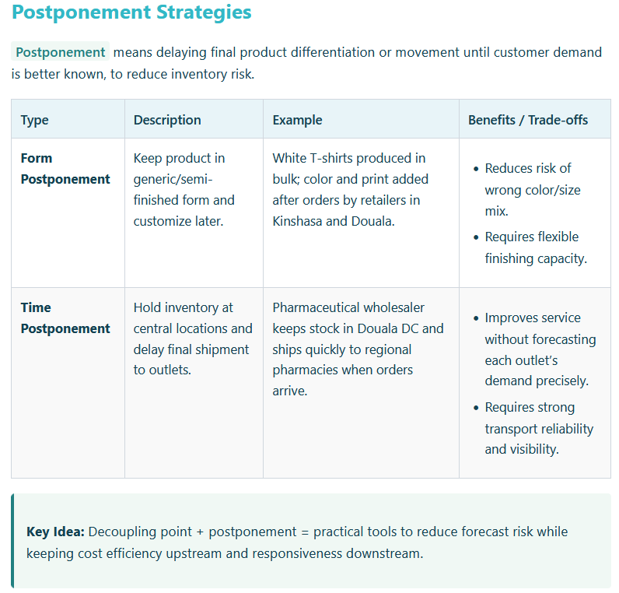
When to Use Lean vs. Agile, Decoupling Point & Postponement

Slide 14
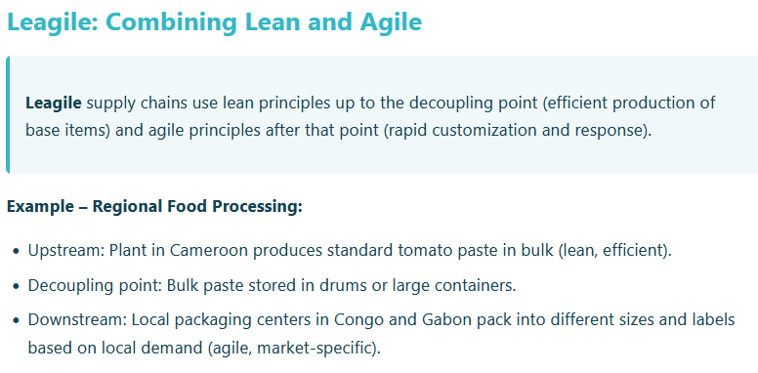
Hybrid (Leagile) Approaches & Market-Sensitive Supply Chains

Slide 15
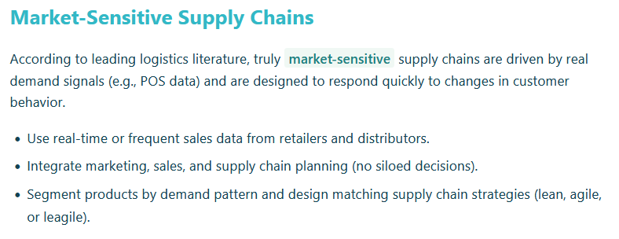
Hybrid (Leagile) Approaches & Market-Sensitive Supply Chains

Slide 16
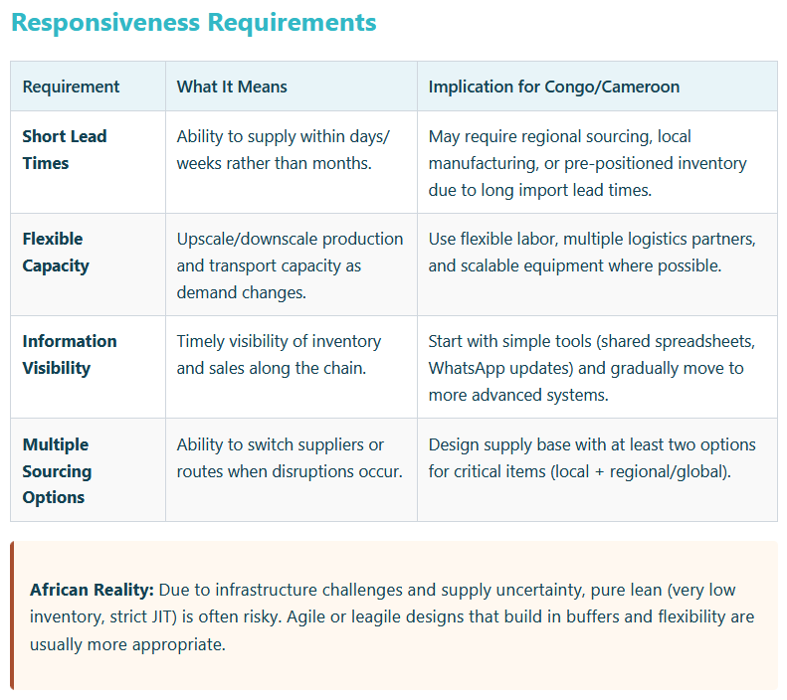

Slide 17
Key Takeaways
Lean is best for stable, predictable, cost-driven environments.
Agile is best for volatile, variety-driven, speed-sensitive environments.
The decoupling point and postponement help manage uncertainty by separating lean upstream from agile downstream.
Leagile combines the strengths of lean and agile and is often ideal in African markets with mixed demand patterns and infrastructure constraints.
Designing a market-sensitive and responsive supply chain requires information visibility, flexible capacity, and appropriate sourcing strategies.

