Slide 1
Supply Chain Risk Management
Daniel Kaszubowski

Slide 2
Road Transportation Systems Engineering Development in the Sub-Saharan Africa – Modern EU Master Programme & Capacity Building

Slide 4
Learning Objectives
Explain why modern supply chains are vulnerable to disruption.
Identify key types of supply chain risk (supply, demand, process, control, environmental).
Apply simple risk assessment tools (risk mapping, basic FMEA, impact–likelihood matrix, risk appetite).
Design basic mitigation strategies (redundancy, flexibility, visibility, collaboration, insurance).
Recognize specific risk patterns in Central and West African contexts and appropriate responses.

Slide 5
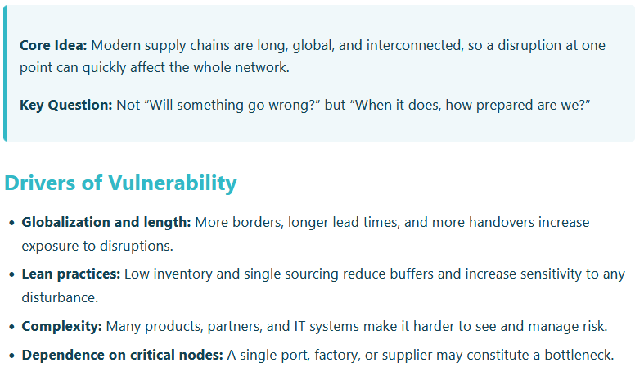
Why Supply Chains Are Vulnerable

Slide 6
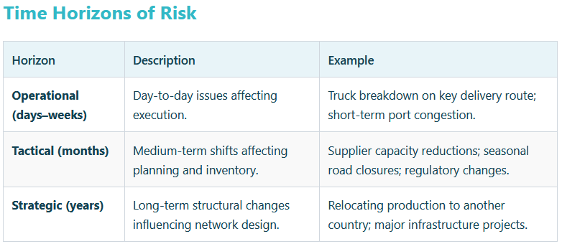
Why Supply Chains Are Vulnerable

Slide 7
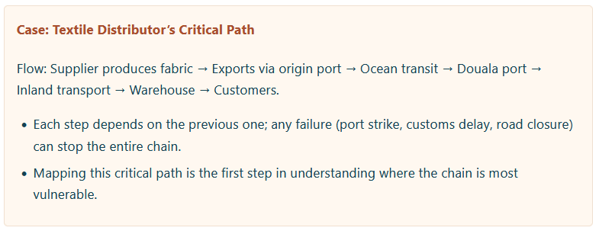
Why Supply Chains Are Vulnerable

Slide 8
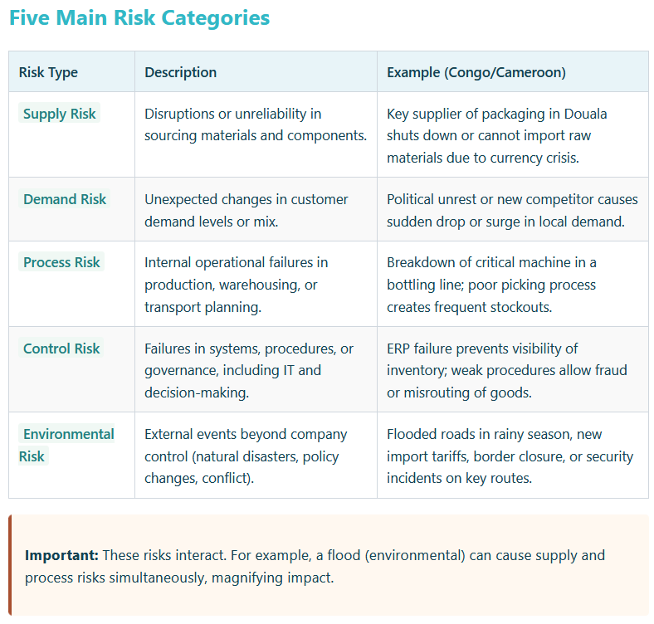
Types of Supply Chain Risk

Slide 9
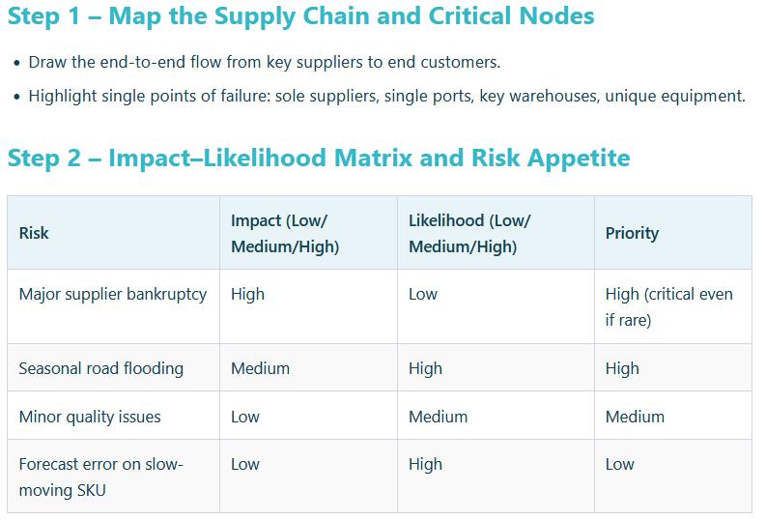
Risk Assessment Methods

Slide 10
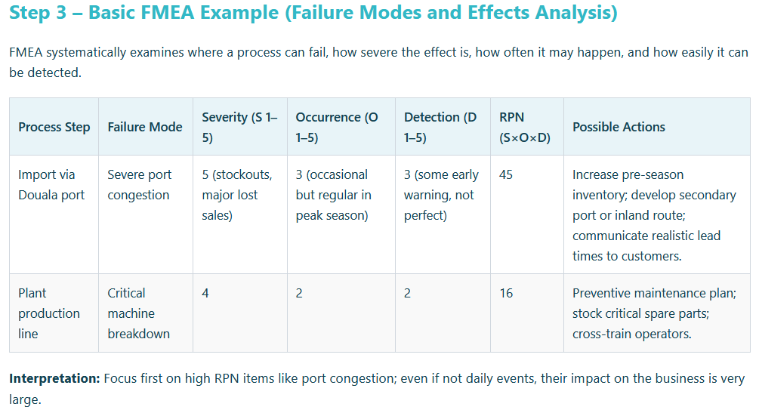
Risk Assessment Methods

Slide 11
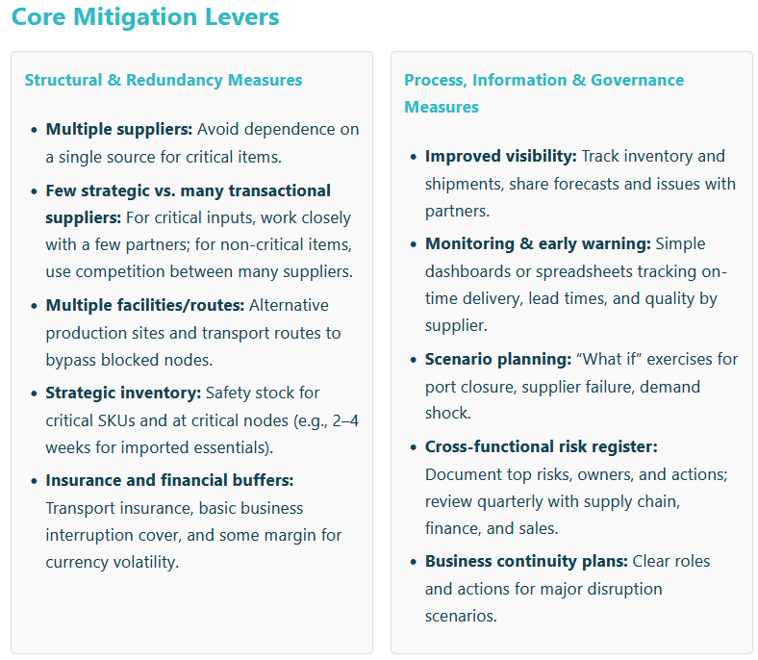
Risk Mitigation Strategies

Slide 12
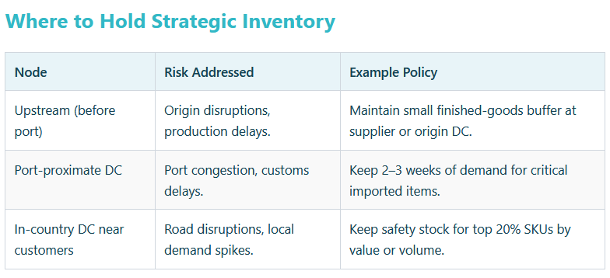
Risk Mitigation Strategies

Slide 13
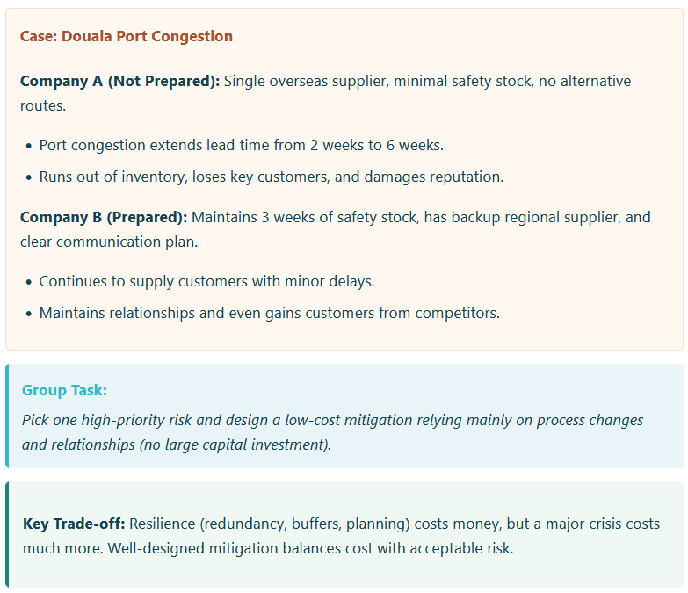
Risk Mitigation Strategies

Slide 14
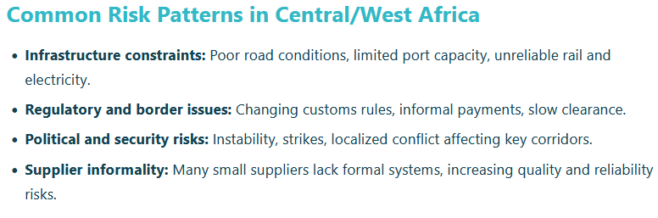
African Context: Typical Risks and Responses

Slide 15
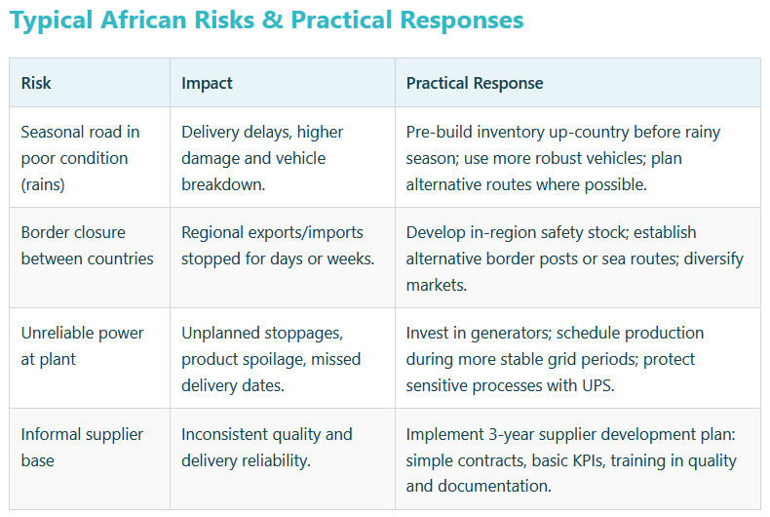
African Context: Typical Risks and Responses

