Slide 1
Quality Management in Supply Chains
Daniel Kaszubowski

Slide 2
Road Transportation Systems Engineering Development in the Sub-Saharan Africa – Modern EU Master Programme & Capacity Building

Slide 4
Learning Objectives
Explain core Total Quality Management (TQM) principles and how they apply along the supply chain.
Describe key quality standards (ISO 9001, ISO 14001) and their relevance for buyers and suppliers.
Define supplier quality requirements and basic supplier development steps.
Calculate the cost of quality and cost of poor quality with simple examples.
Show how quality becomes a competitive weapon, not only a cost.
Distinguish between inspection and prevention approaches to quality.

Slide 5
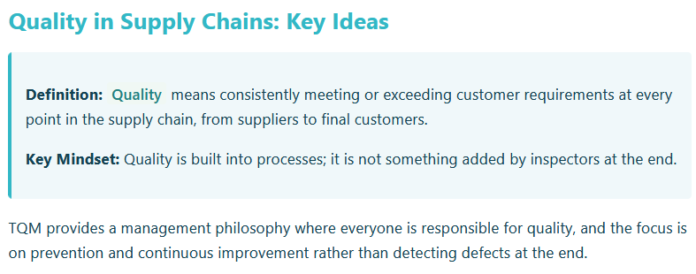
Total Quality Management (TQM) Principles in Supply Chains

Slide 6
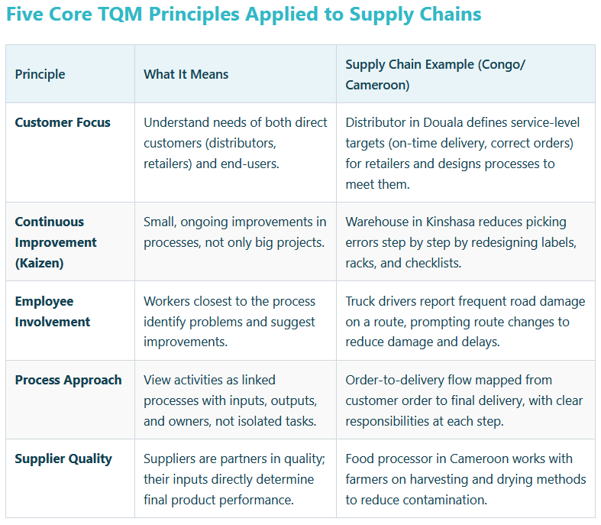

Slide 7
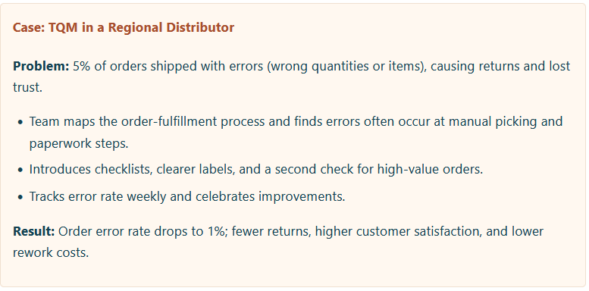
Total Quality Management (TQM) Principles in Supply Chains

Slide 8
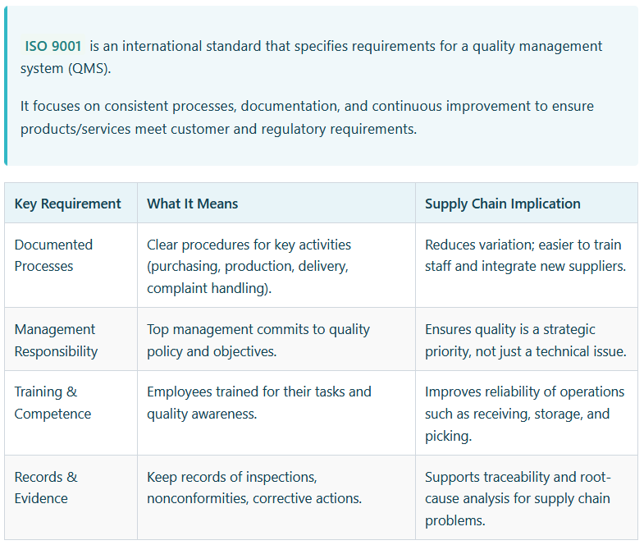
Quality Standards: ISO 9001 and ISO 14001

Slide 9
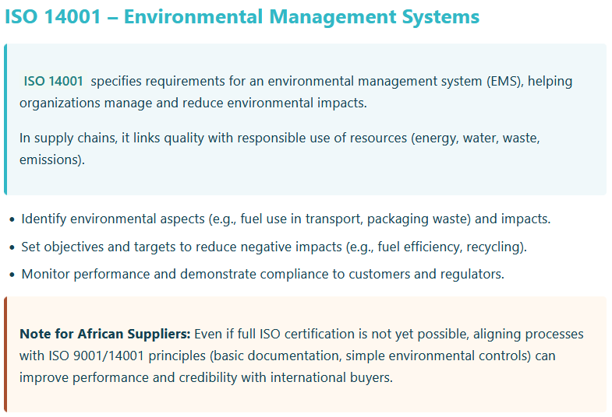
Quality Standards: ISO 9001 and ISO 14001

Slide 10
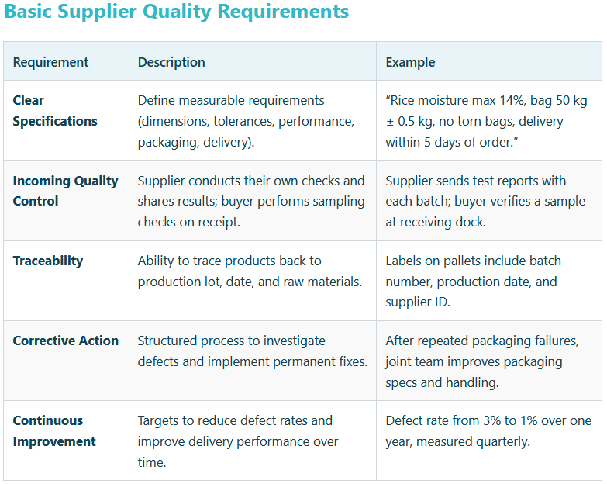
Supplier Quality Requirements and Development

Slide 11
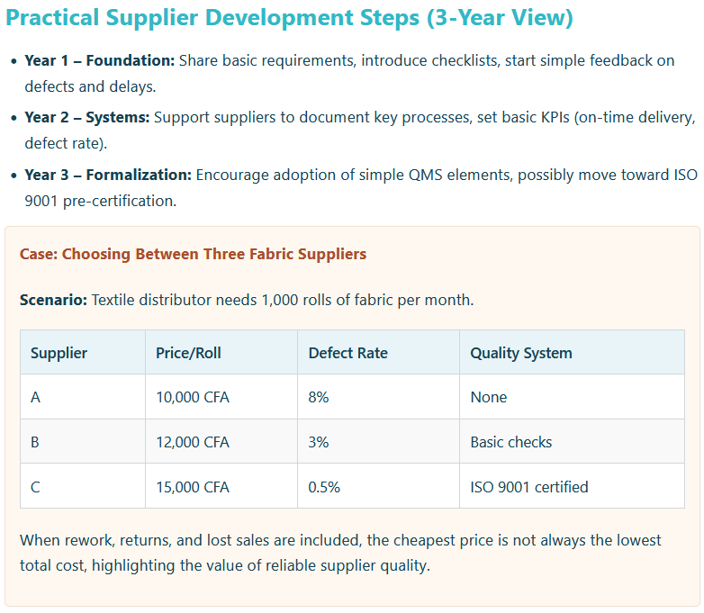

Slide 12
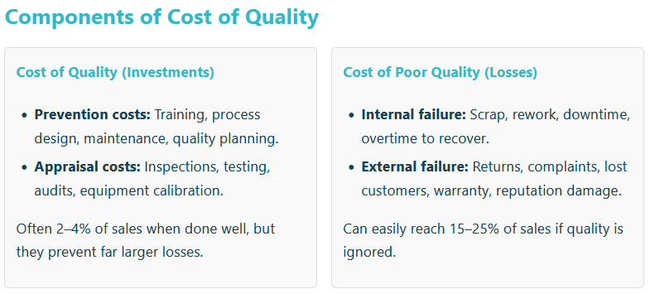
Cost of Quality vs. Cost of Poor Quality

Slide 13
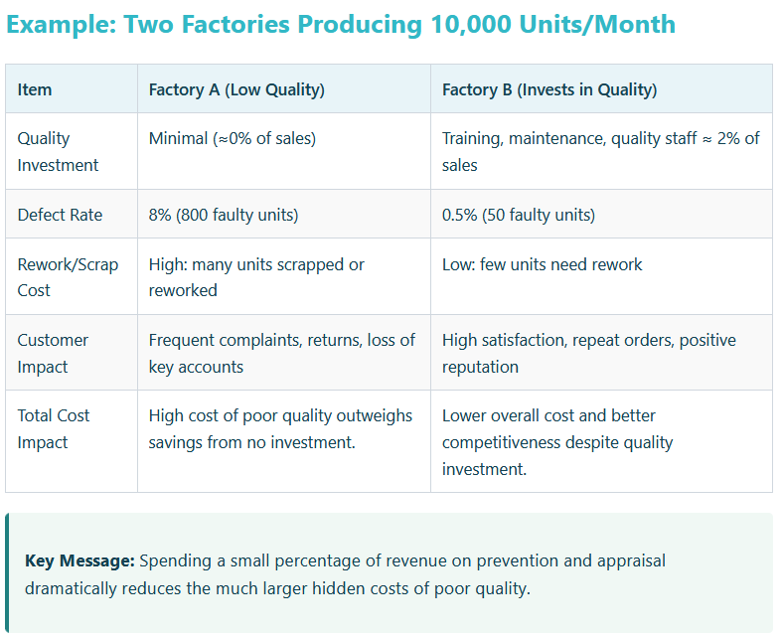

Slide 14
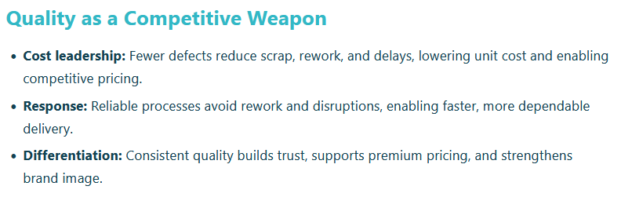
Quality as Competitive Variable & Inspection vs. Prevention

Slide 15
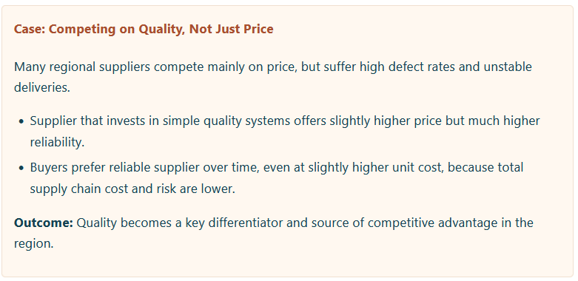
Quality as Competitive Variable & Inspection vs. Prevention

Slide 16
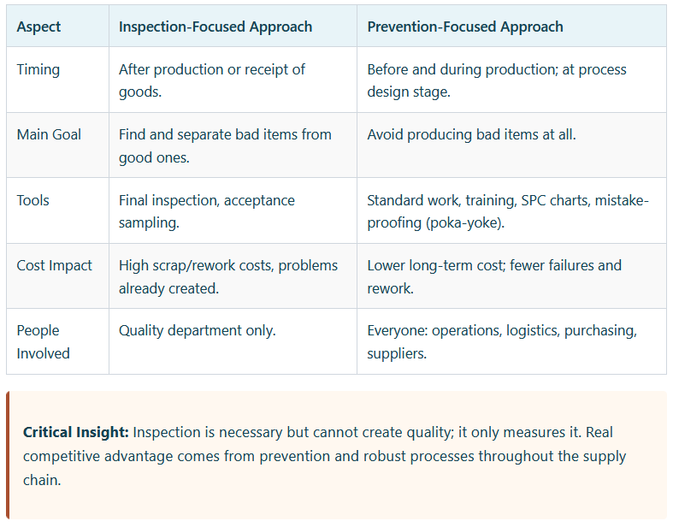
Inspection vs. Prevention

