Slide 1
Supply Chain Performance Measurement
Daniel Kaszubowski

Slide 2
Road Transportation Systems Engineering Development in the Sub-Saharan Africa – Modern EU Master Programme & Capacity Building

Slide 4
Learning Objectives
Identify and classify KPIs across customer, internal, and financial dimensions
Calculate Perfect Order Achievement and understand its four components
Explain the Balanced Scorecard approach and why it prevents silos
Apply benchmarking practices to assess supply chain performance
Describe Kaizen continuous improvement and the PDCA cycle
Develop realistic performance targets aligned with strategy and context

Slide 5
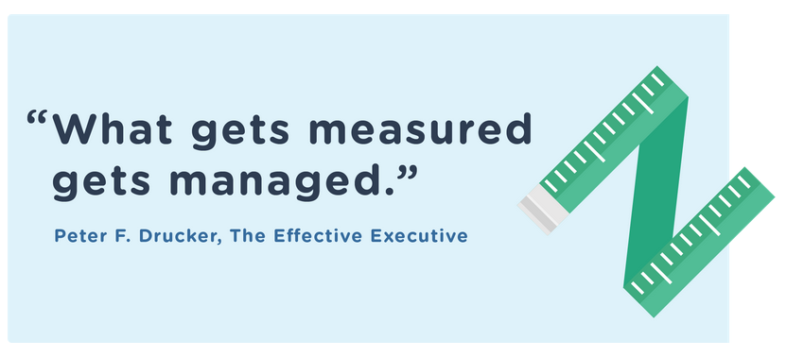
How do you know if your supply chain is winning or losing?

Slide 6
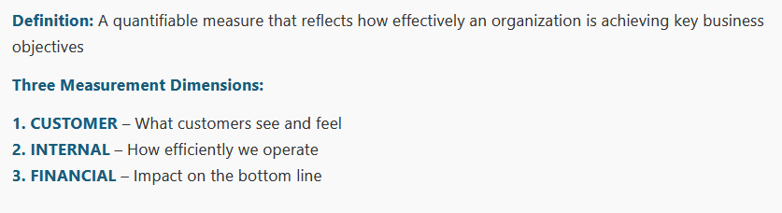
1. Key Performance Indicators (KPIs) – The Measurement Foundation

Slide 7
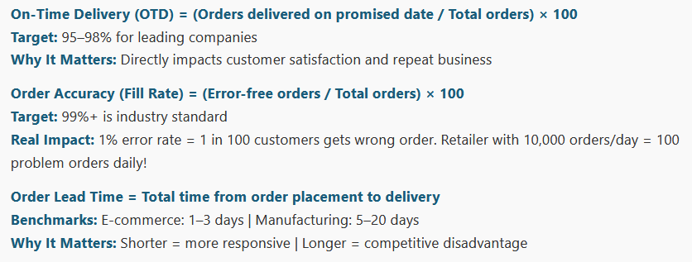
Key Performance Indicators (KPIs)

Slide 8
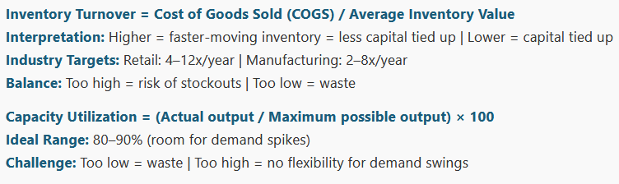
Key Performance Indicators (KPIs)

Slide 9
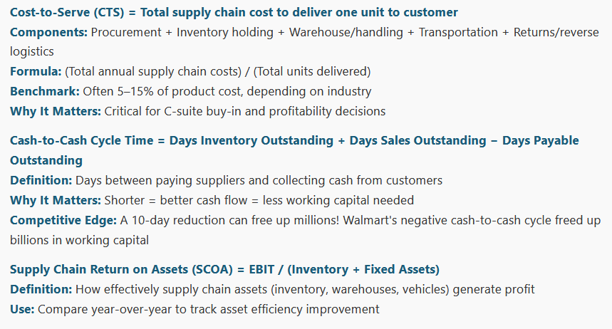
Key Performance Indicators (KPIs)

Slide 10
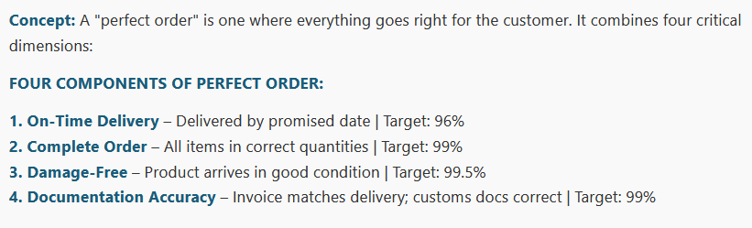
2. Perfect Order Achievement – The Gold Standard

Slide 11
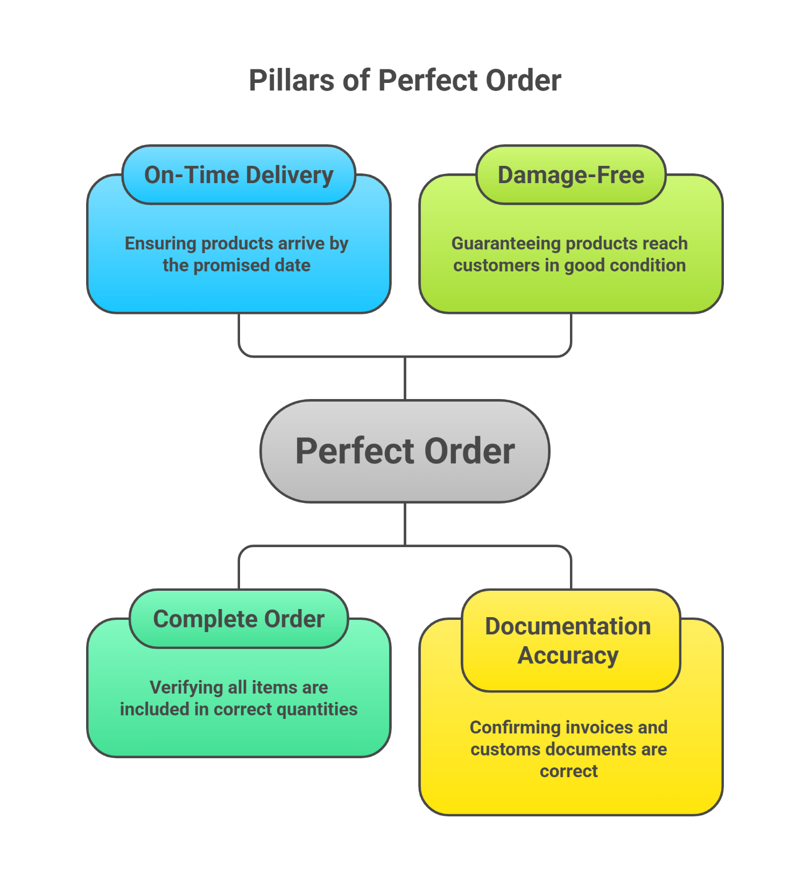

Slide 12
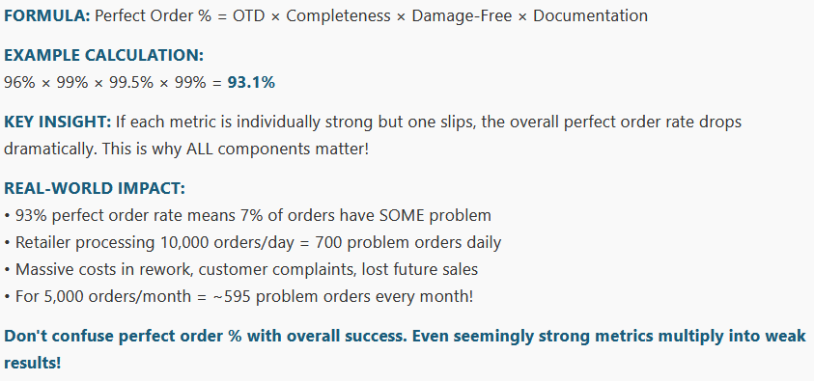
Calculating Perfect Order Achievement

Slide 13
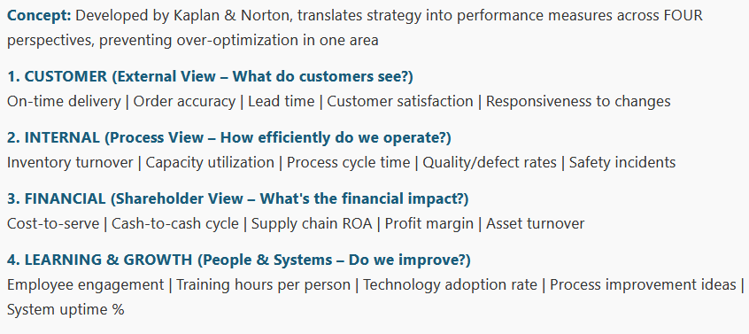
3. The Balanced Scorecard Approach

Slide 14
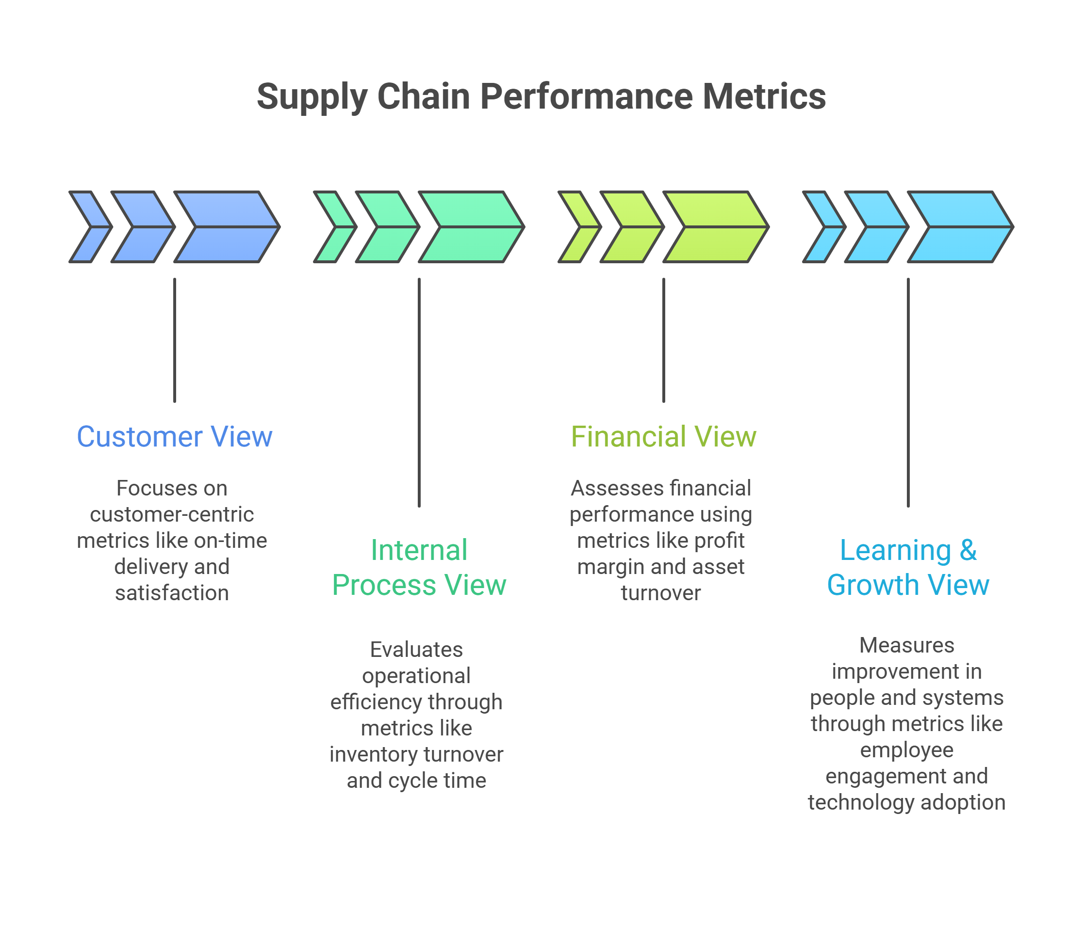

Slide 15
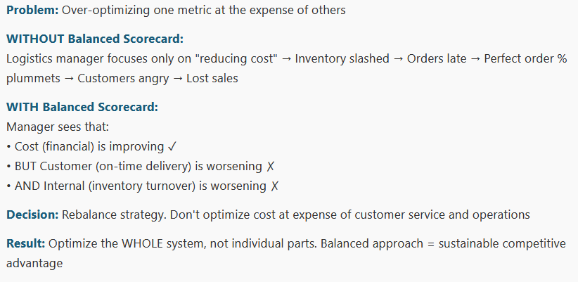
Why the Balanced Scorecard Works

Slide 16
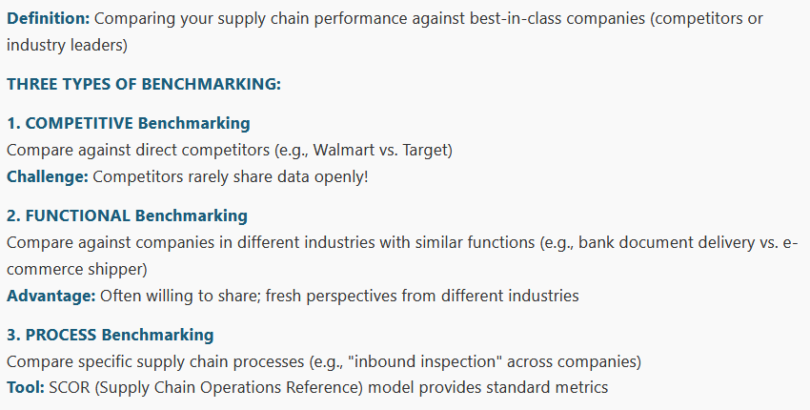
4. Benchmarking Practices

Slide 17
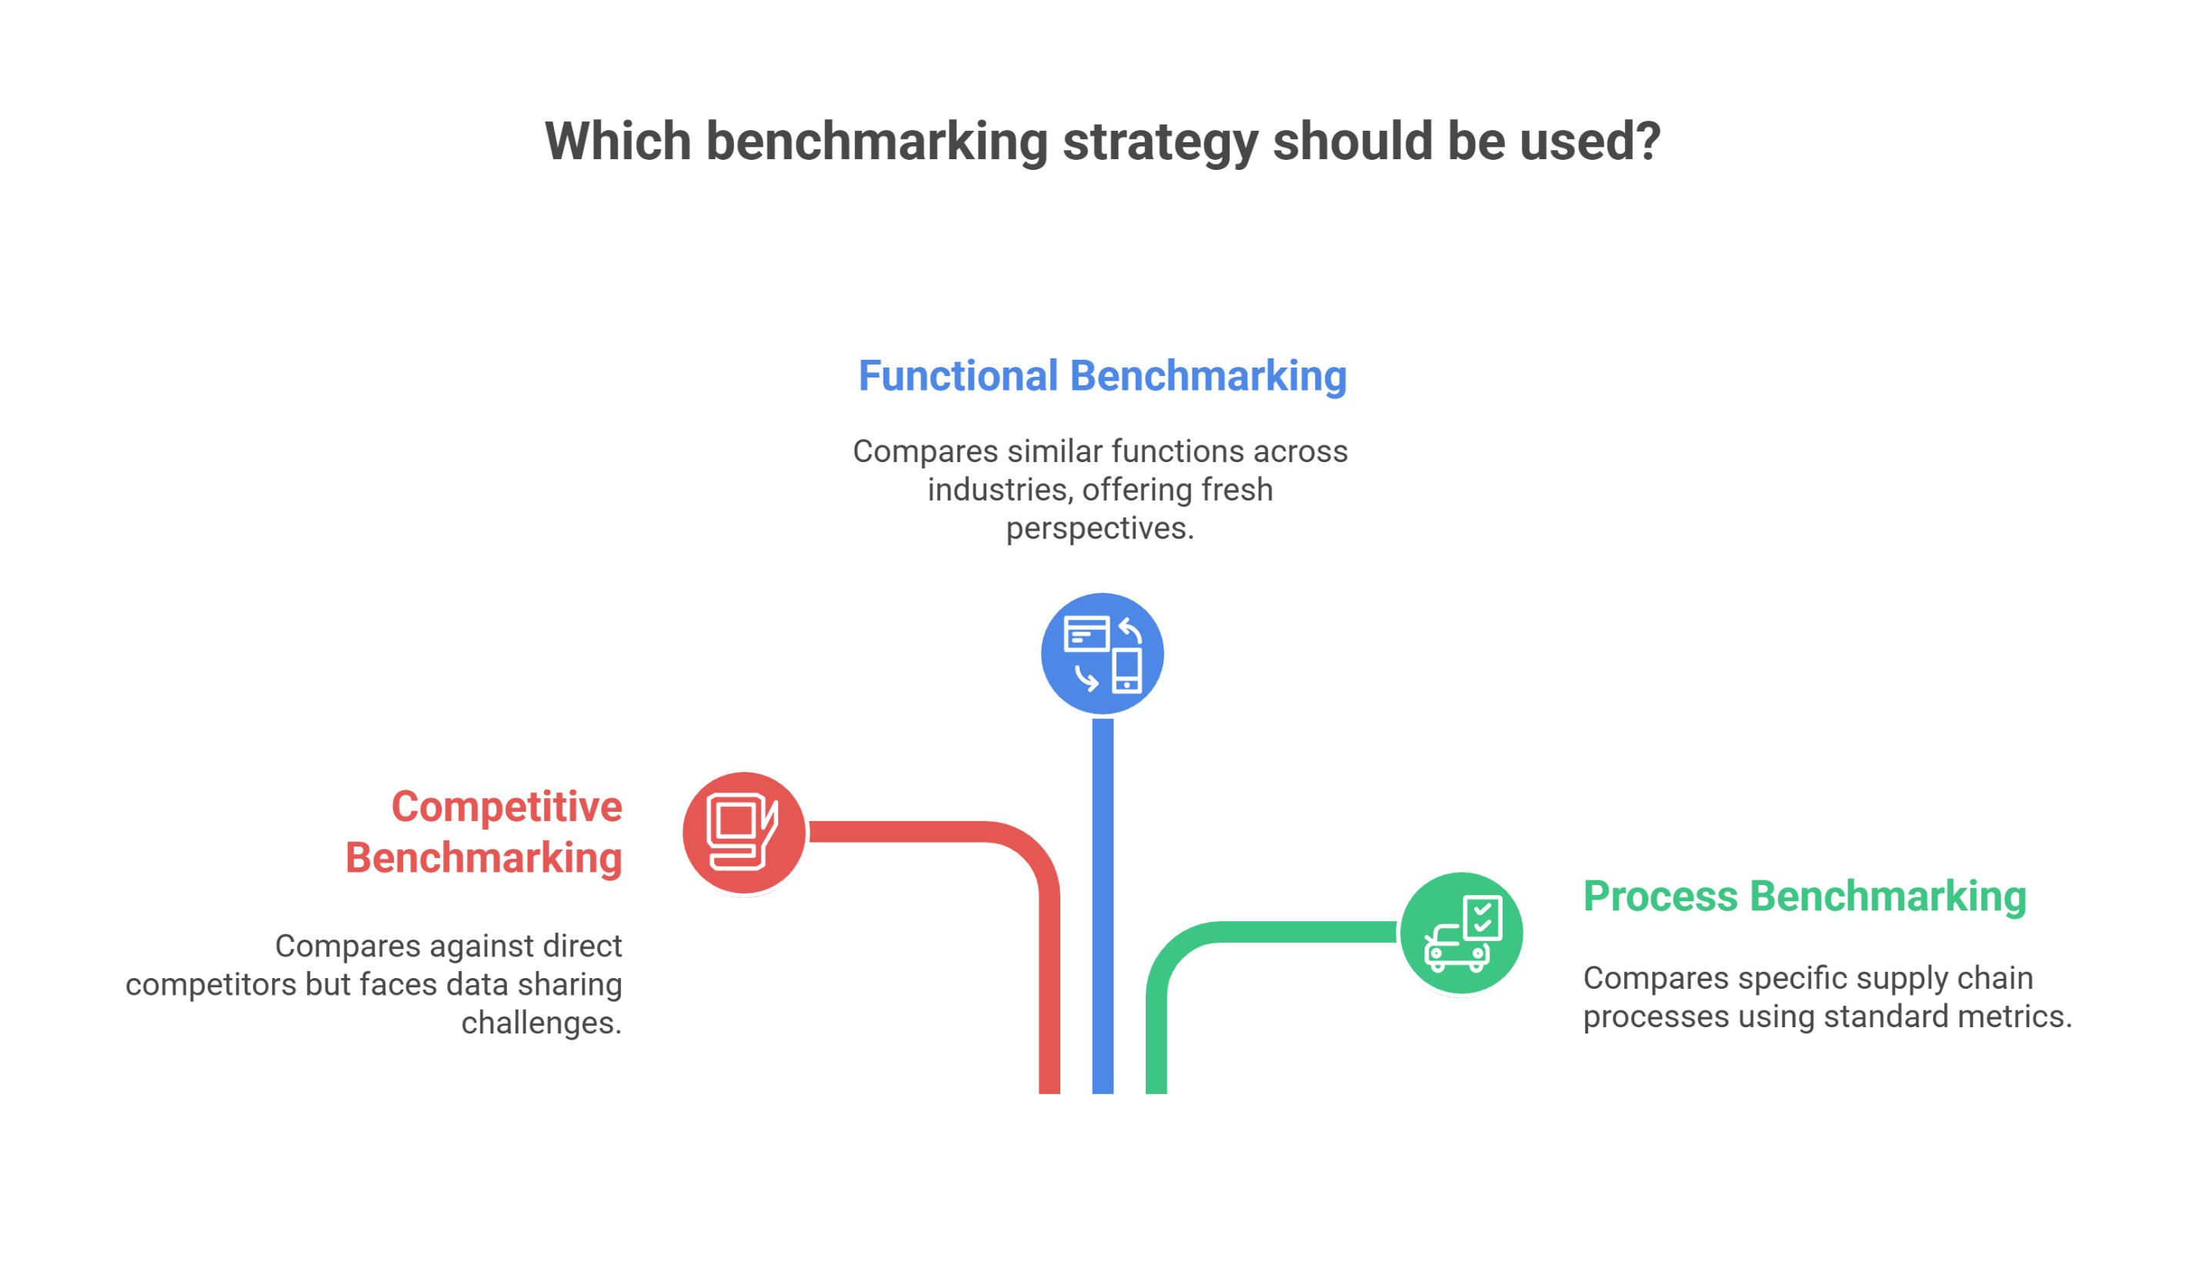

Slide 18
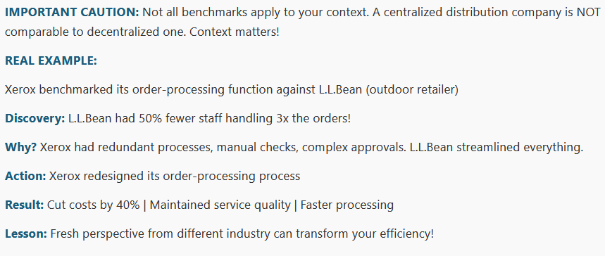
Benchmarking in Action: The Xerox-L.L.Bean Story

Slide 19
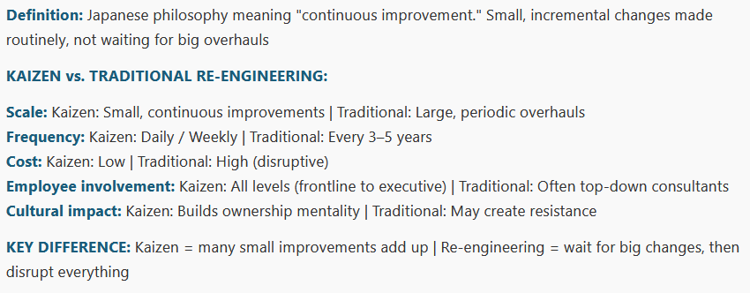
5. Kaizen – Continuous Improvement Philosophy

Slide 20
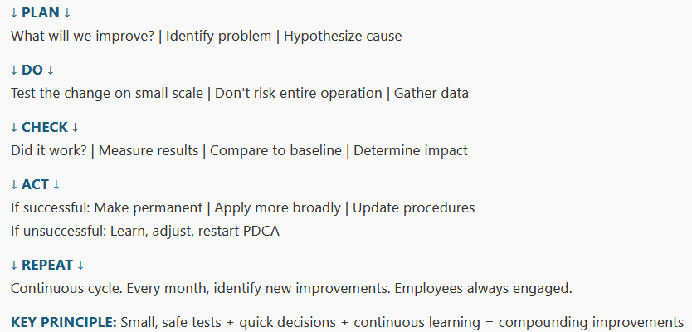
The Kaizen Cycle (PDCA)

Slide 21
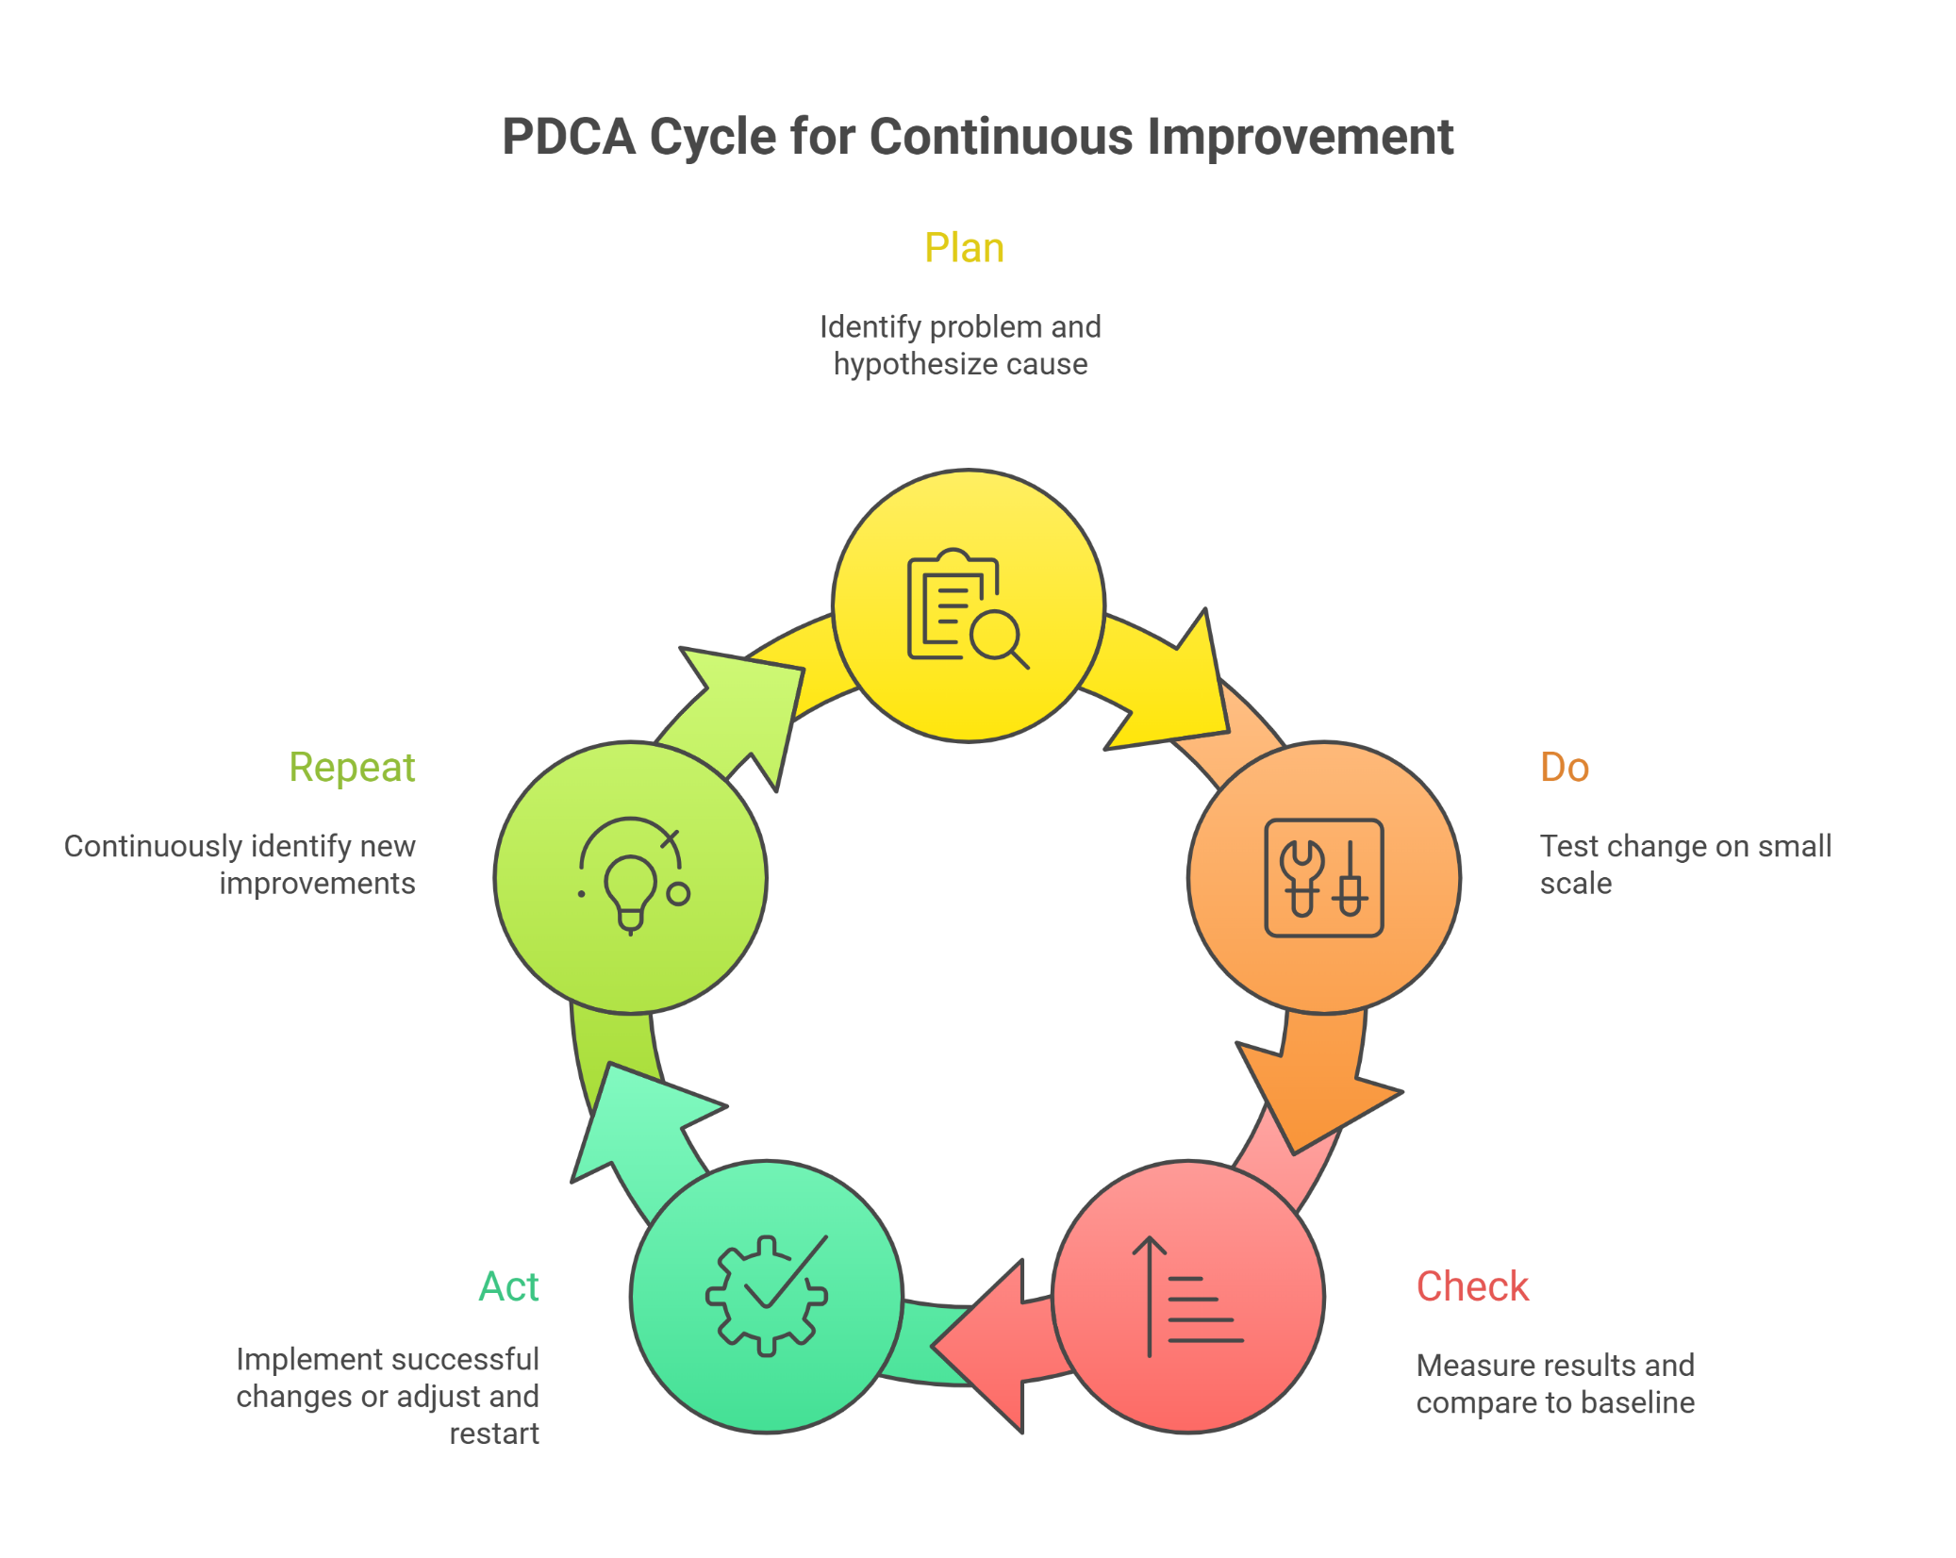

Slide 22
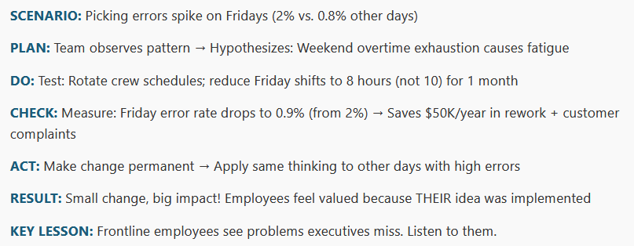
Kaizen in Practice: Warehouse Picking Errors

Slide 23
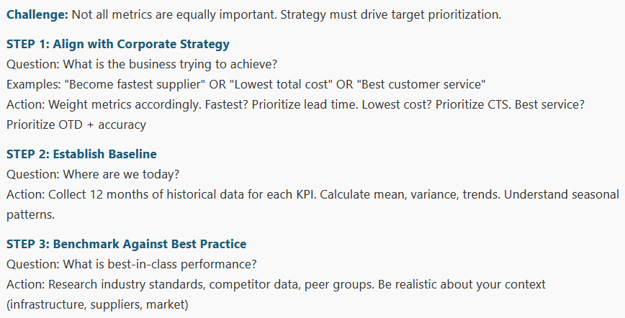
6. Setting Performance Targets – Framework (Part 1)

Slide 24
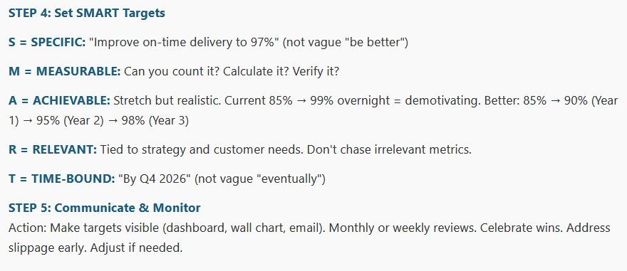
Setting Performance Targets – SMART Targets (Part 2)

Slide 25
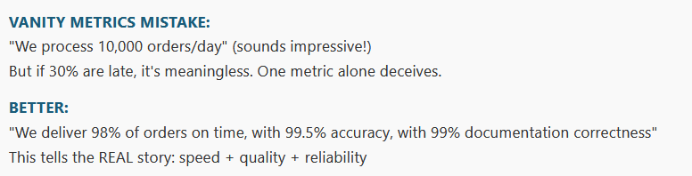
Target Setting: Avoid Vanity Metrics

Slide 26
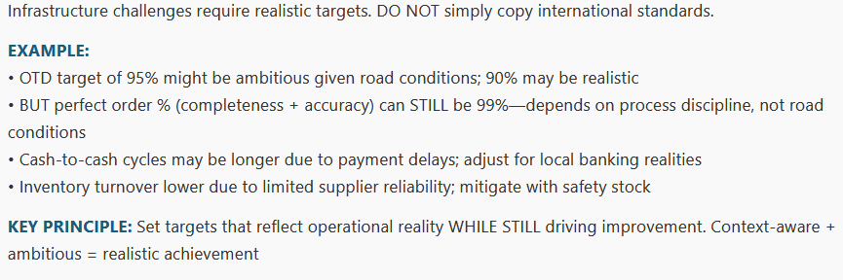
Target Setting: Regional Context

Slide 27
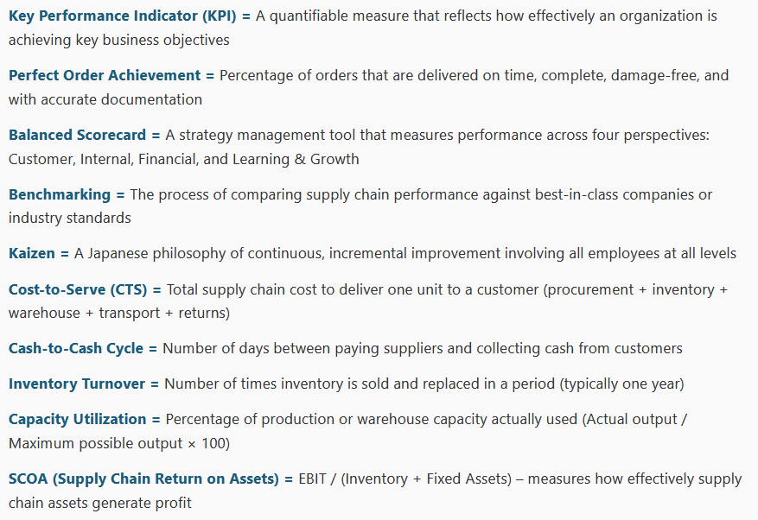
Key Definitions (Reference Sheet)

