Slide 1
Supply Chain Coordination and Integration
Daniel Kaszubowski

Slide 2
Road Transportation Systems Engineering Development in the Sub-Saharan Africa – Modern EU Master Programme & Capacity Building

Slide 4
Learning Objectives
Define supply chain integration and the synchronous supply chain concept
Understand and apply the Sales and Operations Planning (S&OP) process
Identify barriers to integration and strategies to overcome them
Describe collaborative frameworks like CPFR, VMI, and QR
Recognize the critical role of information sharing and visibility

Slide 5
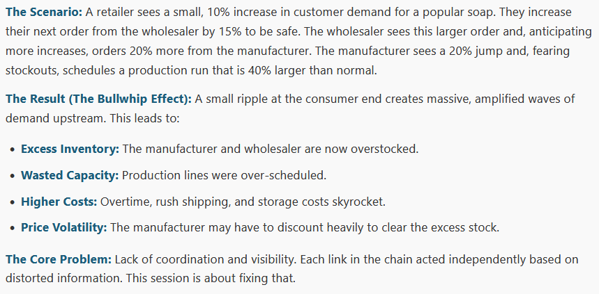
The Bullwhip Effect – Why Small Changes Cause Big Problems

Slide 6
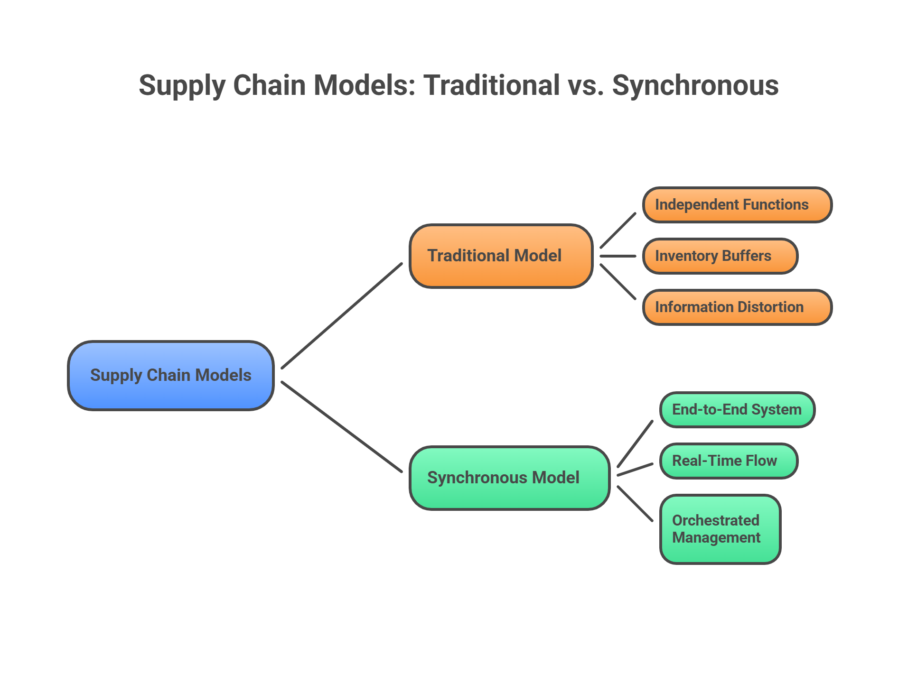
The Goal: The Synchronous Supply Chain

Slide 7
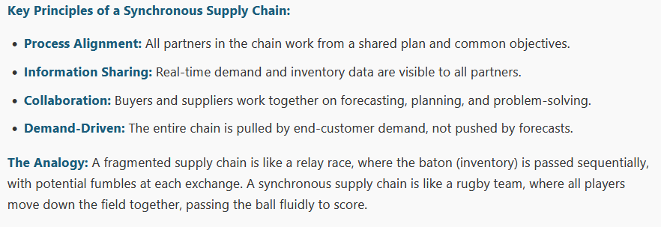
The Bullwhip Effect – Why Small Changes Cause Big Problems

Slide 8
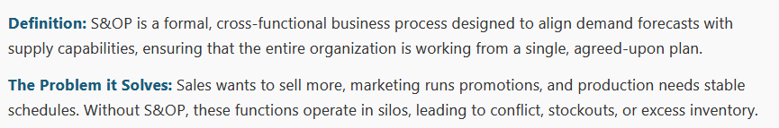
Sales and Operations Planning (S&OP) – The Internal Integration Engine

Slide 9
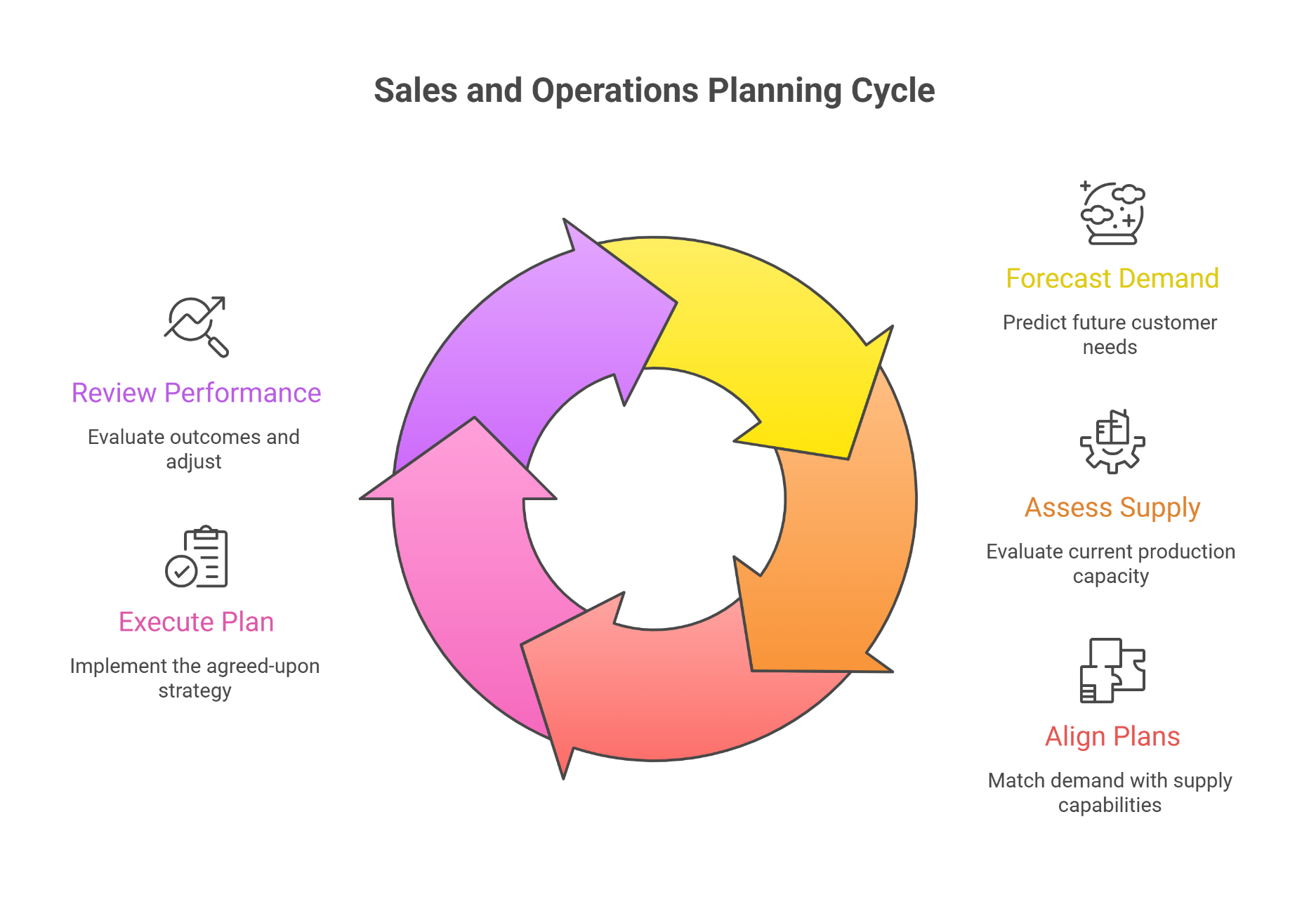
Sales and Operations Planning (S&OP) – The Internal Integration Engine

Slide 10
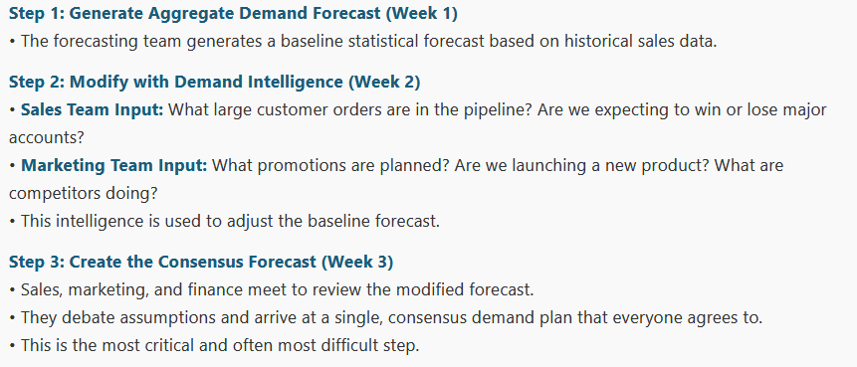
The S&OP Process (A Monthly Cycle)

Slide 11
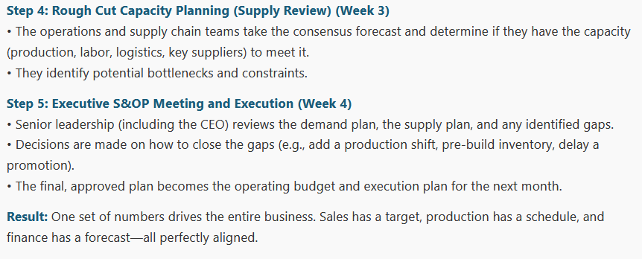
The S&OP Process (A Monthly Cycle)

Slide 12
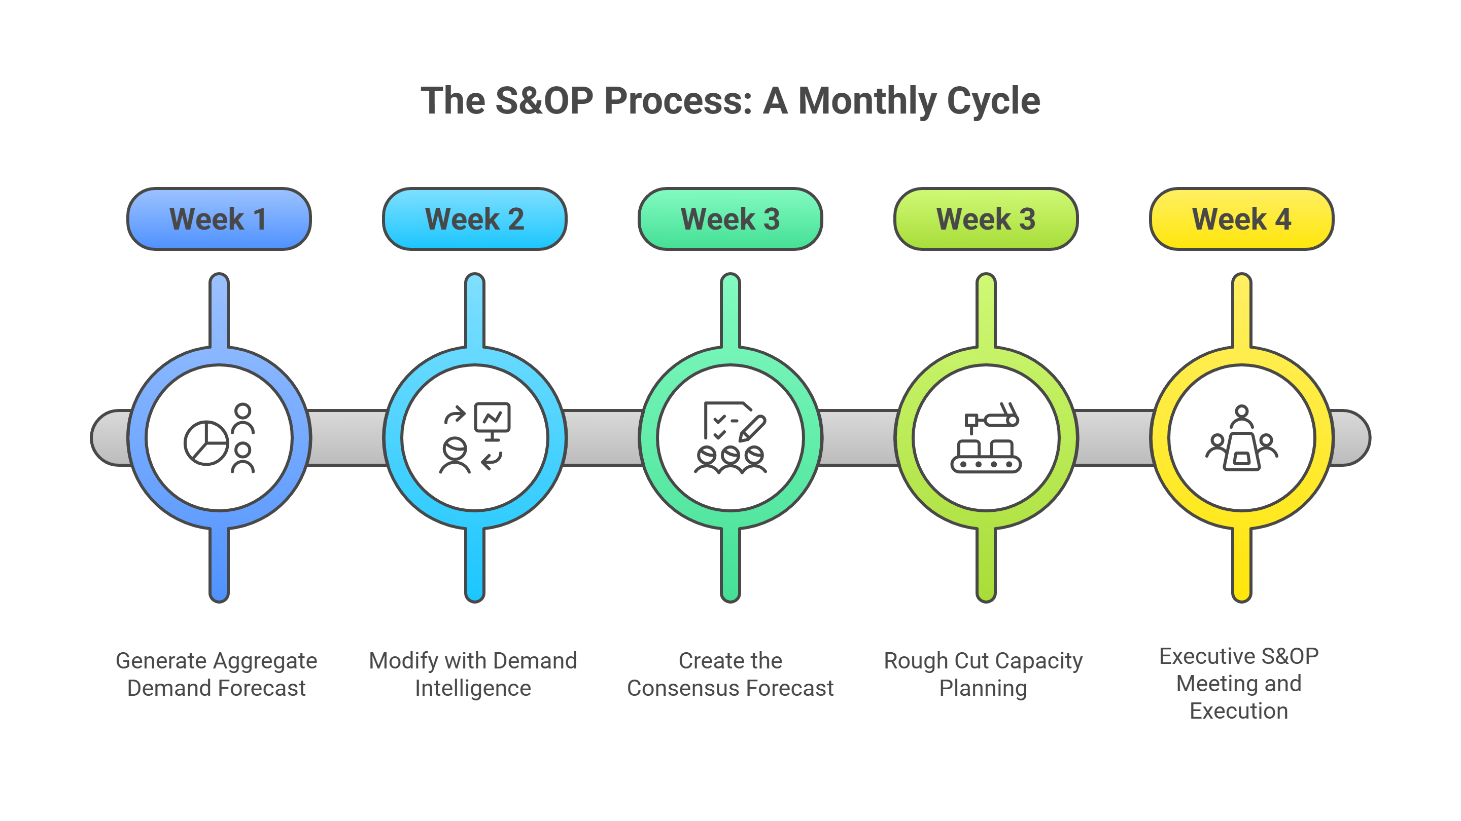

Slide 13
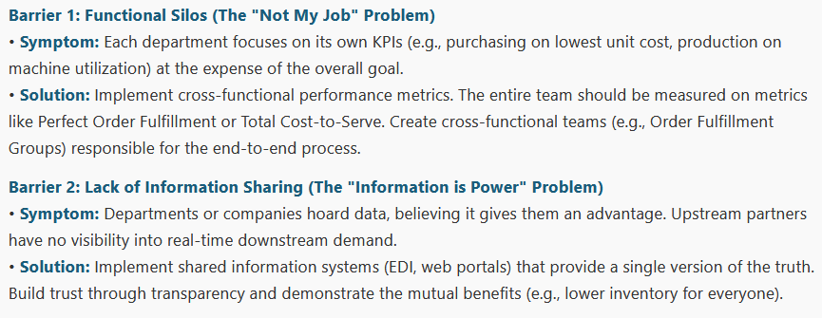
Overcoming Barriers to Integration

Slide 14
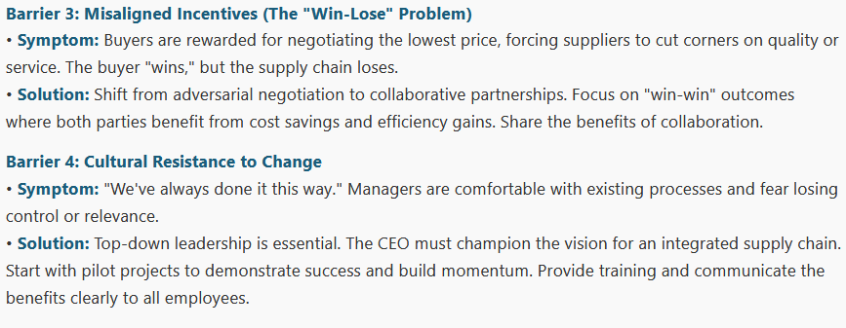
Overcoming Barriers to Integration

Slide 15
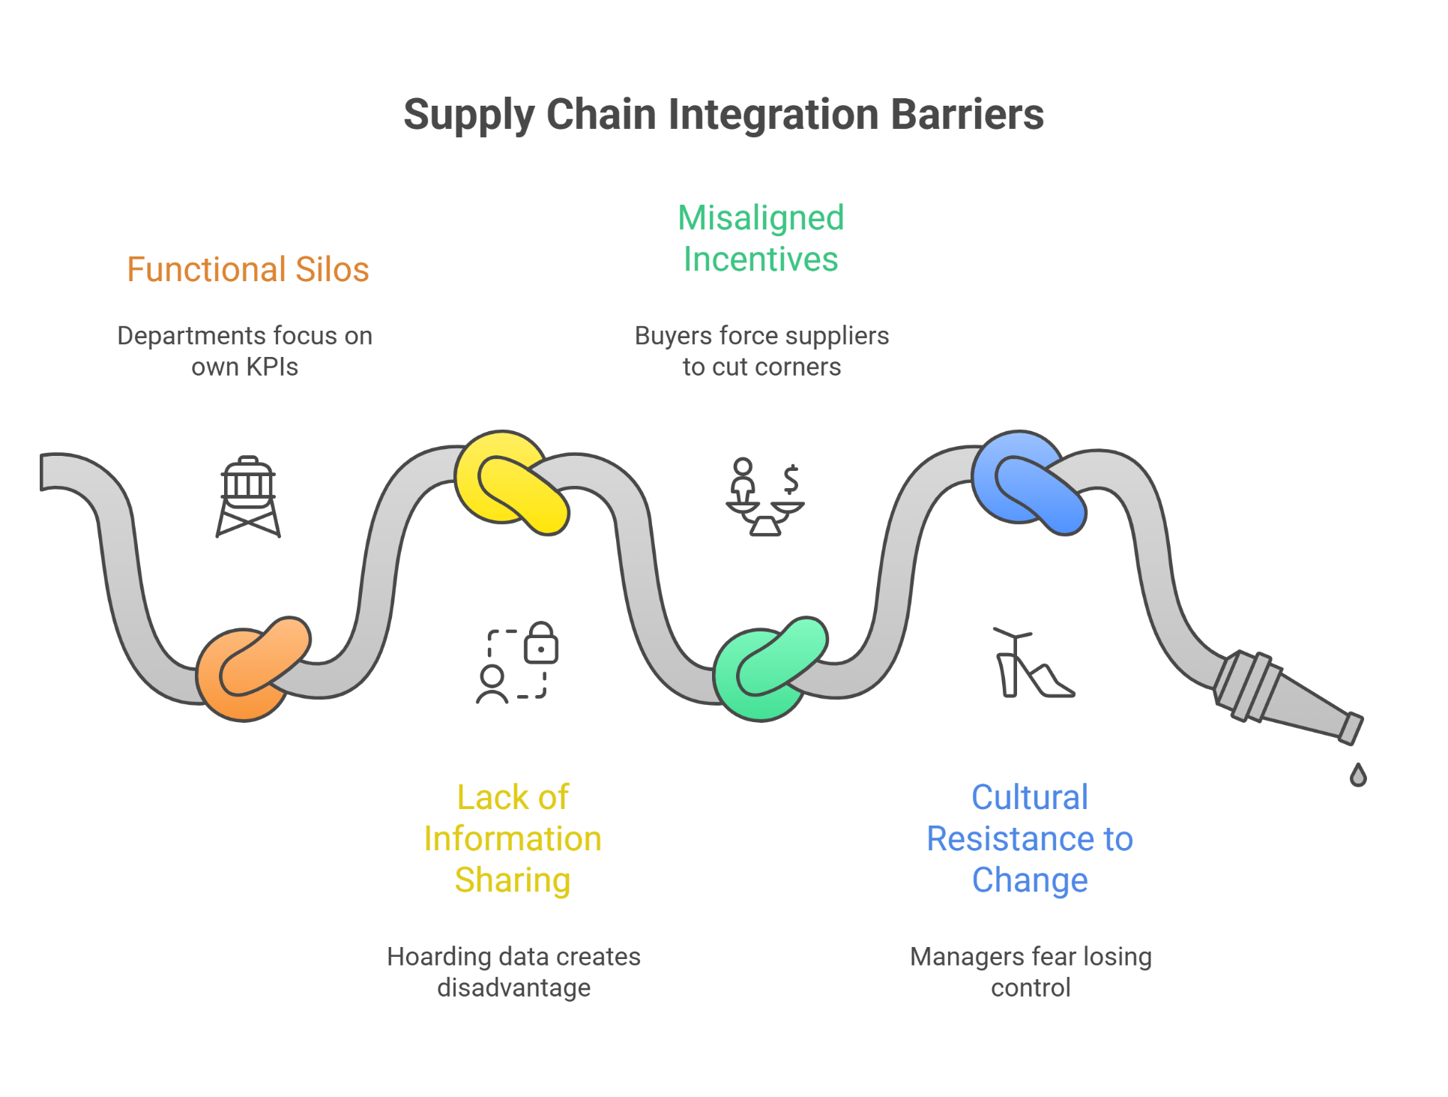
Overcoming Barriers to Integration

Slide 16
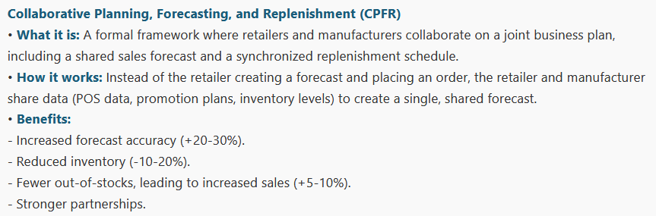
External Integration: Collaborative Frameworks

Slide 17
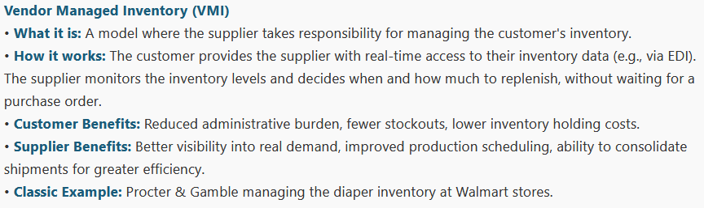
External Integration: Collaborative Frameworks

Slide 18
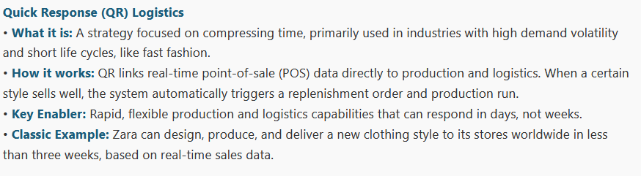
External Integration: Collaborative Frameworks

Slide 19
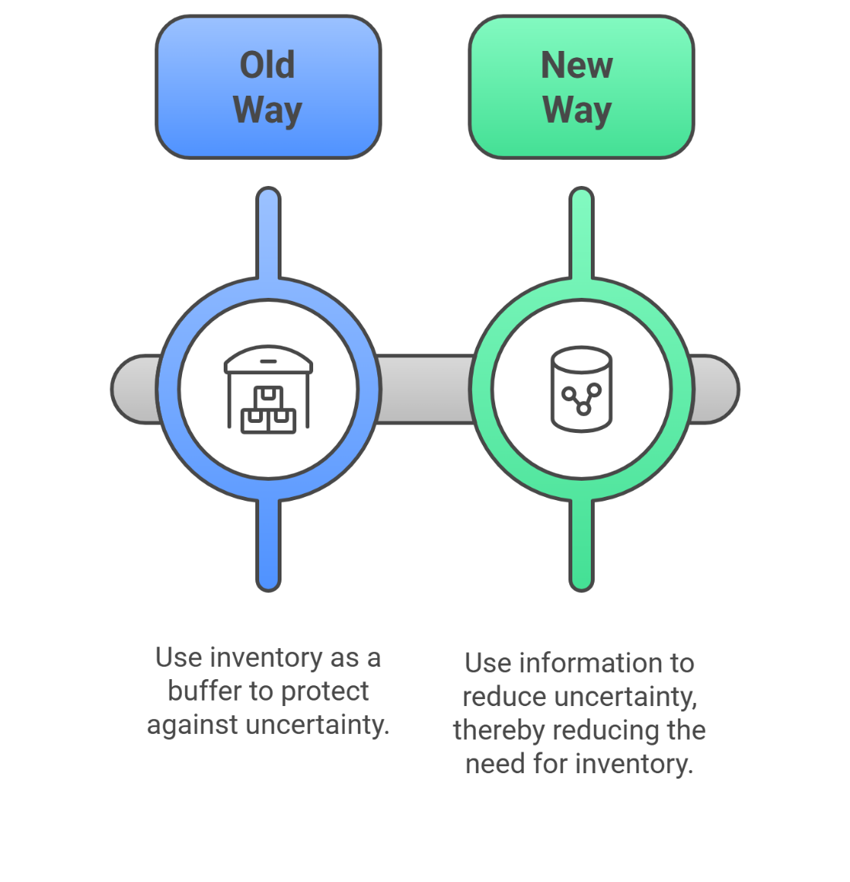
The Role of Information Sharing and Visibility
The Foundation of Integration: None of these collaborative models work without the seamless and transparent flow of information
From Inventory-Based to Information-Based Supply Chains:
Old Way: Use inventory as a buffer to protect against uncertainty.
New Way: Use information to reduce uncertainty, thereby reducing the need for inventory.

Slide 20
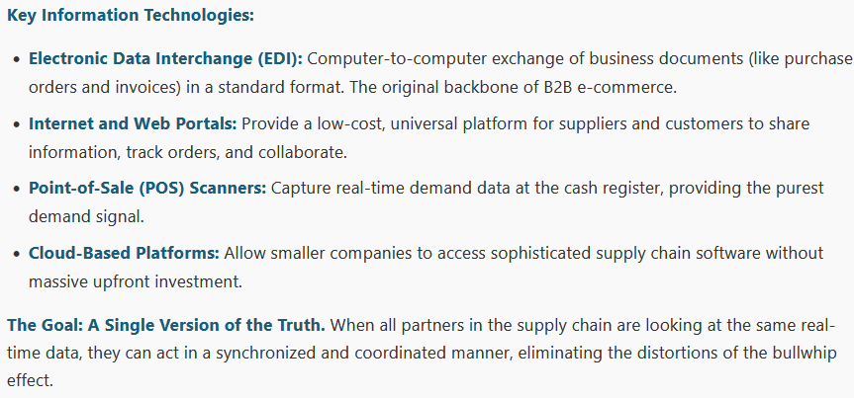
The Role of Information Sharing and Visibility

Slide 21
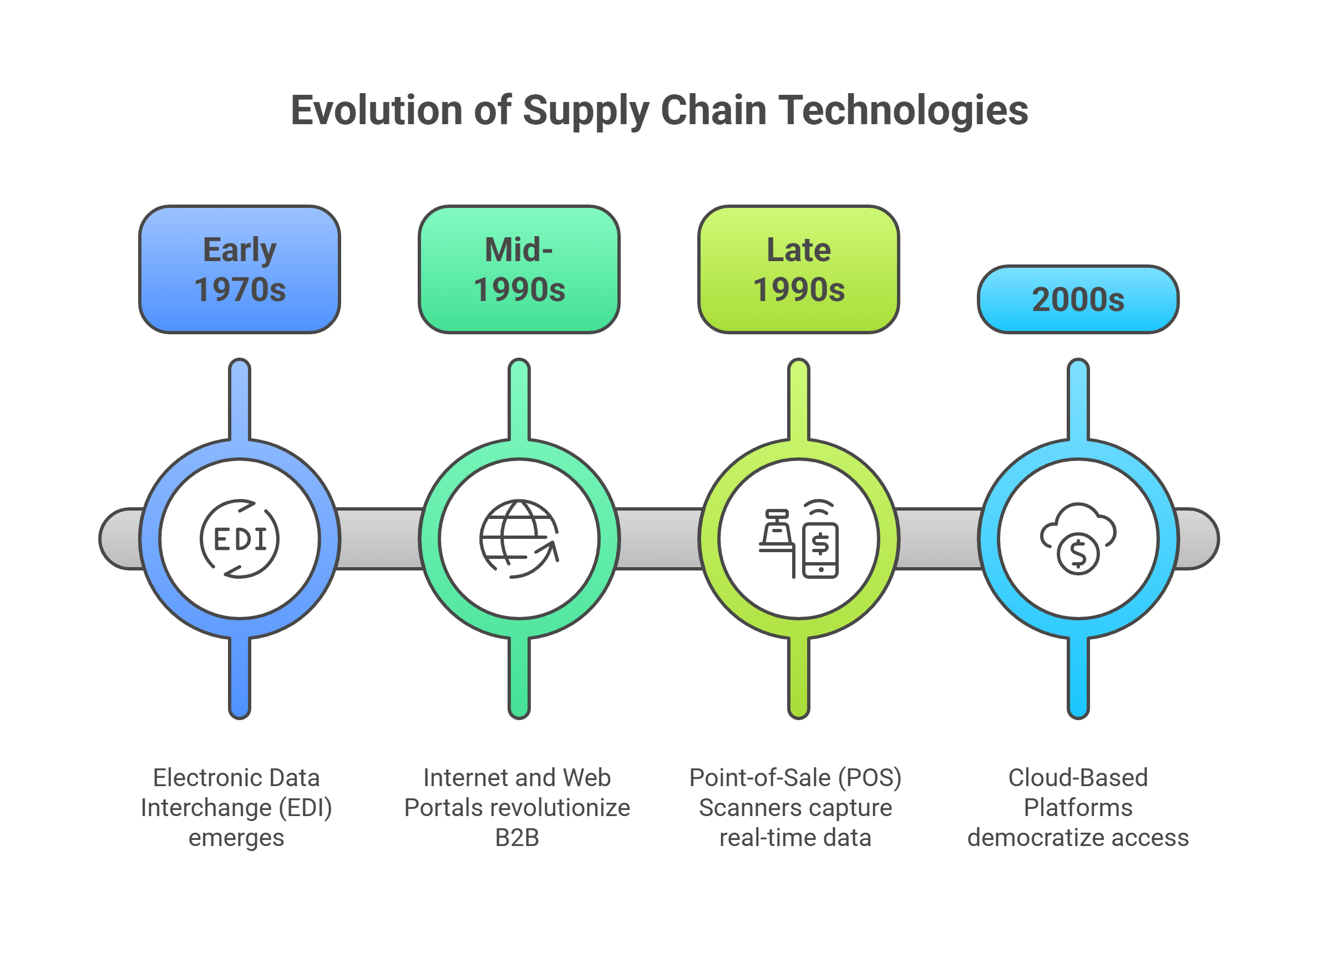

Slide 22
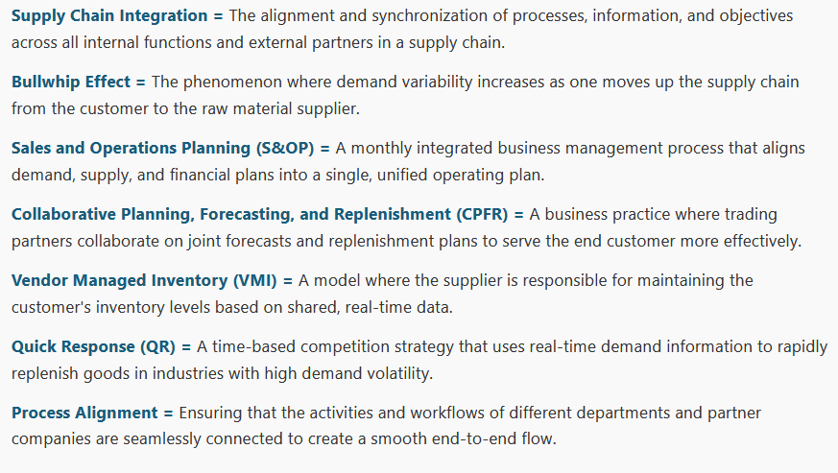
Key Definitions (Reference Sheet)

Slide 23
