Slide 1

Introduction to Distribution
Part 3
Justyna Staszak-Winkler

Slide 2
Road Transportation Systems Engineering Development in the Sub-Saharan Africa – Modern EU Master Programme & Capacity Building

Slide 4
Introduction to Distribution
MODULE 1
Part 3
Justyna Staszak-Winkler

Slide 5
Evaluation of the effectiveness of distribution channels
PRACTICAL CLASSES

Slide 6
Evaluation of the effectiveness of distribution channels
PRACTICAL CLASSES
Objective:
Identify and evaluate the distribution channels of a fictional company, classify them, assess their effectiveness based on logistics and financial criteria, and create an efficiency zone map.
The assignment was created on the basis of article:
Student Assignments
M. Odlanicka-Poczobutt, E. Brodnicka: Wyznaczanie stref efektywności kanałów dystrybucji na przykładzie wybranego producenta artykułów spożywczych

Slide 7
Evaluation of the effectiveness of distribution channels
PRACTICAL CLASSES
Step 1: Create a fictional company
Instructions:
1.1 Invent a name for your company and choose the type of products (e.g., pasta, beverages, cosmetics, clothing).
1.2. Determine the number of distribution channels to final customers (at least 4–6 channels).
1.3. Draw a logistics flow chart for your channels - a visual representation of how your products move from the producer to the final customer. It helps you understand the flow of goods, the role of intermediaries, and the complexity of each distribution channel.
Student Assignments

Slide 8
Evaluation of the effectiveness of distribution channels
PRACTICAL CLASSES
1.3a) Identify all steps in the distribution of your product:
  start with the producer / manufacturer
  include all intermediaries such as distributors, wholesalers, retailers, agents.
  ednd with the final customer (individual or business).
1.3b) Represent each step as a box or node.
1.3c) Use arrows to show the flow of goods from one step to the next - arrows indicate the direction of product movement.
Student Assignments

Slide 9
Evaluation of the effectiveness of distribution channels
PRACTICAL CLASSES
1.4. For each channel, indicate its type and justify your choice:
  whether it is direct or indirect,
  short/long,
  narrow/wide,
  integration type: e.g., conventional, contractual, vertically integrated.
  Tip for Students: Always provide evidence from your flow chart to justify your classification. The justification can be based on the number of intermediaries, the ownership of products, the scope of cooperation, or the size and reach of the channel.
Student Assignments

Slide 10
Evaluation of the effectiveness of distribution channels
PRACTICAL CLASSES
Step 2: Select evaluation criteria
2.1 When evaluating your distribution channels, use
7 criteria. Each criterion should be clearly defined so you can assign points later.
Criterion | Weight (%) | Description
Throughput | 25 | Based on sales volume
Distribution costs | 15 | % of distribution costs in sales
Unit profit | 15 | Profit per unit of product
Payment compliance | 15 | Minimizes credit risk
Promotion effectiveness | 5 | Impact of promotion on sales
Control scope | 10 | Control over product flow and pricing
Competition impact | 15 | Competition affects prices and profit
Student Assignments
Example

Slide 11
Evaluation of the effectiveness of distribution channels
PRACTICAL CLASSES
Weight is a number that shows how important a particular criterion is compared to the other criteria when evaluating distribution channels.
Purpose: Not all criteria are equally important. Some have a bigger impact on the overall effectiveness of a channel. Weight allows you to reflect this importance in your evaluation.
How it works:
  Assign a weight to each criterion (the sum of the weights should be 100).
  When calculating the total score for a channel, the points it receives for each criterion are multiplied by the weight.
  The weighted scores are then summed to get a final evaluation score for the channel.
Student Assignments

Slide 12
Evaluation of the effectiveness of distribution channels
PRACTICAL CLASSES
Here are examples and detailed explanations of each criterion:
Channel Throughput / Capacity
  Explanation: Measures the volume of products that can be handled by the channel over a given period (e.g., per month or year).
  Why it matters: Channels with higher throughput can deliver more products to customers efficiently, which is critical for meeting demand.
Distribution Costs
  Explanation: The total costs of moving goods through the channel, including transportation, storage, packaging, and handling costs.
  Why it matters: Lower-cost channels increase profitability and efficiency.
Student Assignments

Slide 13
Evaluation of the effectiveness of distribution channels
PRACTICAL CLASSES
Unit Profit / Margin
  Explanation: The profit earned per unit of product sold through the channel. It can be calculated as the sales revenue minus costs for that channel, divided by the number of units sold.
  Why it matters: Channels that generate higher profits per unit are generally more attractive.
Payment Compliance / Timeliness
  Explanation: Measures whether customers in the channel pay on time and follow agreed-upon payment terms.
  Why it matters: Timely payments reduce financial risk and ensure smooth cash flow for the business.
Student Assignments

Slide 14
Evaluation of the effectiveness of distribution channels
PRACTICAL CLASSES
Effectiveness of Promotion / Marketing Support
  Explanation: Evaluates how well the channel supports promotional activities, such as advertising, in-store displays, or special offers.
  Why it matters: Channels that actively promote products can boost sales and brand visibility.
Control over the Channel
  Explanation: Measures the degree of influence the producer has over product flow, pricing, inventory, and customer service in the channel.
  Why it matters: More control can ensure consistency, quality, and alignment with the company’s strategy.
Student Assignments

Slide 15
Evaluation of the effectiveness of distribution channels
PRACTICAL CLASSES
Impact of Competition
  Explanation: Assesses how competitive the market is within the channel. High competition may reduce prices or limit market share.
  Why it matters: Channels with less competitive pressure can maintain higher margins and stability.
Student Assignments

Slide 16
Evaluation of the effectiveness of distribution channels
PRACTICAL CLASSES
2.2 After selecting your evaluation criteria define a scoring scale: 1–10
1 = Lowest fulfillment of the criterion
  The channel performs very poorly in this area.
  For example, if the criterion is Distribution Costs, a score of 1 could mean that the channel has very high costs compared to other channels.
  If the criterion is Payment Compliance, a score of 1 could indicate that customers in this channel rarely pay on time.
10 = Highest fulfillment of the criterion
  The channel performs excellently in this area.
  For Distribution Costs, a score of 10 could indicate very low costs, making the channel highly efficient.
  For Payment Compliance, a score of 10 could indicate that customers always pay on time.
Student Assignments

Slide 17
Evaluation of the effectiveness of distribution channels
PRACTICAL CLASSES
Scores in between (2–9)
  Represent varying levels of fulfillment.
  A score of 5 would indicate average performance — neither particularly good nor bad.
  Scores should reflect relative performance among the channels you are evaluating.
Student Assignments

Slide 18
Evaluation of the effectiveness of distribution channels
PRACTICAL CLASSES
Tips for applying the scale:
Look at each criterion individually.
Compare all channels to each other based on real or estimated data.
Assign points that reflect how well each channel meets the specific criterion.
Later, these points will be multiplied by the weight of each criterion to calculate a weighted score.
Student Assignments

Slide 19
Evaluation of the effectiveness of distribution channels
PRACTICAL CLASSES
Step 3: Evaluate channels using an analytical scoring method
3.1 For each channel, assign scores for each criterion.
3.2 Multiply each score by the weight of the criterion → obtain weighted score.
3.3 Sum the weighted scores for each channel → total channel effectiveness score.
Exercise
Student Assignments

Slide 20
Evaluation of the effectiveness of distribution channels
PRACTICAL CLASSES
Criterion | Weight (%) | Score (1–10) | Weighted Score
Distribution Costs | 25 | 8 | 25 × 8 = 200
Channel Throughput | 25 | 7 | 25 × 7 = 175
Control over the Channel | 50 | 6 | 50 × 6 = 300
Total | 100 |  | 675
Example
In this example, control over the channel is considered the most important criterion (weight 50%), so it has the biggest impact on the total score. Distribution costs and throughput are less important (weights 25%), so their scores contribute less to the total.
Student Assignments

Slide 21
Evaluation of the effectiveness of distribution channels
PRACTICAL CLASSES
Step 4: Calculate financial efficiency indicator
4.1 Invent or estimate:
  annual distribution costs for each channel,
  annual sales value through each channel.
4.2 Calculate the efficiency indicator
Efficiency Indicator (EI) = Annual Distribution Costs of the channel / Annual Sales Value of the channel
Interpretation: lower ratio = more cost-efficient channel.
Student Assignments

Slide 22
Evaluation of the effectiveness of distribution channels
PRACTICAL CLASSES
Step 5: Create an efficiency zone map
5.1 Plot the channels on a map based on:
total analytical score,
efficiency ratio.
5.2 Define three zones:
Safety Zone – highly efficient channels with high sales and low distribution costs.
Cost Review Zone – channels requiring cost control and potential efficiency improvements.
Danger Zone – inefficient channels with low sales and high distribution costs.
Student Assignments

Slide 23
Evaluation of the effectiveness of distribution channels
PRACTICAL CLASSES
How to determine the zone thresholds
To define the zones, you first calculate a global efficiency indicator for the entire distribution system.
  Add up all distribution costs across all channels.
  Add up the total sales value generated by all channels.
  Divide total distribution costs by total sales value:
Global Efficiency Indicator = Total Distribution Costs / Total Sales Value
This value represents the average cost intensity of the whole distribution network.
It is then used as a reference point to separate the Safety Zone, Cost Review Zone, and Danger Zone.
Student Assignments

Slide 24
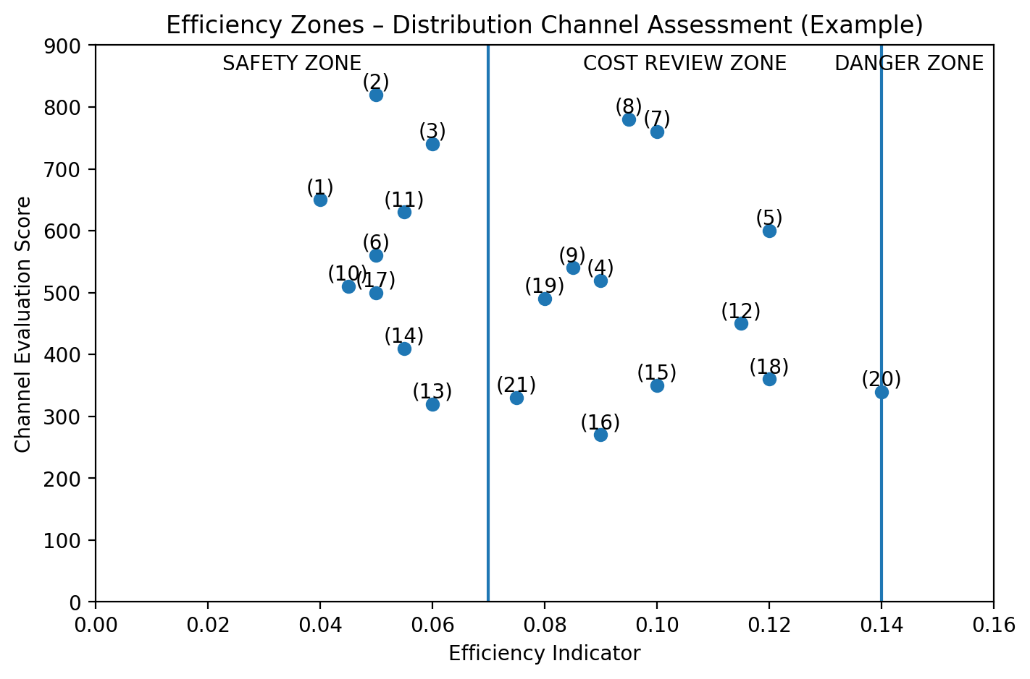
Evaluation of the effectiveness of distribution channels
PRACTICAL CLASSES
Student Assignments
Example

Slide 25
Evaluation of the effectiveness of distribution channels
PRACTICAL CLASSES
5.3 Based on the efficiency zone map, identify the channels that fall into each zone.
For the channels located in the Cost Review Zone and the Danger Zone, propose logistics solutions that could improve their performance and efficiency.
Examples of potential improvement areas may include:
optimizing inventory levels,
consolidating shipments,
reducing unnecessary intermediaries,
improving route planning and transport organization,
negotiating better terms with logistics partners,
redesigning the distribution network.
Student Assignments

Slide 26
Evaluation of the effectiveness of distribution channels
PRACTICAL CLASSES
When proposing improvements, clearly explain why you selected specific logistics solutions.
Your justification should show the connection between the channel’s weaknesses and the recommended actions.
Student Assignments

