Slide 1

Warehousing and material handling
Part 2
Justyna Staszak-Winkler

Slide 2
Road Transportation Systems Engineering Development in the Sub-Saharan Africa – Modern EU Master Programme & Capacity Building

Slide 4
Warehousing and Material Handling
MODULE 3
Part 2
Justyna Staszak-Winkler

Slide 5

Material handling and packaging

Slide 6
Warehouse layout
Warehouse layout refers to the physical arrangement of functional areas to ensure efficient material flow.
Typical functional zones:
receiving area,
storage area,
picking and packing area,
dispatch/shipping area,
returns and auxiliary areas.

Slide 7
Receiving Area
This is where goods and materials enter the warehouse.
It’s the first point of contact for incoming shipments.
Key Activities:
  Unloading from trucks or containers
  Inspection and quality control
  Checking quantities against purchase orders
  Recording items in the warehouse management system (WMS)
  Labeling and tagging for tracking
Design Considerations:
  Wide docks for easy access by vehicles
  Space for sorting and staging goods
  Proximity to storage to minimize handling distances

Slide 8
Storage Area
To safely store products until they are needed for order fulfillment.
Key Activities:
  Placement of goods in racks, shelves, or pallets
  Inventory management (tracking stock levels, location, and turnover)
  Ensuring proper storage conditions (temperature, humidity, security)
Design Considerations:
  Efficient layout for high space utilization (e.g., selective racks, drive-in racks)
  Clear labeling for easy identification
  Safety regulations for stacking and aisle width

Slide 9
Picking and Packing Area
Where goods are selected from storage and prepared for shipping to customers.
Key Activities:
  Picking items according to orders (manual or automated)
  Checking quantities and quality
  Packing items securely for transport
  Adding labels, barcodes, or documentation for delivery
Design Considerations:
  Close to storage for reduced travel time
  Ergonomic workstations to reduce worker fatigue
  Space for packing materials and temporary staging

Slide 10
Dispatch/
Shipping Area
To manage the outbound flow of goods from the warehouse to customers, retailers, or other facilities.
Key Activities:
  Consolidating and staging orders for shipment
  Loading goods onto trucks or containers
  Checking shipping documents and compliance
  Coordinating with carriers and logistics partners
Design Considerations:
  Easy access for outbound vehicles
  Sufficient staging area to organize shipments
  Efficient routing to reduce delays

Slide 11
Returns and Auxiliary Areas
Handles returned goods and supports warehouse operations.
Key Activities (Returns):
  Receiving returned items
  Inspecting condition and deciding on restocking, repair, or disposal
Activities (Auxiliary):
  Maintenance workshops
  Offices for warehouse management
  Employee break rooms
  Equipment storage
Design Considerations:
  Clearly separated from main flow to avoid disrupting operations
  Adequate space for inspection, repair, or repackaging

Slide 12
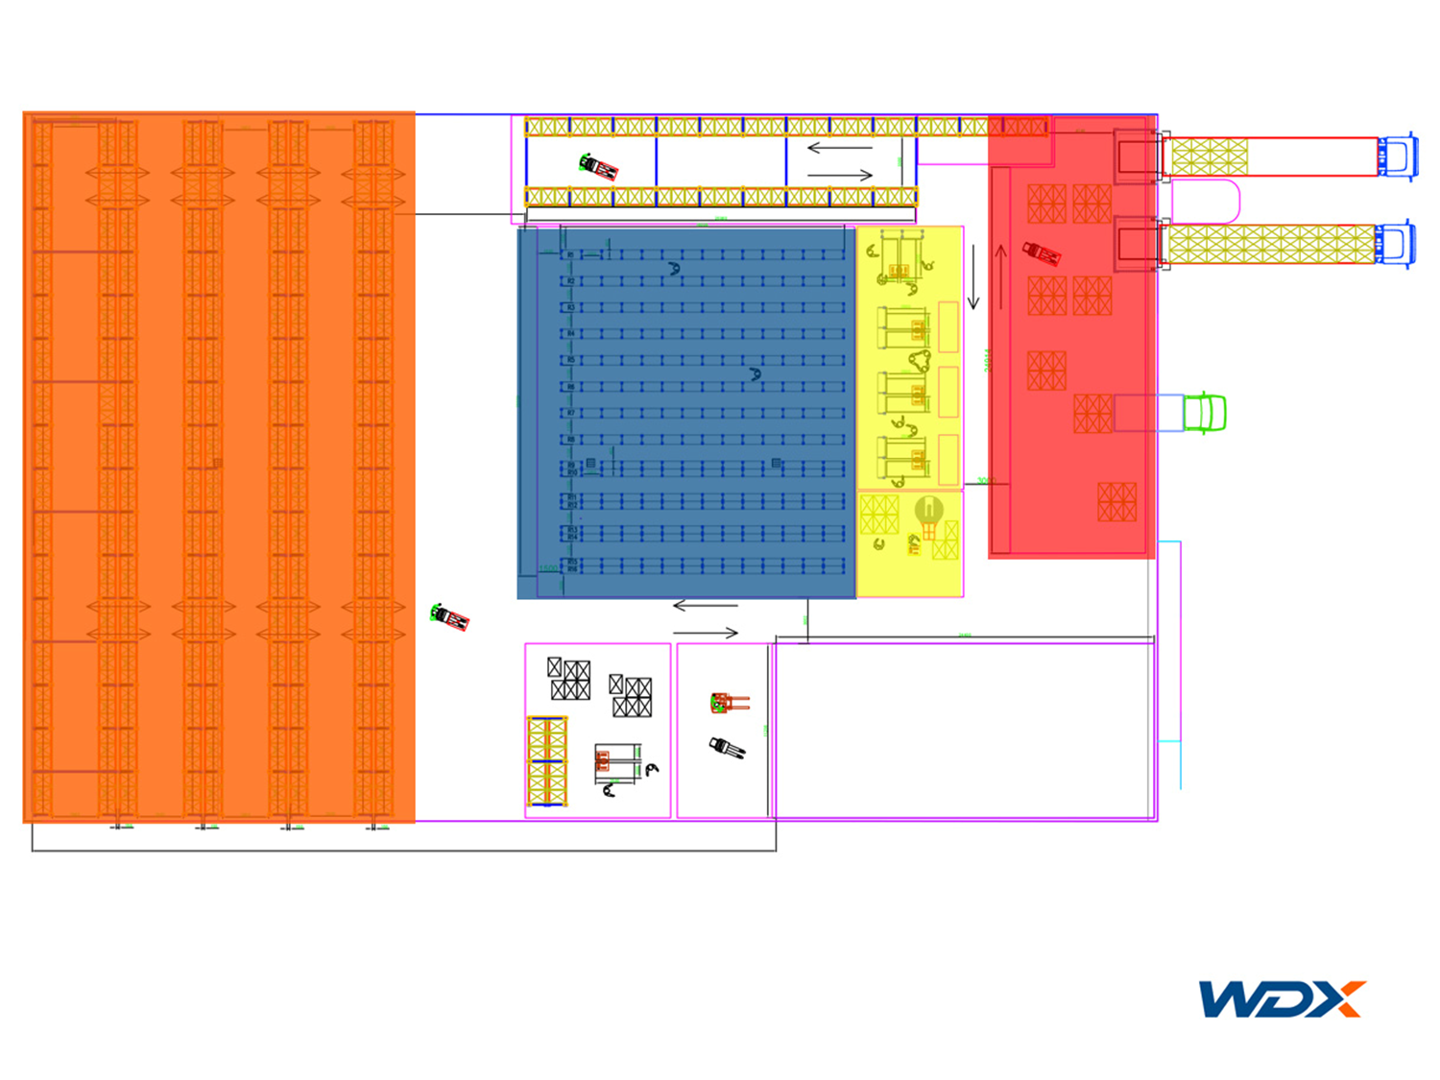
Example of warehouse layout with highlighted zones
https://wdx.pl/blog/podzial-magazynu-na-strefy/
Loading and unloading area (red on the diagram)
Receiving area (red on the diagram)
Storage area (orange on the diagram)
Order picking area (blue on the diagram)
Shipping area (yellow on the diagram)

Slide 13
Layout design principles
Material Flow Efficiency
  Ensure a logical and as direct as possible flow of goods from receiving, through storage and picking, to shipping.
  Minimize internal product movements and avoid crossing paths of different material streams.
  Follow the principle of “from receiving to shipping” to reduce backtracking and congestion.
Flexibility
  The layout should allow easy adaptation to changes in product assortment, seasonality, or increased volume.
  Modular storage areas and movable racking systems enhance warehouse adaptability.
Warehouse layout design is a critical element of efficient warehouse operations. The main goal is to ensure smooth material flow, optimal use of space, and minimization of operational costs.

Slide 14
Layout design principles
Safety
  Design must comply with occupational health and safety regulations, including emergency routes, marked hazardous zones, and minimum distances between racks.
  Ensure safe placement of internal transport equipment (forklifts, conveyors) relative to workstations.
Cost Efficiency
  Optimize internal transport distances to reduce labor time and equipment use.
  Efficient utilization of warehouse space reduces rental or construction costs.
Accessibility and Storage Optimization
  High-turnover products should be stored in easily accessible locations (ABC storage principle).
  Ergonomic considerations in picking, packing, and loading improve efficiency and reduce fatigue.

Slide 15
Layout design principles
Modularity and Standardization
  Use repeatable racking modules and standardized functional zones (receiving, storage, picking, shipping) for easier management and scalability.
  Standardized layout and processes speed up employee training and reduce operational errors.
Integration with Technology
  The layout should accommodate Warehouse Management Systems (WMS), automated racking, conveyors, and robotic picking solutions.
  Ensure potential for future technological upgrades without major redesign.
Visibility and Control
  Design the layout to facilitate monitoring of material flows and process control.
  Clear signage and marked pathways help manage operations and reduce errors.

Slide 16
Common layout types
U-shaped layout – receiving and shipping on the same side,
I-shaped layout – straight flow, opposite ends,
L-shaped layout – adapted to limited space.

Slide 17
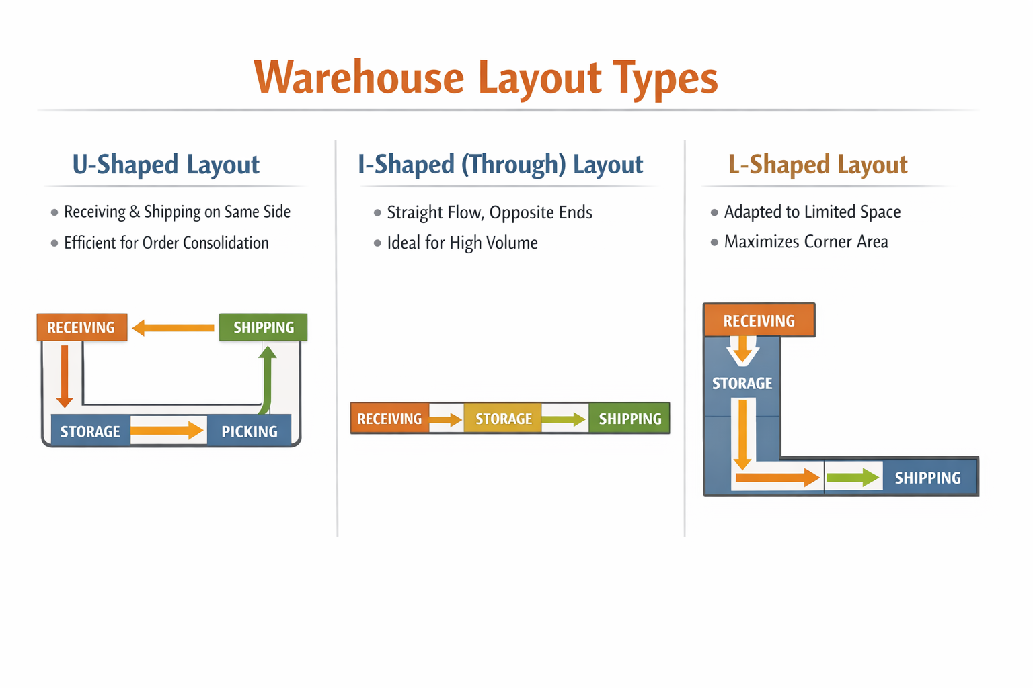
Common layout types

Slide 18
U-Shaped Layout
  Receiving and shipping areas are located on the same side of the warehouse, forming a “U” path through storage and picking zones.
  Material Flow: Goods enter through the receiving area, move through storage and picking zones, and exit via the shipping area, creating a loop.
  Advantages:
    Minimizes travel distance for order consolidation.
    Supports cross-docking operations efficiently.
    Easy supervision of incoming and outgoing goods.
  Best Use: Medium to large warehouses with moderate to high product variety, especially when consolidation of orders or cross-docking is common.

Slide 19
I-Shaped (Through) Layout
A straight-line flow where goods enter at one end of the warehouse (receiving) and exit at the opposite end (shipping).
Material Flow: Linear flow from receiving → storage → picking → shipping, with minimal backtracking.
Advantages:
  Efficient for high-volume operations.
  Reduces congestion, as inbound and outbound flows are separated.
  Ideal for automated systems, conveyor belts, or high-throughput processes.
Best Use: Large warehouses with high-volume distribution, especially those using automation or continuous-flow operations.

Slide 20
L-Shaped Layout
Receiving and shipping areas are located at adjacent sides of the warehouse, forming an “L” flow.
Material Flow: Goods enter through the receiving area, flow along one axis of the warehouse, pass through storage and picking areas, and exit via the shipping area on the perpendicular axis.
Advantages:
  Maximizes use of limited or irregularly shaped warehouse space.
  Separates inbound and outbound flows to reduce congestion.
  Flexible for warehouses with space constraints or irregular building shapes.
Best Use: Small to medium warehouses, urban warehouses, or warehouses built into existing buildings with limited floor space.

Slide 21
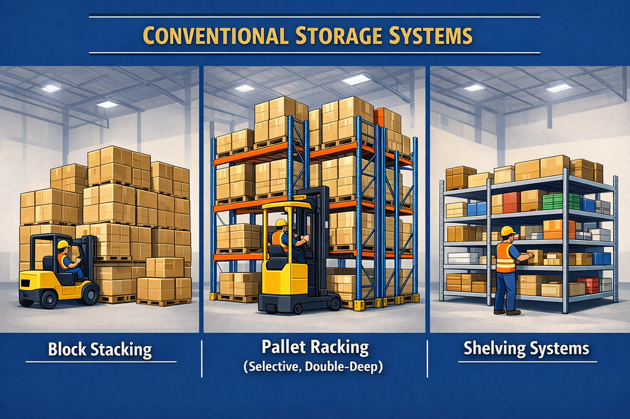
Storage Systems – Conventional storage systems

Slide 22
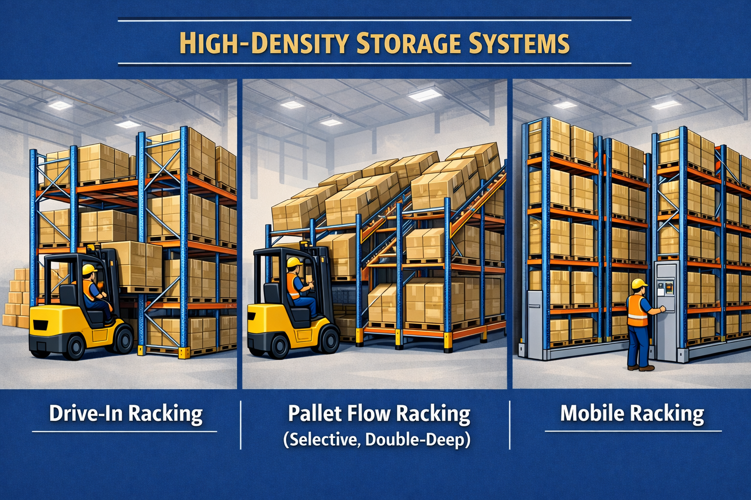
Storage systems –
High-density storage systems

Slide 23
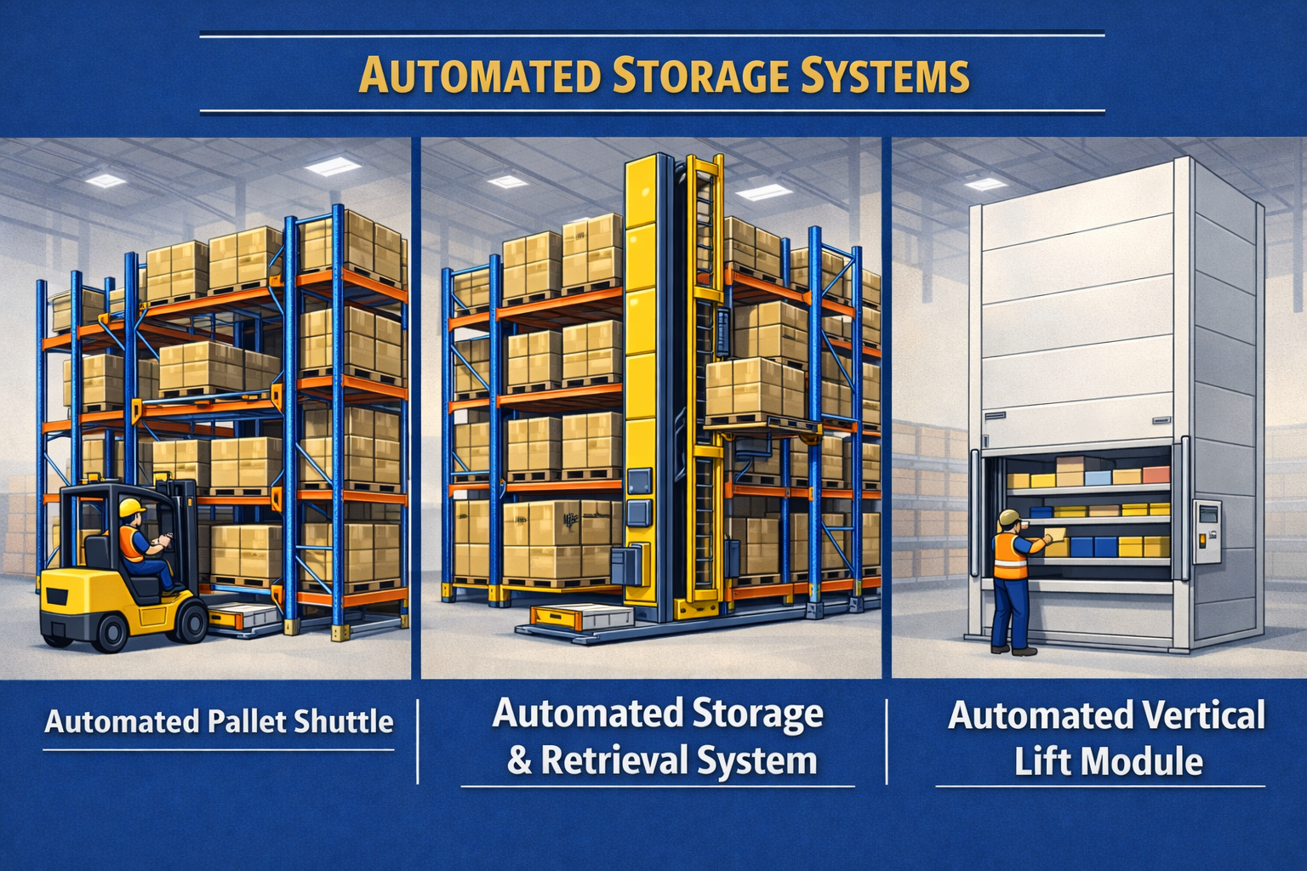
Storage systems –
Automated storage systems

Slide 24
Warehouse Management Principles -Inventory management
Inventory management means planning, controlling, and optimizing inventory levels within a company in order to:
ensure continuity of sales and production,
avoid stock shortages,
reduce warehousing costs and capital tied up in inventory.

Slide 25
Warehouse Management Principles -Inventory management
FIFO (First In, First Out) - inventory items are issued in the order in which they are received.
This method reduces the risk of obsolescence and is commonly used for perishable and time-sensitive goods.
FEFO (First Expired, First Out) - products with the earliest expiration date are issued first, regardless of the receiving date.
This approach is essential in industries such as food, pharmaceuticals, and chemicals.
safety stock management - maintaining additional inventory to protect against demand variability, supply delays, and unexpected disruptions.
Proper safety stock levels help ensure service continuity while minimizing excess inventory.
inventory turnover optimization - managing inventory levels to increase the rate at which stock is sold or used.
Higher inventory turnover improves cash flow, reduces holding costs, and enhances overall warehouse efficiency

Slide 26
Warehouse Management Principles - Warehouse operations management
standardization of processes (establishing uniform procedures for receiving, storage, picking, packing, and shipping. Standardized processes reduce errors, improve consistency, and make training of warehouse staff more effective),
measuring warehouse performance using key indicators such as:
  order accuracy – the percentage of orders picked and shipped correctly,
  picking time – the time required to complete the order-picking process.
KPIs help identify inefficiencies and support continuous improvement.

Slide 27
Warehouse Management Principles -Warehouse operations management
Space Utilization Monitoring
Tracking how effectively warehouse space is used, including storage density and aisle layout.
Proper space utilization improves storage capacity, reduces unnecessary movements, and lowers operating costs.
Labor Productivity Management
Managing workforce efficiency by monitoring output per employee, task completion times, and workload distribution.
Effective labor management helps reduce labor costs while maintaining high service quality.

Slide 28
Warehouse Management Principles -
Use of information systems
Warehouse Management Systems (WMS)
A Warehouse Management System is a specialized IT system used to plan, control, and optimize warehouse operations.
WMS supports activities such as receiving, inventory tracking, storage location management, order picking, packing, and shipping, improving accuracy and operational efficiency.

Slide 29
Warehouse Management Principles -
Use of information systems
Barcode and RFID Technologies
Barcode systems and Radio Frequency Identification (RFID) enable automatic identification and tracking of goods within the warehouse.
These technologies reduce manual data entry, minimize errors, and provide real-time visibility of inventory and material flows.

Slide 30
Warehouse Management Principles -
Use of information systems
Integration with Transport and ERP Systems
Integration of WMS with Transport Management Systems (TMS) and Enterprise Resource Planning (ERP) systems ensures seamless information flow across the supply chain.
This integration improves coordination between warehousing, transportation, purchasing, and sales, leading to better planning and faster decision-making.

Slide 31
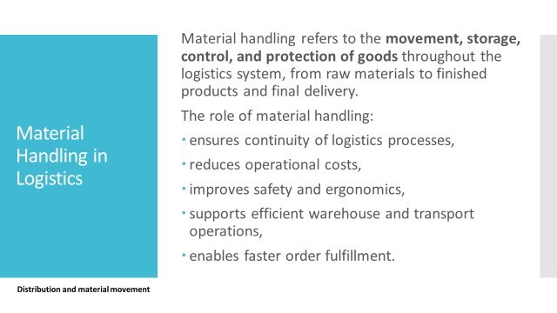

Slide 32
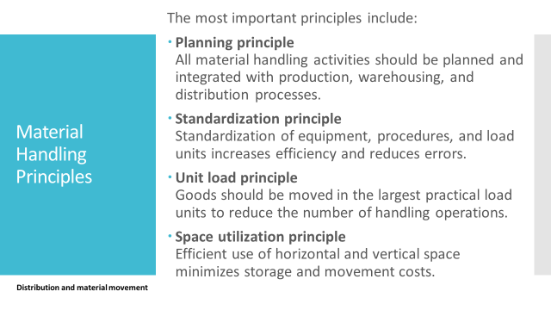

Slide 33
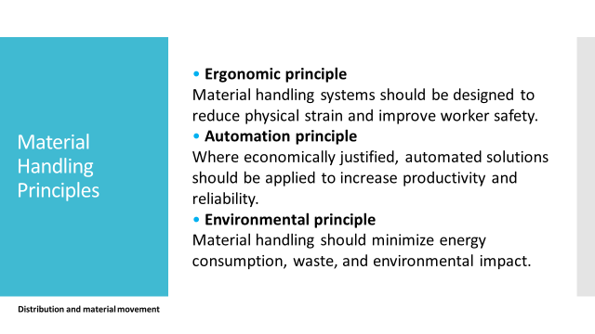

Slide 34
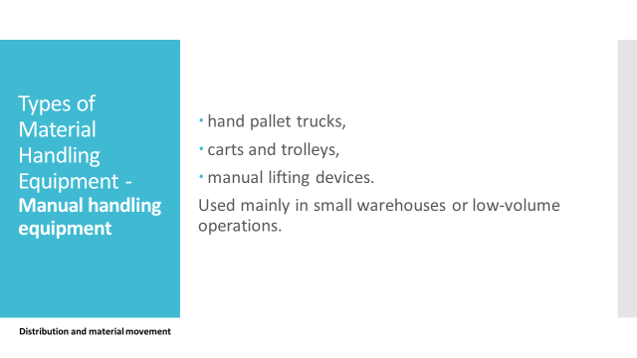

Slide 35
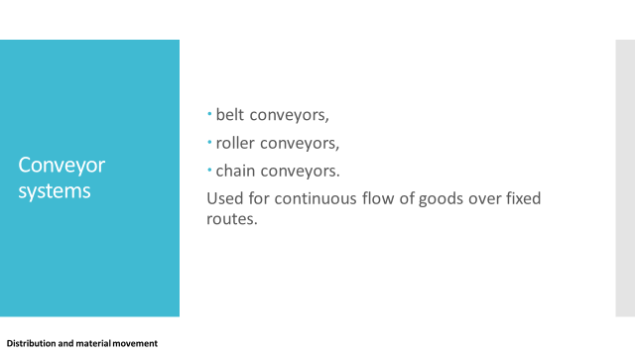

Slide 36
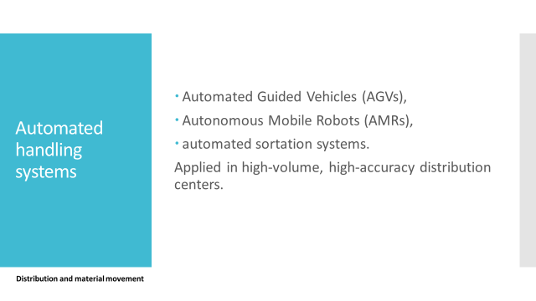

Slide 37
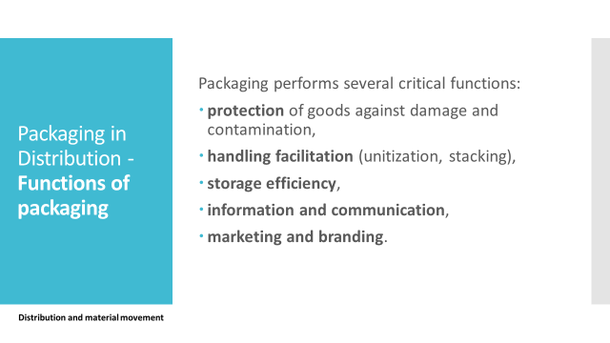

Slide 38
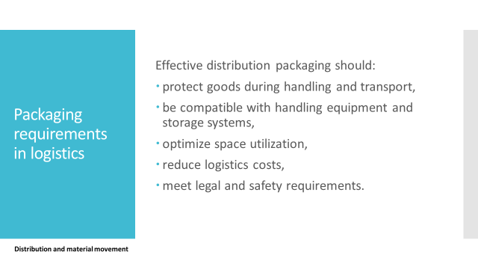

Slide 39
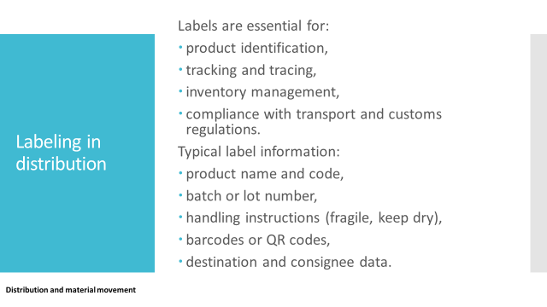

Slide 40
