Slide 1
African Logistics and Supply Chain Case Studies
Justyna Staszak-Winkler
Daniel Kaszubowski

Slide 2
Road Transportation Systems Engineering Development in the Sub-Saharan Africa – Modern EU Master Programme & Capacity Building

Slide 4
Logistics Connectivity and Distribution Challenges in Emerging African Markets
MODULE 4

Slide 5
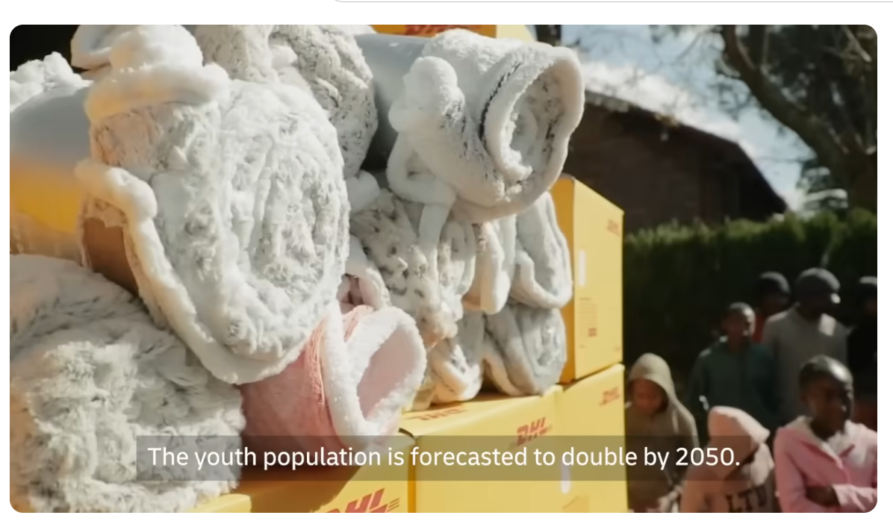
DHL and Logistics Development in Africa
https://www.youtube.com/watch?v=8XFPPOP8Ris

Slide 6
Summary of the Film
The video presents the role of logistics and transport systems in supporting economic development across African countries. DHL demonstrates how modern logistics services, transport connectivity, warehousing systems, and digital solutions can improve supply chains and support trade within Africa and globally. The material emphasizes the importance of distribution infrastructure, transport accessibility, and cross-border logistics in emerging economies.
The film highlights challenges such as limited transport infrastructure, fragmented logistics networks, customs barriers, and inefficient supply chains. It also presents examples of logistics hubs, distribution systems, and transport integration supporting businesses and consumers in African markets. The video strongly promotes DHL solutions and focuses mainly on positive examples. However, it provides limited quantitative data concerning costs, transport performance indicators, infrastructure quality, and operational limitations. Students should therefore critically evaluate the promotional nature of the material and identify additional information necessary for objective analysis.

Slide 7
Learning Outcomes
After completing the assignment, the student:
analyzes the role of logistics and distribution systems in economic development;
identifies major transport and logistics barriers in developing countries;
evaluates the effectiveness of logistics connectivity solutions presented in the film;
compares transport infrastructure conditions between African countries and developed economies;
proposes realistic logistics and transport improvements adapted to local African conditions.

Slide 8
Instruction for Students
Watch the video carefully and identify the main logistics or transport problem discussed in the material. Prepare an analytical report in which you:
Describe the main logistics and transport challenges presented in the video.
Explain the causes and consequences of these problems.
Critically evaluate the solutions proposed in the film.
Assess whether the presented solutions could realistically function in the Democratic Republic of Congo, Cameroon, or another Sub-Saharan African country.
Identify what transport, infrastructure, economic, or operational data would be necessary for deeper analysis.

Slide 9
Instruction for Students
Propose realistic and affordable actions that could improve logistics connectivity and distribution systems in developing countries.
Critically evaluate the credibility and limitations of the video as a source of information.
Your recommendations should consider:
infrastructure limitations,
financial constraints,
institutional capacity,
informal transport systems,
road safety conditions,
local socio-economic realities.

Slide 10
Supporting Questions
What are the main logistics and transport challenges identified in the video?
How does transport infrastructure influence economic development?
What role do logistics hubs and connectivity play in supply chain efficiency?
Which solutions presented in the film seem most realistic for low-income countries?

Slide 11
Supporting Questions
What important information or data is missing from the video?
What barriers could limit the implementation of advanced logistics systems in African cities?
How can governments and universities support logistics system improvements?
What indicators should be collected to evaluate logistics performance in developing countries?

Slide 12
Expected Result of the Assignment
Students should prepare:
an analytical report (3–5 pages) or a presentation (5–7 slides),
3–5 practical recommendations.
Optional elements:
SWOT analysis,
stakeholder analysis,
problem–cause–effect matrix,
simple logistics network diagram.

Slide 13
Evaluation Criteria
Criterion | Very Good | Average | Weak | Points
Understanding of the video | Excellent identification and explanation of logistics and transport problems; clear understanding of key concepts | Partial understanding of main issues; some elements missing or unclear | Superficial or incorrect understanding of the video content | 20
Quality of analysis | Deep, logical, and well-structured analysis of causes and consequences | Basic analysis with limited depth or partial logic | Weak, fragmented, or descriptive analysis without reasoning | 20
Critical evaluation of the source | Strong critical reflection on limitations, bias, and missing data | Some recognition of limitations but not fully developed | No critical evaluation or purely descriptive approach | 10
African context application | Excellent integration of Sub-Saharan African realities and constraints | General reference to African context with limited adaptation | No meaningful connection to local conditions | 20
Quality of recommendations | Practical, realistic, and well-justified solutions adapted to context | Partially realistic recommendations with limited justification | Unrealistic, generic, or unclear recommendations | 20
Structure and presentation quality | Clear, logical structure; professional presentation of report and slides | Minor organizational issues; generally understandable | Poor structure, unclear presentation, difficult to follow | 10
TOTAL |  | 100

