Slide 1
African Logistics and Supply Chain Case Studies
Justyna Staszak-Winkler
Daniel Kaszubowski

Slide 2
Road Transportation Systems Engineering Development in the Sub-Saharan Africa – Modern EU Master Programme & Capacity Building

Slide 4
Analyzing Food Supply Chain Bottlenecks and Transport Systems Engineering in Sub-Saharan Africa
MODULE 4

Slide 5
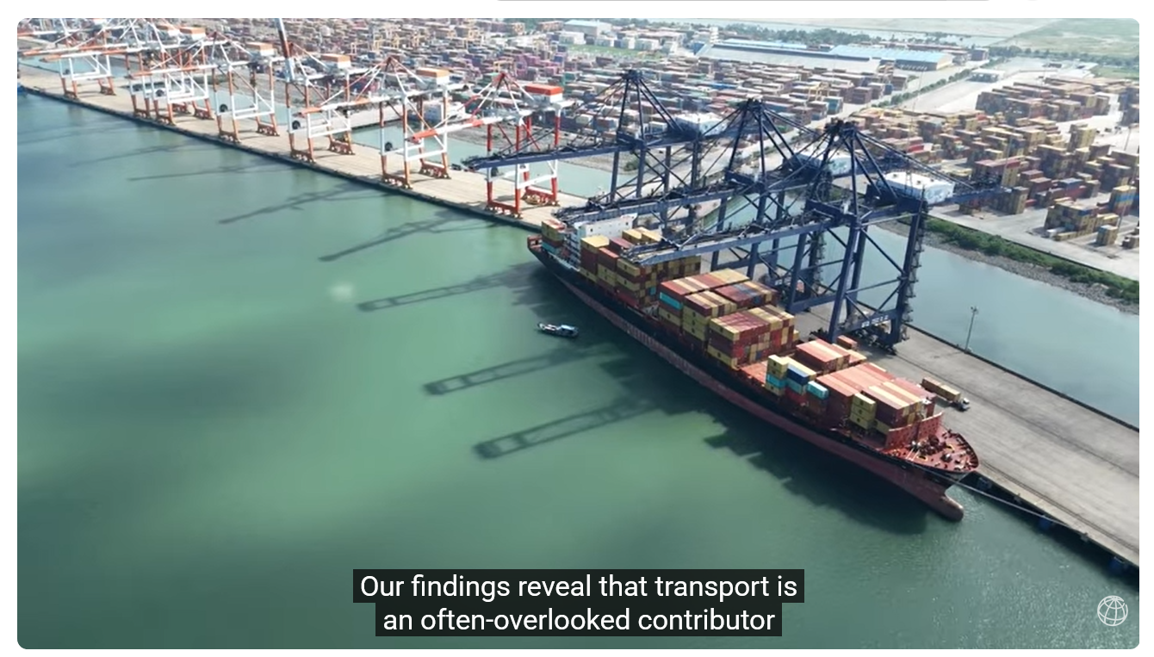
How Poor Transport Drives Food Insecurity in Africa: Fixing Supply Chain Bottlenecks
https://www.youtube.com/watch?app=desktop&v=-HhtF4kgMGU

Slide 6
Summary of the Film
This video analyzes the critical impact of inefficient transport infrastructure on food security in Sub-Saharan Africa. The core problem is that African food supply chains are, on average, four times longer than those in Europe, leading to massive product losses. According to World Bank data, approximately 37% of locally produced food is wasted due to transport and storage gaps, including a lack of cold chain infrastructure.
The material emphasizes that without improved transport connectivity and the elimination of border delays, the region cannot effectively feed its growing population. Key conclusions point to the necessity of investing in rural "feeder roads" and logistics infrastructure to reduce the distance between producers and consumers.

Slide 7
Learning Outcomes
After completing the assignment, the student:
identifies the main technical and organizational barriers in transporting agricultural products in Africa.
analyzes how road conditions affect losses in the food supply chain.
evaluates the importance of "last-mile" infrastructure for food security.
proposes engineering solutions for designing local road networks connecting markets with production areas.

Slide 8
Instruction for Students
Watch the video and identify why transport is considered the main factor generating food waste in Africa.
Describe 3 technical/operational causes and 3 social/economic effects of low efficiency in agricultural transport.
Relate these problems to the transport realities in your country (e.g., DRC or Cameroon)—focus on a specific province.
Indicate what data (e.g., traffic volume, travel time, pavement condition) would be needed to design better transport connectivity for the chosen region.
Propose 3 realistic corrective actions (e.g., modernization of feeder roads, construction of logistics centers).

Slide 9
Supporting Questions
What is the main difference between supply chain lengths in Africa and Europe according to the video?
Why is the lack of cold chains so detrimental to transport systems engineering?
What are the main infrastructural limitations presented in the material?
How do delays at checkpoints affect the condition of transported goods?
Are the World Bank's presented solutions easy to implement in low-budget conditions?

Slide 10
Expected Result
A report (3–5 pages) or presentation (5–7 slides) summarizing key findings.
A list of 3 - 5 recommendations to improve agricultural logistics.

Slide 11
Evaluation Criteria
Criterion | Description | Excellent Performance | Poor Performance | Points
Understanding of the Film | Correct identification and interpretation of key information presented in the film, including the 37% food loss data and supply chain lengths. | Accurately explains all major concepts and statistics from the film. | Misinterprets or omits key information and logistics concepts. | 20
Quality of Problem Analysis | Ability to connect transport infrastructure and road engineering issues with food logistics performance. | Demonstrates deep analytical understanding of logistics and transport relationships. | Provides only basic or superficial observations. | 20
Reference to SSA Realities | Use of realistic examples from Sub-Saharan Africa, especially the DRC, Cameroon, or the student’s home country. | Provides relevant and context-specific regional examples and logistics realities. | Lacks meaningful African context or local references. | 20
Quality of Recommendations | Feasibility, practicality, and technical quality of proposed solutions. | Proposes realistic and implementable technical and logistics improvements. | Recommendations are unrealistic or poorly justified. | 20
Structure and Style | Academic writing quality, clarity, organization, and language correctness. | Well-structured, professional, and linguistically accurate work. | Disorganized structure and significant language issues. | 10
Critical Thinking | Ability to critically assess whether international aid and investments address the most important logistics priorities. | Demonstrates independent and critical reflection supported by arguments. | Accepts information uncritically or provides unsupported opinions. | 10
 |  | TOTAL |  | 100

Slide 12
Short Description for Students
Watch the World Bank video on the impact of transport on food security in Africa. Based on the material, prepare a report analyzing the causes of the 37% food loss in the region. Focus on the engineering aspects of road infrastructure in the DRC or Cameroon. Propose realistic technical solutions to shorten delivery times and improve connectivity between agricultural producers and markets. Deadline: [date].

