Slide 1

Distribution Logistics
Part 1
Justyna Staszak-Winkler

Slide 2
Road Transportation Systems Engineering Development in the Sub-Saharan Africa – Modern EU Master Programme & Capacity Building

Slide 4
Distribution logistics
MODULE 4
Part 1
Justyna Staszak-Winkler

Slide 5

The essence of the concept and the components of a distribution network

Slide 6
MODULE 4 - Objectives
Understand the concept of distribution networks and identify their key components: facilities, transportation links, inventory points, and information flows.
Explain the role of logistics in customer service and use performance indicators such as the Customer Satisfaction Index (CSI) to evaluate service quality.
Analyze last-mile delivery challenges in urban distribution and propose practical solutions.
Understand the function of local consolidation centers and microhubs and their impact on delivery efficiency and sustainability.

Slide 7
The essence of distribution logistics and components of a distribution network
Distribution logistics focuses on planning, organizing, and controlling the flow of finished goods from producers to final customers in a way that ensures availability, timeliness, reliability, and cost efficiency.
A distribution network is a structured system of interconnected elements that enables efficient product delivery across spatially dispersed markets.

Slide 8
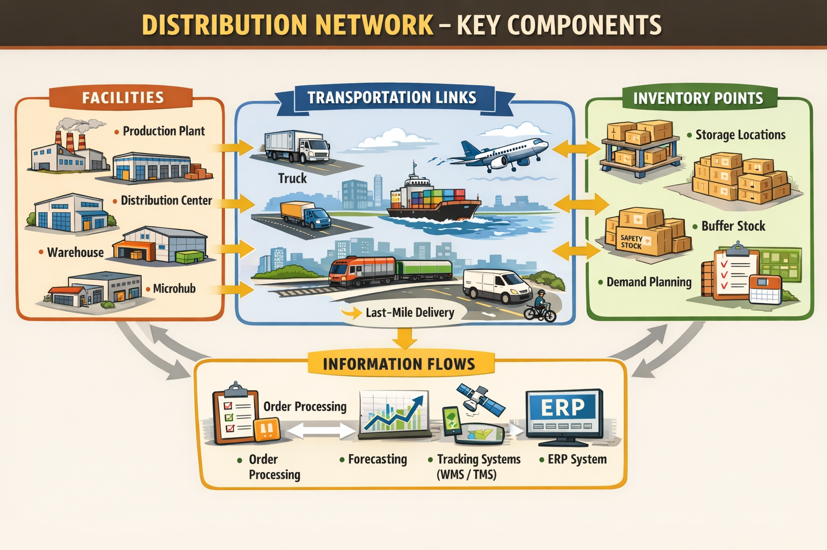
Key components of a distribution network

Slide 9
Key components of a distribution network
Facilities
  Production plants
  Central and regional distribution centers
  Warehouses and cross-docking terminals
  Local consolidation centers and microhubs
Transportation links
  Road, rail, maritime, inland waterways, and air transport
  Intermodal and multimodal transport connections
  Urban delivery routes and last-mile links

Slide 10
Key components of a distribution network
Inventory points
  Locations where stock is stored to balance supply and demand
  Strategic placement of inventory to reduce lead time and transportation costs
  Buffer stocks to ensure service continuity
Information flows
  Order processing systems
  Demand forecasting and inventory management systems
  Real-time tracking, WMS, TMS, and ERP systems

Slide 11
Logistics elements of customer service in logistics networks
Logistics customer service refers to the ability of a logistics network to meet or exceed customer expectations related to time, place, quantity, quality, and information availability throughout the distribution process. It represents the interface between logistics operations and customer satisfaction.
In modern logistics networks, customer service is not a single activity but a set of interrelated logistics elements that jointly determine service performance.

Slide 12
Customer Service –
Pre-transaction, Transaction and Post-transaction elements
Pre-transaction elements define the service conditions and capabilities before an order is placed. They shape customer expectations and perceived reliability of the logistics system.
Transaction elements relate to the execution of the order and physical delivery. They are the most visible and measurable aspects of logistics customer service.
Post-transaction elements concern support activities after delivery, especially in cases of service failures or additional customer needs.

Slide 13
Pre-transaction elements
Customer service policy
  Clearly defined service standards (delivery time, order lead time, availability levels)
  Communication of logistics capabilities and limitations
Information accessibility
  Product availability information
  Delivery options and lead times
  Pricing and logistics conditions
Order placement convenience
  Ease of placing orders (online platforms, EDI, ERP integration)
  Standardized order procedures
Service system reliability
  IT system availability and data accuracy
  Transparency of logistics processes
Pre-transaction elements influence the customer’s decision to place an order and their expectations regarding service quality.

Slide 14
Transaction elements
Order cycle time
  Time from order receipt to delivery
Order accuracy
  Correct product, quantity, documentation, and delivery address
Product availability
  Ability to fulfill orders from stock
  Fill rate and stock-out frequency
Delivery reliability
  On-time and in-full (OTIF) performance
Delivery condition
  Damage-free and compliant delivery
Delivery flexibility
  Ability to adjust delivery time, place, or mode
Transaction elements directly determine customer satisfaction with the delivery itself.

Slide 15
Post-transaction elements
Handling returns and reverse logistics
  Efficient returns procedures
  Ease of product exchange or return
Complaint handling and problem resolution
  Speed and effectiveness of complaint response
  Availability of customer support
Service recovery
  Ability to compensate for delivery failures
  Restoring customer trust after disruptions
After-sales information
  Delivery confirmation
  Performance feedback and customer satisfaction surveys

Slide 16
Integrated perspective
Although presented separately, pre-, transaction, and post-transaction elements are interdependent:
Poor pre-transaction communication leads to unrealistic expectations.
Weak transaction performance increases post-transaction costs.
Effective post-transaction service can mitigate transaction failures.

