Slide 1

Distribution Logistics
Part 2
Justyna Staszak-Winkler

Slide 2
Road Transportation Systems Engineering Development in the Sub-Saharan Africa – Modern EU Master Programme & Capacity Building

Slide 4
Distribution logistics
MODULE 4
Part 2
Justyna Staszak-Winkler

Slide 5

Logistics elements of customer service in logistics networks

Slide 6
Customer Satisfaction Index (CSI) in Logistics and Distribution Management
The Customer Satisfaction Index (CSI) is a composite performance indicator used to evaluate customers’ overall perception of logistics service quality. Unlike single operational metrics, CSI integrates multiple dimensions of logistics performance into one aggregated measure, reflecting how customers experience the logistics system as a whole.
CSI is increasingly applied in supply chain and distribution management because it links operational logistics performance with customer-oriented outcomes, such as satisfaction, loyalty, and repeat purchasing behavior.

Slide 7
Role of CSI in supply chain and distribution management
CSI plays a strategic role in modern logistics systems:
Performance monitoring
  Evaluates the effectiveness of logistics networks and distribution channels
Decision support
  Supports decisions on inventory positioning, transport modes, and service levels
Service differentiation
  Enables companies to compete on logistics service quality, not only on price
Continuous improvement
  Helps align operational improvements with customer expectations
In complex distribution networks, CSI acts as a bridge between operational efficiency and customer value creation.

Slide 8
Role of CSI in supply chain and distribution management
On the one hand, the CSI index makes it possible to analyze all elements of logistics customer service in terms of customer satisfaction.
On the other hand, it enables the assessment of the importance of individual service elements according to the preferences of specific customer segments.
As a result, CSI is a useful indicator of a company’s operational effectiveness, while simultaneously allowing the identification of directions for the company’s further development in the area of customer service.

Slide 9
Determining the directions of a company’s development in customer service based on clients satisfaction measurement
Objective
The aim of this exercise is to analyze logistics customer service performance using the Customer Satisfaction Index (CSI) and to identify directions for improvement and further development of a company’s distribution and customer service system.
Student Assignments

Slide 10
Determining the directions of a company’s development in customer service based on clients satisfaction measurement
Background
A logistics operator handling distribution processes has conducted a customer satisfaction survey covering key elements of logistics customer service.
The survey involved 50 respondents (retail stores).
Customers evaluated:
their level of satisfaction, and
the importance of individual service elements.
The results are summarized in a table.
Student Assignments
The assignment was created on the basis of selected articles:
J.Woźniak, D. Zimon: ZASTOSOWANIE METODY CSI DO BADANIA
SATYSFAKCJI KONSUMENTÓW NA PRZYKŁADZIE WYBRANEJ SIECI HANDLOWEJSI
D. Zimon, U. Kruk: Wykorzystanie metody CSI do badania logistycznej obsługi klienta na przykładzie wybranej organizacji

Slide 11
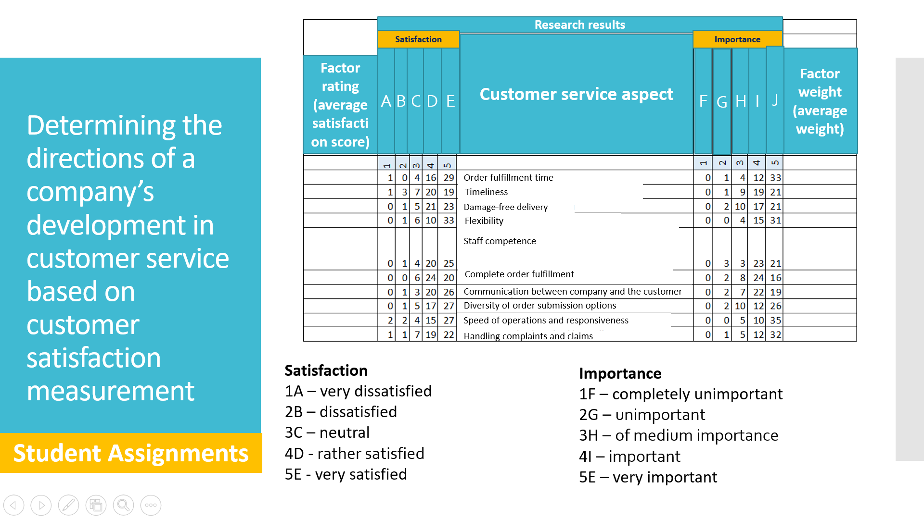

Slide 12
Determining the directions of a company’s development in customer service based on customer satisfaction measurement
You are asked to calculate the average satisfaction rating and average importance weight for each factor of logistics service and make an initial interpretation.
Survey data:
Weight – How important each factor is from the customer's perspective.
Satisfaction rating – Customers evaluated the performance of the company for each factor on a scale from 1 to 5, where:
  1 – extremely poor performance
  5 – fully meets customers expectations
Student Assignments

Slide 13
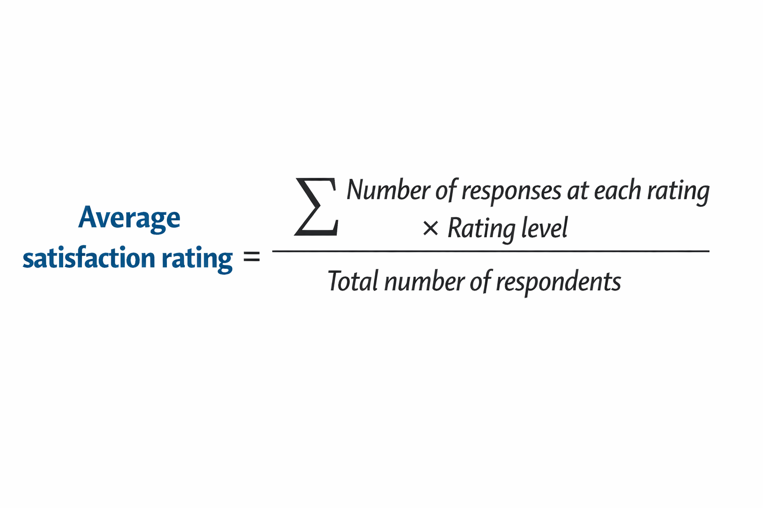
Determining the directions of a company’s development in customer service based on customer satisfaction measurement
Instructions:
For each factor, calculate the average satisfaction rating using the formula:
Calculate the average importance weight for each factor in the same way if the weights were also rated by respondents.
Enter the calculation results in the table
Student Assignments

Slide 14
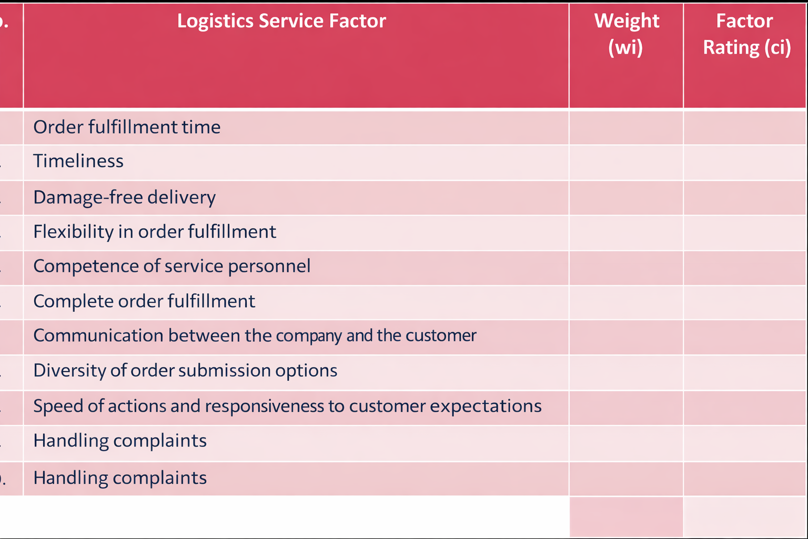
Determining the directions of a company’s development in customer service based on customer satisfaction measurement
Student Assignments

Slide 15
After calculating the averages, provide a brief interpretation of the results, e.g.:
  Which factors have high satisfaction but low importance?
  Which factors have high importance but low satisfaction?
  Which factors should be prioritized for improvement?
Determining the directions of a company’s development in customer service based on customer satisfaction measurement
Student Assignments

Slide 16
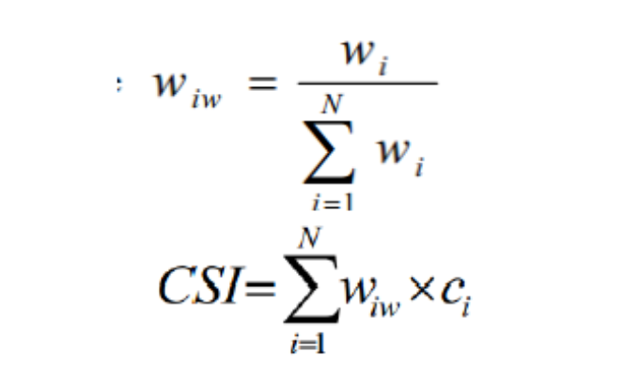
Customer Satisfaction Index (CSI)
Relative Weight
Customer Satisfaction Index (CSI)
I, 1 … n – customer service elements
Wiw – relative weight
Wi – weight of the customer service element
Ci – rating of the customer service element
Student Assignments

Slide 17
CSI max / CSI% – formulas
CSIMAX – maximum achievable Customer Satisfaction Index
ciMAX – maximum possible rating of the i-th feature
Wiw – relative weight
i – number of the current survey/item
N – number of features included in the survey
Student Assignments

Slide 18
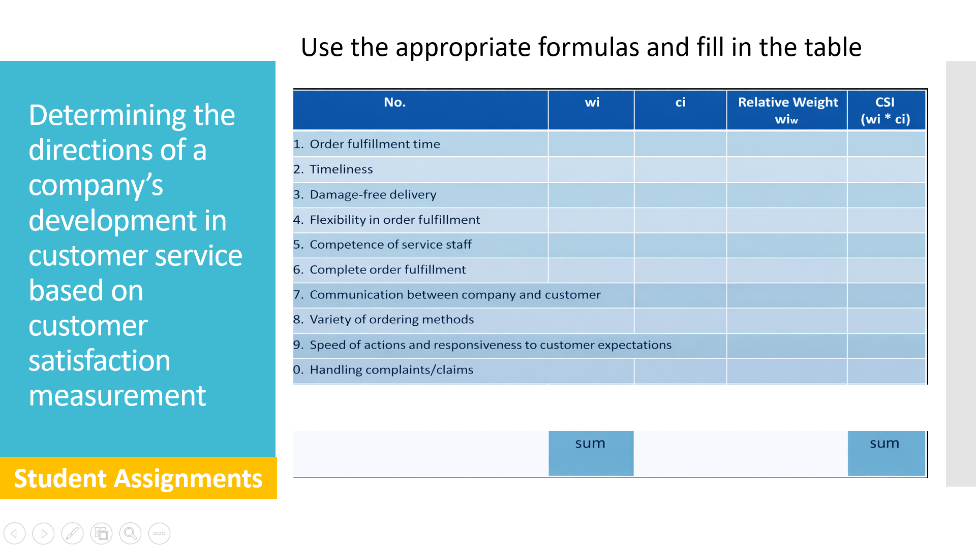

Slide 19
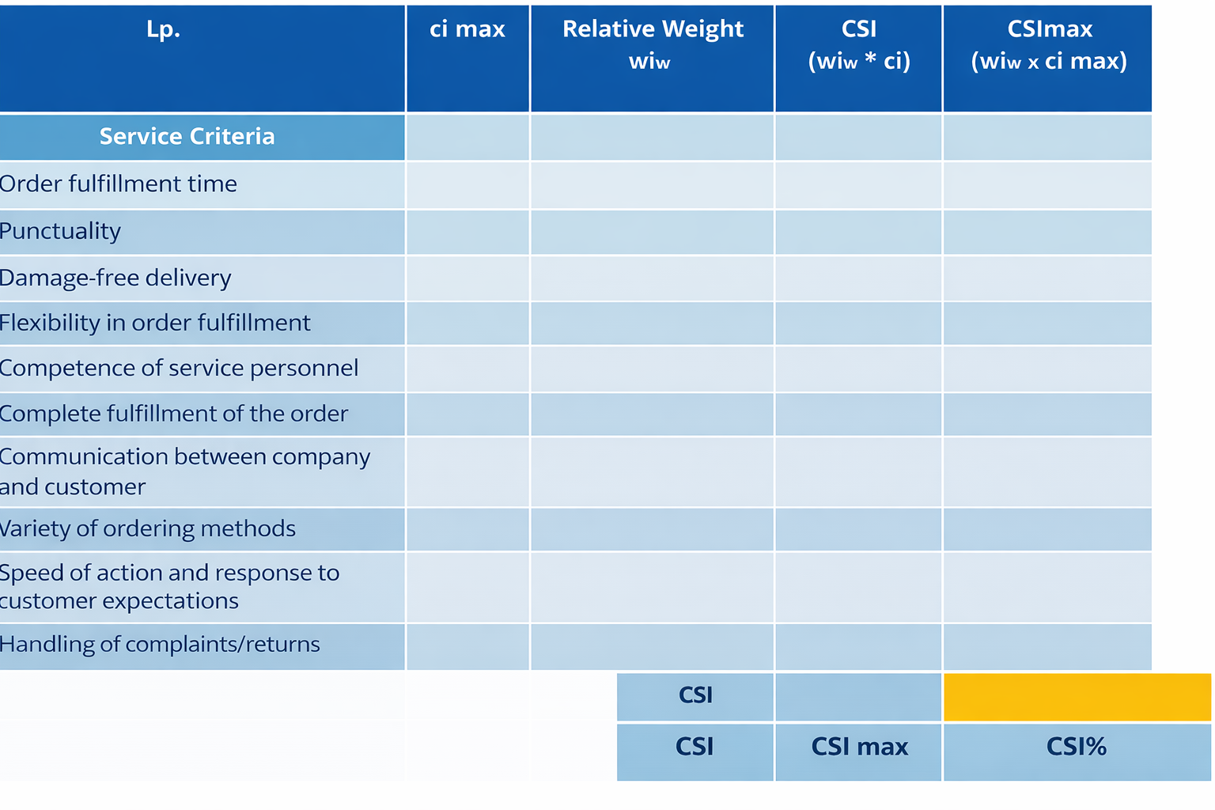
Determining the directions of a company’s development in customer service based on customer satisfaction measurement
Student Assignments

Slide 20
Interpretation of results
0–40%: Very poor – customer extremely dissatisfied
41–60%: Poor – customer dissatisfied
61–75%: Average – some issues with customer satisfaction
76–90%: Good – few issues with customer satisfaction
91–100%: Very good – customer highly satisfied
Student Assignments

Slide 21
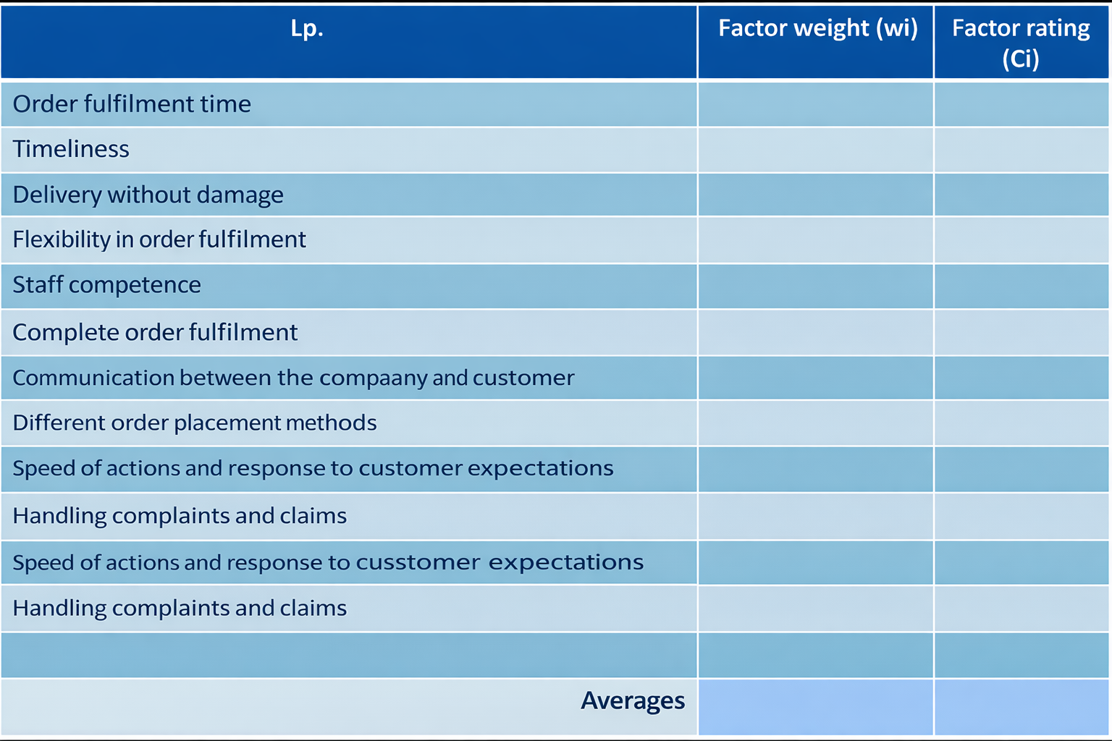
Quality mapping – defining the segmentation points of the quality map
You will determine the division points of the quality map – dividing it into 4 areas. The important axes are importance and satisfaction. The point on the importance axis is determined by calculating the weighted average of all aspects. To determine the point on the satisfaction axis, the previously calculated average rating of all aspects is used.
Student Assignments

Slide 22
Present a quality map for the analyzed operator, classifying factors into the following categories:
  Insignificant factors
  Factors whose values should be maintained
  Factors to be improved as a last priority (in the long term)
  Factors requiring improvement as a first priority (in the short term)
After preparing the quality map, perform an analysis of the chart:
  Draw conclusions
  Identify directions for the company’s development in this area
  Finally, propose actions the operator could take to improve its competitiveness in relation to these factors.
Determining the directions of a company’s development in customer service based on customer satisfaction measurement
Student Assignments

Slide 23
Determining the directions of a company’s development in customer service based on customer satisfaction measurement
Insignificant factors
Factors whose values should be maintained
flexibility
SATISFACTION
Factors requiring improvement last
Factors requiring improvement as a first priority (in the short term)
Student Assignments
IMPORTANCE
Example of a quality map

