Slide 1

Logistics Optimization and Collaboration
Part 1
Justyna Staszak-Winkler

Slide 2
Road Transportation Systems Engineering Development in the Sub-Saharan Africa – Modern EU Master Programme & Capacity Building

Slide 4
Logistics Optimization and Collaboration
MODULE 5
Part 1
Justyna Staszak-Winkler

Slide 5

Optimizing distribution operations

Slide 6
Module 5 - Objectives
understand key tools for optimizing distribution operations,
analyze how logistics optimization reduces costs and improves sustainability,
compare traditional and collaborative distribution models,
critically evaluate real-life distribution strategies used by companies,
propose optimization solutions adapted to African logistics conditions.

Slide 7
Optimizing Distribution Operations
Optimizing distribution operations aims to improve efficiency, reduce operational costs, shorten delivery times, and minimize environmental impact. This is especially important in African logistics systems, where infrastructure constraints, high transport costs, and rapid urbanization pose significant challenges.
Key optimization approaches include cross-docking, merge-in-transit, and collaborative (shared) distribution.

Slide 8
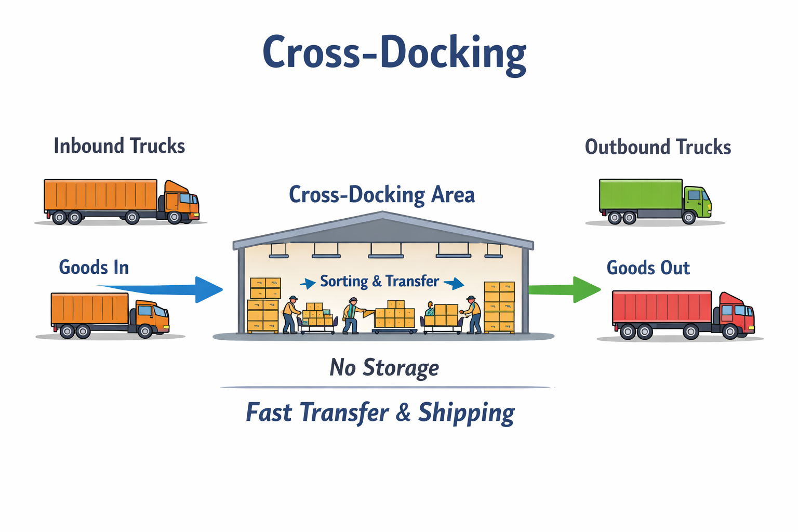
Tools and Methods for Improving Efficiency and Sustainability -Cross-Docking
Cross-docking is a logistics strategy in which products are unloaded from inbound transport and directly transferred to outbound vehicles, with little or no storage.

Slide 9
Tools and Methods for Improving Efficiency and Sustainability -Cross-Docking
Key characteristics:
Minimal warehousing time
Reduced inventory holding costs
Faster order fulfillment
Benefits:
Lower storage and handling costs
Reduced inventory levels
Faster response to customer demand
Lower energy consumption in warehouses

Slide 10
Tools and Methods for Improving Efficiency and Sustainability -Cross-Docking
Challenges (especially in Africa):
Requires reliable transport schedules
Needs good coordination between suppliers and distributors
Sensitive to infrastructure disruptions

Slide 11
Cross-Docking in the African Context (Kenya & South Africa)
Large retail chains and FMCG distributors in countries such as Kenya and South Africa increasingly use cross-docking to ensure fast and reliable distribution of food and household products to urban stores.
How cross-docking works in practice?
Suppliers (food producers, importers, FMCG manufacturers) deliver products to regional distribution centers located near major cities such as Nairobi, Mombasa, Johannesburg, or Cape Town.
Instead of storing goods in warehouses, products are:
unloaded from inbound trucks,
quickly sorted by destination (individual retail stores),
immediately loaded onto outbound vehicles.
Goods usually remain in the facility only a few hours, which is crucial for perishable goods such as fresh food, dairy products, and beverages.
Example

Slide 12
Why cross -docking is used ?
Retailers and distributors apply cross-docking to:
reduce inventory holding and refrigeration costs,
ensure freshness and product availability,
minimize delivery lead time to urban stores,
cope with high demand volatility in large cities.
In dense urban areas, daily or even multiple deliveries per day are organized using synchronized inbound and outbound transport schedules.
Example

Slide 13
Operational and infrastructural conditions
Cross-docking in Kenya and South Africa is typically supported by:
IT systems (basic WMS, barcode scanning, delivery scheduling),
predictable supplier delivery windows,
proximity to main transport corridors and ports (e.g. Port of Mombasa, Port of Durban),
coordination with third-party logistics providers (3PLs).
However, disruptions such as traffic congestion, road conditions, or weather can significantly affect performance, making coordination and flexibility critical.
Example

Slide 14
Operational and infrastructural conditions
Sustainability and social impact
Cross-docking contributes to sustainability by:
reducing warehouse energy consumption,
limiting food waste through faster distribution,
improving vehicle utilization,
lowering overall CO₂ emissions per delivered unit.
It also supports urban food security, ensuring reliable access to essential goods for growing city populations.
Example

