Slide 1

Logistics Optimization and Collaboration
Part 2
Justyna Staszak-Winkler

Slide 2
Road Transportation Systems Engineering Development in the Sub-Saharan Africa – Modern EU Master Programme & Capacity Building

Slide 4
Logistics Optimization and Collaboration
MODULE 5
Part 2
Justyna Staszak-Winkler

Slide 5

Optimizing distribution operations

Slide 6
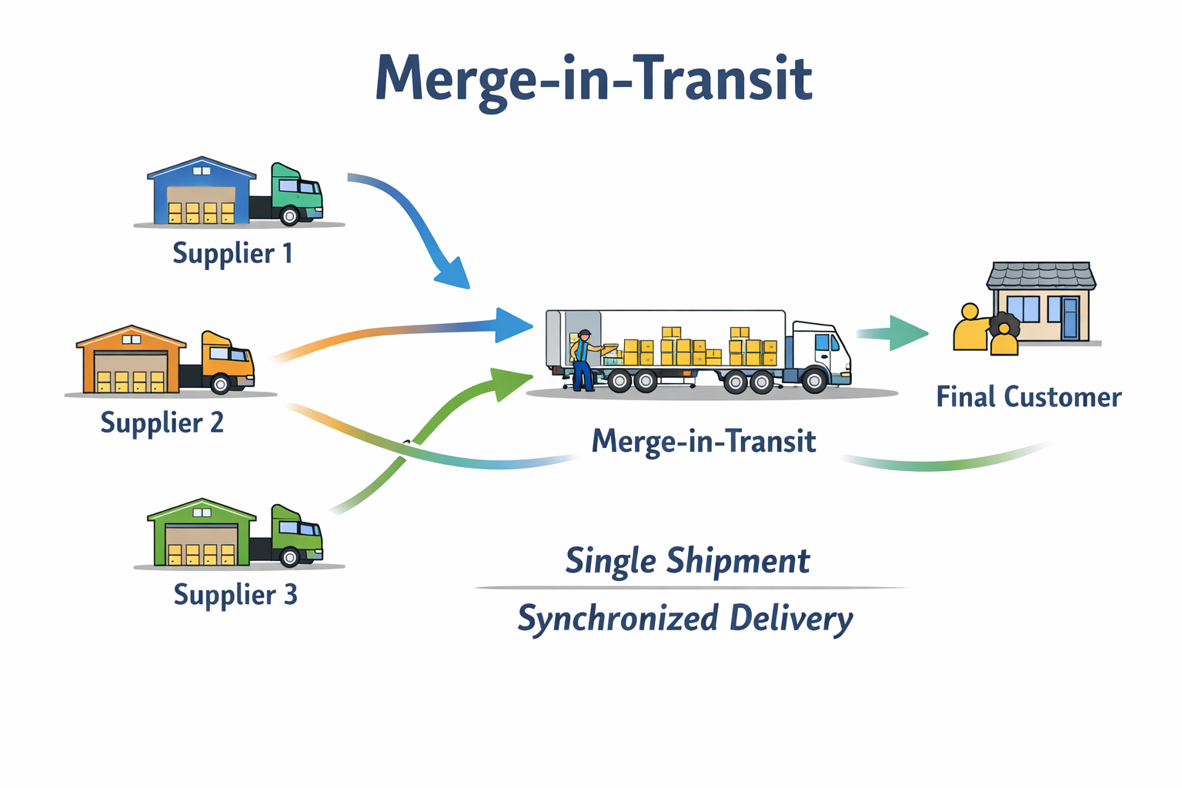
Merge-in-Transit
Merge-in-transit involves combining products from multiple origins into one shipment while they are in transit, instead of assembling them in a warehouse.

Slide 7
Merge-in-Transit
Key characteristics:
Goods from different suppliers arrive simultaneously at the customer
Coordination through information systems (ICT)
Benefits:
Reduced warehousing needs
Lower transport and handling costs
Improved customer service (one consolidated delivery)
Reduced carbon emissions through fewer deliveries
Challenges:
Requires advanced coordination and information sharing
Dependence on ICT systems and data accuracy

Slide 8
Merge-in-Transit in the African Context - Construction and Infrastructure Projects in East Africa
Merge-in-transit is increasingly used in large construction and infrastructure projects in countries such as Kenya, Tanzania, and Rwanda, where materials and equipment are sourced from multiple suppliers.
How merge-in-transit works in practice ?
A construction company building a shopping mall or public infrastructure project in Nairobi requires:
construction materials from local suppliers (cement, steel),
electrical components from regional manufacturers,
specialized equipment imported via the Port of Mombasa.
Example

Slide 9
Why merge-in-transit is used ?
This approach allows companies to:
reduce the number of deliveries to congested urban areas,
avoid costly temporary warehousing,
ensure all components arrive at the same time, enabling immediate installation,
reduce delays caused by missing components.
This is particularly important in African cities, where traffic congestion, limited storage space, and high logistics costs are common challenges.

Slide 10
Merge-in-Transit in the African Context - Construction and Infrastructure Projects in East Africa
Instead of delivering each component separately to the construction site or storing them in a warehouse, shipments are:
transported from different suppliers,
synchronized using delivery schedules and digital tracking,
consolidated while in transit at a designated logistics hub or transport node,
delivered together as a single shipment to the construction site.
Example

Slide 11
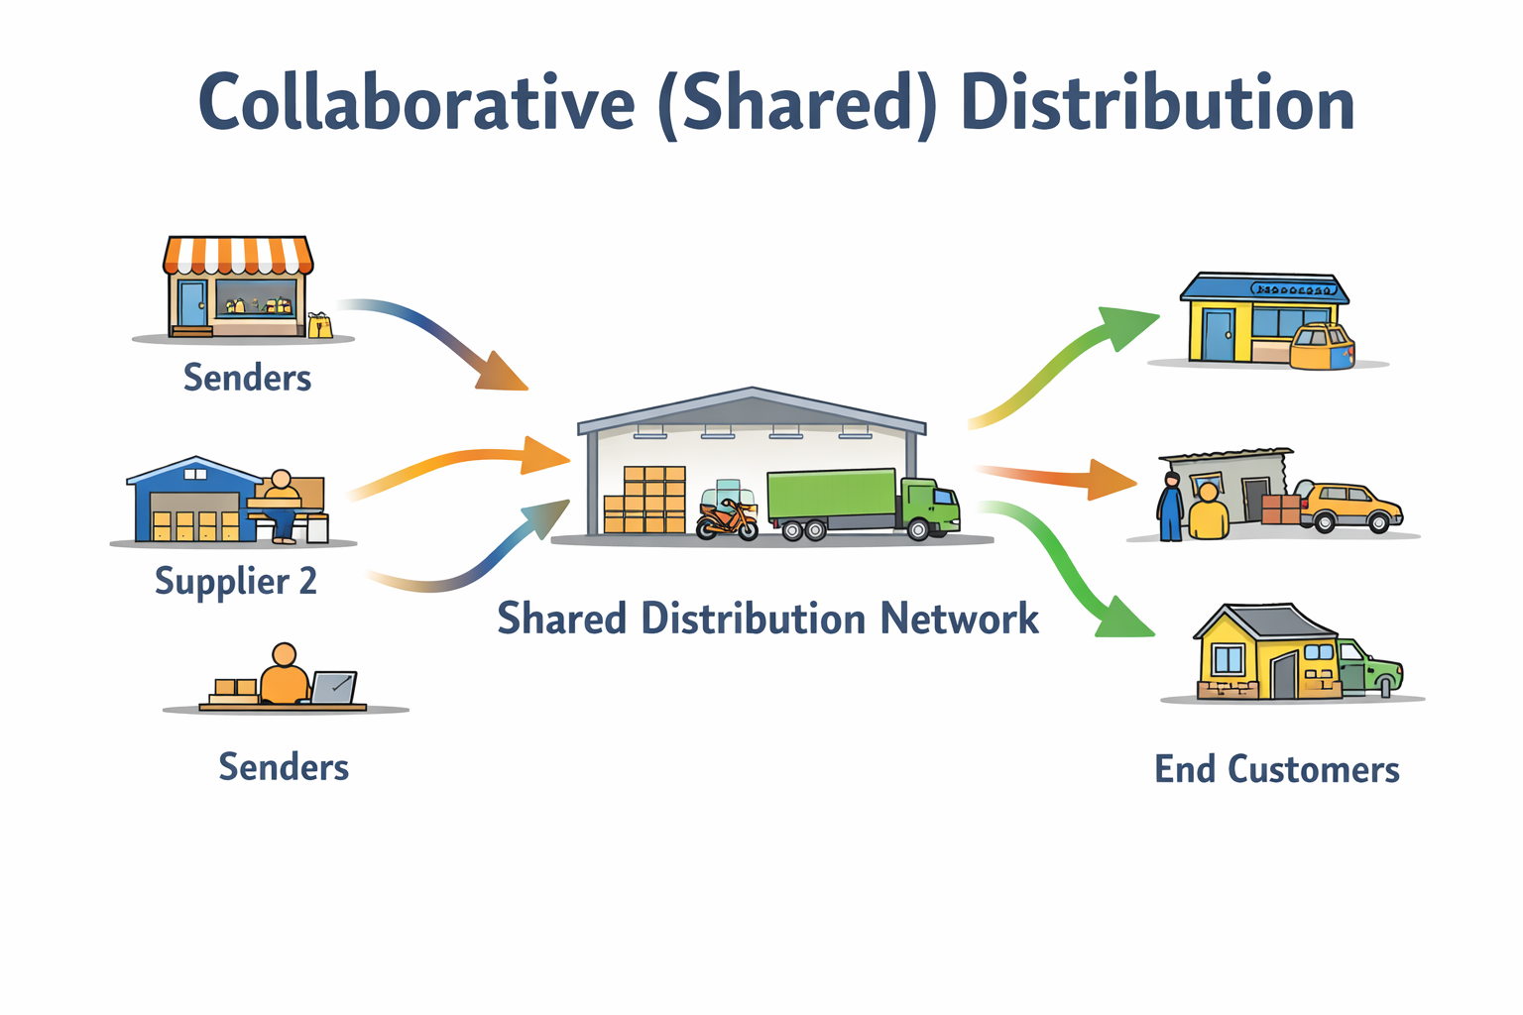
Collaborative (Shared) Distribution
Collaborative distribution refers to sharing transport resources, warehouses, or distribution networks between multiple companies.

Slide 12
Collaborative (Shared) Distribution
Forms of collaboration:
Shared trucks or delivery routes
Shared urban consolidation centers
Joint last-mile delivery systems
Benefits:
Lower transport costs per unit
Better vehicle utilization
Reduced congestion and emissions
Increased access to logistics services for SMEs
Importance for Africa:
High relevance due to fragmented markets
Supports small and medium enterprises
Enables affordable last-mile delivery solutions

Slide 13
Shared Delivery Platforms in African Cities - Motorcycle and E-Trike-Based Shared Distribution in Nairobi, Lagos, and Accra
How shared distribution works in practice ?
Multiple small businesses—such as:
local retailers,
street vendors,
pharmacies,
e-commerce sellers,
restaurants and food suppliers,
Do not operate their own delivery fleets. Instead, they share a common delivery platform that provides:
a pool of delivery riders,
shared vehicles (motorcycles or e-trikes),
digital order management and routing.
Orders from different senders are consolidated and delivered along optimized routes, often serving multiple customers in one trip.
Example

Slide 14
Why motorcycles and e-trikes are used?
These vehicles are particularly suited to African urban conditions because they:
can navigate congested and narrow streets,
require low investment and operating costs,
are flexible and fast for short-distance deliveries,
can access informal settlements and areas with poor road infrastructure.
Electric trikes additionally:
reduce fuel costs,
lower emissions and noise,
support sustainable urban mobility goals.
Example

Slide 15
Benefits for businesses and cities
For businesses:
lower delivery costs (pay-per-delivery model),
access to professional logistics services,
improved service reliability and customer reach.
For cities:
fewer delivery vehicles on the road,
reduced congestion and emissions,
improved organization of informal logistics activities,
increased employment opportunities for riders.

