Slide 1
Mobility Behaviour
Fundamentals of Transport

Slide 2
Road Transportation Systems Engineering Development in the Sub-Saharan Africa – Modern EU Master Programme & Capacity Building

Slide 4
Introduction
Repetition: Definition Mobility
Mobility
Mobility as an opportunity to change location "Mobility in the broadest sense expresses both the desire for mobility and the degree of mobility of people, goods and messages. The demand for transport services results from the mobility wishes." (Kummer 2010: 41)
Traffic
Traffic as a realized change of location "The term transport covers all activities that together form the process of moving people, goods and messages. This includes support processes such as storage and handling processes, insofar as they are part of the movement process." (Kummer 2010: 33)
-> Traffic as a consequence of mobility

Slide 5
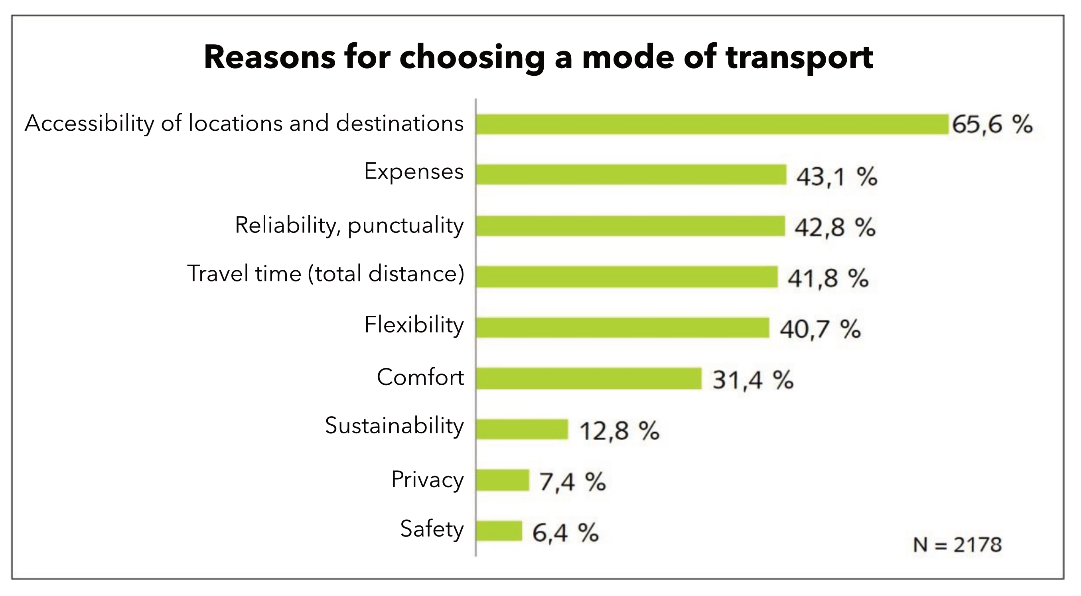
Reasons for choosing a mode of transport
VCD 2014: 19

Slide 6
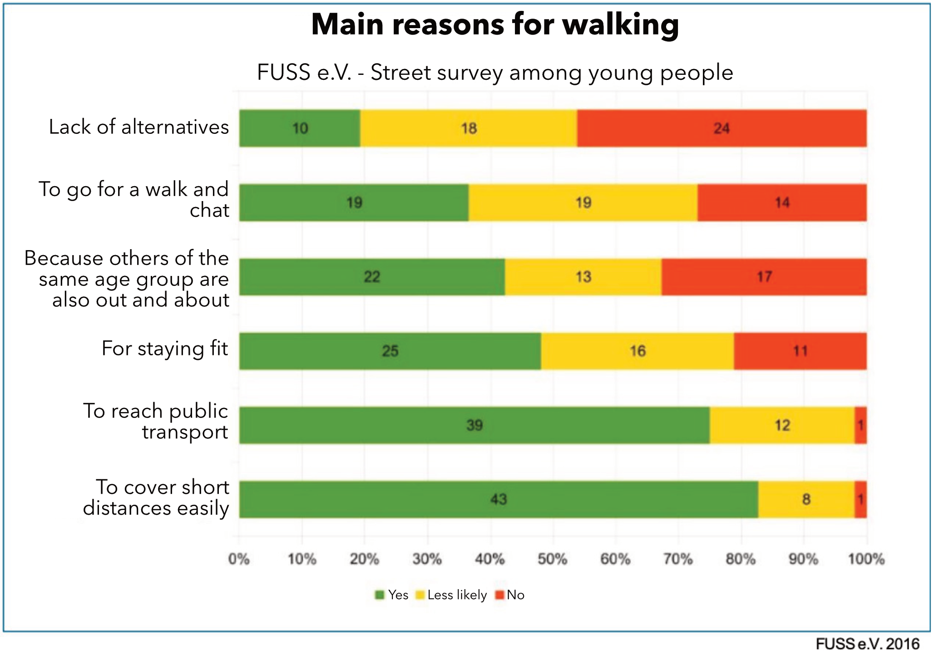
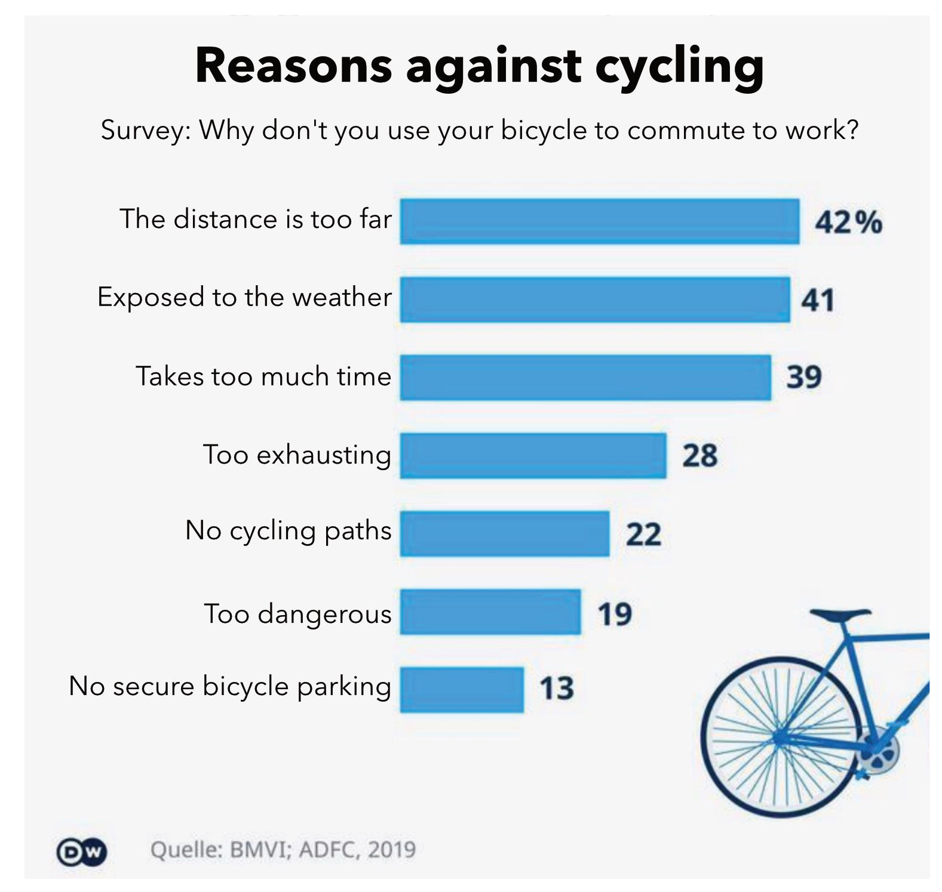
Reasons for choosing a mode of transport

Slide 7
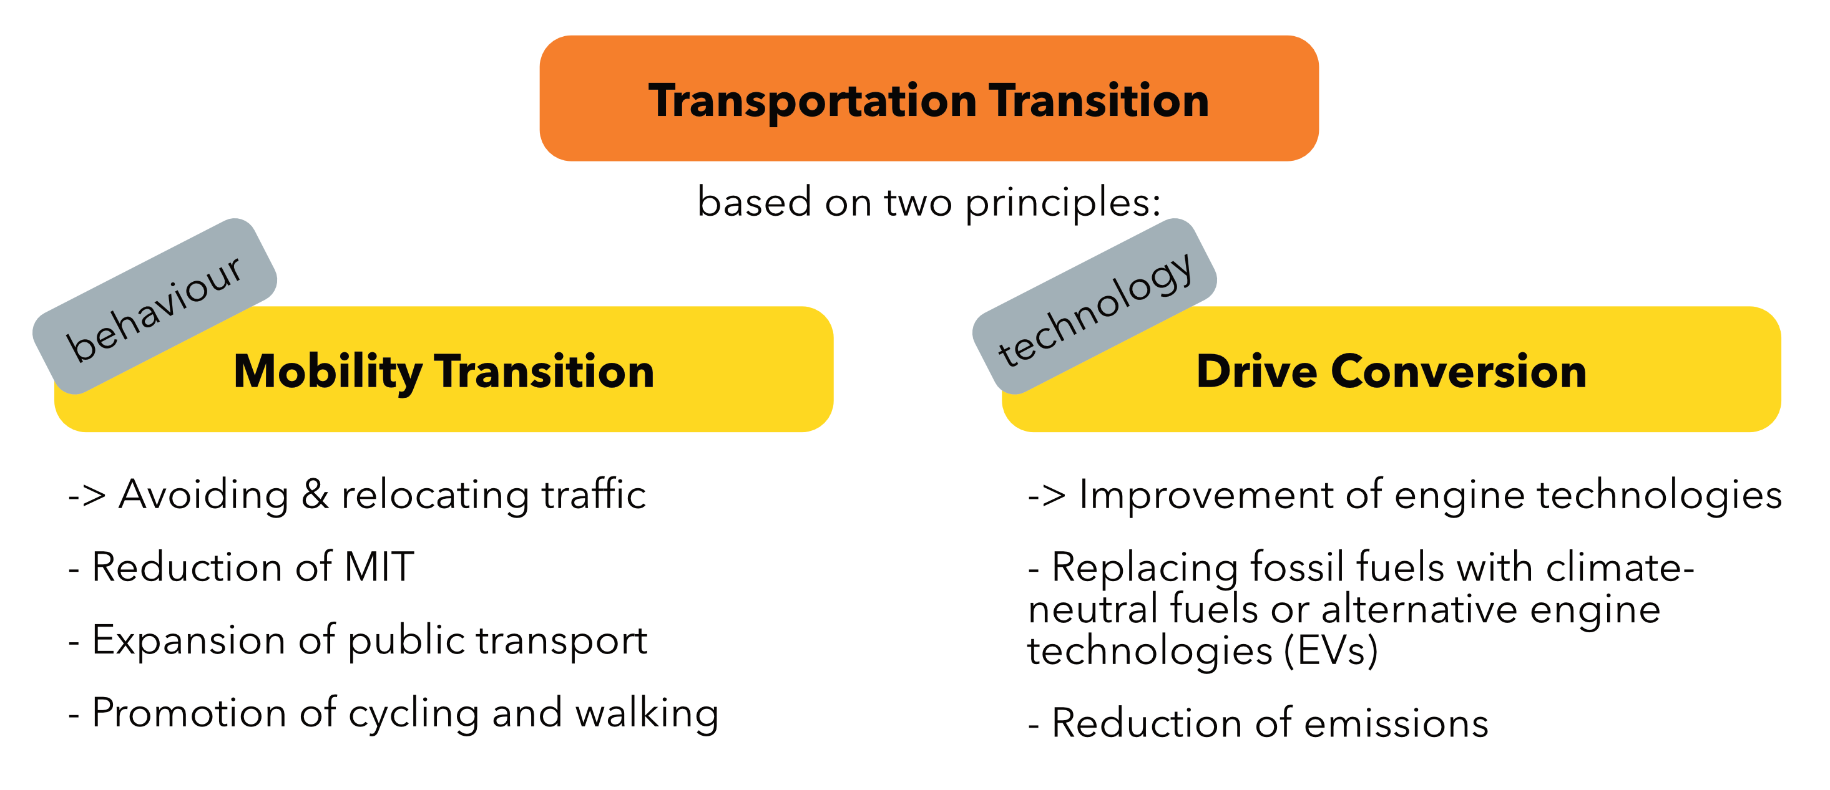
Why do we want to explain mobility behaviour?

Slide 8
Why do we want to explain mobility behaviour?
In order to have a targeted influence on people's mobility behavior, it is first necessary to understand mobility behavior and the reasons behind it.

Slide 9
THEORIES OF ACTION

Slide 10
Why do we need theories?
The complexity of social reality cannot be grasped as a whole
Theories and models structure and abstract these and open up an analytical approach
"The aim is a thematically limited approximation of complex reality. In line with scientific interest, the aim is to make reality tangible" (Wilde 2014: 44)

Slide 11
The object of a theory of action
"'Acting' should mean human behaviour (whether external or internal action, omission or acquiescence) if and insofar as the person or persons acting associate a subjective meaning with it". (Weber 2015: 5)
Action as a "special case" of behavior:
  Behavior becomes action when something is done with an intention/intentionally. -> Action is the result of a conscious decision.
  Non-action - the omission of an action as a result of a conscious selection - is also action

Slide 12
The rational choice approach
Collective term for a variety of theories with common basic assumptions
Core assumptions of action theory
Assumption of Preference
  Actors know their goals
  Their actions serve to realize these goals
Assumption of Restriction
  Opportunities and restrictions influence actions.
Assumption of Maximization
  Actors choose the alternative course of action that - under the given restrictions - best suits the realization of the preferences.
The actors' actions are preceded by a decision-making process in which they make “rational” use of available information.

Slide 13
The rational choice approach
Human beings as homo oeconomicus?
Homo oeconomicus as a classic rational choice theory of economics
The homo oeconomicus is characterized by
  The pursuit of utility maximization of material
  "Objectively rational" decisions
  Being fully informed
Suitable due to its ideal-typical features to explain elementary economic relationships.
But: Transferability to other fields/questions is not possible in a target-oriented way.

Slide 14
The rational choice approach
Broad versions of the rational choice approach:
Subjective rationality as a basis for decision-making
Relevance of all types of preferences: Utility maximization not only in material terms
Relevance of all types of restrictions
Not fully informed
Action results from the subjective preferences of an individual and the subjectively perceived restrictions

Slide 15
The rational choice approach
Broad versions of the rational choice approach:
Subjective rationality as a basis for decision-making
Relevance of all types of preferences: Utility maximization not only in material terms
Relevance of all types of restrictions
Not fully informed
Action results from the subjective preferences of an individual and the subjectively perceived restrictions
What can this look like in reality?

Slide 16
The theory of planned behaviour
Developed in the 1980s by US social psychologist Icek Ajzen
Social-psychological variant of general rational choice approach
Dominant in social science research on the choice of means of transport

Slide 17
The theory of planned behaviour
Basic assumptions
Behavior as the result of individual decisions
In the decision-making process
  Do individuals (subjectively) make rational use of available information
  Are the pros and cons weighed against each other in the sense of a cost-benefit analysis
  If an intention is formed that is ultimately decisive for the behavior
Cost and benefit factors
  Not merely objectifiable variables (in terms of time and money (≠homo oeconomicus))
  The focus is on individual-internal evaluation processes and influencing factors such as norms, attitudes and control beliefs
Environmental characteristics not as person-independent, but as subjectively perceived characteristics

Slide 18
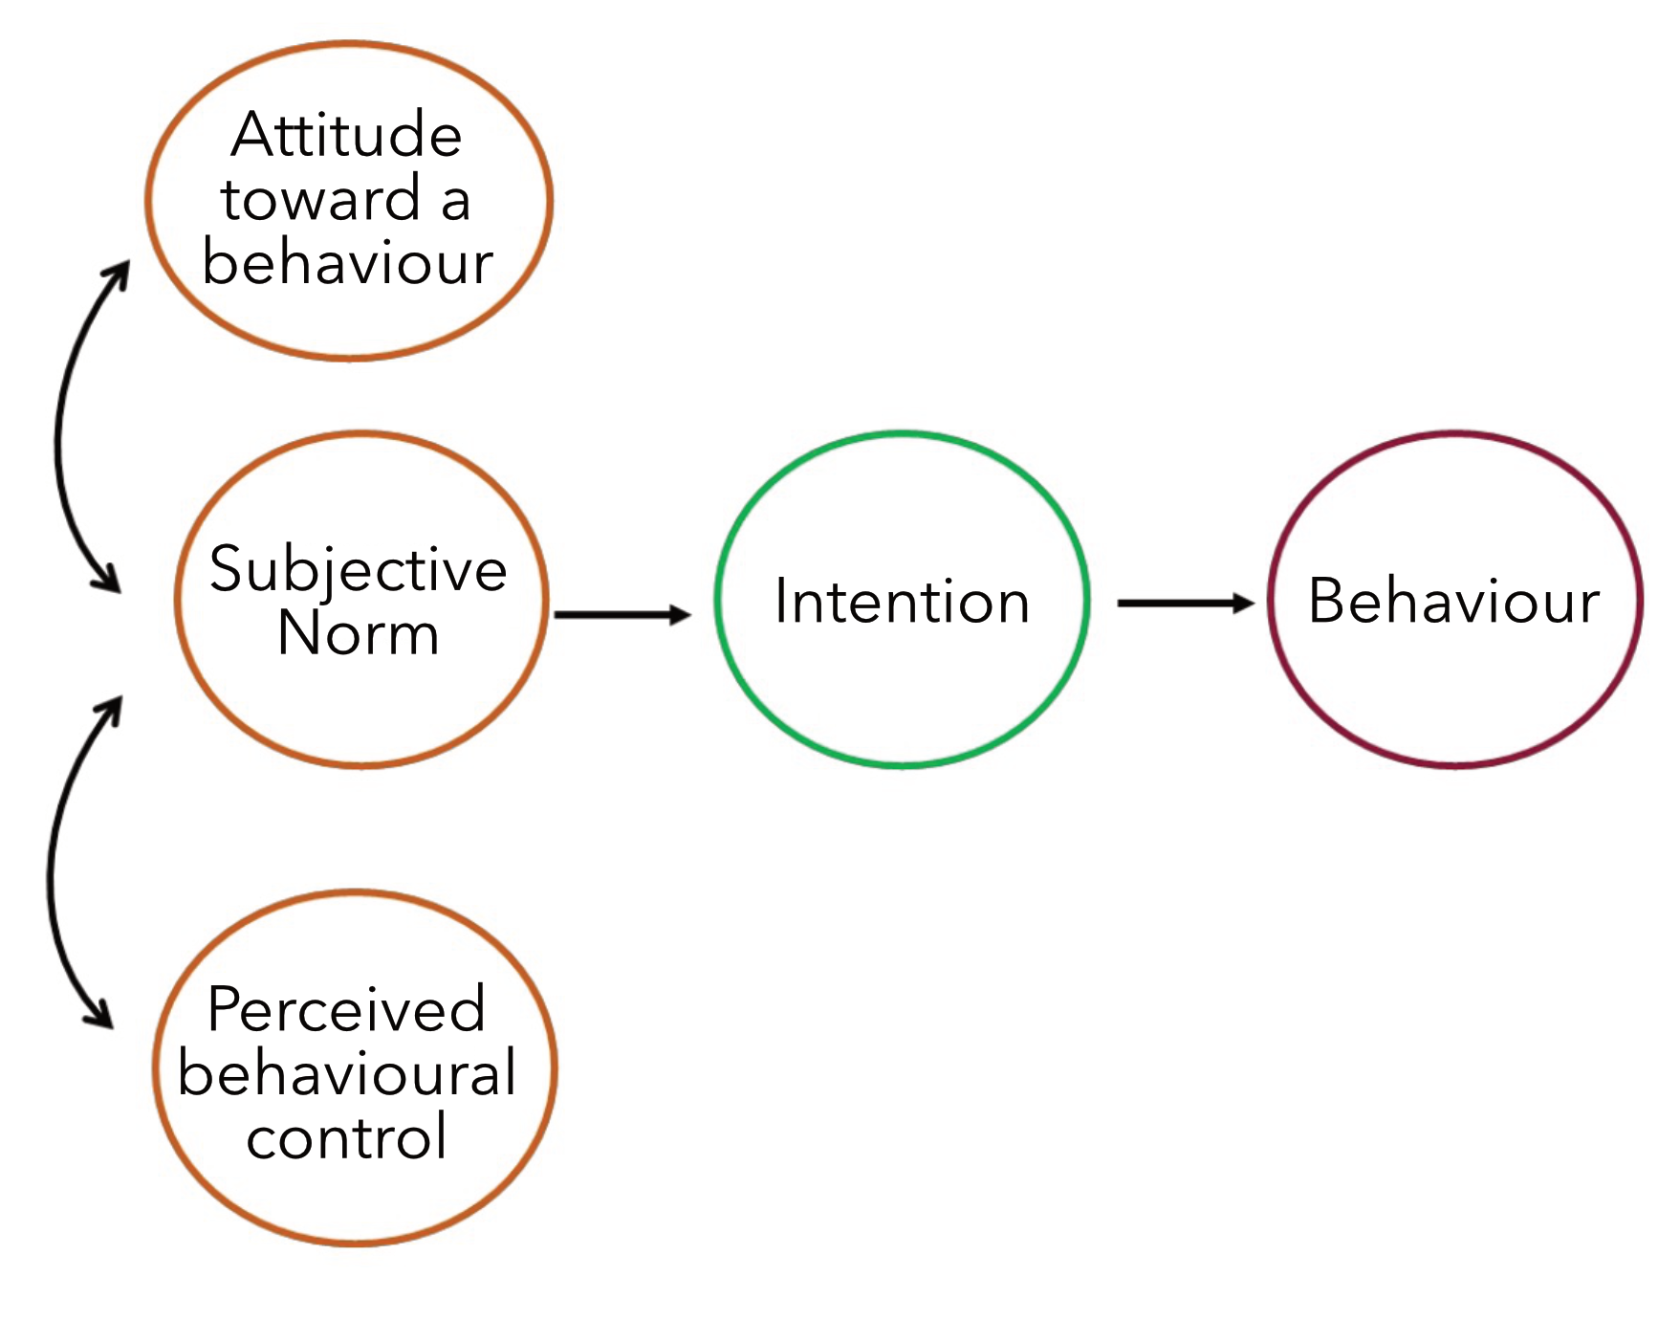
The theory of planned behaviour
Intention:
• Indicator of how strongly an individual is willing to engage in a behaviour
• Formed on the basis of three determinants: attitude toward a behaviour, subjective norm, perceived behavioural control

Slide 19
The theory of planned behaviour
Attitude toward a behaviour
Subjective assessment of the consequences of the behaviour
Subjective norm
Subjectively perceived social pressure to (not) perform a behaviour/ anticipated social sanctions
Perceived behavioral control
Subjective assumption of how easy/difficult it is to perform a behavior or whether it can be successful

Slide 20
The theory of planned behaviour
The following generally applies:
• The more positive/bigger
› the attitude toward a behaviour
› the subjective norm
› the perceived behavioural control
the stronger the intention to perform the behaviour.
• The stronger the intention, the more likely the behaviour will be performed.

Slide 21
The theory of planned behaviour
Example: Choice of transportation: Commuting to work by bicycle
Attitude toward behaviour
• Cost-effective
• Exercise in the fresh air and enjoyment of cycling
• Time-consuming
Subjective norm
• Recognition of my sustainable mobility behaviour and fitness
Perceived behavioural control
• Own a functional bicycle
• Know the route
→ Forming an intention to use the bicycle

Slide 22
The theory of planned behaviour
How can this help us?
After all, explaining the mobility behavior of individuals can hardly make a significant contribution to the mobility transition!
Our interest lies not in individual mobility behavior.
Rather, we are interested in how specific - socially relevant - groups make their mobility decisions
To achieve this, we need to understand mobility as a social phenomenon!

Slide 23
MOBILITY
AS A
SOCIAL PHENOMENON

Slide 24
Analysis of collective contexts
Mobility does not happen a "vacuum": people shape their mobility behavior within social structures and as socialized beings out of them
Theories and models also enable the formation of systematic, group-specific hypotheses and the investigation of collective relationships
Groups that are classically considered in sociology are based on concepts of social inequality such as classes, strata or milieus, or refer to socio-structural characteristics such as age, gender or employment status

Slide 25
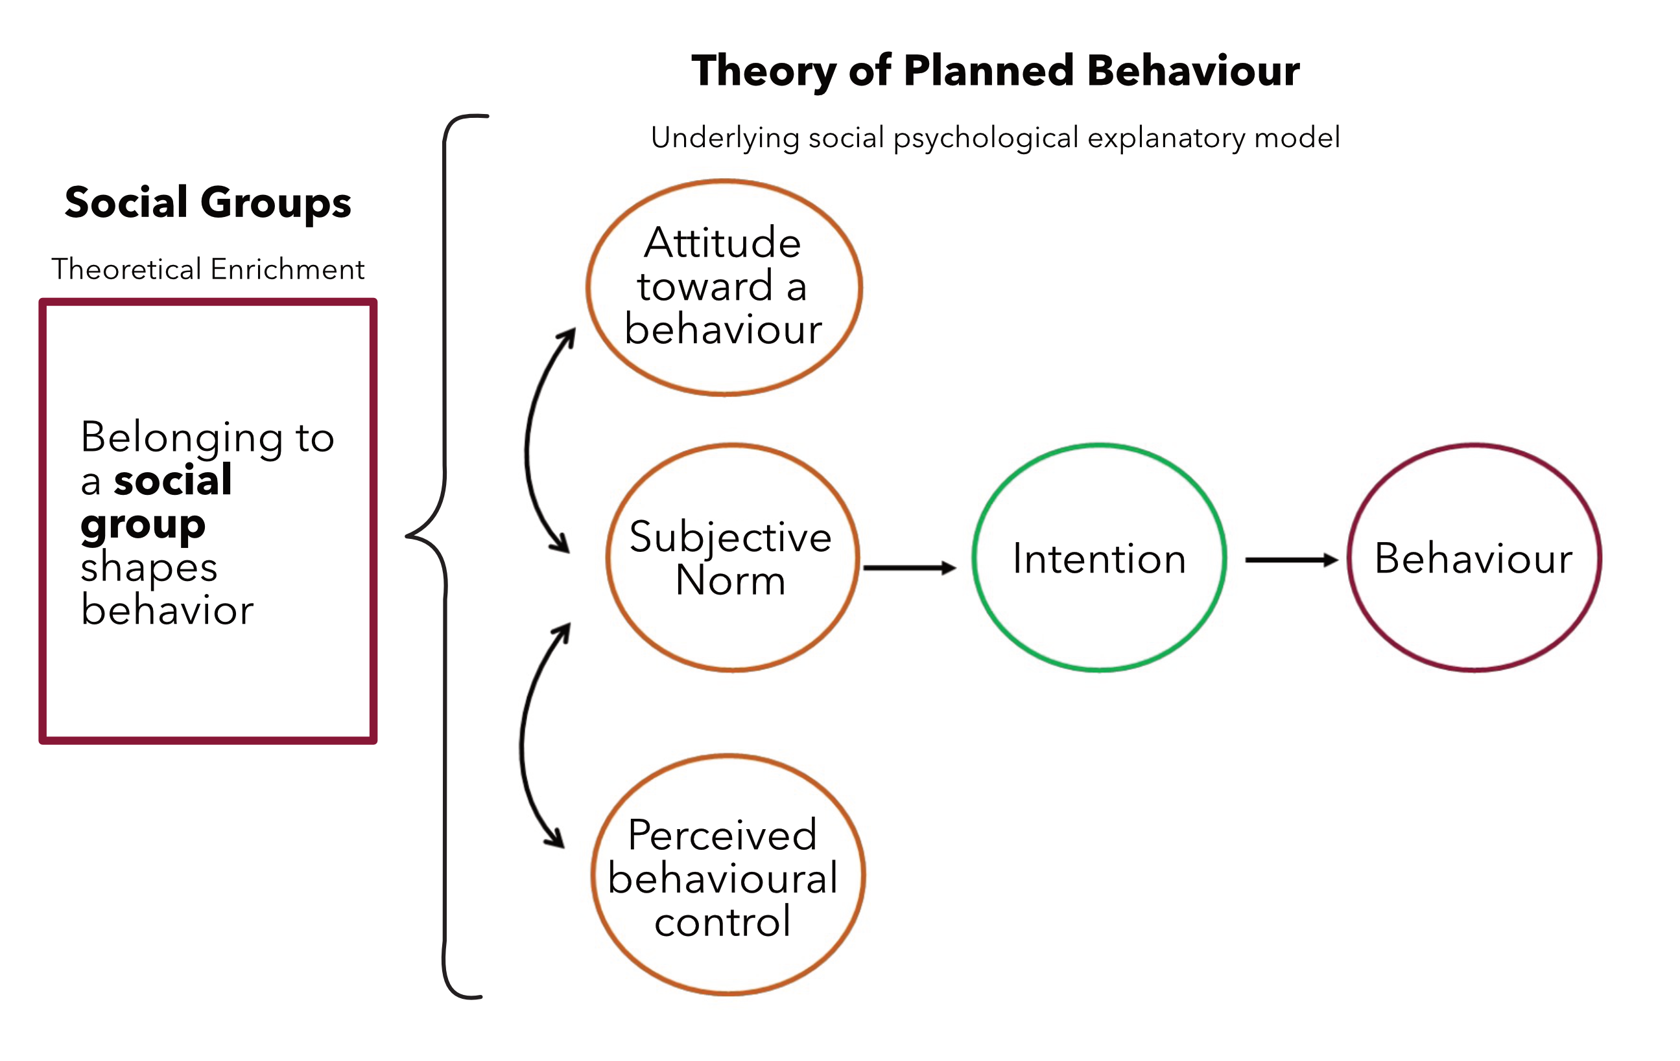
Integration into the theory of planned behaviour
Thesis:
People in a social group are similar in terms of specific characteristics.
→ They therefore form similar intentions in the theory of planned behavior...
→ ...and exhibit similar behavior.
cf. Kopp et al. 2022

Slide 26
Integration into the theory of planned behaviour
Thesis:
People in a social group are similar in terms of specific characteristics.
→ They therefore form similar intentions in the theory of planned behavior...
→ ...and exhibit similar behavior.
cf. Kopp et al. 2022
The selection of the groups considered should always be based on the research topic!
Not every “group affiliation” has an influence on mobility behavior: e.g. (non-)single parents vs. urban/ rural residents.

Slide 27
The theory of planned behaviour
Advantages:
Economy and simplicity of assumptions
Possibility of integrating a large number of (different) variables
Well suited as a theoretical basis for quantitative empirical research and statistical evaluations
Disadvantages:
Is every (mobility) decision based on such a complex weighing process?
  What role do habits play?
  Which factors are actually taken into account and how relevant are they?
Theories of individual utility maximization often consider mobility to be a secondary need: neglect of intrinsic benefits
Neglect of cultural meanings and attributions

Slide 28
The theory of planned behaviour
Advantages:
Economy and simplicity of assumptions
Possibility of integrating a large number of (different) variables
Well suited as a theoretical basis for quantitative empirical research and statistical evaluations
Disadvantages:
Is every (mobility) decision based on such a complex weighing process?
  What role do habits play?
  Which factors are actually taken into account and how relevant are they?
Theories of individual utility maximization often consider mobility to be a secondary need: neglect of intrinsic benefits
Neglect of cultural meanings and attributions
→ Conclusion: A well-proven framework that is well suited to a wide range of research interests — including mobility research!
→ But: No theory can explain everything!

Slide 29
Theory pluralism
Depending on the research interest/subject of investigation, different theories that focus on different areas of social reality are suitable.
In this sense, theories can be seen as glasses that convey different perspectives to the wearer.

Slide 30
OUTLOOK:
CULTURES
OF
MOBILITY

Slide 31
Shift in the analytical perspective
Action theories attempt to analyze mobility based on the actors and their decisions. to understand
The concept of mobility cultures adopts a different analytical perspective
  "Mobility events as a socio-spatial unit", e.g. of cities, regions or countries (Götz et al. 2014: 2)
  Mobility culture as a "complex interdependency of infrastructural, structural, discursive, social, socio-cultural and cultural factors". and action-related factors" (Götz et al. 2014: 2)
"The analysis of mobility cultures attempts to identify design options for policy and practice actors within this complexity." (Götz et al. 2014: 10)
  There are different transformation paths towards a sustainable mobility culture for different mobility cultures
It is not the individual and their actions that become the object of intervention here, but the structure as a space of possibility for action. (Götz et al. 2014 )

Slide 32
Thank you for your attention!

Slide 33
Sources/Further Reading
Götz et al. 2014: Mobility styles and mobility cultures - explanatory potentials, reception and criticism
Aldred & Jungnickel 2014: Why culture matters for transport policy: the case of cycling in the UK

