Slide 1
Transport Policy
Fundamentals of Transport

Slide 2
Road Transportation Systems Engineering Development in the Sub-Saharan Africa – Modern EU Master Programme & Capacity Building

Slide 4
Learning Objectives
Students can:
define transport policy and explain its purpose
identify the need for transport policy interventions
understand major transport policy objectives
analyse factors influencing transport policy decisions
distinguish different transport policy areas and instruments
explain the concept of integrated transport policy

Slide 5
Contents
Introduction: What is Transport Policy?
Transport Policy Objectives
Factors Affecting Transport Policies
Policy Areas in Transport
Framework for Transport Policy
Integrated Transport Policy
Current Trends

Slide 6
Definition of Transport Policy
Transport policy = set of governmental strategies, regulations and measures that shape transport systems
Influences:
  infrastructure development
  mobility behaviour
  transport services
  environmental impacts
-> Transport policy guides how transport systems develop over time

Slide 7
Why Transport Policy Matters
Transport systems affect:
economic development
accessibility
urban quality of life
climate and environment
public health and safety
-> Transport requires political coordination and regulation

Slide 8
Why Governments Intervene in Transport
Transport markets alone often cannot solve:
congestion
pollution
traffic safety problems
unequal accessibility
infrastructure financing
-> Many transport effects are “externalities”

Slide 9
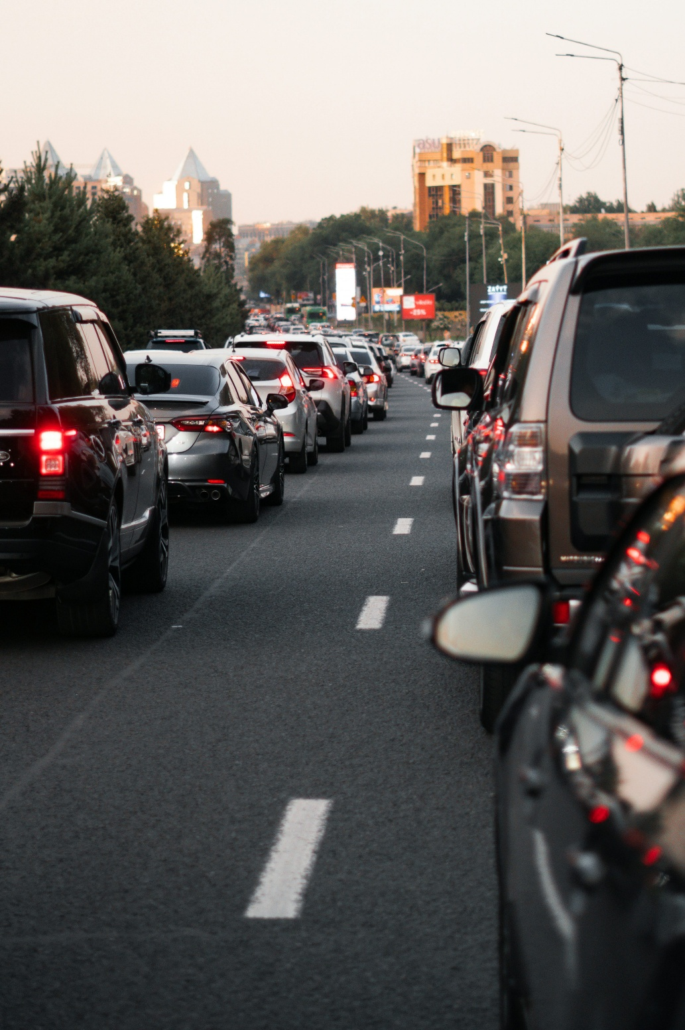
Major Transport Problems
traffic congestion
greenhouse gas emissions
accidents and fatalities
noise pollution
land consumption
social exclusion
Fig. 1: Unsplash

Slide 10
Public vs Private Interests
Transport policy balances:
  individual mobility preferences
  collective societal goals
Examples:
  car use vs public space
  low travel costs vs environmental protection

Slide 11
Contents
Introduction: What is Transport Policy?
Transport Policy Objectives
Factors Affecting Transport Policies
Policy Areas in Transport
Framework for Transport Policy
Integrated Transport Policy
Current Trends

Slide 12
Economic Objectives
support economic growth
improve connectivity
increase efficiency of logistics and mobility
reduce transport costs

Slide 13
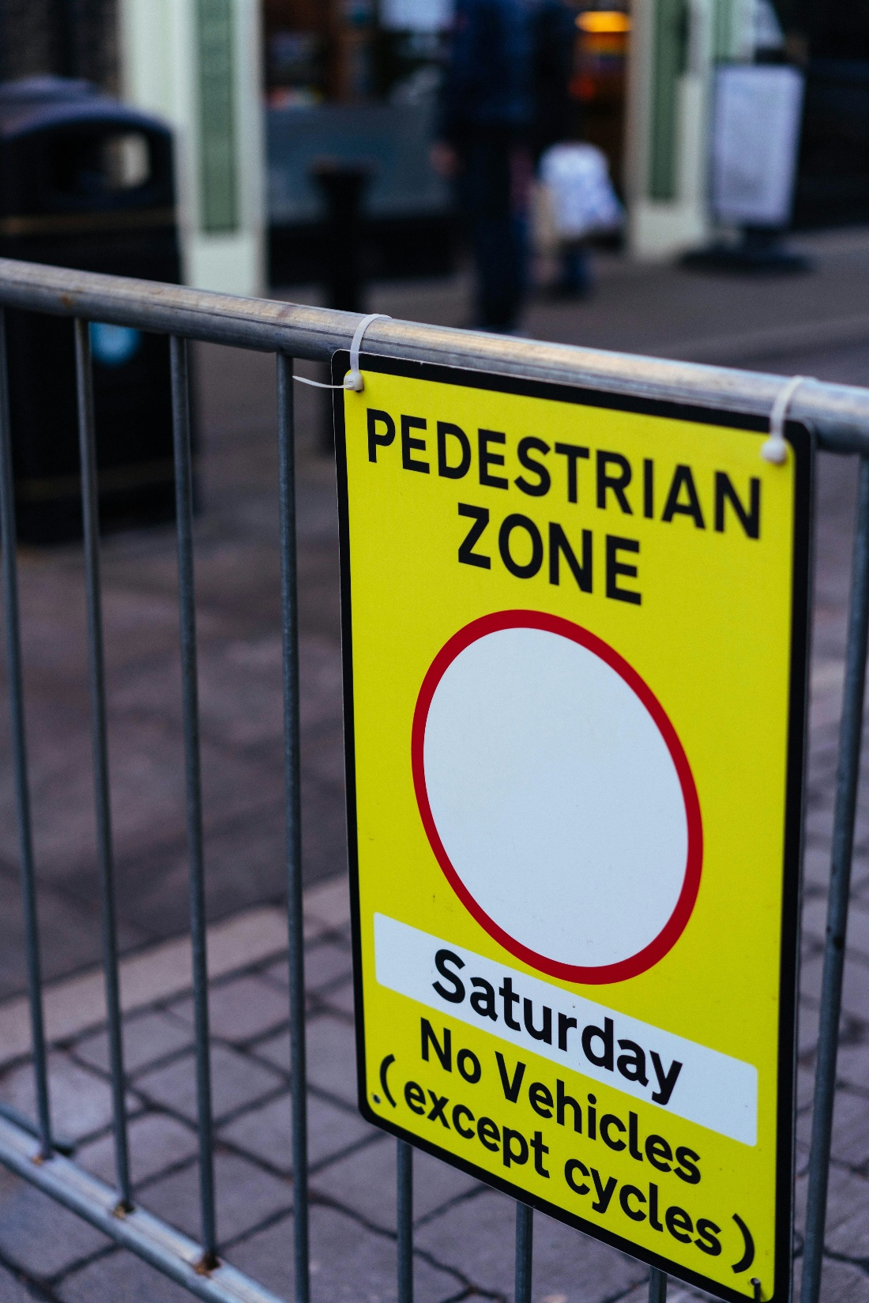
Social Objectives
improve accessibility
ensure affordable mobility
enhance social inclusion
improve traffic safety
Fig. 2: Unsplash

Slide 14
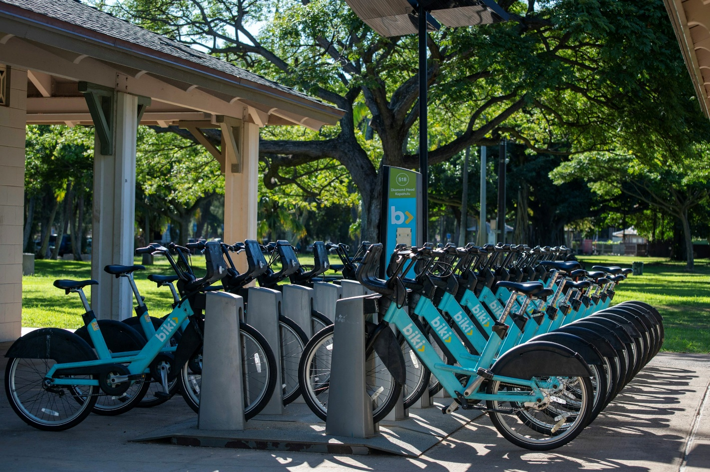
Environmental Objectives
reduce greenhouse gas emissions
improve air quality
reduce noise pollution
promote sustainable mobility
Fig. 3: Unsplash

Slide 15
Sustainability as a Central Objective
Modern transport policy increasingly focuses on:
climate-neutral transport systems
modal shift strategies
active mobility promotion
integrated urban planning

Slide 16
Contents
Introduction: What is Transport Policy?
Transport Policy Objectives
Factors Affecting Transport Policies
Policy Areas in Transport
Framework for Transport Policy
Integrated Transport Policy
Current Trends

Slide 17
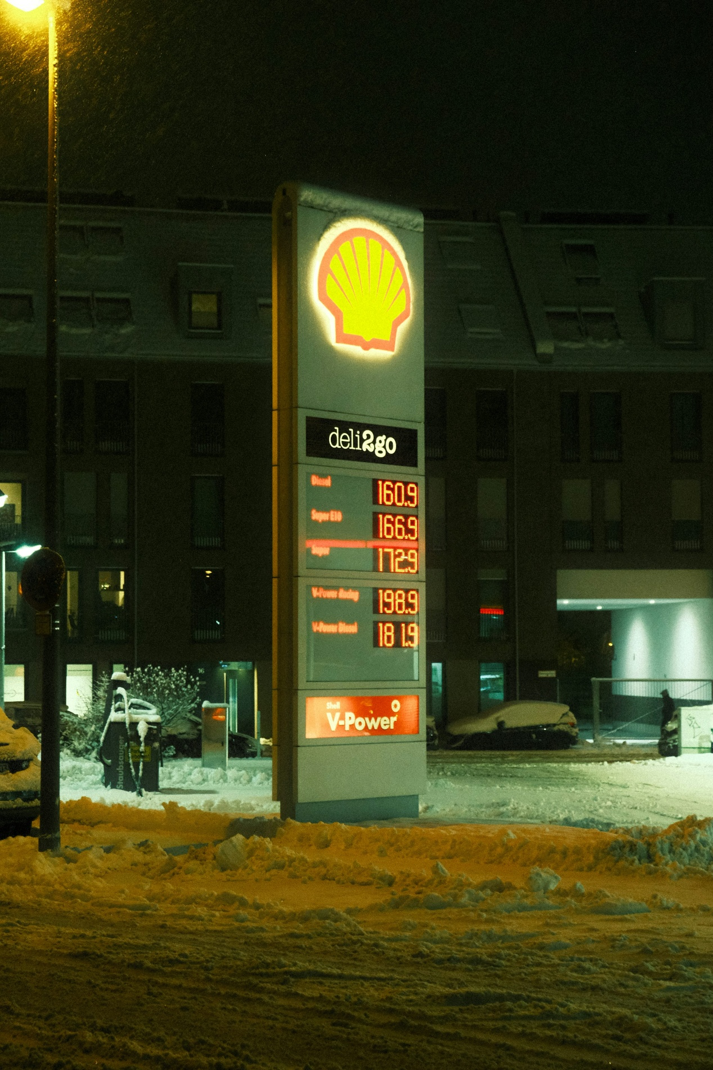
Economic Factors
national income levels
fuel prices
infrastructure investment capacity
logistics demand
Fig. 4: Unsplash

Slide 18
Political & Institutional Factors
government priorities
legal frameworks
institutional structures
international agreements

Slide 19
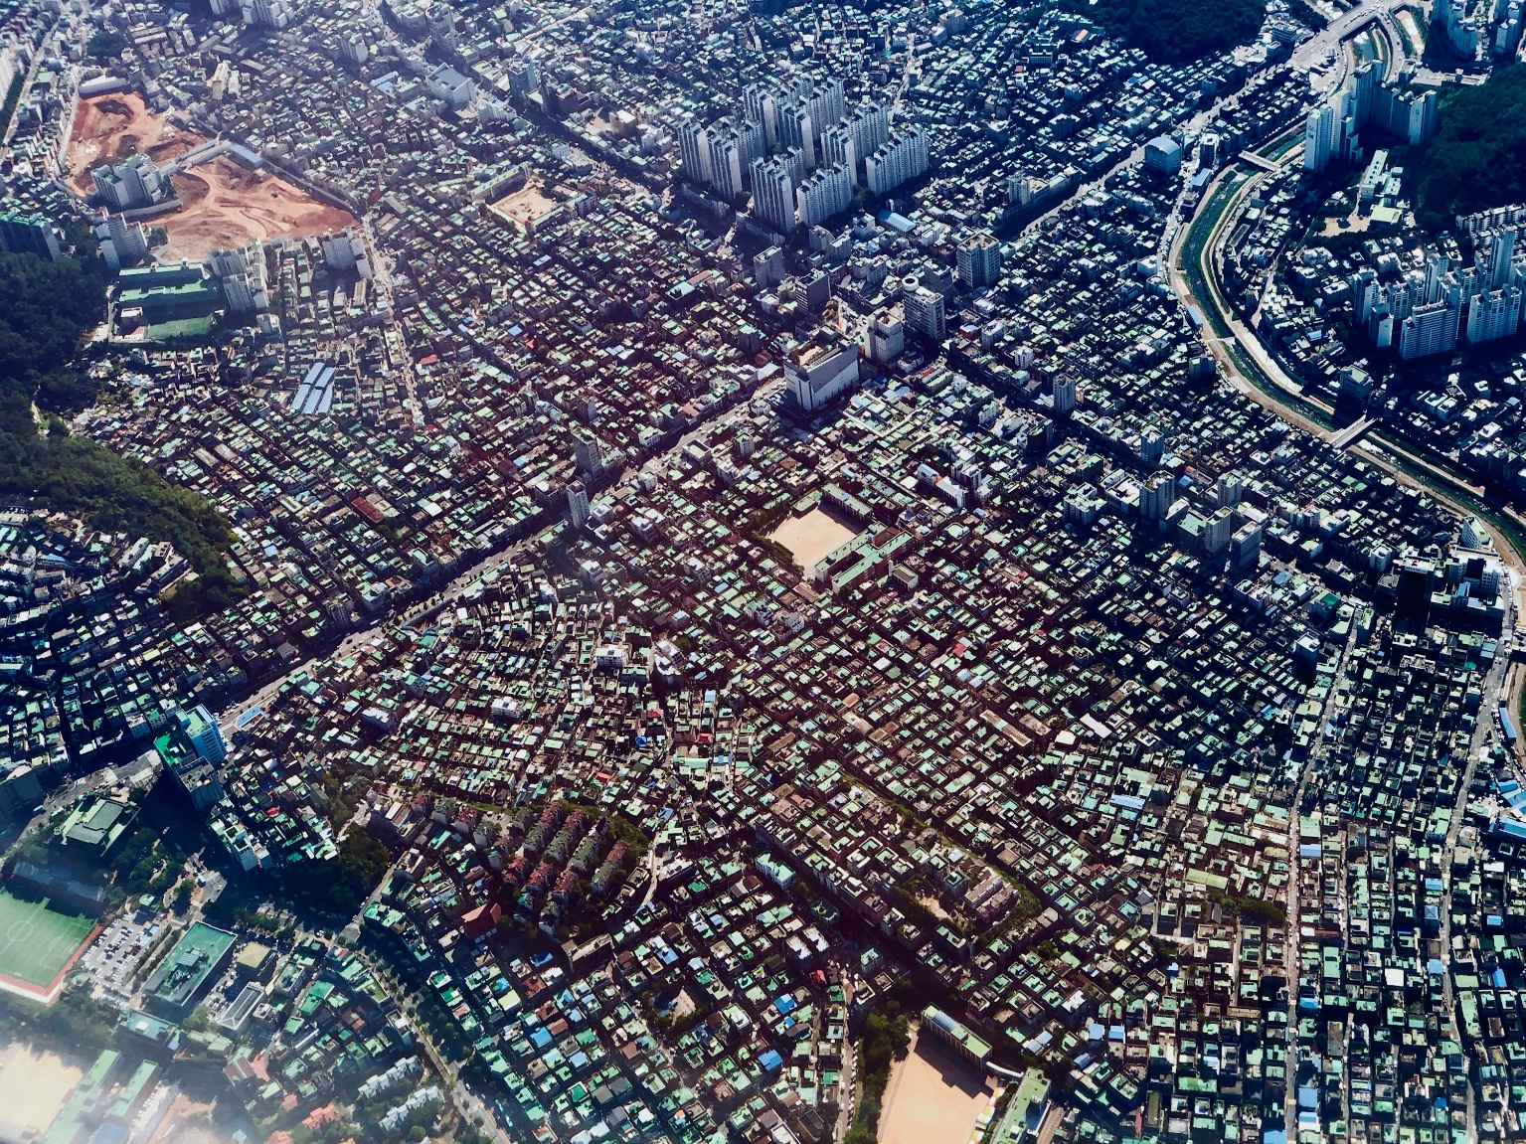
Social & Demographic Factors
population growth
urbanisation
ageing societies
changing mobility behaviour
Fig. 5: Unsplash

Slide 20
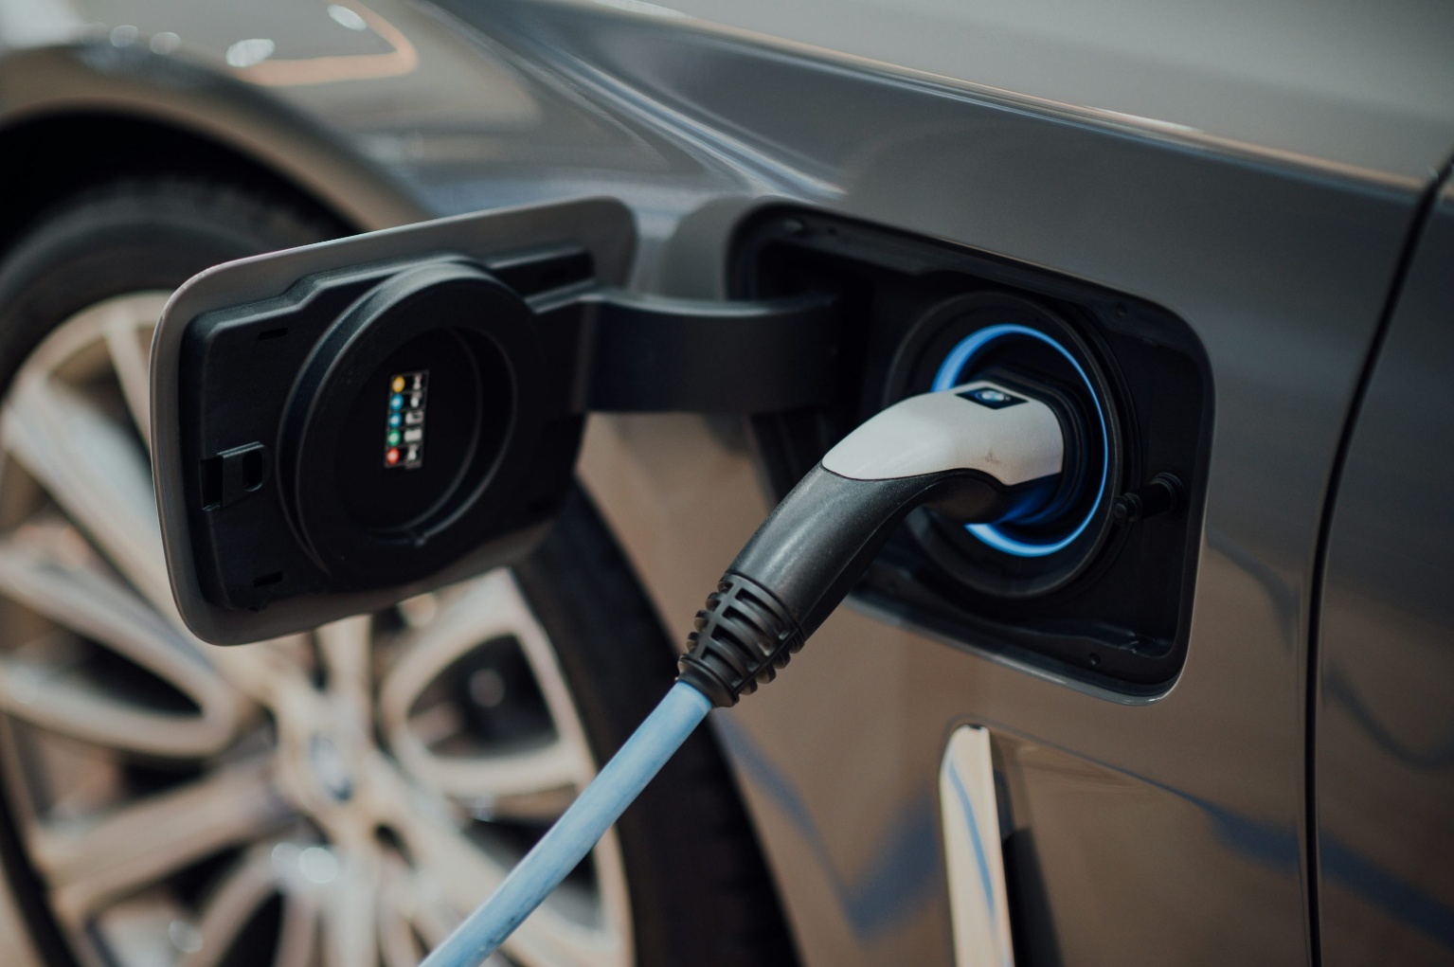
Technological Factors
electrification
digitalisation
autonomous vehicles
smart mobility systems
Fig. 6: Unsplash

Slide 21
Contents
Introduction: What is Transport Policy?
Transport Policy Objectives
Factors Affecting Transport Policies
Policy Areas in Transport
Framework for Transport Policy
Integrated Transport Policy
Current Trends

Slide 22
Infrastructure Policy
Measures include:
investment in roads, railways, ports and airports
maintenance and modernization
network expansion

Slide 23
Environmental Policy
Measures include:
emission standards
low-emission zones
promotion of public transport and cycling
fuel taxation

Slide 24
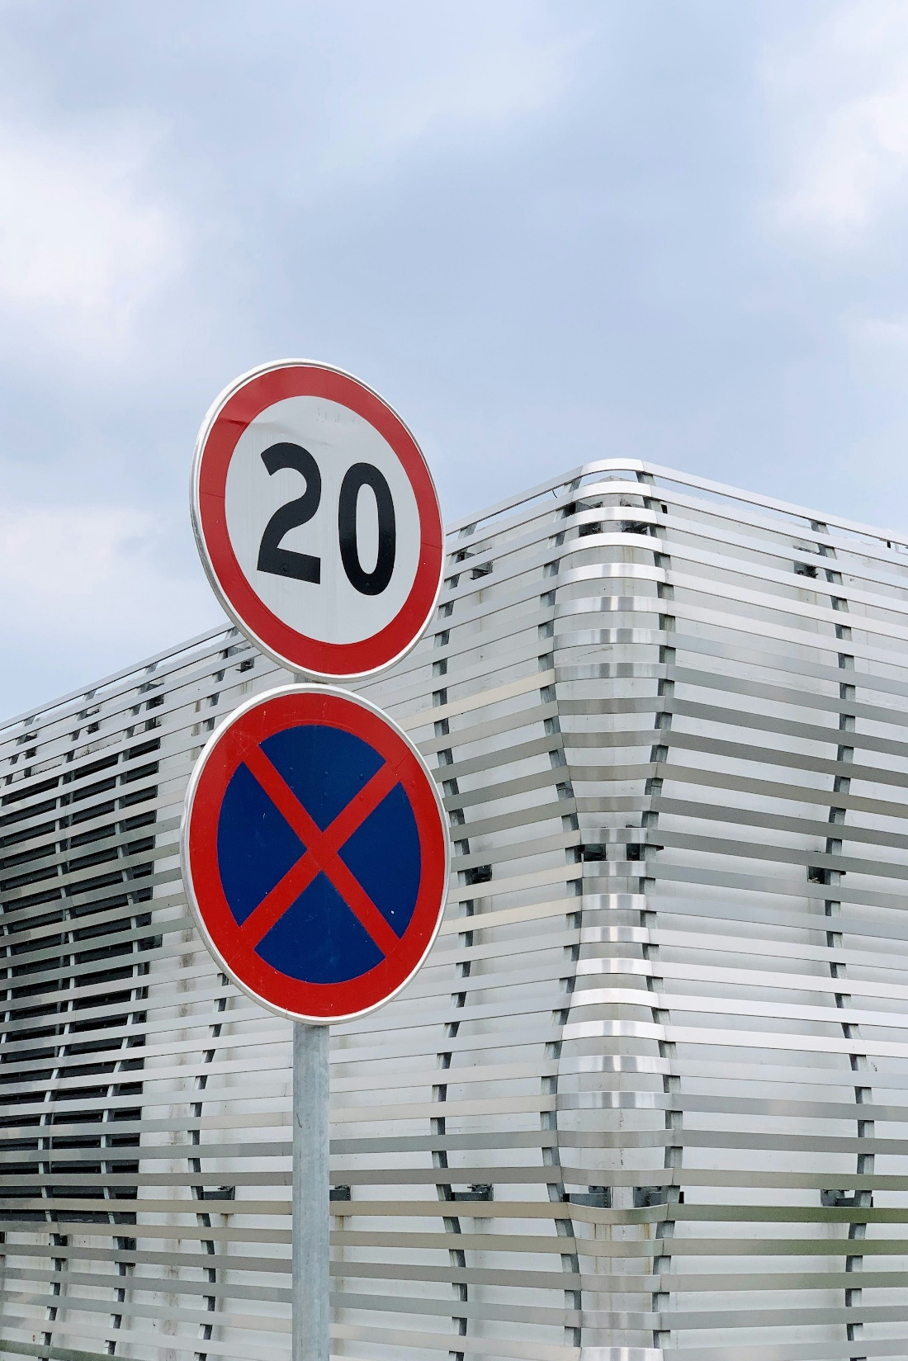
Safety Policy
Measures include:
speed limits
vehicle safety standards
traffic enforcement
road safety campaigns
Fig. 7: Unsplash

Slide 25
Pricing & Economic Policy
Measures include:
road pricing
congestion charging
fuel taxes
subsidies for public transport

Slide 26
Urban Mobility Policy
pedestrianisation
cycling infrastructure
parking management
transit-oriented development (TOD)

Slide 27
Contents
Introduction: What is Transport Policy?
Transport Policy Objectives
Factors Affecting Transport Policies
Policy Areas in Transport
Framework for Transport Policy
Integrated Transport Policy
Current Trends

Slide 28
Policy Framework Components
Transport policy requires:
legal frameworks
institutions
funding mechanisms
planning systems
evaluation methods

Slide 29
Levels of Transport Policy
Local Level
  urban mobility management
  local public transport
Regional Level
  regional connectivity
  commuter systems
National Level
  national infrastructure strategy
  legislation
International Level
  climate agreements
  aviation and maritime regulation

Slide 30
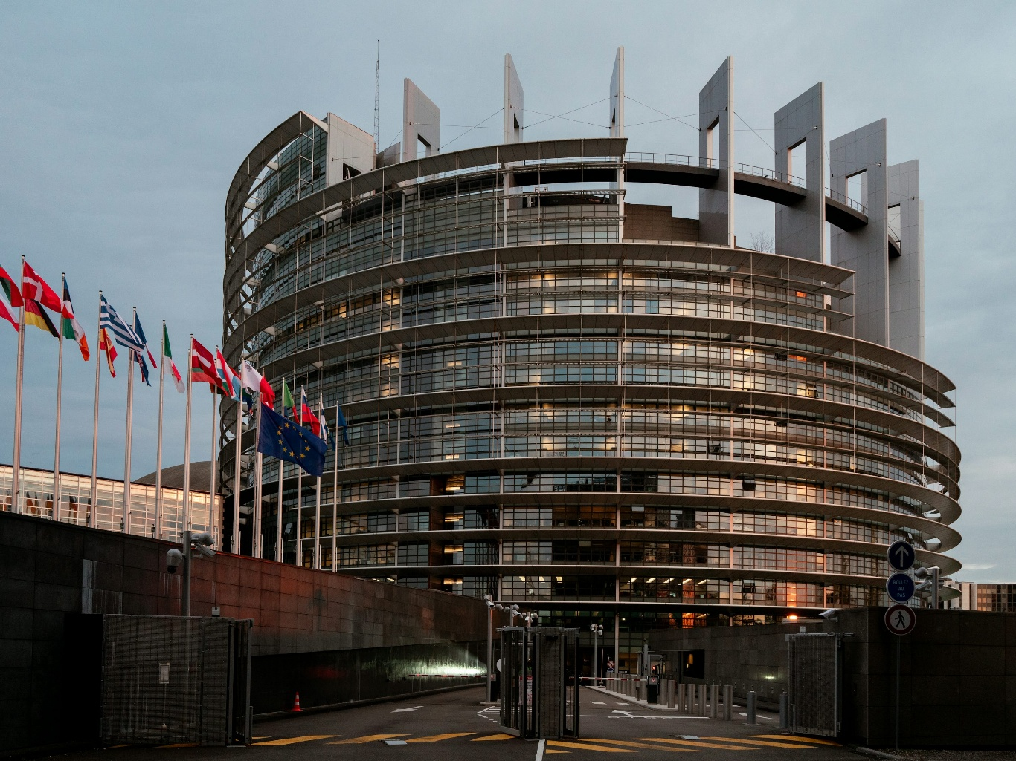
Key International Actors
World Bank
OECD
International Transport Forum
European Commission
...
Fig. 8: Unsplash

Slide 31
Contents
Introduction: What is Transport Policy?
Transport Policy Objectives
Factors Affecting Transport Policies
Policy Areas in Transport
Framework for Transport Policy
Integrated Transport Policy
Current Trends

Slide 32
What is Integrated Transport Policy?
Coordination of:
transport modes
land use planning
environmental policy
economic policy
-> Goal: coherent and sustainable transport systems

Slide 33
Principles of Integrated Policy
multimodal planning
sustainability orientation
accessibility focus
stakeholder participation
long-term perspective

Slide 34
Examples of Integrated Policies
Mobility-as-a-Service (MaaS)
congestion charging + public transport investment
integrated ticketing systems
climate-oriented mobility plans

Slide 35
Challenges of Integration
conflicting policy goals
institutional fragmentation
financing difficulties
coordination across governance levels

Slide 36
Contents
Introduction: What is Transport Policy?
Transport Policy Objectives
Factors Affecting Transport Policies
Policy Areas in Transport
Framework for Transport Policy
Integrated Transport Policy
Current Trends

Slide 37
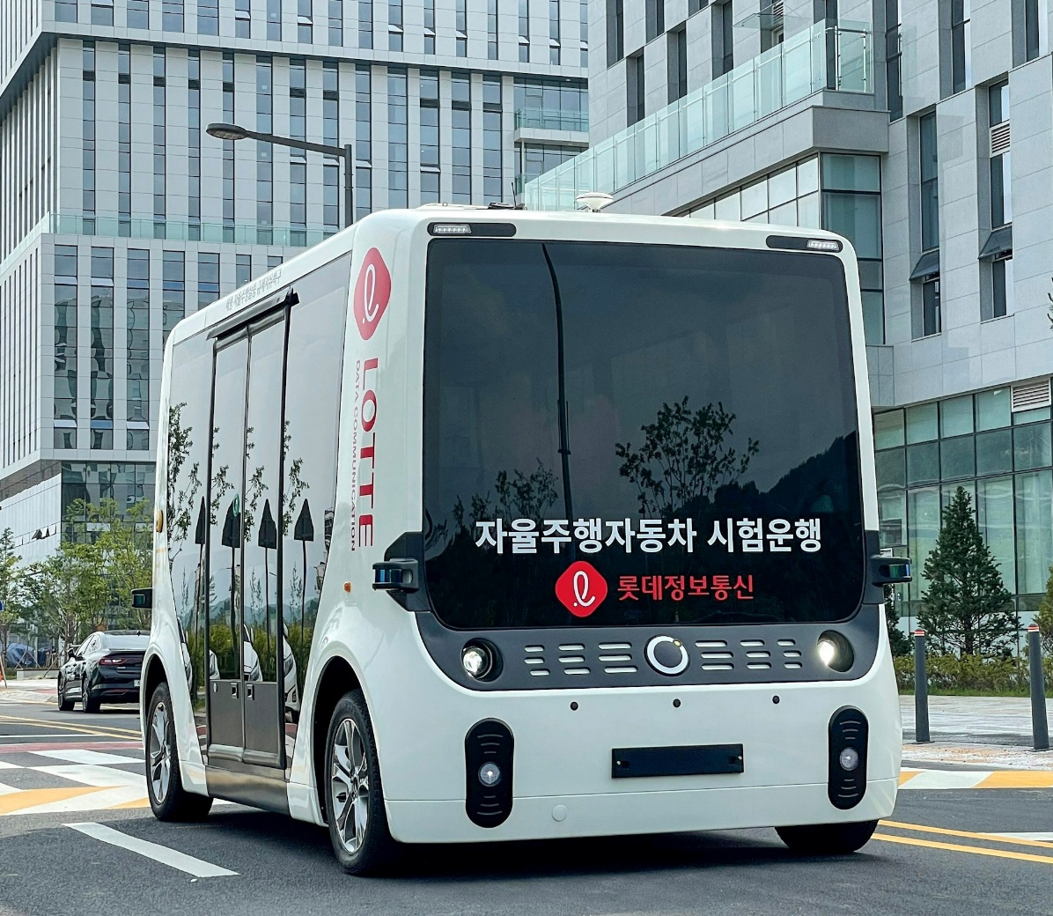
Emerging Trends
decarbonisation of transport
digital mobility platforms
smart city policies
resilience and climate adaptation
Fig. 9: Unsplash

Slide 38
Key Takeaways
Transport policy shapes mobility systems and societal outcomes
Governments intervene to address externalities and public needs
Modern transport policy focuses increasingly on sustainability and accessibility
Integrated transport policy coordinates multiple sectors and actors
Effective policy requires long-term and multi-level planning

Slide 39
Thank you for your attention!

Slide 40
Sources - Pictures
Fig. 1: https://unsplash.com/photos/a-street-filled-with-lots-of-traffic-next-to-tall-buildings-VgB0PyBBxtA
Fig. 2: https://unsplash.com/photos/pedestrian-zone-sign-on-metal-barrier-HfKQiO9R6ng
Fig. 3: https://unsplash.com/photos/row-of-blue-rental-bicycles-at-a-station-IwC6GYd70fg
Fig. 4: https://unsplash.com/photos/a-gas-station-sign-in-the-snow-at-night-l9-XIYW8fvg
Fig. 5: https://unsplash.com/photos/aerial-view-photography-of-city-skyline-FctT17Wbhnk
Fig. 6: https://unsplash.com/photos/black-and-white-usb-cable-plugged-in-black-device-xJLsHl0hIik
Fig. 7: https://unsplash.com/photos/red-and-white-no-smoking-sign-Ot6qzn4Q6pk
Fig. 8: https://unsplash.com/photos/a-large-building-with-a-lot-of-flags-in-front-of-it-dyBoCDncvX4
Fig. 9: https://unsplash.com/photos/a-bus-driving-down-the-street-BhmPy9paa6Y

Slide 41
Sources – Literature (Further Reading)
European Commission n.y.: Mobility and Transport. https://transport.ec.europa.eu/index_en (10.05.26).
European Environment Agency 2026: Transport and Mobility. https://www.eea.europa.eu/en/topics/in-depth/transport-and-mobility (10.05.26).
Global Designing Cities Initiative n.y.: Change Streets, change the world. https://globaldesigningcities.org/ (10.05.26).
International Association of Public Transport n.y.: https://www.uitp.org/ (10.05.26).
International Transport Forum 2026: https://www.itf-oecd.org/ (10.05.26).
OECD n.y.: Transport. https://www.oecd.org/en/topics/transport.html (10.05.26).
UN Habitat n.y.: Mobility and Transport. https://unhabitat.org/topic/mobility-and-transport (10.05.26).
United Nations n.y.: Sustainable Development. https://sdgs.un.org/goals (10.05.26).
World Bank n.y.: Transport. https://www.worldbank.org/ext/en/topic/transport (10.05.26).

