Slide 1
Air Transport
Fundamentals of Transport

Slide 2
Road Transportation Systems Engineering Development in the Sub-Saharan Africa – Modern EU Master Programme & Capacity Building

Slide 4
Learning Objectives
Students can:
explain key concepts and terminology in air transport
distinguish different forms of aviation
understand the Nine Freedoms of the Air
analyse the role of air transport in the modal split
evaluate strengths, limitations and challenges of aviation

Slide 5
Overview
Basic Terms and Definitions
The Nine Freedoms of Air Transport
Economic and Societal Significance
Aviation Infrastructure
Quality Criteria
Challenges, Advantages and Environmental Impact
Future Trends

Slide 6
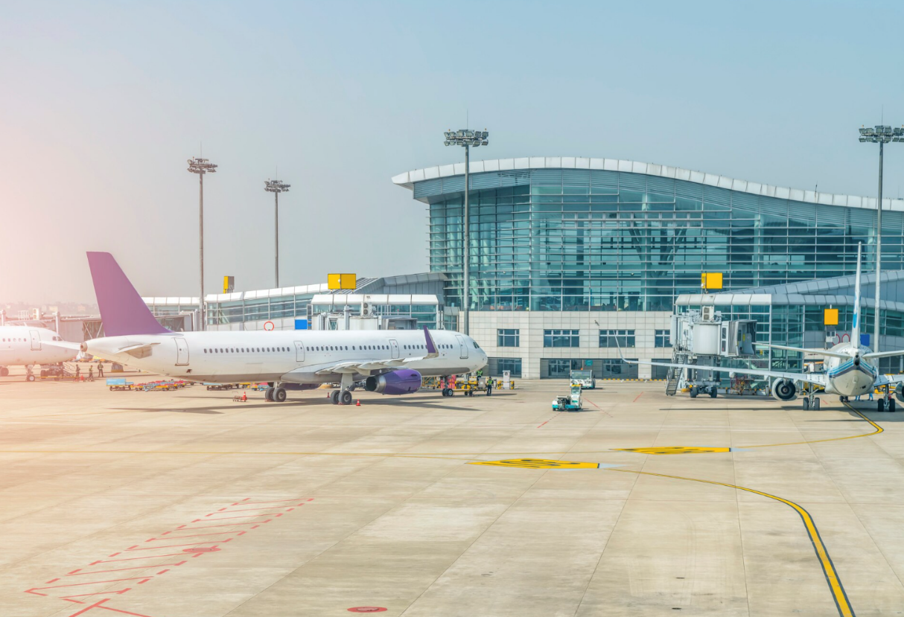
What is Air Transport?
Air transport = movement of passengers and freight via aircraft in controlled airspace
Operates through a global network of airports and air traffic control systems
Key feature: high speed over long distances
Fig. 1: Freepik

Slide 7
Basic Terms
Aircraft: vehicle capable of flight (airplanes, helicopters)
Airline: company providing air transport services
Airport: infrastructure for take-off, landing, and passenger/freight handling
Air Traffic Control (ATC): system ensuring safe aircraft movement
Hub-and-spoke system: network structure with central hubs

Slide 8
Basic Terms
Aviation refers to mechanical flight within the atmosphere
Aerospace includes space flight
ICAO: International Civil Aviation Organization (UN body setting global standards)
IATA: International Air Transport Association (Trade association for airlines)
Payload: The combined weight of passengers, mail, and cargo that generates revenue
Available Seat Kilometers (ASK): Measure of passenger capacity
Revenue Passenger Kilometers (RPK): Measure of actual traffic flow

Slide 9
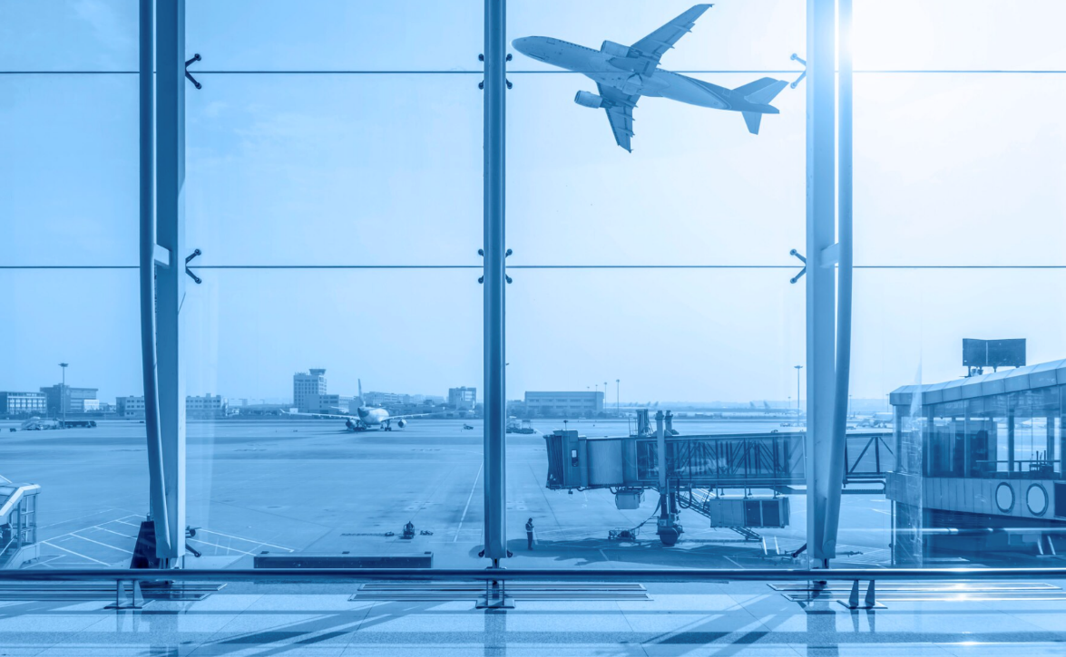
Forms of Aviation
Commercial aviation
  Scheduled passenger flights
  Non-scheduled passenger flights (Charters)
  Low-cost carriers (LCCs)
Cargo aviation
  Dedicated freight aircrafts
General aviation
  Private flights, flight training, emergency services (Air Ambulance)
Military aviation
Unmanned Aerial Vehicles (UAVs/Drones)
Fig. 2: Freepik

Slide 10
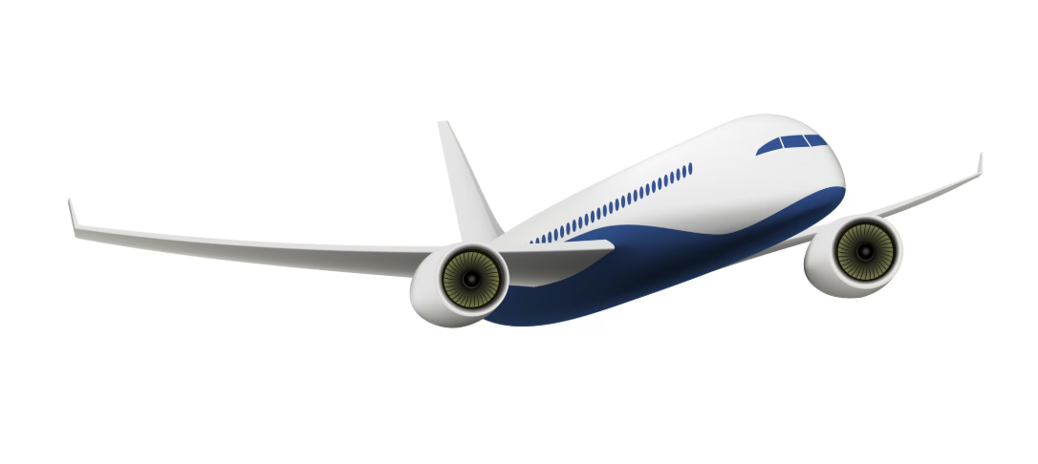
Forms of Aviation: Scheduled Flights vs. Charter Flights
Scheduled flights
  fixed routes and timetables
Charter flights
  demand-based, flexible
Fig. 3: Freepik

Slide 11
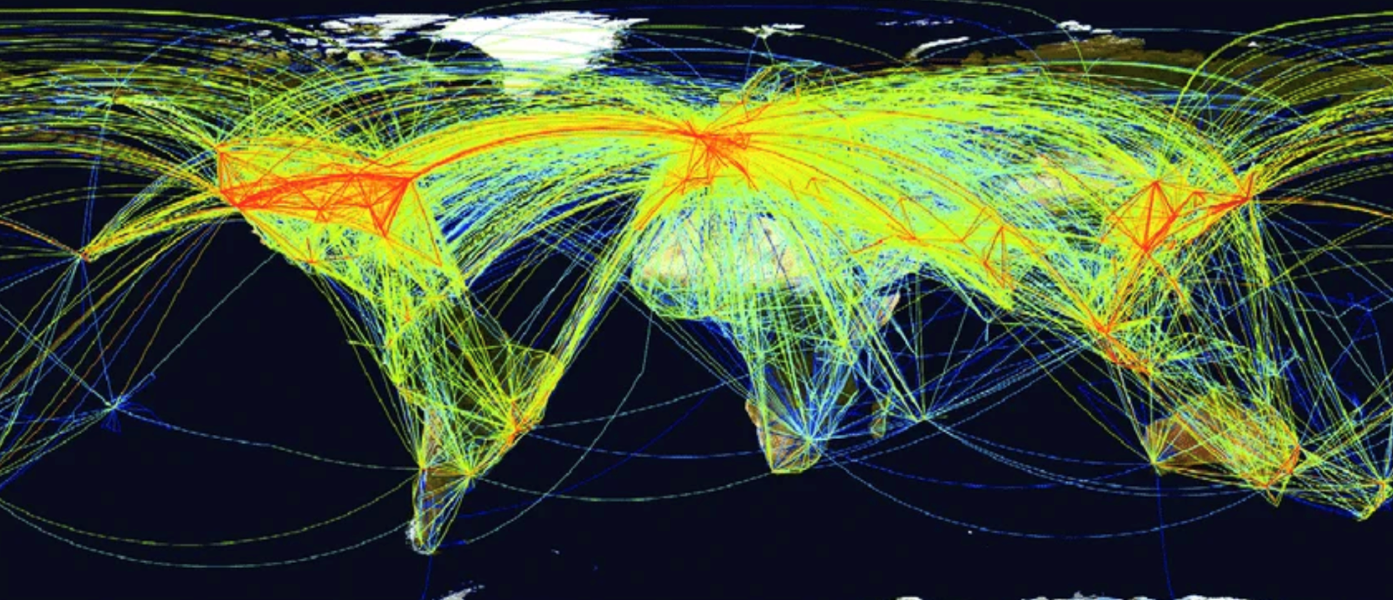
Network Structures
Hub-and-spoke
  efficient for airlines
  increases connectivity
Point-to-point
  direct connections
  common for low-cost airlines
Fig. 4: Researchgate

Slide 12
Overview
Basic Terms and Definitions
The Nine Freedoms of Air Transport
Economic and Societal Significance
Aviation Infrastructure
Quality Criteria
Challenges, Advantages and Environmental Impact
Future Trends

Slide 13
The Nine Freedoms of Air Transport
Definition: A set of commercial and international aviation rights granting a country's airlines the privilege to enter and land in another country's airspace. (ICAO)
Defined under the Chicago Convention in 1944

Slide 14
The Nine Freedoms of Air Transport
Freedom #1: The right to overfly another country
Freedom #2: Land for technical reasons
Freedom #3 & #4: Carrying traffic from home country to another and vice versa
Freedom #5: Carry passengers between two foreign countries (via home country)
ICAO characterizes all "freedoms" beyond the Fifth as "so-called" because only the first five "freedoms" have been officially recognized as such by international treaty

Slide 15
The Nine Freedoms of Air Transport
Freedom #6: the right of transporting, via the home state of the carrier, traffic moving between two other states
Freedom #7: Operate between two foreign countries without home country
Freedom #8: the right of transporting cabotage traffic between two points in the territory of the granting state on a service which originates or terminates in the home country of the foreign carrier or outside the territory of the granting state
Freedom #9: Operating flights within a foreign country

Slide 16
Overview
Basic Terms and Definitions
The Nine Freedoms of Air Transport
Economic and Societal Significance
Aviation Infrastructure
Quality Criteria
Challenges, Advantages and Environmental Impact
Future Trends

Slide 17
Market Development: Modal Split & Volumes
Development of Modal Split: Air transport dominates long-distance travel (>1000km) but faces competition from High-Speed Rail in shorter corridors
Key mode of transport for international mobility
Air Freight Volume: Measured in FTK (Freight Tonne Kilometers)
Air Freight Share: While air transport carries less than 1% of global trade by weight, it accounts for over 35% by value (high-value, time-sensitive goods)

Slide 18
Growth of Air Transport
Passenger Volume: Recovering post-pandemic with high growth rates in emerging markets (Africa/Asia)
Global air passenger numbers grew from ~1 billion (1990) to >4 billion pre-COVID
Strong growth driven by:
  globalisation
  tourism
  low-cost airlines

Slide 19
Economic Significance & The Aviation Industry
Direct Impact: Employment in airlines, airports, and aircraft manufacturing (e.g., Boeing, Airbus)
Indirect/Induced Impact: Supply chains and spending by employees
Catalytic Impact: Tourism and global trade facilitation
Industry Structure: Network carriers (Hub-and-Spoke), Low-Cost Carriers (LCCs), and Cargo Integrators (e.g., DHL, FedEx)

Slide 20
Overview
Basic Terms and Definitions
The Nine Freedoms of Air Transport
Economic and Societal Significance
Aviation Infrastructure
Quality Criteria
Challenges, Advantages and Environmental Impact
Future Trends

Slide 21
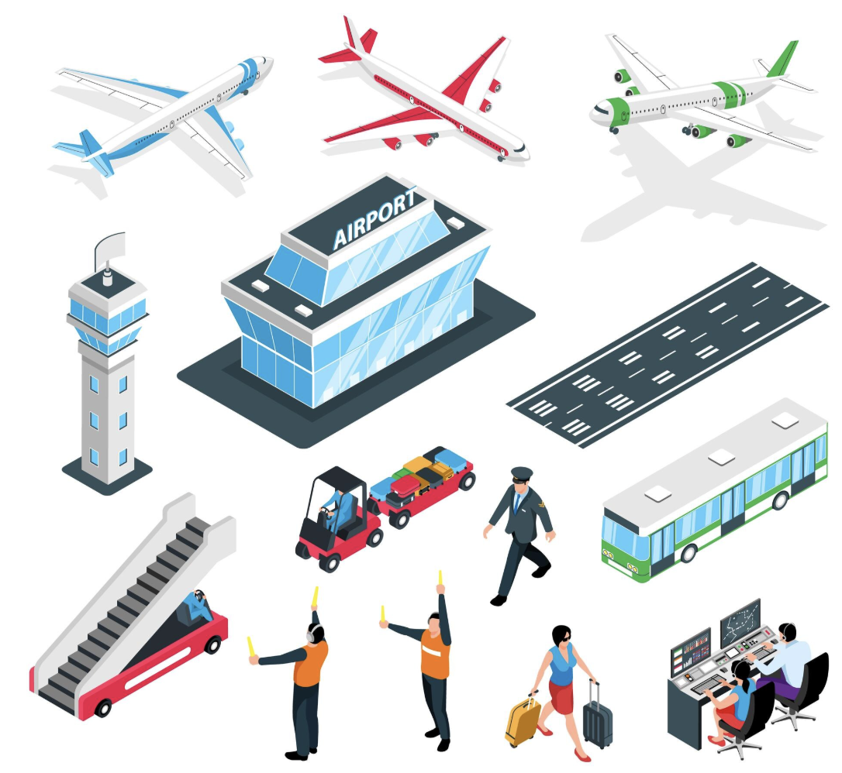
Aviation Infrastructure
Airside: Runways, taxiways, aprons, and Air Traffic Control (ATC) towers
Landside: Passenger terminals, check-in, security, and ground access (rail/road links)
Air Navigation Services (ANS): The technology managing the safe flow of aircraft through airspace
Fig. 5: Freepik

Slide 22
Overview
Basic Terms and Definitions
The Nine Freedoms of Air Transport
Economic and Societal Significance
Aviation Infrastructure
Quality Criteria
Challenges, Advantages and Environmental Impact
Future Trends

Slide 23
Quality Criteria
Connectivity: The number of destinations reachable from a specific point
Total Travel Time: Including ground access and security processing
Safety & Security: Rigorous global standards to minimize risk
Reliability: Departure/arrival punctuality

Slide 24
Overview
Basic Terms and Definitions
The Nine Freedoms of Air Transport
Economic and Societal Significance
Aviation Infrastructure
Quality Criteria
Challenges, Advantages and Environmental Impact
Future Trends

Slide 25
Environmental Impact
Carbon Footprint: Aviation contributes roughly 2-3% of global CO2 emissions
Emissions per passenger-km are higher than those of rail or road transport
Non-CO2 Effects: Contrails and nitrogen oxides (NO_{X}) also contribute to climate warming
Mitigation: Sustainable Aviation Fuel (SAF), fleet renewal (more efficient engines), and carbon offsetting (CORSIA)
Noise pollution, land use around airports

Slide 26

Advantages of Air Transport
very high speed
global connectivity
essential for remote regions
Fig. 6: Freepik

Slide 27
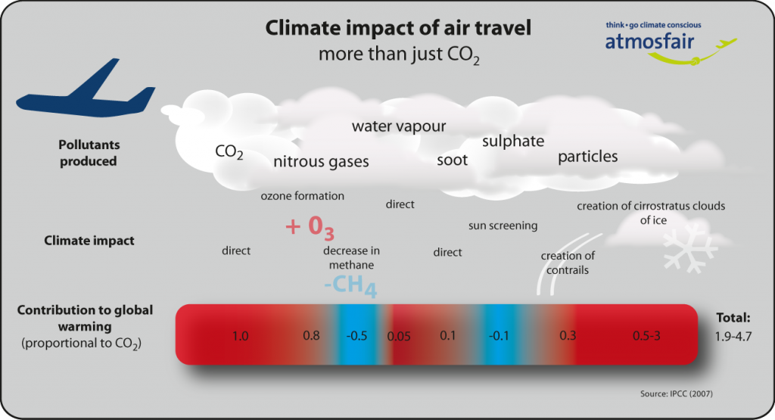
Limitations
high cost
high environmental impact
dependence on infrastructure (airports)
security requirements
Fig. 7: Atmosfair

Slide 28
Challenges
Decarbonization: Difficulty in electrifying long-haul heavy aircraft
Infrastructure Bottlenecks: Congested airports and inefficient airspace routing
Geopolitical Restrictions
SAATM (Single African Air Transport Market): The challenge of liberalizing African skies to lower ticket prices and increase intra-African connectivity

Slide 29
Policy & Future Trends
Policy Priorities:
  sustainable aviation fuels (SAF)
  emission reduction targets
  international regulation via ICAO
Future Trends:
  electric and hydrogen aircraft (early stage)
  digital air traffic management
  increasing demand in developing regions

Slide 30
Key Takeaways
Air transport is essential for long-distance global mobility
Governed by international agreements (Nine Freedoms)
Strong growth but major environmental challenges
Critical role in global economy and logistics

Slide 31
Thank you for your attention!

Slide 32
Sources - Pictures
Fig. 1: https://www.freepik.com/free-photo/airport-terminal_1278169.htm#fromView=search&page=1&position=0&uuid=690c9ad2-ba13-43b7-a258-946be3b1a945&query=airport
Fig. 2: https://www.freepik.com/free-photo/airport-terminal_1278164.htm#fromView=search&page=1&position=1&uuid=690c9ad2-ba13-43b7-a258-946be3b1a945&query=airport
Fig. 3: https://www.freepik.com/free-vector/passenger-airplane-isolated_10601216.htm#fromView=search&page=1&position=0&uuid=f82d26a3-9e72-44c0-8da1-343c7ae0a0bd&query=plane
Fig. 4: https://www.researchgate.net/figure/The-global-aviation-network-Lines-show-direct-links-between-airports-and-the-colour_fig4_233826809
Fig. 5: https://www.freepik.com/free-vector/isometric-airport-set-with-isolated-icons-traffic-control-equipment-terminal-building-controllers-team-members-vector-illustration_26762475.htm#fromView=search&page=1&position=20&uuid=690c9ad2-ba13-43b7-a258-946be3b1a945&query=airport
Fig. 6: https://www.freepik.com/free-vector/plane-service-isolated-flat-vector-illustration-cartoon-mechanics-repairing-airplane-before-flight-adding-fuel-aircraft-maintenance-aviation-concept_10613414.htm#fromView=search&page=1&position=9&uuid=5f275c9d-1aec-4960-b9ad-5529c8ef01b8&query=air+transport
Fig. 7: https://www.atmosfair.de/en/air_travel_and_climate/flugverkehr_und_klima/climate_impact_air_traffic/

Slide 33
Sources – Literature (Further Reading)
Airports Council International n.y.: https://aci.aero/about-aci/ (10.04.26).
Air Transport Action Group 2021: Fact sheets on aviation and climate change, energy transition, aviation fuel, CORSIA, airport sustainability influence contours, etc. https://atag.org/resources/fact-sheets (10.04.26).
Federal Aviation Administration n.y.: A Brief History of the FAA. https://www.faa.gov/about/history/brief_history (10.04.26).
IATA 2026: Sustainability & Economics. https://www.iata.org/economics (10.04.26).
IATA n.y.: World Air Transport Statistics. https://www.iata.org/en/services/data/market-data/world-air-transport-statistics/ (10.04.26).
ICAO n.y.: Environmental Protection: https://www.icao.int/environmental-protection (10.04.26).
ICAO n.y.: Freedoms of the Air. https://www2023.icao.int/Pages/freedomsAir.aspx (10.04.26).
ICAO n.y.: Frequently Asked Questions. https://www.icao.int/UA/UASToolkit/Frequently-Used-Terms (10.04.26).
IEA n.y.: Aviation. https://www.iea.org/energy-system/transport/aviation (10.04.26).

