Slide 1
Non-motorized private transport: Cycling
Fundamentals of Transport

Slide 2
Road Transportation Systems Engineering Development in the Sub-Saharan Africa – Modern EU Master Programme & Capacity Building

Slide 4
Overview
Cycling: development and challenges
Road safety for cyclists
Promotion of cycling as a means of transport

Slide 5
Overview
Cycling: development and challenges
Road safety for cyclists
Promotion of cycling as a means of transport

Slide 6
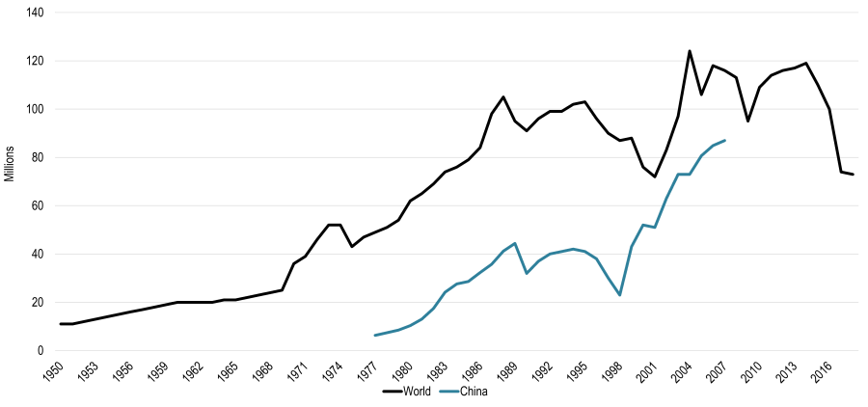
Development of bikes as means of transport
Bicycle production in the world:
Transportgeography.org

Slide 7
Development of bikes as means of transport
The international growth in production of bikes was faster than the growth in production of cars since the 1960s
In 2022, 143.000.000 bicycles were sold worldwide, with China leading with around 43.000.000 sold units (Statista 2025)
Biking is predominantly male, for every three male riders there is just one female cyclist
About 7% of all urban trips worldwide are done by bycicle (Runrepeat 2023)

Slide 8

Development of bikes as means of transport
The Netherlands are the leading country in biking, with 58% of their population commuting using bikes
Around 21% of bikers switched from regular bikes to e-bikes
Pixabay

Slide 9
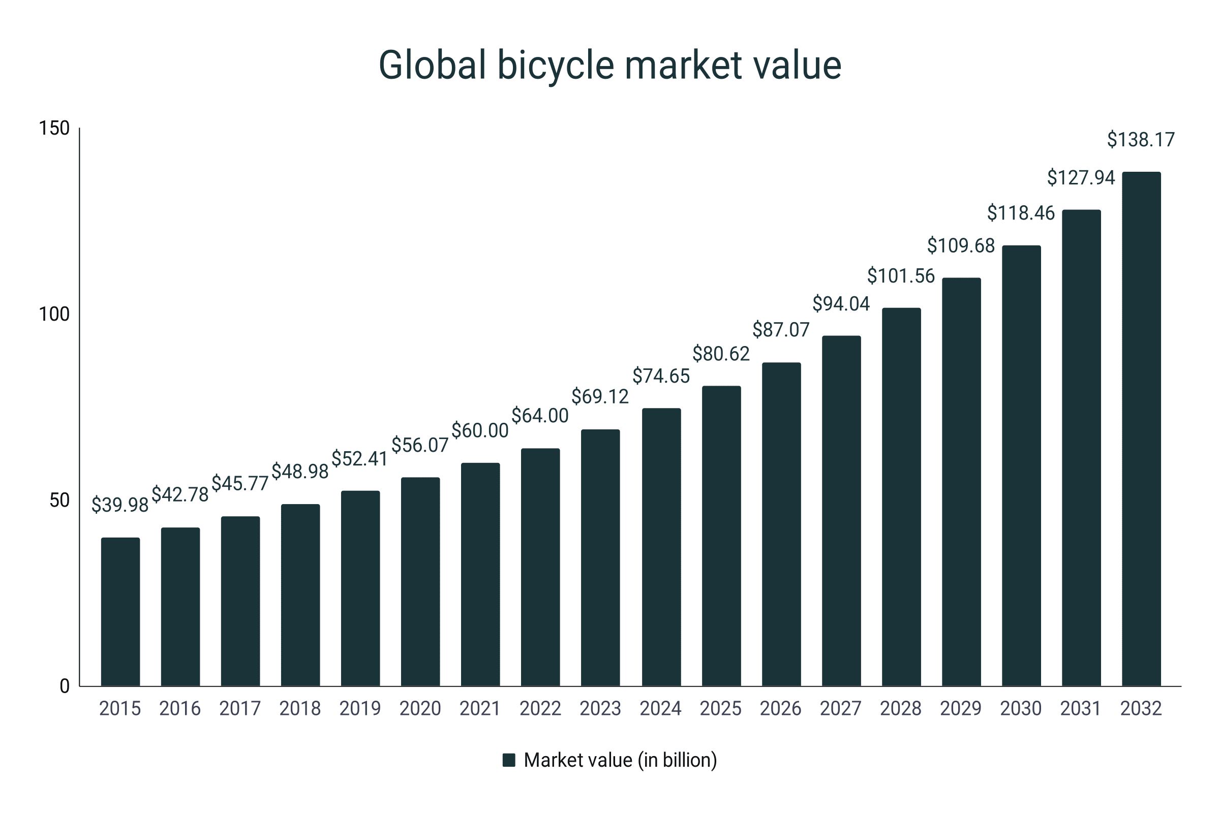
Development of bikes as means of transport
The bicycle industry is predicted to expand at an annual growth rate of 8% (Runrepeat 2023)
runrepeat.com/cycling-statistics

Slide 10
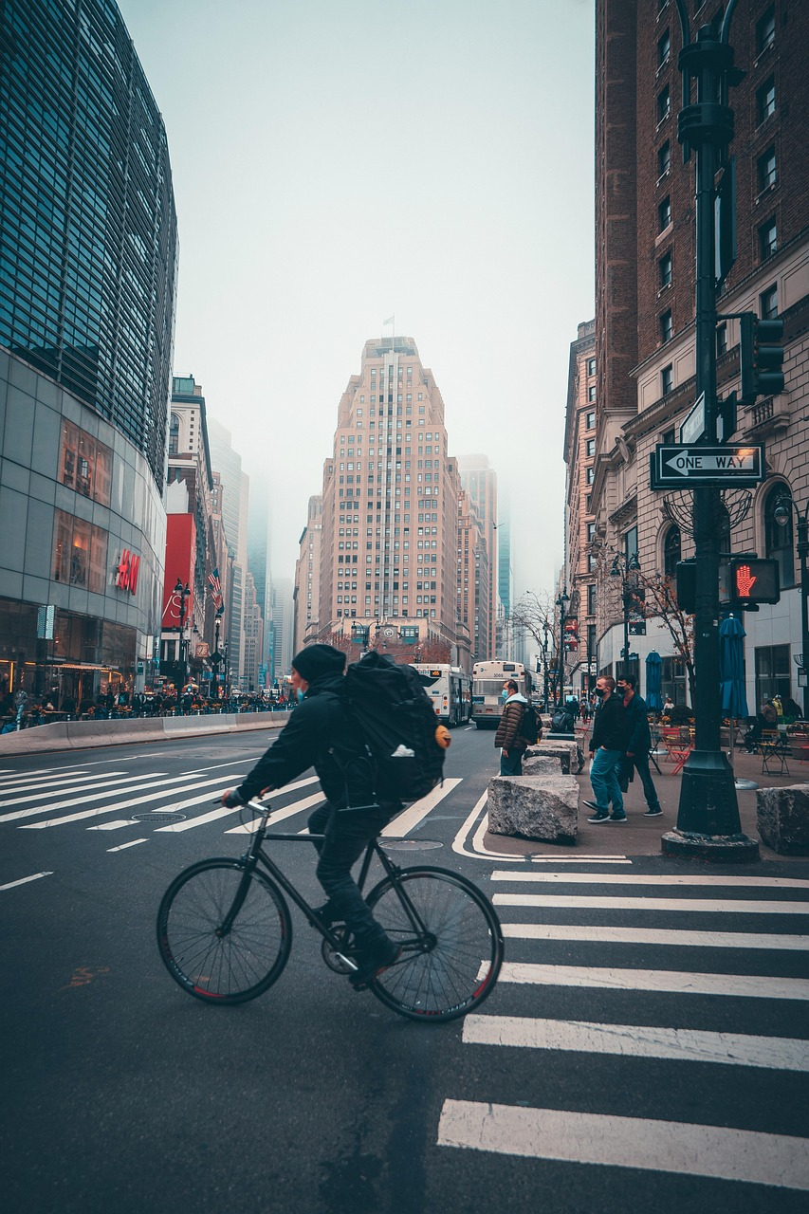
Advantages of Cycling
Quick
  especially in dense cities: on average, the bicycle is the faster option compared to cars
Health-promoting
Environmentally friendly
  low emission
  space-saving
  low noise
Cost-effective
Pixabay

Slide 11
Challenges of Cycling
Weather dependency
Influence of the topography
Bad or missing infrastructure, infrastructure is often geared towards motorized traffic
High vulnerability
  air & noise pollution
  gaps in the cycle path network and the risk of accidents with and caused by motorized traffic

Slide 12
Overview
Cycling: development and challenges
Road safety for cyclists
Promotion of cycling as a means of transport

Slide 13
Cycling Safety as a central field of action
Worldwide, more than a quarter of 1.2 million annual road deaths are cyclists or pedestrians
More than one pedestrian or cyclist is killed every two minutes in a crash on the world‘s roads (WHO 2025)
Fatalities among cyclists rose by 50% in the European Region and by 88% in the WHO Western Pacific Region between 2011 and 2021
When walking and cycling are safe, more people choose these healthy and green ways of moving around, which even helps reduce the risk of diseases

Slide 14
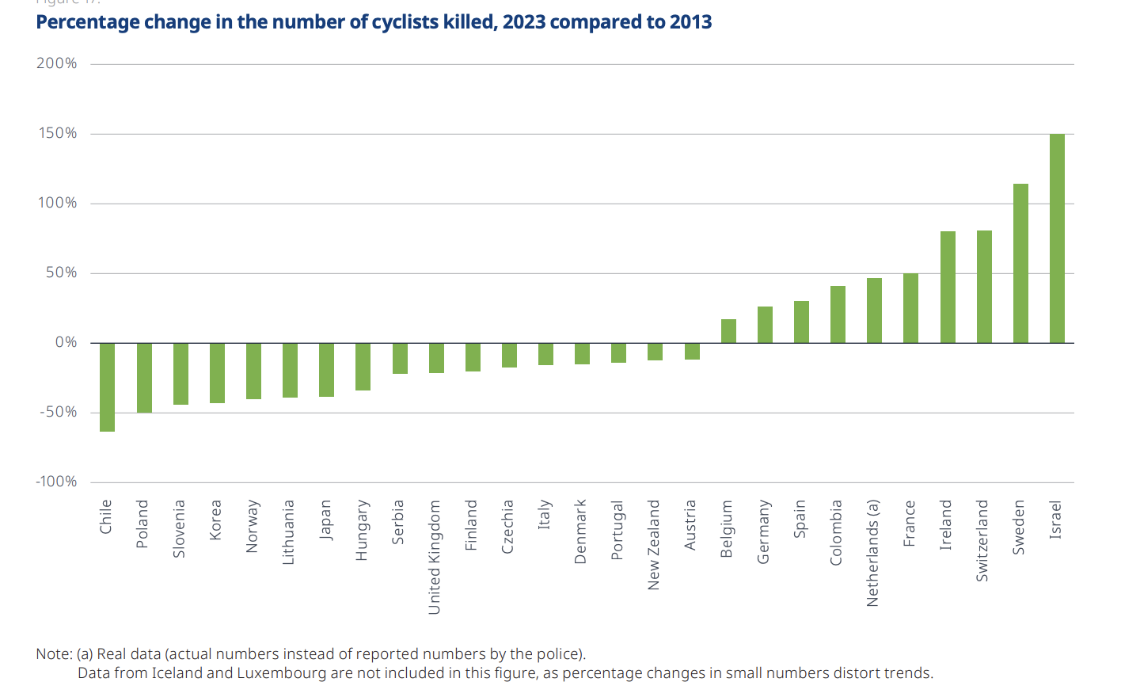
Cycling Safety as a central field of action
OECD 2024: 51

Slide 15
Cycling Safety as a central field of action: Main risk factors
Missing infrastructure
Conflicts with motorized traffic
  Research shows, cyclists are usually not primarily responsible for accidents between bikes and cars
Lack of visibility
Differences in speed between cyclists and motorized traffic
Dooring accidents
  Accidents through car doors being opened in the path of a cyclist

Slide 16
Cycling Safety as a central field of action: Subjective Safety
52% of adults from 28 countries say cycling in their area is too dangerous (Ipsos 2022)
The subjective risk perception at a given location can deviate significantly from the actual crash risk (Stülpnagel/Lucas 2020)
Reasons for a sense of insecurity (SINUS 2023: 101):
  careless car drivers (64%)
  too much traffic (59%)
  speeding cars (54%)
  poor condition of cycling paths, no cycling infrastructure (48%)
  missing lights on cycling path (28%)

Slide 17
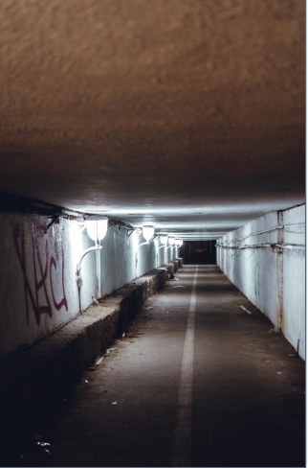
Cycling Safety as a central field of action: Social Safety
Cycling facilities should be experienced without fear (similar to pedestrian traffic)
Presence of other people
Lighting in the dark
No restriction of movement options or lines of sight, good visibility
Secure bicycle parking facilities to protect against theft
Unsplash

Slide 18
Cycling Safety: Demands on Politicians
More cycling paths
Better separation of cyclists from car drivers
Secure bicycle parking facilities
Bicycle transport options on public transport
Wider cycle lanes, also for cargo bikes
Better separation of cyclists from pedestrians
- Sinus Bicycle Monitor 2023 (Germany)

Slide 19
Overview
Cycling: development and challenges
Road safety for cyclists
Promotion of cycling as a means of transport

Slide 20
Promotion of Cycling – Why it matters
Public Health Benefits
  Cycling as part of an active lifestyle significantly lowers the risk of diseases like heart diseases, stroke, cancer and diabetes
Climate & Environmental Impact
  Cycling as a zero emission mode of transport
Economic and Social Benefits
  Cycling supports jobs through increased bike sales, tourism, and infrastructure investment while lowering healthcare costs
Efficient Use of Urban Space
  Bicycles require less space than cars both on the road and parking, which makes urban areas more livable and less congested

Slide 21
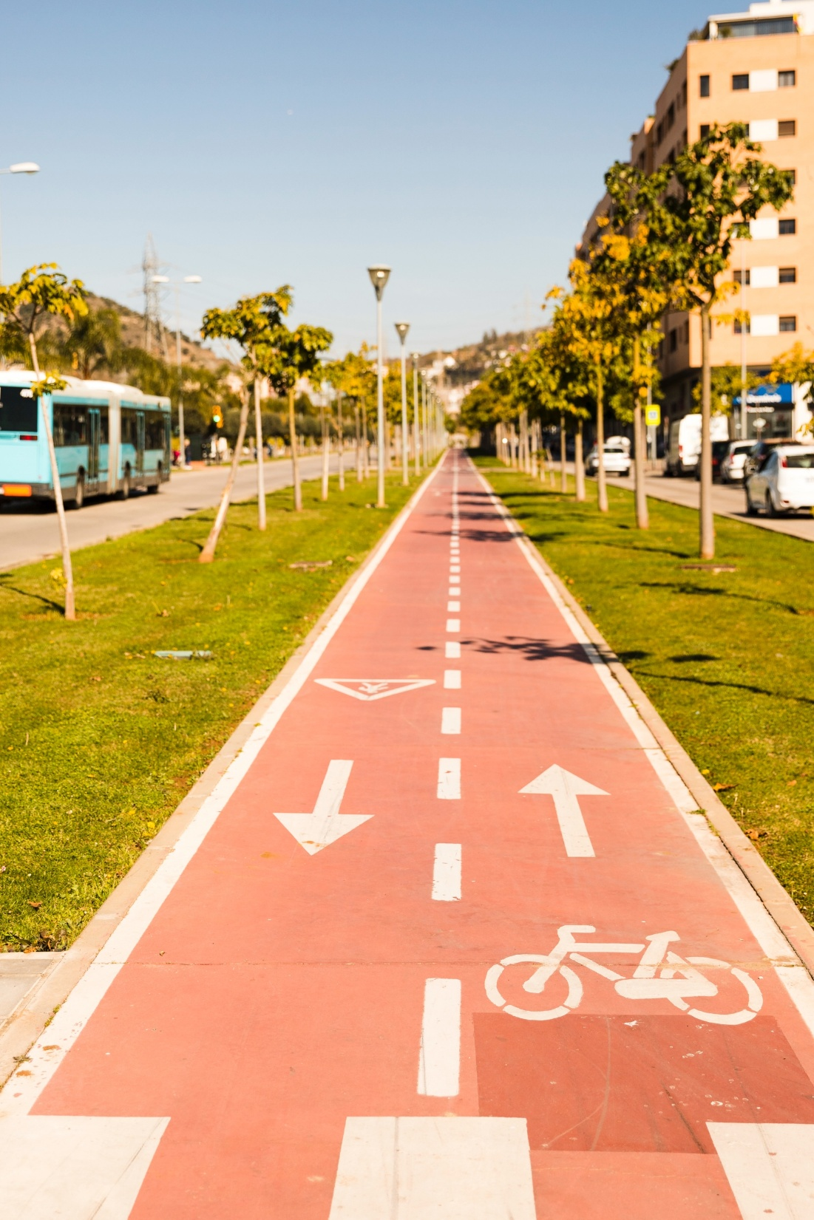
Promotion of Cycling – How to achieve it
Develop and expand safe infrastructure
  continuous, protected bike lanes; this does not only improve actual safety, but also enhances cyclists perception of safety, a key factor in increasing cycling uptake
Freepik

Slide 22
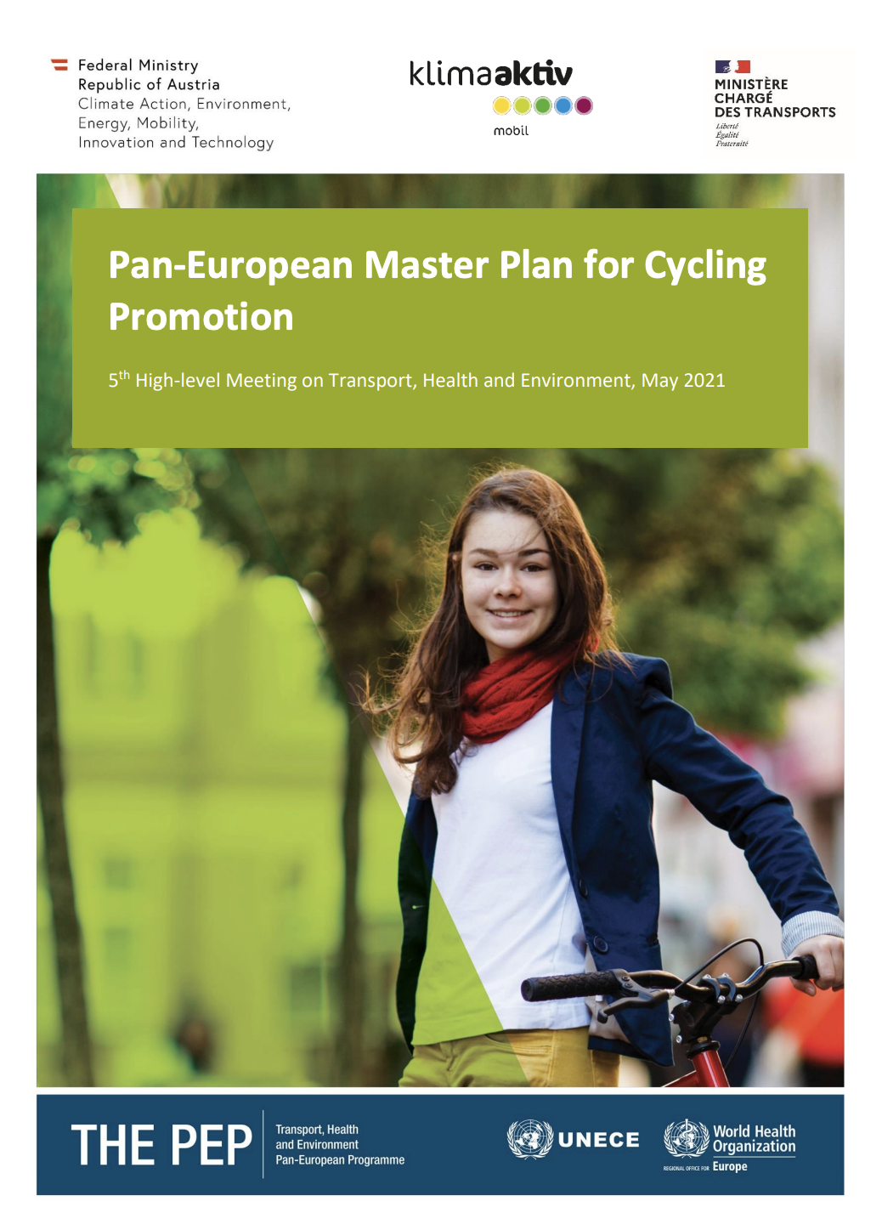
Promotion of Cycling – How to achieve it
Integrate Cycling into Policy Framework
  National and local governments can embed cycling into broader transport, health and environmental policies
  Example: Pan-European Master Plan for Cycling Promotion
UNECE

Slide 23
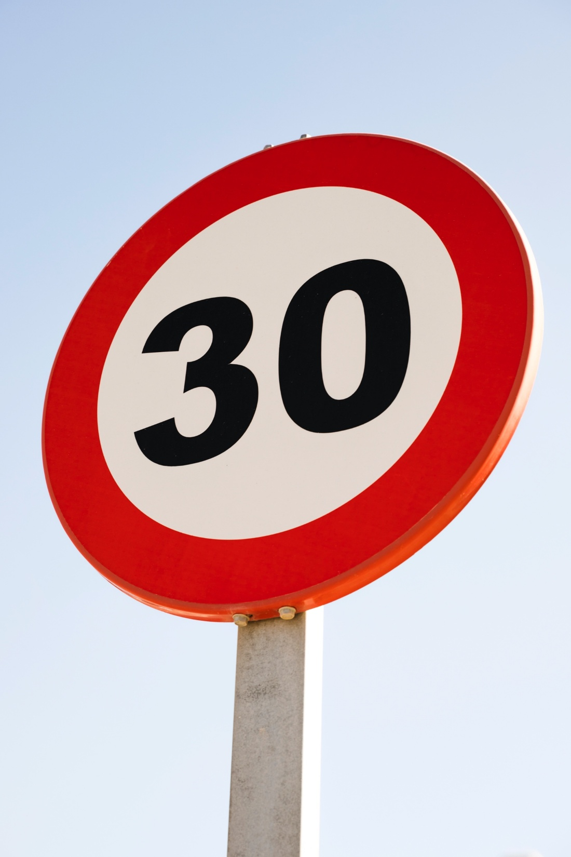
Promotion of Cycling – How to achieve it
Speed Management and Road Safety Measures
  Lowering speed limits in urban areas (e.g. to 30km/h) reduces the severity of collisions
Freepik

Slide 24

Promotion of Cycling – How to achieve it
Awareness Raising & Behaviour Change Campaigns
  Education and awareness campaigns for cyclists and other road users
  Addressing safety concerns and benefits
  Reshaping social norms around cycling as a legitimate alternative
Freepik

Slide 25

Promotion of Cycling – How to achieve it
Financial Incentives and Support Programs
  Governments or employers can offer incentives like subsidies for bike purchases, tax benefits or investments in bike sharing systems
  These incentives lower the cost barrier and encourage people to choose bicycles over motorized transport
Freepik

Slide 26
Promotion of Cycling – New e-mobility trend?
About 300.000.000 E-bikes are in use worldwide
Rapidly growing
In Germany, e-bikes sales exceeded regular bike sales for the first time in 2023
Gaining popularity:
  Extended travel range, often more practicable in cities than cars
  Lower physical barriers, especially for older or less fit people
  Environmental benefits compared to a car
Successful integration requires appropriate infrastructure, regulation and safety planning

Slide 28
Sources - Pictures
https://www.statista.com/outlook/mmo/micromobility/bicycles/regular-bicycles/worldwide
https://pixabay.com/de/photos/roller-fahrrad-freizeit-radfahren-7396608/
https://pixabay.com/de/photos/radfahrer-kreuzung-stadt-stra%c3%9fen-5832393/
https://unsplash.com/photos/brown-concrete-hallway-AQ6rg16_Qzc
https://de.freepik.com/fotos-kostenlos/richtungspfeile-und-fahrrad-unterzeichnen-auf-sich-verringerndem-perspektivenzyklusweg_4624908.htm#fromView=search&page=1&position=28&uuid=69bef2a2-b0dc-4679-937c-ac5bf7a1d25f&query=sicherer+fahrradweg
https://unece.org/sites/default/files/2023-03/MASTERPLAN_2021-05-20-II_BF%203%20June_0.pdf
https://de.freepik.com/fotos-kostenlos/runden-sie-30-hoechstgeschwindigkeitszeichen-gegen-blauen-himmel_4624948.htm#fromView=search&page=1&position=0&uuid=abe32277-0970-4720-afd4-18d8e6233c38&query=30kmh
https://de.freepik.com/fotos-kostenlos/revolution-stillleben-design_17119054.htm#fromView=search&page=1&position=2&uuid=a6326a2b-7583-4b9b-bacf-9a91d6bc19e5&query=campaign
https://de.freepik.com/fotos-kostenlos/dollarzeichen-gemacht-aus-muenzen-auf-hoelzernem-hintergrund-heraus_5683096.htm#fromView=search&page=1&position=32&uuid=a450d111-62dc-4f5c-9d39-db3001d589fc&query=dollar+sign

Slide 29
Sources - Literature
International Transport Forum 2024: Road Safety – Annual Report. https://www.itf-oecd.org/sites/default/files/docs/irtad-road-safety-annual-report-2024.pdf (03.02.26).
IPSOS 2022: Cycling across the world – key findings. https://www.ipsos.com/en/global-advisor-cycling-across-the-world-2022 (03.02.26).
Run Repeat 2023: Cycling Statistics. https://runrepeat.com/cycling-statistics (03.02.26).
Sinus 2023: Fahrradmonitor 2023. https://www.bmv.de/SharedDocs/DE/Anlage/StV/fahrradmonitor-langfassung.pdf?__blob=publicationFile (03.02.26).
Statista 2025: Regular Bicycles. https://www.statista.com/outlook/mmo/micromobility/bicycles/regular-bicycles/worldwide (03.02.26).
Stülpnagel/Lucas 2022: Crash risk and subjective risk perception during urban cycling: Evidence for congruent and incongruent sources. https://pubmed.ncbi.nlm.nih.gov/32445971/ (03.02.26).
Transport Geography 2018: World Bicycle Production. https://transportgeography.org/contents/chapter5/road-transportation/bicycle-production-world (03.02.26).
UNECE 2023: Pan-European Master Plan for Cycling Promotion. https://unece.org/sites/default/files/2023-03/MASTERPLAN_2021-05-20-II_BF%203%20June_0.pdf (03.02.26).
WHO 2025: Make walking and cycling safe to unlock huge health, life and green gains. https://www.who.int/news-room/commentaries/detail/make-walking-and-cycling-safe-to-unlock-huge-health--life-and-green-gains (03.02.26).

