Slide 1
Water Transport
Fundamentals of Transport

Slide 2
Road Transportation Systems Engineering Development in the Sub-Saharan Africa – Modern EU Master Programme & Capacity Building

Slide 4
Learning Objectives
Students can:
explain key concepts and forms of water transport
distinguish between civil, military, passenger and freight shipping
understand the global importance of maritime freight transport
describe key infrastructure elements (waterways, ports, locks)
evaluate strengths, limitations and challenges of water transport

Slide 5
Overview
Basic Terms and Definitions
Types of Shipping
Infrastructure
Quality Criteria, Advantages & Disadvantages
Challenges, Environmental Impact & Future Trends

Slide 6
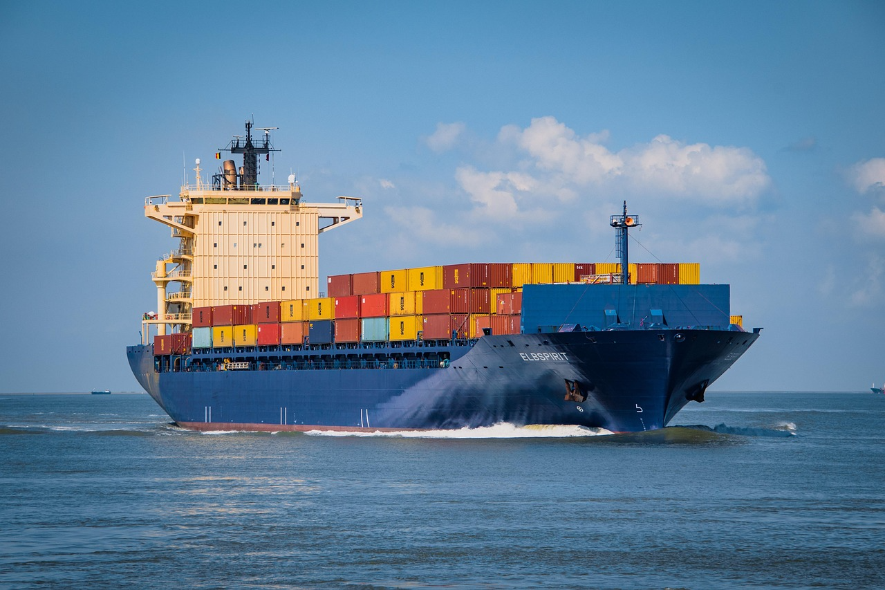
What is Water Transport?
Definition: movement of passengers or goods via navigable waterways
Includes maritime (oceans/seas) and Inland Water Transport (IWT; rivers, canals)
One of the oldest transport systems in human history
Fig. 1: Pixabay

Slide 7
Key Terminology
Vessel: any watercraft used for transport
Shipping: transport of goods or passengers by water
Port: facility for loading/unloading ships
Inland waterways: rivers, canals, lakes
Draft (Draught): The vertical distance between the waterline and the bottom of the hull (determines which ports/rivers a ship can enter)
Deadweight Tonnage (DWT): The total weight a ship can carry (cargo, fuel, water, crew)
Hydrography: Mapping the water depths and obstacles

Slide 8
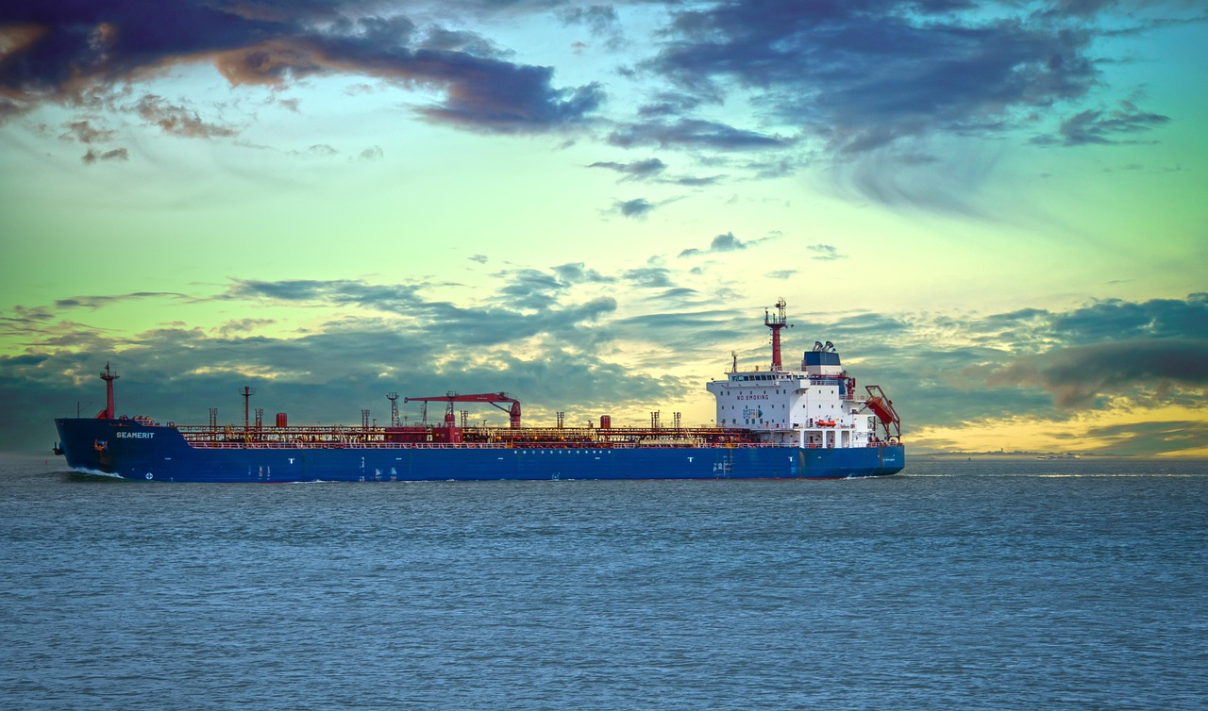
Vessel Types
Liner: Operates on a fixed schedule and route (mostly container ships)
Tramp: No fixed schedule; travels wherever cargo is available (mostly bulk carriers)
Fig. 2: Pixabay

Slide 9
Overview
Basic Terms and Definitions
Types of Shipping
Infrastructure
Quality Criteria, Advantages & Disadvantages
Challenges, Environmental Impact & Future Trends

Slide 10
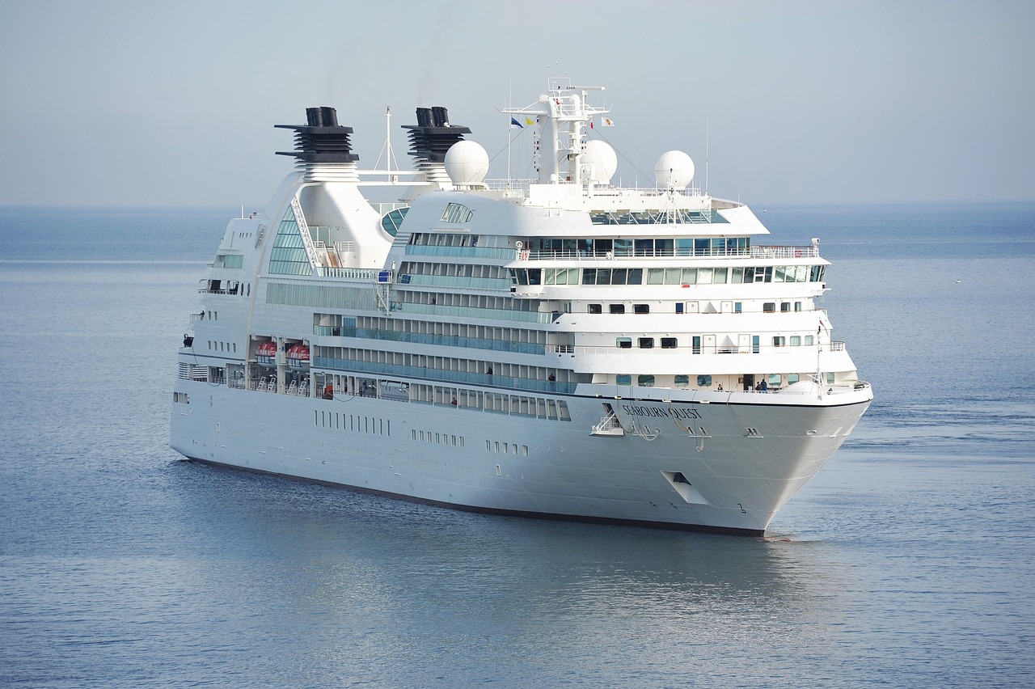
Civil Shipping
Commercial activities including freight and passenger transport.
includes:
  container shipping
  bulk shipping
  passenger transport (ferries, cruises)
Fig. 3: Pixabay

Slide 11
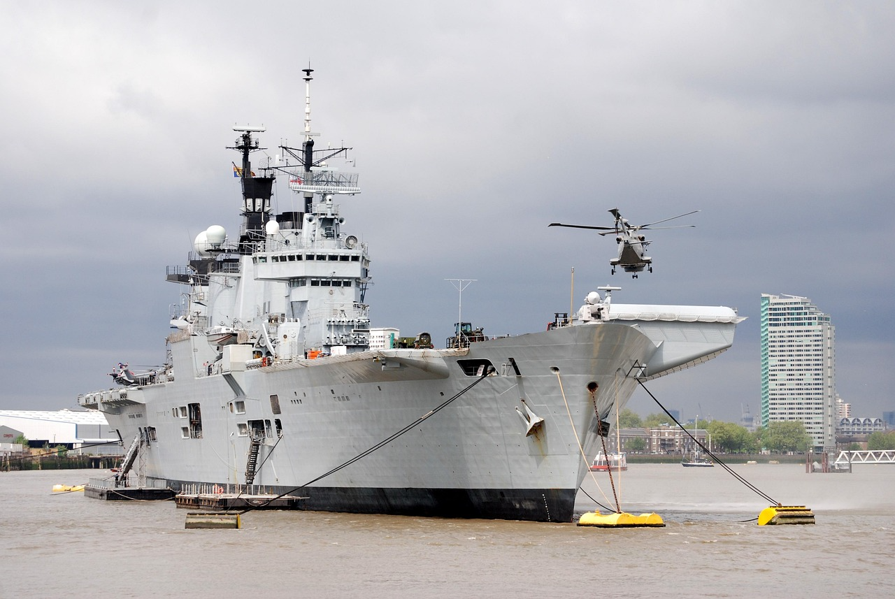
Military Shipping
Navies & Coastguards - naval operations (defense, security, sovereignity)
Troop and equipment transport
Strategic importance for global trade routes:
  Protecting trade routes from piracy
Fig. 4: Pixabay

Slide 12
Freight Shipping
Freight Types:
  Containerized: Standardized boxes (TEU = Twenty-foot Equivalent Unit)
  Bulk (Dry/Liquid): Iron ore, grain, coal, or oil/LNG
  Break Bulk: Goods that don't fit in containers (machinery, large vehicles)
The Share of Freight Transport:
  By Volume: Over 80% of global trade is carried by sea
  By Value: Roughly 50-70% (lower than volume because low-value bulk goods dominate water transport)
Freight Shipping as the backbone of global supply chains

Slide 13
Passenger Shipping
Ferries: Vital for regional connectivity (e.g., Lake Victoria or island nations like Cape Verde)
Ocean Cruises:
  Tourism-focused, global tourism sector
  "floating hotels" with high infrastructure requirements
  Economic importance for some coastal regions
River Cruises: Specialized tourism on major inland waterways (e.g., the Nile or the Rhine)

Slide 14
Overview
Basic Terms and Definitions
Types of Shipping
Infrastructure
Quality Criteria, Advantages & Disadvantages
Challenges, Environmental Impact & Future Trends

Slide 15
Infrastructure
Waterways: Natural (rivers/oceans) or artificial (canals like Suez or Panama)
Locks: Mechanical systems used to raise or lower vessels between different water levels in canals or rivers
Ports: The interface between water and land. Includes:
  Berths: Where the ship moors
  Quay Cranes: For loading/unloading
  Hinterland Connection: Links to rail, road & inland waterways
  Functions: Cargo Handling, storage, logistics integration
  Types: Container ports, bulk ports, passenger ports

Slide 16
Overview
Basic Terms and Definitions
Types of Shipping
Infrastructure
Quality Criteria, Advantages & Disadvantages
Challenges, Environmental Impact & Future Trends

Slide 17
Quality Criteria
Cost Efficiency: Lowest cost per tonne-kilometer of all modes
Capacity: Mass transport capability (one large container ship can carry 20,000+ TEU)
Reliability: Weather-dependent; "Just-in-Time" delivery is harder than in rail/road
Safety: Highly regulated via the SOLAS convention (Safety of Life at Sea)

Slide 18
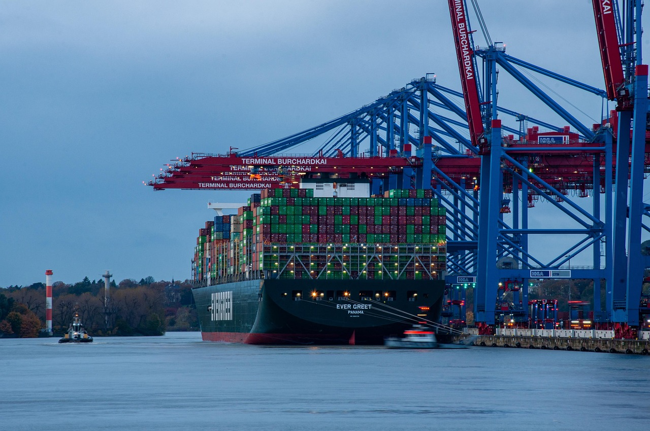
Limitations and Advantages as a mode of transport
Advantages
  very low cost per tonne-km
  high capacity
  energy efficient
Limitations
  slow speed
  dependence on ports
  limited inland accessibility
Fig. 5: Pixabay

Slide 19
Overview
Basic Terms and Definitions
Types of Shipping
Infrastructure
Quality Criteria, Advantages & Disadvantages
Challenges, Environmental Impact & Future Trends

Slide 20
CO2 Emissions and Environment
CO2 Emissions: Shipping accounts for ~2.9% of global GHG emissions
Energy Efficiency: Most energy-efficient mode per tonne-km
Regulations: IMO 2023 Strategy aims for net-zero emissions by or around 2050
Other Impacts: Ballast water (invasive species), oil spills, and sulfur oxides (SO_{x}).

Slide 21
Challenges
Climate Change: Changing water levels in rivers and rising sea levels impacting port infrastructure
Congestion: Bottlenecks at major ports and canals (e.g., the "Ever Given" Suez incident)
Geopolitical risks on trade routes (Strait of Hormuz)
Infrastructure Deficit: Many ports require dredging (deepening) and modernizing to handle larger, modern vessels
Security: Piracy and maritime "choke points."

Slide 22
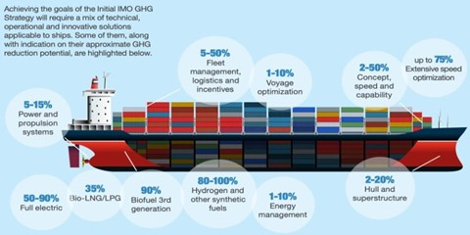
Policy Priorities
decarbonisation of shipping
cleaner fuels (LNG, hydrogen)
digitalisation of logistics
Fig. 6: Safety4Sea

Slide 23
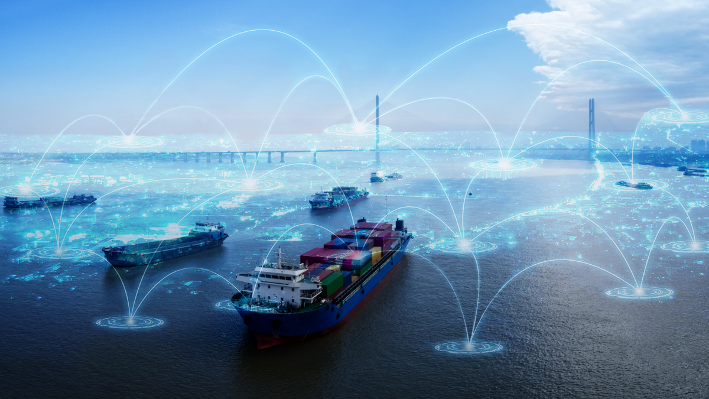
Future Trends
automation in ports
green shipping technologies
increasing global trade demand
Fig. 7: Riviera

Slide 24
Key Takeaways
Water transport is the backbone of global freight transport
Extremely efficient but slow and infrastructure-dependent
Essential for global trade and logistics
Facing environmental and geopolitical challenges

Slide 25
Thank you for your attention!

Slide 26
Sources - Pictures
Fig. 1: https://pixabay.com/de/photos/containerschiff-container-transport-6631117/
Fig. 2: https://pixabay.com/de/photos/frachtschiff-seeschiff-7221154/
Fig. 3: https://pixabay.com/de/photos/kreuzfahrt-schiff-ozean-1578528/
Fig. 4: https://pixabay.com/de/photos/flugzeugtr%c3%a4ger-hubschrauber-themse-344346/
Fig. 5: https://pixabay.com/de/photos/containerschiff-hamburger-haften-6779968/
Fig. 6: https://safety4sea.com/cm-imo-webinar-what-is-the-future-of-decarbonization-in-shipping/
Fig. 7: https://www.rivieramm.com/news-content-hub/news-content-hub/key-technology-trends-transforming-shipping-in-2023-74237

Slide 27
Sources – Literature (Further Reading)
African Development Bank Group n.y.: Transport. https://www.afdb.org/en/topics-and-sectors/sectors/transport (10.04.26).
Cruise Lines International Association n.y.: https://cruising.org/news (10.04.26).
International Maritime Organization n.y.: IMO GHG Studies. https://www.imo.org/en/ourwork/environment/pages/imo-ghg-studies.aspx (10.04.26).
International Maritime Organization n.y : International Convention for the Safety of Life at Sea (SOLAS), 1974. https://www.imo.org/en/about/conventions/pages/international-convention-for-the-safety-of-life-at-sea-(solas),-1974.aspx (10.04.26).
International Maritime Organization n.y : Introduction to IMO. https://www.imo.org/en/about/pages/default.aspx (10.04.26).
PIANC n.y.: The World Association for Waterborne Transport Infrastructure. https://www.pianc.org/ (10.04.26).
UN Trade & Development n.y.: Review of Maritime Transport. https://unctad.org/topic/transport-and-trade-logistics/review-of-maritime-transport (10.04.26).

