Slide 1
Logistics
Fundamentals of Transport

Slide 2
Road Transportation Systems Engineering Development in the Sub-Saharan Africa – Modern EU Master Programme & Capacity Building

Slide 4
Learning Objectives
Students can:
explain the concept and scope of logistics
identify key characteristics of logistics systems
understand how logistics is used in global supply chains
analyse major challenges in logistics systems

Slide 5
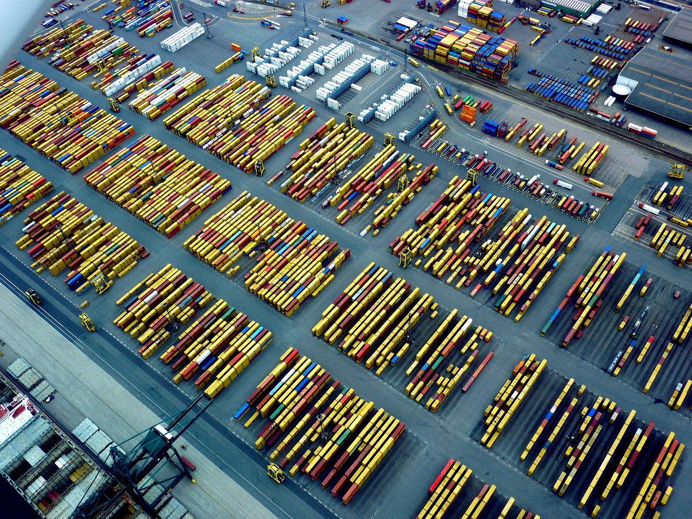
What is Logistics?
Definition: planning, implementation and control of efficient flow of goods, services and information
Covers transport, storage, handling and distribution
Fig. 1: Pixabay

Slide 6
Characteristics of Logistics
The "7 Rs" Rule: Ensuring the Right product, in the Right quantity, in the Right condition, at the Right place, at the Right time, for the Right customer, at the Right price.
Flow Orientation: Logistics isn't just transport; it’s the synchronisation of:
  Material Flow: Physical movement of goods
  Information Flow: Data, tracking, and documentation (digitalization)
  Financial Flow: Payments and credit terms
Intermodality: The seamless use of multiple transport modes (Sea → Rail → Truck) under a single contract
Lead Time: The total time from an order being placed to delivery—a key metric of logistics performance

Slide 7
Logistics vs. Transport
Feature | Transport | Logistics
Focus | Physical movement of goods from A to B | Entire flow management and storage
Goal | Speed and cost of the trip | Customer satisfaction and system efficiency
Primary Actor | Carriers (Airlines, Trucking firms) | LSPs (Logistics Service Providers/3PLs)
„If Transport is the "vehicle," then Logistics is the "brain" that decides where the vehicle goes, what it carries, and how it connects with the rest of the world.“

Slide 8
Usage and Applications
Inbound Logistics: Procurement and movement of raw materials from suppliers to a manufacturing plant
Outbound Logistics: Distribution of finished products to the end consumer (Last-Mile Delivery)
Reverse Logistics: The process of moving goods from their typical final destination for the purpose of capturing value, or proper disposal (recycling/returns)
Warehouse Management: Not just storage, but value-added services like "kitting" (assembling parts) and labeling
Cold Chain Logistics: Temperature-controlled supply chains (vital for African agriculture and pharmaceutical/vaccine distribution)

Slide 9
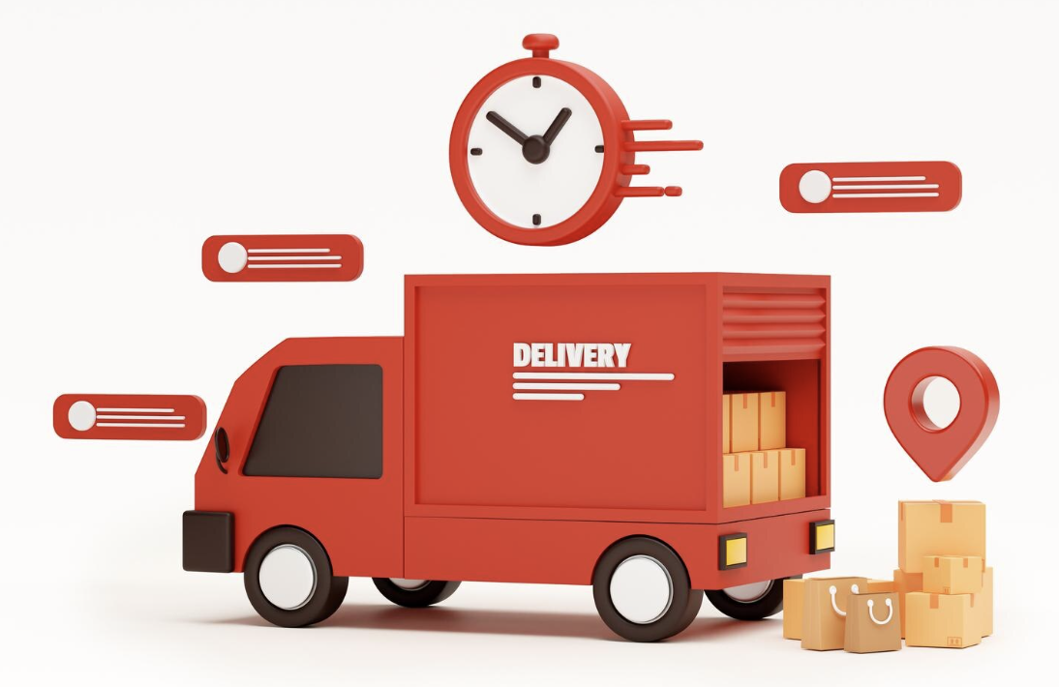
Logistics in Everyday Life
online shopping delivery
supermarket supply chains
global production networks
Fig. 2: Freepik

Slide 10
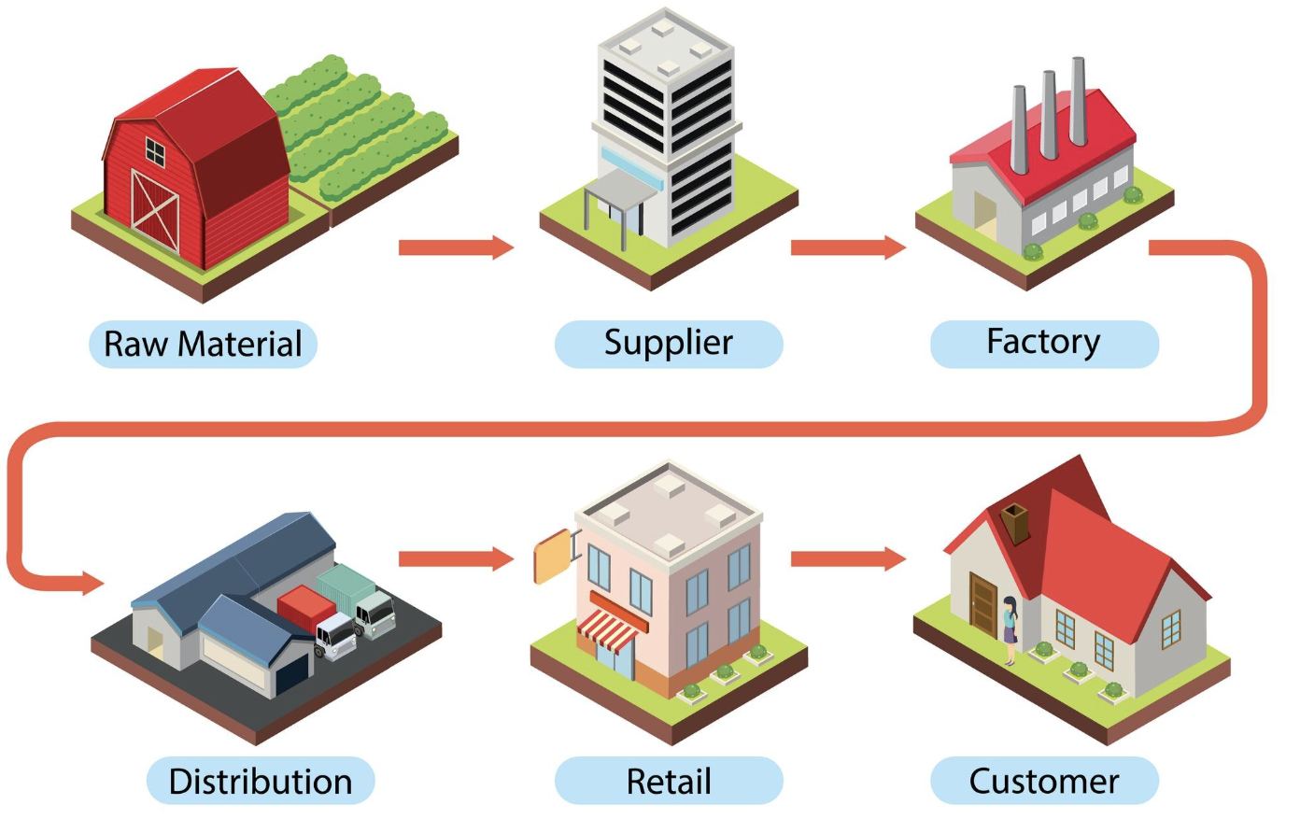
Supply Chains
logistics operates within supply chains
connects:
  suppliers
  manufacturers
  distributors
  customers
Fig. 3: Freepik

Slide 11

Urban Logistics
last-mile delivery
e-commerce logistics
increasing importance in cities
Fig. 4: Freepik

Slide 12
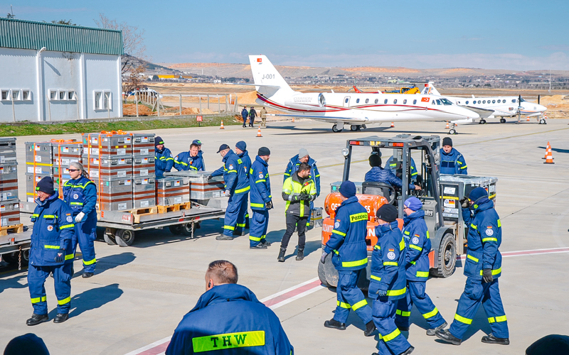
Humanitarian Logistics
disaster relief operations
emergency supply chains
time-critical logistics
Fig. 4: Logistics Hall of Fame

Slide 13
Logistics and different transport modes
road → last mile
rail → bulk inland
water → global freight
air → high-value/time-critical goods

Slide 14
Challenges in Logistics
Infrastructure Gaps: "Missing links" in road and rail networks that increase transport costs
The "Last Mile" Problem: In many rural cities, disorganized layouts make the final delivery to the customer the most expensive and inefficient part of the chain
Customs and Border Delays: Administrative bottlenecks that can leave trucks stranded for days, spoiling perishable goods
Fragmentation: A market made up of many small, informal operators rather than large, integrated logistics providers
Security and Risk: Cargo theft, regional instability, the need for expensive insurance, geopolitical conflicts, pandemics,...
Sustainability: Reducing the carbon footprint of global supply chains while maintaining speed and low costs

Slide 15
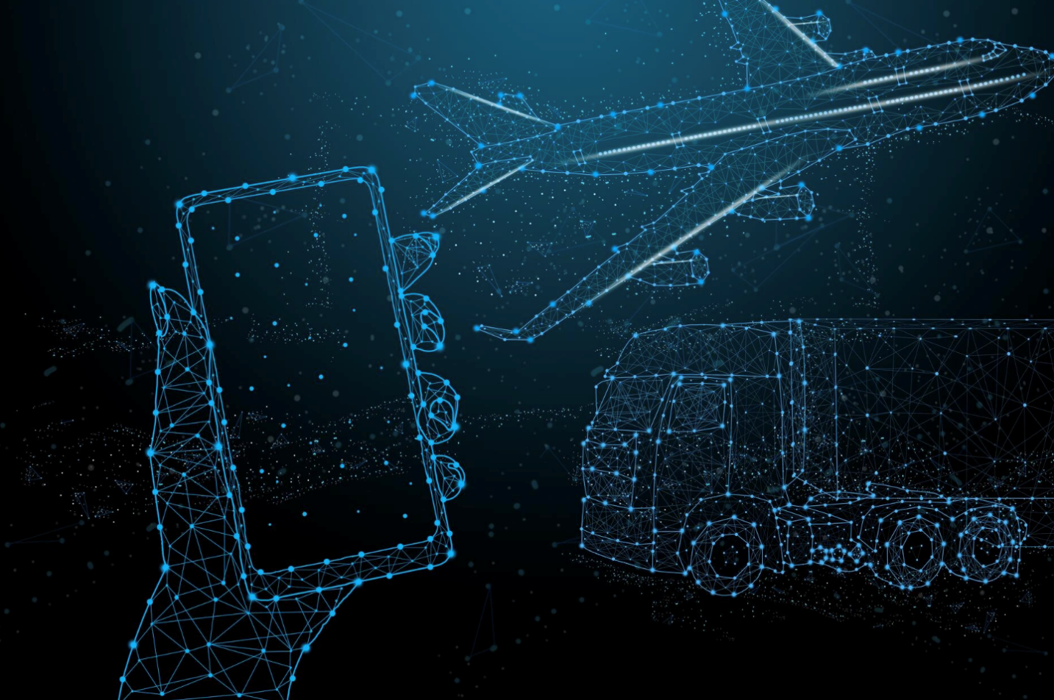
Future Trends
automation (warehouses, ports)
AI & data-driven logistics
e-commerce growth
sustainable logistics
Fig. 6: Freepik

Slide 16
Key Takeaways
Logistics coordinates the flow of goods, information and money
Essential for global trade and economic systems
Highly complex and interconnected
Facing major challenges: cost, sustainability, disruptions

Slide 17
Thank you for your attention!

Slide 18
Sources - Pictures
Fig. 1: https://pixabay.com/de/photos/antwerpen-hafen-logistik-verkehr-3388127/
Fig. 2: https://www.freepik.com/free-photo/red-delivery-car-deliver-express-shipping-fast-delivery-background-3d-rendering-illustration_30133175.htm#fromView=search&page=1&position=2&uuid=41fd4ea3-08e0-4ea8-835a-c4ce3f112c41&query=delivery
Fig. 3: https://www.freepik.com/free-vector/diagram-supply-chain-management_25537237.htm#fromView=search&page=1&position=2&uuid=da9a1a76-d934-4350-946c-671af98d6cfc&query=supply+chain
Fig. 4: https://www.freepik.com/free-photo/close-up-delivery-person-giving-parcel-client_18262757.htm#fromView=search&page=1&position=13&uuid=ae98bd91-f28c-4f4d-a7b9-e074c243dab9&query=last+mile+delivery
Fig. 5: https://www.logisticshalloffame.net/en/blog/working-group-ai-in-humanitarian-logistics
Fig. 6: https://www.freepik.com/free-photo/hand-holding-smartphone-futuristic-abstract-illuminate-line-dot-wireless-connection-wave-with-triangle-bright-blue-background-mobile-banking-shopping-online-concept-technology-future_35892936.htm#fromView=search&page=1&position=0&uuid=8442a1ed-0871-448a-a256-71e44c791692&query=future+trends+logistics

Slide 19
Sources – Literature (Further Reading)
Council of Supply Chain Management Professionals n.y.: CSCMP Supply Chain Management Definitions and Glossary. https://cscmp.org/CSCMP/Educate/SCM_Definitions_and_Glossary_of_Terms.aspx (10.04.26).
DHL n.y.: Innovation in logistics. https://www.dhl.com/de-de/home/innovation-in-logistics.html?locale=true (10.04.26).
IEA n.y.: Transport. https://www.iea.org/energy-system/transport (10.04.26).
Investopedia 2025: Optimizing Supply Chains: From Raw Materials to Consumers. https://www.investopedia.com/terms/s/supplychain.asp (10.04.26).
UN Trade & Development n.y.: Economic Development in Africa Report. https://unctad.org/publication/economic-development-africa-report-2023 (10.04.26).
World Bank Group n.y.: Logistics Performance Index. https://lpi.worldbank.org/ (10.04.26).
World Food Programme n.y.: Supply Chain. https://www.wfp.org/supply-chain (10.04.26).

