Slide 1
Motorized Transport
Fundamentals of Transport

Slide 2
Road Transportation Systems Engineering Development in the Sub-Saharan Africa – Modern EU Master Programme & Capacity Building

Slide 4
Definition Motorized Individual Transport (MIT)
Refers to the use of privately operated motor vehicles for personal travel
  cars, motorcycles, light trucks
Typically driver-controlled and not part of public transit systems
Includes both combustion engine vehicles and electric vehicles
Often measured in indicators like vehicle ownership per capita or vehicle kilometers travelled

Slide 5
Car ownership: Trends
Global passenger car fleet has grown from ~500 million (2000) to ~1.4 billion vehicles (2025)
Worldwide car ownership is expected to reach ~2 billion by 2040 without major policy shifts
As urbanization increases, car ownership increases faster than population growth in many regions
Rapid motorization seen in China, India, Southeast Asia and Latin America over the past 20 years

Slide 6
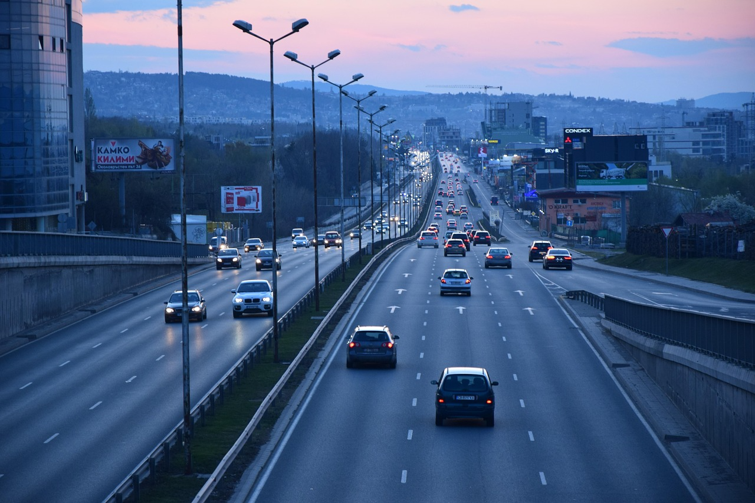
Car ownership per region
High-income countries: ~500–800 cars per 1000 people (very high car density)
Upper-middle-income countries: ~200–400 cars per 1000 people
Low-income countries: <50 cars per 1000 people
Pixabay

Slide 7
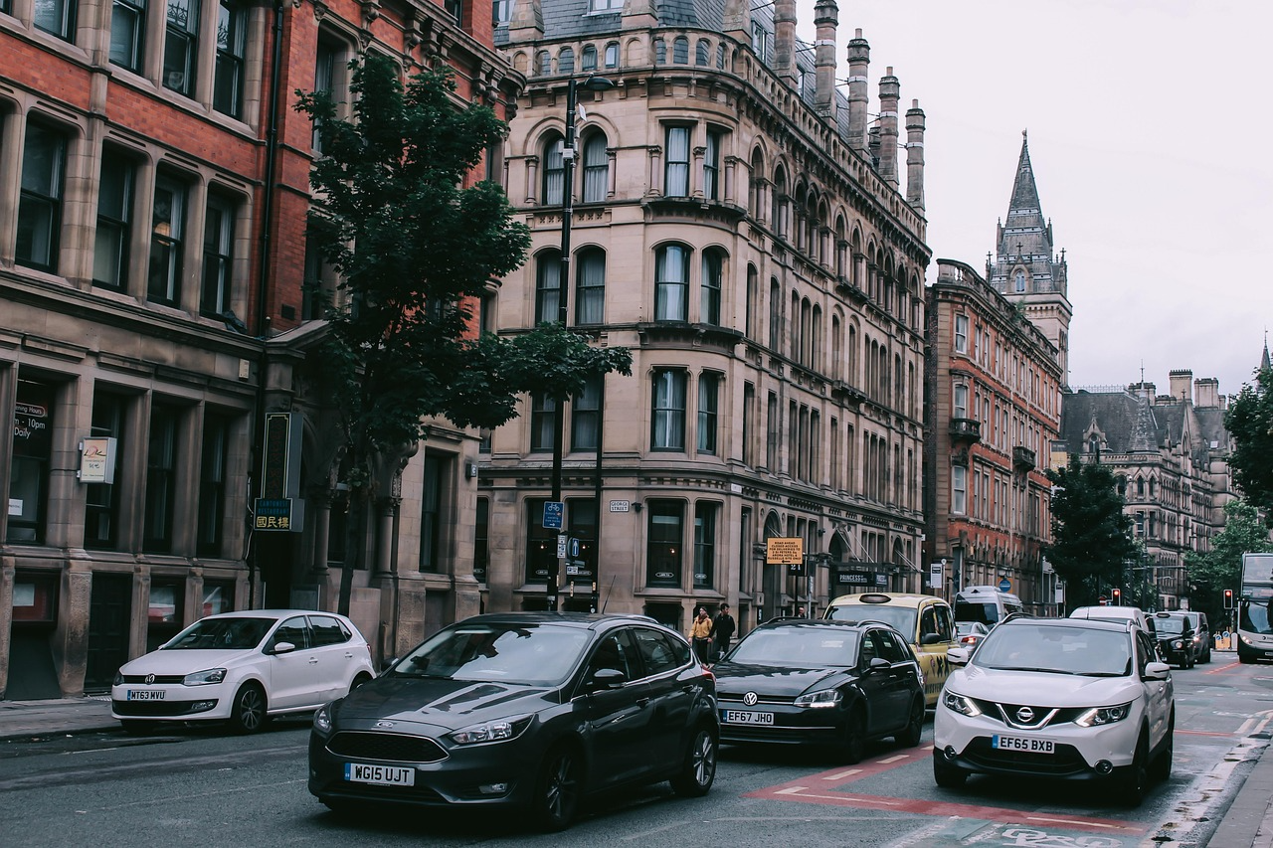
Car availability and usage
Car availability and usage depends on:
Gender
Age
Driving license possession
Personal financial situation
Social environment
Worldview
Mobility requirements
Geographical conditions: Topography, city/countryside
Attractiveness of "competing" means of transport
Infrastructure condition, limited parking, traffic congestion
Pixabay

Slide 8
Advantages of motorized traffic
Unbound: freely movable (in compliance to the rules)
High availability
Largest transportation network
Depending on the destination: shortest travel time "door-to-door“
High level of comfort: space, air conditioning, music etc.
Car as a private area

Slide 9
Disadvantages of motorized traffic
Traffic accidents
Land consumption
Economic damage caused by traffic jams
High energy requirement
emissions
  Noise
  Air pollutants
  Greenhouse gases
  Negative effects on humans, the environment and the climate

Slide 10
Accidents, Safety & Fatalities
~1.3 million people die in road crashes worldwide annually
Vulnerable road users (pedestrians, cyclists, motorized two-wheelers) account for >50% of all fatalities
Car occupant deaths: ~29% of total global road deaths

Slide 11
Accidents, Safety & Fatalities
Fatalities have fallen in high-income countries due to stronger safety systems -> Vision Zero
Road deaths estimated to increase in low- and middle-income countries (rapid motorization regions) unless infrastructure and policy change

Slide 12
Traffic Accidents: Vision Zero
"Vision Zero" originally comes from occupational safety and was further developed for traffic in the mid-1990s by the Swedish Public Roads Administration
Stands for a comprehensive paradigm shift in road safety, with the goal of no more deaths and serious injuries on the roads
Comprises a concept for action based on two basic principles:
  Accident prevention as a social task: it is not only those involved in accidents who must take responsibility for accidents, because human error can never be completely avoided
  Stress limits of the human body as a benchmark: even in the worst-case scenario, the consequences of an accident must not be fatal
Means of transportation and infrastructure must be designed in such a way that accidents with injuries and fatalities must be avoided and legislation must also be enacted in line with Vision Zero

Slide 13
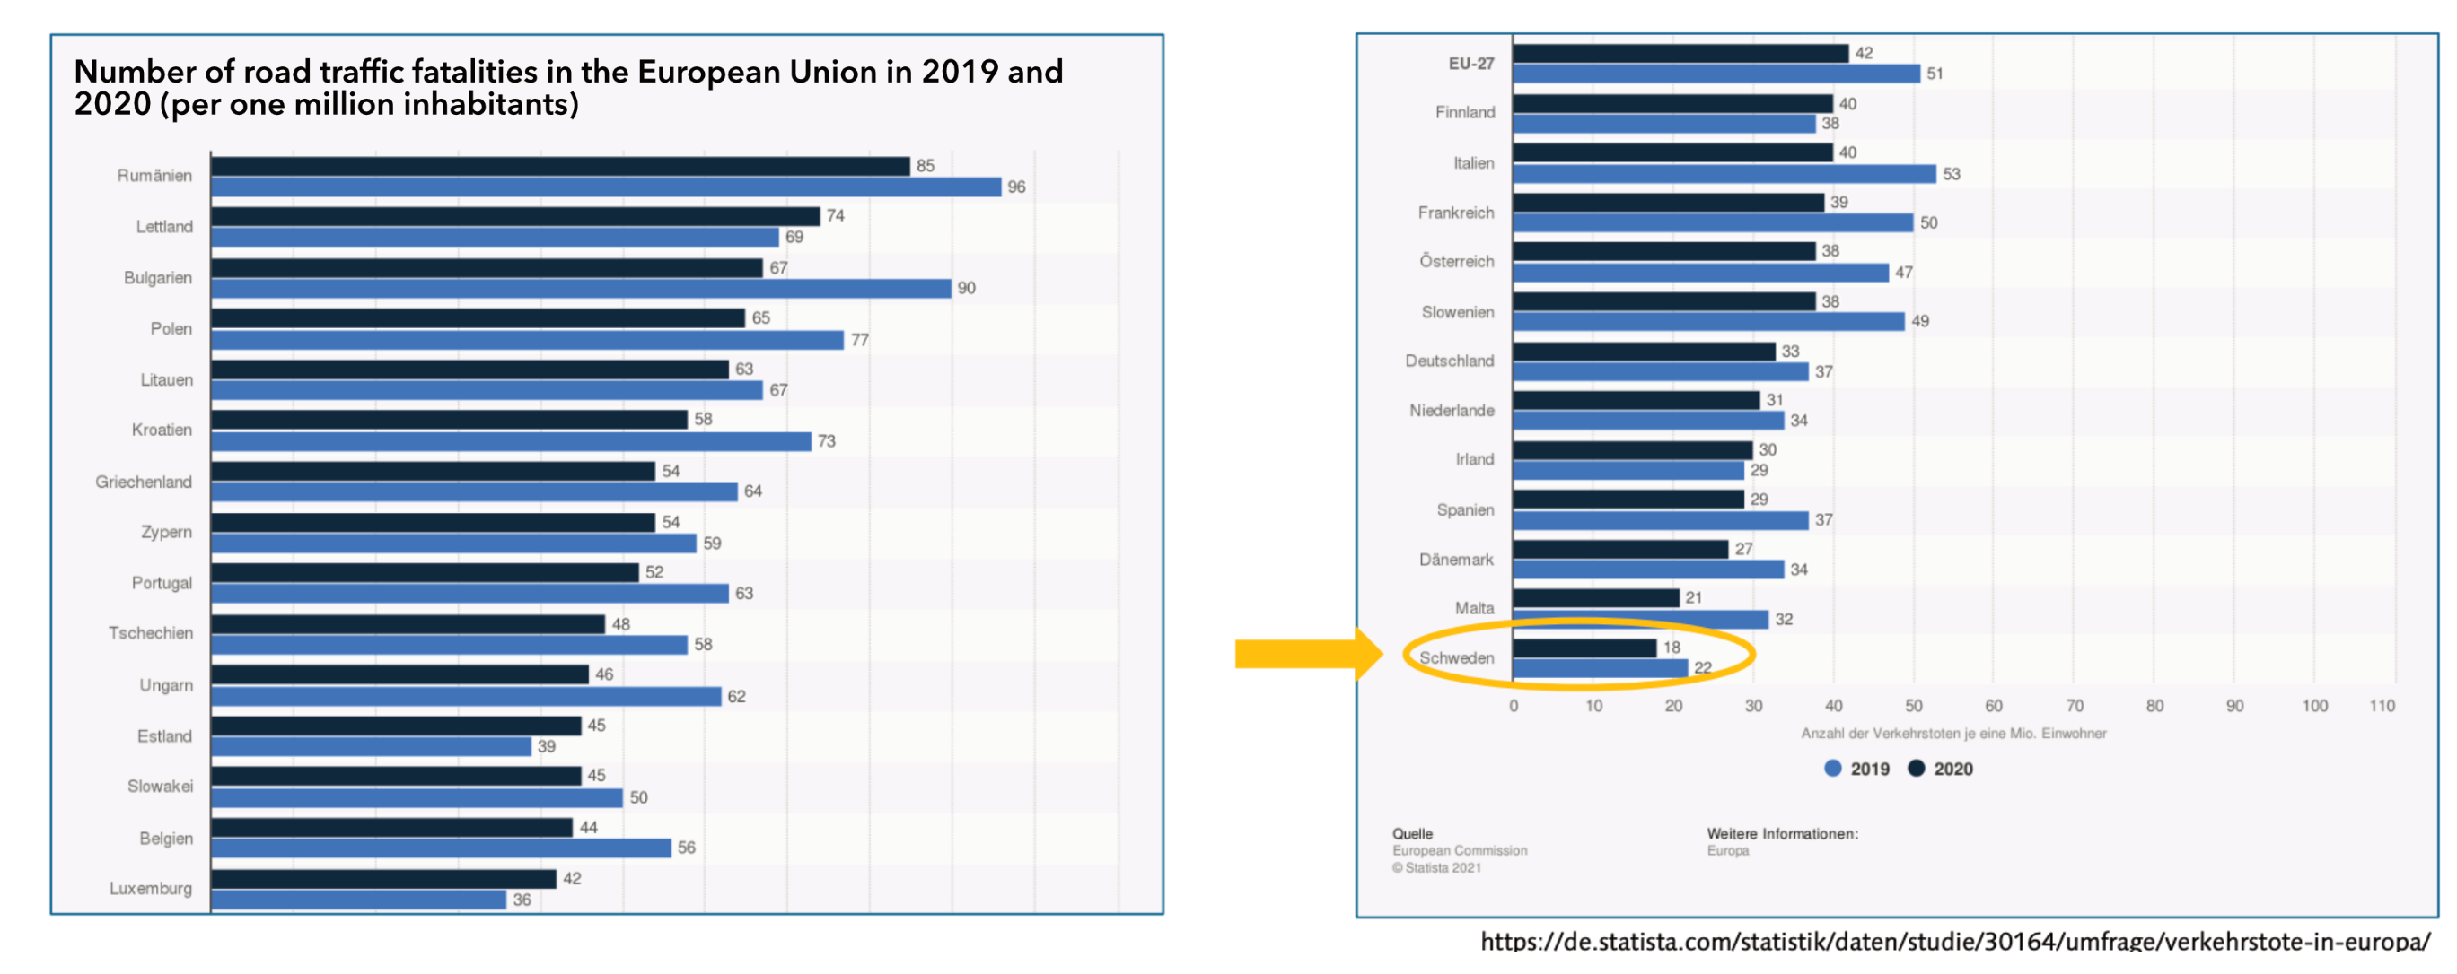
Traffic Accidents: Vision Zero
As a pioneer in the implementation of Vision Zero, Sweden has the lowest number of road deaths in Europe

Slide 14
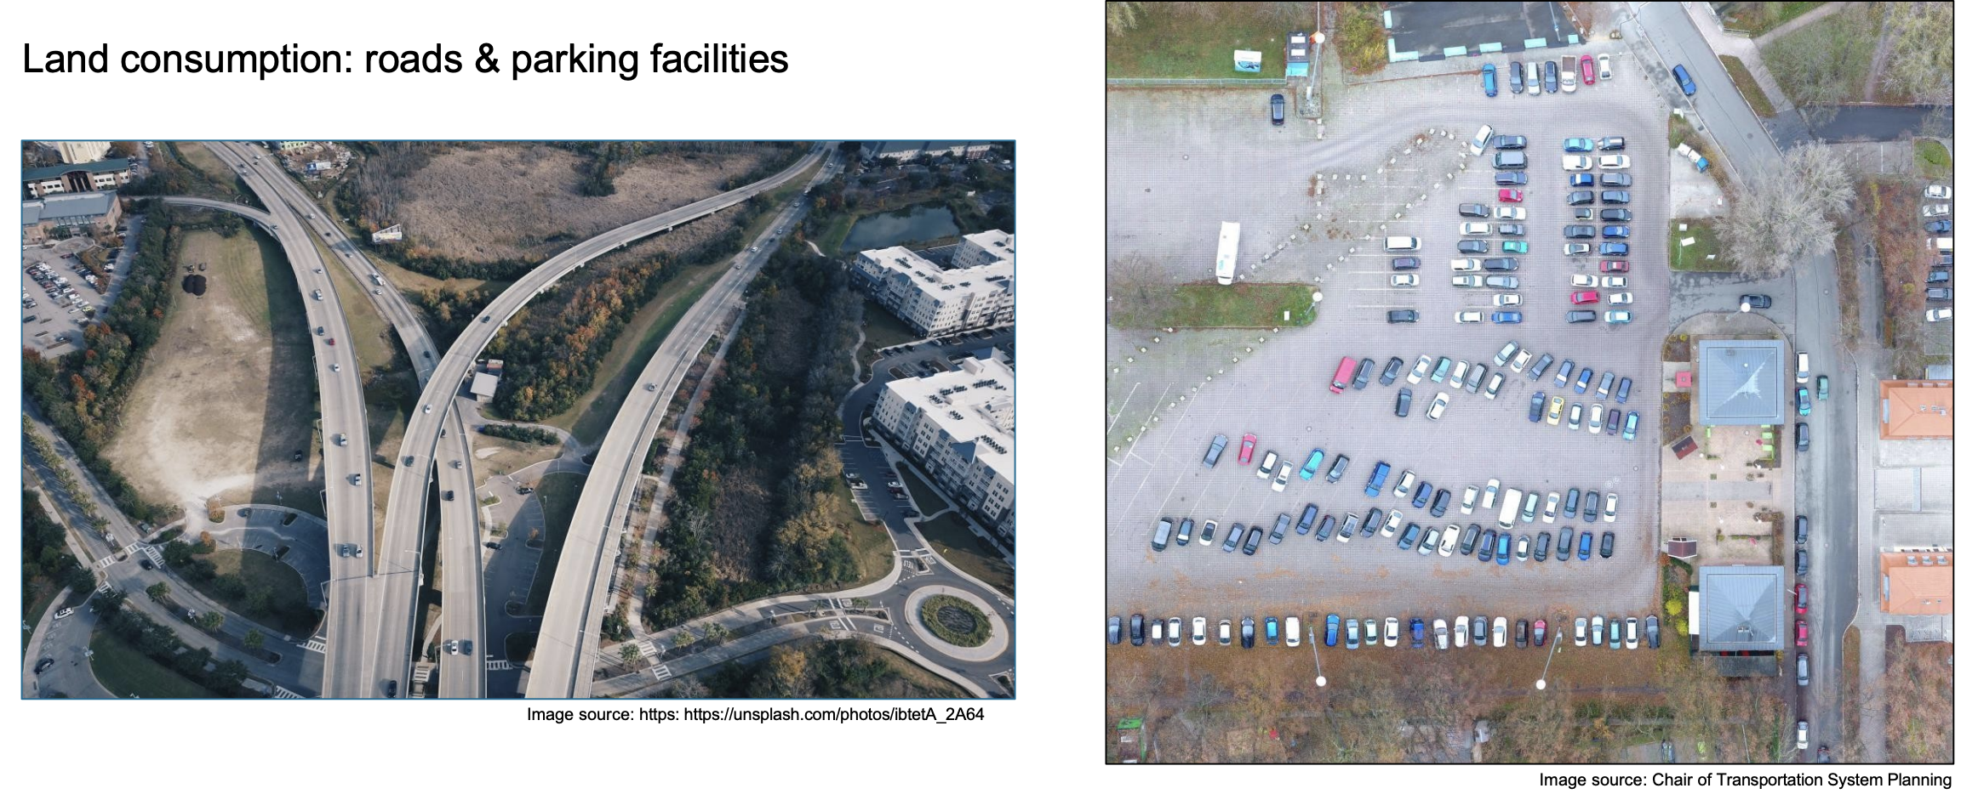
Land Consumption
Land consumption: roads & parking facilities

Slide 15
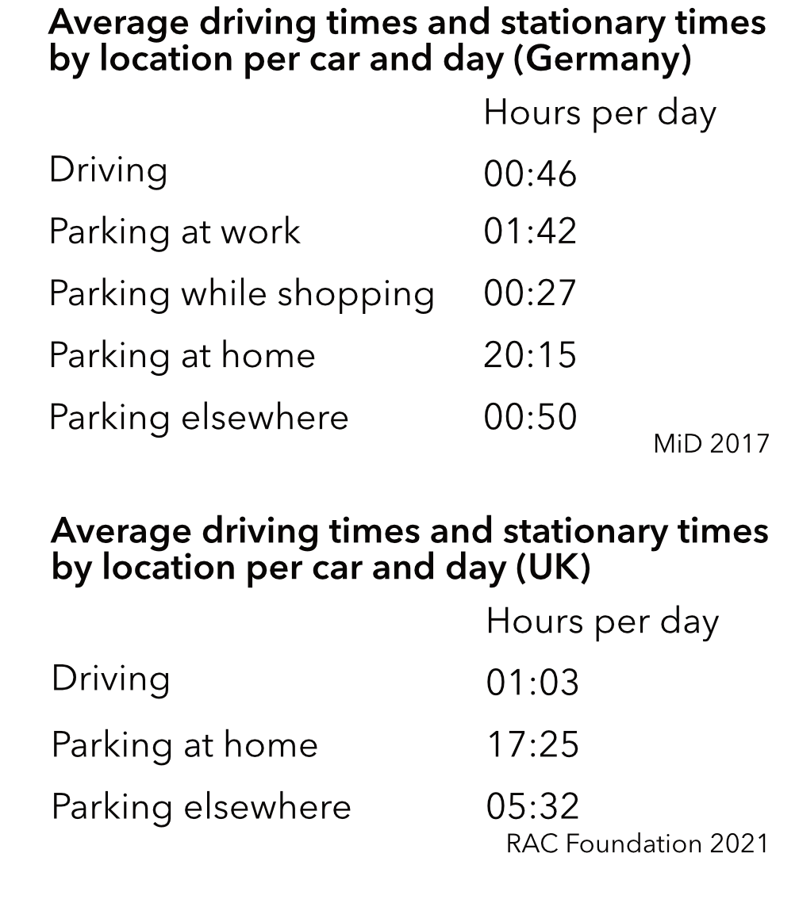
Land Consumption
Private cars require large amounts of urban space for roads, parking and infrastructure
A parked car typically occupies ≈10–15 m², but total space demand per vehicle (including roads) is far higher
In many cities, up to 50–60 % of public space in central areas is allocated to motorized traffic
On average, cars are parked for more than 23 hours per day
Especially in cities, almost half of them park in public spaces

Slide 16
Land Consumption
Moving one person by car requires far more space per passenger-km than public transport, cycling or walking
Urban sprawl is strongly linked to car-dependent transport systems
Road expansion often induces additional traffic (“induced demand”)
Increased land sealing → reduced biodiversity, higher flood risk
Car-oriented development reduces urban density and walkability

Slide 17
Land Consumption: Reducing Car Space Demand
One Solution: Car Sharing
  Users access vehicles on demand instead of owning them
  Shared vehicles replace multiple privately owned cars - one shared car can replace 5–15 private cars depending on the area
  Car sharing reduces demand for parking infrastructure and road space
  Users tend to drive less and combine modes more often
  Often integrated into Mobility-as-a-Service (MaaS) platforms
  Supports transition from ownership to access-based mobility

Slide 18
Land Consumption: Reducing Car Space Demand
Parking Policy Reforms
  Dynamic Pricing in parking reduces car use and space demand
  Less public parking, increasing pricing,...
Public Transport & Active Mobility
  Shifting trips to transit, walking and cycling dramatically reduces space consumption per traveler
Urban Planning Measures
  Mixed-use development reduces travel distances and car dependency
  Compact city design reduces infrastructure footprint

Slide 19
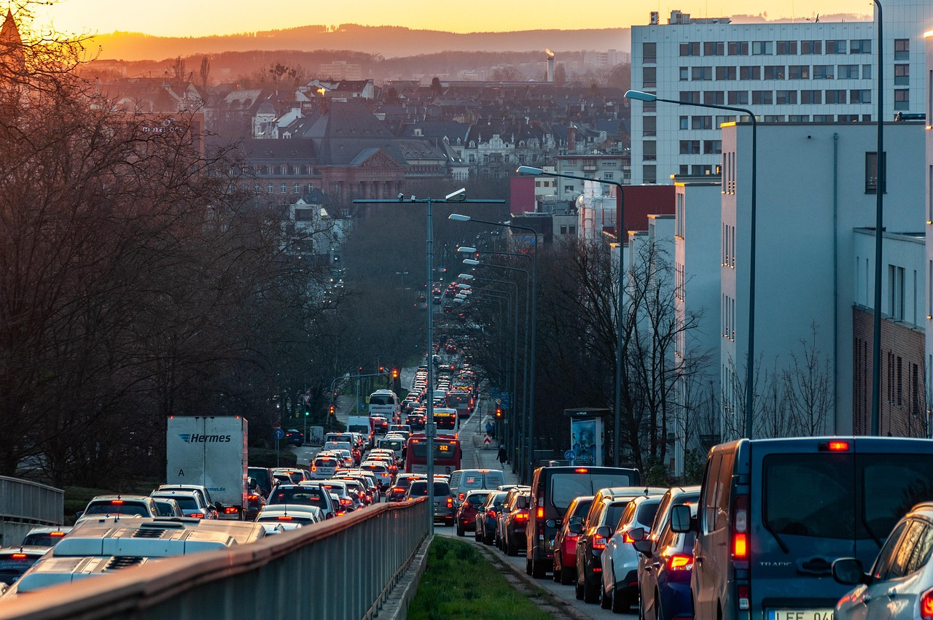
Traffic Jams
Time lost in traffic
  In large global cities, the average commuter loses ~100–200 hours/year to congestion
Economic costs
  Direct costs: are borne by motorists
    Opportunity costs of time wasted in traffic jams
    Costs of additional fuel consumption
  Indirect costs: are borne by society as a whole
    emissions
    Higher prices for goods and services
Pixabay

Slide 20
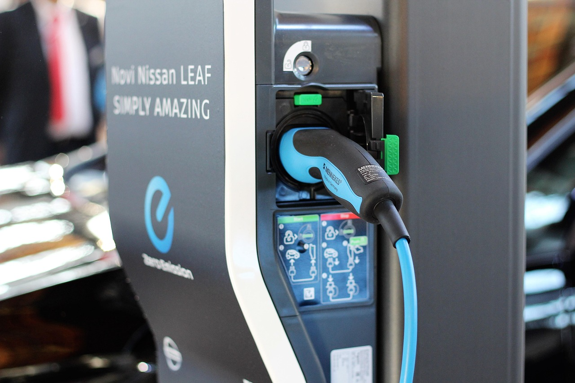
Development: Electric Vehicles
Global electric car stock surpassed ~16 million in 2024, doubling in two years
EV sales share in total new car sales: ~15% globally, ~30–40% in leading markets (Europe, China)
Global charger count rising rapidly: ~2 million public chargers worldwide (2025 estimate)
Pixabay

Slide 21
Sources
IEA 2024: Outlook for Electric mobility. https://www.iea.org/reports/global-ev-outlook-2024/outlook-for-electric-mobility (15.02.26).
MiD 2017: Ergebnisbericht. https://www.mobilitaet-in-deutschland.de/archive/pdf/MiD2017_Ergebnisbericht.pdf (03.02.26).
RAC Foundation 2021: Cars parked 23 hours a day. https://www.racfoundation.org/media-centre/cars-parked-23-hours-a-day (15.02.26).
WHO 2023: Global Status Report on Road Safety. https://iris.who.int/server/api/core/bitstreams/46275f9f-ef66-4892-8ddd-a496ef8c1b74/content (15.02.26).

Slide 22
Sources: Pictures
https://pixabay.com/de/photos/autobahn-stadt-autos-der-verkehr-7213206/
https://pixabay.com/de/photos/autos-geb%c3%a4ude-stadt-stra%c3%9fe-wagen-3819225/
https://pixabay.com/de/photos/der-verkehr-stra%c3%9fe-autos-stau-7060425/
https://pixabay.com/de/photos/ladestation-nissan-leaf-ladestation-3325418/

Slide 23
Thank you for your attention!

