Slide 1
Railway Transport
Fundamentals of Transport

Slide 2
Road Transportation Systems Engineering Development in the Sub-Saharan Africa – Modern EU Master Programme & Capacity Building

Slide 4
Learning Objectives
Students can:
explain key railway terminology and system components
distinguish passenger and freight railway transport
evaluate railway transport using key performance criteria
understand environmental and spatial impacts of railway transpprt
identify current challenges and policy priorities

Slide 5
Overview
Basic Terms and Definitions
Rail Passenger and Freight Transport
The Railroad System
Quality Criteria
Challenges and Environmental Impact

Slide 6
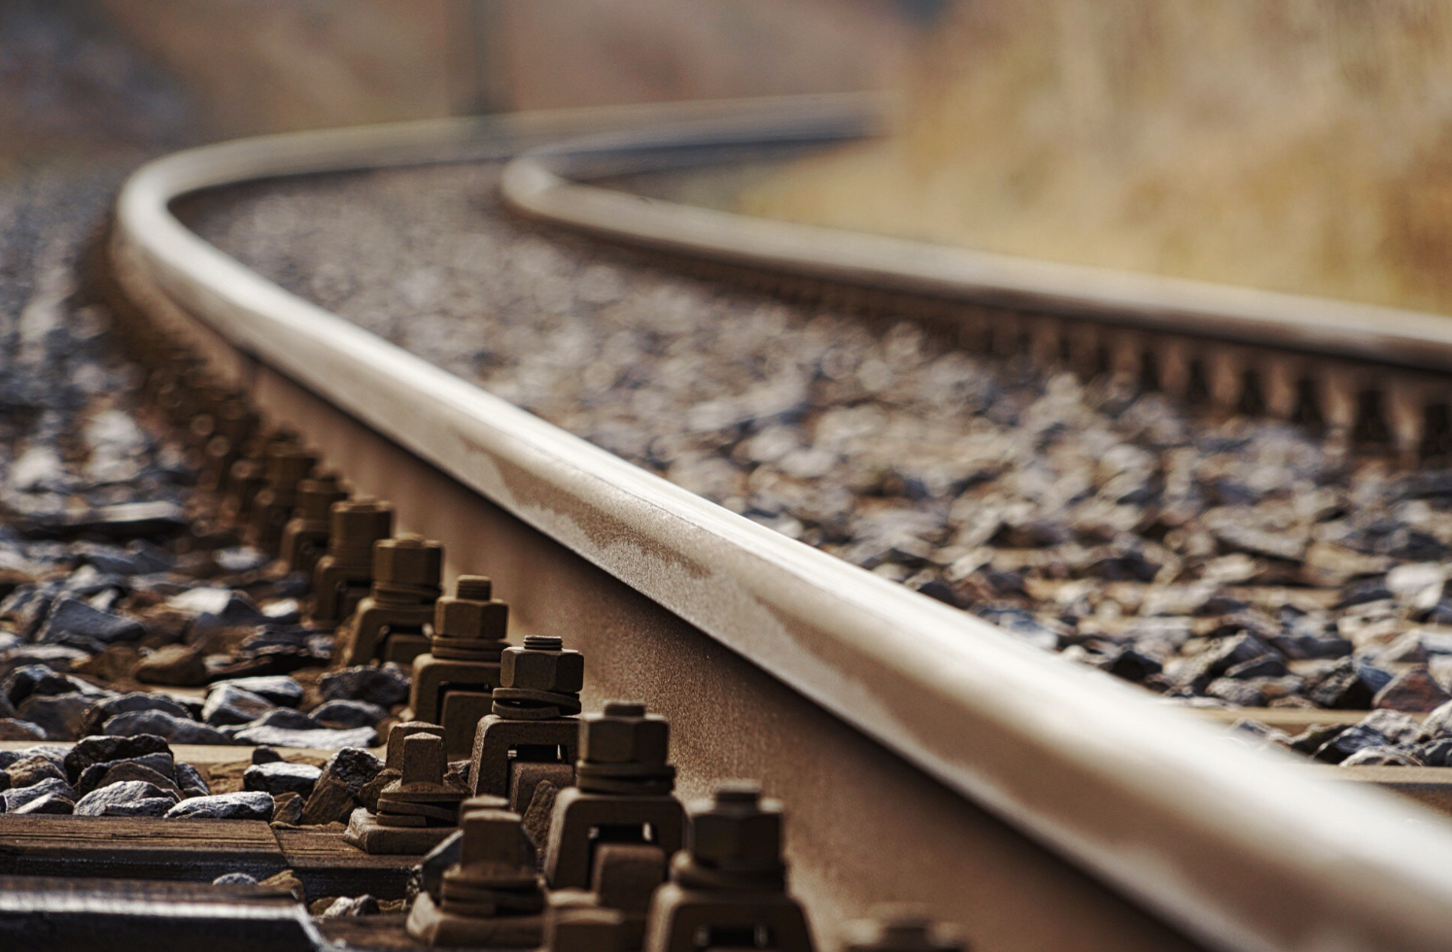
What is rail transport?
Definition: A guided mode of transport, movement of passengers or goods using wheeled vehicles running on tracks (rails)
Typically operates on fixed infrastructure with scheduled services
Key characteristic: low rolling resistance → high energy efficiency
Fig. 1: Freepik

Slide 7
Key Railway Terminology
Railway / railroad: complete system (infrastructure + operations)
Rolling stock: All vehicles that move on a railway (locomotives, wagons, coaches)
Track gauge: The distance between the inner sides of the rails (e.g., Standard Gauge 1435mm, Narrow Gauge, Broad Gauge)
Train: connected series of rail vehicles/rolling stock
Network: interconnected rail lines
Interoperability: The ability of different rail systems to operate across different networks

Slide 8
Overview
Basic Terms and Definitions
Rail Passenger and Freight Transport
The Railroad System
Quality Criteria
Challenges and Environmental Impact

Slide 9
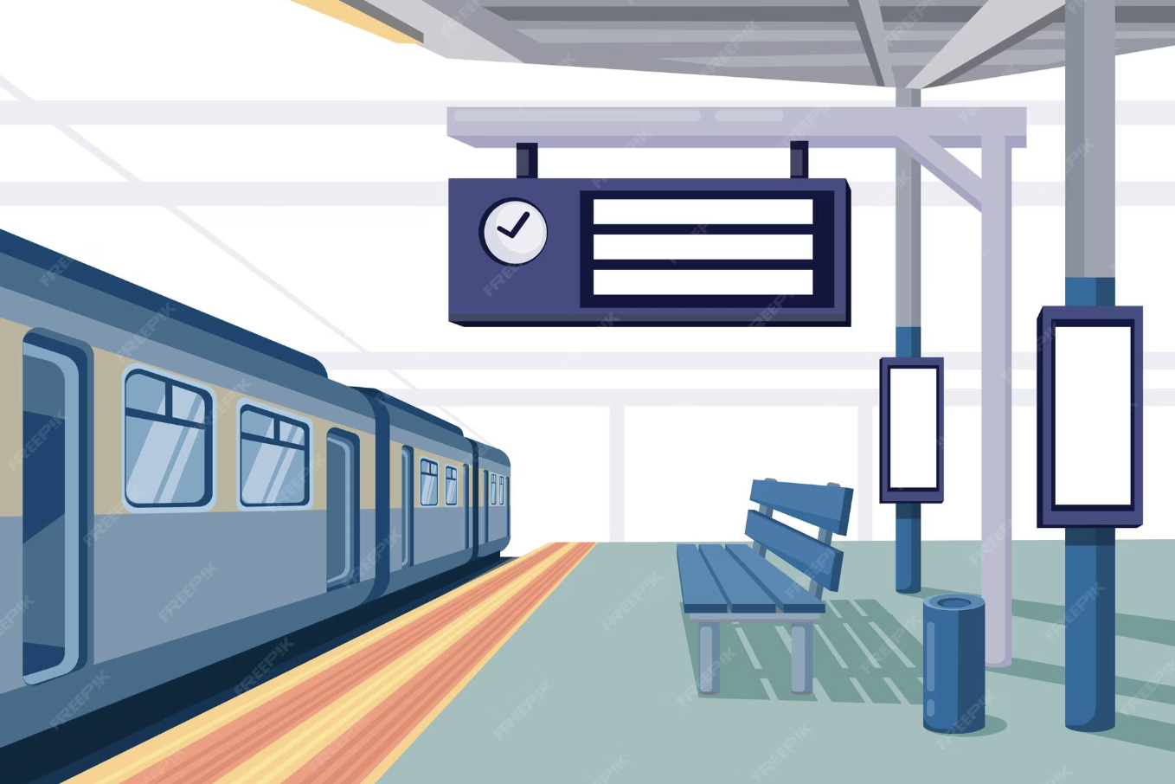
Passenger Rail Transport
Urban rail (metro, tram/light rail)
Regional rail/Commuter
Inter-City
High-speed rail (HSR)
Key priorities:
  travel time
  frequency
  comfort
Fig. 2: Freepik

Slide 10
Freight Rail Transport
Bulk goods (coal, minerals, grain)
Container transport (intermodal logistics)
Long-distance heavy haul transport
Key advantages:
  high capacity per ‘slot’ compared to road transport
  low cost per tonne-km
  energy efficiency

Slide 11
Comparison: Passenger vs. Freight Rail Transport
Aspect | Passenger | Freight
Priority | speed, safety & comfort | cost & reliability
Scheduling | fixed timetable | flexible/logistics-driven
Demand | daily mobility | supply chain

Slide 12
Overview
Basic Terms and Definitions
Rail Passenger and Freight Transport
The Railroad System
Quality Criteria
Challenges and Environmental Impact

Slide 13
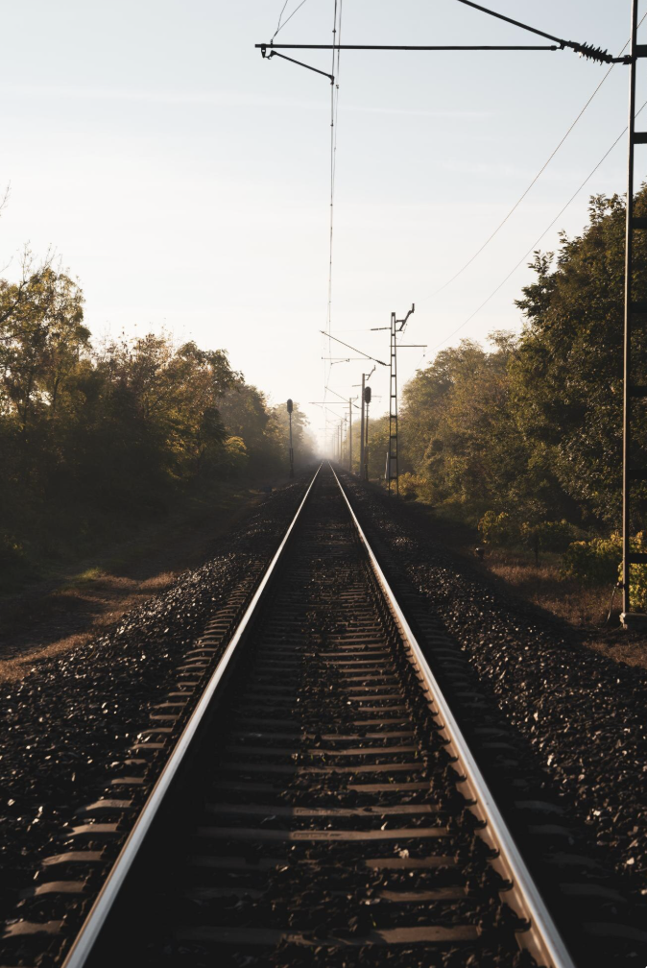
Elements of a Railway System
Infrastructure (tracks, stations, signals)
Rolling stock
Operations & control
Energy supply (Drive systems)
Institutions & regulation
Fig. 3: Freepik

Slide 14
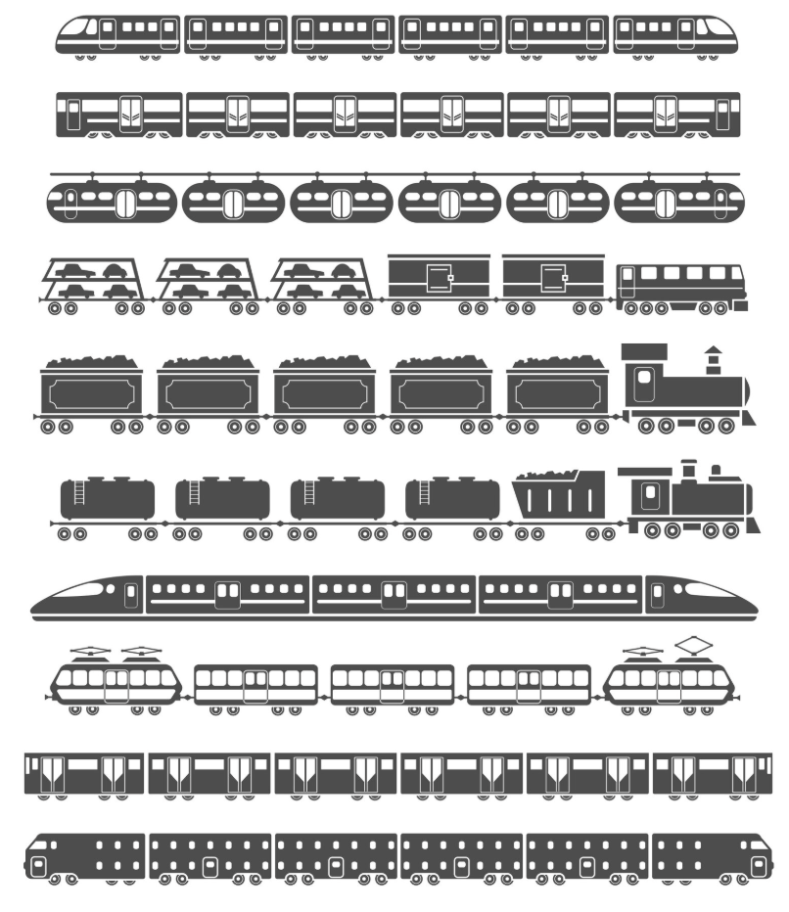
Rail Vehicles (Rolling Stocks)
Locomotives: Power units (Diesel, Electric, or Hybrid)
Multiple Units (MUs): Integrated trains where motors are located under the floors of passenger cars
Freight Wagons: Specialized types (flatbeds for containers, hoppers for bulk, tankers for liquids)
Fig. 4: Freepik

Slide 15
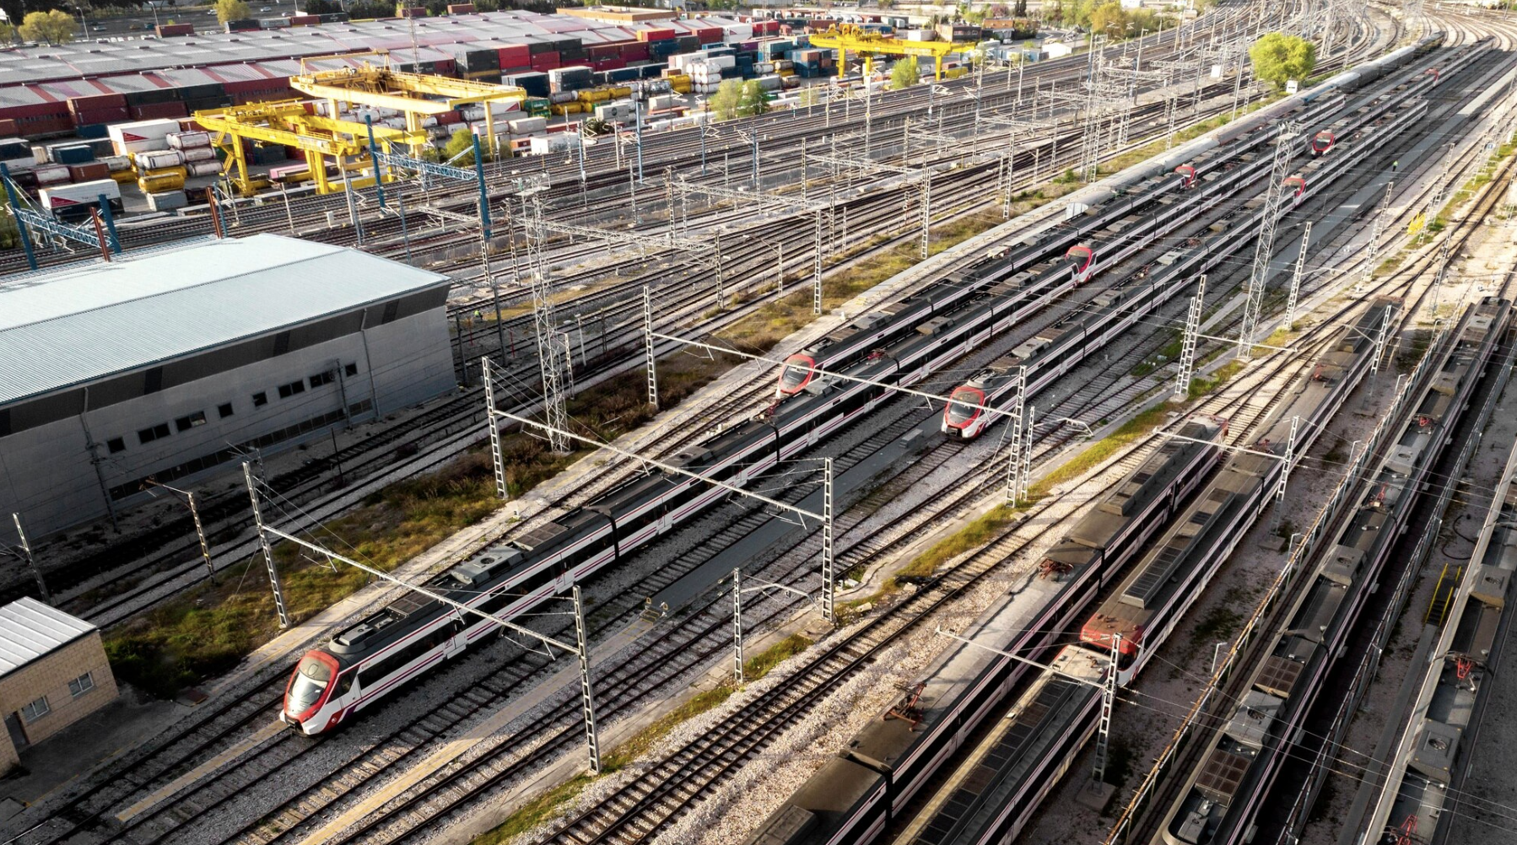
Rail Infrastructure
Tracks, switches, signalling systems
Stations & terminals
Maintenance facilities
Fig. 5: Freepik

Slide 16

Railway Operations
Timetable planning
Traffic control systems
Safety systems (e.g. signalling)
Fig. 6: Pixabay

Slide 17
Drive Systems/Energy Supply
Diesel traction
  flexible, no electrification required
  higher emissions
Electric traction
  Drawing power from an external grid
  most efficient
  low emissions (depending on electricity mix)
Hybrid
Hydrogen/Hydrail
  Fuel cells for non-electrified lines
Battery Electric (BEMU):
  For short gaps in electrification

Slide 18
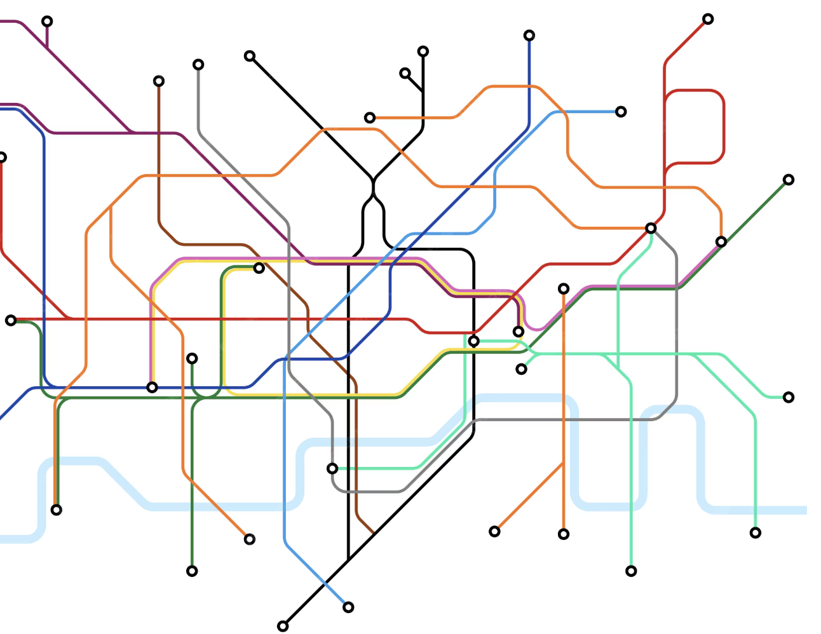
Network Characteristics
Fixed routes → high reliability
Requires high demand density
Strong dependency on infrastructure quality and regular maintenance
Fig. 7: Freepik

Slide 19
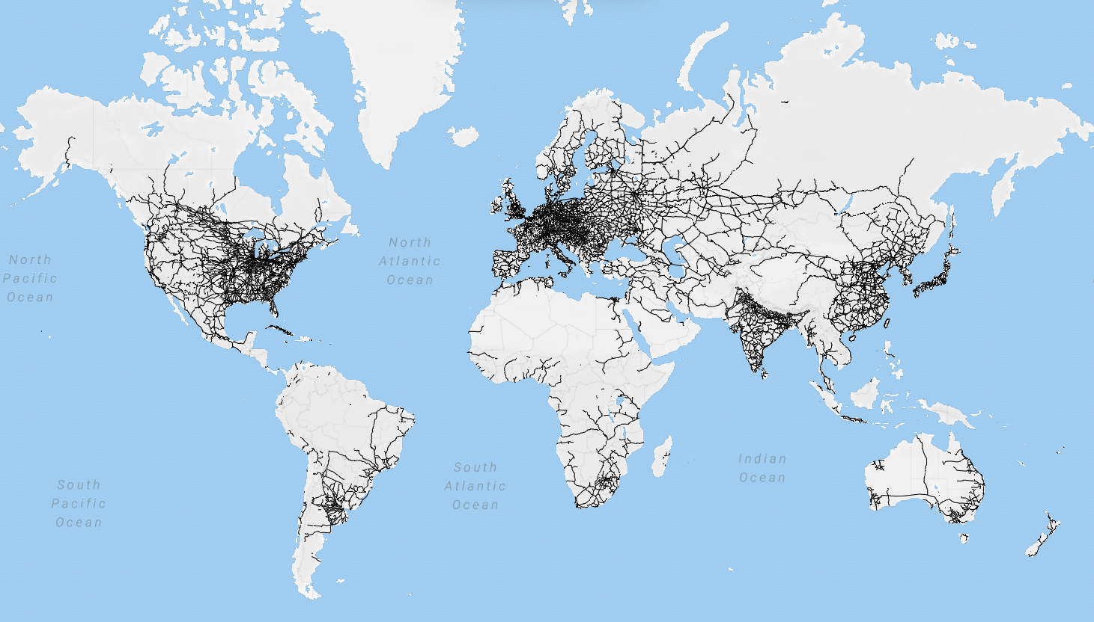
Global Rail Networks
Dense networks in Europe, China, Japan
Expansion of high-speed rail in Asia
Limited coverage in parts of Africa
Fig. 8: Wikipedia

Slide 20
Overview
Basic Terms and Definitions
Rail Passenger and Freight Transport
The Railroad System
Quality Criteria
Challenges and Environmental Impact

Slide 21
Key Quality Indicators
Speed: Commercial speed, travel time
Reliability: Punctuality, frequency
Capacity: Passengers/hour, tonnes/year
Cost efficiency
Safety: Statistically the safest land transport mode
Comfort: Ride quality (vibration/noise) and on-board services
Intermodality: Ease of switching from rail to other modes of transport

Slide 22
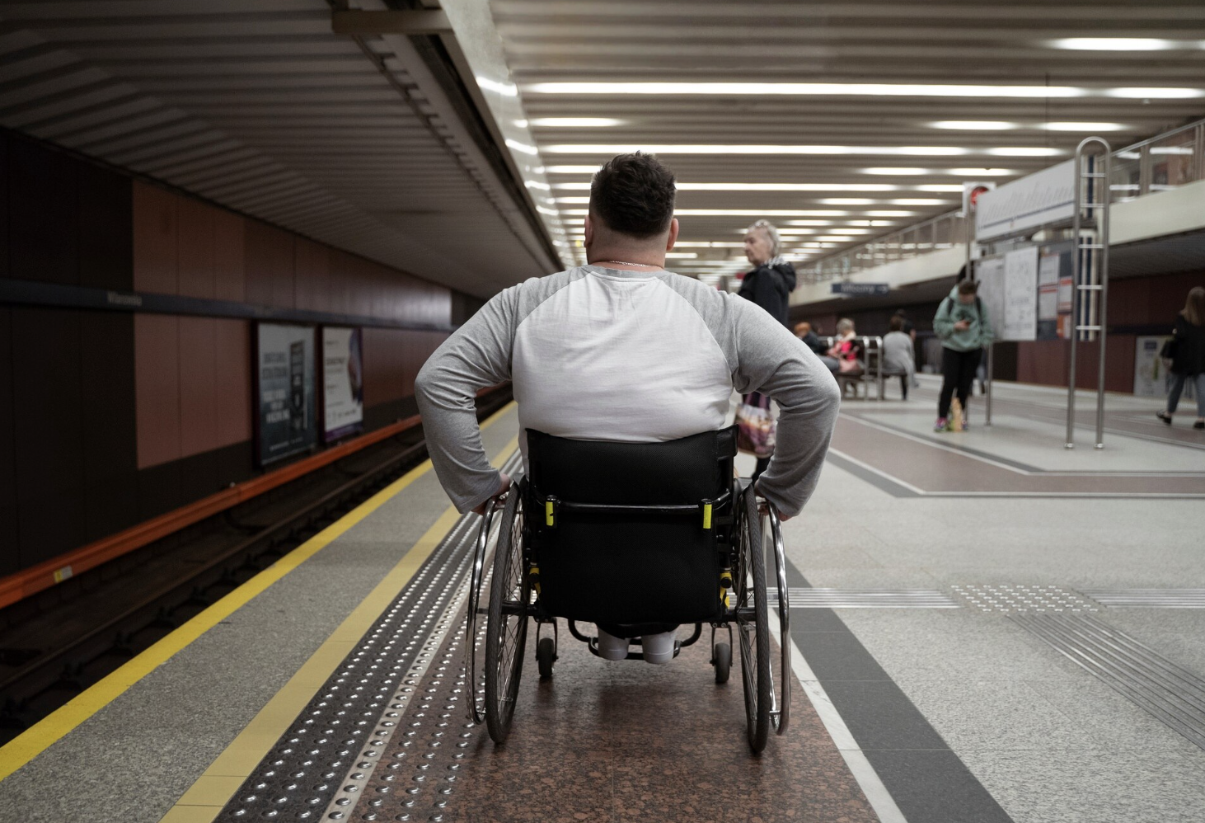
Accessibility
Station coverage, especially in rural areas
Integration with other modes
Barrier-free access
Affordability
Fig. 9: Freepik

Slide 23
Overview
Basic Terms and Definitions
Rail Passenger and Freight Transport
The Railroad System
Quality Criteria
Challenges and Environmental Impact

Slide 24
Environmental Impact
Greenhouse Gas Emissions
  Rail accounts for ~2% of global transport energy demand but carries ~8% of passengers and freight
  Significantly lower CO₂ emissions per passenger-km than cars or aviation, especially if electrified
  High energy efficiency
Land Consumption
  Rail uses less land per transported unit than road transport
  Fixed infrastructure → efficient corridor use
  But high initial land take for new lines
Noise pollution
  A primary challenge for residential areas near tracks

Slide 25
Policy Goals
Decarbonisation of transport
Modal shift: Moving traffic from road to rail
Infrastructure investments
Digitalisation (smart rail systems)
Cross-border integration: e.g. African Continental Free Trade Area (AfCFTA) support, project Integrated High Speed Train Network of the AU
Liberalization: Allowing private operators on state-owned tracks.

Slide 26
Key Challenges
High infrastructure costs
Limited flexibility
Maintenance requirements, maintenance backlog in many regions
Competition with road and air transport
Interoperability issues (different gauges across borders)

Slide 28
Sources - Pictures
Fig. 1: https://www.freepik.com/free-photo/railway-closeup_12647279.htm#fromView=search&page=1&position=0&uuid=f7a2e3b8-8e08-4565-a489-f1c09a422929&query=railway
Fig. 2: https://www.freepik.com/premium-vector/train-station-with-billboard-banner-light-box-scene-illustration-template-editable-vector_35591820.htm#fromView=search&page=1&position=0&uuid=780524ad-e9e0-4319-a655-e5920217213f&query=train+station
Fig. 3: https://www.freepik.com/free-photo/vertical-shot-railway-surrounded-by-trees-transmission-towers_30222185.htm#fromView=search&page=1&position=0&uuid=0f6fedf9-8cd7-479f-9c69-27853cb599ca&query=railway
Fig. 4: https://www.freepik.com/free-vector/train-black-silhouettes-set_4425884.htm#fromView=search&page=1&position=0&uuid=fc054d94-97d2-4a76-9304-9e7896529741&query=train
Fig. 5: https://www.freepik.com/free-photo/trains-railways-transport-concept_13951947.htm#fromView=search&page=1&position=2&uuid=56c2a63c-b5fa-455c-90cd-be2188785f7a&query=railway+operation
Fig. 6: https://pixabay.com/de/photos/zug-stellwerk-eisenbahn-4083883/
Fig. 7: https://www.freepik.com/premium-vector/london-underground-map-subway-public-transportation-scheme_6625283.htm#fromView=search&page=1&position=15&uuid=8f1d0209-48d8-48d6-8717-5d8fa5e189a7&query=train+network
Fig. 8: https://de.wikipedia.org/wiki/Datei:World_railway_network.png
Fig. 9: https://www.freepik.com/free-photo/full-shot-man-traveling-wheelchair_27644689.htm

Slide 29
Sources – Literature (Further Reading)
African Development Bank Group n.y.: Transport. https://www.afdb.org/en/topics-and-sectors/sectors/transport (10.04.26).
AU 2026: Integrated High Speed Train Network. https://au.int/en/flagships/integrated-high-speed-train-network (10.04.26).
European Commission n.y.: Rail Safety. https://transport.ec.europa.eu/transport-modes/rail/interoperability-safety/rail-safety_en (10.04.26).
European Environment Agency 2021: Rail and waterborne – best for low-carbon motorised transport. https://www.eea.europa.eu/en/analysis/publications/rail-and-waterborne-best-for-low-carbon-motorised-transport (10.04.26).
International Energy Agency 2019: The Future of Rail. https://www.iea.org/reports/the-future-of-rail (10.04.26).
International Union of Railways n.y.: https://uic.org/ (10.04.26).
Network Rail n.y.: Looking after the railway. https://www.networkrail.co.uk/our-work/looking-after-the-railway/ (10.04.26).
The Railway Technical Website n.y.: Rolling Stock Index. http://www.railway-technical.com/trains/rolling-stock-index-l/ (10.04.26).
World Bank Group n.y.: Railways. https://www.worldbank.org/en/topic/transport/brief/railways (10.04.26).

