Slide 1
Comportements de mobilité
Fondements du transport

Slide 2
Road Transportation Systems Engineering Development in the Sub-Saharan Africa – Modern EU Master Programme & Capacity Building

Slide 4
Introduction
Repetition : Définition Mobilité
Mobilité
Mobilité as an opportunity to change location "Mobilité in the broadest sense expresses both the desire for mobilité and the degree of mobilité of personnes, marchandises and messages. The demande for transport services results from the mobilité wishes." (Kummer 2010 : 41)
Trafic
Trafic as a realized change of location "The term transport covers all activités that together form the processus of moving personnes, marchandises and messages. This includes soutenir processus such as storage and handling processus, insofar as they are part of the movement processus." (Kummer 2010 : 33)
→ Trafic as a consequence of mobilité

Slide 5
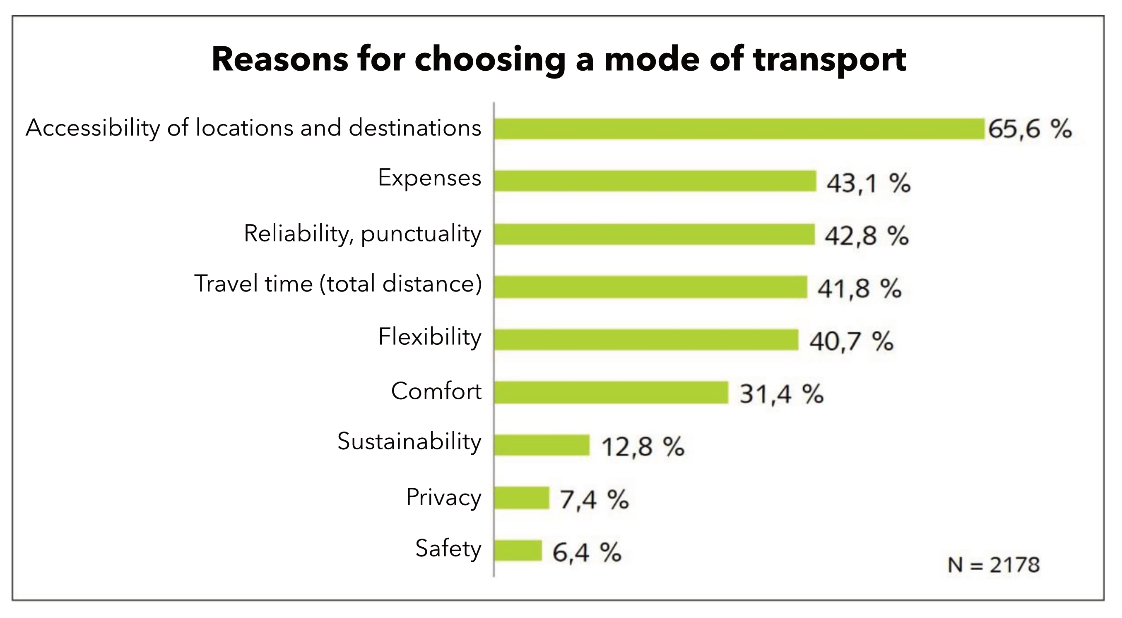
Reasons for choosing a mode of transport
VCD 2014: 19

Slide 6
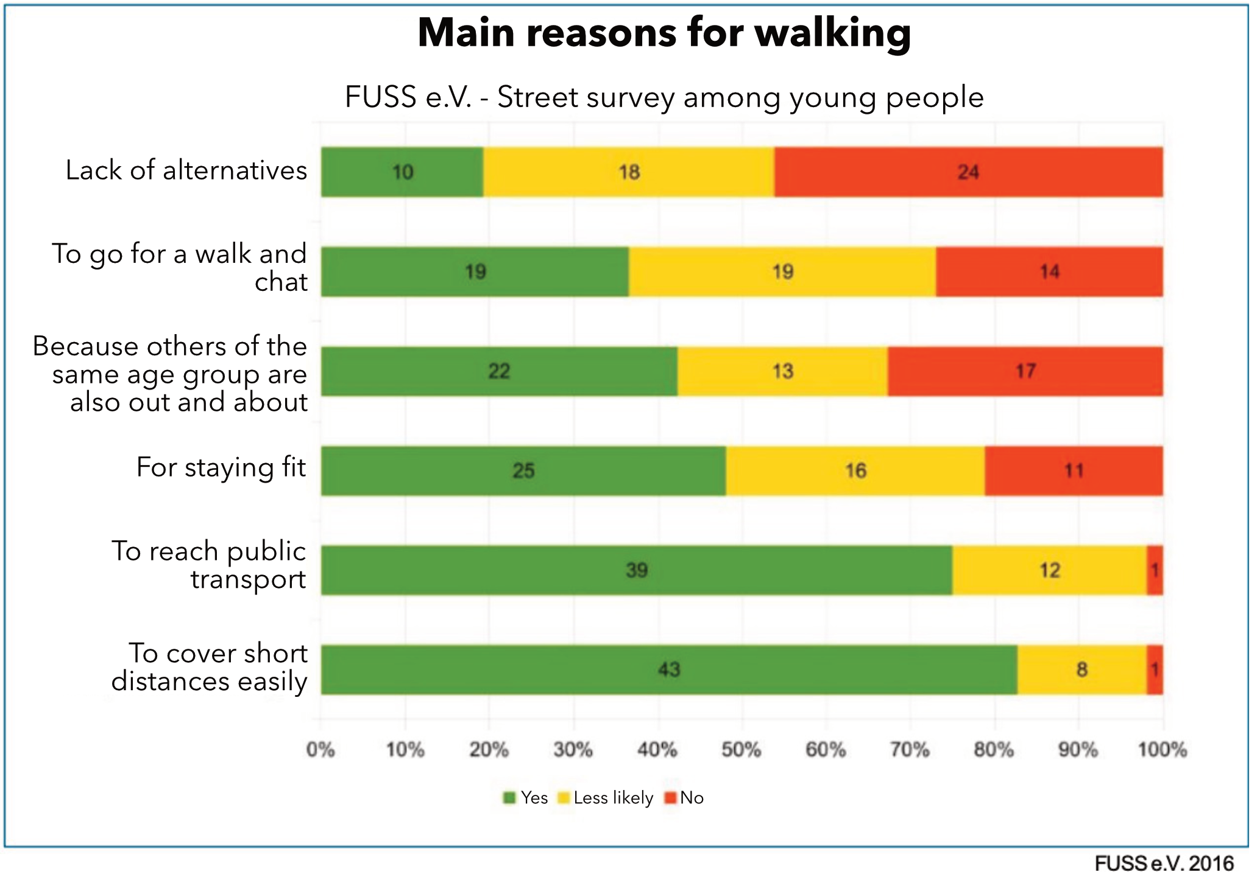
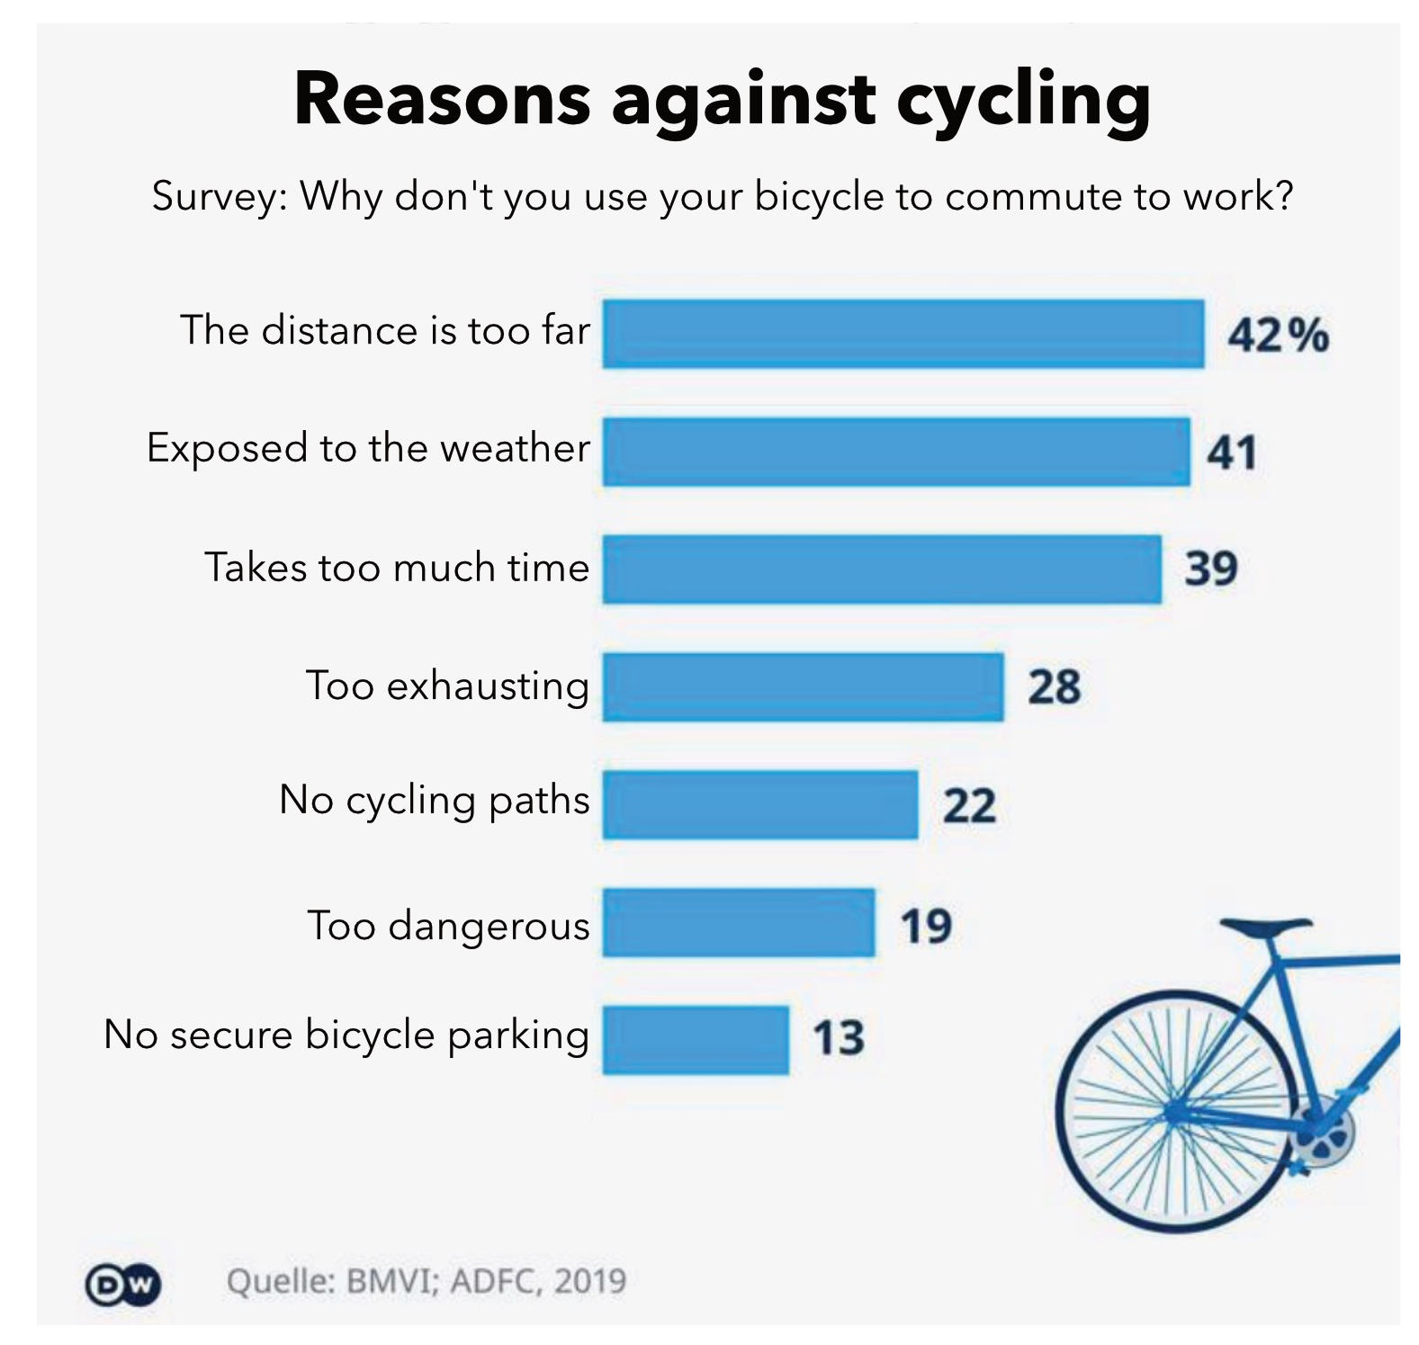
Reasons for choosing a mode of transport

Slide 7
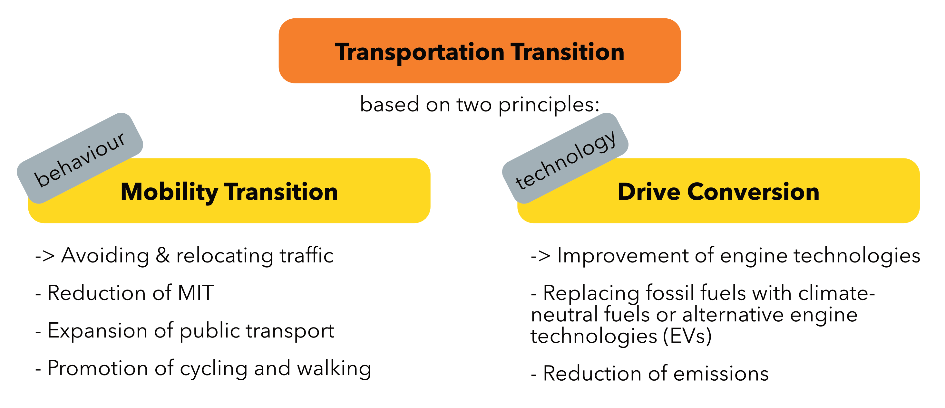
Pourquoi do we want to expliquer mobilité comportement ?

Slide 8
Pourquoi do we want to expliquer mobilité comportement ?
In order to have a targeted influence on people's mobilité comportement, it is first necessary to comprendre mobilité comportement and the reasons behind it.

Slide 9
THÉORIES DE L’ACTION

Slide 10
Pourquoi avons-nous besoin de théories ?
The complexity of social reality cannot be grasped as a whole
Théories and models structure and abstract these and open up an analytical approche
"The aim is a thematically limité approximation of complex reality. In line with scientific interest, the aim is to make reality tangible" (Wilde 2014 : 44)

Slide 11
The object of a théorie of action
"'Acting' should mean human comportement (whether external or internal action, omission or acquiescence) if and insofar as the person or persons acting associate a subjectif meaning with it". (Weber 2015 : 5)
Action as a "special cas" of comportement :
  Comportement becomes action quand something is done with an intention/intentionally. → Action is the result of a conscious decision.
  Non-action - the omission of an action as a result of a conscious selection - is also action

Slide 12
L’approche du choix rationnel
Collective term for a variety of théories with common basic assumptions
Core assumptions of action théorie
Assumption of Preference
  Actors know their objectifs
  Their actions serve to realize these objectifs
Assumption of Restriction
  Opportunités and restrictions influence actions.
Assumption of Maximization
  Actors choose the alternative course of action that - under the given restrictions - best suits the realization of the preferences.
The actors' actions are preceded by a decision-making processus in which they make “rationnel” use of available information.

Slide 13
L’approche du choix rationnel
Human beings as homo oeconomicus ?
Homo oeconomicus as a classic rationnel choix théorie of economics
The homo oeconomicus is characterized by
  The pursuit of utility maximization of material
  "Objectively rationnel" decisions
  Being fully informed
Suitable due to its ideal-typical features to expliquer elementary économique relationships.
But : Transferability to other fields/questions is not possible in a target-oriented way.

Slide 14
L’approche du choix rationnel
Broad versions of the rationnel choix approche :
Subjectif rationality as a base for decision-making
Relevance of all types of preferences : Utility maximization not only in material terms
Relevance of all types of restrictions
Not fully informed
Action results from the subjectif preferences of an individual and the subjectively perçu restrictions

Slide 15
L’approche du choix rationnel
Broad versions of the rationnel choix approche :
Subjectif rationality as a base for decision-making
Relevance of all types of preferences : Utility maximization not only in material terms
Relevance of all types of restrictions
Not fully informed
Action results from the subjectif preferences of an individual and the subjectively perçu restrictions
Quoi can this look like in reality ?

Slide 16
La théorie du comportement planifié
Developed in the 1980s by US social psychologist Icek Ajzen
Social-psychological variant of general rationnel choix approche
Dominant in social science research on the choix of moyens of transport

Slide 17
La théorie du comportement planifié
Basic assumptions
Comportement as the result of individual decisions
In the decision-making processus
  Do individuals (subjectively) make rationnel use of available information
  Are the pros and cons weighed against each other in the sense of a cost-benefit analysis
  If an intention is formed that is ultimately decisive for the comportement
Coût and benefit facteurs
  Not merely objectifiable variables (in terms of temps and money (≠homo oeconomicus))
  The focus is on individual-internal evaluation processus and influencing facteurs such as norms, attitudes and contrôle beliefs
Environnemental characteristics not as person-independent, but as subjectively perçu characteristics

Slide 18
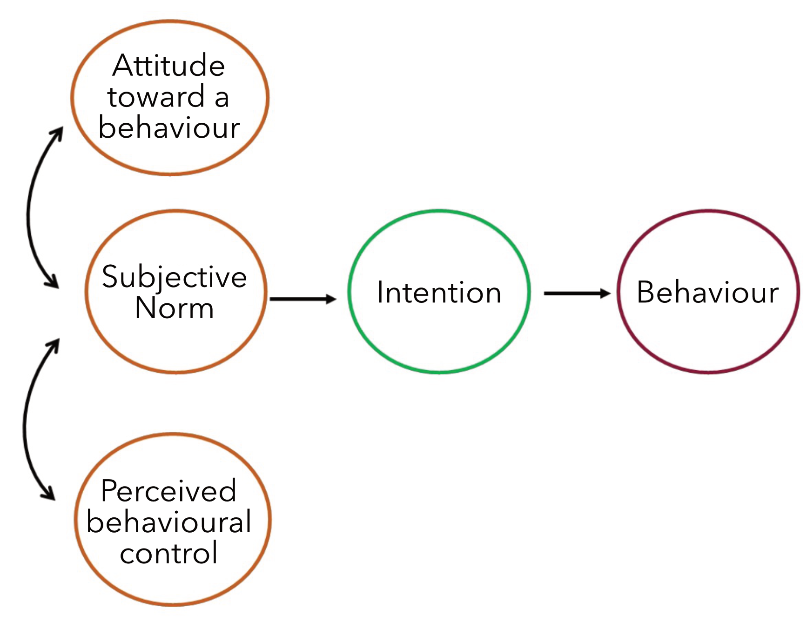
La théorie du comportement planifié
Intention :
• Indicator of comment strongly an individual is willing to engage in a comportement
• Formed on the base of trois determinants : attitude toward a comportement, subjectif norme, perçu behavioural contrôle

Slide 19
La théorie du comportement planifié
Attitude envers un comportement
Subjectif assessment of the consequences of the comportement
Norme subjectif
Subjectively perçu social pressure to (not) perform a comportement/ anticipated social sanctions
Contrôle comportemental perçu
Subjectif assumption of comment easy/difficult it is to perform a comportement or whether it can be successful

Slide 20
La théorie du comportement planifié
The following generally applies :
• The more positive/bigger
› the attitude toward a comportement
› the subjectif norme
› the perçu behavioural contrôle
the stronger the intention to perform the comportement.
• The stronger the intention, the more likely the comportement will be performed.

Slide 21
La théorie du comportement planifié
Exemple : Choix of transportation : Commuting to work by vélo
Attitude toward comportement
• Cost-effective
• Exercise in the fresh air and enjoyment of vélo
• Time-consuming
Norme subjectif
• Recognition of my durable mobilité comportement and fitness
Perçu behavioural contrôle
• Own a functional vélo
• Know the route
→ Forming an intention to use the vélo

Slide 22
La théorie du comportement planifié
Comment can this help us ?
After all, explaining the mobilité comportement of individuals can hardly make a significant contribution to the mobilité transition !
Our interest lies not in individual mobilité comportement.
Rather, we are interested in comment specific - socially relevant - groupes make their mobilité decisions
To achieve this, we need to comprendre mobilité as a social phenomenon !

Slide 23
MOBILITÉ AS A SOCIAL PHENOMENON

Slide 24
Analysis of collective contexts
Mobilité does not happen a "vacuum" : personnes shape their mobilité comportement within social structures and as socialized beings out of them
Théories and models also enable the formation of systematic, group-specific hypotheses and the investigation of collective relationships
Groupes that are classically considered in sociology are based on concepts of social inequality such as classes, strata or milieus, or refer to socio-structural characteristics such as age, genre or employment status

Slide 25
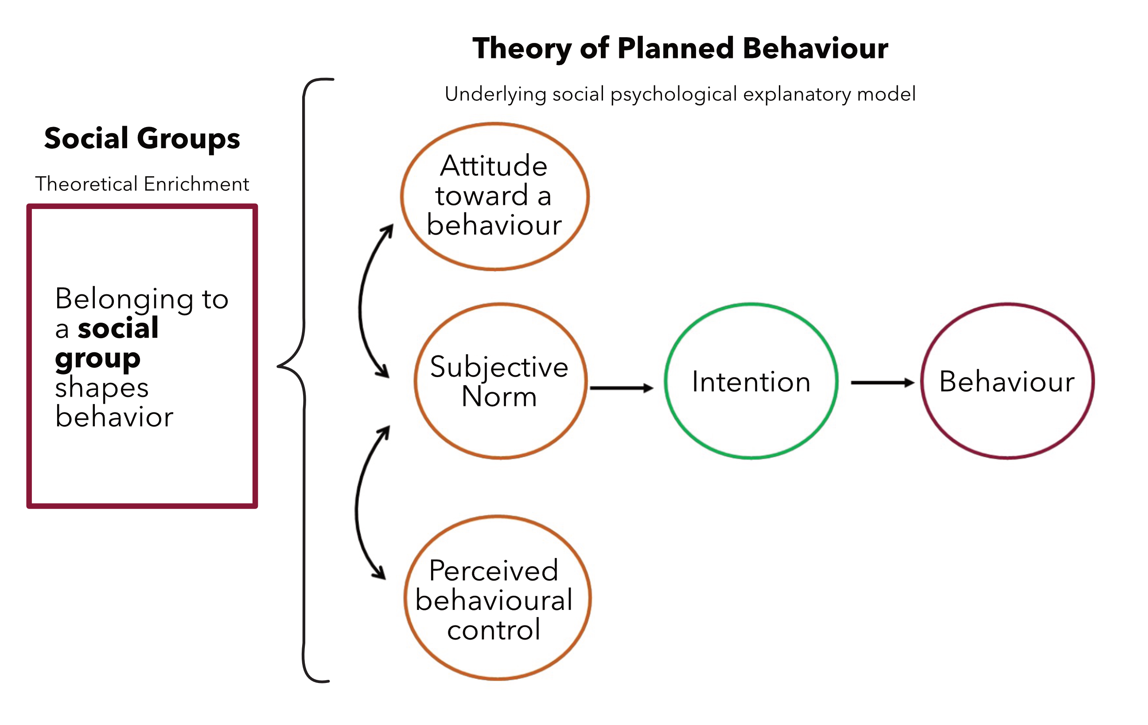
Intégration into the théorie of planned comportement
Thesis :
Personnes in a social group are similar in terms of specific characteristics.
→ They therefore form similar intentions in the théorie of planned comportement...
→ ...and exhibit similar comportement.
cf. Kopp et al. 2022

Slide 26
Intégration into the théorie of planned comportement
Thesis :
Personnes in a social group are similar in terms of specific characteristics.
→ They therefore form similar intentions in the théorie of planned comportement...
→ ...and exhibit similar comportement.
cf. Kopp et al. 2022
The selection of the groupes considered should always be based on the research topic !
Not every “group affiliation” has an influence on mobilité comportement : e.g. (non-)single parents contre urbain/ rural residents.

Slide 27
La théorie du comportement planifié
Avantages :
Economy and simplicity of assumptions
Possibility of integrating a large number of (different) variables
Well suited as a theoretical base for quantitative empirical research and statistical evaluations
Inconvénients :
Is every (mobilité) decision based on such a complex weighing processus ?
  Quoi role do habits play ?
  Which facteurs are actually taken into account and comment relevant are they ?
Théories of individual utility maximization often consider mobilité to be a secondary need : neglect of intrinsic bénéfices
Neglect of cultural meanings and attributions

Slide 28
La théorie du comportement planifié
Avantages :
Economy and simplicity of assumptions
Possibility of integrating a large number of (different) variables
Well suited as a theoretical base for quantitative empirical research and statistical evaluations
Inconvénients :
Is every (mobilité) decision based on such a complex weighing processus ?
  Quoi role do habits play ?
  Which facteurs are actually taken into account and comment relevant are they ?
Théories of individual utility maximization often consider mobilité to be a secondary need : neglect of intrinsic bénéfices
Neglect of cultural meanings and attributions
→ Conclusion : A well-proven cadre that is well suited to a wide range of research interests — including mobilité research !
→ But : No théorie can expliquer everything !

Slide 29
Théorie pluralism
Depending on the research interest/subject of investigation, different théories that focus on different areas of social reality are suitable.
In this sense, théories can be seen as glasses that convey different perspectives to the wearer.

Slide 30
OUTLOOK :CULTURES OF MOBILITÉ

Slide 31
Shift in the analytical perspective
Action théories attempt to analyser mobilité based on the actors and their decisions. to comprendre
The concept of mobilité cultures adopts a different analytical perspective
  "Mobilité events as a socio-spatial unit", e.g. of villes, régions or countries (Götz et al. 2014 : 2)
  Mobilité culture as a "complex interdependency of infrastructural, structural, discursive, social, socio-cultural and cultural facteurs". and action-related facteurs" (Götz et al. 2014 : 2)
"The analysis of mobilité cultures attempts to identifier design options for politique and practice actors within this complexity." (Götz et al. 2014 : 10)
  There are different transformation pistes towards a durable mobilité culture for different mobilité cultures
It is not the individual and their actions that become the object of intervention here, but the structure as a espace of possibility for action. (Götz et al. 2014 )

Slide 32
Merci pour votre attention !

Slide 33
Sources/Further Reading
Götz et al. 2014 : Mobilité styles and mobilité cultures - explanatory potentials, reception and criticism
Aldred et Jungnickel 2014 : Pourquoi culture matters for transport politique : the cas of vélo in the UK

