Slide 1
Transport public
Fondements du transport

Slide 2
Road Transportation Systems Engineering Development in the Sub-Saharan Africa – Modern EU Master Programme & Capacity Building

Slide 4
Aperçu
Notions de base
Organisation
Planification
Communication et marketing

Slide 5
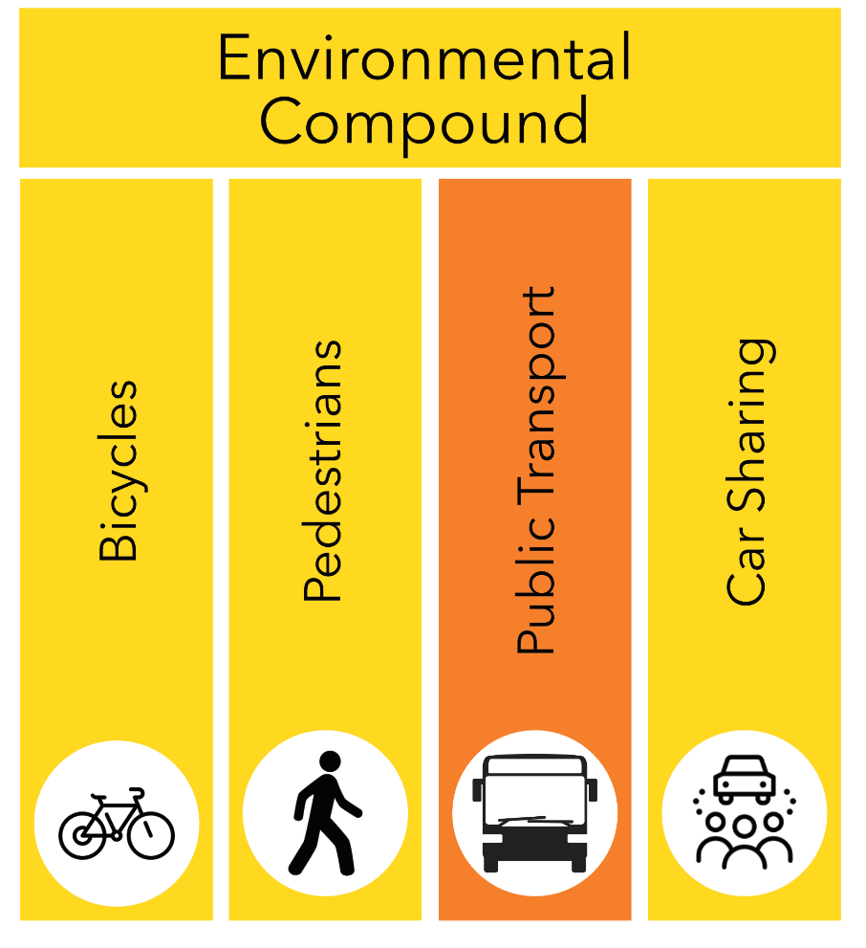
Définition
Transport public local
  Déplacement distance : up to 50km
  Déplacement temps : up to 1h
Differentiation :
  Public Local Route Transport de voyageurs
  Public Local Rail Transport de voyageurs
Public transport is part of the Environnemental Compound (Environmentally friendly transport)

Slide 6
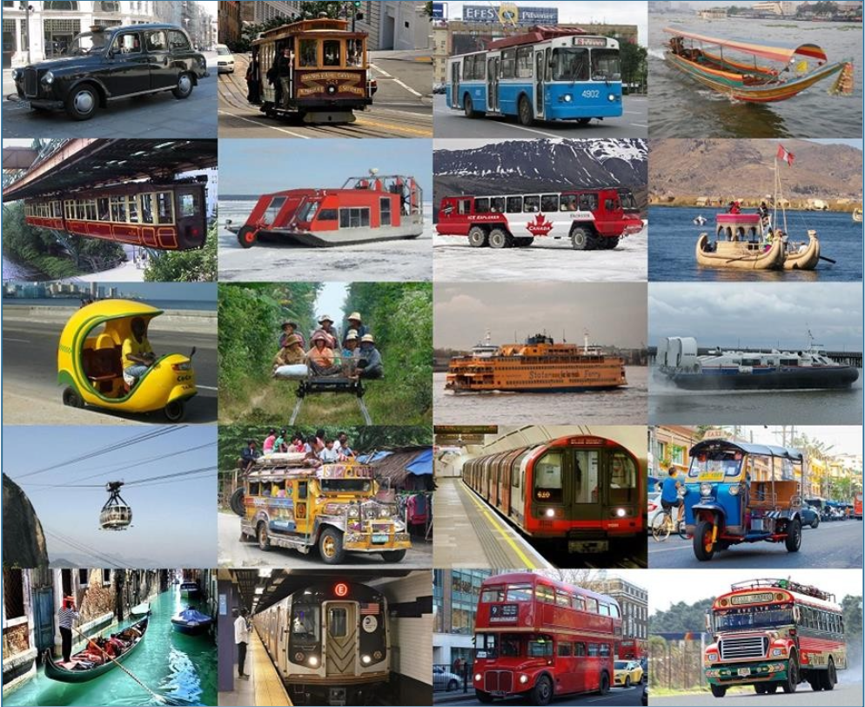
Moyens de transport public
Suburban trains, régional trains
Métros, tramways
Ville and régional busses
Cabs
Ferries
Ropeways, cable voitures
Generally accessible transport services :
  Autopartage
  Bike Partage
  Ride Partage

Slide 7
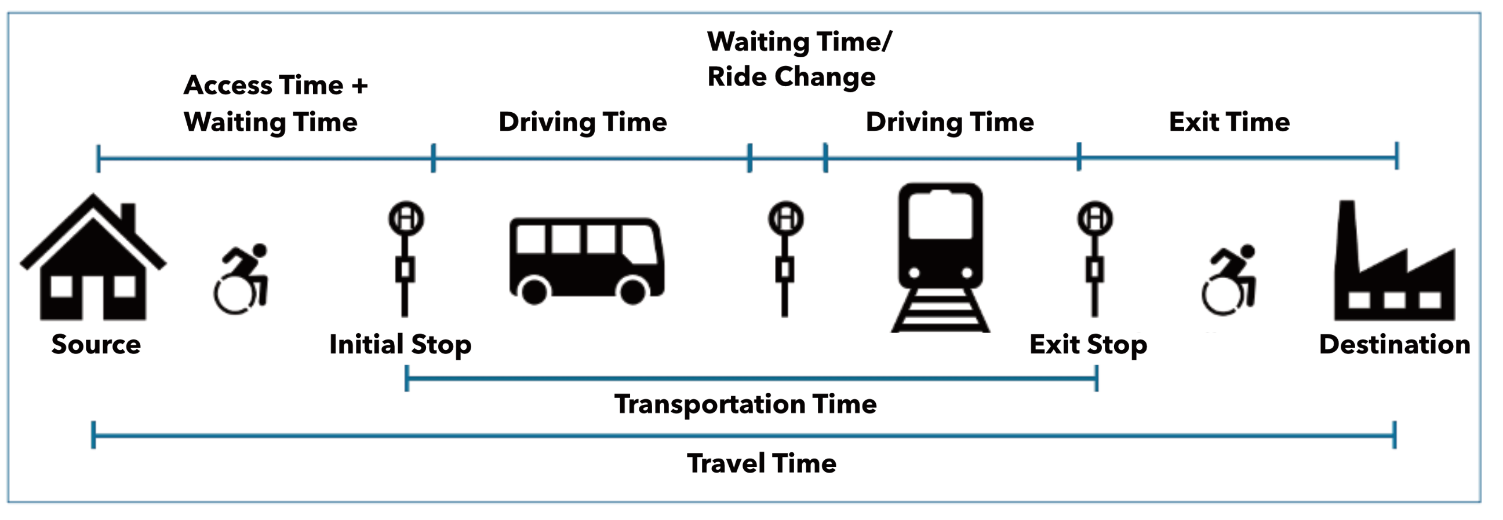
Concept central

Slide 8
Utilisation du transport public : répartition modale
On average, 26% of journeys in villes worldwide are made by public transport (Project Drawdown)
The modal répartition share varies hugely by région and ville
  Southeast Asian villes often have a lower public transport share due to the prevalence of motocyclettes
  Zürich (Switzerland) has one of the highest shares due to the ‚Zurich modèle‘ with different mesures for increasing the attractiveness of public transport

Slide 9
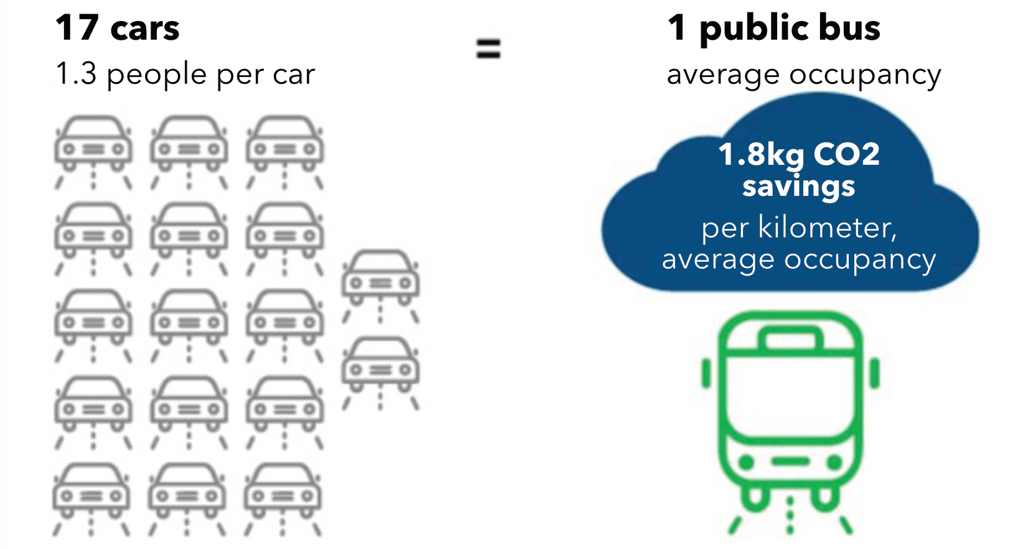
Utilisation du transport public : climat
Every kilometer travelled by public transport saves an average of 95 grams of effet de serre gaz and 19 grams of nitrogen oxides compared to a voiture journey

Slide 10
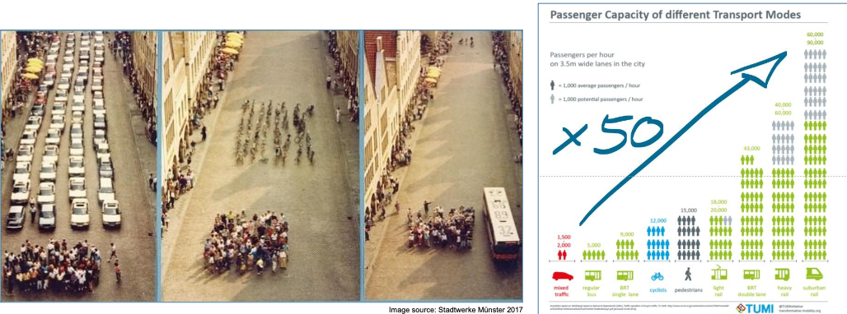
Utilisation du transport public : consommation d’espace

Slide 11
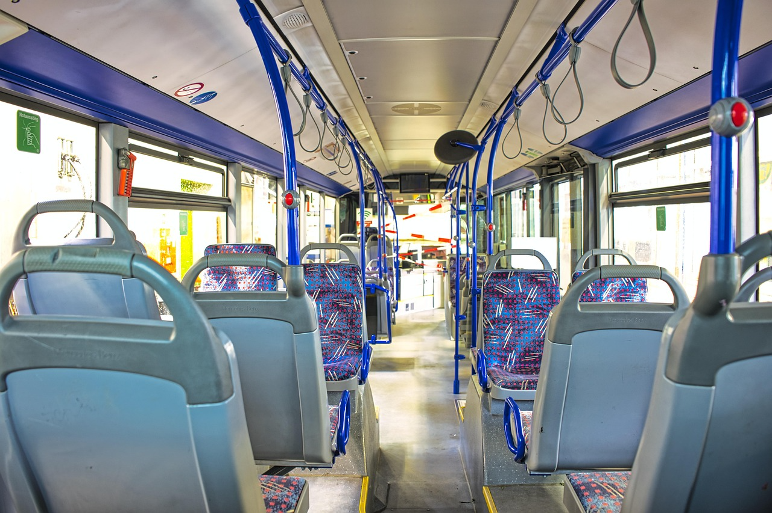
Popularité du transport public
Public transport utilisation is highest in dense metropolitan régions où formats like metro and tramway systèmes are efficient
Public transport is often popular among lower-income groupes, étudiants, and daily navetteurs due to accessibilité financière and temps predictability
Pixabay

Slide 12
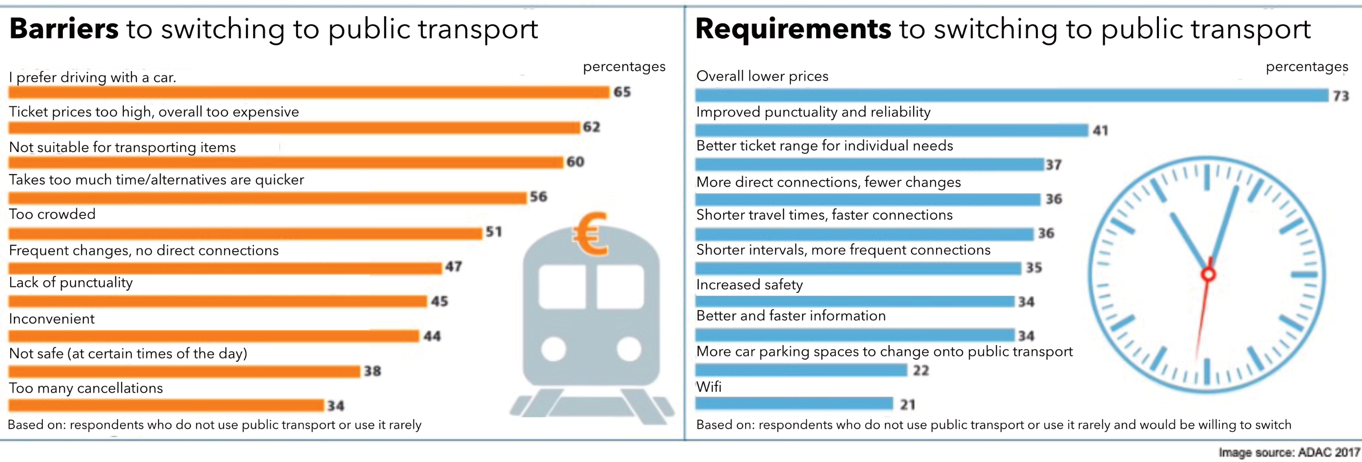
Popularité du transport public
huge German survey about Transport public from 2017

Slide 13
Groupes d’usagers
Central role of public transport in ensuring equal mobilité for all potential usager groupes, especially for those qui do not have accès to privé transport
Specific usager groupes of public transport are :
Navetteurs
Étudiants
Personnes âgées
Personnes with limité financial moyens
Femmes
Personnes with handicap

Slide 14
Aperçu
Notions de base
Organisation
Planification
Communication et marketing

Slide 15
Organisation : cadre juridique
EU
Principle of an open market economy with free competition
Liberalization of the public transport market with a common competitive cadre in accordance with Regulation (EC) No. 1370/2007 of the European Parliament and of the Council of 23 October 2007 on public voyageurs transport services by rail and by route
Germany
Public transport as part of public services of general interest
Transport public local laws of the federal states, each with their own regulations on the financement and promotion of local public transport
Approche of controlled competition

Slide 16
Organisation : modèle à trois niveaux
The three-level modèle as an organizational modèle for a competitively organized public transport système
1. Politique niveau
Développement of targets for public transport services and financement
Assumption of contrôle functions
2. Gestion niveau
Coordination of planification, tariff système, marketing, etc.
Tendering and awarding of transport services
3. Company niveau
Implementation of transport services by transport companies
Performing all activités necessary to meet the targets (marketing, sales, etc.)
Independent position as a commercial enterprise

Slide 17
Organisation : modèle à trois niveaux
Implementation of the orderer-creator principle
Clear separation of the political and entrepreneurial levels
Intended distribution of tasks
  Provision of infrastructure as a cross-sectional task of all trois levels
  Politique niveau with fundamental decision-making powers for the planification définition of service standards, tarif structure and route réseau
  Competencies for planification, organisation and financement of public transport as well as implementation of service standards and the route réseau at gestion niveau
Ensuring the consistency of the offering for customers

Slide 18
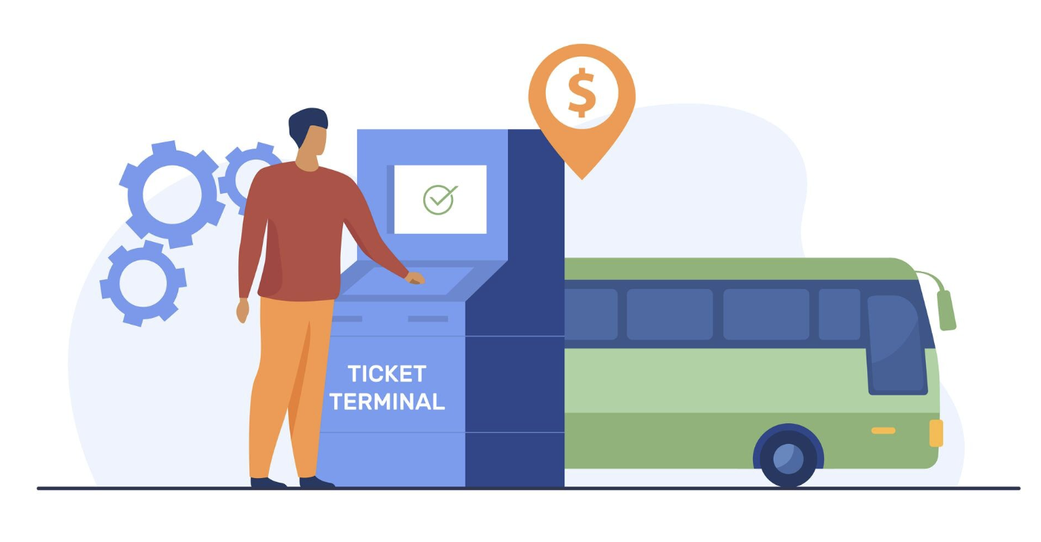
Financement : principes de base
Two pillars of financement
1. Revenue from billet sales = Financement by public transport usagers
2. Public secteur payments et subsidies (in Germany : EU, federal governments)
Freepik

Slide 19
Financement : tarification des billets
Kilometer rate
Price calculation according to distance traveled
Creating prices according to tariff kilometers moyens a lot of effort
Zone tarif
Several stops in one area are combined into one tarif point
Zone tariffs are more suitable for vending machines and enable clear display plans
Automated tarif
Can be distributed via on-board computers, billet machines or digital channels
Easily customizable
Good usability and billing capability of tariffs from different transport associations in one vending machine

Slide 20
Financement : tarification des billetsExemples de bonnes pratiques
Fixed price : 365€ annual billet in Vienna
Spatial : Free Tramway Zone Melbourne for journeys by streetcar
Temps : Free public transport in Aschaffenburg on Saturdays
For residents : Free public transport in Tallinn
For certain population groupes : Free déplacement for all pupils up to their 15th birthday during the Viennese school vacations

Slide 21
Aperçu
Notions de base
Organisation
Planification
Communication et marketing

Slide 22
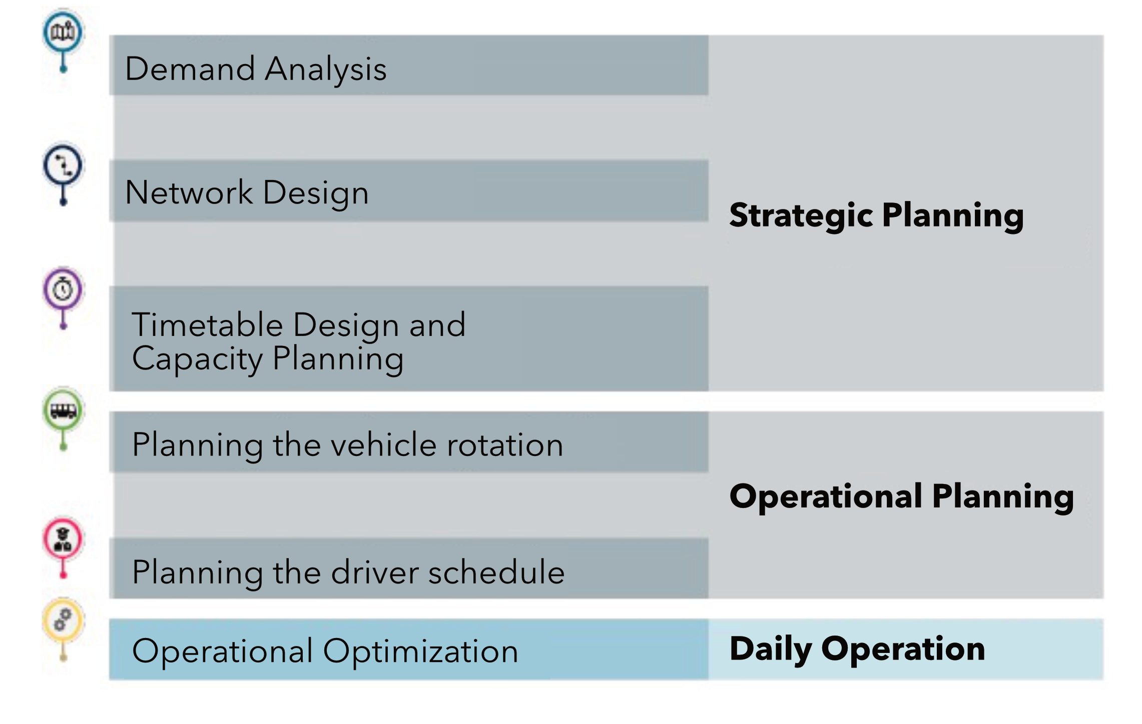
Planification : processus de planification

Slide 23
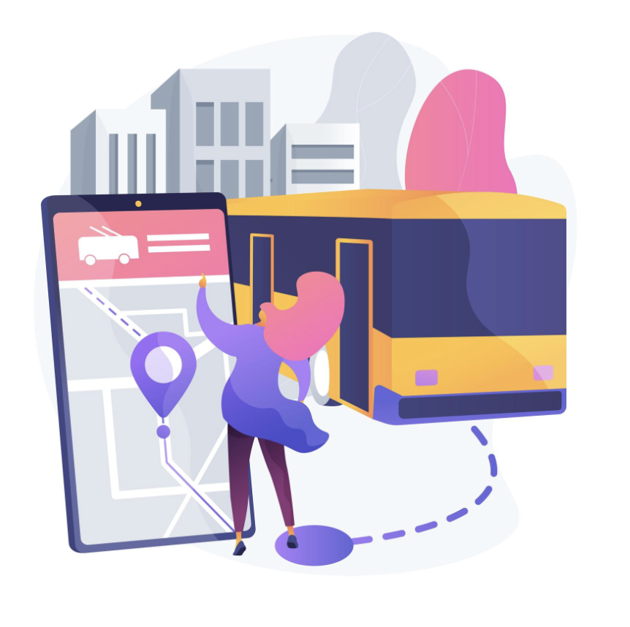
Planification : service régulier
Régulier Service as the most usual and conventional form of public transport
Régulier Service : all journeys in both directions over the entire length of the route/line with intermediate stops
A temps table is not a mandatory requirement for Régulier Service
Freepik

Slide 24
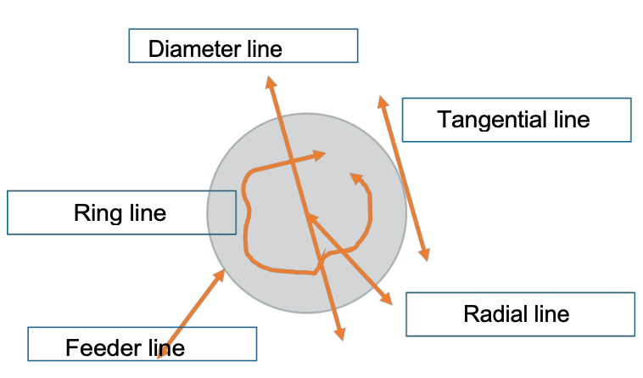
Planification : types de service régulier
Radial line : Journeys end in the ville center. Voyageurs with other source-destination requests than suburban-intermediate destination- ville center are obliged to change trains.
Diameter line : advantageous for voyageurs qui want to reach destinations beyond ville center from the outskirts.
Tangential line : avoids the inconvenient route into the ville center to reach large villes
Approche line : usually takes voyageurs from the surrounding area to a stop of a higher-quality moyens of transport on the outskirts of the ville (S-Bahn, light rail).
Ring line : can complement bus lines and streetcar lines

Slide 25
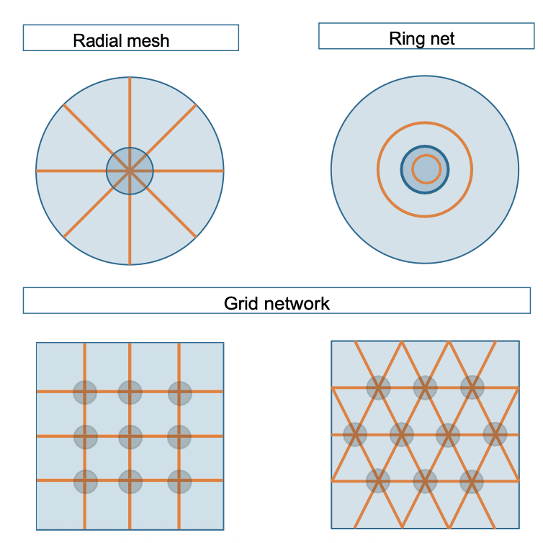
Planification : types de réseaux

Slide 26
Équité et accessibilité : Planification sensible au genre
Objectif : Improve sécurité, usability, and mobilité opportunités for all genders
  Éclairage et visibilité
  Well-lit stops, transparent waiting areas
  Open design without “fear zones”
  Emergency call systèmes
  Femmes worldwide are more likely to make multi-modal trips (shopping, caregiving, etc.) → denser réseaux, flexible connections instead of purely commuter-oriented systèmes
Gender-sensitive transport design as part of durable urbain développement

Slide 27
Équité et accessibilité : Planification pour les personnes en situation de handicap
Objectif : Barrier-free use of the entire mobilité système.Éclairage et visibilité
  Step-free accès to stops and véhicules
  Elevators, ramps, tactile guidance systèmes
  High-contrast signage and clear orientation
  Low-floor véhicules, wheelchair spaces et priority seats
  Acoustic and visual stop announcements
  Barrier-free apps and voyageurs information
  Simple tarif systèmes, comprehensible routing (“universal design”)
  Door-to-door accessibilité (including footpaths to stops)
  Staff training for assistance

Slide 28
Aperçu
Notions de base
Organisation
Planification
Communication et marketing

Slide 29
Communication et marketing
Public transport autorités use :
  integrated wayfinding et voyageurs information systèmes
  digital apps, real-time service updates
  social milieux campagnes promoting sécurité, ticketing ease, service expansions
  brand campagnes tied to sustainability, équité and fiabilité
In many villes, transit agencies highlight carbon savings, coût savings contre voiture ownership, and multimodal connectivity as marketing narratives
Free public transport experiments (e.g., Luxembourg, national fare-free politique) attract attention and discussion internationally

Slide 30
Merci pour votre attention !

Slide 31
Sources : littérature
ADAC 2017 : Umfrage 2017 : Nichtnutzung des ÖPNV. https ://vm.baden-wuerttemberg.de/fileadmin/redaktion/m-mvi/intern/bilder/VM_Bilder/Innovationskongress/2-ADAC-A-Nichtnutzung_%C3%96PNV.pdf (15.02.26).
Drawdown 2025 : Enhance Public Transit. https ://drawdown.org/explorer/enhance-public-transit (15.02.26).
Ho/Tirachini 2006 : Mobility-as-a-Service and the role of multimodality in the sustainability of urbain mobilité in developing and developed countries. https ://ris.utwente.nl/ws/portalfiles/portal/328905216/1-s2.0-S0967070X23002810-principal.pdf (15.02.26).
Zürich 2023 : Modalsplit der Stadt Zürich : Geprägt von der Pandemie. https ://www.stadt-zuerich.ch/de/aktuell/medienmitteilungen/2023/06/230605a.html (15.02.26).

Slide 32
Sources : graphiques
https://pixabay.com/de/photos/stadtbus-bus-linienbus-omnibus-5205148/
https://www.freepik.com/free-vector/man-buying-bus-ticket-via-terminal_12291165.htm#fromView=search&page=1&position=2&uuid=2aa564fb-2faa-4f7b-b49c-2e7d116c13a4&query=public+transport+ticket
https://www.freepik.com/free-vector/autonomous-public-transport-abstract-concept-illustration_12291364.htm#fromView=search&page=1&position=2&uuid=6d405322-d233-4ca8-a16f-0456e95b6a11&query=public+transport

