Slide 1
Transport privé non motorisé : vélo
Fondements du transport

Slide 2
Road Transportation Systems Engineering Development in the Sub-Saharan Africa – Modern EU Master Programme & Capacity Building

Slide 4
Aperçu
Vélo : développement et défis
Sécurité routière des cyclistes
Promotion du vélo comme moyen de transport

Slide 5
Aperçu
Vélo : développement et défis
Sécurité routière des cyclistes
Promotion du vélo comme moyen de transport

Slide 6
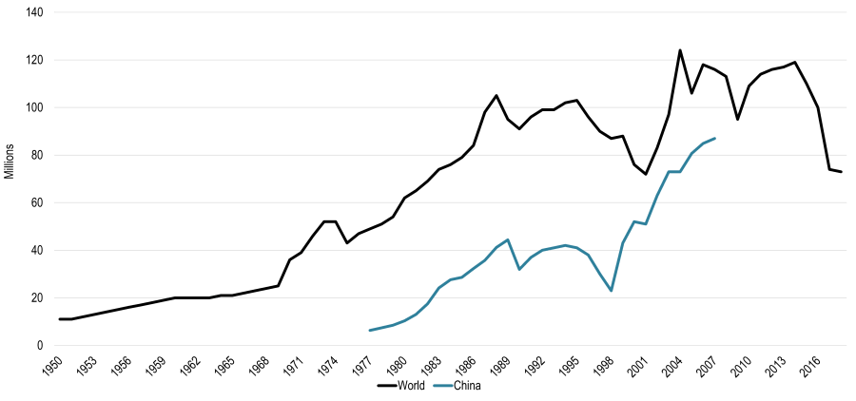
Développement du vélo comme moyen de transport
Vélo production in the world :
Transportgeography.org

Slide 7
Développement du vélo comme moyen de transport
The international croissance in production of bikes was faster than the croissance in production of voitures since the 1960s
In 2022, 143.000.000 vélos were sold worldwide, with China leading with around 43.000.000 sold units (Statista 2025)
Biking is predominantly male, for every trois male riders there is just one female cyclist
About 7% of all urbain trips worldwide are done by bycicle (Runrepeat 2023)

Slide 8

Développement du vélo comme moyen de transport
The Netherlands are the leading country in biking, with 58% of their population commuting using bikes
Around 21% of bikers switched from régulier bikes to e-bikes
Pixabay

Slide 9
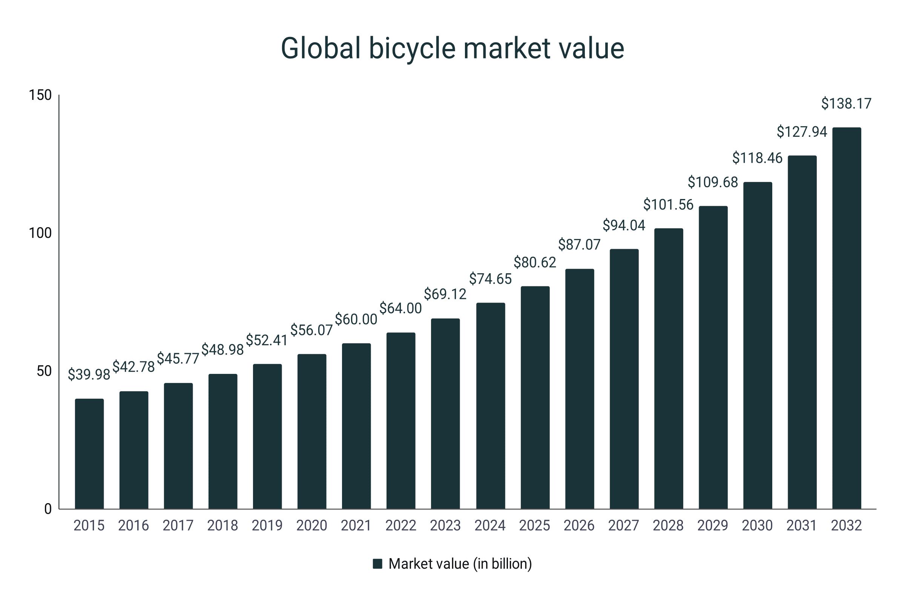
Développement du vélo comme moyen de transport
The vélo industry is predicted to développer at an annual croissance rate of 8% (Runrepeat 2023)
runrepeat.com/cycling-statistics

Slide 10

Avantages du vélo
Quick
  especially in dense villes : on average, the vélo is the faster option compared to voitures
Health-promoting
Environmentally friendly
  low émission
  space-saving
  low bruit
Cost-effective
Pixabay

Slide 11
Défis du vélo
Weather dependency
Influence of the topography
Bad or missing infrastructure, infrastructure is often geared towards motorisé trafic
High vulnerability
  air et bruit pollution
  gaps in the cycle piste réseau and the risque of accidents with and caused by motorisé trafic

Slide 12
Aperçu
Vélo : développement et défis
Sécurité routière des cyclistes
Promotion du vélo comme moyen de transport

Slide 13
Sécurité cycliste comme champ d’action central
Worldwide, more than a quarter of 1.2 million annual route deaths are cyclistes or piétons
More than one piéton or cyclist is killed every two minutes in a crash on the world‘s routes (QUI 2025)
Décès among cyclistes rose by 50% in the European Région and by 88% in the QUI Western Pacific Région between 2011 and 2021
Quand marche and vélo are sûr, more personnes choose these healthy and green ways of moving around, which even helps reduce the risque of diseases

Slide 14
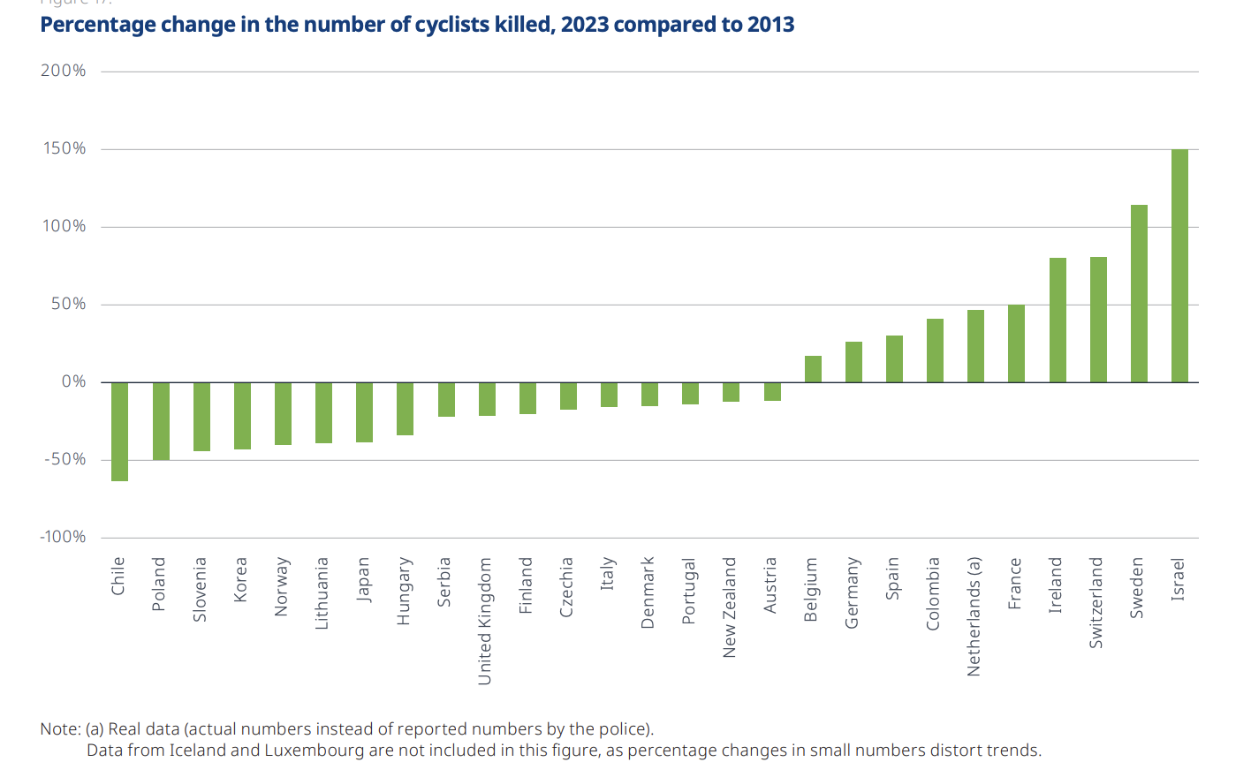
Sécurité cycliste comme champ d’action central
OECD 2024: 51

Slide 15
Sécurité cycliste comme champ d’action central : Principaux facteurs de risque
Missing infrastructure
Conflicts with motorisé trafic
  Research shows, cyclistes are usually not primarily responsible for accidents between bikes and voitures
Lack of visibilité
Differences in vitesse between cyclistes and motorisé trafic
Dooring accidents
  Accidents through voiture doors being opened in the piste of a cyclist

Slide 16
Sécurité cycliste comme champ d’action central : Sécurité subjectif
52% of adults from 28 countries say vélo in their area is too dangerous (Ipsos 2022)
The subjectif risque perception at a given location can deviate significantly from the actual crash risque (Stülpnagel/Lucas 2020)
Reasons for a sense of insecurity (SINUS 2023 : 101) :
  careless voiture drivers (64%)
  too much trafic (59%)
  speeding voitures (54%)
  poor condition of vélo pistes, no vélo infrastructure (48%)
  missing lights on vélo piste (28%)

Slide 17
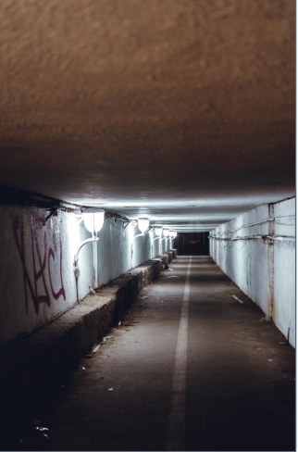
Sécurité cycliste comme champ d’action central : Sûreté sociale
Vélo facilities should be experienced without fear (similar to piéton trafic)
Presence of other personnes
Éclairage in the dark
No restriction of movement options or lines of sight, good visibilité
Secure vélo stationnement facilities to protect against theft
Unsplash

Slide 18
Sécurité cycliste : demandes aux responsables politiques
More vélo pistes
Better separation of cyclistes from voiture drivers
Secure vélo stationnement facilities
Vélo transport options on public transport
Wider cycle bandes, also for cargo bikes
Better separation of cyclistes from piétons
- Sinus Vélo Monitor 2023 (Germany)

Slide 19
Aperçu
Vélo : développement et défis
Sécurité routière des cyclistes
Promotion du vélo comme moyen de transport

Slide 20
Promotion du vélo – pourquoi c’est important
Public Santé Bénéfices
  Vélo as part of an active lifestyle significantly lowers the risque of diseases like heart diseases, stroke, cancer and diabetes
Climat et Environnemental Impact
  Vélo as a zéro émission mode of transport
Économique and Social Bénéfices
  Vélo soutient emplois through increased bike sales, tourism, and infrastructure investment while abaissement soins de santé coûts
Efficient Use of Urbain Espace
  Vélos require less espace than voitures both on the route and stationnement, which makes urbain areas more livable and less congested

Slide 21
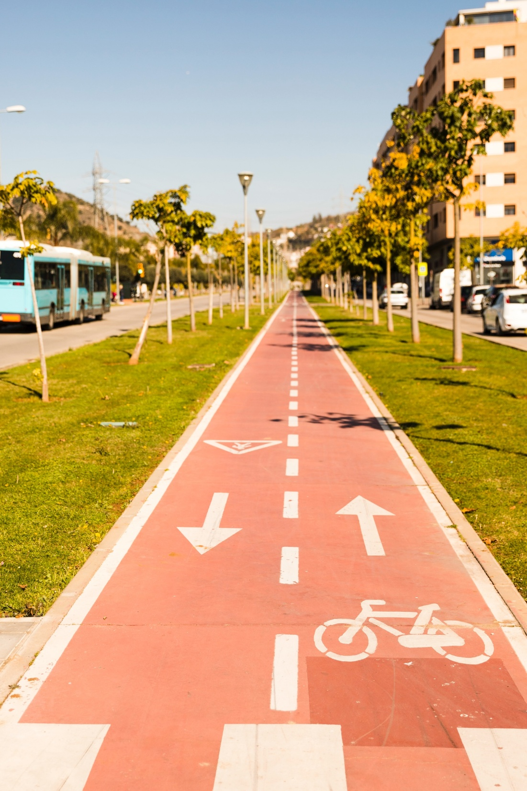
Promotion du vélo – comment y parvenir
Develop and développer sûr infrastructure
  continuous, protégé bike bandes ; this does not only improve actual sécurité, but also enhances cyclistes perception of sécurité, a clé factor in increasing vélo uptake
Freepik

Slide 22

Promotion du vélo – comment y parvenir
Intégrer Vélo into Politique Cadre
  National and local governments can embed vélo into broader transport, santé and environnemental politiques
  Exemple : Pan-European Master Plan for Vélo Promotion
UNECE

Slide 23
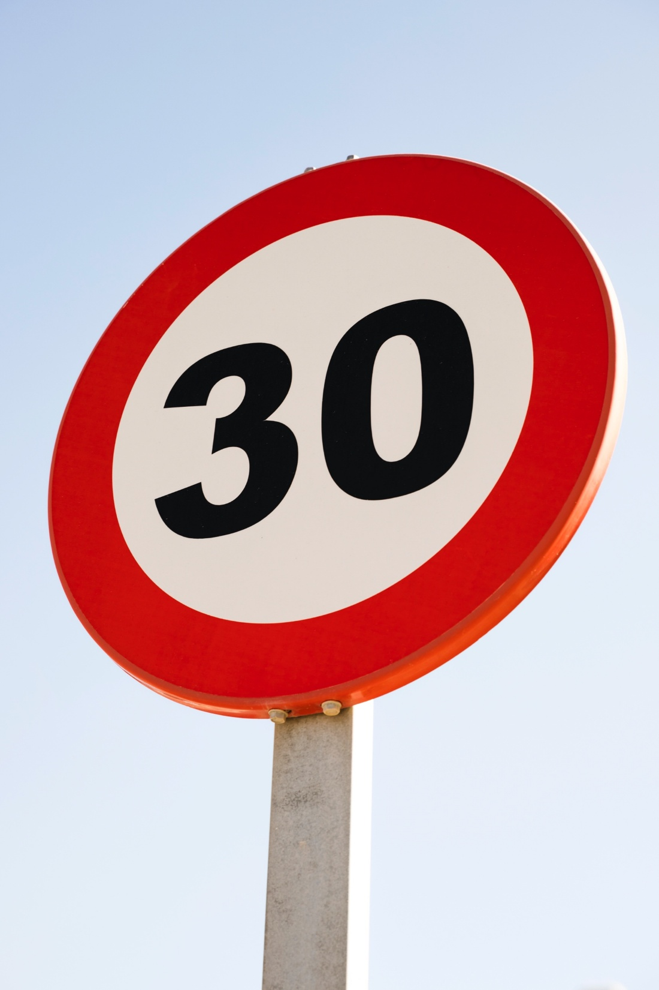
Promotion du vélo – comment y parvenir
Vitesse Gestion and Route Sécurité Mesures
  Abaissement vitesse limites in urbain areas (e.g. to 30km/h) reduces the severity of collisions
Freepik

Slide 24

Promotion du vélo – comment y parvenir
Sensibilisation Raising et Comportement Change Campagnes
  Éducation and sensibilisation campagnes for cyclistes and other route usagers
  Addressing sécurité concerns and bénéfices
  Reshaping social norms around vélo as a legitimate alternative
Freepik

Slide 25

Promotion du vélo – comment y parvenir
Financial Incitations and Soutenir Programs
  Governments or employers can offer incitations like subsidies for bike purchases, tax bénéfices or investments in bike partage systèmes
  These incitations lower the coût barrier and encourage personnes to choose vélos over motorisé transport
Freepik

Slide 26
Promotion du vélo – nouvelle tendance de l’électromobilité ?
About 300.000.000 E-bikes are in use worldwide
Rapidly growing
In Germany, e-bikes sales exceeded régulier bike sales for the first temps in 2023
Gaining popularité :
  Extended déplacement range, often more practicable in villes than voitures
  Lower physical barriers, especially for older or less fit personnes
  Environnemental bénéfices compared to a voiture
Successful intégration requires appropriate infrastructure, regulation and sécurité planification

Slide 28
Sources – images
https://www.statista.com/outlook/mmo/micromobility/bicycles/regular-bicycles/worldwide
https://pixabay.com/de/photos/roller-fahrrad-freizeit-radfahren-7396608/
https://pixabay.com/de/photos/radfahrer-kreuzung-stadt-stra%c3%9fen-5832393/
https://unsplash.com/photos/brown-concrete-hallway-AQ6rg16_Qzc
https://de.freepik.com/fotos-kostenlos/richtungspfeile-und-fahrrad-unterzeichnen-auf-sich-verringerndem-perspektivenzyklusweg_4624908.htm#fromView=search&page=1&position=28&uuid=69bef2a2-b0dc-4679-937c-ac5bf7a1d25f&query=sicherer+fahrradweg
https://unece.org/sites/default/files/2023-03/MASTERPLAN_2021-05-20-II_BF%203%20June_0.pdf
https://de.freepik.com/fotos-kostenlos/runden-sie-30-hoechstgeschwindigkeitszeichen-gegen-blauen-himmel_4624948.htm#fromView=search&page=1&position=0&uuid=abe32277-0970-4720-afd4-18d8e6233c38&query=30kmh
https://de.freepik.com/fotos-kostenlos/revolution-stillleben-design_17119054.htm#fromView=search&page=1&position=2&uuid=a6326a2b-7583-4b9b-bacf-9a91d6bc19e5&query=campaign
https://de.freepik.com/fotos-kostenlos/dollarzeichen-gemacht-aus-muenzen-auf-hoelzernem-hintergrund-heraus_5683096.htm#fromView=search&page=1&position=32&uuid=a450d111-62dc-4f5c-9d39-db3001d589fc&query=dollar+sign

Slide 29
Sources – littérature
International Transport Forum 2024 : Route Sécurité – Annual Report. https ://www.itf-oecd.org/sites/default/files/docs/irtad-road-safety-annual-report-2024.pdf (03.02.26).
IPSOS 2022 : Vélo across the world – clé findings. https ://www.ipsos.com/en/global-advisor-cycling-across-the-world-2022 (03.02.26).
Run Repeat 2023 : Vélo Statistics. https ://runrepeat.com/cycling-statistics (03.02.26).
Sinus 2023 : Fahrradmonitor 2023. https ://www.bmv.de/SharedDocs/DE/Anlage/StV/fahrradmonitor-langfassung.pdf ?__blob=publicationFile (03.02.26).
Statista 2025: Regular Bicycles. https://www.statista.com/outlook/mmo/micromobility/bicycles/regular-bicycles/worldwide (03.02.26).
Stülpnagel/Lucas 2022 : Crash risque and subjectif risque perception during urbain vélo : Evidence for congruent and incongruent sources. https ://pubmed.ncbi.nlm.nih.gov/32445971/ (03.02.26).
Transport Geography 2018 : World Vélo Production. https ://transportgeography.org/contents/chapter5/road-transportation/bicycle-production-world (03.02.26).
UNECE 2023 : Pan-European Master Plan for Vélo Promotion. https ://unece.org/sites/default/files/2023-03/MASTERPLAN_2021-05-20-II_BF%203%20June_0.pdf (03.02.26).
QUI 2025 : Make marche and vélo sûr to unlock huge santé, life and green gains. https ://www.qui.int/news-room/commentaries/detail/make-walking-and-cycling-safe-to-unlock-huge-health--life-and-green-gains (03.02.26).

