Slide 1
Transport motorisé
Fondements du transport

Slide 2
Road Transportation Systems Engineering Development in the Sub-Saharan Africa – Modern EU Master Programme & Capacity Building

Slide 4
Définition du transport individuel motorisé (MIT)
Refers to the use of privately operated motor véhicules for personal déplacement
  voitures, motocyclettes, light camions
Typically driver-controlled and not part of public transit systèmes
Includes both combustion engine véhicules and électrique véhicules
Often measured in indicateurs like véhicule ownership per capita or véhicule kilometers travelled

Slide 5
Motorisation individuelle : tendances
Mondial voyageurs voiture fleet has grown from ~500 million (2000) to ~1.4 billion véhicules (2025)
Worldwide voiture ownership is expected to reach ~2 billion by 2040 without majeur politique shifts
As urbanisation increases, voiture ownership increases faster than population croissance in many régions
Rapide motorization seen in China, India, Southeast Asia and Latin America over the past 20 years

Slide 6
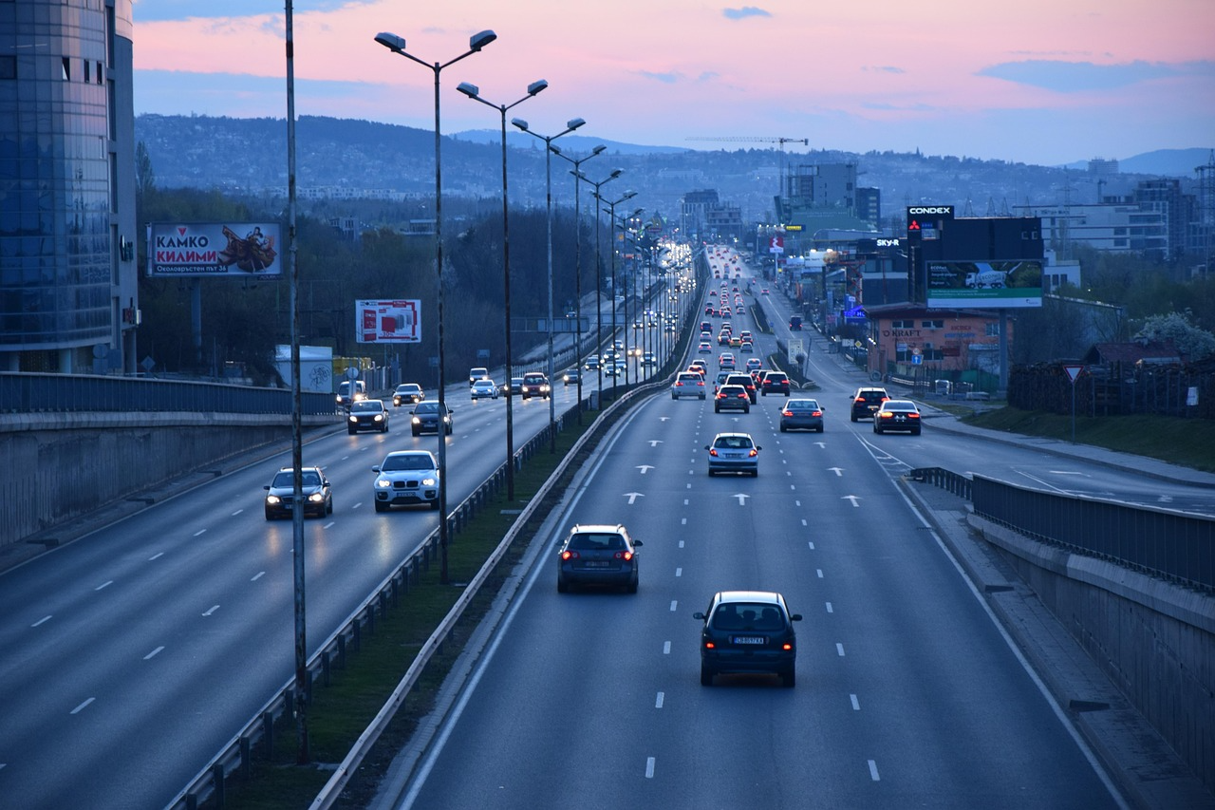
Motorisation par région
High-income countries : ~500–800 voitures per 1000 personnes (very high voiture density)
Upper-middle-income countries : ~200–400 voitures per 1000 personnes
Low-income countries : <50 voitures per 1000 personnes
Pixabay

Slide 7
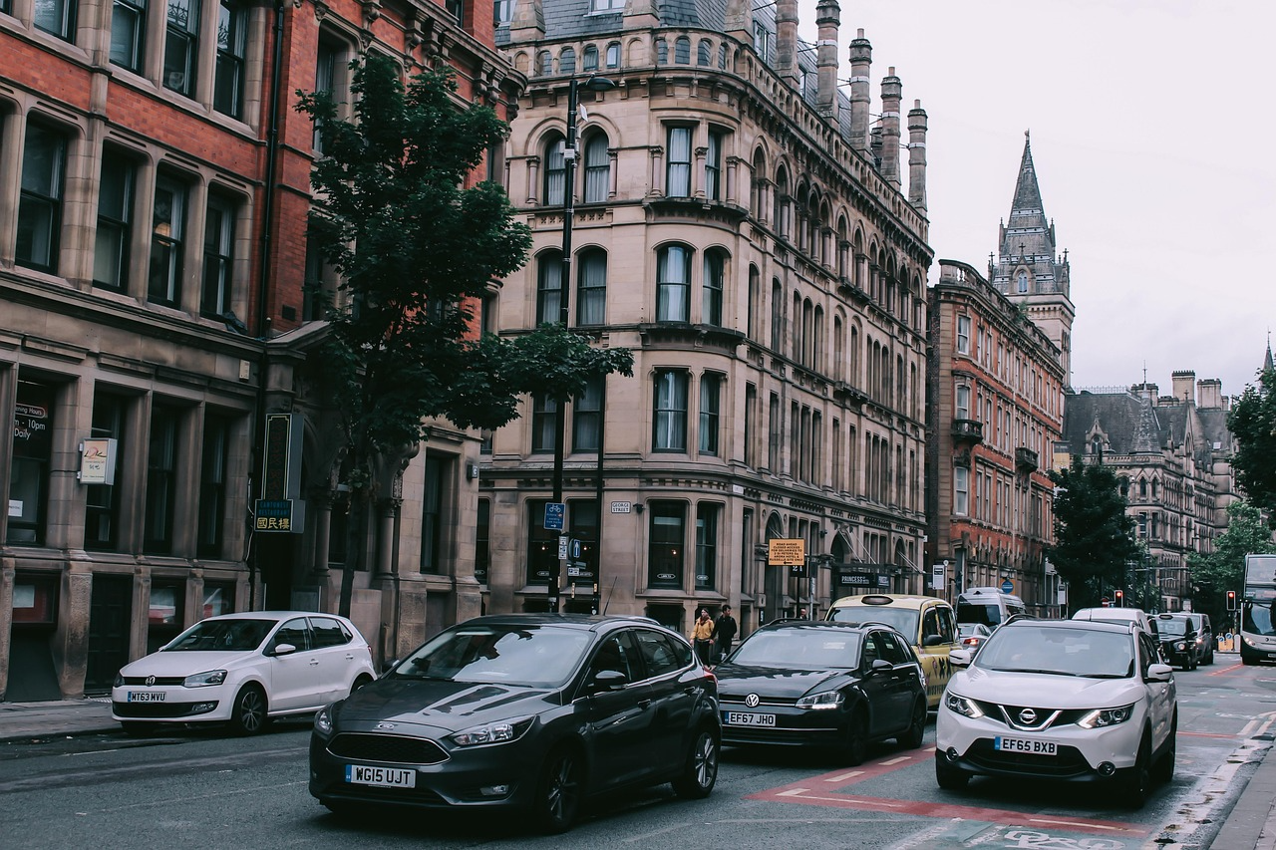
Disponibilité et utilisation de la voiture
Disponibilité et utilisation de la voiture depends on :
Genre
Age
Driving license possession
Personal financial situation
Social environnement
Worldview
Mobilité requirements
Geographical conditions : Topography, ville/countryside
Attractiveness of "competing" moyens of transport
Infrastructure condition, limité stationnement, trafic congestion
Pixabay

Slide 8
Avantages du trafic motorisé
Unbound : freely movable (in compliance to the rules)
High availability
Largest transportation réseau
Depending on the destination : shortest déplacement temps "door-to-door“
High niveau of confort : espace, air conditioning, music etc.
Voiture as a privé area

Slide 9
Inconvénients du trafic motorisé
Trafic accidents
Land consommation
Économique damage caused by trafic jams
High énergie requirement
émissions
  Bruit
  Polluants atmosphériques
  Gaz à effet de serre
  Negative effects on humans, the environnement and the climat

Slide 10
Accidents, sécurité et décès
~1.3 million personnes die in route crashes worldwide annually
Vulnerable route usagers (piétons, cyclistes, motorisé two-wheelers) account for >50% of all décès
Voiture occupant deaths : ~29% of total mondial route deaths

Slide 11
Accidents, sécurité et décès
Décès have fallen in high-income countries due to stronger sécurité systèmes → Vision Zéro
Route deaths estimated to increase in low- and middle-income countries (rapide motorization régions) unless infrastructure and politique change

Slide 12
Accidents de la route : Vision Zéro
"Vision Zéro" originally comes from occupational sécurité and was further developed for trafic in the mid-1990s by the Swedish Public Routes Administration
Stands for a comprehensive paradigm shift in route sécurité, with the objectif of no more deaths and serious injuries on the routes
Comprises a concept for action based on two basic principes :
  Accident prevention as a social task : it is not only those involved in accidents qui must take responsibility for accidents, because human error can never be completely avoided
  Stress limites of the human body as a benchmark : even in the worst-case scenario, the consequences of an accident must not be fatal
Moyens of transportation and infrastructure must be designed in such a way that accidents with injuries and décès must be avoided and legislation must also be enacted in line with Vision Zéro

Slide 13
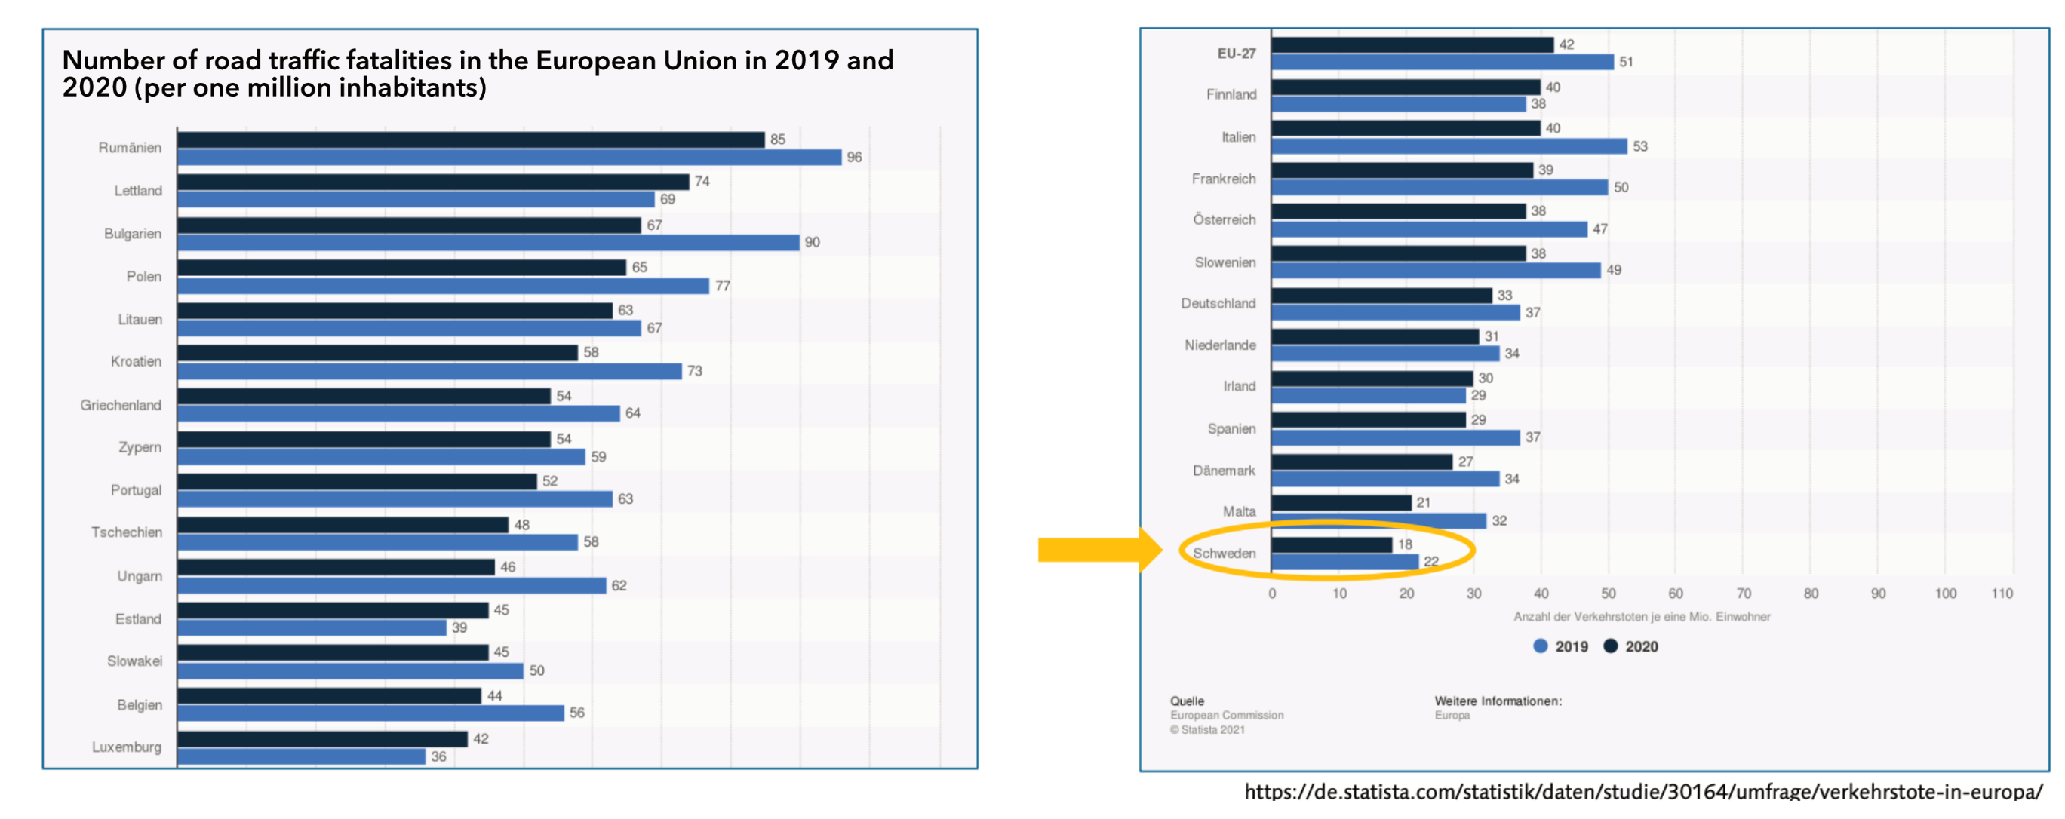
Accidents de la route : Vision Zéro
As a pioneer in the implementation of Vision Zéro, Sweden has the lowest number of route deaths in Europe

Slide 14
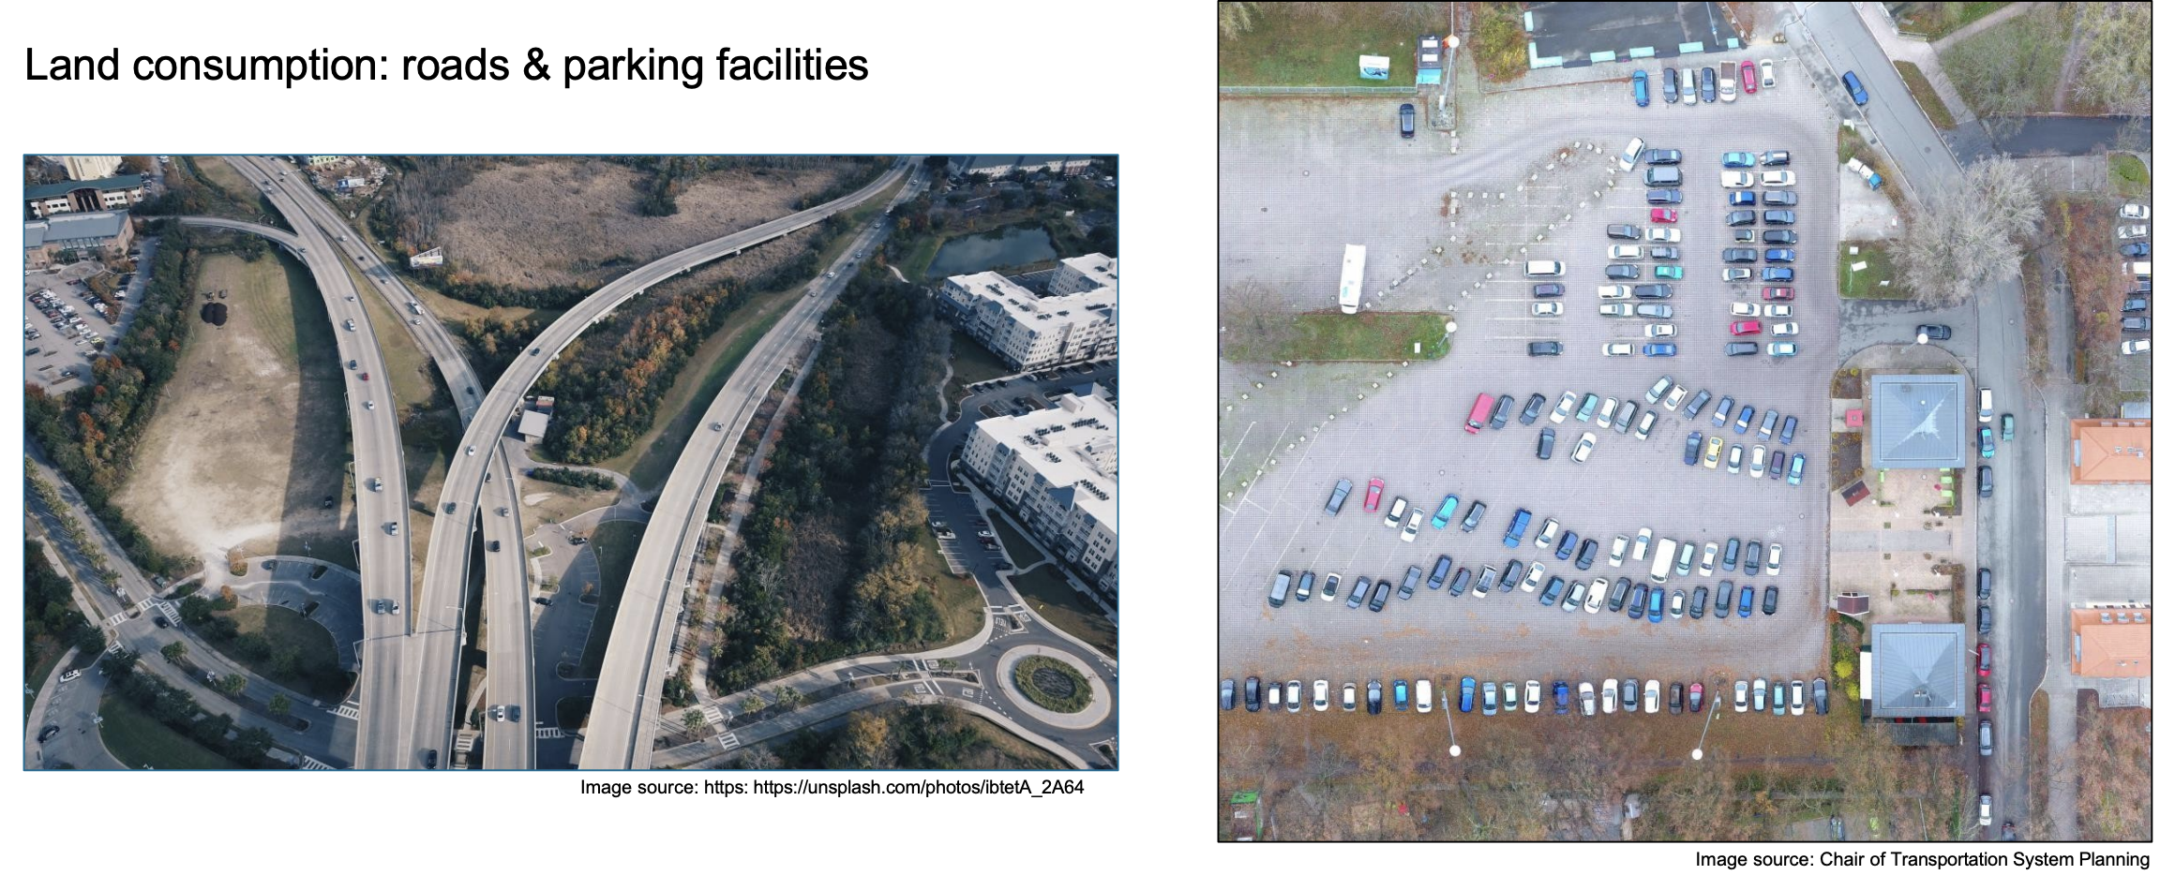
Consommation d’espace
Land consommation : routes et stationnement facilities

Slide 15
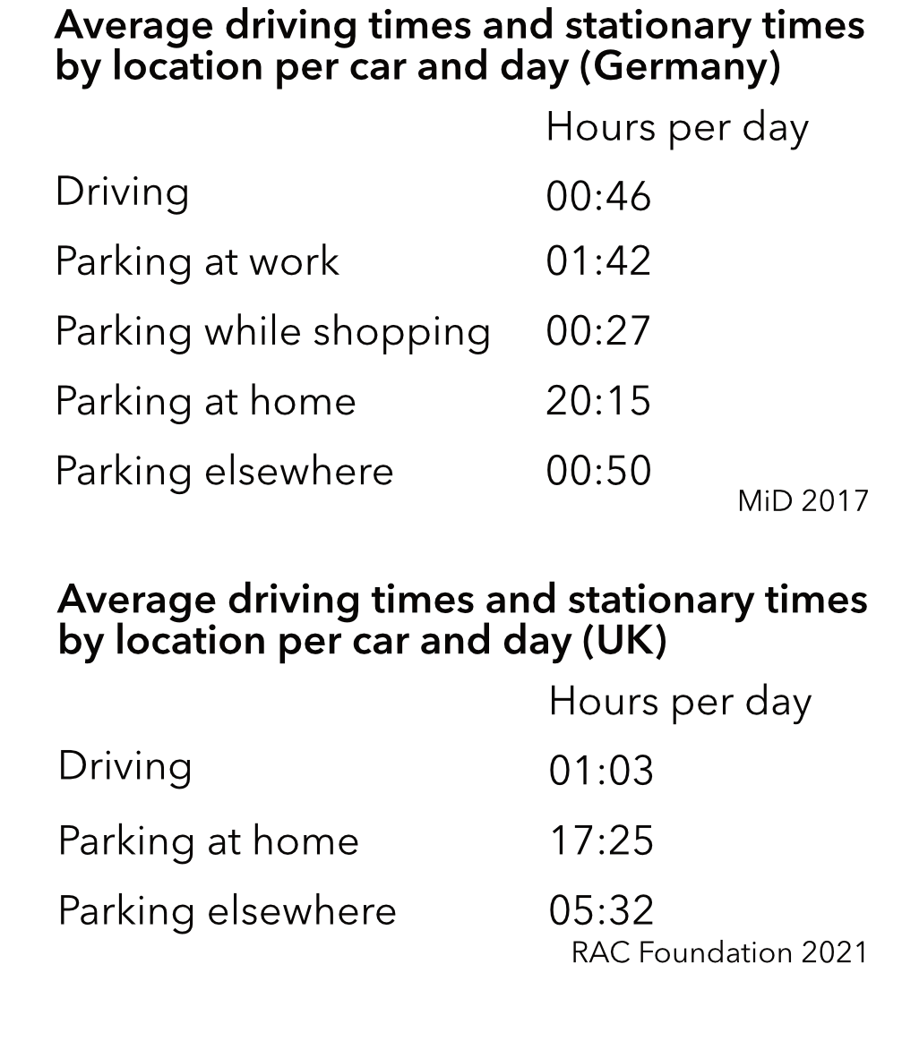
Consommation d’espace
Privé voitures require large amounts of urbain espace for routes, stationnement and infrastructure
A parked voiture typically occupies ≈10–15 m², but total espace demande per véhicule (including routes) is far higher
In many villes, up to 50–60 % of public espace in central areas is allocated to motorisé trafic
On average, voitures are parked for more than 23 hours per day
Especially in villes, almost half of them park in public spaces

Slide 16
Consommation d’espace
Moving one person by voiture requires far more espace per passenger-km than public transport, vélo or marche
Urbain sprawl is strongly linked to car-dependent transport systèmes
Route expansion often induces additional trafic (“induced demande”)
Increased land sealing → reduced biodiversity, higher flood risque
Car-oriented développement reduces urbain density and walkability

Slide 17
Consommation d’espace : Reducing Voiture Espace Demande
One Solution : Autopartage
  Usagers accès véhicules on demande instead of owning them
  Shared véhicules replace multiple privately owned voitures - one shared voiture can replace 5–15 privé voitures depending on the area
  Voiture partage reduces demande for stationnement infrastructure and route espace
  Usagers tend to drive less and combine modes more often
  Often integrated into Mobility-as-a-Service (MaaS) platforms
  Soutient transition from ownership to access-based mobilité

Slide 18
Consommation d’espace : Reducing Voiture Espace Demande
Réformes de la politique de stationnement
  Dynamic Tarification in stationnement reduces voiture use and espace demande
  Less public stationnement, increasing tarification,...
Transport public et Active Mobilité
  Shifting trips to transit, marche and vélo dramatically reduces espace consommation per traveler
Urbain Planification Mesures
  Mixed-use développement reduces déplacement distances and voiture dependency
  Compact ville design reduces infrastructure footprint

Slide 19
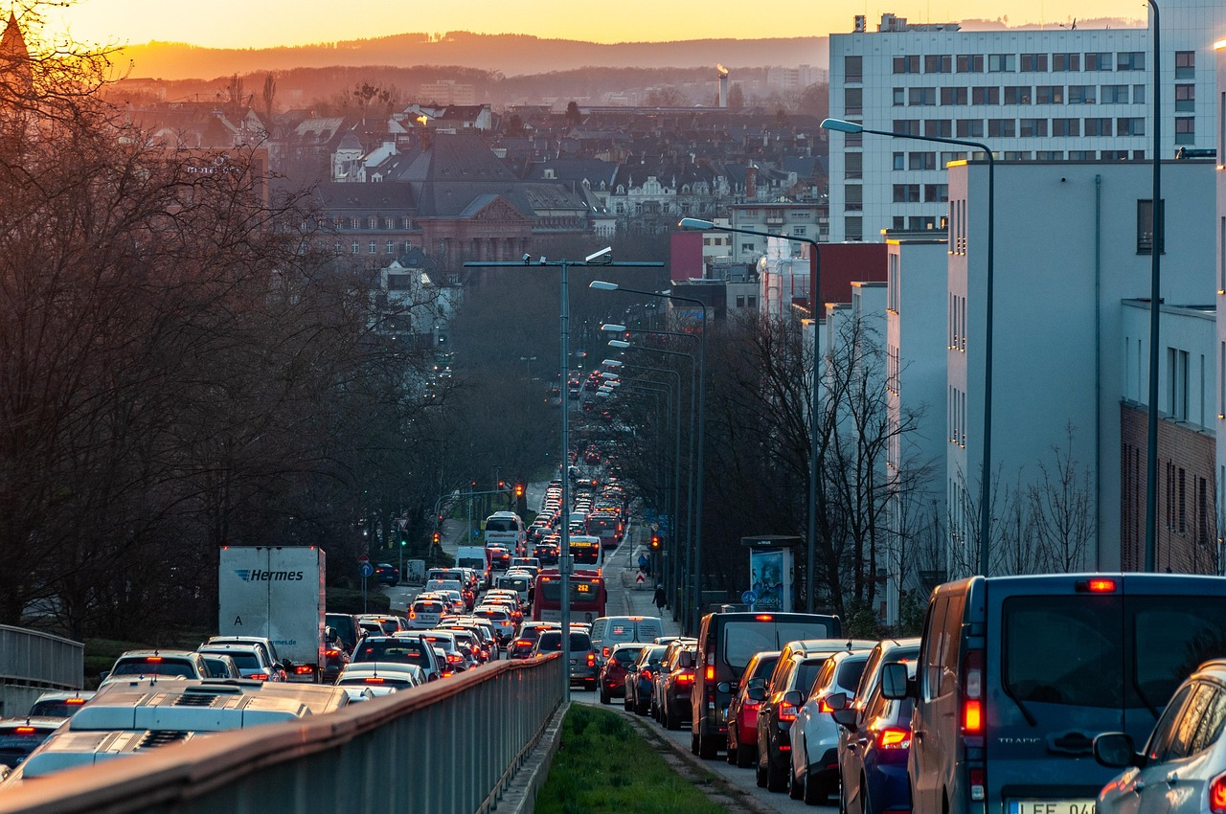
Trafic Jams
Temps lost in trafic
  In large mondial villes, the average commuter loses ~100–200 hours/année to congestion
Économique coûts
  Direct coûts : are borne by motorists
    Opportunity coûts of temps wasted in trafic jams
    Coûts of additional carburant consommation
  Indirect coûts : are borne by society as a whole
    émissions
    Higher prices for marchandises and services
Pixabay

Slide 20
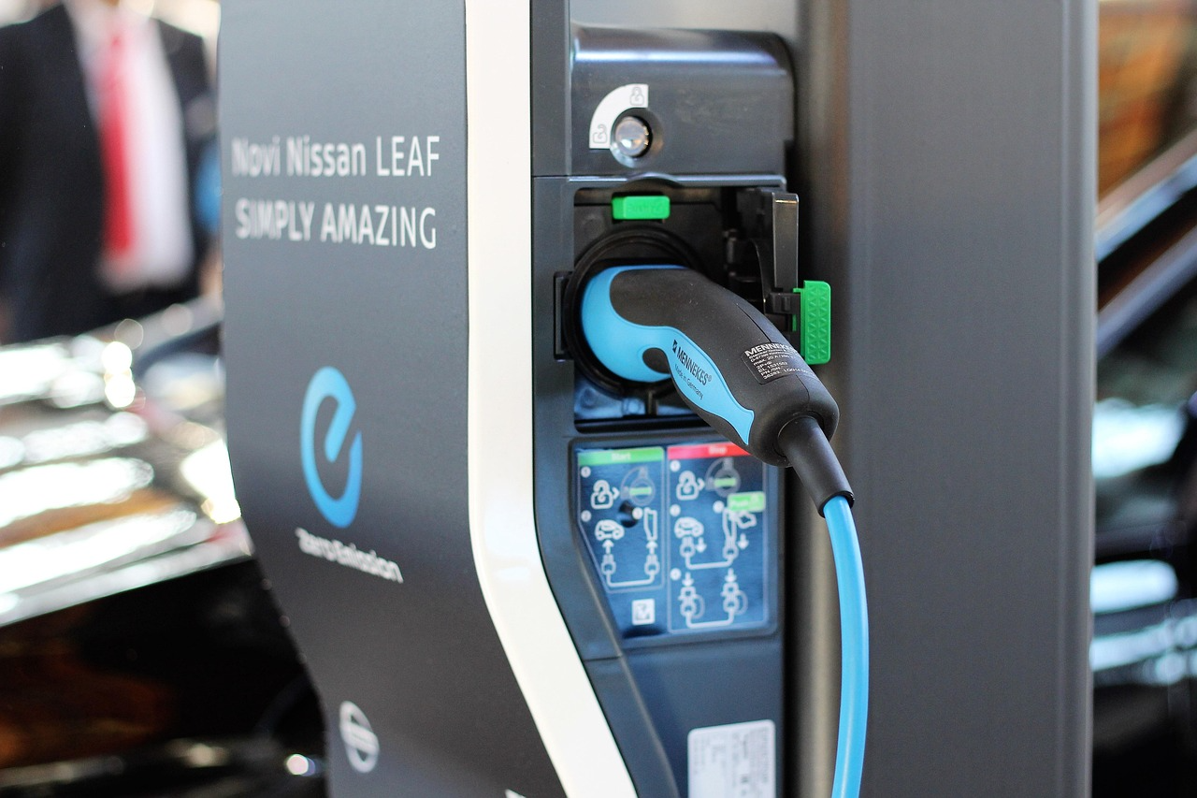
Développement : Électrique Véhicules
Mondial électrique voiture stock surpassed ~16 million in 2024, doubling in two years
EV sales share in total new voiture sales : ~15% globally, ~30–40% in leading markets (Europe, China)
Mondial charger count rising rapidly : ~2 million public chargers worldwide (2025 estimate)
Pixabay

Slide 21
Sources
IEA 2024 : Outlook for Électrique mobilité. https ://www.iea.org/reports/global-ev-outlook-2024/outlook-for-electric-mobility (15.02.26).
MiD 2017: Ergebnisbericht. https://www.mobilitaet-in-deutschland.de/archive/pdf/MiD2017_Ergebnisbericht.pdf (03.02.26).
RAC Foundation 2021 : Voitures parked 23 hours a day. https ://www.racfoundation.org/media-centre/cars-parked-23-hours-a-day (15.02.26).
QUI 2023 : Mondial Status Report on Route Sécurité. https ://iris.qui.int/server/api/core/bitstreams/46275f9f-ef66-4892-8ddd-a496ef8c1b74/content (15.02.26).

Slide 22
Sources : Images
https://pixabay.com/de/photos/autobahn-stadt-autos-der-verkehr-7213206/
https://pixabay.com/de/photos/autos-geb%c3%a4ude-stadt-stra%c3%9fe-wagen-3819225/
https://pixabay.com/de/photos/der-verkehr-stra%c3%9fe-autos-stau-7060425/
https://pixabay.com/de/photos/ladestation-nissan-leaf-ladestation-3325418/

Slide 23
Merci pour votre attention !

