Slide 1
Traffic Engineering
Exercise 1: Introduction to traffic Engineering

Slide 2
Excercise
In your own words, explain what Traffic Engineering is. Then, discuss how the principles and applications of traffic engineering contribute to African cities, considering issues such as rapid urbanization, informal transport, and limited road infrastructure.
What are typical traffic-related problems in your area/city? List out the problems and discuss how the principles in traffic engineering can contribute to solving them.

Slide 3
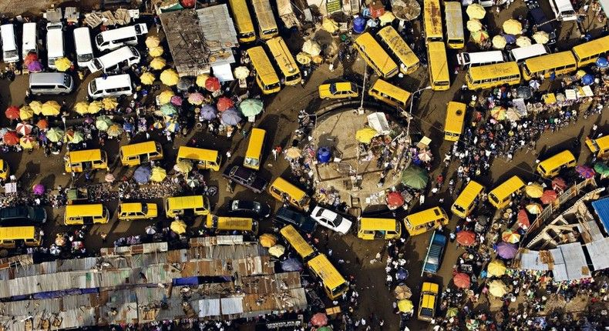
Exercise:
The following image shows the typical traffic flow conditions in major African cities. Identify and list the problems. What do you propose to solve the problem?

