Slide 1
Traffic Engineering
Lecture 2.2: Traffic Flow Models: Macroscopic, Mesoscopic,
and Microscopic Approaches

Slide 2
Learning objectives
Discuss the different levels of traffic flow models
Discuss key traffic flow models’ principles and assumptions
Understand the criteria for selecting appropriate models for traffic flow analysis

Slide 3
Lecture outline
Traffic stream characteristics
Macroscopic Traffic Flow Models
Microscopic Traffic Flow Models
Mesoscopic Traffic Flow Models
Basic reference:
Roger P. Roess; Elena S. Prassas; William R. McShane, Traffic Engineering, 5th edition, Pearson, 2019

Slide 4
Traffic Stream Characteristics
Uninterrupted Flow Facilities
  No fixed external interruptions
  Freeways and controlled-access highways (suburban multilane highways and rural highways with long spacing)
  Flow governed by vehicle interactions
Interrupted Flow Facilities
  Presence of fixed interruptions such as intersections
  Traffic signals and stop control
  Results in platoons of vehicles
  Common in urban environments

Slide 5
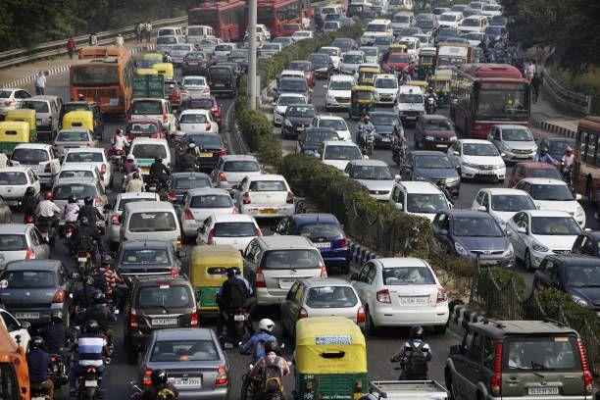
Traffic Flow Models
  Traffic flow models are commonly classified according to the level of detail, behavioral assumptions, and mathematical formulation used to represent traffic dynamics.
  Based on the Level of detail, 3 classes
    Macroscopic
    Microscopic
    Mesoscopic

Slide 6
Macroscopic Traffic Flow Models
These models describe traffic flow in an aggregate sense, analogous to fluid flow, without tracking individual vehicles.
Key variables
Flow (q)
Speed (v)
Density (k)

Slide 7
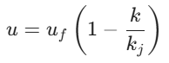
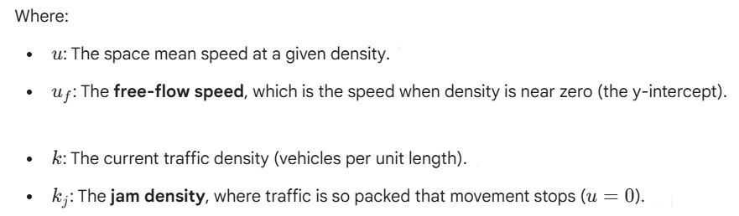
Macroscopic Traffic Flow Models
Greenshield’s Model
  A fundamental mathematical framework to describe the relationship between traffic speed and traffic density.
  It assumes a Linear relationship
  Mathematically given by

Slide 8
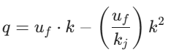
Macroscopic Traffic Flow Models
Greenshield’s Model
Because of the fundamental traffic property [q = u*k], the Greenshields model leads to a parabolic relationship for traffic flow.
It is used to estimate the Level of Service (LOS) and capacity of a roadway based on observed data.
It is easy to compute, however, in real-world traffic data often deviates from a perfectly linear speed-density line

Slide 9
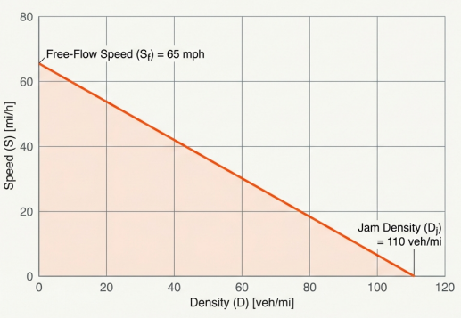
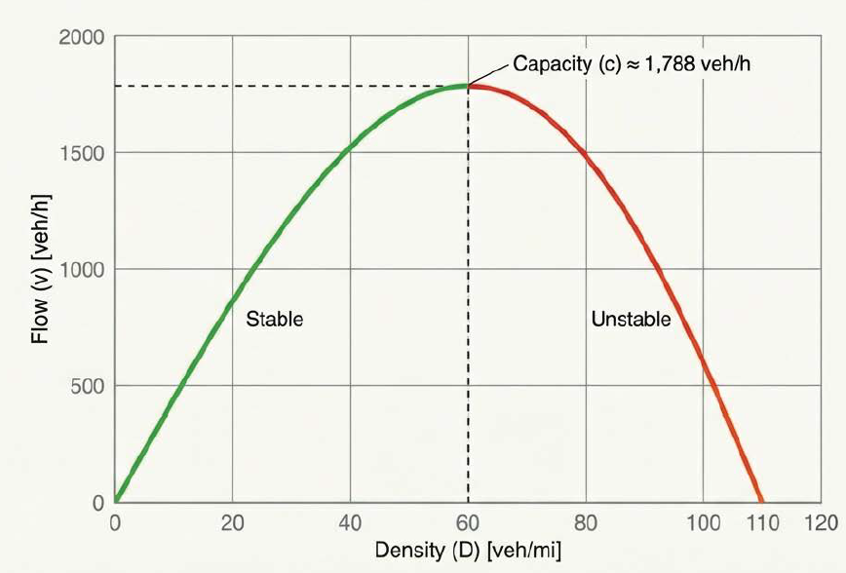
Macroscopic Traffic Flow Models
Greenshield’s Model

Slide 10
Macroscopic Traffic Flow Models
Greenberg Model
Describes the relationship between speed and density using a logarithmic function.
Key Assumptions
Traffic behaves like a compressible fluid.
Drivers react primarily to local density rather than individual vehicles.
Valid mainly under congested conditions.
Speed approaches zero as density approaches jam density.

Slide 11

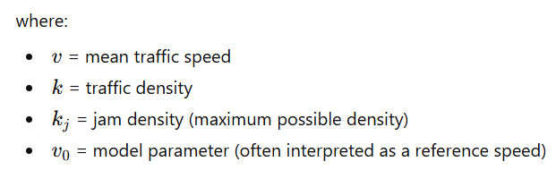
1. Macroscopic Traffic Flow Models
Greenberg Model
Model Characteristics
Speed–density relationship is logarithmic, unlike the linear form in Greenshields’ model.
Predicts very high speeds at low densities, which is not realistic.
Provides a good fit for dense urban traffic streams.
The fundamental speed–density relationship in the Greenberg model is:

Slide 12




1. Macroscopic Traffic Flow Models
Greenberg Model
Using the fundamental relationship [q = u*k], the flow–density relationship becomes:
The maximum flow (capacity) occurs when:
Maximum flow:
Speed at capacity:

Slide 13
1. Macroscopic Traffic Flow Models
Other macroscopic traffic models include:
Underwood Model
Exponential speed–density relationship.
Drake Model
Generalized exponential form.
Lighthill–Whitham–Richards (LWR) Model
Continuum model based on vehicle conservation.
Applications of the macroscopic traffic flow models
Capacity analysis
Fundamental diagrams
Corridor-level planning
However, they fail to represent heterogeneous traffic
and real driving behavior.

Slide 14
Group Exercise
Critically review and present the following paper on Greenshields’ foundational work on Traffic Flow theory.
https://www.krbalek.cz/for_students/mds/clanky/Greenshields.pdf

Slide 15
2. Microscopic Traffic Flow Models
These models simulate individual vehicle behavior and interactions.
Core concepts
  Car-following behavior
  Lane-changing decisions
  Gap acceptance
Applications
  Intersection and corridor simulation
  ITS evaluation
  Safety and operational analysis

Slide 16
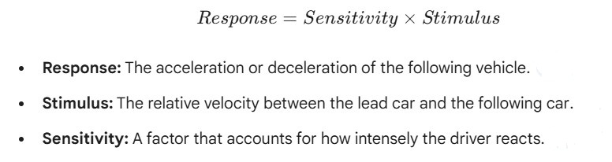
2. Microscopic Traffic Flow Models
General Motors (GM) Car following model
used to describe how a driver controls a vehicle in response to the motion of the immediately preceding vehicle.
The GM models are based on the Stimulus-Response principle.
The model assumes that a driver reacts to a stimulus from the vehicle ahead after a brief time lag (perception-reaction time).

Slide 17

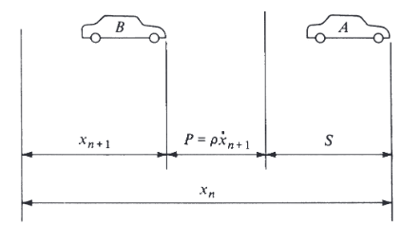
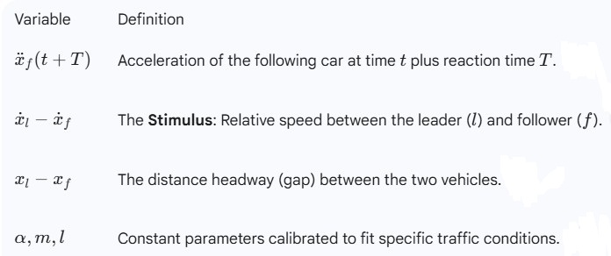
2. Microscopic Traffic Flow Models
General Motors (GM) Car following model
The general expression of the GM model can be written as:

Slide 18

2. Microscopic Traffic Flow Models
Gipps model
The Gipps Model is a collision-avoidance car-following model.
Unlike the GM models, this model assumes that a driver will choose a speed that allows them to stop safely, even if the vehicle in front suddenly brakes to a complete stop.
Core Idea: At each time step, a driver selects the minimum of two speeds:
    A desired (free-flow) speed, limited by acceleration capability,
    A safe speed, ensuring the vehicle can stop safely if the leader brakes suddenly

Slide 19
3. Mesoscopic Traffic Flow Models
These models combine macroscopic flow representation with microscopic vehicle movements.
Characteristics
  Vehicles are grouped, but individual movement logic is retained
  Less detailed than microscopic, more detailed than macroscopic
  Applicable for large urban networks

Slide 20
Features | Microscopic Models | Mesoscopic models | Macroscopic Models
Unit of detail | Individual vehicle | Small groups/Platoons | Traffic stream
Primary focus | Car following and lane changing | Distribution of speed/flow | Flow, Speed, Density, capacity
Relative Computational demand/Cost | High | Medium | low
Best use case | Individual intersections | Regional networks | Long freeways/ City wide planning

Slide 21
Discussion Questions
Do classical speed–density models (e.g., Greenberg or Greenshields) realistically represent traffic flow under mixed and weak lane-discipline conditions commonly observed in African cities? Why or why not? What do you propose?
For an urban arterial in the DRC or a big city in Cameroon with cars, minibuses, motorcycles, and pedestrians, which traffic stream modeling approach would you select, and what local factors would most influence this choice? Why?

Slide 22
Additional materials
Ciuffo, B., Punzo, V., & Montanino, M. (2012). Thirty Years of Gipps’ Car-Following Model: Applications, Developments, and New Features: Applications, Developments, and New Features. Transportation Research Record: Journal of the Transportation Research Board, 2315(1), 89-99. https://doi.org/10.3141/2315-10 (Original work published 2012)
Garber, N. J., & Hoel, L. A. (2009). Chapter 6: Fundamental Principles of Traffic Flow. In Traffic and Highway Engineering (4th ed., pp. 253–305).

