Slide 1
Traffic Engineering
Lecture 3.1: Traffic Data Collection Methods

Slide 2
Learning objectives
Understand the need for traffic data
Identify major traffic data types
Explain data collection methods
Discuss advantages and limitations

Slide 3
Lecture outline
Importance of Traffic Data
Types of Traffic Studies
Traffic Data Collection Methodologies
Emerging Data Sources
Basic reference:
Roger P. Roess; Elena S. Prassas; William R. McShane, Traffic Engineering, 5th edition, Pearson, 2019

Slide 4
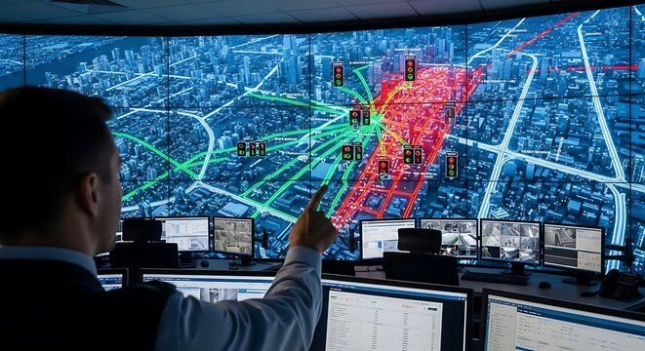
Importance of Traffic Data
Foundation of traffic engineering
Supports planning and design
Improves safety and operations
Enables performance evaluation
Data Quality
Errors affect decisions
Models depend on data quality
Quality data supports sustainable transport

Slide 5
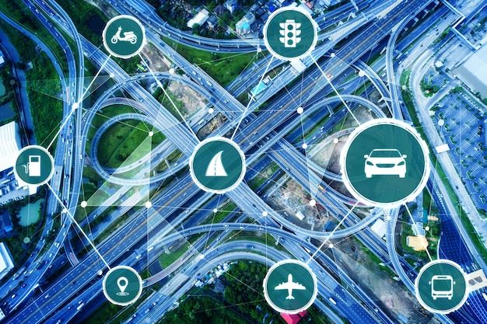
Applications of Traffic Data
Traffic management
Trend analysis
Study travel behavior
Model calibration
Assess the effectiveness of improvements
Congestion analysis
Safety improvement
Evaluate facility or system performance

Slide 6
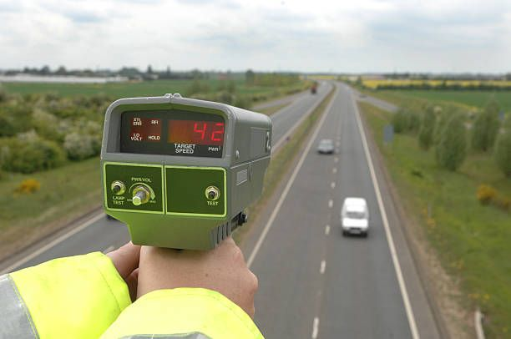
Types of Traffic Studies
Traffic volume studies
Speed studies
Travel time studies
Delay studies
Density studies
Accidents
Parking studies
Pedestrian studies

Slide 7
Traffic Data collection methodologies
In general, data collection takes place at one of the following three levels:
  Manual methods
  Semi-automated/ Portable methods
  Fully automated/ Permanent methods
Selection depends on duration, and the accuracy needs
Cost and site conditions influence method choice

Slide 8
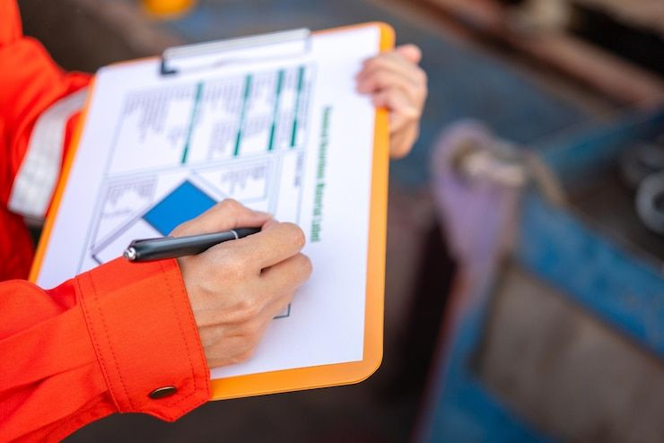
Manual Data Collection
Observers record vehicles using tally counters
Suitable for intersections and short durations
Allows turning movement and vehicle classification
Labor-intensive and limited in duration

Slide 9
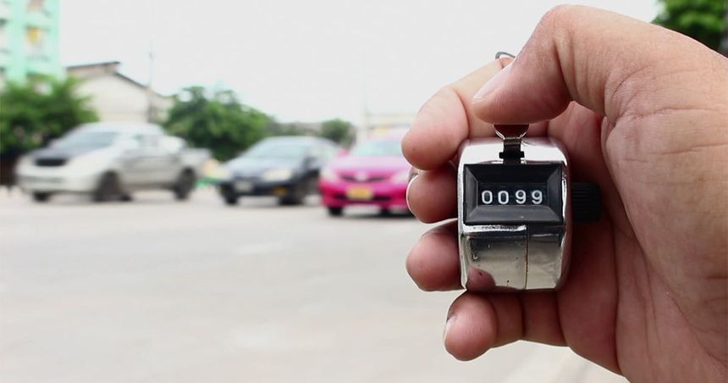
Manual Data Collection
Manual Traffic Counts
  Turning movement counts
  Intersection counts
  Facilitated by push-button counter
Manual Speed Studies
  Stopwatch method
  Radar guns
  Spot speed measurements

Slide 10
Manual Data Collection
Travel Time Studies
  Test vehicle method
  Floating car technique
  License plate matching
Intersection delay Studies
Parking Studies

Slide 11
Manual Data Collection
Advantages of Manual Methods
  Low equipment cost
  High flexibility
  Useful for complex observations
Limitations of Manual Methods
  Labor-intensive
  Human error
  Good for short duration only

Slide 12
Portable/Semi-Automated Methods
Portable devices
Temporary installation
Reduced manpower
The pneumatic tube is the most common portable traffic device

Slide 13
Pneumatic Road Tubes
Axle-based detection
Portable counters
Widely used
Need axle to vehicle conversion
Pneumatic Road Tubes Applications
24-hour counts
Directional volumes
Speed estimation

Slide 14
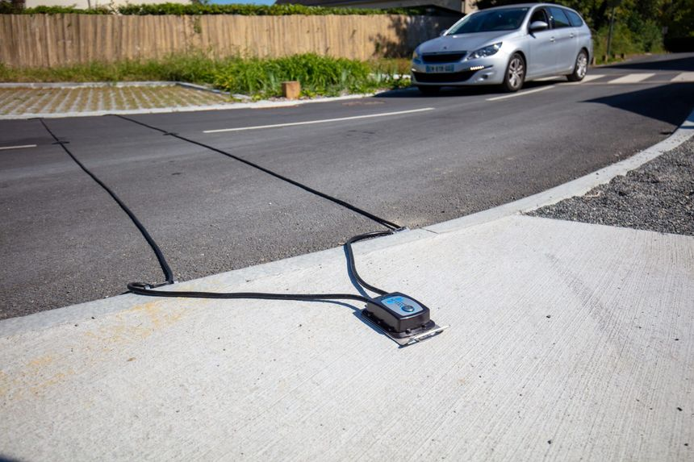
Pneumatic Road Tubes
Advantages
Low cost
Quick deployment
Suitable for rural roads
Limitations
Counts axles
Damage and vandalism
Urban limitations

Slide 15
Fully Automated/ Permanent Methods
Use sensors and detectors to count vehicles
Suitable for long-term and continuous counts
Higher initial cost but lower labor demand
Provide large volumes of reliable data
Inductive Loop Detectors
Most common detector
Presence and passage
Pavement embedded

Slide 16
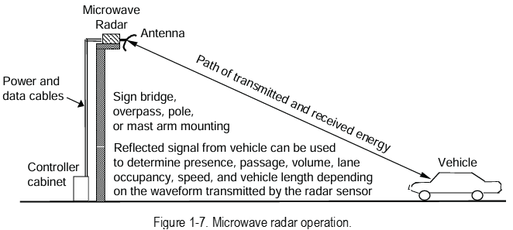
Fully Automated/ Permanent Methods
Magnetic Detectors
Detect magnetic field change
Low maintenance
Limited data
Radar-Based Detectors
Microwave radar
Speed and volume
Overhead or roadside
Source: FHWA, Traffic detection handbook, 3rd edition

Slide 17
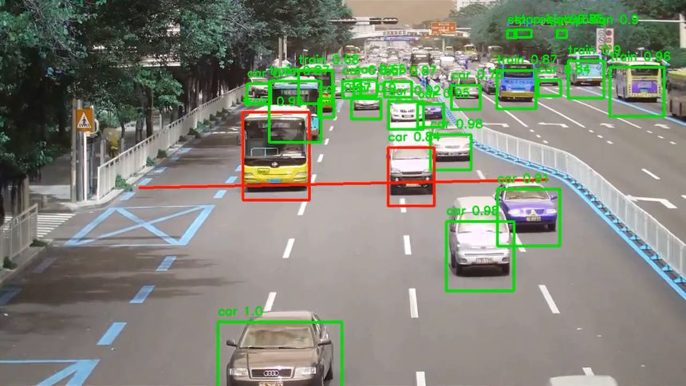
Fully Automated/ Permanent Methods
Infrared and Laser Sensors
Non-intrusive
Vehicle classification
Weather sensitivity
Video Image Processing
Camera-based
Multi-lane detection
Advanced image detection and analytics

Slide 18
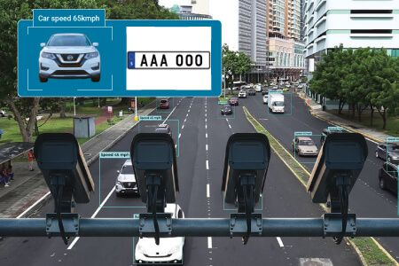
Fully Automated/ Permanent Methods
Advantage
Continuous data
High accuracy
ITS integration
Limitations
High cost
Maintenance
Data overload

Slide 19
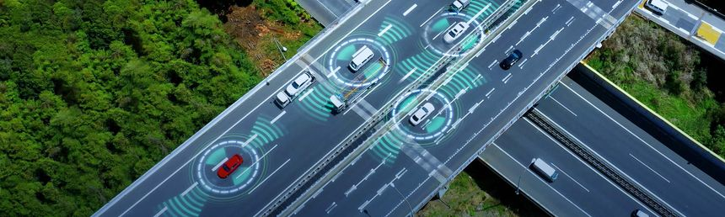
Emerging Data Sources
GPS probe vehicles
  Use location and time data from equipped vehicles
  Provide travel time, speed, and route choice information in real time.
Mobile phone data
  Derived from cellular network signals or apps
  Useful for origin–destination patterns and large-scale mobility analysis
Connected vehicles
  Vehicles communicate with infrastructure and other vehicles (V2V, V2I)
  Enable high-resolution, real-time data on speed, position, and driving behavior

Slide 20
Crowdsourced Traffic Data
Navigation apps
  Collect real-time speed, location, and user-reported incidents
  Examples: Google Maps, Waze, Apple Maps
Floating car data
  Vehicles act as moving probes, sending position and speed data
  Examples: Taxi GPS fleets, ride-hailing vehicles (Uber, Bolt), delivery fleets

Slide 21
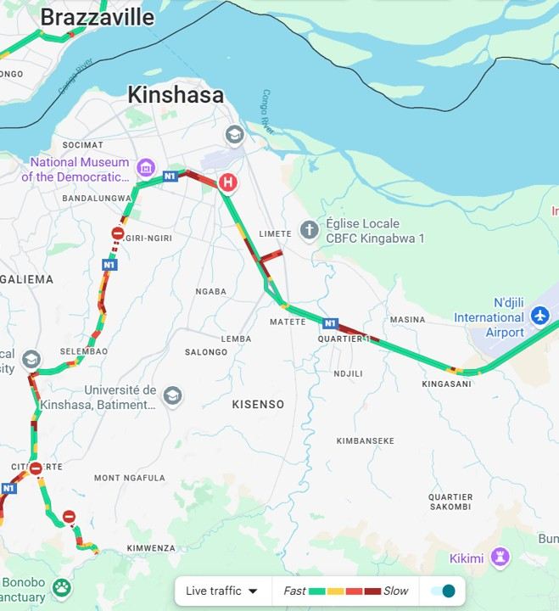
Crowdsourced Traffic Data
Real-time conditions
  Provide live information on congestion, delays, and incidents
  Examples: Traffic congestion layers on Google Maps, Waze accident alerts, live rerouting suggestions
Live traffic flow data for Kinshasa, DRC from Google map. On January 24, 13:25

Slide 22
Data Quality Issues
Accuracy
  Degree to which collected data represents true traffic conditions
  Affected by sensor errors, environmental conditions, and human mistakes
Completeness
  The extent to which data is fully captured over the required time and location
  Influenced by equipment failure, data loss, or interrupted observations
Calibration
  Process of adjusting instruments and models to reflect local conditions
  Ensures consistency and reliability of measured traffic parameters

Slide 23
Summary
Multiple methods available
Method depends on the objective
Technology evolving
Good data = good decisions
Understand limitations
Combine methods

Slide 24
Additional materials
https://www.fhwa.dot.gov/publications/research/operations/its/06108/06108.pdf

