Slide 1
Traffic Engineering
Lecture 2.1: Fundamental Traffic Flow Variables: Speed, Density, and Flow

Slide 2
Learning objectives
Understand the characteristics of the traffic stream
Define and explain key traffic stream parameters
Discuss the fundamental relationships among traffic stream parameters

Slide 3
Lecture outline
Traffic stream characteristics
Traffic Volume and Rate of Flow
Density, Speed, Headway, and Spacing
Relationship among Flow, speed, and density
Basic reference:
Roger P. Roess; Elena S. Prassas; William R. McShane, Traffic Engineering, 5th edition, Pearson, 2019

Slide 4
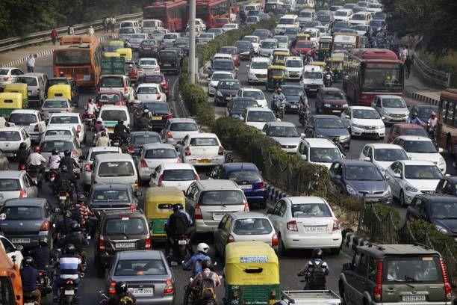
Traffic Stream Characteristics
Traffic stream
  resulted from the interaction of drivers, vehicles, and the roadway environment
  Highly variable due to humans/drivers’ behavior
  Can be an uninterrupted or interrupted flow
Traffic vs Fluid Flow
  Fluid flow is predictable and deterministic
  Traffic flow is stochastic and affected by driver behavior
  Hence, analysis requires probabilistic approaches

Slide 5
Traffic Stream Characteristics
Uninterrupted Flow Facilities
  No fixed external interruptions
  Freeways and controlled-access highways (suburban multilane highways and rural highways with long spacing)
  Flow governed by vehicle interactions
Interrupted Flow Facilities
  Presence of fixed interruptions such as intersections
  Traffic signals and stop control
  Results in platoons of vehicles
  Common in urban environments

Slide 6
Traffic Stream parameters
Traffic Stream parameters can be categorized as
Macroscopic parameters that describe the traffic stream as a whole. include
  Traffic Volume or rate of flow
  Density
  Speed
Microscopic parameters describe individual vehicle behavior. Include
  Speed of individual vehicle
  Headway
  Spacing

Slide 7
Traffic volume and Rate of Flow
Traffic Volume
  Number of vehicles passing a point
  Measured over a time interval usually “per day” or “per hour.”
  Key indicator of demand

Slide 8
Traffic volume and Rate of Flow
Daily traffic volumes
  Trend analysis
  Long-term planning
  Not sufficient for operational design
  There are four types of daily traffic volumes
  Average annual daily traffic (AADT)
  Average annual weekday traffic (AAWT)
  Average daily traffic (ADT)
  Average weekday traffic (AWT)
  Watch the following video
  https://www.youtube.com/watch?v=2mBjYZTeaTc

Slide 9
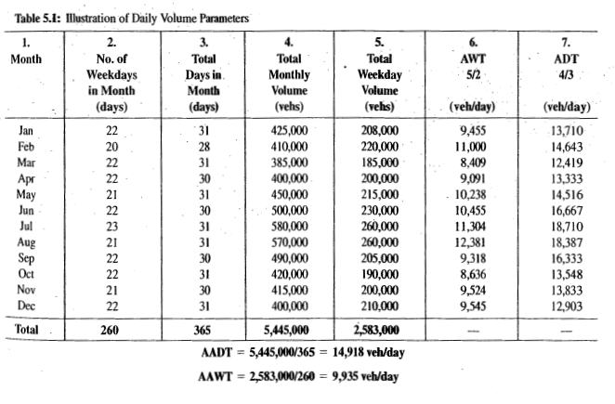
Example
Source: Traffic Engineering, 4th Edition,

Slide 10
Traffic volume and Rate of Flow
Hourly traffic volumes
  Traffic varies by time of day
  Peak hour is critical
  Design focuses on peak demand
Peak-hour volume
  Highest hourly volume of the day
  Direction-specific
  Critical for facility design
Source: Traffic Engineering, 4th Edition,

Slide 11
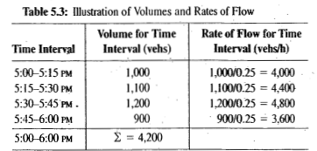
Traffic volume and Rate of Flow
Rate of Flow
  Volume expressed per unit time usually less than an hour
  Often veh/h
  calculated for short observation periods
q = n
t
Where,
q = flow rate, veh/hr
t = time period of observation
n= number of observed vehicles
Source: Traffic Engineering, 4th Edition,

Slide 12
Density
Defined as the number of vehicles occupying a given length of highway or lane
  Vehicles per unit length
  veh/Km or veh/Km/lane
  Best indicator of congestion
  Instantaneous and spatial parameter
Measuring section 1 km
Here: 5 vehicles/km

Slide 13
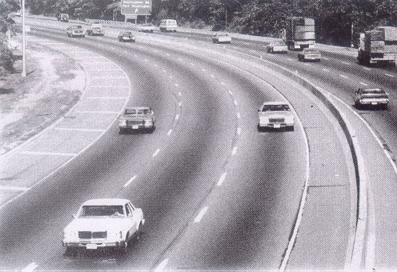
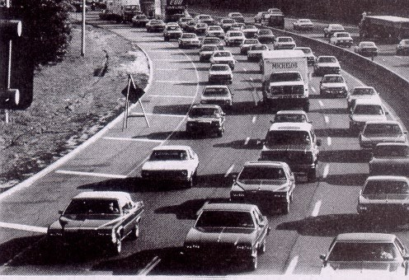
Density
"low traffic density"
"high traffic density"

Slide 14
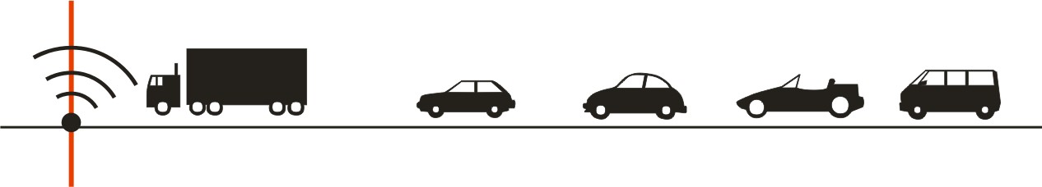

Speed (V)
In a moving traffic stream, each vehicle travels at a different speed.
An average speed for a traffic stream can be computed in two ways:
  Time mean speed (TMS) : is the average speed of all vehicles passing a point over some specified time period.
Where,
d= distance traversed, m
ti = time of vehicle “i” to traverse the section
n= number of observed vehicles

Slide 15

Speed (V)
  Space mean speed (SMS): is the average speed of all vehicles occupying a given section of highway or lane over some specified time period.
81 km/h
77 km/h
75 km/h
76 km/h
71 km/h
here: 76 km/h
Measuring section 500 m
Where,
d= distance traversed, m
ti = time of vehicle “i” to traverse the section
n= number of observed vehicles

Slide 16
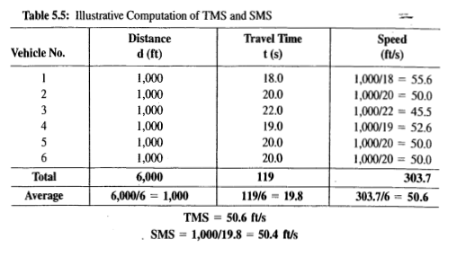
Speed (V)
Source: Traffic Engineering, 4th Edition,

Slide 17
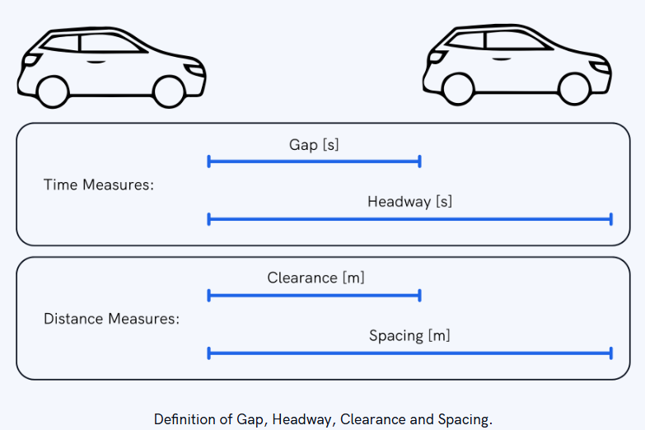
(Time) Headway
The (time) headway for vehicle i, h_{i}, is the time elapsed between arrivals of consecutive vehicles, generally measured between front bumpers.
Source: https://www.isarsoft.com/

Slide 18

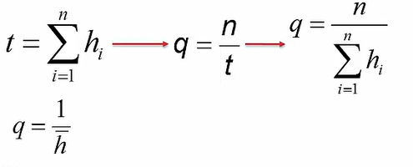
(Time) Headway
The summation of the headways of all vehicles is equal to the observation time period.
Mathematical relationships between flow, q, and average headway, h, can be established as:
Where,
t= duration of the time interval
hi = time headway of the i^{th} vehicle
n= number of vehicles passing the point

Slide 19
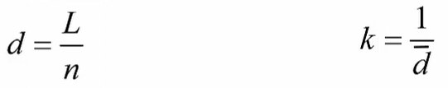
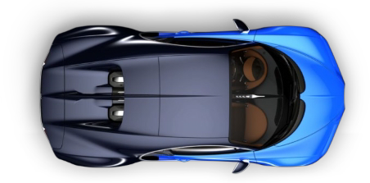
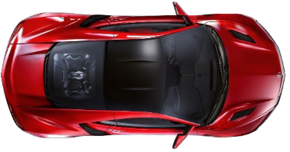
Spacing/ Space headway
Space headway, d, is the physical distance between the front bumper of successive vehicles.
Where,
d= space headway between vehicles
L = length of the road segment
n= number of vehicles observed
k = density (veh/km)
Spacing, d(m)
Clearance

Slide 20
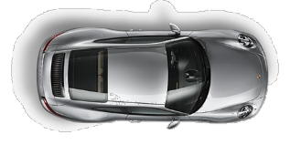
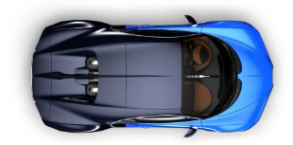

Direction of movement of the
vehicles
Measured at cross-section i,
Measured across the road segment, L
Traffic Volume
Flow
Time headway
Time mean speed
Density
Space headway/spacing
Space mean speed

Slide 21
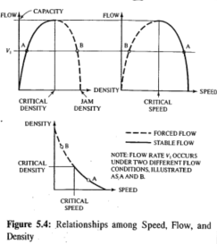
Relationship among Flow, speed and density
The three macroscopic measures of traffic stream, Flow (v), Speed (S), and Density (D), are related as follows:
      q= S * K
Where,
q = flow, veh/hr, or veh/hr/ln
S = space mean speed, Km/hr
K= density, veh/km or veh/km/ln
Source: Traffic Engineering, 4th Edition,

Slide 22
Example
A through lane in a multilane highway observed to have an average spacing of 50m and an average headway of 3.5 sec. Calculate the flow, density, and speed of traffic on this lane.
Solution:
flow= 1 / headway = 3600 sec/hr = 1028.6 veh/hr
3.5 sec
density = 1/ spacing = 1000m/km = 20 vehicle/Km
50m
speed = flow/ density = 1028.6 veh/hr = 51.4 Km/hr
20 veh/Km
Given:
d=50m
h= 3.5 sec
Required:
v=?
k=?
S=?

Slide 23
Discussion Questions
Why does traffic flow differ from fluid flow, and why can fluid-flow principles not be fully applied to traffic streams?
How can congested traffic conditions be explained using fundamental traffic flow parameters?
Which roadway in your vicinity exhibits the highest and lowest traffic density, and what factors explain this difference?

Slide 24
Additional materials
https://www.youtube.com/watch?v=okNd_G38n4o
https://www.youtube.com/watch?v=Chje8rIEUhU
https://www.youtube.com/watch?v=G7qU7HOw9QA
https://www.youtube.com/watch?v=AN85spukBoc

