Slide 1
Traffic Engineering
Exercise 5.2: Level of Service (LOS) Analysis -Concepts

Slide 2
Exercise
Estimate the free flow speed of a six-lane suburban freeway with 11-ft lanes, right-side lateral clearance of 2 ft, and ramp density of 4.5 /mi.
A six-lane freeway (three lanes in each direction) in rolling terrain has 10-ft lanes and obstructions 4 ft from the right edge of the traveled pavement. There are five ramps within three miles upstream of the segment midpoint and four ramps within three miles downstream of the segment midpoint. A directional peak-hour volume of 2000 vehicles (primarily commuters) is observed, with 600 vehicles arriving in the highest 15-minute flow rate period. The traffic stream contains 12% large trucks and buses, and no recreational vehicles. What is the density of the traffic stream and LOS of the facility?

Slide 3
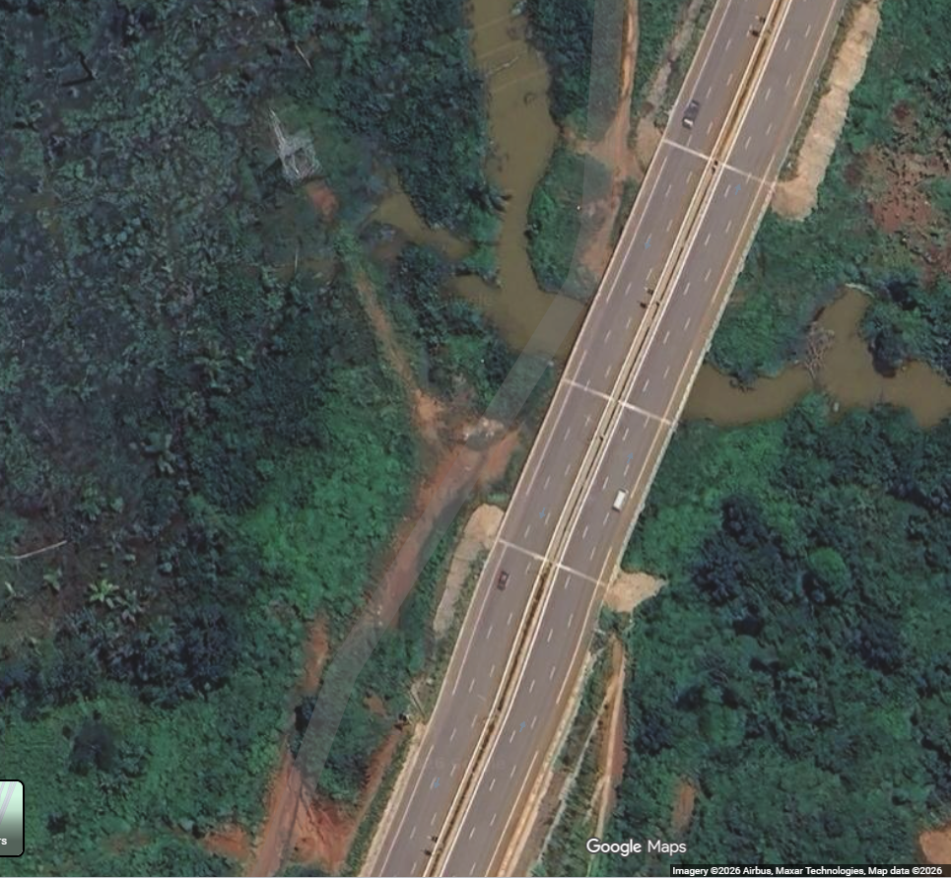
Exercise
Assume you want to assess the capacity and LOS of an urban freeway segment connecting Yaoundé City Center to Nsimalen Airport. The segment is a basic freeway section (no weaving influence), and the following basic data are collected or assumed.
  Lanes: 6-lane freeway (3 lanes per direction)
  Direction analyzed: Outbound direction
  Lane width: 11 ft
  Right lateral clearance: > 2 ft
  Total ramps within 3 mi upstream + 3 mi downstream: 10 ramps
  Peak hour volume (directional): V = 2,500 veh/h
  Highest 15-min volume in peak hour: V15 = 720 veh/15-min
  Heavy vehicles: 12% trucks/buses
  RVs: 0%
  Driver population: Commuter traffic (fp = 1.0)
  Terrain: Level
  Compute the freeway’s capacity and LOS.
Source: Google Maps accessed on 15.02.2026, time 4:15 PM

