Slide 1
Traffic Engineering
Lecture 4.3: Intersection Control

Slide 2
Learning objectives
Understand traffic control devices
Explain types and functions
Apply to traffic safety and operations

Slide 3
Lecture outline
Introduction
Hierarchy of Intersection Control
Level I: Basic rules of the road
Level II: YIELD or STOP Control
Level III: Traffic Control Signals
Basic reference:
Roger P. Roess; Elena S. Prassas; William R. McShane, Traffic Engineering, 5th edition, Pearson, 2019
https://mutcd.fhwa.dot.gov/

Slide 4
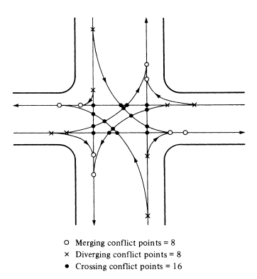
Introduction
An at-grade intersection is the most complex location in the highway system,
For instance, at a typical four-leg two-way intersection,
    There are 12 vehicle movements
    Four pedestrian crossing movements
    16 vehicle crossing conflicts
Typical conflicts at a four-leg intersection
Source: Traffic Engineering, 5th edition, Pearson, 2019

Slide 5
Introduction
The critical task of a traffic engineer is to control and manage conflicts, ensuring safety and efficient movements,
Two factors that affect a driver’s ability to avoid conflict are:
    Ability to see conflicting vehicles/pedestrians in time to implement an avoidance maneuver (Consideration of sight distance and avoidance maneuver)
    Volume levels must allow reasonable opportunities for safe maneuver (assessment of demand intensity and complexity of conflicts)

Slide 6
Hierarchy of intersection Control
There are three basic level of intersection controls:
  Level I: Basic rules of the road
  Level II: Direct assignment of right-of-way using YIELD or STOP signs,
  Level III: Traffic signalization

Slide 7
Level I: Basic rules of the road
  Apply at any intersection where right-of-way is not explicitly assigned through the use of a traffic signal, STOP, or YIELD signs,
  Responsibility for avoiding potential conflict is assigned to the vehicle on the LEFT,
  Through vehicles have priority over turning vehicles

Slide 8
Level I: Basic rules of the road
Drivers must see each other in time to assess the hazard
Sight distances must be sufficient to allow avoidance action
The sight triangle must be sufficiently large to ensure that at no time could two vehicles be on a conflicting path at a distance and speed that leads to an accident,

Slide 9
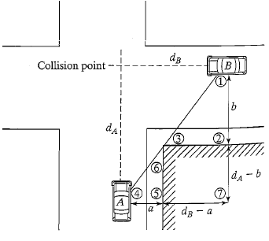
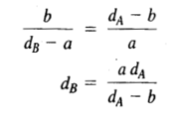
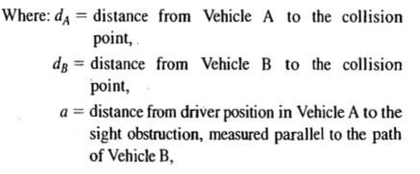

Level I: Basic rules of the road
The sight lines form 3 similar triangles (∆132, ∆147, ∆645),
Accordingly, the following relationship
Visibility triangles at the intersection
Source: Traffic Engineering, 5th edition, Pearson, 2019

Slide 10
Level I: Basic rules of the road
AASHTO suggests that, to ensure safe operation with no control, both drivers should be able to stop before reaching the collision point.
Hence, d_{A} and d_{B} should be equal to or greater than the safe stopping distance at the point where visibility is established
It also suggests to use 85th percentile speed and reaction time t = 2.5 sec

Slide 11

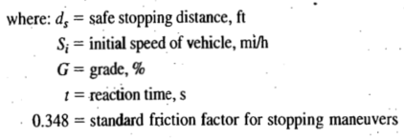
Level I: Basic rules of the road

Slide 12

Level I: Basic rules of the road
Analysis Steps:
Assume Vehicle A is located one safe stopping distance from the collision point (i.e., d_{A}=d_{s}​) using Equation -2. Vehicle A is typically on the minor street.
Using Equation 1, determine the location of Vehicle B when the drivers first see each other. This is the actual visibility distance, d_{Bact}.​
Since both vehicles must have at least one safe stopping distance, compute the minimum required distance for Vehicle B using Equation 2. This becomes d_{Bmin}​.
The intersection is safe under basic road rules (no control) if:

Slide 13
Level I: Basic rules of the road
Analysis Steps (continued):
If for any of the sight triangles, d_{Bact} < d_{Bmin,} then operation using no control can not be permitted.
  Three potential remedies when d_{Bact} < d_{Bmin,}
    Implement STOP or YIELD-control or traffic signal
    Lower the speed limit on the major road to a level where sight distances are adequate
    Remove or reduce sight obstructions to provide adequate sight distance

Slide 14
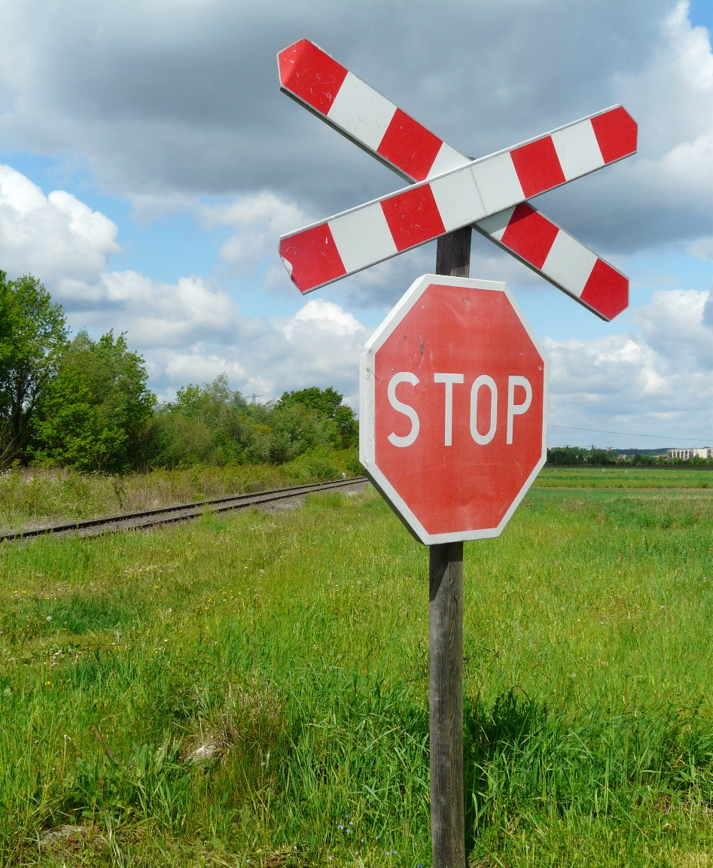
Level II: YIELD or STOP Control
According to the MUTCD manual
STOP or YIELD signs should be used at an intersection if one or more of the following conditions exist:
    An intersection of a less important road with a main road where application of the normal right-of-way rule would not be expected to provide reasonable compliance with the law;
    A street entering a designated through highway; and/or
    An unsignalized intersection within a signalized area.

Slide 15
Level II: YIELD or STOP Control
Two-Way STOP Control
is the most common Level II control
According to the MUTCD guideline, STOP signs shall not be installed:
    At the intersection where traffic control signals are installed and operating
    For the purpose of speed control
In general STOP sign is installed on minor roads

Slide 16
Level II: YIELD or STOP Control
Sight distance criteria for STOP-controlled intersection (AASHTO)
    Based on observed gap acceptance behavior of drivers
    The distance to collision point d_{A} has three component
      Distance from the driver eye to the front of the vehicle (assumed to be 8 ft)
      Distance from front of vehicle to the curb line (assumed to be 10ft)
      Distance from curb line to the center of right-most travel lane (d_{cl} )

Slide 17
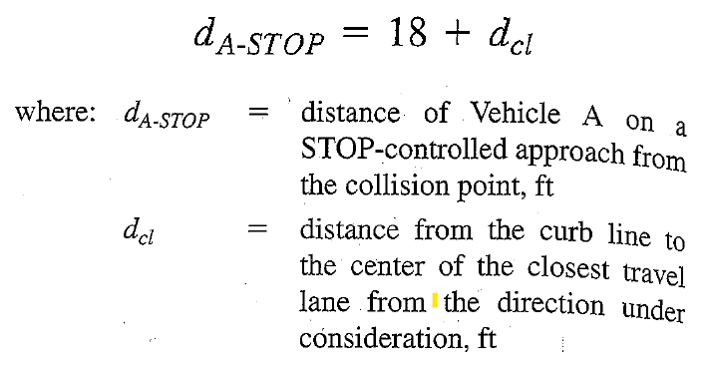
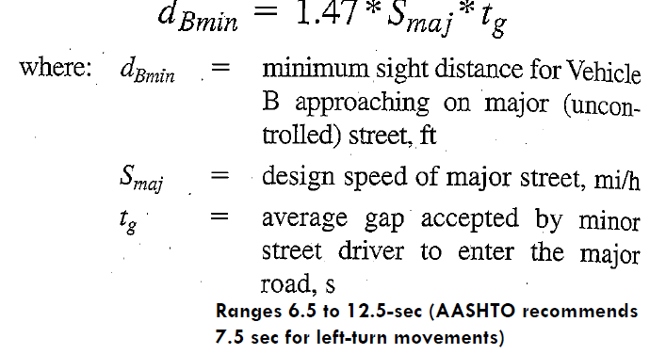
Level II: YIELD or STOP Control
Sight distance criteria for STOP-controlled intersection (AASHTO)

Slide 18
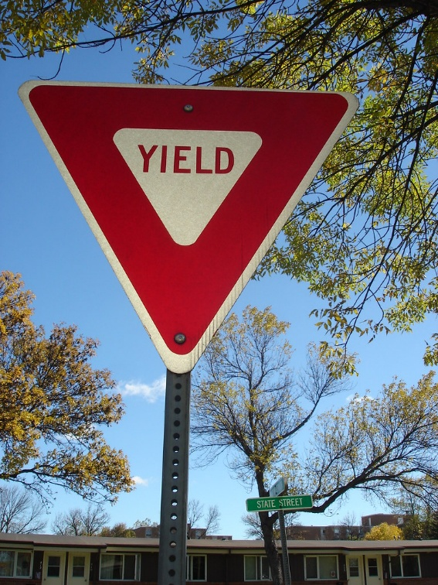
Level II: YIELD or STOP Control
YIELD Control:
Assign right-of-way to the major uncontrolled roads
YIELD-controlled approaches slow to 8-10 mi/hr before entering the major roads.
This Photo by Unknown Author is licensed under CC BY

Slide 19
Level II: YIELD or STOP Control
According to MUTCD, YIELD signs may be installed:
When sight distance is adequate for road users traveling at the posted speed, 85th percentile speed, or statutory speed to pass through or stop safely.
For merge-type movements where acceleration geometry or sight distance is inadequate for safe merging.
At the second crossroad of a divided highway with a median width of 30 ft or more, a STOP sign may be used at the first roadway entrance and a YIELD sign at the second.
At intersections with special problems where engineering judgment indicates a YIELD sign can correct the issue.

Slide 20
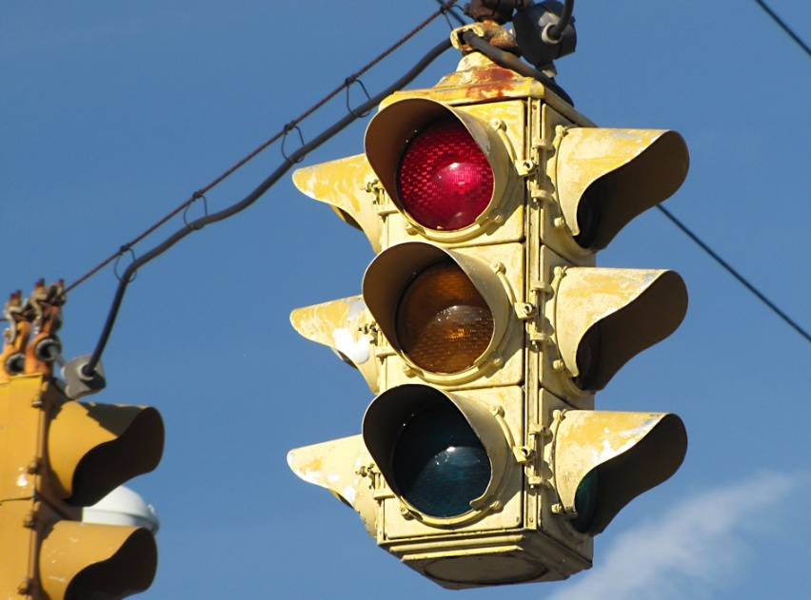
Level III: Traffic Control Signals
The ultimate form of intersection control
Substantially reduce intersection conflicts
Alternatively assigns right-of-way to specific movements
Due to high cost and introduction of delay, the use of the traffic signal should be the last option

Slide 21
Level III: Traffic Control Signals
Advantages:
Improved safety (reduced right-angle collision)
Increase capacity and improve LOS
Provide orderly movement
Can be coordinated to provide a continuous flow of traffic on certain routes

Slide 22
Level III: Traffic Control Signals
Disadvantages: (if not properly designed or used where it is not warranted)
Excessive delay (may be due to cycle lengths that are too short for exiting demand)
Increasing disobedience of the signal indications
Increase the use of less adequate routes as road users attempt to avoid traffic control signals
Increase the frequency of collisions (especially rear-end collisions)

Slide 23
Level III: Traffic Control Signals
Warrants for Traffic Signals (MUTCD)
Eight-hour vehicular volume
Four-hour vehicular volume
Peak hour
Pedestrian volume
School crossing
Coordinated signal system
Crash experience
Roadway network

Slide 24
Level III: Traffic Control Signals
Warrant 1: Eight-hour vehicular volume
  Used when heavy volumes persist for ≥8 hours
  Condition A: heavy volume of conflicting cross movements, making it difficult to select gaps for safe passage (minimum vehicular volume)
  Condition B: Volume on major roads is heavy so that no minor road vehicle can safely pass (interruption of continuous traffic)

Slide 25
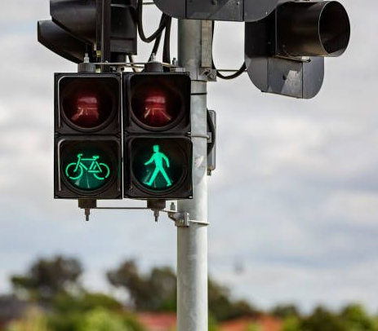
Level III: Traffic Control Signals
Warrant 1: Eight-hour vehicular volume
  Warrant is met when:
    Either condition A or B is met 100%
    Either condition A or B is met to the 70% level (for small community or major road approach speed is 40mi/hr or higher)
    Both conditions A and B are met to the 80% level

Slide 26
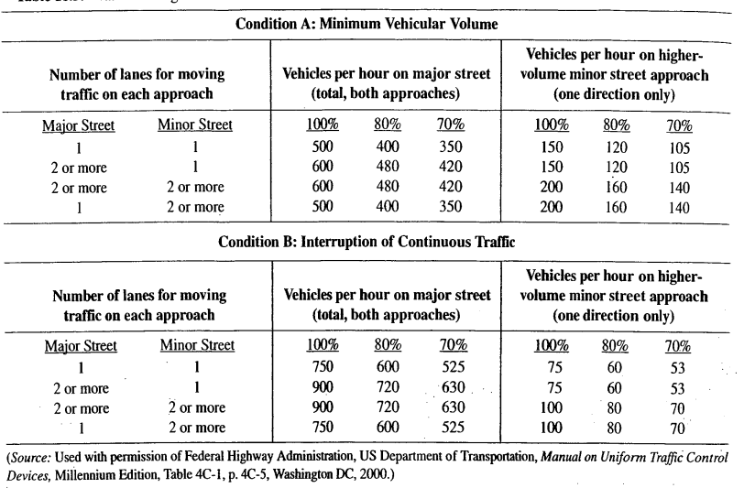
Level III: Traffic Control Signals
Warrant 1: Eight-hour vehicular volume

Slide 27
Level III: Traffic Control Signals
Warrant 2: Four-hour vehicular volume
    Used when high volumes occur for a shorter period, less than 8 hours
    The two-way major-street volume is plotted against the highest one-way volume on the minor street for each hour of the study period
    To meet the warrant, at least four hours must plot above the appropriate decision curve.

Slide 28
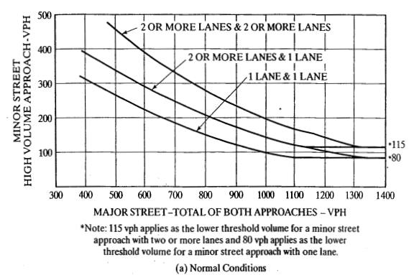
Warrant 2: Four-hour vehicular volume
Source: Traffic Engineering, 5th edition, Pearson, 2019

Slide 29
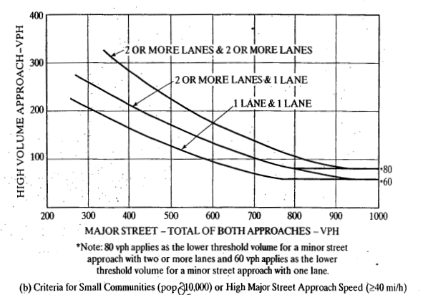
Warrant 2: Four-hour vehicular volume
Source: Traffic Engineering, 5th edition, Pearson, 2019

Slide 30
Level III: Traffic Control Signals
Warrant 3: Peak Hour
    Addresses two critical situations
      A volume condition, similar to warrant 2 (Only one hour plot above the appropriate decision line)
      A delay warrant
          If either condition is satisfied, the peak-hour warrant is met.

Slide 31
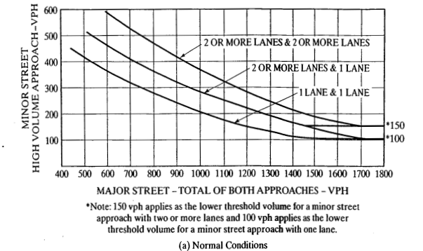
Warrant 3: Peak Hour
Source: Traffic Engineering, 5th edition, Pearson, 2019

Slide 32
Reading Exercise
Please read the following reference book and MUTCD for the remaining warrants of Level III control.
Basic reference:
Roger P. Roess; Elena S. Prassas; William R. McShane, Traffic Engineering, 5th edition, Pearson, 2019
https://mutcd.fhwa.dot.gov/

