Slide 1
Traffic Engineering
Lecture 2.3: Queuing Theories

Slide 2
Learning objectives
Discuss the fundamentals of queueing theory
Understand deterministic and stochastic queue analysis
Define the parameters required to fully specify a queue
Analyze the performance of systems in queue

Slide 3
Lecture outline
Basics of Queueing Theory
Queueing theories: Deterministic analysis
Queueing theories: Stochastic analysis
Basic reference:
Garber, N. J., & Hoel, L. A. (2009). Chapter 6: Fundamental Principles of Traffic Flow. In Traffic and Highway Engineering (4th ed., pp. 253–305).

Slide 4
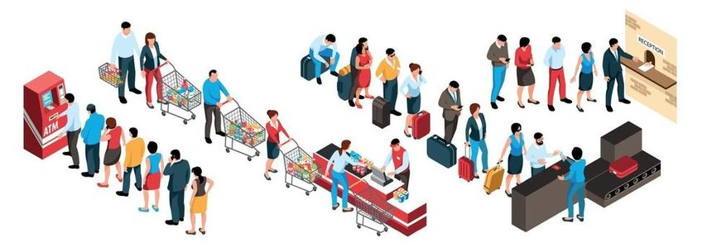
Basics of Queueing Theory
Watch the following video and summarize the key principles of queueing theory.
https://www.youtube.com/watch?v=SqSUJ0UYWMQ

Slide 5
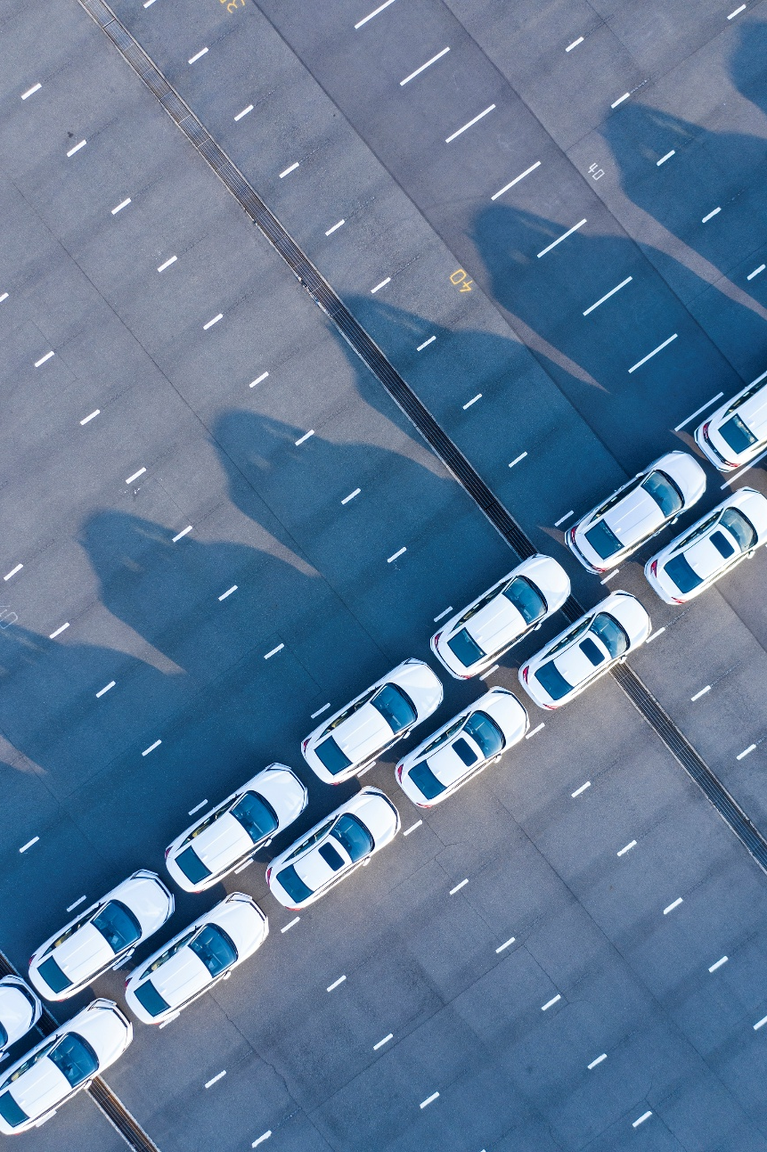
Queuing Theories
Queueing theory in traffic engineering involves mathematical modeling to describe the processes by which traffic queues form and dissipate.
On uninterrupted flow, queues form behind breakdown points at which arriving demand flow exceeds capacity,
On interrupted flow facilities, queueing forms at every signalized intersection.

Slide 6
Queuing Theories
It is used to analyze the delay, queue length, and service efficiency at bottlenecks such as toll booths, signalized intersections, and construction zones.
Queueing theory is generally divided into two analytical approaches:
  Deterministic (for oversaturated conditions) and,
  Stochastic (for random arrivals).

Slide 7

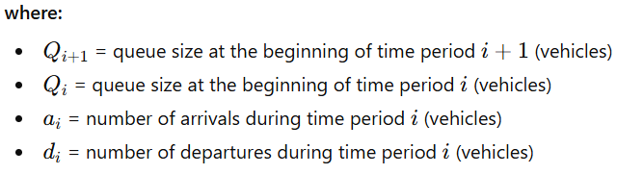
Queuing Theories
Deterministic Queueing Analysis
The length of the queue is the difference between arrivals and departures at a point.

Slide 8
Example
Consider a section of a three-lane highway with a capacity of 2000 veh/hr/ln. If an incident occurs that results in the closure of one lane for 90 minutes. Assume the demand volume is 5000 veh/hr throughout the incident period.
  Before the incident, the is NO QUEUE because the DEMAND VOLUME is less than the CAPACITY.
  During the incident, the demand volume (arriving vehicles) is higher than the reduced capacity of the road, which results in the formation of a QUEUE.
  Once the incident is removed, the QUEUE will take some time to dissipate, and the normal flow will be restored.
  The following Figures show the scenario presented above.

Slide 9
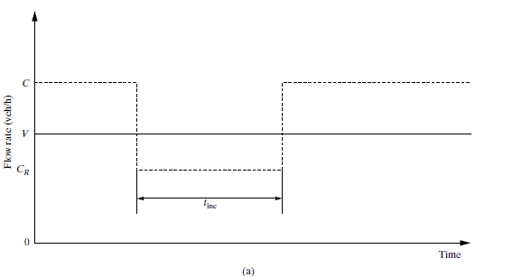
Queuing diagram for an incident situation
Source: Garber, N. J., & Hoel, L. A. (2009). Traffic and Highway Engineering (4th ed., pp. 251)

Slide 10
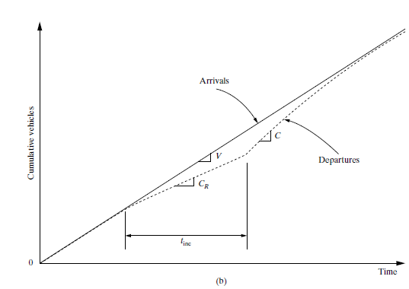
Queuing diagram for an incident situation
Source: Garber, N. J., & Hoel, L. A. (2009). Traffic and Highway Engineering (4th ed., pp. 251)

Slide 11
Example (continued..)
The maximum queue length is the excess demand rate multiplied by the duration of the incident:
          q _{max} = (demand flow – reduced capacity)* time of incident
          = (5000veh/hr – 2 lane * 2000 veh/hr/ln)* 1.5 hr
          = 1500 vehicles
The time duration of the queue is the queue length divided by the excess capacity (capacity minus demand rate)
          t _{q} = (demand flow – reduced capacity)* time of incident
          (Capacity – demand flow)
          = (5000veh/hr – 2 lane * 2000 veh/hr/ln)* 1.5 hr
          (3 lane* 2000 veh/hr/ln - 5000 veh/hr)
          = 1500 veh
          1000 veh/hr
          = 1.5 hours

Slide 12
Queuing Theories
Stochastic Queueing Analysis
Stochastic queue analysis is a method used to evaluate traffic scenarios where arrival rates and service times are random rather than deterministic.
This approach is most applicable to light-to-medium traffic conditions, where arrivals follow probabilistic patterns (often modeled by a Poisson distribution).
However, deterministic patterns seen in high-volume congestion

Slide 13
Queuing Theories
Stochastic Queueing Analysis
Requirements for proper queue specification
  Arrival Distribution: How vehicles arrive (e.g., Uniform, Poisson, etc.)
  Service Method: The order in which vehicles are served (typically First-Come–First-Served, priority, or random)
  Queue Length Characteristics: Whether the queue is finite (limited waiting space) or infinite (unrestricted space).
  Service Distribution: The time pattern for servicing vehicles (e.g., negative exponential distributions)
  Channel Layout: The number of waiting lines (single or multiple)
  Oversaturated (q > Q) and undersaturated (q< Q) queues:

Slide 14
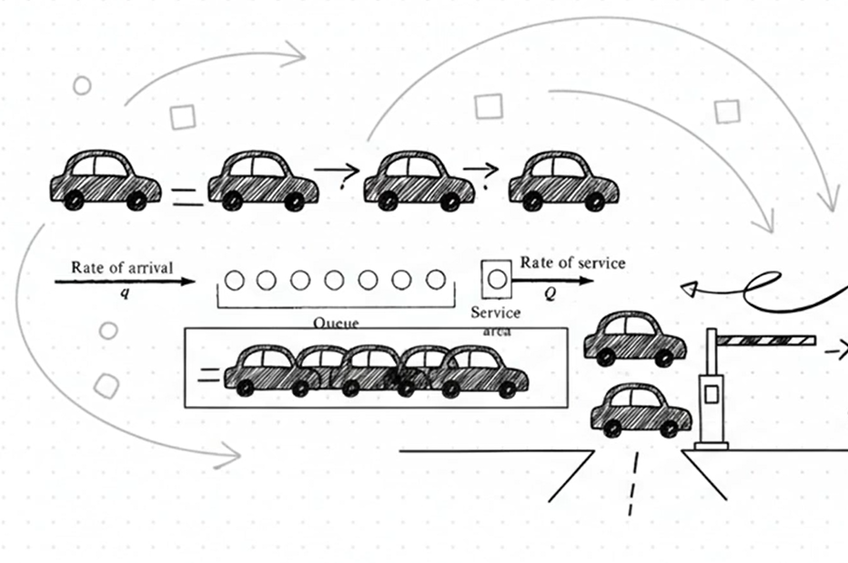
Queuing Theories
Stochastic Queueing Analysis
Scenario-1: Single-Channel, Undersaturated, Infinite Queues
Assume an arrival rate of q veh/hr and a service rate of Q veh/hr, where Q > q, and both rates of arrival and service are random, the following relationship can be established:

Slide 15




Queuing Theories
Stochastic Queueing Analysis
Scenario-1: Single-Channel, Undersaturated, Infinite Queues
Probability of “n” vehicles in the system, P(n)
Expected number of vehicles in the system, E(n)
Expected number of vehicles waiting for service (mean queue length), E(m)
Average waiting time in queue, E(w)

Slide 16
Example: Application of the Single-Channel, Undersaturated, Infinite Queue Theory to a Tollbooth Operation
On a given day, 425 Veh/hr. arrive at a toll booth with a single-channel service at a rate of 625 Veh/hr. Determine (a) the percentage of time the operator of the tool booth will be free, (b) the average number of vehicles in the system, and (c ) the average waiting time in the queue (Assume Poisson arrival and negative binomial service time).
Solution:
q=425, and Q=625, hence the condition Q >q is satisfied, and the flow is undersaturated. For the operator to be free, the number of vehicles in the system must be zero. Hence, P(0) is
      P(0) = 1-q/Q = 1 – (425/625) = 1- 0.68 = 0.32
      Hence, the operator is free for 32% of the time.
Adapted from: Garber, N. J., & Hoel, L. A. (2009. Traffic and Highway Engineering (4th ed., pp. 256).

Slide 17
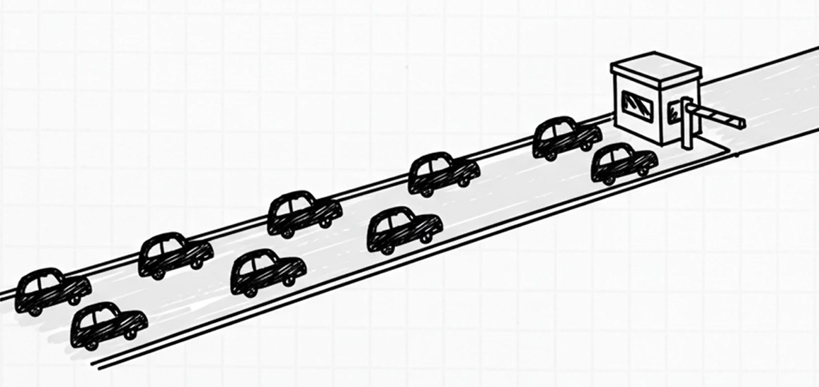
b) The average number of vehicles in the system will be
    E(n) = q = 425 = 2 vehicles
    (Q-q) (625-425)
b) The average waiting time in the queue will be
    E(w) = q = 425 = 12 seconds
    Q(Q-q) 625(625-425)

Slide 18
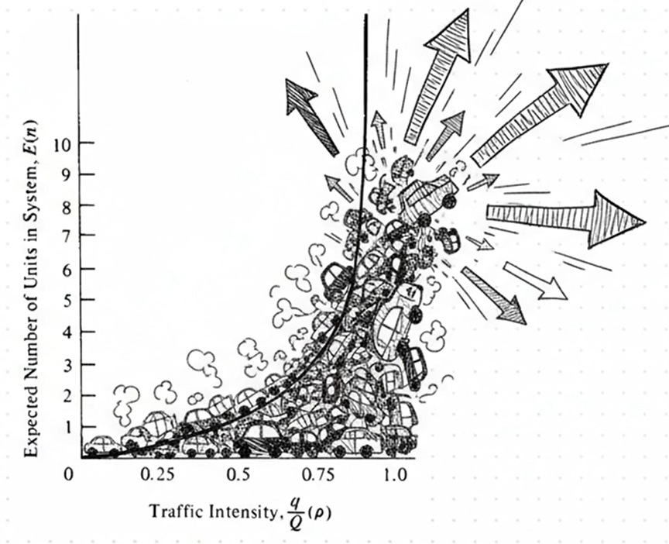
Queuing Theories
Stochastic Queueing Analysis
As traffic intensity (q/Q) increases, the expected number of vehicles in the system increases exponentially,
As the intensity tends to approach 1, the expected number of vehicles tends to infinity, and the rupture of the system.
As a rule of thumb, it is useful to keep the ratio below 0.85 and certainly below 0.9.

Slide 19
Discussion Questions
How does the "two-capacity" phenomenon challenge the accuracy of standard deterministic queueing models during facility breakdowns, and what are the practical implications for predicting clearance times?
Traffic engineers often apply a rule of thumb to keep the q/Q ratio below 0.85 or 0.90. Why is "wasted" capacity considered a necessary requirement for a high level of service, and how does this contradict the goal of maximizing resource utilization?

Slide 20
Additional materials
https://www.youtube.com/watch?v=d6WC3TPMDuA&list=PLneifN52CCdu_uMCA-R6zHD_1YYxVS0Oe&index=12
https://www.youtube.com/watch?v=EGgTcr6aBFU&list=PLneifN52CCdu_uMCA-R6zHD_1YYxVS0Oe&index=13
Garber, N. J., & Hoel, L. A. (2009). Chapter 6: Fundamental Principles of Traffic Flow. In Traffic and Highway Engineering (4th ed., pp. 253–305).

