Slide 1
Traffic Engineering
Lecture 1: Introduction to Traffic Engineering

Slide 2
Learning objectives
Understand the scope of traffic engineering
Explain the objectives and responsibilities of traffic engineers
Discuss the key elements and concepts of traffic engineering

Slide 3
Lecture outline
Traffic engineering as a profession
Objectives, Goal and Application of traffic engineering
Responsibility, Ethics and Liabilities
Mobility Vs Accessibility
Key elements of traffic engineering
Basic reference:
Roger P. Roess; Elena S. Prassas; William R. McShane, Traffic Engineering, 5th edition, Pearson, 2019

Slide 4
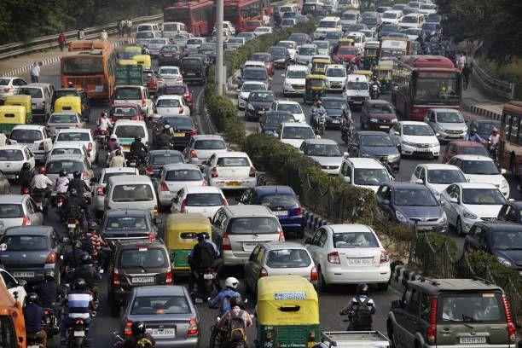
Traffic Engineering as a Profession:
Definition
  As per the Institute of Transportation Engineers,
Transportation Engineering is the application of technology and scientific principles to planning, functional design, operation, and management of facilities for any mode of transportation to provide safe, rapid, comfortable movement of goods and people.
And
Traffic Engineering is that phase of transportation engineering which deals with the planning, geometric design and traffic operations of roads, streets, and highways, their networks, terminals, abutting lands, and relationship with other mode of transportation.

Slide 5
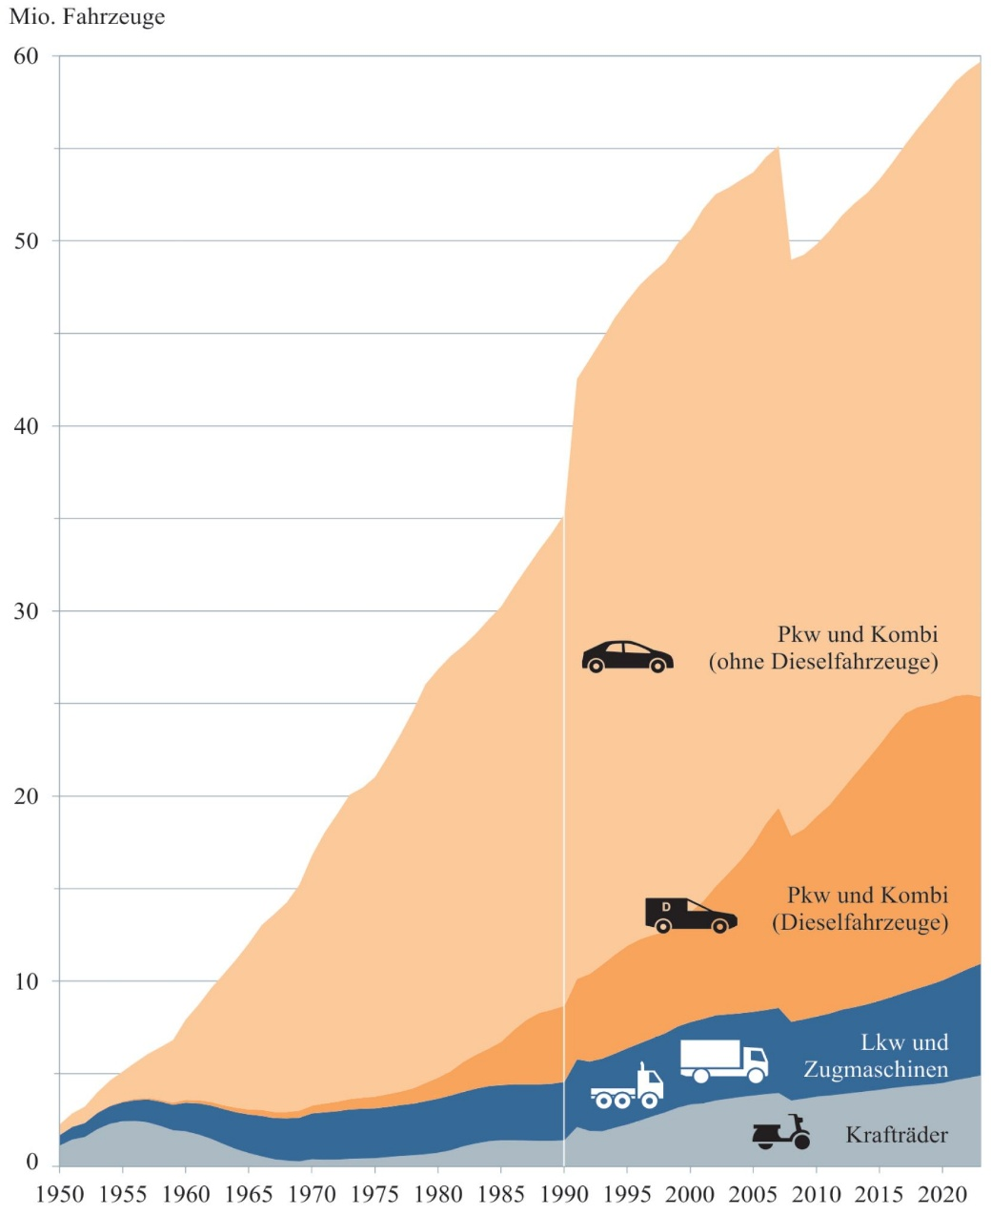
Evolution of Traffic Engineering
Growth of motorization
Need for traffic control and safety
Transition from vehicle-focused to people-focused systems planning
Source: BMVI, Transport in Figures 2023/2024

Slide 6
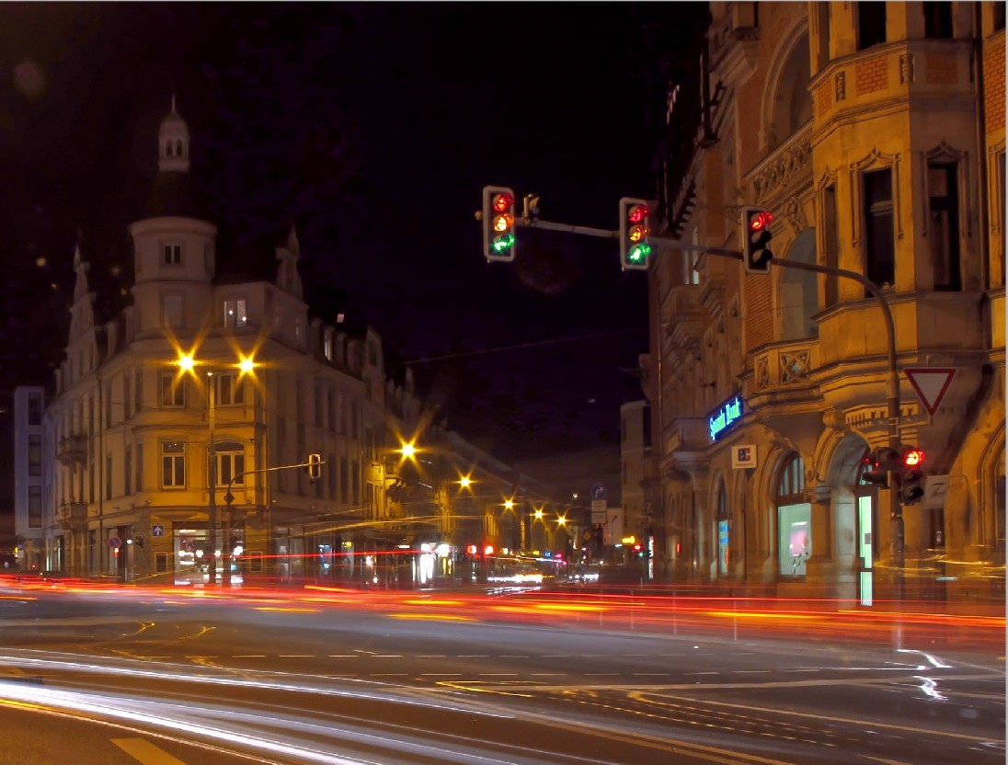
Traffic Engineering as a Profession:
Traffic Engineering deals with:
the regulations and organization of the traffic flow,
the design and dimensioning of the Transportation facilities,
the methods and technologies for recording and describing the traffic flow and
the spatial-temporal influence of traffic events in both private and public transport
It includes calculation and dimensioning methods for traffic systems for private and public transport (differentiated according to routes, junctions, and road networks)

Slide 7
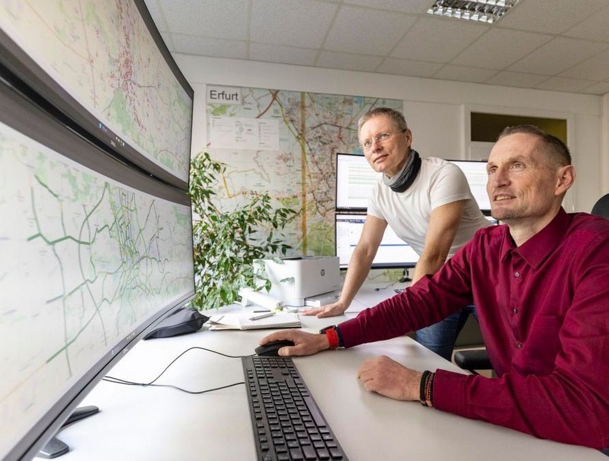
Objectives of Traffic Engineering
Safety is the foremost objective
Speed and efficiency
Comfort and convenience
Economy and affordability
Environmental compatibility
Balancing Objectives
  Trade-offs between speed and safety
  Equity among different road users
  Resource limitations in developing countries

Slide 8
Goal and Tasks
Avoid congestion and bottlenecks through appropriate planning, design, and operational measures
Optimize the use of existing transport infrastructure by applying effective traffic management strategies, including:
    Better utilization of available capacity across different locations and time periods.
    Continuous monitoring of traffic conditions using detection and sensing technologies
    Systematic collection, processing, and storage of traffic data in centralized databases
Reduce the negative impacts of motorized individual transport (MIT), including Air pollutants and greenhouse gas emissions, noise, land consumption, and environmental degradation

Slide 9
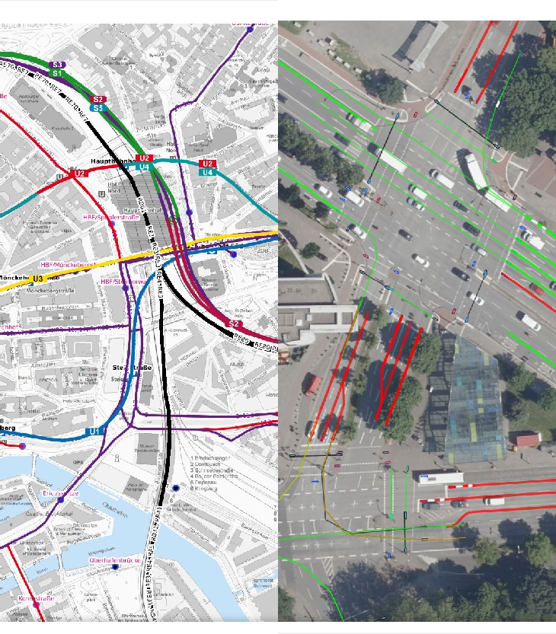
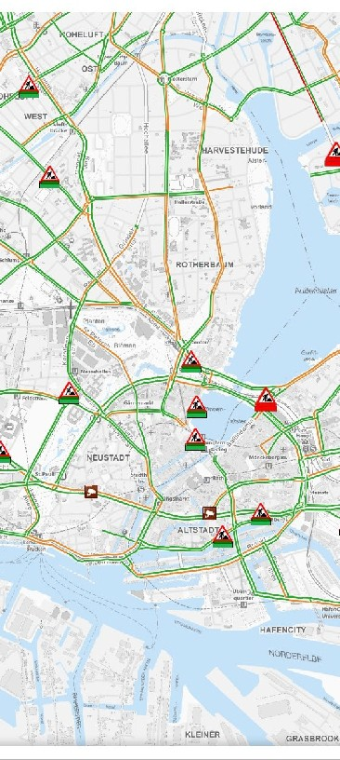
Application Examples
Control and regulation of traffic flow for both private and public transport systems
Traffic management and operations, including signal control, corridor management, and incident response
Analysis, forecasting, and control of traffic demand to improve system efficiency and reliability
Quality management in transportation, focusing on safety, reliability, level of service, and user satisfaction
Traffic modeling and simulation to support planning, design, and operational decision-making
Traffic and environmental data collection, including detection of flows, speeds, emissions, and noise
Assessment of transport–environment interactions, including impacts and mitigation potential
Intelligent vehicle and transport systems, such as vehicle-to-vehicle (V2V) and vehicle-to-infrastructure (V2I) communication
Highly automated and connected driving technologies, and their implications for traffic flow and safety

Slide 10
Responsibility, Ethics, and Liability of the Traffic Engineer
Responsibility
  Direct impact on public safety
  High ethical and professional responsibility
  Accountability to society
Ethics and Professional Practice
  care and non-arbitrary decisions
  Honest communication of impacts
  Compliance with standards and guidelines
Liability
  Failure to meet standards
  Poor maintenance of traffic control devices
  Inadequate or incomplete analysis

Slide 11
Transportation Systems Overview
Highways, transit, rail, air, water, and non-motorized modes
Together form the physical and operational backbone for the movement of people and goods.
Integrated system perspective
Modes must function as a coordinated, multimodal network, with effective connections between facilities, terminals, and transfer points.
Support economic and social activities
Enable daily travel, freight distribution, regional development, and access to employment, education, and services.
Influence land use and development patterns
Transportation systems shape urban form, accessibility, and the spatial distribution of economic activities.

Slide 12
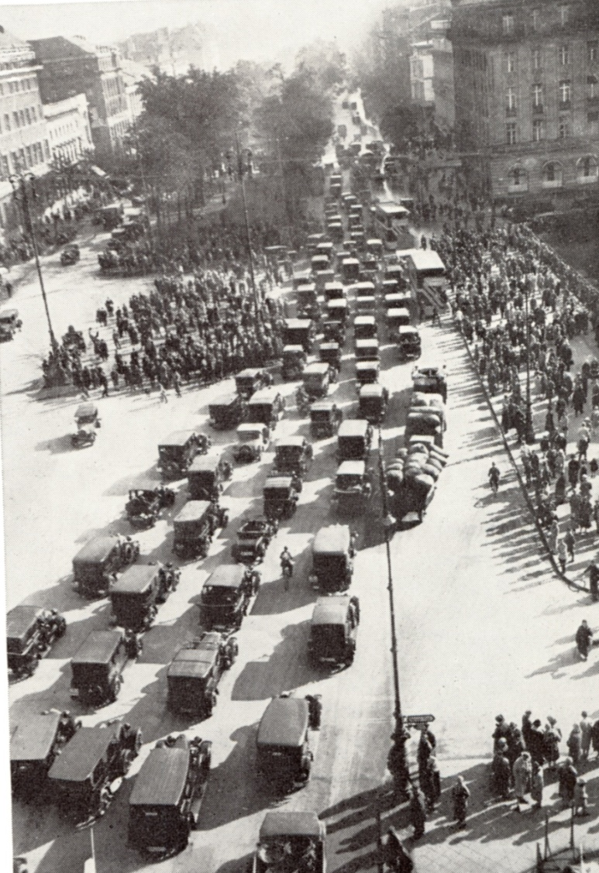
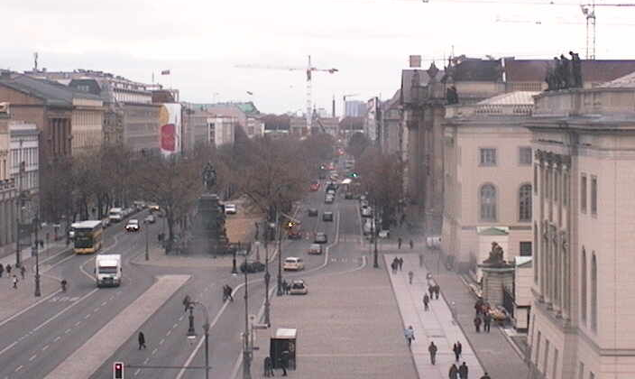
Traffic planning changes cities
1930
Berlin
2008

Slide 13
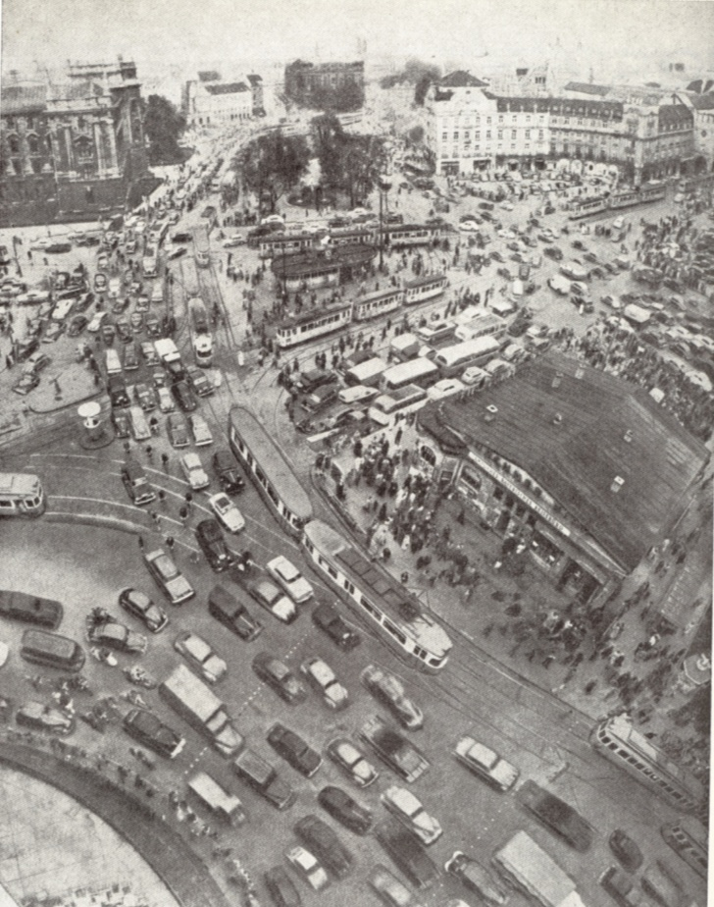
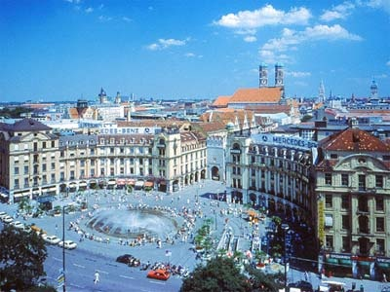
Traffic planning changes cities
1957
Munich Stachus
2007

Slide 14
Transportation Systems: African Perspective
Rapid urbanization and spatial expansion
Accelerated urban growth, often unplanned, has increased travel demand and strained existing transport infrastructure.
High reliance on road transport
Roads dominate passenger and freight movement, with limited modal diversification compared to rail or inland waterways.
Limited public transport capacity in many cities
Formal public transport systems are frequently insufficient, leading to congestion, overcrowding, and reliance on informal services.
Significant role of non-motorized and informal modes
Walking, cycling, and paratransit modes play a critical role in daily mobility, particularly for low-income populations.

Slide 15
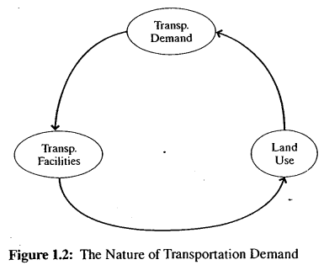
Transportation Demand
Derived from land use
Continuous and self-reinforcing process
Difficult to predict accurately
Induced Demand
New roads generate new traffic
Common in growing African cities
Importance of demand management

Slide 16
Mobility vs Accessibility
Two strongly interrelated but distinct concepts
Mobility refers to the ability to travel to many different destinations with relative ease, speed, and convenience,
      Provide a wide range of choices of where to go and an efficient trip
      Allow choice among competing trip purposes
Accessibility refers to the ability to gain entry to a particular site or area.
      Major factor in the value of land
      Proximity to major highway and public transportation facilities
Mobility and accessibility are two competing functions of transportation facilities and are not necessarily compatible.

Slide 17
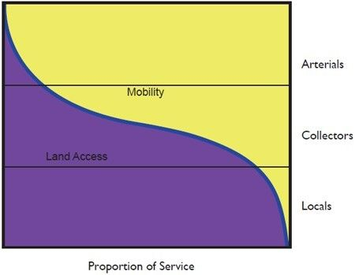
Mobility and Accessibility in Practice
Highways prioritize mobility
Local streets prioritize access
Poor separation increases conflict, congestion, and safety risk

Slide 18
People, Goods, and Vehicles
Vehicles are the common unit and the medium of movement, but not the goal
Modern traffic engineering focuses more on people and goods to evaluate capacity.
Focus on the movement of people and goods
Vehicle occupancy matters
      1 Bus of 50 passengers = 50 passenger cars carrying one person
      = 25 passenger cars carrying two persons

Slide 19
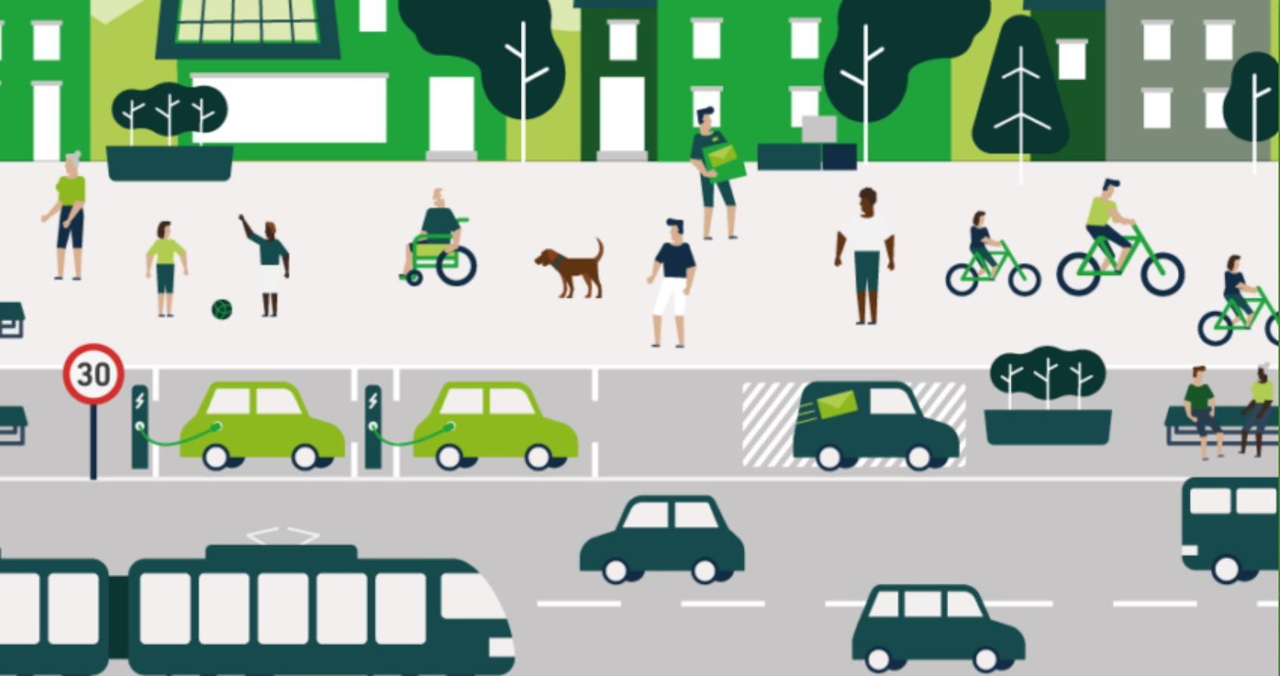
Transportation Modes
Primary modes include Automobile, bus, rail, air, water, and pipe
Formal and informal modes
Non-motorized transport importance
Multimodal Integration
Transfers between modes
Terminal and access design
Key role of traffic engineers

Slide 20
Elements of Traffic Engineering
There are a number of key elements of traffic engineering:
    Traffic studies and characteristics
      Volumes, speeds, delays, crashes
      Manual and automated methods
      Data scarcity in African cities
    Performance evaluation of facilities
      Capacity analysis
      Level of Service (LOS) concept
      Limitations in heterogeneous traffic
    Facility Design
      Functional and geometric design of facilities
      Provide context-sensitive solution
      Accommodation of non-motorized traffic (NMT)

Slide 21
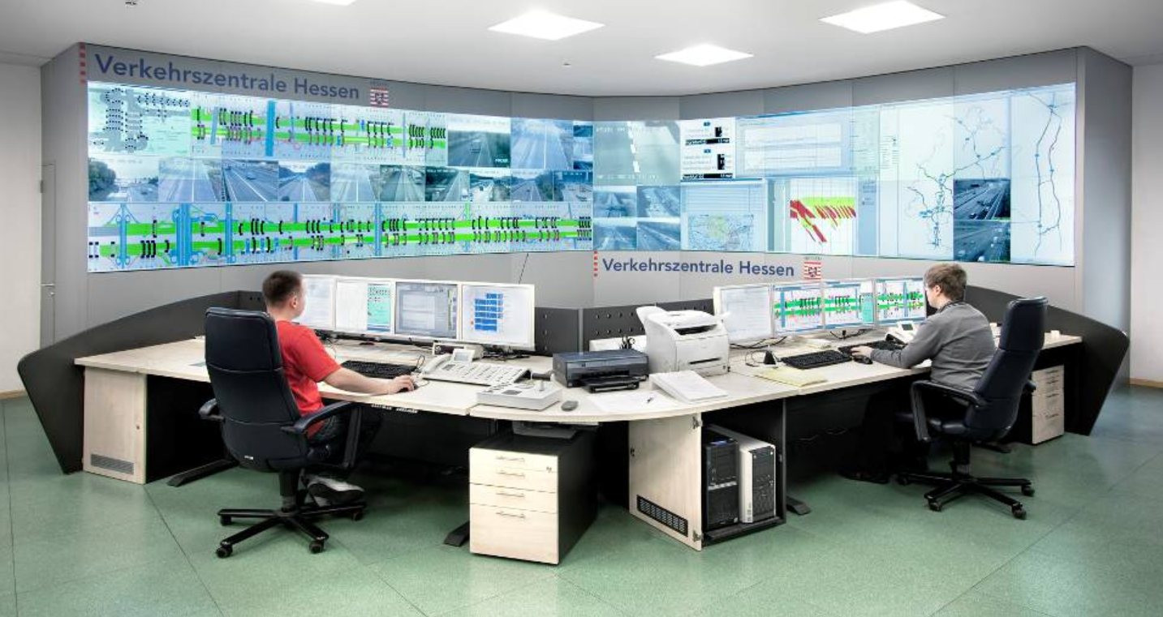
Elements of Traffic Engineering
    Traffic Control
      Traffic signs, markings, and signals
      Regulatory, warning, and guidance functions
      Maintenance challenge
    Traffic Operation
      One-way systems
      Signal coordination
      Incident management
    Transport Systems Management
      Optimizing existing capacity
      Demand management strategies
      Cost-effective for low-income context
    Intelligent Transportation Systems
      Use of ICT in transport
      Traffic surveillance and control
      Emerging technology for adaption in Africa

Slide 22
Modern Challenges for Traffic Engineers
Urban traffic congestion
Rapid motorization
Limited funding
African Urban Challenges
Mixed traffic conditions
Informal transport dominance
High pedestrian exposure

Slide 23
Future Directions
Sustainable transport
Public transport prioritization
Safe System Approach

Slide 24
Discussion Questions
Why does congestion persist despite road expansion?
How should traffic engineering adapt to your cities?

Slide 25
Additional references
Traffic Engineering Handbook, 7th edition,
      Link: Wiley - Traffic Engineering Handbook, 7th Edition
Manual on Uniform Traffic Control Devices (MUTCD), 11th Edition
      Link: FHWA Official MUTCD 11th Edition Website
Highway Capacity Manual (HCM), 7th Edition
      Link: The National Academies Press - HCM 7th Edition
A Policy on Geometric Design of Highways and Streets (AASHTO Green Book), 7th Edition
Signal Timing Manual, 2nd Edition
      Link: TRB - NCHRP Report 812 (PDF)
Transportation Planning Handbook, 4th Edition
      Link: Wiley - Transportation Planning Handbook, 4th Edition
Trip Generation Manual, 11th Edition
      Link: ITE - Trip Generation Manual 11th Edition Resources
Parking Generation Manual, 6th Edition
      Link: ITE - Parking Generation Manual 6th Edition

