Slide 1
Traffic Engineering
Lecture 2.4: Shockwave Theories

Slide 2
Learning objectives
Understand traffic shockwaves
Classify shockwave types
Compute shockwave speed
Analyze queues at signals and bottlenecks

Slide 3
Lecture outline
Review: Fundamental Traffic Variables
What is traffic Shockwave?
Types of Shockwaves
Velocity of Shockwaves
Worked Example- Signalized Intersection
Basic reference:
Garber, N. J., & Hoel, L. A. (2009). Chapter 6: Fundamental Principles of Traffic Flow. In Traffic and Highway Engineering (4th ed., pp. 253–305).

Slide 4
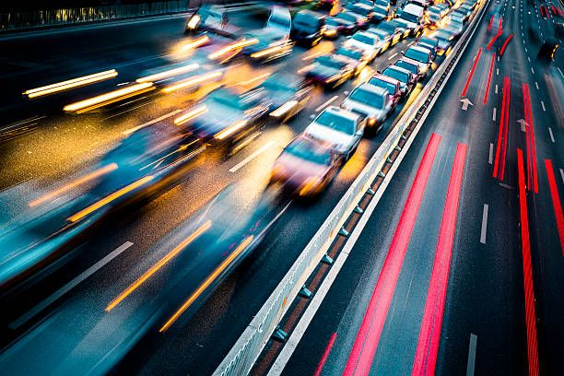
Why Shockwave?
Shockwaves describe how sudden changes in speed, flow, or capacity propagate through a traffic stream, forming a moving queue.
Essential for traffic operations and control because it explains how congestion forms, grows, and dissipates
Critical for signal design, work zones, and incident management
Strong link to road safety and congestion mitigation
Watch these videos
https://www.youtube.com/watch?v=Suugn-p5C1M
https://www.youtube.com/watch?v=Mh6PNQbKBYo

Slide 5
Review: Fundamental Traffic Variables
Flow (q)= Rate of vehicles passing a point. Unit: veh/h
Density (k)= Concentration of V1ehicles over a distance. Unit:
Veh/ Km
Speed (u)= Space mean speed of the stream. Unit: Km/hr
Space mean speed vs time mean speed
Fundamental relation: q = k · u

Slide 6
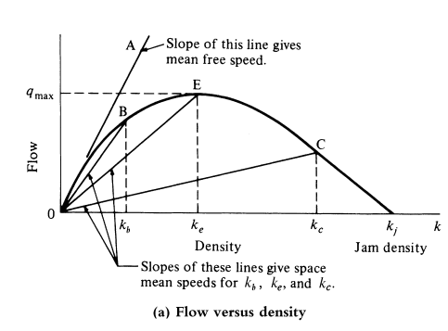
Fundamental Diagram of Traffic Flow
Shows the relationship between flow and density
Defines capacity and jam density
Source: Garber, N. J., & Hoel, L. A. (2009). Traffic and Highway Engineering (4th ed., pp. 251)

Slide 7
What is a Traffic Shockwave?
A moving boundary between two traffic states with different speeds, flows, and densities.
Represents the propagation of a disturbance, not the motion of individual vehicles.
Can move upstream, downstream, or remain stationary.
Commonly observed as sudden braking or acceleration in traffic streams
Typical at signals, bottlenecks, work zones, and incidents

Slide 8
Types of Shockwaves
Major types:
  Frontal stationary
  Backward forming
  Backward recovery
  Rear stationary
  Forward recovery

Slide 9
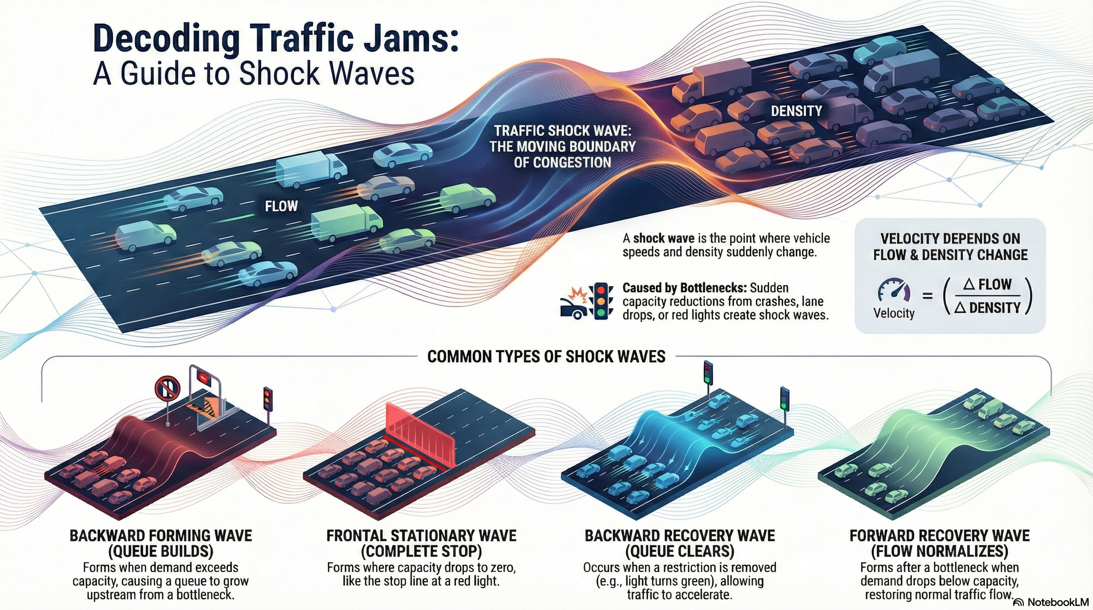

Slide 10
Types of Shockwaves
Frontal Stationary Shockwave
  Occurs when capacity drops to zero
  Example: red signal
  Waves remain fixed in space
Backward Forming Shockwave
  Queue grows upstream when demand > capacity
  Common at bottlenecks and red signals
Backward Recovery Shockwave
  Queue dissipates when demand < capacity
  Moves upstream, releasing vehicles

Slide 11
Types of Shockwaves
Rear Stationary Shockwave
  Demand equals capacity after oversaturation
  Queue neither grows nor shrinks
  Transitional condition
Forward Recovery Shockwave
  Occurs after congestion clears
  Wave moves downstream
  Vehicles accelerate to free-flow speed

Slide 12
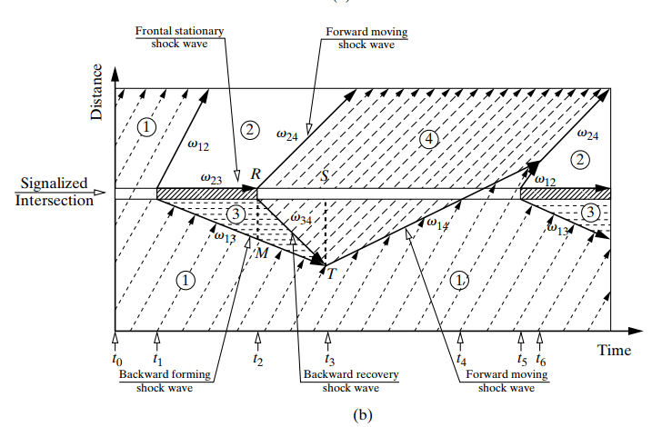
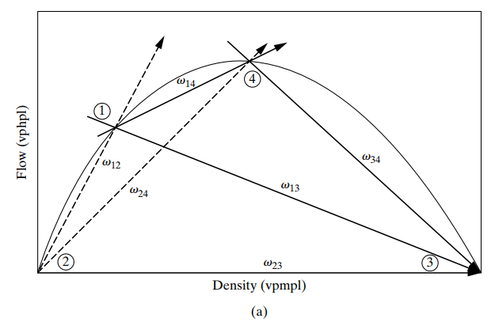
Example: Shockwaves at Signalized Intersections
Shock Wave at Signalized Intersection
Source: Garber, N. J., & Hoel, L. A. (2009). Traffic and Highway Engineering (4th ed., pp. 232)

Slide 13
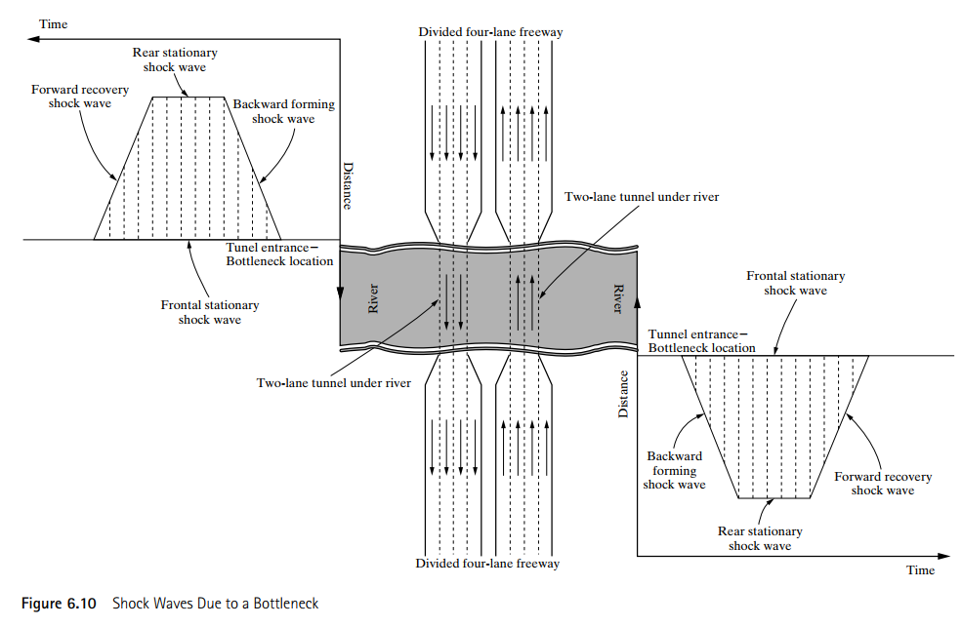
Example: Shockwaves at Bottleneck
Source: Garber, N. J., & Hoel, L. A. (2009). Traffic and Highway Engineering (4th ed., pp. 233)

Slide 14
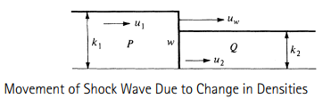
Velocity of Shock Waves
Traffic States
State 1: (q₁, k₁, u₁)
State 2: (q₂, k₂, u₂)
Shockwave boundary between the two states (w)
Conservation Principle
No vehicle creation or loss across the wave
Vehicles entering = vehicles leaving
Basis for shockwave speed derivation

Slide 15



Velocity of Shock Waves
The relative space mean speeds of vehicles in the two traffic states are
The number of vehicles crossing the line “w” during a time period t is:
Since the net change is zero—that is, N₁ =N₂ (conservation)
However,
=>

Slide 16


Velocity of Shock Waves
Substituting q₁ and q₂ gives
Hence, the shockwave speed will be
Interpretation of Shockwave Speed
u_{w} < 0: upstream wave
u_{w} > 0: downstream wave
Source: Garber, N. J., & Hoel, L. A. (2009). Traffic and Highway Engineering (4th ed., pp. 234)

Slide 17
Worked Example- Signalized Intersection
The southbound approach of a signalized intersection carries a flow of 1000 veh/h/ln at a velocity of 50 km/h. The red signal duration is 15 seconds. If the saturation flow is 2000 veh/h/ln and the density is 75 veh/ln, the jam density is 150 veh/km. Determine the following:
    The length of the queue at the end of the red phase
    The maximum queue length
    Queue dissipation time after the end of the red.
Adapted from: Garber, N. J., & Hoel, L. A. (2009). Traffic and Highway Engineering (4th ed., pp. 237)

Slide 18




Worked Example- Signalized Intersection
Given:
Saturation flow
Density at saturation
Jam density
Solution:
a) Let us first determine the speed of the backward-forming shock wave when the signals turn to red (w₁₃)

Slide 19




Using the fundamental relationship, determine the initial density (k1)
Since flow stops at the signal during red, q₃=0
Queue length at the end of red:
=

Slide 20
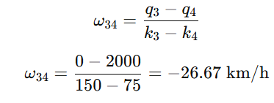

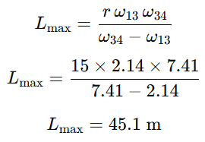
b) Maximum queue length
Let us calculate the backward recovery shockwave speed
Hence, the maximum queue length is given by
=

Slide 21
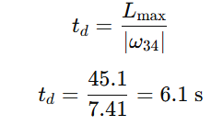
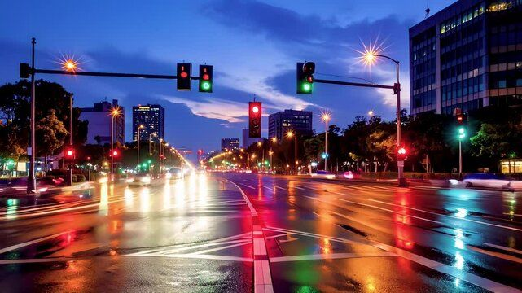
c) Queue dissipation time after the end of red
Queue dissipation time is given by:

Slide 22
Discussion Questions
At a signalized intersection, why is the dissipation of a queue not instantaneous when the light turns green, and how do the "Forward Moving" and "Backward Recovery" waves interact to determine the total time to clearance?
In the scenario of a slow-moving truck, how can a facility experience both a "backward moving" shockwave and a "forward moving" shockwave simultaneously, and what does this tell us about density relative to the obstacle?

Slide 23
Additional materials
https://ocw.tudelft.nl/course-lectures/4-shockwave-theory-s-p-hoogendoorn/
https://ocw.tudelft.nl/course-readings/chapter-8-shock-wave-analysis/
https://open.umn.edu/opentextbooks/textbooks/973
Garber, N. J., & Hoel, L. A. (2009). Chapter 6: Fundamental Principles of Traffic Flow. In Traffic and Highway Engineering (4th ed., pp. 253–305).

