Slide 1
Ingénierie du trafic
Exercice 1 : Introduction à l’ingénierie du trafic

Slide 2
Exercice
In your own words, expliquer what ingénierie du trafic is. Then, discuter how the principles and applications of ingénierie du trafic contribute to Africain villes, considering issues such as urbanisation rapide, informal transport, and limité route infrastructure.
What are typical traffic-related problems in your area/ville? List out the problems and discuter how the principles in ingénierie du trafic can contribute to solving them.

Slide 3
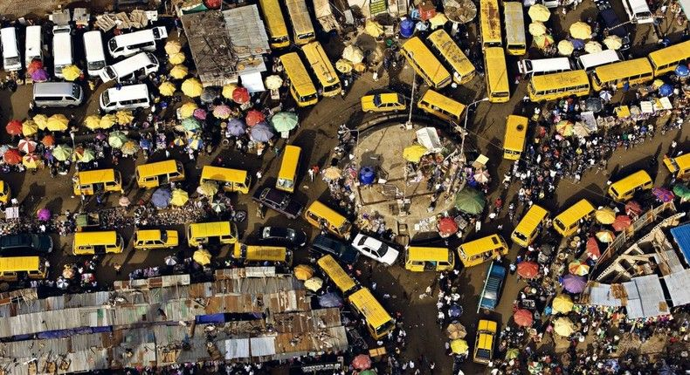
Exercise:
The following image shows the typical flux de trafic conditions in majeur Africain villes. Identifier and list the problems. What do you propose to solve the problem?

