Slide 1
Ingénierie du trafic
Exercice 4.3 : Régulation des intersections

Slide 2
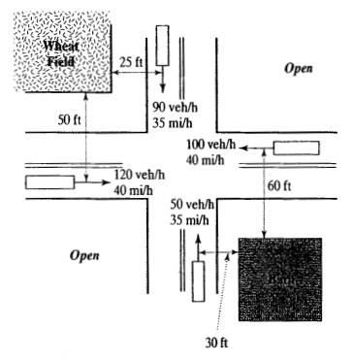
Exercise -1 (Adapted de reference -1)
For le intersection de two rural routes known dans le figure, determine whether ou not operation under le basic rule du route (Level I control) would be safe. If not, what type de control would you recommend et why ?
Assume trafic signals are not warranted. Reaction temps, t=2.5 sec, F=0.348, et G=0.00%.

Slide 3
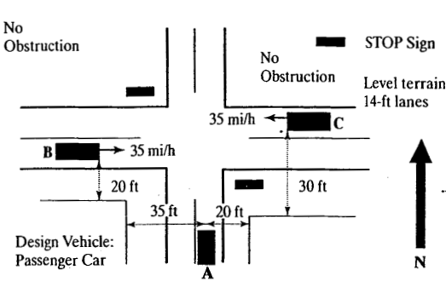
Exercise -2 (Adapted de reference -1)
Déterminer whether le distance de visibilités pour le STOP-controlled intersection shown dans Figure are adequate. If not what measure would you recommend à ensure sécurité ? Pourquoi ?

Slide 4
Références
Roger P. Roess ; Elena S. Prassas ; William R. McShane, Traffic Engineering, 5th edition, Pearson, 2019
https ://mutcd.fhwa.dot.gov/

