Slide 1
Additional material
Implementation of Inverted Pavements
TRB Webinar
Imad L. Al-Qadi, U. Illinois; Erol Tutumluer, U. Illinois; TRB, 18.09.2023

Slide 2
Road Transportation Systems Engineering Development in the Sub-Saharan Africa – Modern EU Master Programme & Capacity Building

Slide 4
TRB Webinar: Implementation of Inverted Pavements
Inverted pavement is an effective design option that can enhance the sustainability and resilience of pavements. TRB hosted a webinar on Monday, September 18, 2023 from 2:00 PM to 3:30 PM
Eastern that presented the structural mechanics and effective uses of inverted pavements. Presenters provided a summary of the state-of-technology.
Presenters also shared case studies that discuss agency experiences during the design and construction of inverted pavements and the performance of inverted pavements compared with control sections.
This webinar was sponsored by TRB’s Standing Technical Committees on Mechanics and Drainage of Saturated and Unsaturated Geomaterials, Transportation Earthworks, and Geotechnical Instrumentation and Modelling.

Slide 5
TRB Webinar: Implementation of Inverted Pavements
Webinar agenda and presenters:
  Inverted pavement basics – Imad L Al-Qadi, University of Illinois
  Implementation of inverted pavements – Erol Tutumluer, University of Illinois
  Question and answer session moderated by Jeff Uhlmeyer, QES

Slide 6
TRB Webinar: Implementation of Inverted Pavements
Learning Objectives:
  Explain inverted pavements and the structural mechanics of the system
  Determine appropriate and effective uses of inverted pavements

Slide 7
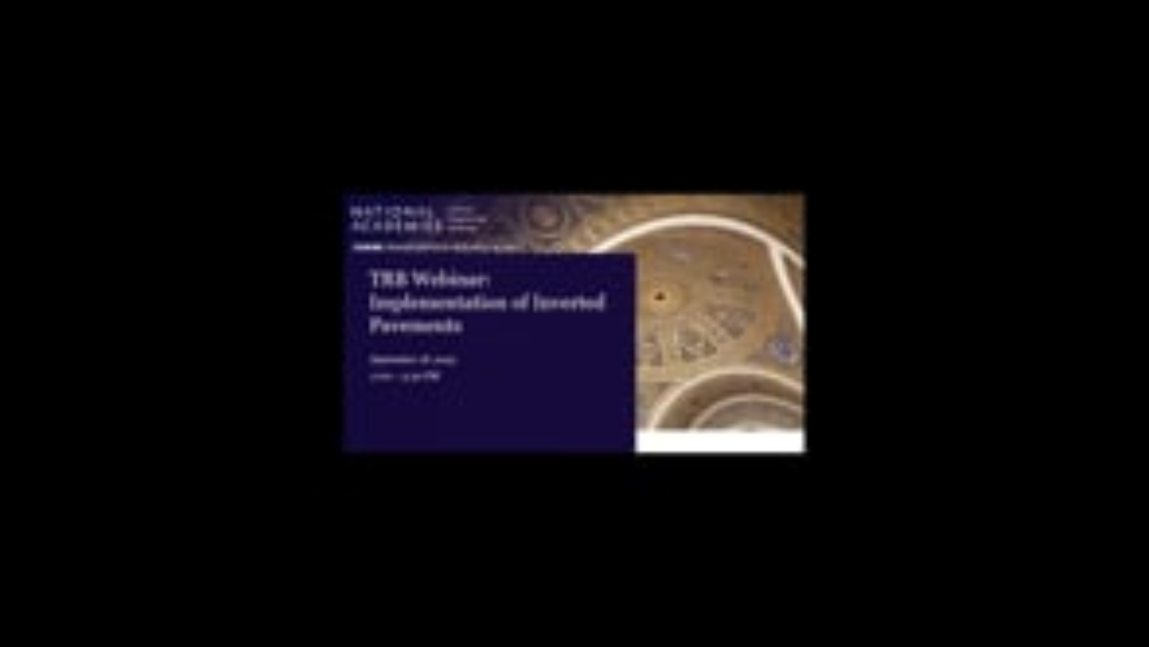
TRB Webinar: Implementation of Inverted Pavements

