Slide 1
Additional material
Implementing Alternative Flexible Pavement Binders
TRB Webinar
Eivind O. Andersen, Veiteknologen; Flavien Geisler, Eiffage; moderator Hassan Tabatabaee, Cargill; TRB, 12.02.2024

Slide 2
Road Transportation Systems Engineering Development in the Sub-Saharan Africa – Modern EU Master Programme & Capacity Building

Slide 4
TRB Webinar: Implementing Alternative Flexible Pavement Binders
Recent low-carbon infrastructure legislations around the world have led to increased interest and research in alternative flexible pavement binders.
TRB hosted a webinar on Monday, February 12, 2024 from 10:00 AM to 11:30 AM Eastern that reviewed strategic, practical, and implementation needs for low-carbon alternative binders for flexible pavements.
Presenters shared the motivation for seeking alternative binders, including bitumen availability, life-cycle assessment, and cost.
Presenters also addressed the life-time performance and post-life performance of alternative binders.
This webinar was sponsored by TRB’s Standing Technical Committees on Mechanics and Drainage of Saturated and Unsaturated Geomaterials, Transportation Earthworks, and Geotechnical Instrumentation and Modelling.

Slide 5
TRB Webinar: Implementing Alternative Flexible Pavement Binders
Webinar agenda and presenters
Bitumen availability and sustainability pushing for innovation and alternative binders – Eivind Olav Andersen, Veiteknologen AS
Challenges in lifecycle assessment of road products incorporating alternative binders – Flavien Geisler, Eiffage
Question and answer session moderated by Hassan Tabatabaee, Cargill

Slide 6
TRB Webinar: Implementing Alternative Flexible Pavement Binders
Learning Objectives:
Assess potential low-carbon alternative binders for implementation
Identify key research gaps and needs to guide present and future research

Slide 7
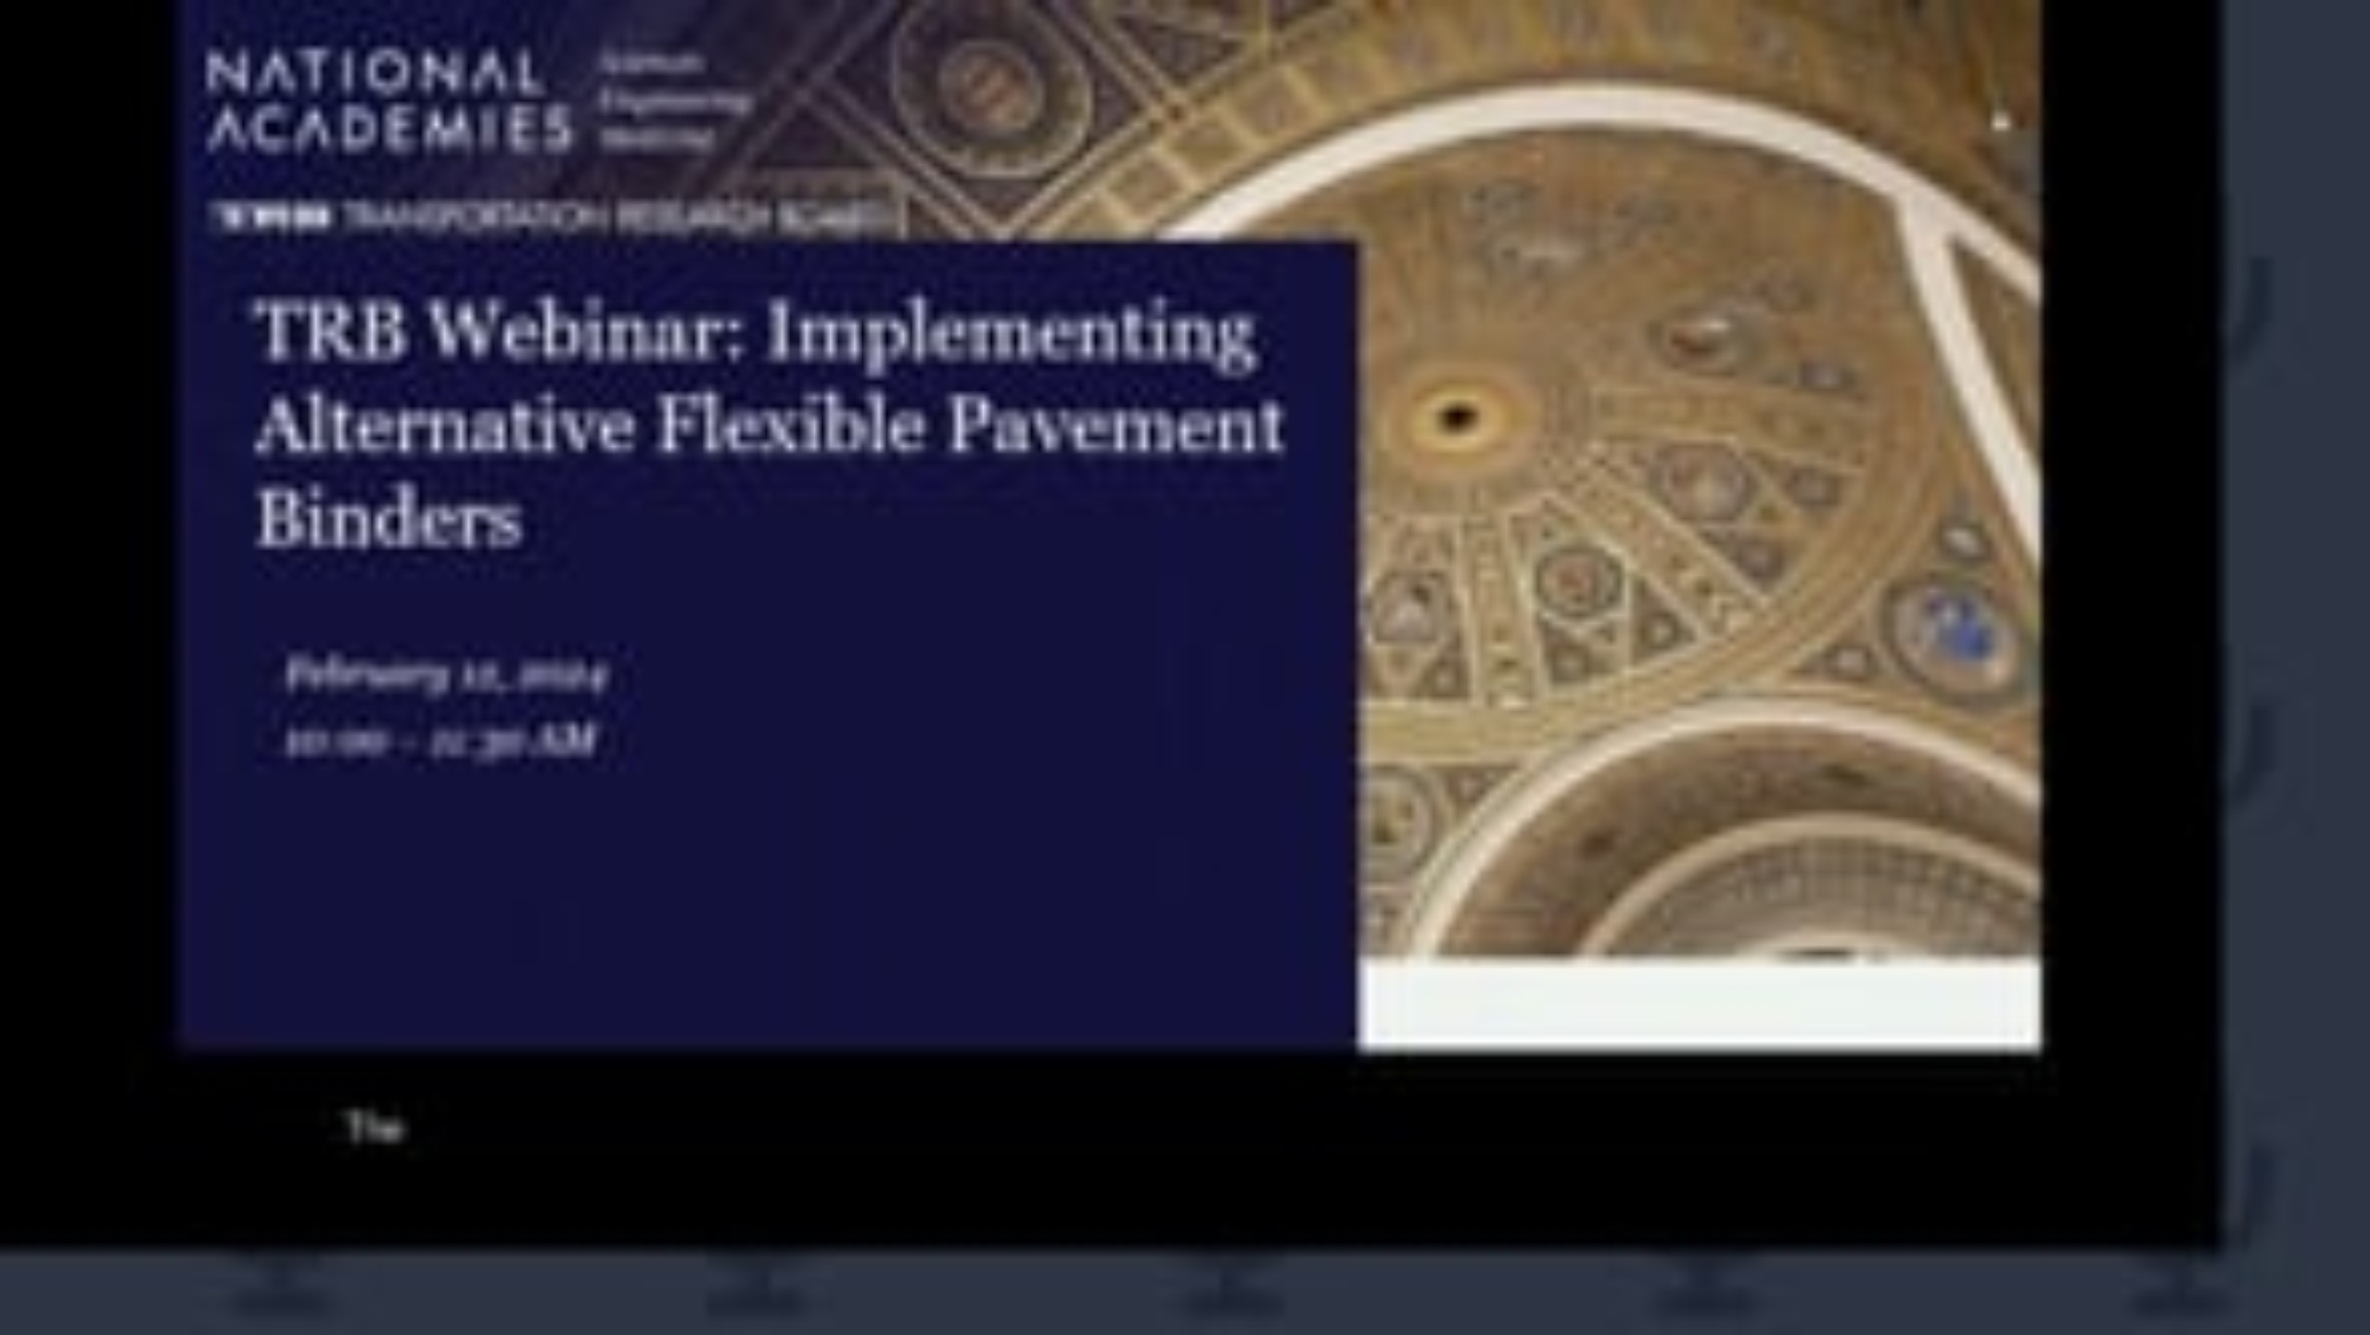
TRB Webinar: Implementing Alternative Flexible Pavement Binders

