Slide 1
Cours C.03.06.01
Liants bitumineux
Marek Pszczola
(présentation préparée sur la base des cours du prof. Romanochi, États-Unis)

Slide 2
Road Transportation Systems Engineering Development in the Sub-Saharan Africa – Modern EU Master Programme & Capacity Building

Slide 4
Histoire de la construction routière
Premières routes en Mésopotamie et dans l’Empire romain
  Grosses pierres sur un lit de sable (vides remplis d’argile)
  Ex. : Via Appia (voie Appienne)
Dicton latin :
  « VIA VITAE » – les routes sont la vie

Slide 5
Histoire de la construction routière
Routes non revêtues en Europe occidentale, puis aux États-Unis
McAdam (England) & Tresaguet (FR):
  couche de grosses pierres recouverte d’une couche de pierres plus petites, compactée manuellement
  les pierres doivent être propres et de granulométrie appropriée
  l’importance du drainage est reconnue

Slide 6
Histoire de la construction routière
Routes non revêtues – principaux problèmes :
  Faibles / déformables / impraticables lorsqu’elles sont humides
  Poussiéreuses lorsqu’elles sont sèches
  Nécessitent un entretien périodique
  Sorespectésimes Le tapiserials Besoin à be replaced
Besoin d’une solution constructive pour :
  lier les matériaux entre eux
  améliorer la résistance et réduire la perméabilité
  tout cela alors que le trafic et les charges de roue augmentaient

Slide 7
Histoire de la construction routière
SOLUTION :

Slide 8
Histoire de la construction routière
ENROBÉ À CHAUD
  Efficace
  Adapté à une production et une mise en œuvre mécanisées
  Abordable
CHAUSSÉE EN BÉTON
  Coût initial plus élevé, mais coûts d’entretien réduits
  Particulièrement adapté aux routes à fort trafic

Slide 9
Historique
First US enrobé à chaud (HMA) constructed dans 1870s
  Pennsylvania Ave.
  utilisé naturelsly occurring asphalt à partir de a lake sur Island de Trinidad
Two sources:
  Island de Trinidad
  Bermudez, Venezuela
Notes:
The first paved roadway in the United States was Pennsylvania Avenue in front of the White House. This pavement was constructed with an asphalt product quarried from a naturally occurring “lake” of asphalt on the island of Trinidad off the coast of Venezuela. A second source of this type of asphalt product can be found in Bermudez, Venezuela. These asphalts are still used today. In fact, a Trinidad lake asphalt project was placed near Mobile, Alabama in July, 1998.
Each lake asphalt has consistent but different amounts of bitumen, inorganic material. Because of these consistent differences, the amount of solvent-insoluble inorganic material is one common method used to identify and specify the lake asphalt source. This solubility test was used in all subsequent asphalt cement specifications throughout the 20th century.

Slide 10
Historique
Each lake asphalt Source very régulier
  utilisé Le solubility essai à Déterminer Le Source
    Insolubles differed substantially between sources
Demand pour paved roads exceeded supply de lake asphalts dans late 1800s
  Led à Utilisation de petroleum asphalts (1902)
Notes:
During the late 1800's and early 1900's the demand for paved roads increased so fast that the time-intensive processing and shipping of lake asphalt was limiting the miles of paved roads constructed each year. This led to the increasing use of petroleum refinery-based asphalts. It is interesting to note that these asphalts were originally considered inferior to lake asphalt because of their crude source-dependent material properties.

Slide 11
Contexte
Asphalte / bitume
  Soluble dans petroleum products
  Generally a par-product de petroleum distillation processus
  Can be naturelsly occurring
Goudron
  Resistant à petroleum products
  Generally par-product de coke (à partir de charbon) production
Notes:
Students commonly use the words “asphalt” and “tar” interchangeably. However, asphalt is actually a waste product from the refining of petroleum crude oil while tar is a coal by-product. These chemical distinctions are important in a selecting the appropriate product for a given application.
For example, if protection from oil and fuel spills is desired, then a coating which will not be dissolved by these products is needed. Since motor oils, fuel, and asphalt are all derived from petroleum, any spills on this pavement can damage the asphalt-based coating as well as the asphalt concrete. The old chemistry rule-of-thumb applies: Like dissolves like. Because tar is a coal rather than asphalt-based product, sealers from this material will not be damaged by petroleum product spills.

Slide 12
Bitume
Goudron
(à partir de charbon)
road tar
charbon tar
bitume routier
(à partir de petroleum crude)
asphaltic bitumen
asphaltic liant

Slide 13
Enrobé à chaud (HMA) – terminologie
Terminologie américaine :
  Béton bitumineux / mélange bitumineux / enrobé / asphalte
Terminologie européenne / internationale :
  Béton bitumineux / mélange bitumineux pour chaussée / mélange bitumineux
béton bitumineux
Bituminous paving mélanger
mélange bitumineux
Notes:
Hence, there is a need for a mechanical test which can tell us whether the designed mix is resistant to rutting. It should be able to proof test the mixes and tell us whether a mix satisfies a definite criteria and passes or fails the torture test. This test should be a laboratory test method so that it can be used on designed mixes, and it should be a simple test method so that it can be used routinely by the folks who actually build our pavements.

Slide 14
Asphaltes issus du pétrole
Asphalt is a waste product à partir de refinery processusing de crude oil
  Sorespectésimes called Le "bottom de Le barrel"
Les propriétés dépendent de :
  Opérations de raffinage
  Composition du pétrole brut (dépendante de la source)
Essence
Kérosène
Lt. Gas Oil
Gazole
Huiles moteur
Asphalte / bitume
Barrel de Crude Oil
Notes:
A number of products are obtained from one barrel of crude. Asphalt cement is what is left after the more volatile products are removed and it is commonly referred to as the “bottom of the barrel”.

Slide 15
Pétrole brut
Classified using Le API (American Petroleum Institute) gravité:
  API gravité = [ 141.5 / SG ] – 131.5
  Asphalts – API gravité de 5–10
  Gasoligne – API gravité de 55
  Faible API gravité = crude oil rich dans asphalt
Sour crude oil – Élevée sulfur teneur – bad bitumen
Notes:
During the late 1800's and early 1900's the demand for paved roads increased so fast that the time-intensive processing and shipping of lake asphalt was limiting the miles of paved roads constructed each year. This led to the increasing use of petroleum refinery-based asphalts. It is interesting to note that these asphalts were originally considered inferior to lake asphalt because of their crude source-dependent material properties.

Slide 16
Principales sources de pétrole brut
Nationales
Gulf coast
Mid-continent
Rocky Mountain
West coast
Alaska
Étrangères
Mexico
Venezuela
Canada
Moyen-Orient

Slide 17
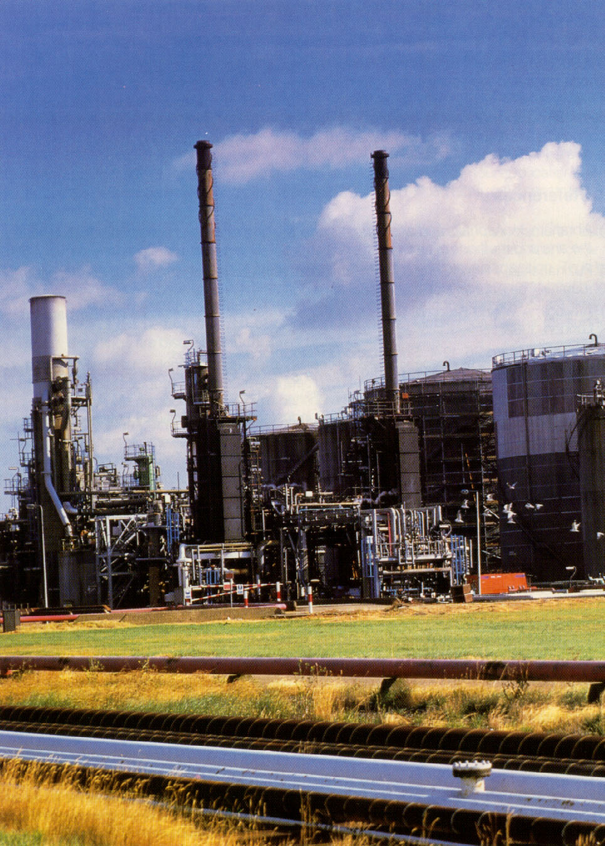

Slide 18
Fonctionnement d’une raffinerie
Léger DISTILLATE
PUMPING
STATION
Moyen DISTILLATE
terrain STORAGE
Lourd DISTILLATE
TOUR
DISTILLATION
RAFFINERIE
RÉSIDU
PROCÉDÉ
UNITÉ
STOCKAGE
TUBE
RÉCHAUFFEUR
CONDENSERS
ET
REFROIDISSEURS
OU
ASPHALTE
CIMENTS
GAZ
PETROLEUM
AIR
SOUFFLÉ
ASPHALTE
FOR PROCESSING INTO
EMULSIFIED AND
CUTBACK ASPHALTS
sable AND WATER
AIR
ALAMBIC
Notes:
Distillation is used to separate the various crude fractions by boiling point ranges. The crude oil is heated in a large furnace to about 343 ºC and partially vaporized. The remaining material is transferred to a distillation tower. Different fractions reach their boiling point ranges at various heights in the tower. When the temperature is reduced, each material condenses on a tray and is drawn off at each level.

Slide 19
La distillation est la première étape
Séparers various crude fractions avec different boiling plages
Residuum (Resid) is asphalt
Atmospheric et vacuum distillation
Superheated steam also utilisé
Various fractions condensed dans trays
Vacuum et steam distillation avides fissurapportn (molecular se désagrègentdown)
  Vacuum (1 PSI) / Vacuum & Steam (0.25 PSI)

Slide 20
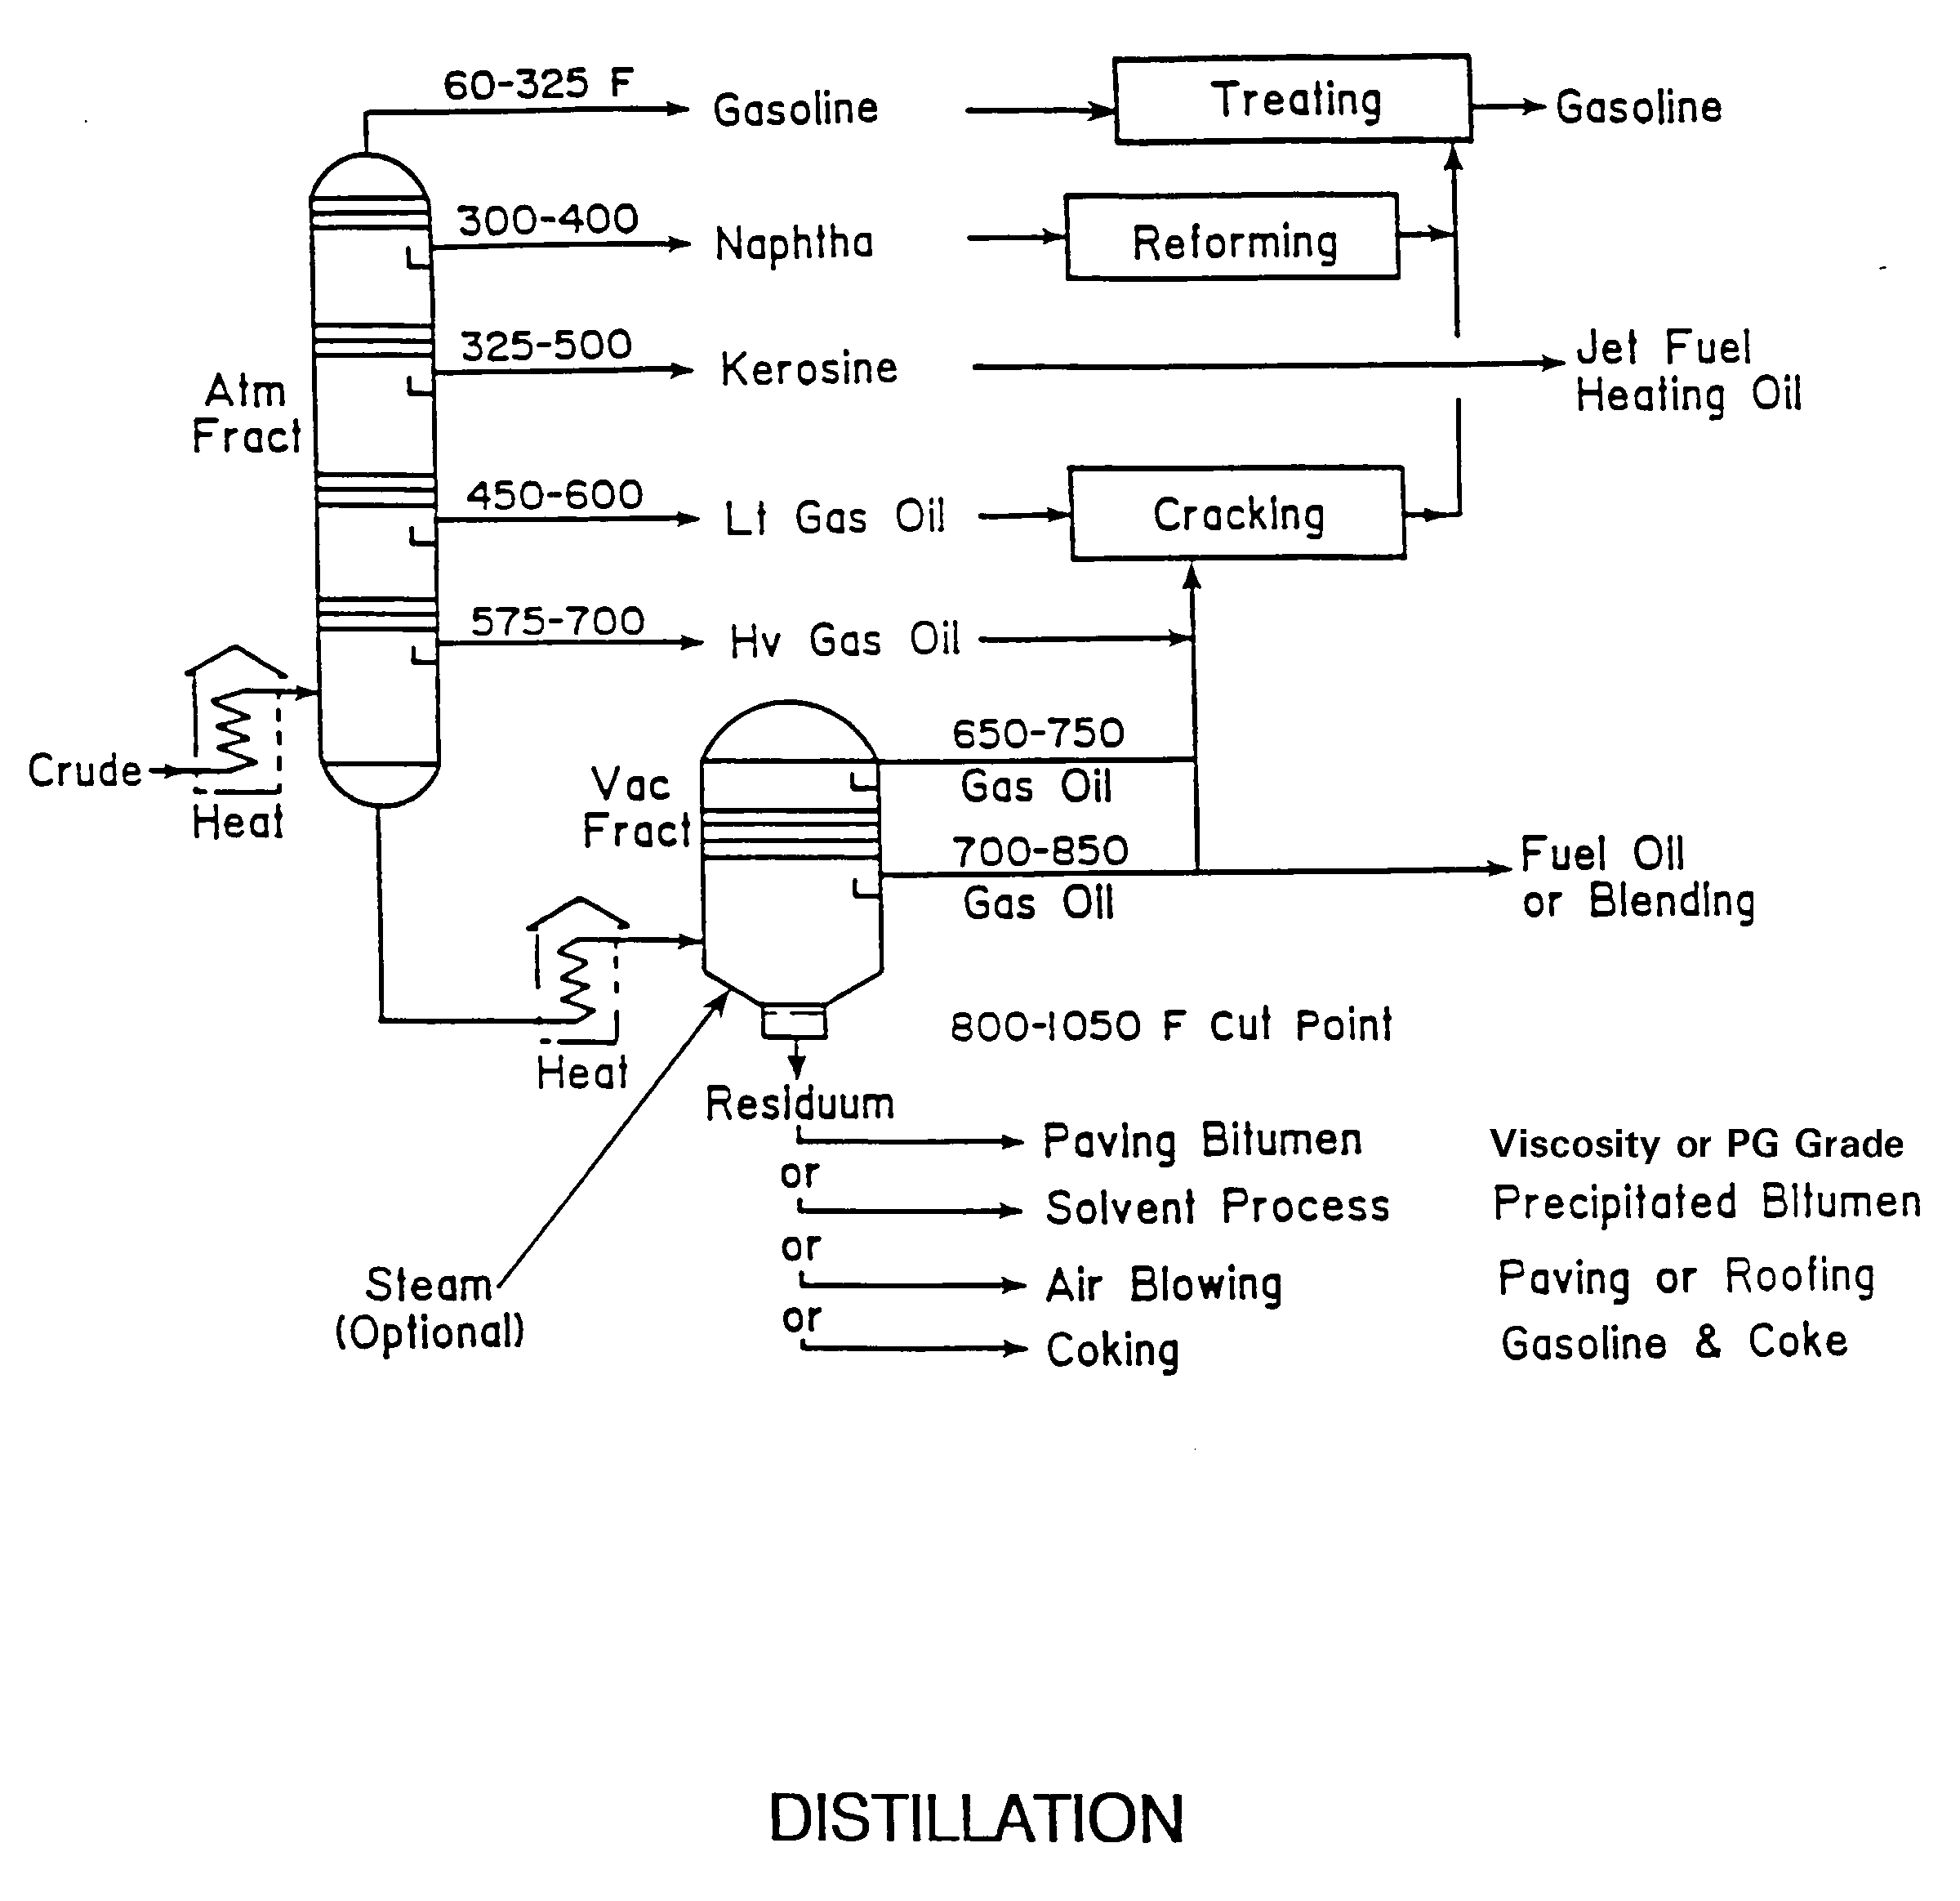

Slide 21
Produits pétrochimiques
Obtained par fissurapportn crude oil into chemical building blocks (olefins)
Products synthedimensiond à partir de petrochemicals:
  Plastics, Rubber, Fabrics, Synthetic drugs
  Dyes, glues & paints
Polymers synthedimensiond à partir de petrochemicals:
  SBS, Neoprene, Polyester, Nylon, EVA, Polyethylene, PVC, SBR
Pas dans crude or asphalt – made à partir de olefins

Slide 22
Désasphaltage au solvant
Asphalt broken down into 2 components:
  Asphaltenes et resins
  Oils
Blended à produce asphalt de souhaitée properties

Slide 23
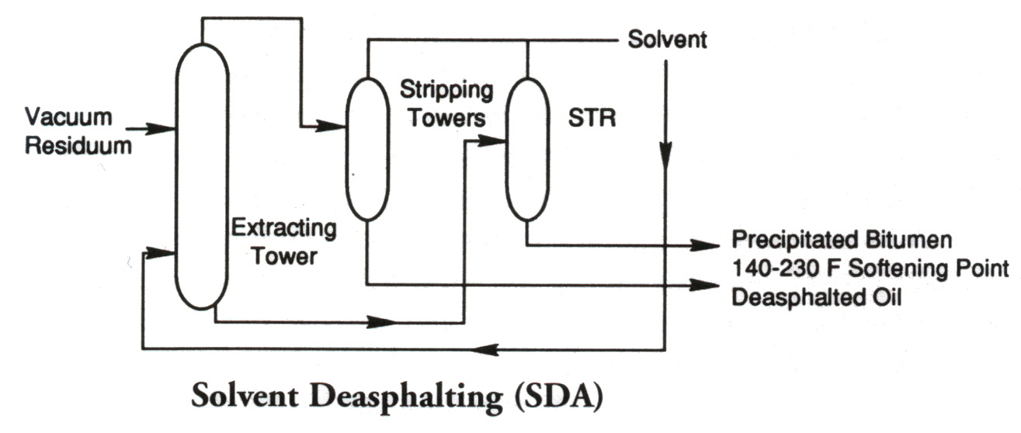
Désasphaltage au solvant

Slide 24
Residuum Oil Supercritiques Extraction (ROSE)
Asphalt broken down into 3 components:
  Asphaltenes
  Resins
  Oil
Blended à produce asphalt de souhaitée properties

Slide 25
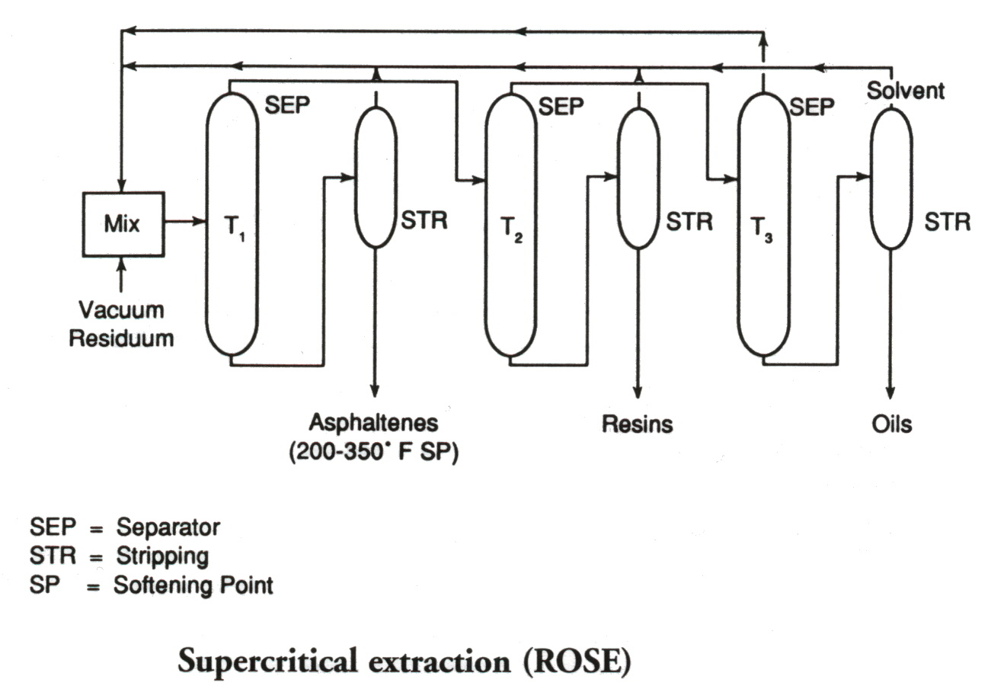
Supercritiques Extraction (ROSE)

Slide 26
Soufflage à l’air de l’asphalte
To produce asphalt de souhaitée consistency (more viscous)
To reduce température susceptibility
Sélectionnerion de production Méthode depends sur type de crude oil et souhaitée asphalt

Slide 27
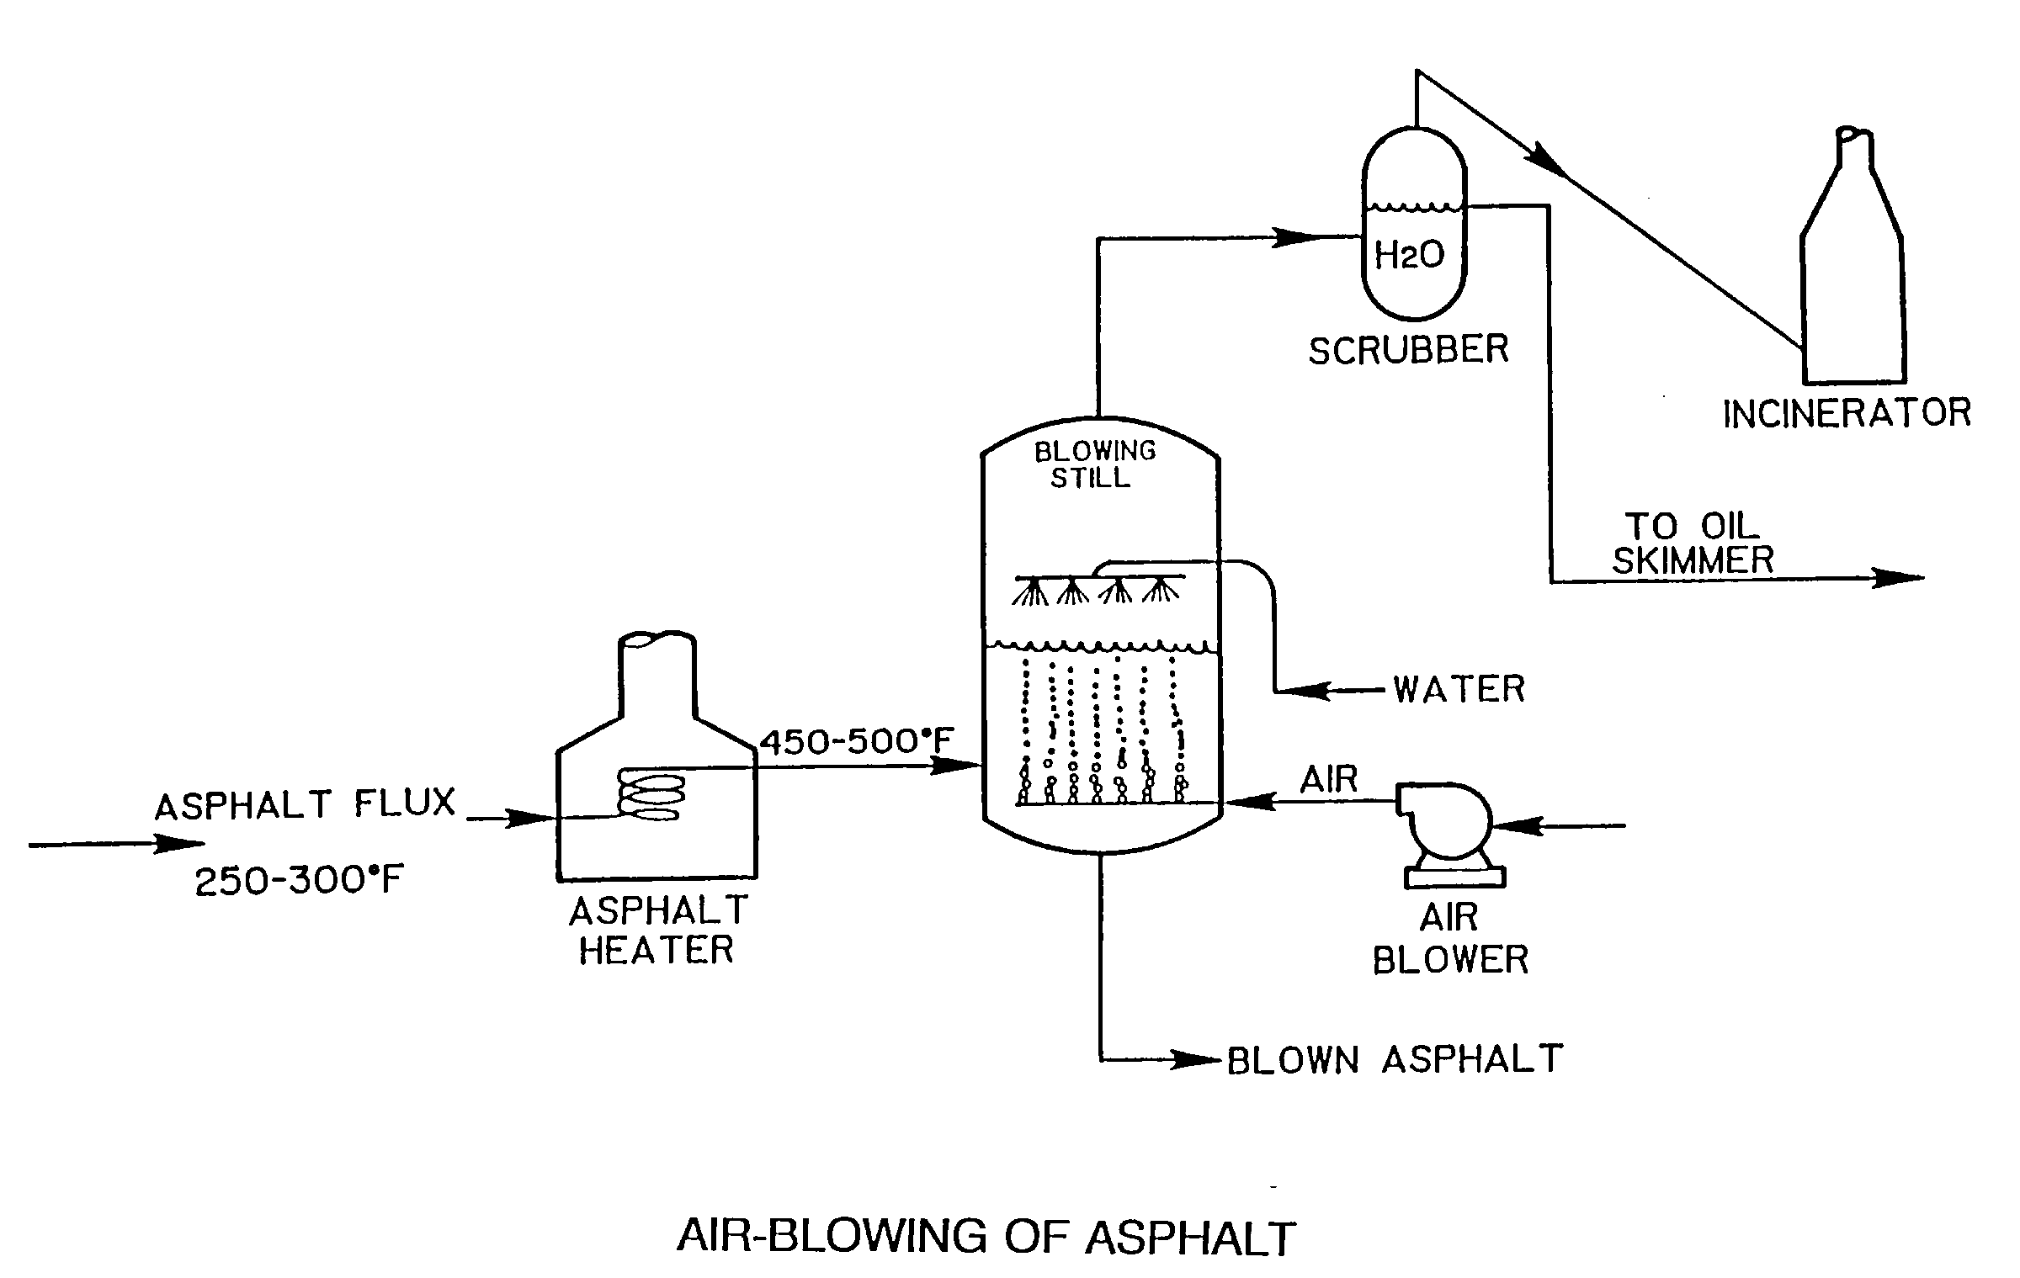

Slide 28
Composants du bitume routier
Asphaltenes
  Large, discrete solid inclusions (black)
  Élevée viscosité component
Resins
  Semi-solid or solid at marge température
    Fluid when heated
    Brittle when cold
Oils
  Colormoins liquid
  Soluble dans most solvents
  Albassess asphalt à fluage
Notes:
The simplest general compositional model considers asphalt cements to be made up of asphaltenes, resins, and oils. The combination of the resins and oils is also referred to as the maltenes.
Asphaltene contents vary considerably from asphalt to asphalt. Low concentrations have been linked to tenderness in the HMA by some researchers.
Resins are credited with dispersing the solid asphaltene particles in the asphalt. Oxidation of resins produce asphaltene-type molecules.
Oils are soluble in most solvents. Upon oxidation, they produce both resin and asphaltene-type molecules.

Slide 29
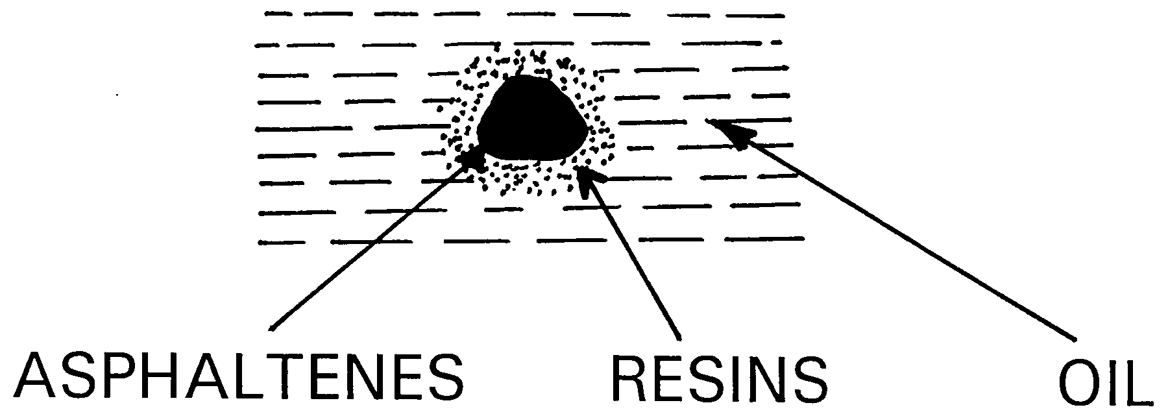
Peptizer
Semisolid
Gives température susceptibility
Gives ductility
Polar
Liquid
Nonpolar
Black powder
Gives body à AC
Élevéely polar

Slide 30
Quelles sont les utilisations du béton bitumineux en génie civil ?

Slide 31
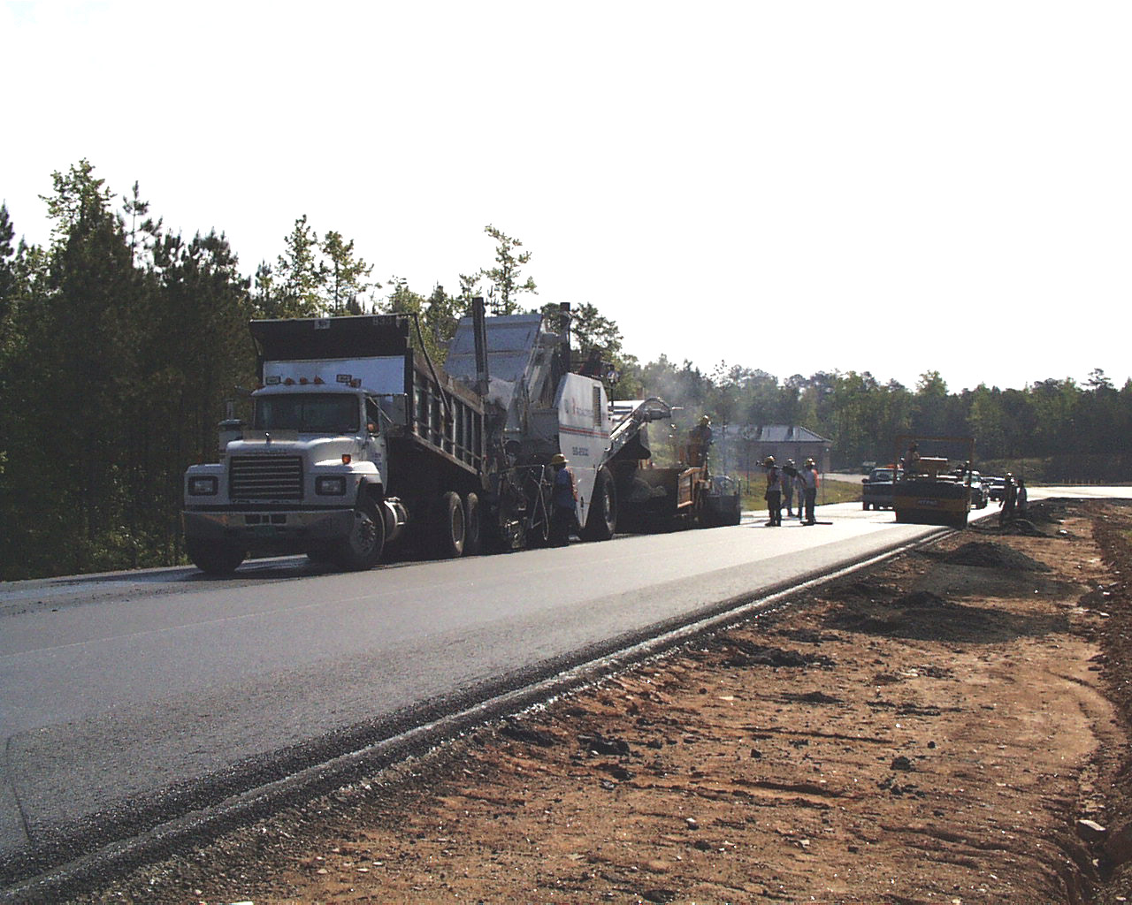

Slide 32
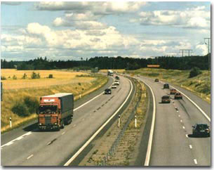

Slide 33
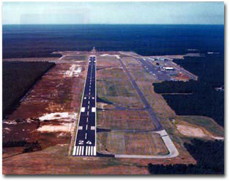

Slide 34
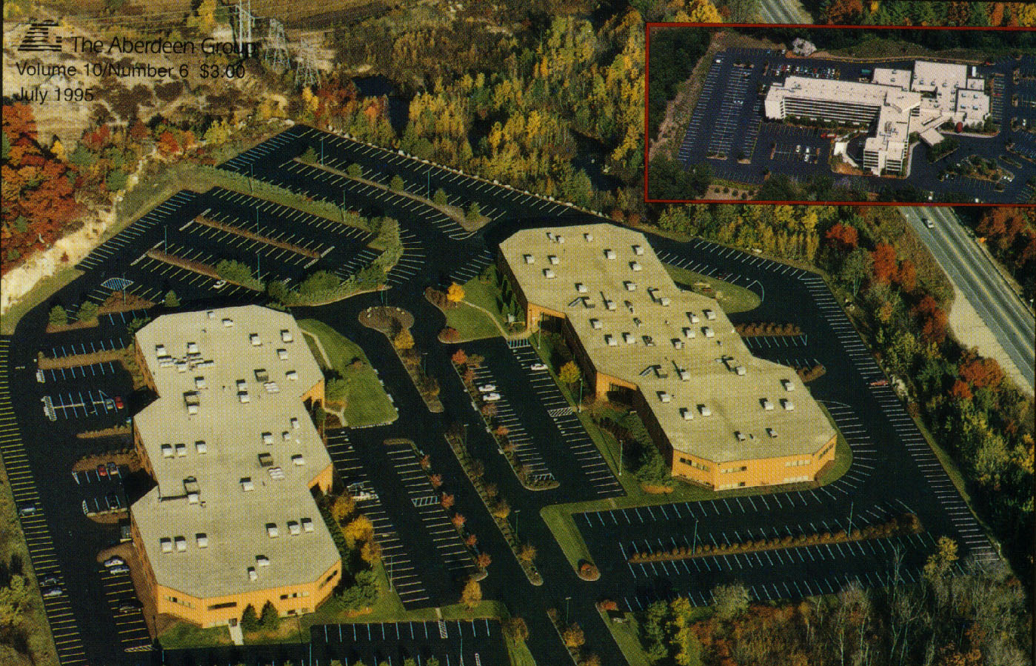

Slide 35
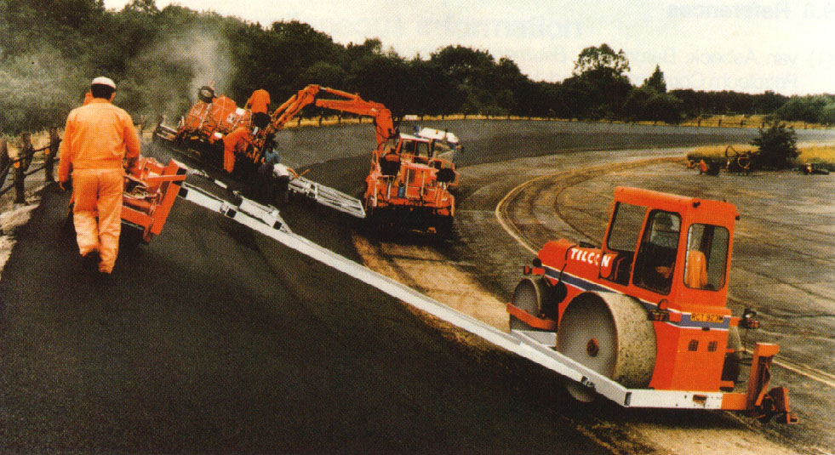

Slide 36
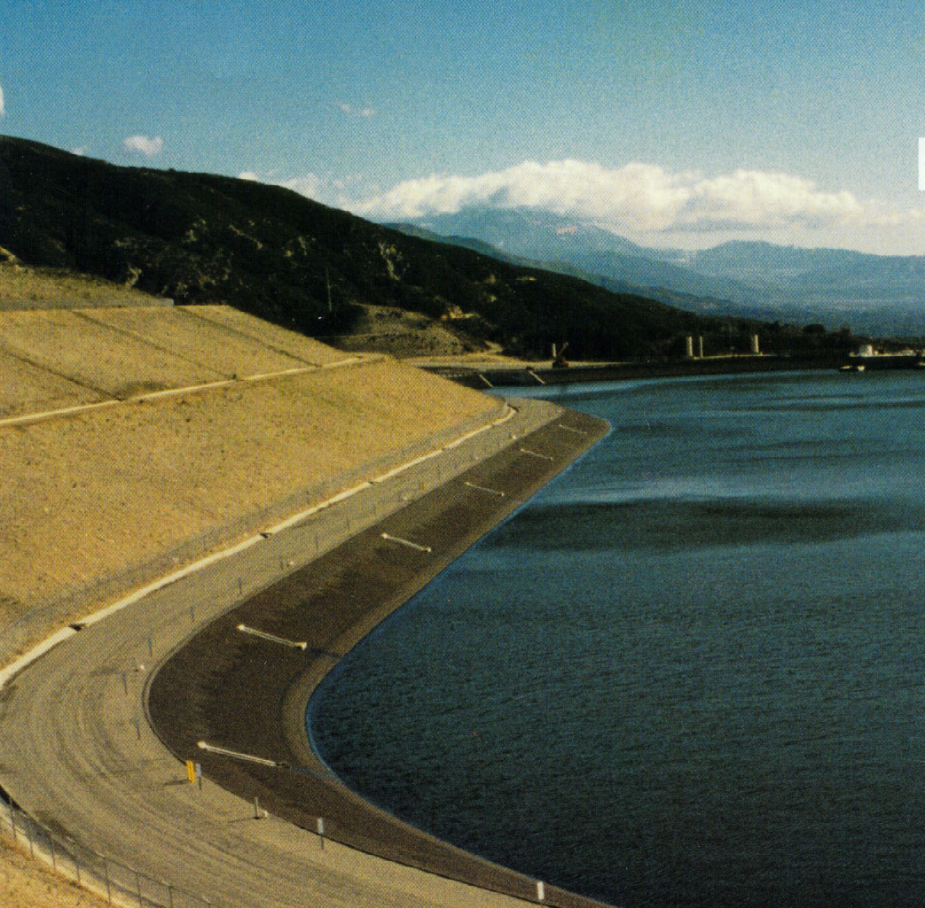

Slide 37
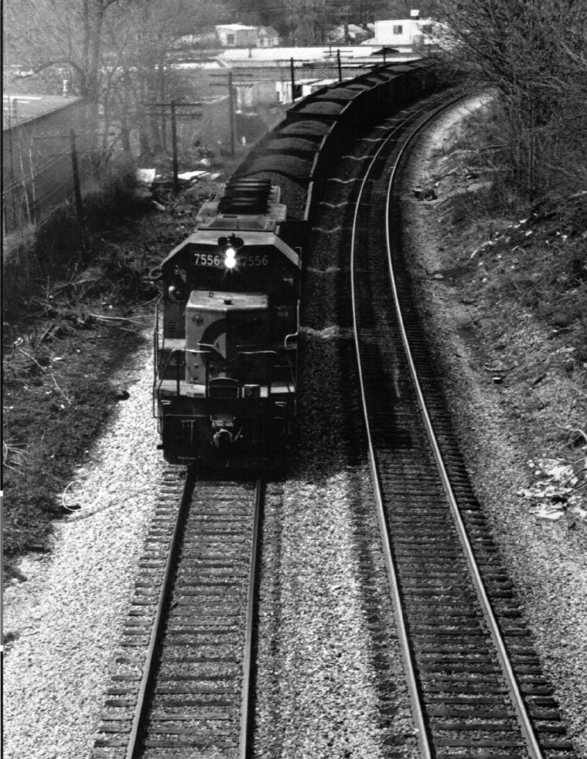

Slide 38
Comment utilise-t-on le bitume routier dans la construction routière ?
Comment utilise-t-on le bitume routier dans la construction routière ?

Slide 39
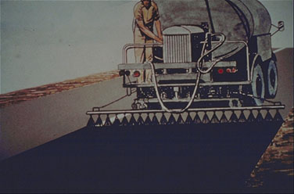

Slide 40
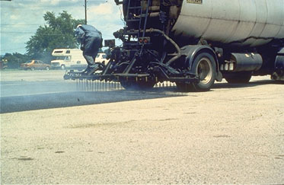

Slide 41
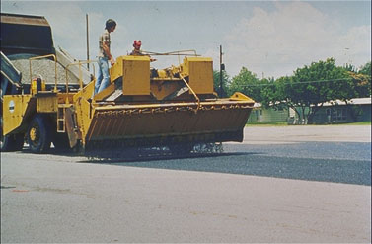

Slide 42
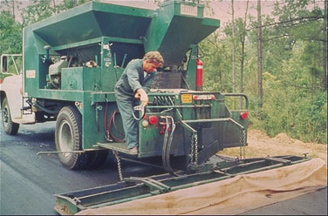

Slide 43
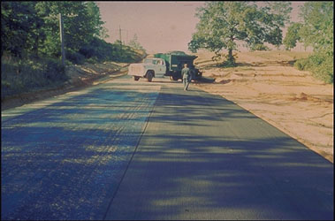

Slide 44
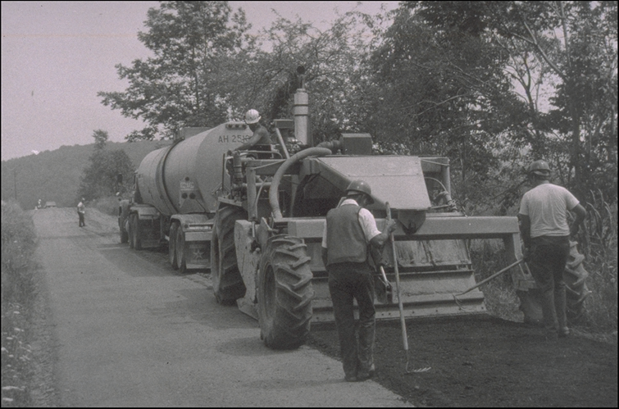
Recyclage avec une seule machine
Notes:
This slide shows a photo of a single machine CIR operation.

Slide 45
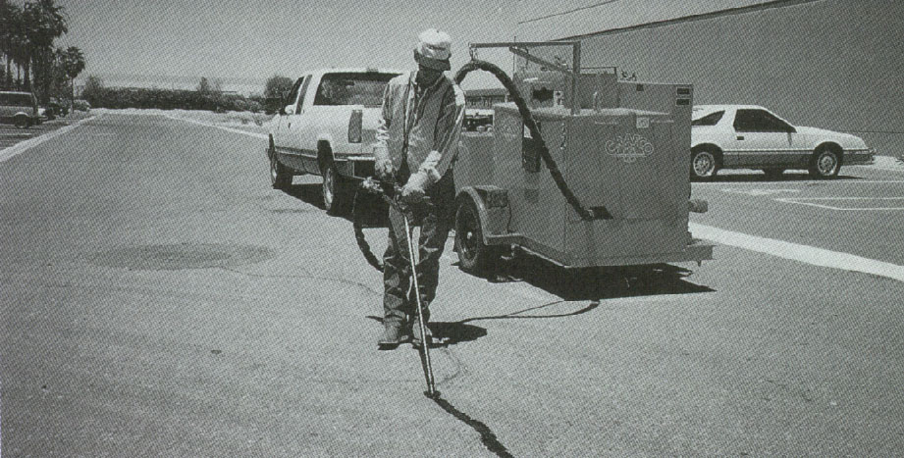

Slide 46
Types de liants bitumineux
bitume routier
  Generally refinery produced tapiserial
  Air bbassesn bitume routier
Bitumes fluidifiés
  Asphalt cements "déblai" avec petroleum solvents
Émulsions bitumineuses
  mélange de bitume routier, water, et emulsifying agent
Notes:
The residuum or “resid” from the distillation process is used to make various asphalt cement products.

Slide 47
Bitumes fluidifiés
Rapid cure (RC) (Naphtha or Gasoligne)
  Élevée volatility de solvent
  couches d’accrochage, Surface treatments
Moyen cure (MC) (Kerosene)
  Modevitesse volatility
  stock de granulats patching mélanger
Sbasses cure (SC) (Faible viscosité oil)
  Faible volatility
  Prime coat, Poussière Contrôler
Notes:
Cutbacks are liquid at room temperature and are manufactured by adding or “cutting” asphalt cements with petroleum solvents. The volatility of the solvent dictates the rate at which the solvent evaporates. How fast the solvent escapes into the atmosphere regulates how fast a mixture of cutback and aggregate will set. Environmental regulations are increasingly limiting the use of these products.

Slide 48
Bitumes fluidifiés
Moyen cure (MC)
Asphalt + Kerosene
stock de granulats Patch
Prime Coat
MC - 30
MC - 70
MC - 250
MC - 800
Sbasses cure (SC)
Asphalt + Oil
SC - 70
SC - 250
SC - 800
SC - 3000
Rapid cure (RC)
Asphalt + Naphtha
Surface Treatment
RC - 30
RC - 70
RC - 250
RC - 800

Slide 49
Cutback Asphalt – Limitations
Élevée volatility de solvent:
  Vapors dangerous à workers
  May ignite dans CHAUD weather
  Environmentally unsafe
Expensive – Utilisation de Élevée-Énergie solvents
Notes:
Cutbacks are liquid at room temperature and are manufactured by adding or “cutting” asphalt cements with petroleum solvents. The volatility of the solvent dictates the rate at which the solvent evaporates. How fast the solvent escapes into the atmosphere regulates how fast a mixture of cutback and aggregate will set. Environmental regulations are increasingly limiting the use of these products.

Slide 50
Émulsions
Emulsifier gives Surface charge à asphalt chutelets en suspension dans water
  Anionic: Negative charge / Alkaligne / Bonne avec limestones (+)
  Cationic: Positive charge / Acid / Bonne avec silica gravels (−)
Notes:
Emulsions are produced by blending asphalt cements, water and an emulsifier (e.g. soap) in a high shear colloid mill. The resulting asphalt droplet suspended in the water has a charge which reflects the chemistry of the emusifier. The charge of the emulsion is usually selected so that it is opposite that of the aggregate to promote adhesion of the asphalt to the aggregate surface.
Emulsions are an asphalt-based product which is also liquid at room temperature.

Slide 51
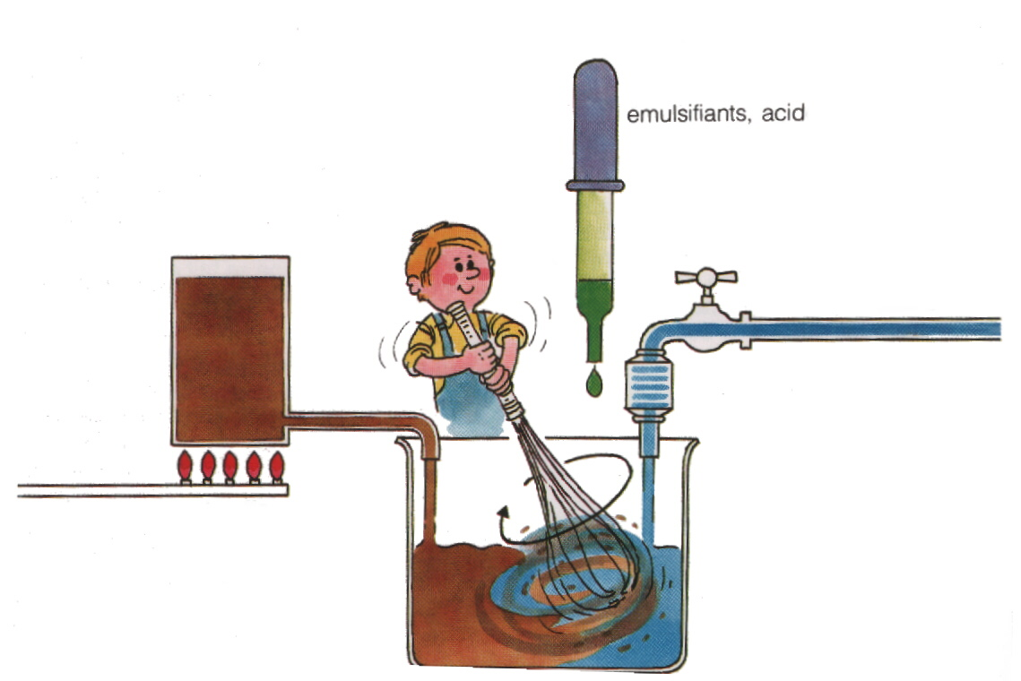
Fabrication des émulsions
Notes:
This slide shows a schematic of the emulsion mixing operation.

Slide 52
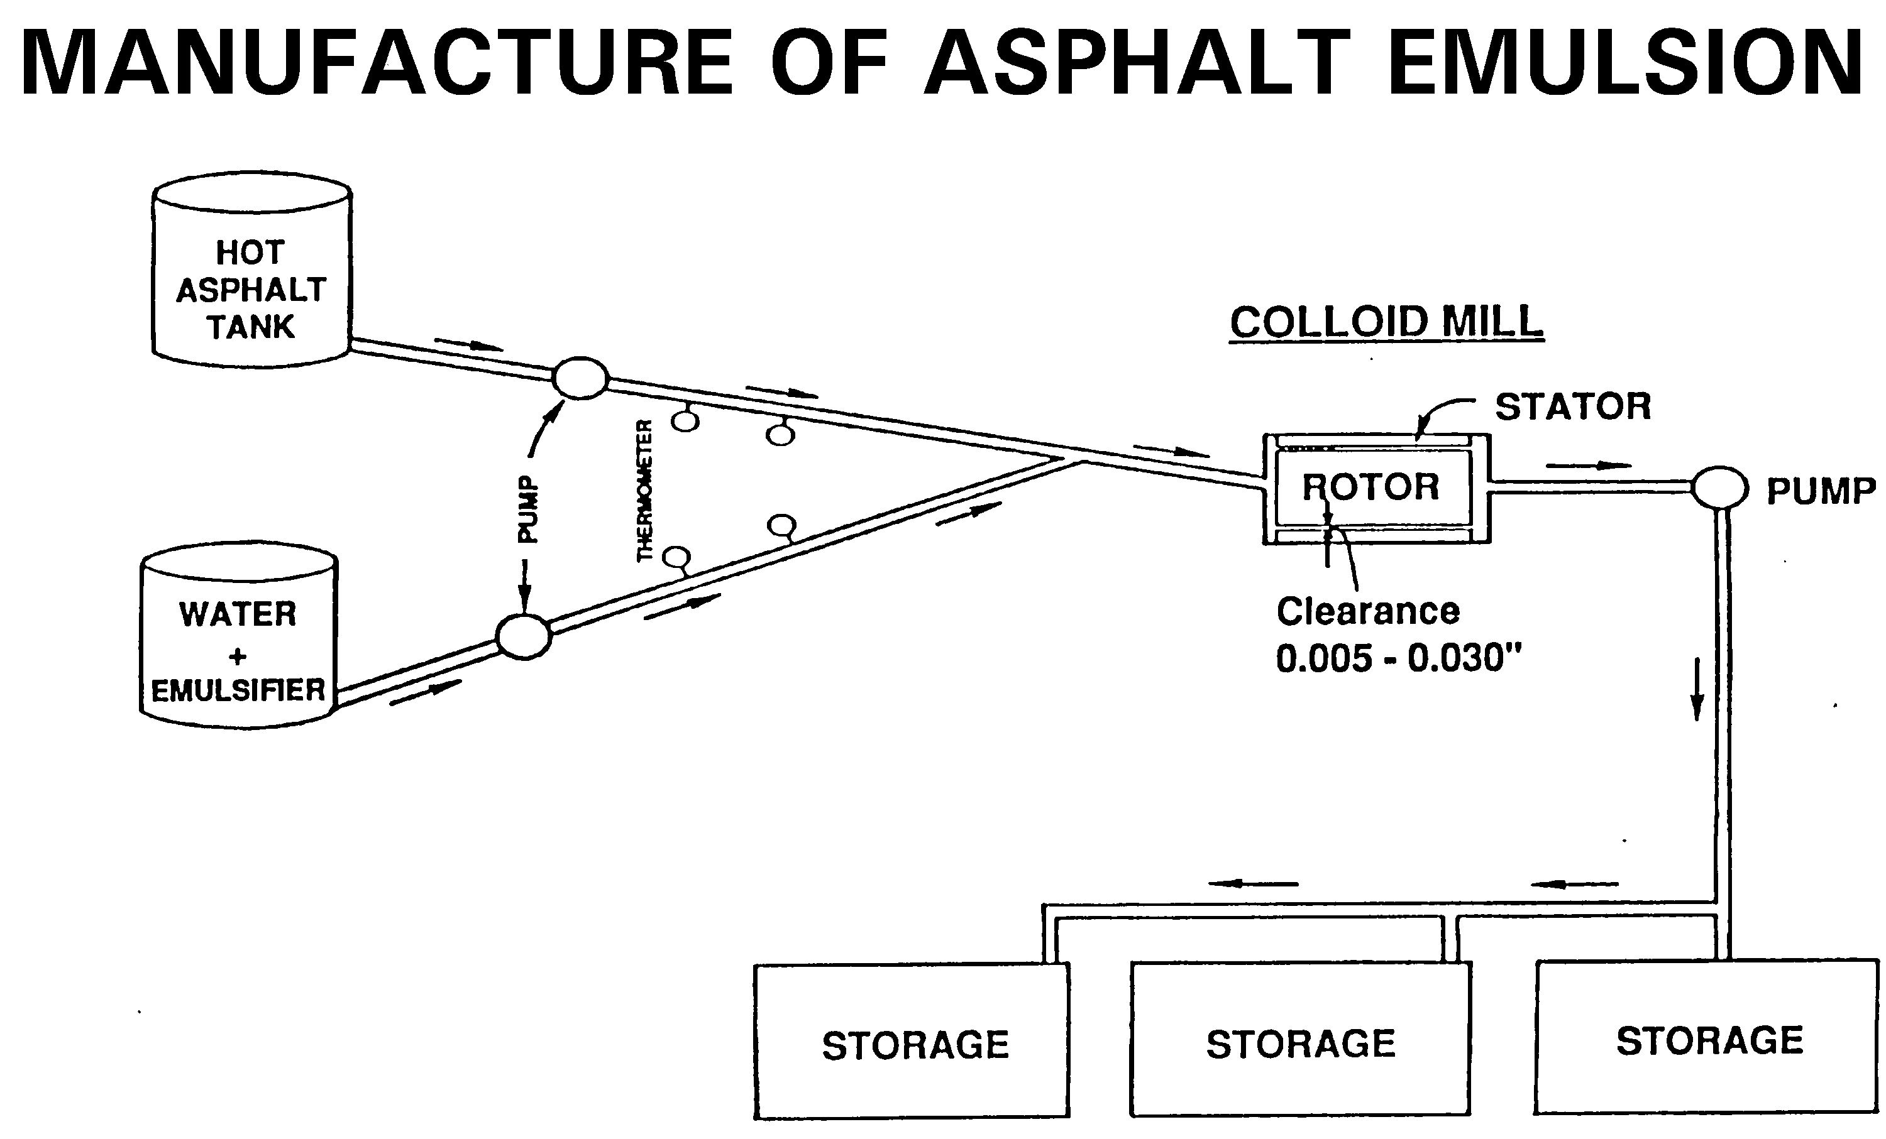

Slide 53
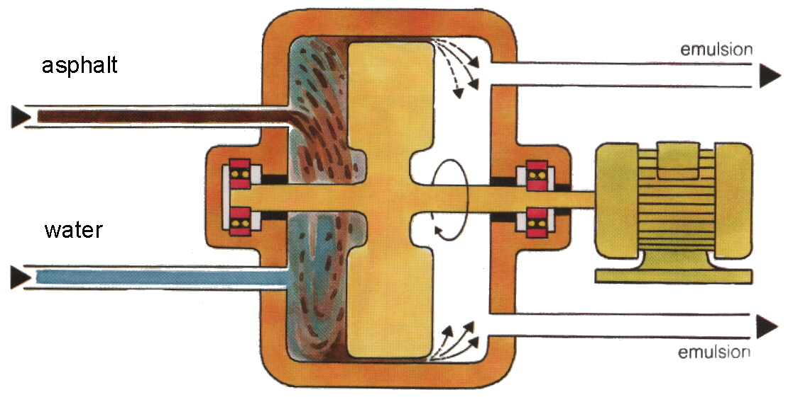
Fabrication des émulsions
Notes:
This slide shows a photo of a single machine CIR operation.

Slide 54
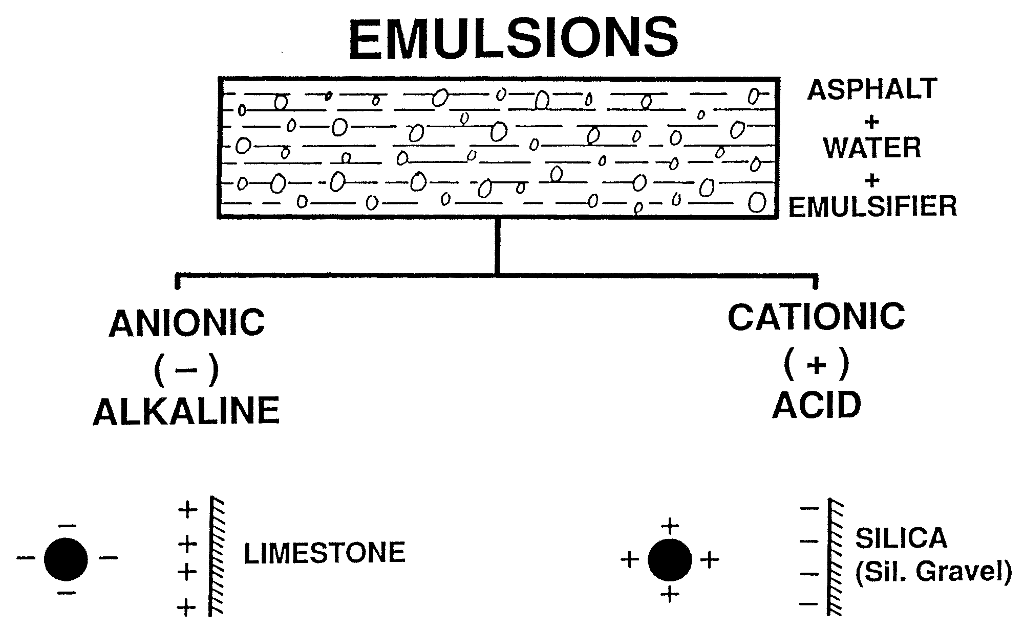

Slide 55
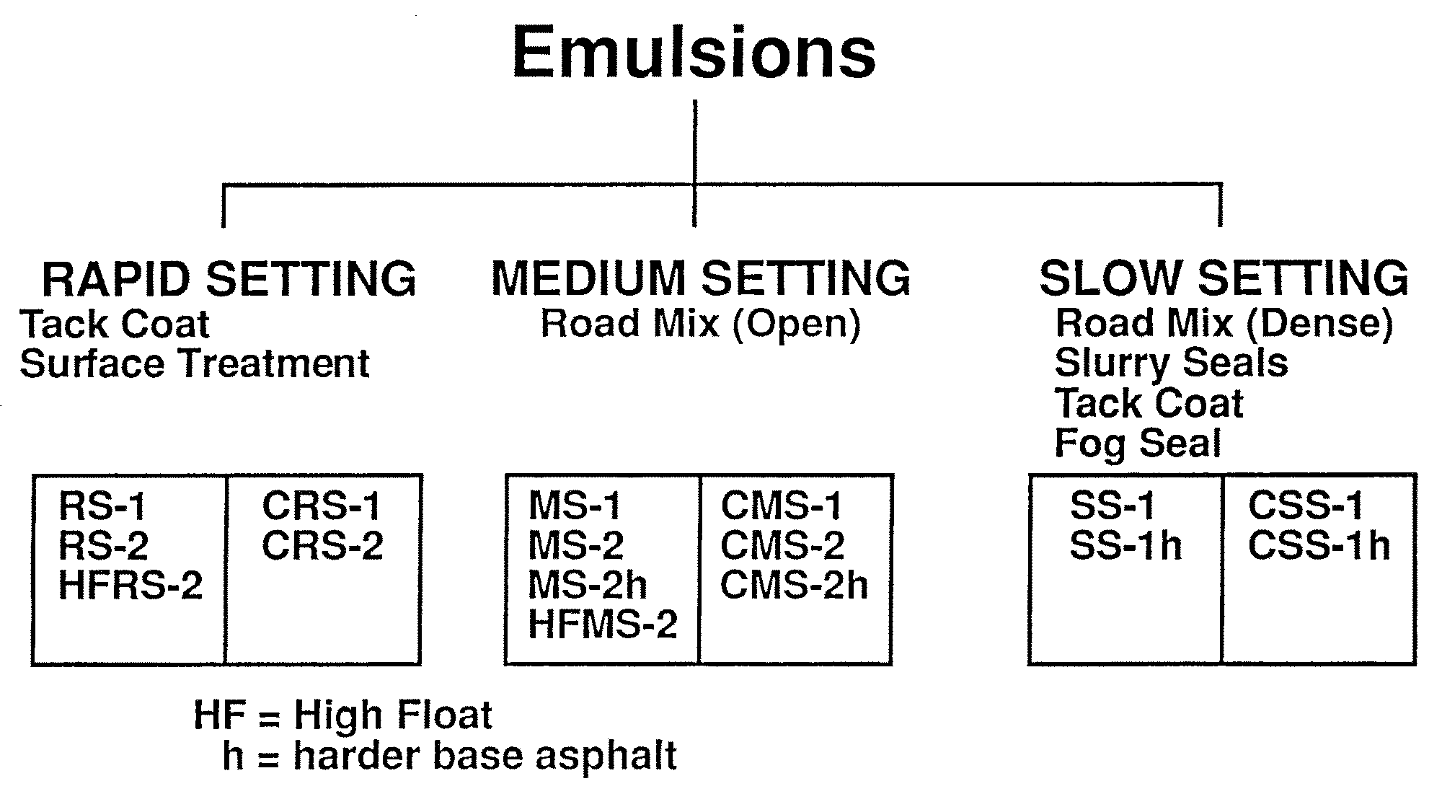

Slide 56
Émulsions vs bitumes fluidifiés
environnementaux Problèmes – emulsions are pollution free
Safety Problèmes – déblaibacks are dangerous
Cheaper – Élevée Énergie solvents wasted into atmosphere
Emulsions may be utilisé at Inférieure températures
Emulsions may be utilisé sur damp chaussée
Notes:
Emulsions are produced by blending asphalt cements, water and an emulsifier (e.g. soap) in a high shear colloid mill. The resulting asphalt droplet suspended in the water has a charge which reflects the chemistry of the emusifier. The charge of the emulsion is usually selected so that it is opposite that of the aggregate to promote adhesion of the asphalt to the aggregate surface.
Emulsions are an asphalt-based product which is also liquid at room temperature.

Slide 57
Émulsions vs bitume routier conventionnel
Cost is Le main factor dans selection de appropriate tapiserial
Emulsion is very popular dans Europe, moins utilisé dans Le United States
About 95% is cationic emulsion
Notes:
Emulsions are produced by blending asphalt cements, water and an emulsifier (e.g. soap) in a high shear colloid mill. The resulting asphalt droplet suspended in the water has a charge which reflects the chemistry of the emusifier. The charge of the emulsion is usually selected so that it is opposite that of the aggregate to promote adhesion of the asphalt to the aggregate surface.
Emulsions are an asphalt-based product which is also liquid at room temperature.

Slide 58
Propriétés des bitumes routiers
Liquid at normal températures
Softens at Élevée températures
Brittle at Faible températures
Ages avec time (oxidation)
Must be compatible avec granulats à assure adhesion
Notes:
In order to purchase a product, the desirable characteristics and important material properties must be known. When these parameters are presented in written form, they are called specifications.

Slide 59

Émulsions
Notes:
In order to purchase a product, the desirable characteristics and important material properties must be known. When these parameters are presented in written form, they are called specifications.

Slide 60
Achat des bitumes routiers
Besoin à be able à spécifier desirable characteristics
"Desirable characteristics" have evolved over time avec increasing technological advances
Purchasing exigents Les spécifications
Notes:
In order to purchase a product, the desirable characteristics and important material properties must be known. When these parameters are presented in written form, they are called specifications.

