Slide 1
Cours C.03.06.01
Granulats
Marek Pszczola
(présentation préparée sur la base des cours du prof. S. Romanoschi, États-Unis)

Slide 2
Road Transportation Systems Engineering Development in the Sub-Saharan Africa – Modern EU Master Programme & Capacity Building

Slide 4
Granulats – définition
Désigne généralement un matériau de sol ayant été, d’une manière ou d’une autre, traité ou trié.
Notes:
Soils are materials that are used as-is. An example would be a finished subgrade surface. Aggregates are materials that have been specifically sorted or processed to achieve given properties. This block will present general background information about how aggregates are obtained and processed.

Slide 5
Types de roches – origine
Magmatiques – formées par refroidissement de la lave volcanique (granite, diorite, basaltes)
  60-70% silica, dur, durable granulats
Sédimentaires – altération par abrasion et météorisation de la roche, formation de dépôts (calcaires et dolomies, conglomérats crayeux)
  moins silica, more lime, plus tendre, moins uniforme
Métamorphiques – modification de la roche à haute température et sous forte pression (marbre, gneiss)
  Properties dépendent sur Le origineal rock
River sable et Gravier

Slide 6
Traitement des granulats
Extraction
Transport
Concassage
Criblage / classification dimensionnelle
Lavage
Notes:
There are five general steps needed to prepare individual stockpiles of aggregates. Once stockpiles have been prepared, two or more stockpiles are typically blended together to produce a final gradation for a given construction application.

Slide 7
Extraction
* naturels sables et gravels
  - Sous-marines sources
    + Rivières & lacs
    + Barge-mounted drbords, draglignes, scoop, conveyors, or pumps
    + Relativement propre
  - Terrestres sources
    + Gravier or sable carrières
    + Bucket chargeuse
Notes:
Excavation of natural sands and gravels from under water sources requires the use of barge-mounted dredges, draglines, scoops, conveyors, or pumps to bring the material above the water line. Sand and gravel pits (land sources) are excavated using back hoes and bucket loaders. The following photos show examples of these procedures.
Natural sands and gravels have a rounded appearance due to the weathering action of water. Rounded natural sands are commonly used in portland cement concrete applications but crushing is required to obtain a more angular shape for use in asphalt concrete.

Slide 8
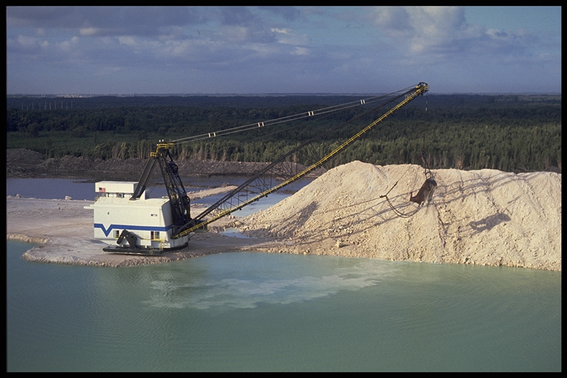
Extraction
Notes:
Some aggregate sources are obtained by removing materials from the bottom of lakes and rivers.

Slide 9
Extraction
* Crushed stone et rock
  - Rock profondeurs < 50 ft., overburden washed out during processusing
  - Rock profondeurs > 50 ft., remove overburden
    + sol bandeped avec bulldozers et scrapers
  - Minage nécessaire
Notes:
Excavation of rock ledges requires blasting the solid ledges into transportable sizes. However, this can still leave very large blocks of rock to be moved. One or more crushing operations are needed to further reduce the size of the material. As a result of the blasting and crushing operations, quarried aggregates always have an angular particle shape.
The following photographs show examples of these types of operations.

Slide 10
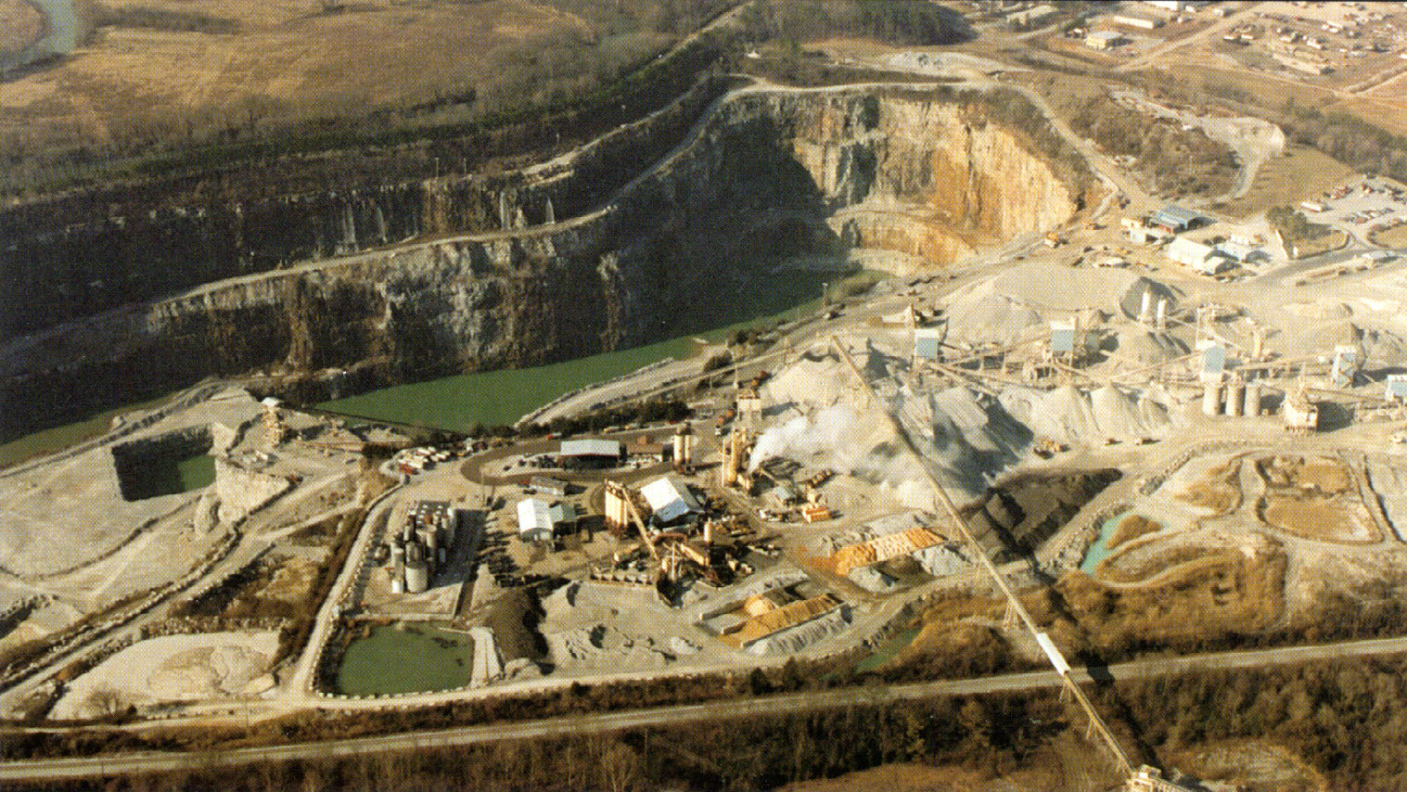
Extraction

Slide 11
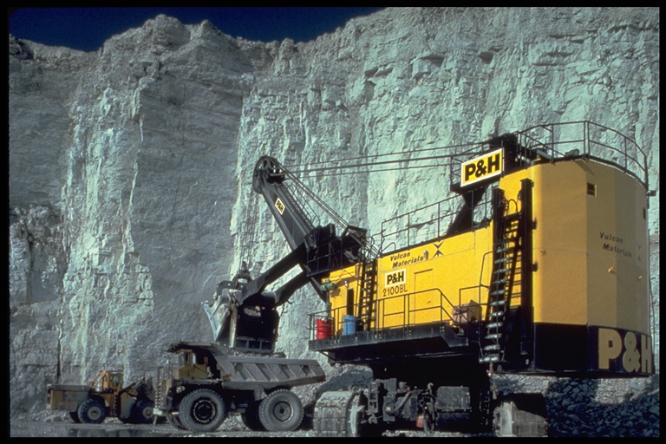
Extraction
Notes:
This photograph shows typical operations in a limestone quarry.

Slide 12
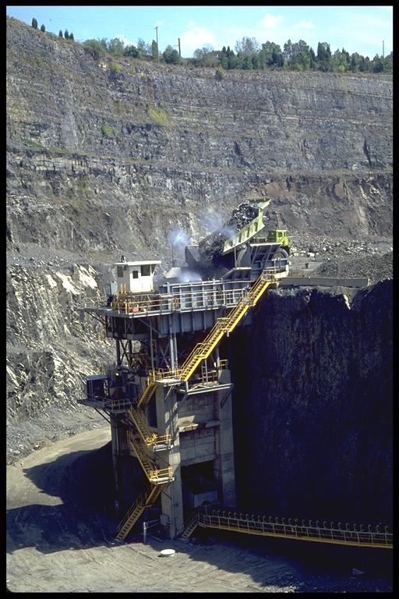
Concassage
Réduction Le granulats à Le souhaitée dimension
Notes:
The first step in preparing stockpiles for specific uses is the crushing the larger boulders and aggregates into usable sizes.

Slide 13
Concassage
River Gravier vs. Partially Crushed River Gravier
Notes:
Crushing of river gravels is used to change the shape of the aggregate particles.

Slide 14
Concassage
Facteurs à prendre en compte lors du choix de l’équipement :
  résistance / résistance à l’usure de Le tapiserial
  dimension de Le tapiserial à be crushed
  souhaitée dimension pour Le final tapiserial
  Énergie nécessaire
  Reduction rapport = max. dimension Avant / max. dimension Après
Other Problèmes:
  Poussière Contrôler
  Bruit Contrôler

Slide 15
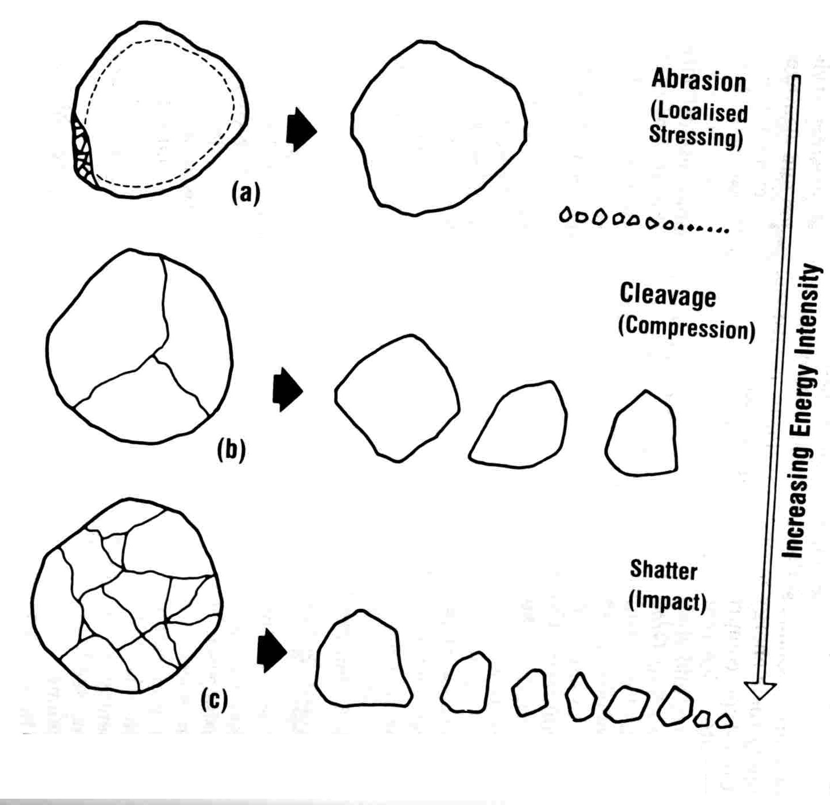
Crushing – Énergie effects
Notes:
Once materials are obtained,they are usually transported by land, rail, or barge to a centrally located plant for separation into specific sizes.

Slide 16
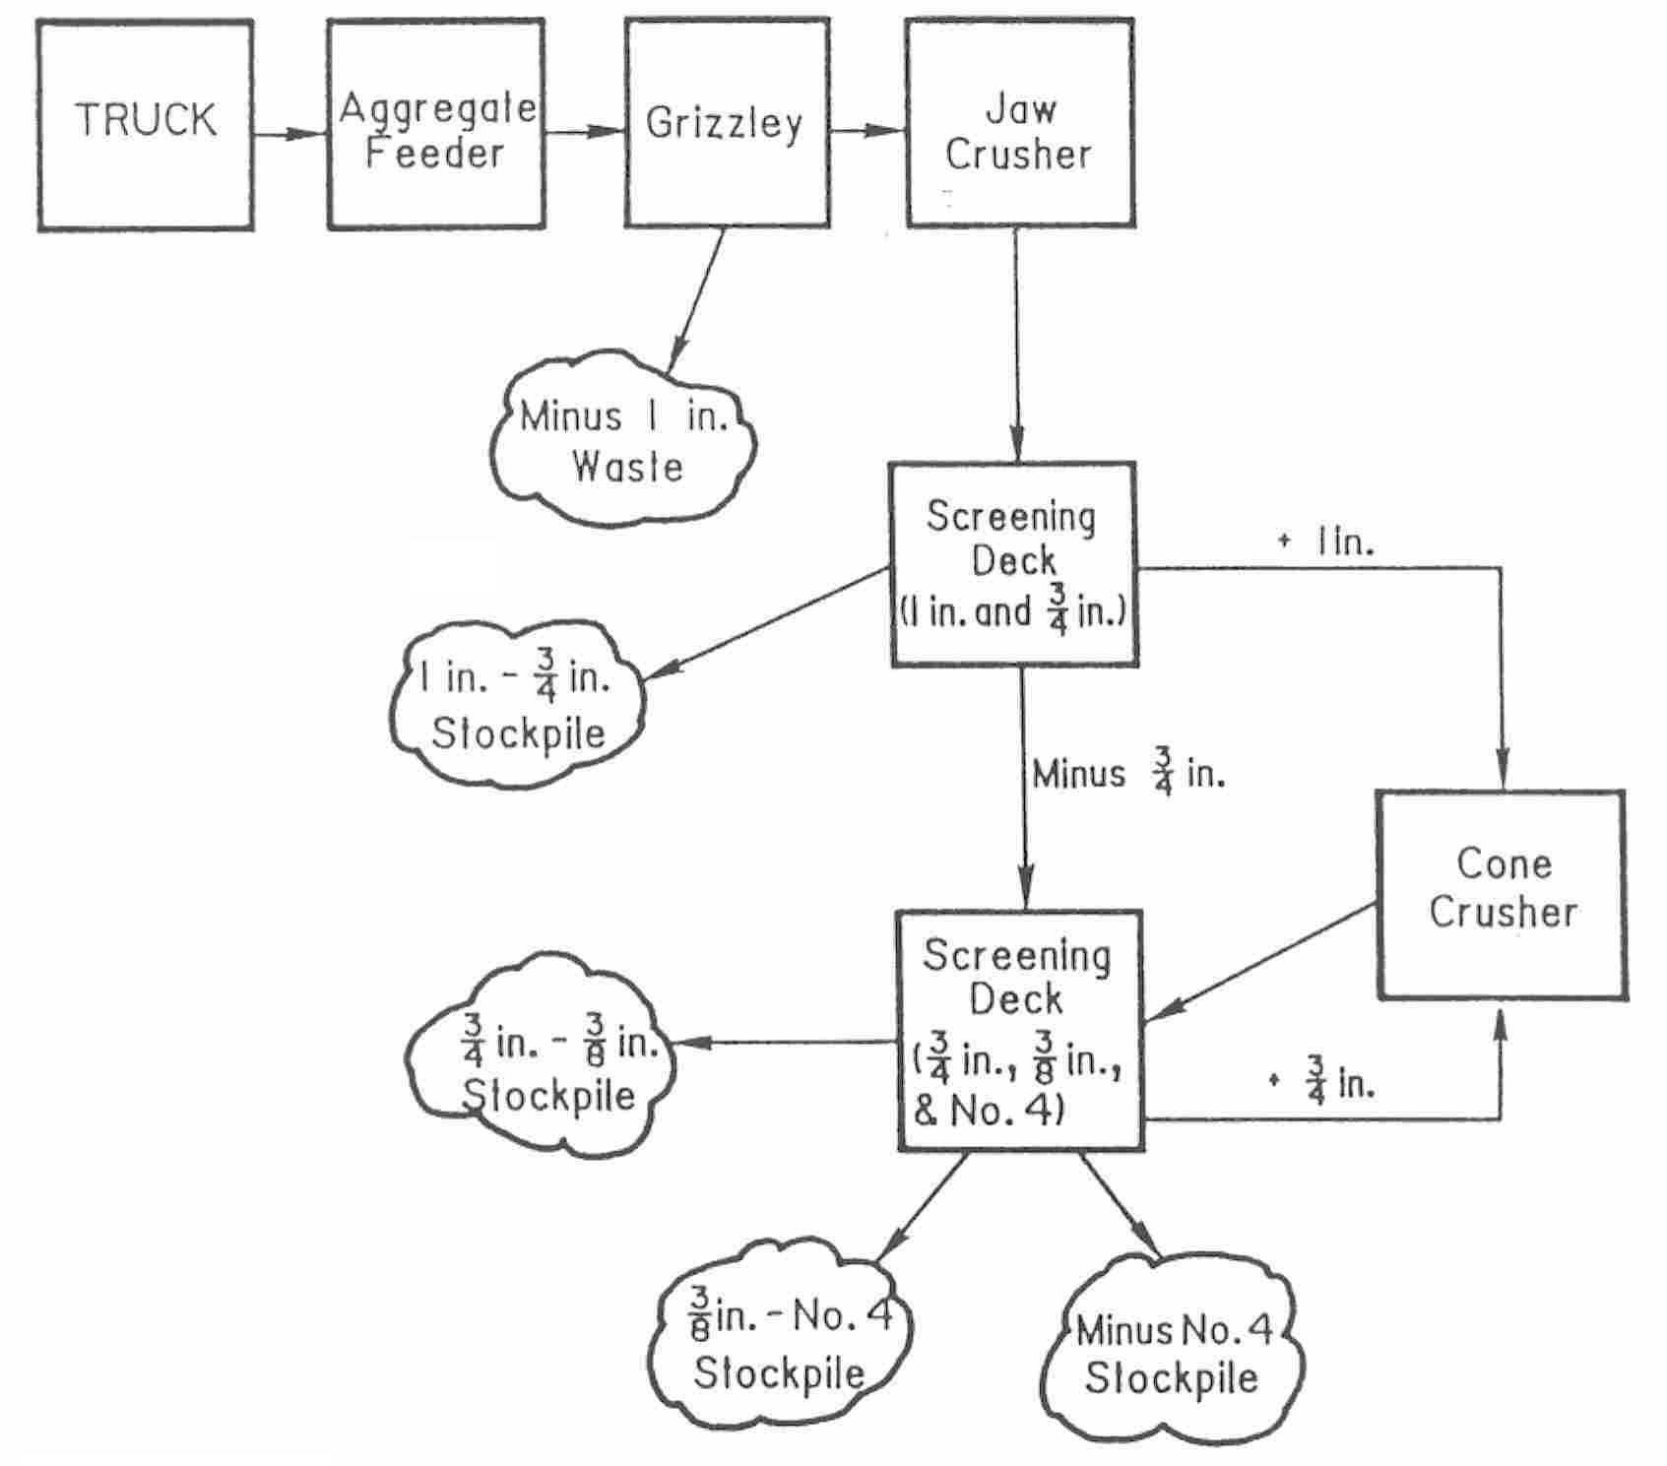
Crushing – simplified setup
Notes:
Once materials are obtained,they are usually transported by land, rail, or barge to a centrally located plant for separation into specific sizes.

Slide 17
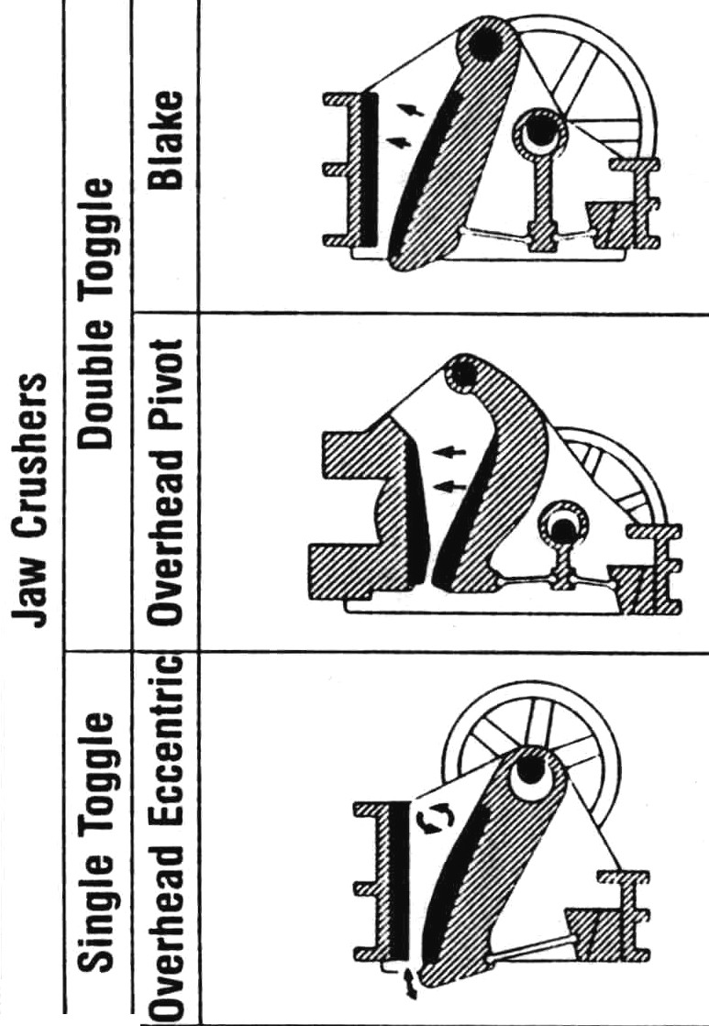
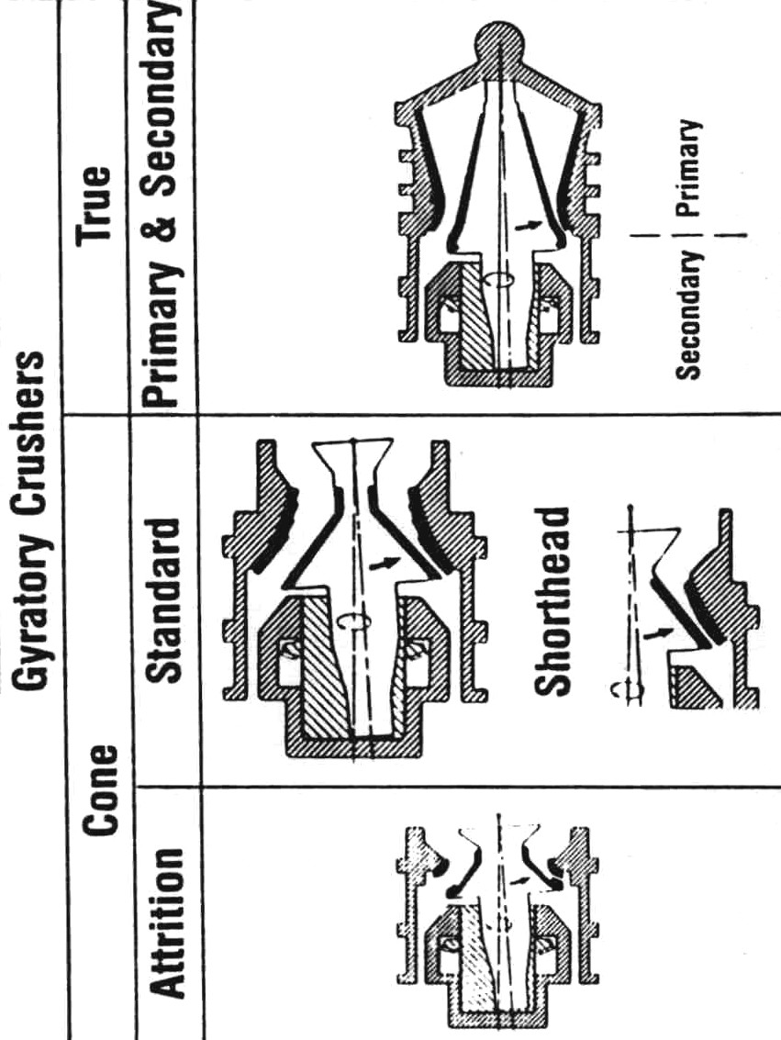
Crushers
Notes:
Once materials are obtained,they are usually transported by land, rail, or barge to a centrally located plant for separation into specific sizes.

Slide 18
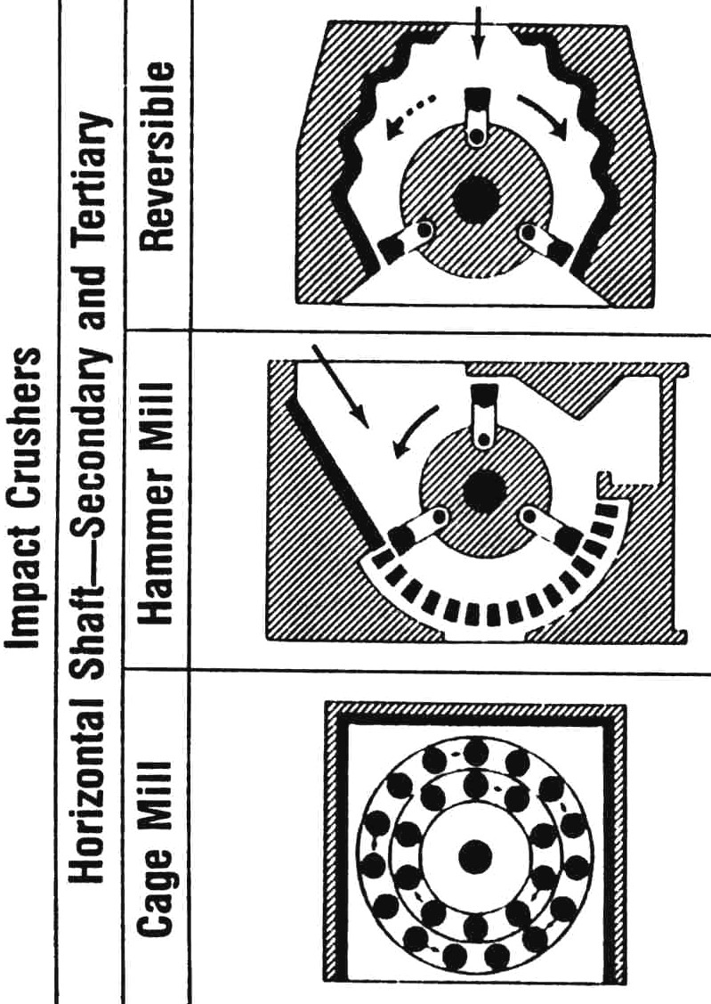
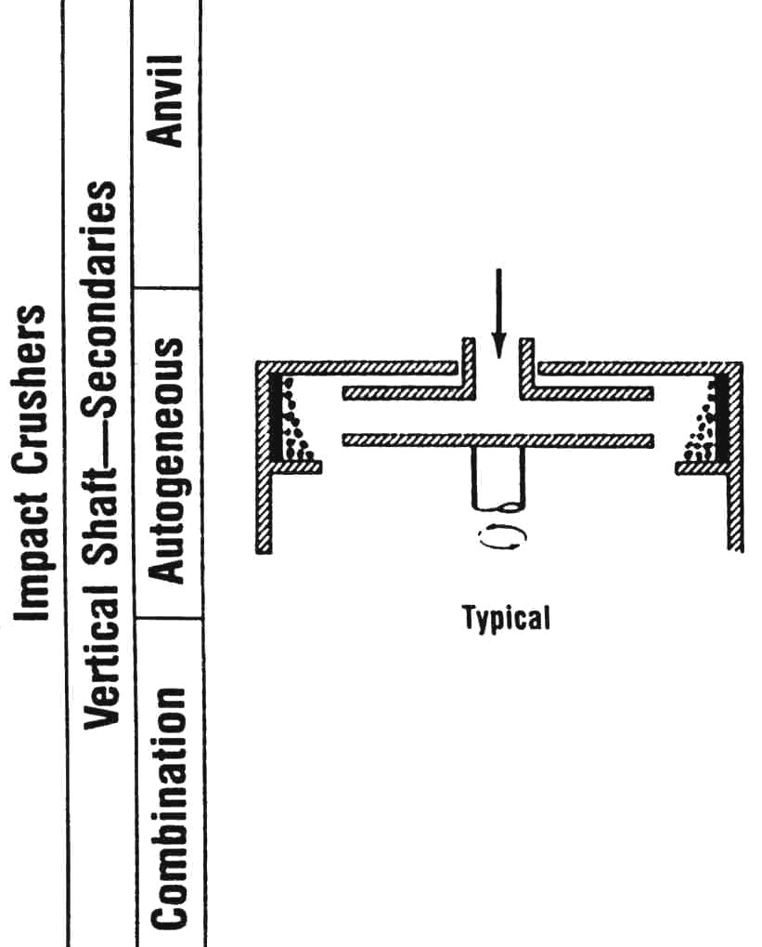
Crushers
Notes:
Once materials are obtained,they are usually transported by land, rail, or barge to a centrally located plant for separation into specific sizes.

Slide 19
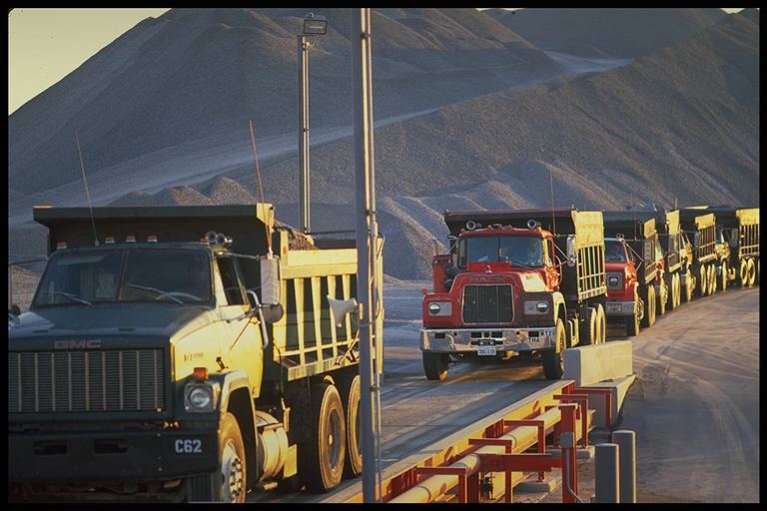
Transport
Notes:
Once materials are obtained,they are usually transported by land, rail, or barge to a centrally located plant for separation into specific sizes.

Slide 20
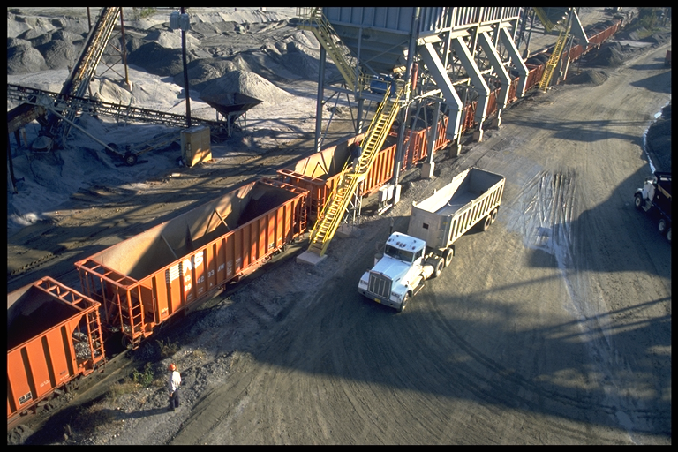
Transport

Slide 21
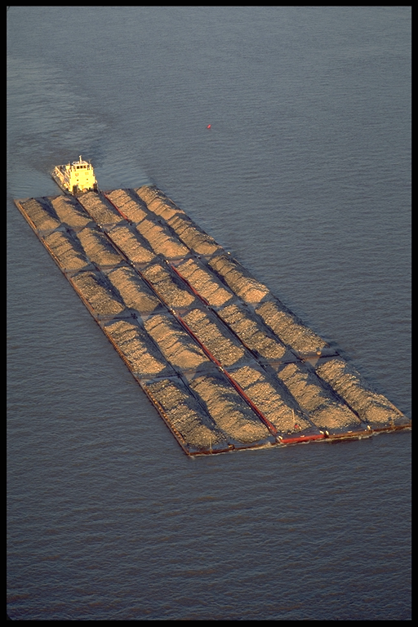
Transport
Transport is 90% de Le cost

Slide 22
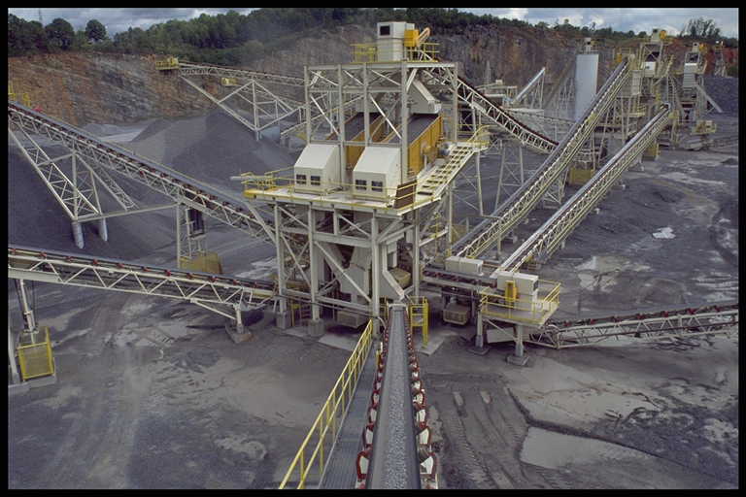
Criblage / classification dimensionnelle
Notes:
Once the rock has been sufficiently reduced in size, it is separated into individual stockpiles with specific ranges of particle sizes. Large screening operations have a number of wire mesh screen decks with each deck having progressively smaller openings between the wires. These screens are slanted and empty the material retained on each screen out onto conveyor belts. These belts then move the material into individual stockpiles of a particular size.

Slide 23
Mise en stock
Éviter ségrégation et contamination
Bonne stockpiling = uniforme granulométrie
To obtenir a Bonne stock de granulats:
  Faibles chute distances
  Minimiser déplacement
  Don't Utiliser 'single cone' Méthode
  Séparer stocks de granulats
Notes:
Poor stockpiling practices can result in particle size separation even within a pile of limited particle sizes. Good stockpiling practices limit the drop distance and prepare a number of small stockpiles for a particular gradation of aggregate. This minimizes the separation of the fine and coarse particles. Moving stockpiles with trucks and dozers should be minimized in order to prevent excessive degradation of the aggregate (that is, more very fine particles). The following photographs show examples of good stockpiling practices.

Slide 24
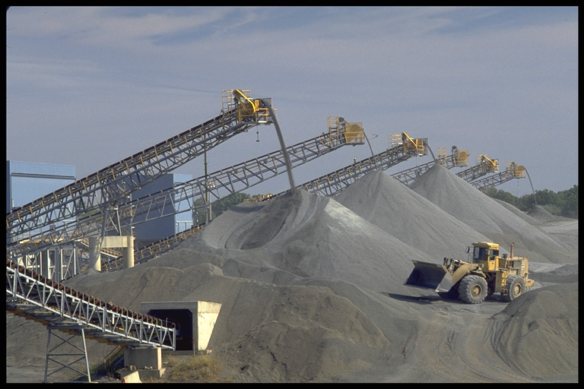
Mise en stock
Notes:
This photograph shows a typical stockpiling operation.

Slide 25
Échantillonnage
Why Échantillonnage Is Important
  Évaluer la qualité potentielle d’une source de granulats proposée
    La nouvelle source respecte-t-elle les spécifications relatives aux granulats ?
  Déterminer la conformité aux exigences des spécifications du projet
    Les granulats actuels respectent-ils les spécifications ?
Notes:
Once stockpiles have been produced, it is necessary to determine the final gradation and aggregate properties of each stockpile. There are specific guidelines which need to be followed in order to obtain samples of aggregates which represent the entire stockpile. Samples can be obtained from the stockpiles themselves or from the conveyor belts which move the aggregate from storage bins into the hot mix asphalt (HMA) plant.

Slide 26
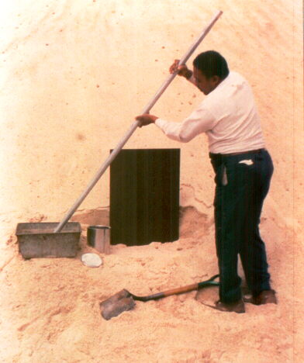
Échantillonnage à partir de stock de granulats
Granulat fin
Notes:
Samples can be carefully obtained from an individual stockpile.

Slide 27
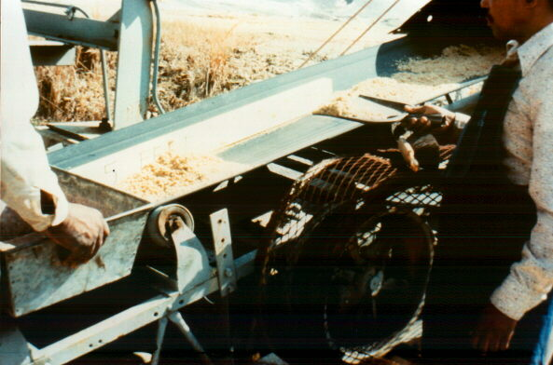
Échantillonnage à partir de Conveyor
Notes:
Or they can be obtained by “catching” a sample off of the end of the conveyor belt which feeds into the HMA plant.

Slide 28
Source granulat Properties
Résistance à l’usure / ténacité
Résistance aux cycles d’altération
Matériaux nuisibles
Granulométrie
Notes:
Source aggregate properties are those properties which are measured for the aggregate as-stockpiled and are commonly used for aggregate source acceptance control. These properties are toughness, soundness, and deleterious materials. In addition, the gradations of individual stockpiles may be evaluated.

Slide 29
Définitions
* gros granulat
  Retenu sur 4.75 mm (No. 4) – ASTM D692
  Retenu sur 2.38 mm (No. 8) – Asphalt Institute
  Retenu sur 2.00 mm (No. 10) – HMA Book
* granulat fin
  Passant 4.75 mm (No. 4) – ASTM D1073
  Passant 2.38 mm (No. 8) – Asphalt Institute
* remblaier minéral
  At moins 70% Passant 0.075 mm – ASTM D242
Notes:
Source aggregate property tests evaluate specific fractions of each stockpile. Toughness evaluates the percent change in coarse aggregate particle size while aggregate soundness and the amount of deleterious material (clay lumps and friable particles) can be assessed for both fine and coarse aggregate. For Superpave testing, coarse aggregate is usually that which would be retained on a 4.75 mm sieve and fine aggregate the fraction which would pass this sieve. However, each test method needs to be checked to determine which definition is being used. Depending upon the test requirements, the very fine aggregate, called mineral filler, may or may not be included in the fine aggregate.

Slide 30
Résistance à l’usure / ténacité
* Los Angeles abrasion (AASHTO T96, ASTM C131):
  Résistance de gros granulat à abrasion et mechanical degranulométrie
* granulat at standard granulométrie subjected à dommages par rotatives acier billes
* % perte = (origineal masse - remaining masse Après essai) / origineal masse × 100
Notes:
This test subjects the coarse aggregate (in this case, retained on the 2.36 mm sieve) to impact and grinding by steel spheres. Each sphere has a mass between 390 and 445 g. The number of spheres introduced into the drum depends on the gradation of the aggregate to be tested. The number of spheres increases with increasing size of aggregate.
Once the aggregate and spheres are placed in the steel drum, the machine is rotated at between 30 and 33 rpm’s for 500 revolutions. The aggregates are then removed from the drum and sieved to determine the degradation as a percent loss. The percent loss is the difference between the original mass at the required gradation and the final mass of the test sample)

Slide 31
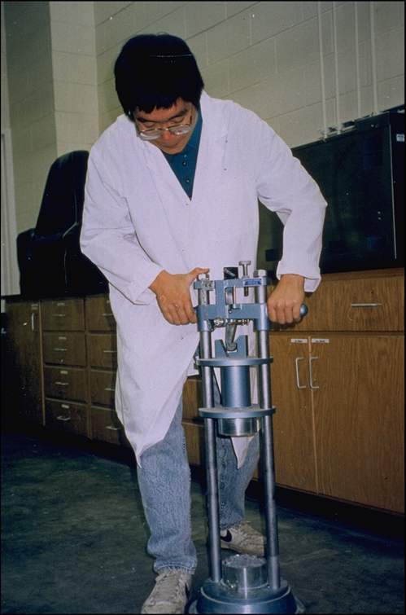
Résistance à l’usure / ténacité

Slide 32
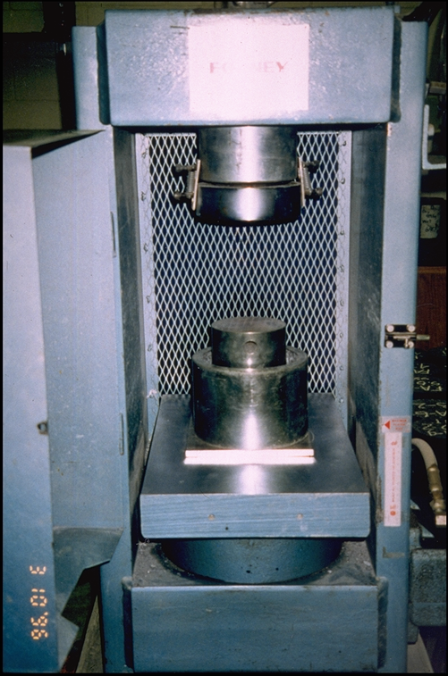
Résistance à l’usure / ténacité

Slide 33
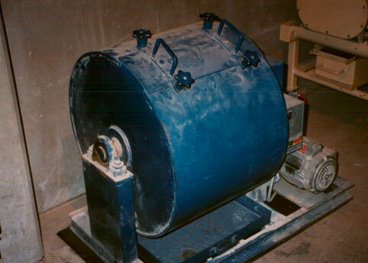
Essai d’abrasion Los Angeles
Typique valeurs:
  10% perte pour extremely dur Magmatique rocks
  60% perte pour soft limestones et sablestones
Notes:
This photo shows the equipment needed for the Los Angeles abrasion test. The panel on theside of the drum is removed and the aggregate and steel balls are placed inside. The panel is replaced and the drum rotated the prescribed number of cycles.
Examples of typical values are noted at the bottom of this photo.

Slide 34
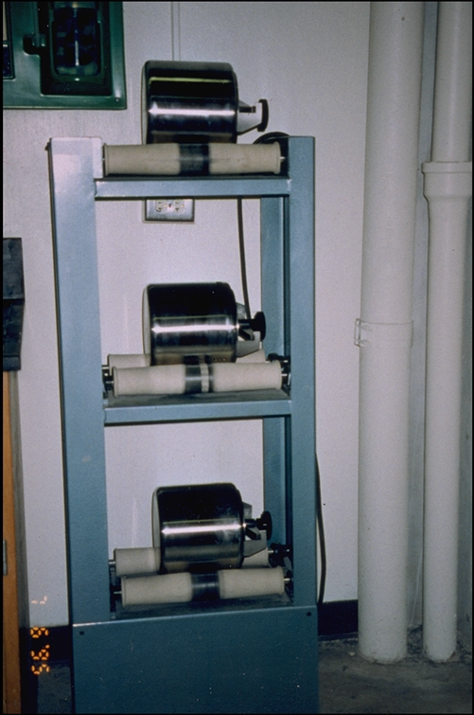
Essai d’abrasion Los Angeles

Slide 35
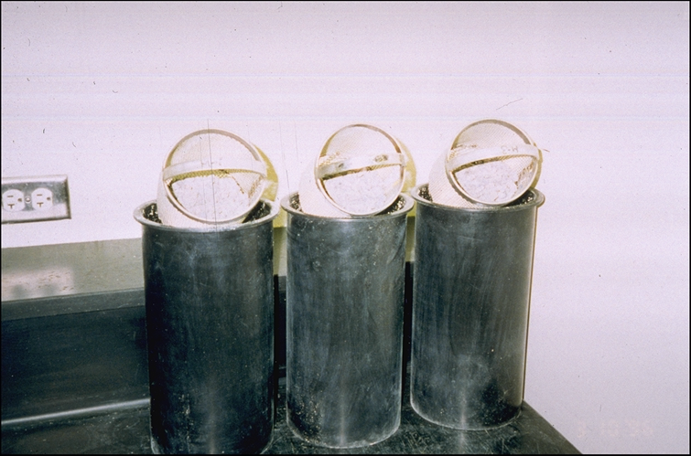
Essai d’abrasion Los Angeles

Slide 36
Résistance aux cycles d’altération
* Estitapises Résistance à altérapportn
* Simule gel/dégel et cycles humidification/séchage
* AASHTO T104, ASTM C88
granulat trempé dans sodium or magnesium sulfate, séché, retrempé – répété 5 times
Maximum perte: 12% sodium sulfate, 18% magnesium sulfate
Notes:
Weathering of aggregates is simulated by repeated immersion in saturated solutions of either sodium or magnesium sulfate followed by oven drying. The internal expansive force from the expansion of the rehydration of the soluble salts upon re-immersion simulates freeze-thaw damage. The difference between the original and final mass, expressed as a percent of the original mass is the percent loss. A weighted percentage is used when several fractions are tested. The soundness of both fine (passing the 4.75 mm sieve) and coarse aggregate can be determined using this test.

Slide 37
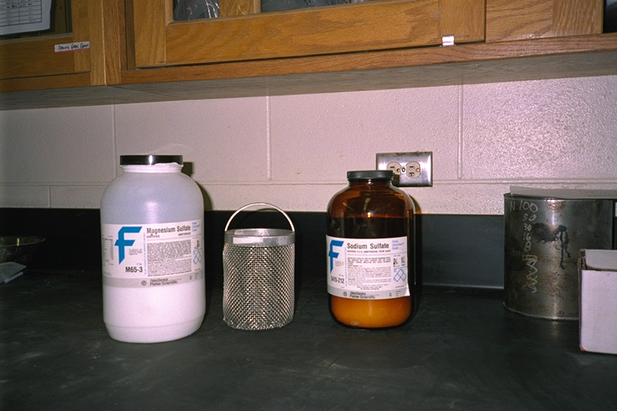
Résistance aux cycles d’altération
Notes:
Minimal supplies are needed for this test. Either sodium or magnesium sulfate can be used by dissolving the appropriate amount in water. Aggregates are placed in a wire mesh basket and then submerged in the solution (not shown).

Slide 38
Résistance aux cycles d’altération
Comparaison avant et après
Notes:
Damage to the aggregate after a number of wet-dry cycles can be seen by visual examination as well as in the change in gradation.

Slide 39
mottes d’argile et particules friables ASTM C 142
Sèche a given masse de granulats
Soaks pour 24 hours et each particule is squeezed between thumb et forefinger
particules that se désagrègent down or se déforment are "mottes d’argile et particules friables"
max. limite: 0.5 à 3.0%
Notes:
Deleterious material is the mass percent of contaminants such as clay lumps, shale, wood, mica, and coal in the blended aggregate. This test can also be performed for both fine and coarse aggregates. The mass percentage of the material lost during a wet sieve is reported as the percent of clay lumps and friable particles.

Slide 40
Gradations
Granulométrie des granulats
Répartition des dimensions des particules exprimée en pourcentage du poids total
Notes:
A complete sieve analysis of the blended aggregate gradation consists of two parts. The first part determines the percent of particles finer than the 0.075 mm sieve. The second part is a discrete mechanical separation of various aggregate particle sizes and incorporates the results from the first part in the final gradation reported.

Slide 41
Étapes de l’analyse granulométrique
Partie 1 – analyse granulométrique par tamisage lavé
  Dry granulat et Déterminer masse (M1)
  Wash granulat over 0.075mm tamis à remove Poussière
  Dry et Déterminer nouveau masse (M2)
  % Poussière = (M1 - M2) / M1 × 100
Notes:
For this test (ASTM C117), a portion of aggregate is dried and the original mass of the sample is recorded. The aggregate is then placed in a bowl, gently washed with water, and the water decanted over a 0.075 sieve. When the water being decanted is reasonably clear, the aggregate is removed container. Any aggregate retained on the sieve used for decanting is returned to this sample and then dried to a constant mass. Once the dry mass is recorded, it is used for the mechanical particle size analysis.

Slide 42
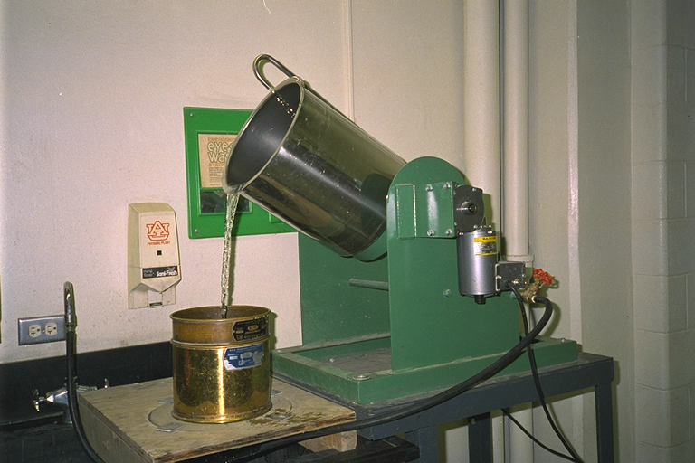
Washed tamis
Notes:
This photograph shows a mechanical washing system. The aggregate is placed in the large bucket and a gentle stream of water is started. Once the bucket is full of water, the excess water pours out the side and over a nest of two sieves. The larger sieve on top is there to protect the 0.075 mm sieve below in case larger aggregate particles are washed out of the bucket. The bucket is slowly rotating during this process.
Once the water pouring over the sieves is clear, the aggregate in the bucket is emptied into a pan. Any material retained on either of the two wash screeens is also added to the pan. The aggregate is then dried to a constant mass. The amount of 0.075 mm material lost during washing is the difference between the original mass and the dry mass after washing.

Slide 43
Étapes de l’analyse granulométrique
Partie 2 – analyse granulométrique par tamisage à sec
  Stack tamis à partir de largest opening at top à smallest at bottom
  Place washed/séché granulat sur top tamis
  Shake pour prescribed period
  Weigh tapiserial Retenu sur each tamis
Notes:
In the second step, the oven dry aggregate is placed in a stack of increasing smaller sieves, placed in a shaker and agitated for about 5 to 10 minutes. Gently separate the sieves and determine the mass of the sieve and aggregate. Dump aggregate out of sieve, thoroughly clean the sieve, and determine the mass of the sieve without the aggregate.

Slide 44
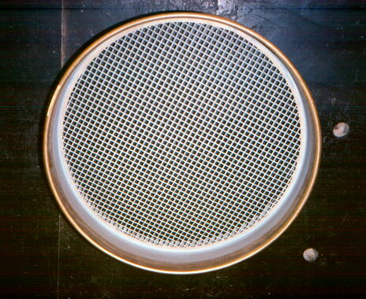
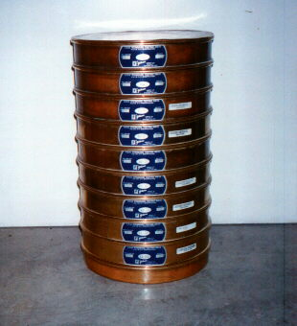
Analyse granulométrique
Notes:
Each sieve has wire mesh in the bottom. The sieve size (4.75 mm, 2.36, mm etc.) denote the distance between each wire. Sieves are stacked from largest openings on the top to smallest openings on the bottom. There is always a pan (no openings) at the bottom of the stack.

Slide 45
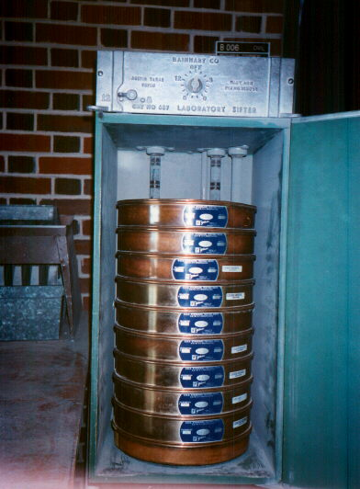
Tableau granulométrique
Notes:
Once the stack is assembled and the oven dry aggregate added to the top, it is placed in a mechanical shaker. This is run from 5 to 15 minutes. Care needs to be taken to ensure that any given sieve is not overloaded. That is, that there is so much material on the screen that material cannot be efficiently separated.

Slide 46
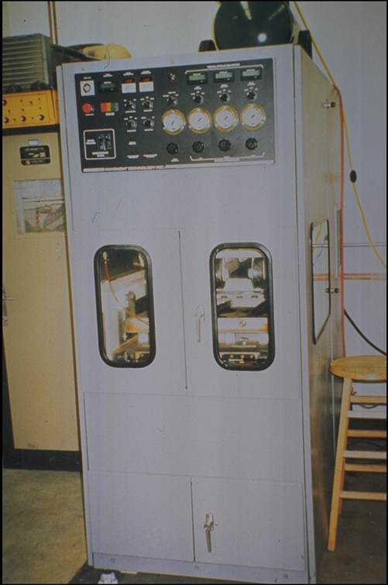
Analyse granulométrique

Slide 47
Courbe granulométrique
Notes:
Once the shaker stops, the stack is removed and the mass of aggregate retained on each screen is determined. These masses are recorded and used in subsquent calculations (next slides).

Slide 48
Forme et angularité des particules
* Influence Le empilement de particules dans a mélange
* Angular/rugueux-textured particules s’imbriquent et resist defortapision
* Round/smooth particules pack more densely but are moins stable
* mesuré par Flat &amp; Elongated particule Essais
Notes:
The percent retained on each sieve is a ratio of the mass of aggregate on each sieve divided by the original mass (before washing). The cumulative percent retained is simply the sum of the percent retained on each sieve above the one of interest. The cumulative percent passing, commonly referred to as “percent passing”, is 1 minus the cumulative percent retained.

Slide 49
Forme des particules
Notes:
This is an example of the calculations necessary for a sieve analysis. What is not shown is that the 22.4 g of material in the pan is the sum of the mass which was washed past the0.075 mm sieve in the first part and the mass of the aggregate retained in the pan after the mechanical sieve analysis. This is an important point as the final gradation reported needs to reflect the true percentage of fractions in the stockpile which will be used during construction.

Slide 50
Résumé

