Slide 1
Transport Research and Analysis
Module 1: Introduction to Transport Research and Analysis
Lecture 4: Ethical Considerations in Transport Research

Slide 3
Table of Contents
Lecture 4: Ethical Considerations in Transport Research
3. Consent and Confidentiality | 13
3.1 Understanding Informed Consent in Research | 14
3.2 Legal and Ethical Frameworks for Data Confidentiality | 16
3.3 Challenges in Maintaining Confidentiality in Engineering Data | 18
4. Quiz | 20
4.1 Questions | 21
4.2 Discussion on Real-World Ethical Dilemmas | 23
5. Ethical Research Practices | 26
5.1 Guidelines for Ethical Data Collection in Engineering | 27
5.2 Ethical Data Handling and Storage Practices | 28
5.3 Future of Ethical Considerations in Data-Driven Engineering | 29
1. Background and Motivation | 1
1.1 Introduction to Ethical Considerations in Data Collection | 2
1.2 Importance of Ethics in Engineering Research | 3
1.3 Case Studies of Ethical Violations in Data Collection | 4
2. Ethical Issues in Data Collection | 6
2.1 Privacy Concerns in Data Collection | 7
2.2 Misuse of Data in Engineering Research | 9
2.3 Bias and Manipulation in Data Gathering | 11
i
Ethical Considerations in Transport Research

Slide 4
Section 01:
Background and Motivation
Ethical Considerations in Transport Research

Slide 5
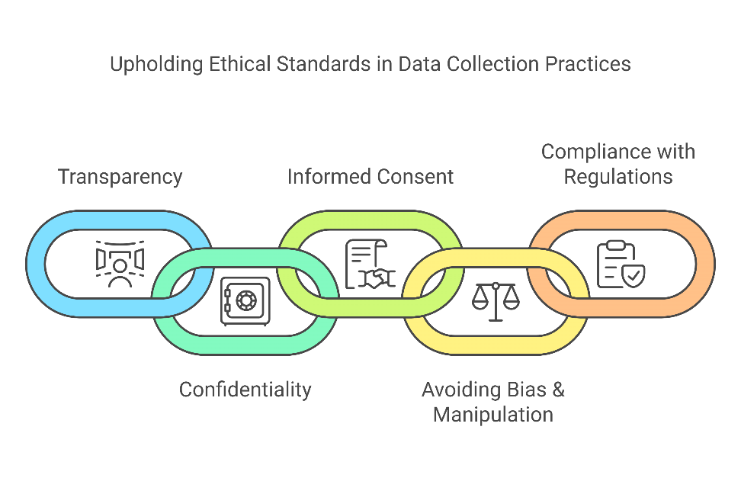
1.1 Introduction to Ethical Considerations in Data Collection
1.1 Introduction to Ethical Considerations in Data Collection
What is Ethics in Data Collection?
Ethics in data collection refers to moral principles that govern the acquisition, use, and dissemination of data in research and practice.
It ensures integrity, honesty, and fairness in data handling to prevent misuse, misrepresentation, or harm to individuals or communities.
Ethical data collection is crucial for engineering fields, especially in transportation, artificial intelligence, and automation, where decision-making depends on data reliability and fairness​.
Key Ethical Principles in Data Collection
Transparency: Researchers must clearly explain how data is collected, stored, and used.
Confidentiality: Ensuring sensitive data remains protected.
Informed Consent: Participants must be aware of the study’s purpose and agree voluntarily.
Avoiding Bias & Manipulation: Data should not be collected or analyzed in ways that intentionally distort findings.
Compliance with Regulations: Ethical guidelines from institutions like IEEE, GDPR (General Data Protection Regulation), and national research boards must be followed.
2
Ethical Considerations in Transport Research

Slide 6
1.2 Importance of Ethics in Engineering Research
1.2 Importance of Ethics in Engineering Research
Why is Ethics Important in Engineering Data Collection?
Engineers collect and analyze data that directly affects public safety, security, and well-being. Unethical data practices can lead to flawed designs, unfair policies, or hazardous implementations.
Examples of unethical consequences in engineering research:
i. Flawed AI models in autonomous vehicles: Bias in training data may cause unsafe driving decisions.
ii. Surveillance-based research without consent: Public data collection (e.g., face recognition systems) raises privacy concerns.
Benefits of Ethical Data Collection in Engineering
Enhances Public Trust: Ensures the public believes in the reliability of engineering solutions.
Prevents Harm: Avoids unintended consequences such as privacy breaches or discrimination in AI-based decision systems.
Improves Data Integrity: High-quality data collection leads to more accurate and replicable research findings.
Ensures Legal Compliance: Many countries have strict laws (e.g., GDPR, IEEE standards) that require engineers to handle data ethically.
3
Ethical Considerations in Transport Research

Slide 7
1.3 Case Studies of Ethical Violations in Data Collection
1.3 Case Studies of Ethical Violations in Data Collection
Case Study 1: Cambridge Analytica Scandal (2018)
A political consulting firm collected and misused Facebook data from over 87 million users without proper consent.
Machine learning models used this data to manipulate voter behavior in elections.
Resulted in lawsuits and public backlash over data privacy violations.
Lesson Learned: Even publicly available data must be collected and used ethically.
Case Study 2: Volkswagen Emissions Scandal (2015)
Volkswagen manipulated emissions test data to falsely show their diesel engines were environmentally compliant.
The scandal led to fines exceeding $30 billion and a loss of public trust in engineering ethics.
Lesson Learned: Data manipulation for commercial gain can lead to long-term damage and legal consequences.
4
Ethical Considerations in Transport Research

Slide 8
1.3 Case Studies of Ethical Violations in Data Collection
1.3 Case Studies of Ethical Violations in Data Collection
Case Study 3: Google AI Bias in Facial Recognition (2019)
Google’s AI for facial recognition was found to have racial bias, misidentifying non-white individuals at a higher rate than white individuals.
Root cause: Training data lacked diversity - a fundamental ethical issue in data collection.
Lesson Learned: Bias in data collection leads to real-world consequences, especially in AI-driven engineering fields.
5
Ethical Considerations in Transport Research

Slide 9
Section 02:
Ethical Issues in Data Collection
Ethical Considerations in Transport Research

Slide 10
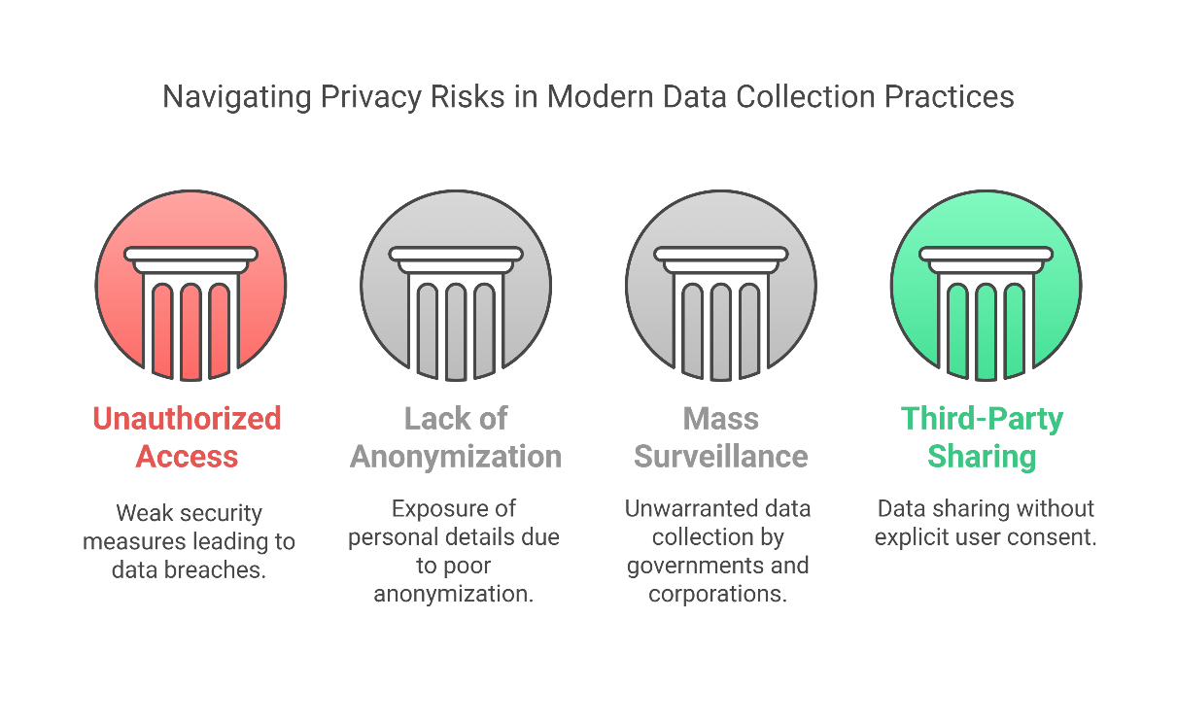
2.1 Privacy Concerns in Data Collection
2.1 Privacy Concerns in Data Collection
What is Privacy in Data Collection?
Privacy in data collection refers to protecting individuals' personal and sensitive information from unauthorized access, use, or distribution.
In engineering research, privacy concerns arise when data is collected without consent or is used in ways that violate ethical and legal standards.
Major Privacy Risks in Data Collection:
Unauthorized Data Access: Weak security measures can lead to data breaches.
Lack of Anonymization: Personal details may be exposed when data is not properly anonymized.
Mass Surveillance Issues: Governments and corporations may collect data without individuals’ awareness.
Third-Party Data Sharing: Companies often share or sell user data without explicit consent.
7
Ethical Considerations in Transport Research

Slide 11
2.1 Privacy Concerns in Data Collection
2.1 Privacy Concerns in Data Collection
Example: Strava Heat Map Controversy (2018)
Strava, a fitness-tracking app, released a heat map of global user activity, which unintentionally revealed locations of secret U.S. military bases.
Even though the data was anonymized, patterns of movement exposed sensitive security details.
Lesson: Even aggregated data can pose serious privacy risks.
8
Ethical Considerations in Transport Research

Slide 12
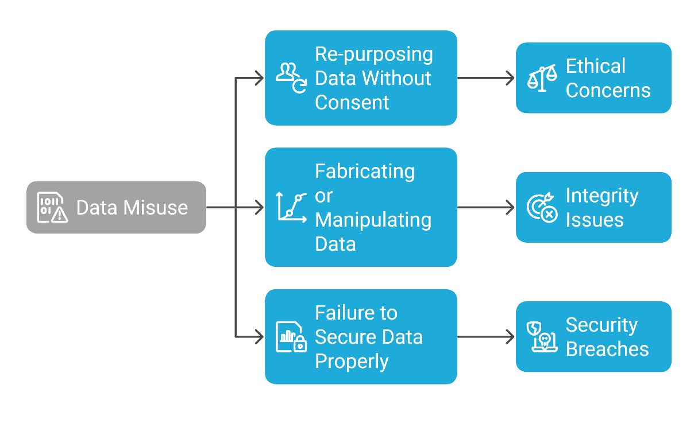
2.2 Misuse of Data in Engineering Research
2.2 Misuse of Data in Engineering Research
What is Data Misuse?
Data misuse occurs when collected information is used for purposes other than what was originally intended or disclosed.
This can include manipulating findings, unauthorized sharing, or using data for financial/political gain.
Common Forms of Data Misuse in Engineering:
Re-purposing Data Without Consent: Using medical research data for marketing purposes.
Fabricating or Manipulating Data: Altering research findings to support a biased conclusion.
Failure to Secure Data Properly: Leading to leaks or cyberattacks.
9
Ethical Considerations in Transport Research

Slide 13
2.2 Misuse of Data in Engineering Research
2.2 Misuse of Data in Engineering Research
Example: Facebook and Cambridge Analytica (2018)
Data from 87 million Facebook users was collected under the pretense of a survey but was later used to influence political campaigns.
The scandal resulted in legal penalties and major trust issues in data ethics.
Lesson: Ethical transparency is crucial when handling data.
10
Ethical Considerations in Transport Research

Slide 14
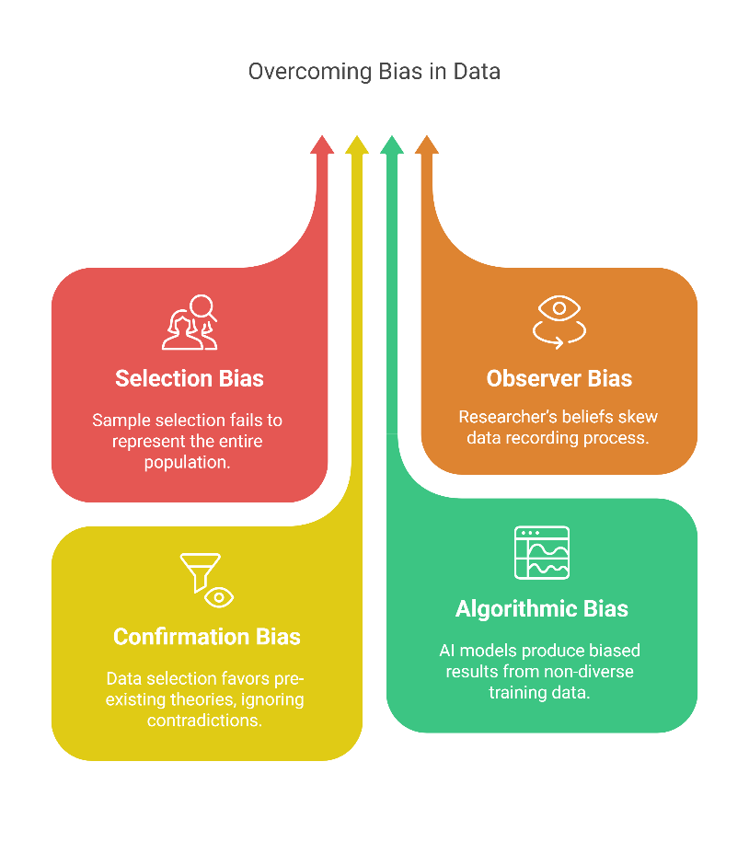
2.3 Bias and Manipulation in Data Gathering
2.3 Bias and Manipulation in Data Gathering
What is Bias in Data Collection?
Bias in data collection occurs when certain groups or perspectives are overrepresented or underrepresented, leading to skewed conclusions.
In engineering, biased data can result in flawed AI models, inaccurate predictions, and unfair policy decisions.
Types of Bias in Data Collection:
Selection Bias: Choosing a sample that does not represent the entire population (e.g., only testing new vehicle safety on small cars, excluding trucks).
Observer Bias: The researcher’s personal beliefs influence how data is recorded.
Confirmation Bias: Selecting data that supports a pre-existing theory while ignoring conflicting evidence.
Algorithmic Bias: AI and machine learning models trained on non-diverse datasets produce unfair results.
11
Ethical Considerations in Transport Research

Slide 15
2.3 Bias and Manipulation in Data Gathering
2.3 Bias and Manipulation in Data Gathering
Example: Racial Bias in AI Facial Recognition (2019)
Studies found that AI facial recognition systems misidentified Black and Asian individuals up to 100 times more often than white individuals.
Cause: Training datasets contained mostly white faces, leading to biased algorithms.
Lesson: Ensuring diversity in datasets is crucial for ethical data collection.
12
Ethical Considerations in Transport Research

Slide 16
Section 03:
Consent and Confidentiality
Ethical Considerations in Transport Research

Slide 17
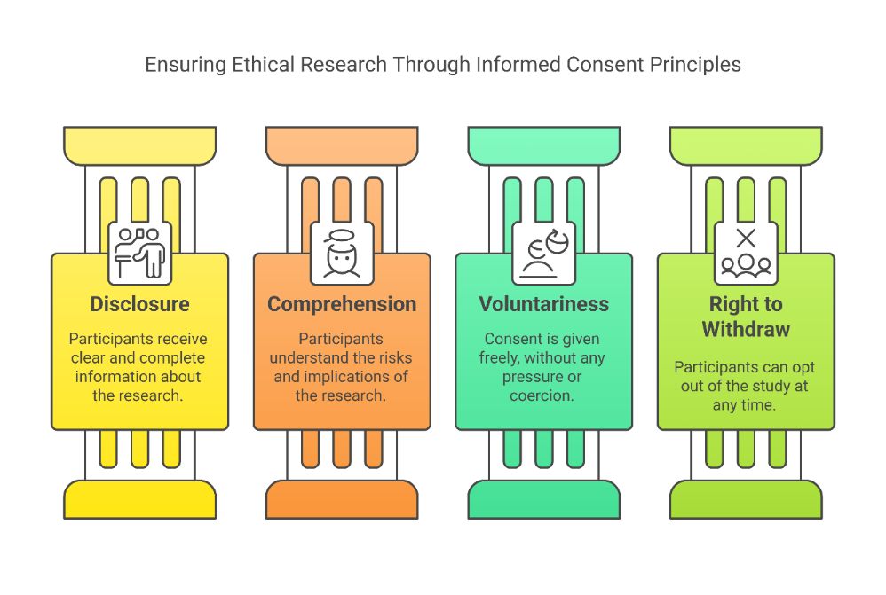
3.1 Understanding Informed Consent in Research
3.1 Understanding Informed Consent in Research
What is Informed Consent?
Informed consent ensures that participants voluntarily agree to provide data, understanding the purpose, risks, and how their information will be used.
It is a fundamental ethical requirement in engineering research, particularly when collecting personal, medical, or behavioral data.
Key Elements of Informed Consent:
Disclosure: Participants must receive clear, complete information about the research.
Comprehension: They must understand the risks and implications.
Voluntariness: Consent must be given freely, without pressure or coercion.
Right to Withdraw: Participants should be able to opt out at any time.
14
Ethical Considerations in Transport Research

Slide 18
3.1 Understanding Informed Consent in Research
3.1 Understanding Informed Consent in Research
Example: Google Street View Privacy Violations (2010)
Google collected personal data from Wi-Fi networks without users’ knowledge while capturing Street View images.
Many governments sued Google for failing to obtain informed consent before gathering this data.
Lesson: Consent must be explicitly obtained before collecting sensitive data.
15
Ethical Considerations in Transport Research

Slide 19
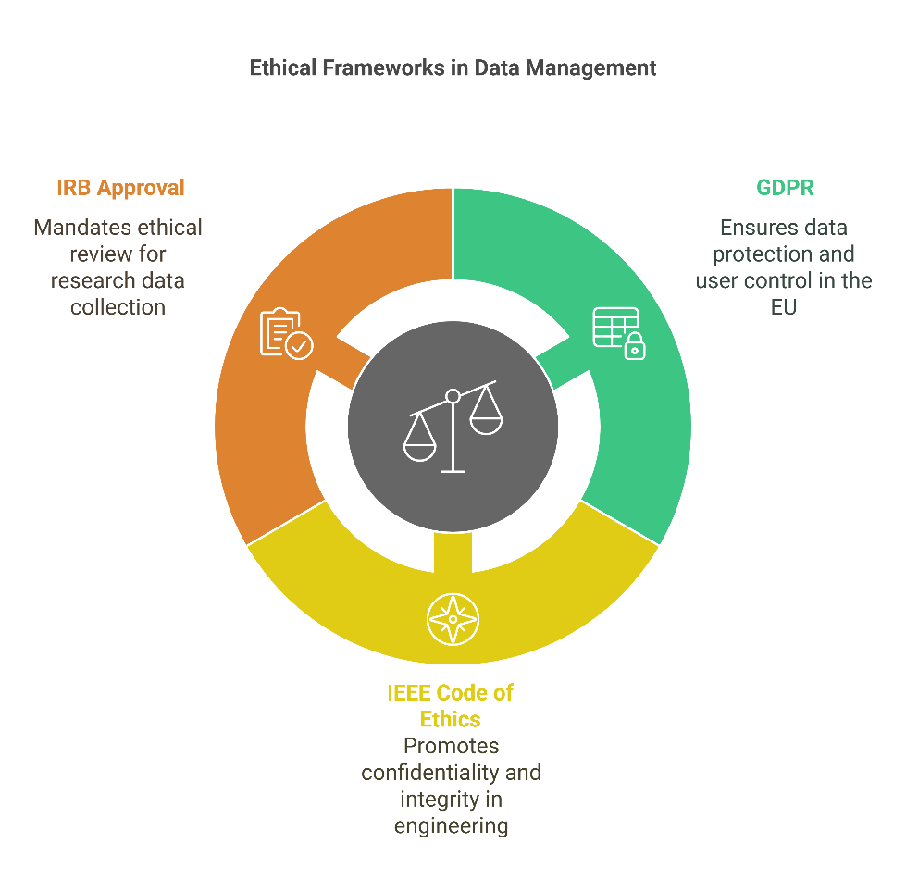
3.2 Legal and Ethical Frameworks for Data Confidentiality
3.2 Legal and Ethical Frameworks for Data Confidentiality
Why is Data Confidentiality Important?
Data confidentiality ensures that sensitive information is protected from unauthorized access, exposure, or misuse.
In engineering research, confidentiality is crucial when handling medical records, biometric data, proprietary designs, or cybersecurity vulnerabilities
Legal and Ethical Frameworks Governing Data Confidentiality:
General Data Protection Regulation (GDPR) (EU):
    i. Requires companies to protect users’ personal data.
ii. Gives individuals control over how their data is used.
IEEE Code of Ethics:
i. Engineers must maintain professional confidentiality and avoid conflicts of interest.
Institutional Review Boards (IRB) & Ethical Committees:
i. Research institutions require ethics approval before data collection begins.
16
Ethical Considerations in Transport Research

Slide 20
3.2 Legal and Ethical Frameworks for Data Confidentiality
3.2 Legal and Ethical Frameworks for Data Confidentiality
Example: Uber Data Breach Cover-Up (2016)
Hackers stole 57 million users' data, but Uber concealed the breach instead of informing affected individuals.
The company faced legal consequences for violating confidentiality and transparency regulations.
Lesson: Protecting confidential data is both a legal and ethical responsibility.
17
Ethical Considerations in Transport Research

Slide 21
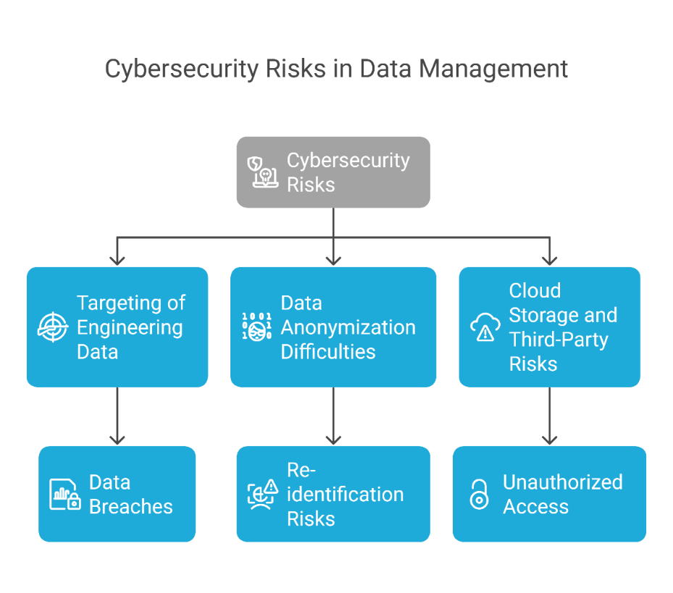
3.3 Challenges in Maintaining Confidentiality in Engineering Data
3.3 Challenges in Maintaining Confidentiality in Engineering Data
Cybersecurity Risks
  i. Engineering data is frequently targeted by cybercriminals, especially in industries like transportation, healthcare, and AI research.
  ii. Cyberattacks can lead to data breaches, affecting both individuals and organizations.
Data Anonymization Difficulties
  i. Simply removing names from a dataset does not always ensure confidentiality.
  ii. Re-identification risks: Even anonymized data can be linked to individuals when combined with other datasets.
Cloud Storage and Third-Party Risks
  i. Many organizations store sensitive research data on cloud platforms like AWS and Google Cloud.
  ii. Risk: If security measures are weak, unauthorized parties may gain access.
18
Ethical Considerations in Transport Research

Slide 22
3.3 Challenges in Maintaining Confidentiality in Engineering Data
3.3 Challenges in Maintaining Confidentiality in Engineering Data
Example: Strava Heatmap Incident (2018) – Military Base Exposure
Strava, a fitness tracking app, released a global heatmap of users’ exercise routes.
Military personnel using Strava unintentionally exposed secret military base locations through aggregated movement data.
Lesson: Even aggregated data can compromise confidentiality if not handled carefully.
19
Ethical Considerations in Transport Research

Slide 23
Section 04:
Quiz
Ethical Considerations in Transport Research

Slide 24
4.1 Questions
4.1 Questions
1. Which of the following is NOT a key element of informed consent?
a) Disclosure
b) Voluntariness
c) Coercion
d) Right to Withdraw
2. What was the primary ethical violation in the Cambridge Analytica scandal?
a) Unauthorized access to confidential medical data
b) Manipulation of election results using collected data
c) Informed consent was not obtained from users
d) Cybersecurity breach leading to leaked passwords
3. Why is anonymization alone NOT always sufficient for maintaining confidentiality?
a) Anonymized data is always secure
b) Data can be re-identified when cross-referenced with other datasets
c) People willingly share their anonymized data
d) Confidentiality applies only to financial data
21
Ethical Considerations in Transport Research
Notes:
1. Answer: c) Coercion
2. Answer: c) Informed consent was not obtained from users
3. Answer: b) Data can be re-identified when cross-referenced with other datasets

Slide 25
4.1 Questions
4.1 Questions
4. What ethical principle ensures that research participants can choose whether to participate without pressure?
a) Data Confidentiality
b) Informed Consent
c) Data Bias Prevention
d) Predictive Analysis
5. Which regulation is primarily used to enforce data confidentiality in the European Union?
a) HIPAA
b) IEEE Code of Ethics
c) GDPR
d) Fair Use Policy
22
Ethical Considerations in Transport Research
Notes:
4. Answer: b) Informed Consent
5. Answer: c) GDPR

Slide 26
4.2 Discussion on Real-World Ethical Dilemmas
4.2 Discussion on Real-World Ethical Dilemmas
Scenario 1: AI Bias in Hiring Systems
i. A tech company develops an AI-based hiring system that ranks candidates based on previous successful employee profiles.
ii.The AI model discriminates against female applicants because past hiring data was male-dominated.
Discussion Questions:
1. What ethical issue does this scenario illustrate?
2. How could bias have been prevented in data collection?
3. What steps should the company take to correct the issue?
23
Ethical Considerations in Transport Research
Notes:
4. Answer: b) Informed Consent
5. Answer: c) GDPR

Slide 27
4.2 Discussion on Real-World Ethical Dilemmas
4.2 Discussion on Real-World Ethical Dilemmas
Scenario 2: Smart City Surveillance Without Public Awareness
i. A government installs facial recognition cameras in public areas to track crime but does not inform citizens.
ii. Later, it is revealed that the data is shared with third-party organizations without public consent.
Discussion Questions:
1. What ethical issues arise from collecting data without public knowledge?
2. How does this scenario relate to informed consent and confidentiality?
3. What legal frameworks could regulate such surveillance programs?
24
Ethical Considerations in Transport Research
Notes:
4. Answer: b) Informed Consent
5. Answer: c) GDPR

Slide 28
4.2 Discussion on Real-World Ethical Dilemmas
4.2 Discussion on Real-World Ethical Dilemmas
Scenario 3: Data Breach at a Research Institution
i. A university engineering lab collects medical sensor data from volunteers for a research project.
ii. Due to a cybersecurity vulnerability, the dataset is leaked, exposing participants’ health records.
Discussion Questions:
1. What confidentiality principles were violated in this case?
2. How could the institution have prevented the breach?
3. What legal or ethical actions should be taken after the breach?
25
Ethical Considerations in Transport Research
Notes:
4. Answer: b) Informed Consent
5. Answer: c) GDPR

Slide 29
Section 05:
Ethical Research Practices
Ethical Considerations in Transport Research

Slide 30
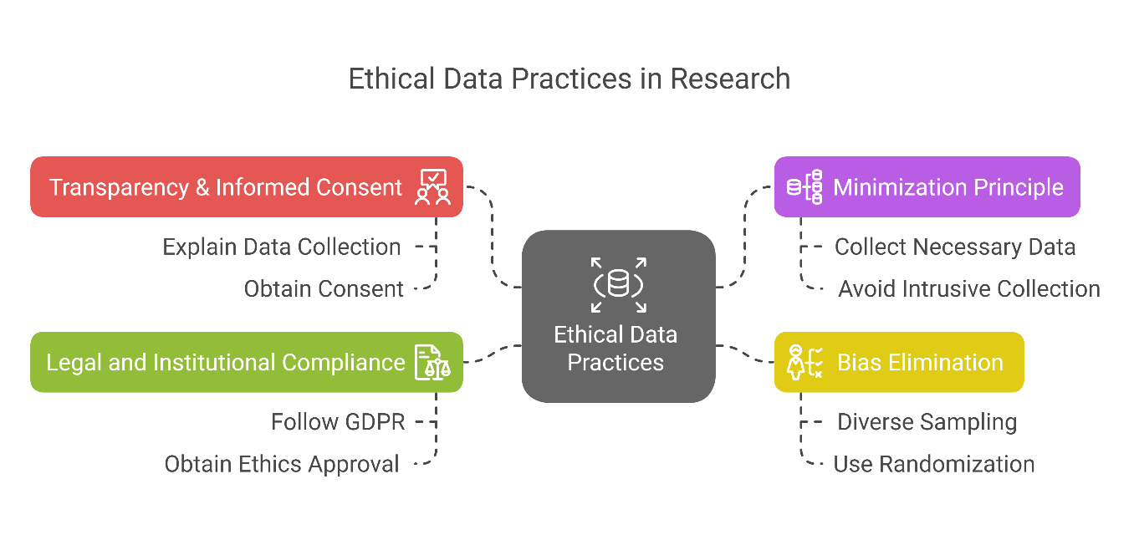
5.1 Guidelines for Ethical Data Collection in Engineering
5.1 Guidelines for Ethical Data Collection in Engineering
Transparency & Informed Consent:
  i. Clearly explain how, why, and what data is being collected.
  ii. Obtain explicit consent from participants before collecting their data.
Minimization Principle:
  i. Collect only the necessary data required for the research.
  ii. Avoid excessive or intrusive data collection (e.g., tracking unnecessary personal details).
Bias Elimination:
  i. Ensure diverse and representative sampling to prevent biased results.
  ii. Use randomization and statistical balancing techniques in data selection.
Legal and Institutional Compliance:
  i. Follow GDPR, IEEE, IRB, and national research guidelines when handling sensitive data.
  ii. Obtain ethics board approval before conducting human- centered studies.
27
Ethical Considerations in Transport Research

Slide 31
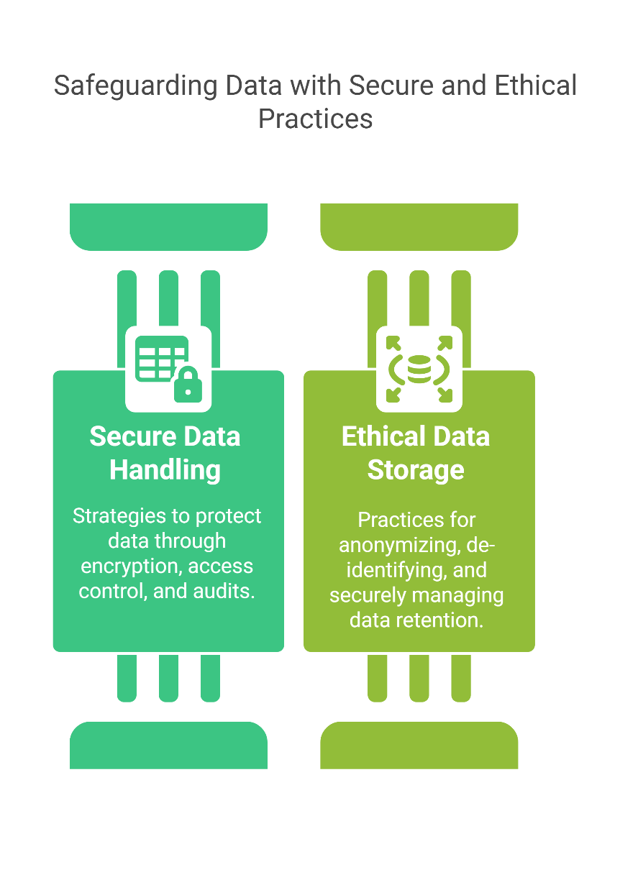
5.2 Ethical Data Handling and Storage Practices
5.2 Ethical Data Handling and Storage Practices
Secure Data Handling Strategies:
i. Data Encryption: Protect sensitive information during storage and transmission.
ii. Access Control: Restrict access to authorized personnel only.
iii. Regular Audits: Conduct periodic security assessments to prevent breaches.
Best Practices for Ethical Data Storage:
i. Anonymization & De-identification:
    Strip personal identifiers (e.g., name, address) from datasets.
Use pseudonymization techniques to separate data from individual identities.
ii. Data Retention & Disposal Policies:
Define clear timelines for data retention.
Securely delete data when no longer needed, using data-wiping algorithms.
28
Ethical Considerations in Transport Research

Slide 32
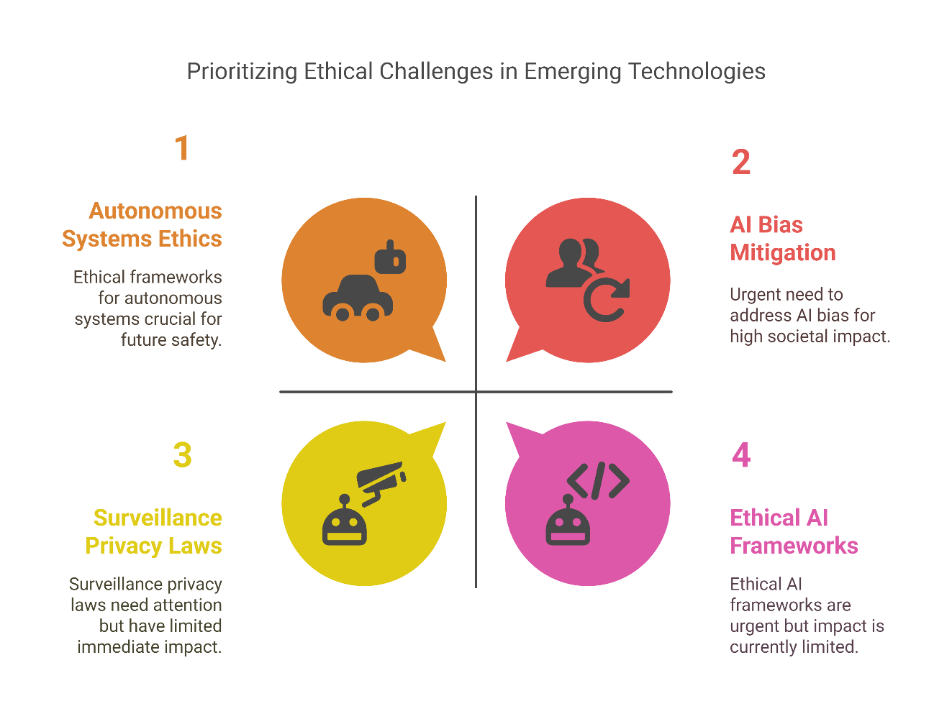
5.3 Future of Ethical Considerations in Data-Driven Engineering
5.3 Future of Ethical Considerations in Data-Driven Engineering
Emerging Ethical Challenges:
i. AI & Machine Learning Bias:
AI-driven decision-making must be explainable and fair.
Ethical AI frameworks need to eliminate discrimination in engineering applications.
ii. Surveillance and Privacy Concerns:
The rise of smart cities and IoT devices increases the risk of mass surveillance.
Stricter privacy laws and transparency regulations are required.
iii. Autonomous Systems & Decision-Making Ethics:
Future engineering systems (e.g., self-driving cars, AI-based medical diagnostics) will need moral decision frameworks.
Who is responsible if an AI-driven system causes harm?
29
Ethical Considerations in Transport Research

Slide 33
Thank you for your Attention!

