Slide 1
Transport Research and Analysis
Module 1: Introduction to Transport Research and Analysis
Lecture 3: Transport Analysis Techniques

Slide 3
Table of Contents
Lecture 3: Transport Analysis Techniques
1. Introduction | 1
1.1 Overview of Data in Transportation | 2
1.2 Why Data Matters in Modern Transportation | 4
1.3 Scope of the Lecture | 6
2. Data in Transportation | 7
2.1 Types of Data in Transportation | 8
2.2 Sources of Data | 9
2.3 Challenges in Data Collection & Management | 10
3. Importance of Data | 11
3.1 Role of Data in Decision-Making | 12
3.2 Data-Driven Transport Planning and Policy | 13
3.3 Safety & Efficiency Improvements through Data | 14
4. Descriptive Analysis | 15
4.1 Definition and Purpose | 16
4.2 Key Techniques | 17
4.3 Real-World Examples in Transportation | 18
5. Inferential Analysis | 19
5.1 Definition and Statistical Methods | 20
5.2 Regression Models | 21
5.3 Applications | 22
6. Predictive Analysis | 23
6.1 Definition | 24
6.2 Time-Series Analysis and ML Models | 25
6.3 Predicting Travel Demand, Traffic Congestion, and Incidents | 26
i
Transport Analysis Techniques

Slide 4
Table of Contents
Lecture 3: Transport Analysis Techniques
7. Quiz & Final Remarks | 27
7.1 Quiz | 28
7.2 Summary of Key Takeaways | 29
7.3 The Future of Data in Transportation | 30
i
Transport Analysis Techniques

Slide 5
Section 01:
Introduction
Transport Analysis Techniques

Slide 6
1. Introduction
1.1 Overview of Data in Transportation
Definition of transportation data: Refers to all information related to the movement of people, vehicles, and goods within a transport system. This includes traffic counts, travel times, vehicle speeds, transit ridership, and any other measures that capture mobility patterns and network performance.
Evolution of data collection: Methods have progressed from manual traffic surveys and paper-based travel diaries to automated data collection via sensors and IoT devices. The advent of Big Data has been paradigm-shifting for transportation modeling and analytics, enabling analysts to handle massive, real-time datasets rather than just small, infrequent samples.
Key data sources: Modern transport systems generate data from a wide range of sources – sensors embedded in infrastructure, GPS traces from vehicles and smartphones, smart card transactions in transit systems, mobile phone location data, and video feeds from traffic cameras. Researchers categorize these sources into groups like smart cards, GPS, video sensors (traffic cameras), connected vehicles, and even passive data from mobile or social media​. Such diverse datasets provide rich detail on how travelers move through the network.
Data-enabled planning and management: Abundant data allows planners to better design and manage transport systems based on evidence rather than intuition. By capturing and analyzing mobility patterns, agencies can make informed decisions to improve operations and policy​. For example, data-driven insights help identify congestion hotspots, evaluate the impact of interventions, and optimize services. In essence, modern transportation analytics is bridging the gap between traditional planning approaches and advanced data science to address complex mobility challenges​.
2
Transport Analysis Techniques

Slide 7
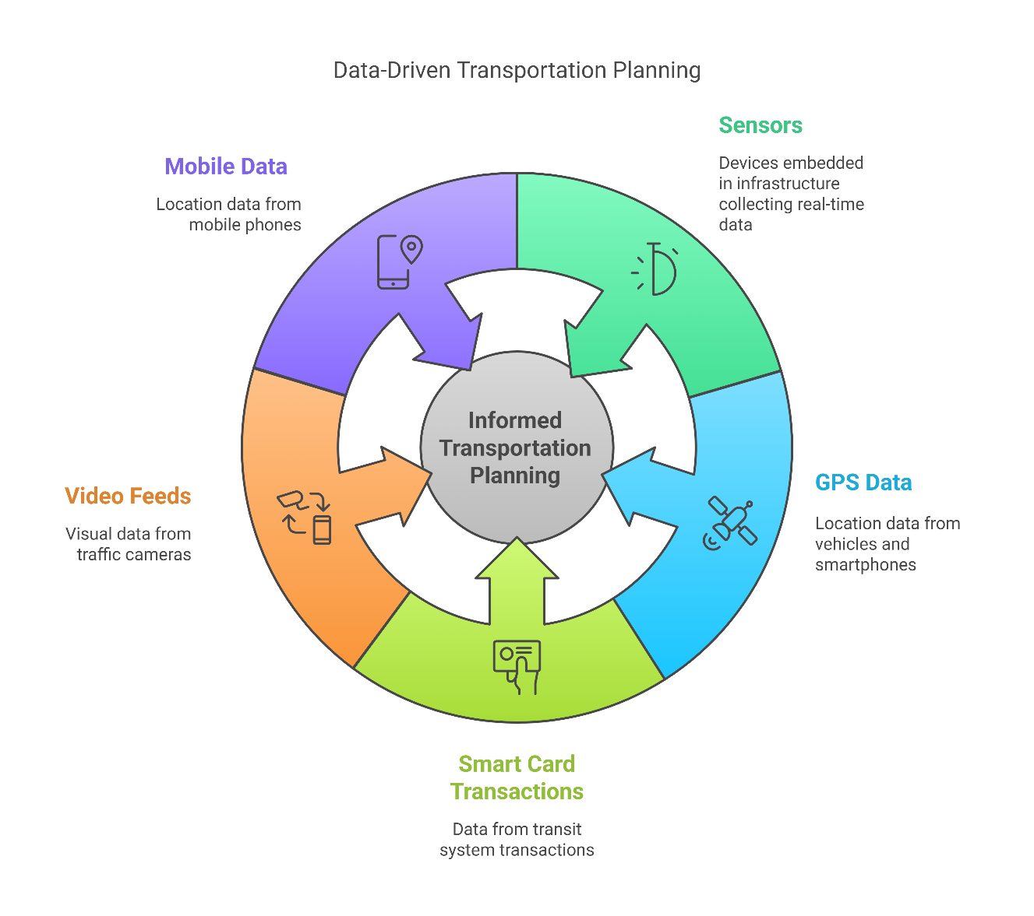
1. Introduction
1.1 Overview of Data in Transportation
3
Transport Analysis Techniques

Slide 8
1. Introduction
1.2 Why Data Matters in Modern Transportation
Optimizing flow and improving safety: Data plays a pivotal role in optimizing traffic flow, reducing congestion, and enhancing safety on roads. By leveraging real-time information (e.g. from sensors and connected vehicles), traffic signal timings can be adjusted dynamically, and routes can be optimized, leading to smoother traffic and shorter travel times​. At the same time, continuous monitoring and analysis of traffic incidents and driver behavior help pinpoint safety issues, allowing targeted measures that enhance road safety (e.g. identifying accident-prone locations and deploying appropriate countermeasures).
Data-driven decision-making: In modern transport planning and policy, decisions are increasingly backed by data analytics. Big Data provides planners and policymakers with deeper insights into travel demand and network performance, supporting evidence-based policies. For instance, city authorities now use large-scale data to justify infrastructure investments, evaluate public transit performance, and implement policies like congestion pricing. In fact, the integration of IoT and analytics in “smart cities” enables officials to make informed, real-time decisions – leveraging the massive information produced by connected transport systems​.
4
Transport Analysis Techniques

Slide 9
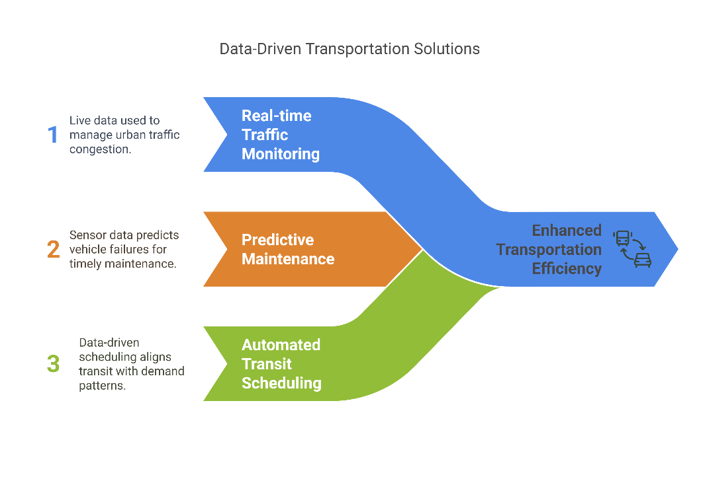
1. Introduction
1.2 Why Data Matters in Modern Transportation
Examples of data applications: Real-world transportation management showcases numerous data-driven applications:
      Real-time traffic monitoring: Cities use live traffic data to manage congestion in real time (e.g. adjusting traffic signal plans based on current flow). For example, Barcelona’s transportation system uses big data to control traffic signals and manage bus routes in real time, significantly reducing congestion.
      Predictive maintenance: Agencies analyze sensor data from vehicles and infrastructure to predict when equipment is likely to fail, so maintenance can be performed before breakdowns occur. For instance, airlines and transit agencies monitor engine and vehicle sensor data to replace parts just in time, avoiding unexpected failures
      Automated transit scheduling: Public transit systems are increasingly data-driven. Using GPS trackers and smart card data, transit agencies can automatically adjust bus/train schedules and frequencies to match actual demand patterns​. This results in more efficient service provision and timely updates to passengers (such as accurate real-time arrival information).
5
Transport Analysis Techniques

Slide 10
1. Introduction
1.3 Scope of the Lecture
Session outline: This introductory session will set the stage for how data is utilized in transportation engineering. We will discuss the lifecycle of transportation data – from collection and management to analysis and application in decision-making. In particular, the lecture will introduce three fundamental categories of analytics in transportation and illustrate how each is applied:
Descriptive analytics – Using historical and real-time data to describe what has happened in the transport system. This involves summarizing trends and patterns (e.g. average daily traffic volumes, travel time distributions) to provide situational awareness and baseline knowledge of system performance.
Inferential analytics – Applying statistical methods to draw conclusions or inferences from transport data. Through sampling and modeling, inferential analysis helps us understand relationships and test hypotheses (e.g. determining whether a new policy significantly reduced accidents, or identifying factors that influence public transit usage) beyond the immediate observed data.
Predictive analytics – Utilizing current and past data (often coupled with machine learning or simulation models) to predict future transportation conditions. Examples include forecasting traffic congestion levels for the next hour or next week, predicting public transit ridership under various scenarios, or anticipating asset failures. Predictive analytics enables proactive planning, such as adjusting operations in advance of expected demand surges or maintenance needs.
Expected learning outcomes: By the end of this lecture, students should appreciate the critical role of data in modern transportation systems and policy. You will be able to identify major transportation data sources and understand how they have evolved over time, recognize how data-driven approaches improve transportation outcomes, and distinguish between descriptive, inferential, and predictive analytical techniques in a transport context. This foundation will prepare you for more advanced topics in Mobility Patterns, Big Data, and Transport Analytics and their practical applications in the field.​
6
Transport Analysis Techniques

Slide 11
Section 02:
Data in Transportation
Transport Analysis Techniques

Slide 12
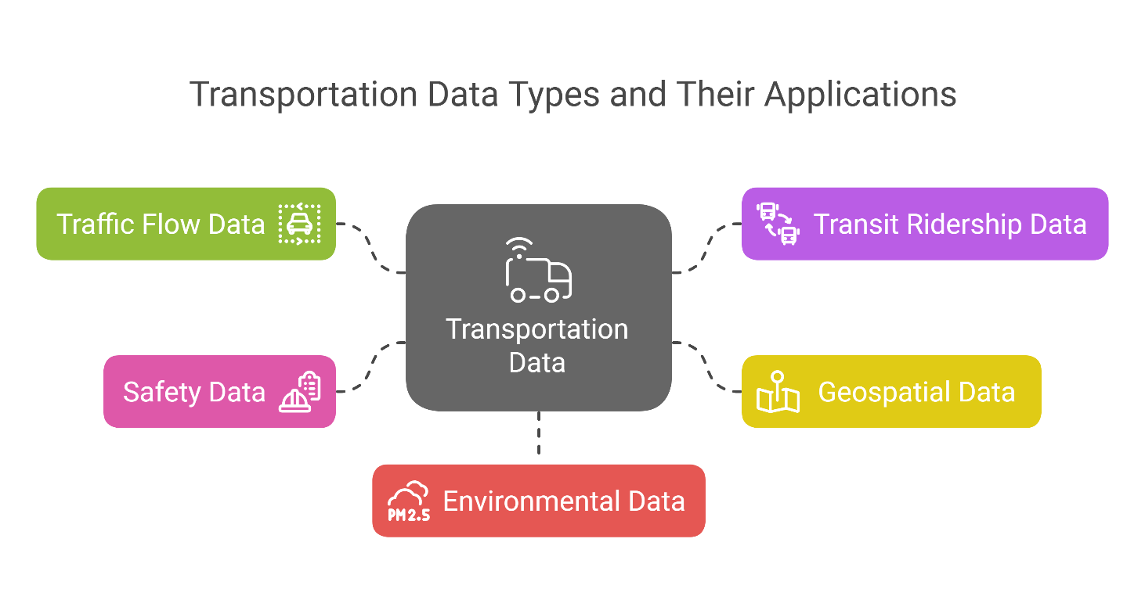
2. Data in Transportation
2.1 Types of Data in Transportation
Traffic Flow Data: Information on vehicle movements, including speed, volume, and density, collected through sensors like inductive loops and cameras.
Transit Ridership Data: Records of passenger counts and travel patterns on public transport systems, often gathered via automated fare collection systems.
Geospatial Data: Spatial information, such as maps and geographic features, utilized for route planning and navigation.
Safety Data: Details on traffic incidents, accidents, and near-misses, aiding in identifying hazardous locations and improving safety measures.
Environmental Data: Information on weather conditions and emissions, influencing transportation planning and operations.
8
Transport Analysis Techniques

Slide 13
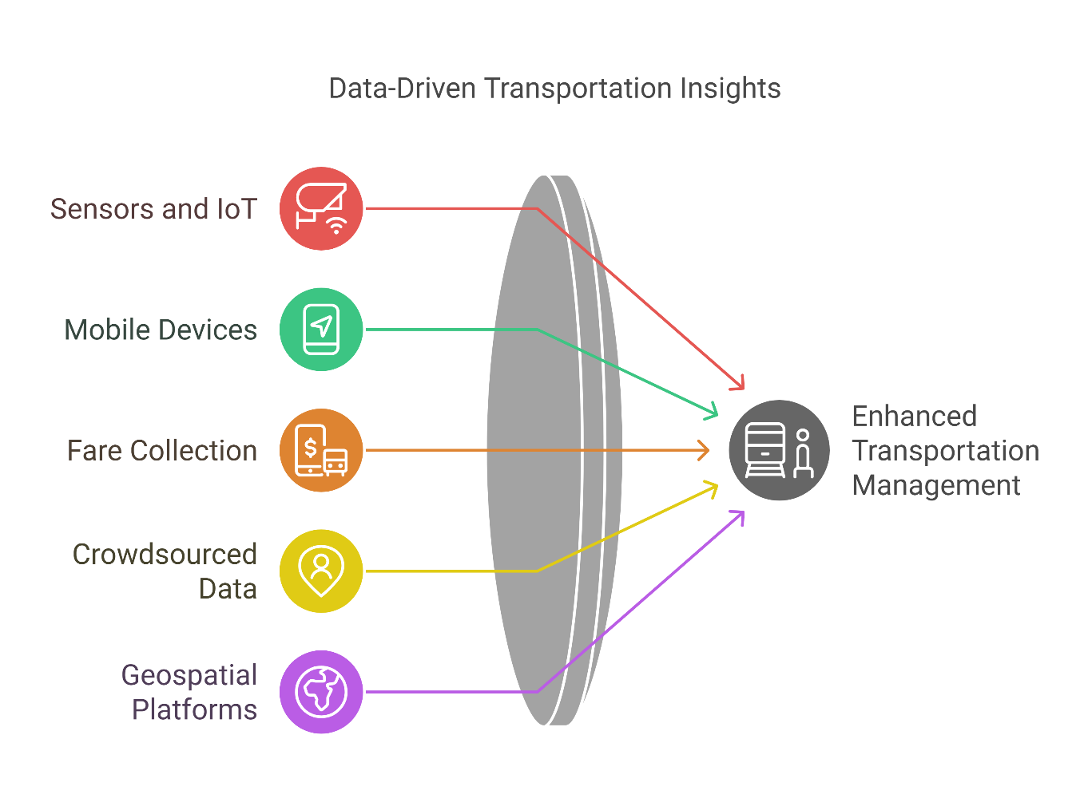
2. Data in Transportation
2.2 Sources of Data
Sensors and IoT Devices: Fixed installations like traffic cameras and inductive loops that monitor vehicle movements.​
Mobile Devices and GPS: Smartphones and in-vehicle GPS systems providing real-time location and movement data.
Automated Fare Collection Systems: Smart card readers and ticketing systems in public transport capturing passenger usage patterns.
Crowdsourced Data: User-generated information from navigation apps, offering insights into traffic conditions and incidents.​
Geospatial Platforms: Open-source mapping services like OpenStreetMap, supplying detailed geographic data for route planning.
9
Transport Analysis Techniques

Slide 14
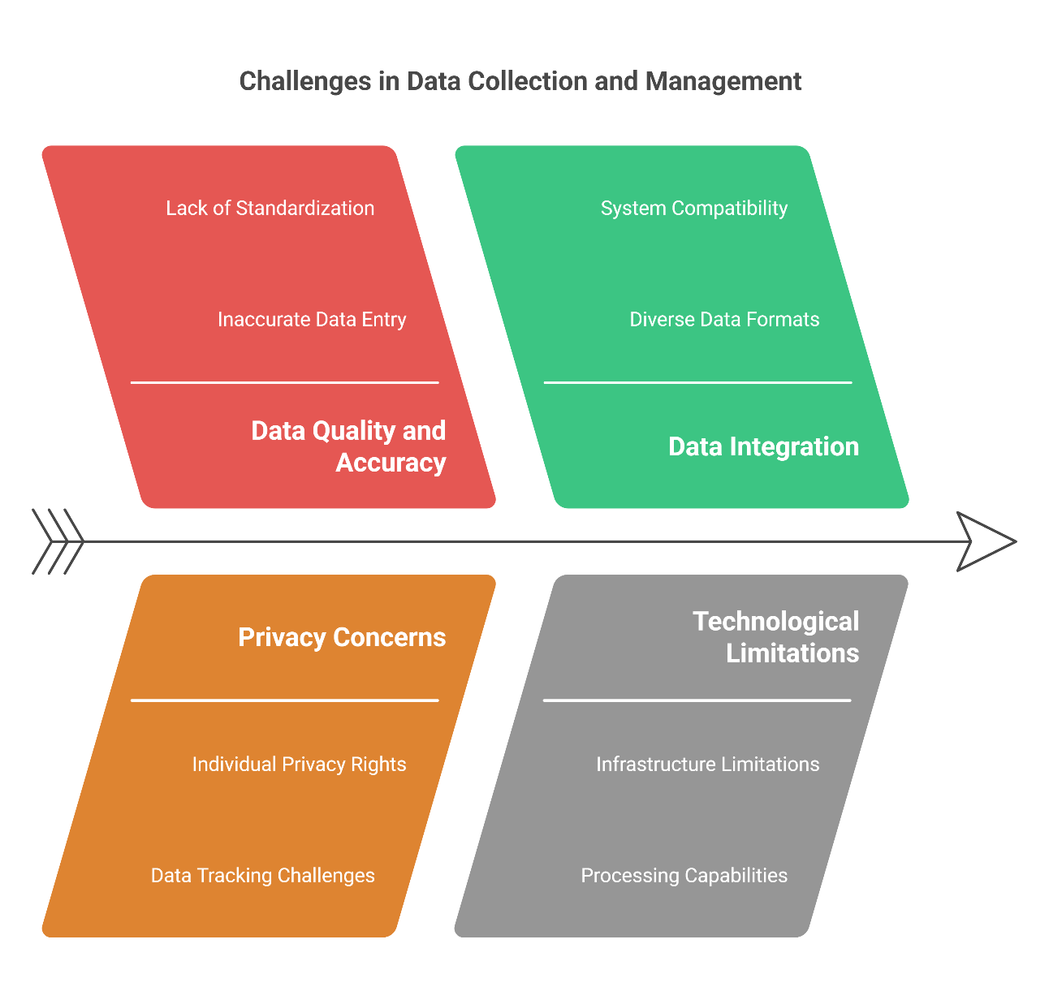
2. Data in Transportation
2.3 Challenges in Data Collection & Management
Data Quality and Accuracy: Ensuring the reliability of data, as inaccuracies can lead to misguided decisions.
Privacy Concerns: Balancing data collection with individual privacy rights, especially when tracking personal movements.
Data Integration: Combining diverse data sources into a cohesive system for comprehensive analysis.
Technological Limitations: Managing large volumes of data requires robust infrastructure and advanced processing capabilities.​
Security Risks: Protecting transportation data from cyber threats to maintain system integrity and public trust.
10
Transport Analysis Techniques

Slide 15
Section 03:
Importance of Data
Transport Analysis Techniques

Slide 16
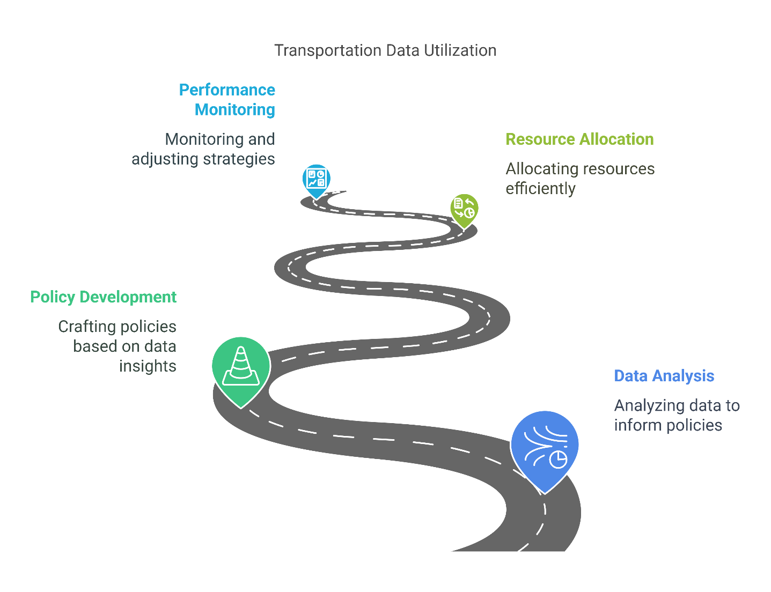
3. Importance of Data
3.1 Role of Data in Decision-Making
Informed Policy Development: Data analysis enables transportation authorities to craft policies that address actual issues, such as implementing congestion pricing based on traffic flow patterns.​
Resource Allocation: Accurate data guides the efficient distribution of funds and resources, ensuring critical infrastructure projects receive priority.​
Performance Monitoring: Continuous data collection allows for the assessment of implemented strategies, facilitating timely adjustments to improve outcomes.
12
Transport Analysis Techniques

Slide 17
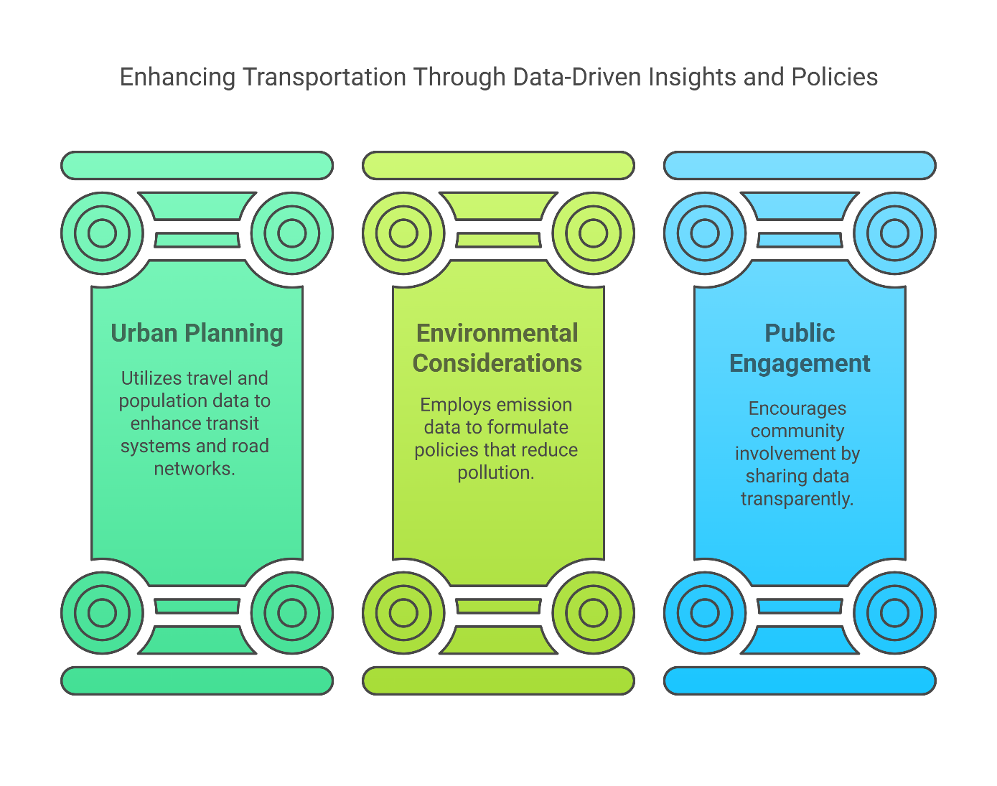
3. Importance of Data
3.2 Data-Driven Transport Planning and Policy
Urban Planning: Data on travel behavior and population growth informs the development of public transit systems and road networks.​
Environmental Considerations: Emission data supports the creation of policies aimed at reducing pollution and promoting sustainable transportation options.​
Public Engagement: Sharing data with the public fosters transparency and encourages community involvement in transportation planning decisions.
13
Transport Analysis Techniques

Slide 18
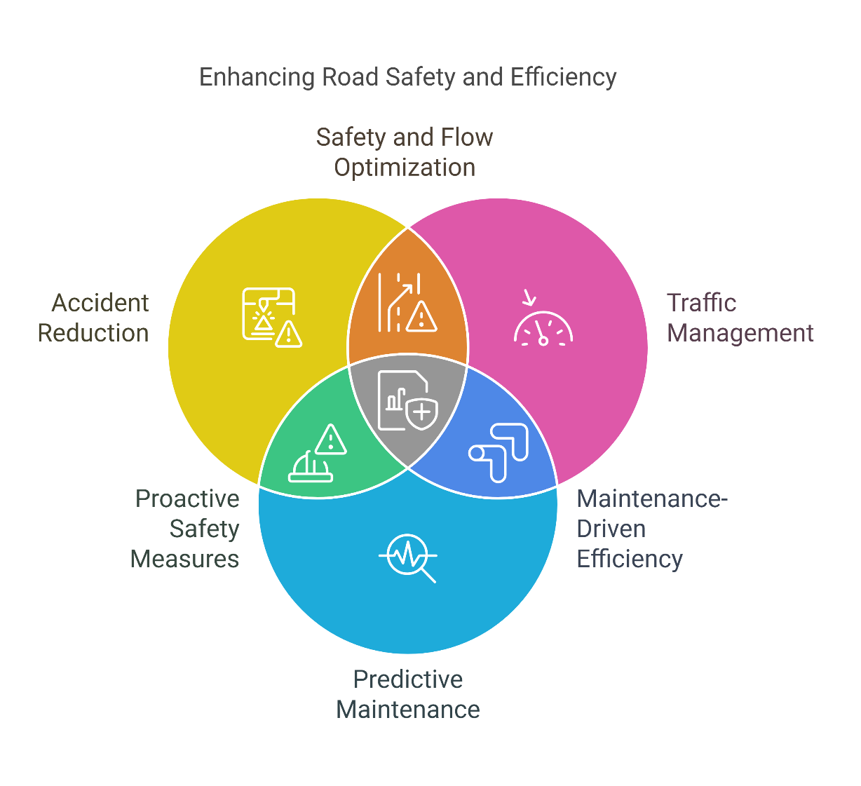
3. Importance of Data
3.3 Safety & Efficiency Improvements through Data
Accident Reduction: Analyzing collision data helps identify hazardous areas, leading to targeted interventions that enhance road safety.​
Traffic Management: Real-time data allows for dynamic traffic signal adjustments, reducing congestion and improving flow.​
Predictive Maintenance: Monitoring infrastructure conditions through data analytics enables proactive maintenance, preventing failures and extending asset life.
14
Transport Analysis Techniques

Slide 19
Section 04:
Descriptive Analysis
Transport Analysis Techniques

Slide 20
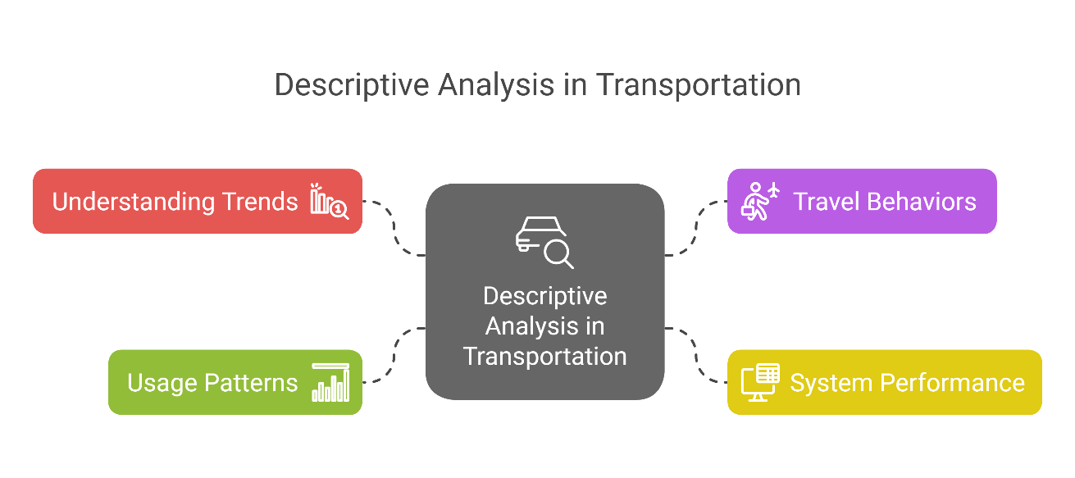
4. Descriptive Analysis
4.1 Definition and Purpose
Definition: Descriptive analysis in transportation involves summarizing and interpreting historical data to understand past and current trends within transportation systems. It addresses questions like "What has happened?" and "What is happening?" by providing insights into travel behaviors, system performance, and usage patterns.​
Purpose: The primary goal is to transform raw data into meaningful information that can inform decision-making. By understanding existing conditions and historical trends, transportation professionals can identify areas for improvement, allocate resources effectively, and enhance overall system efficiency.
16
Transport Analysis Techniques

Slide 21
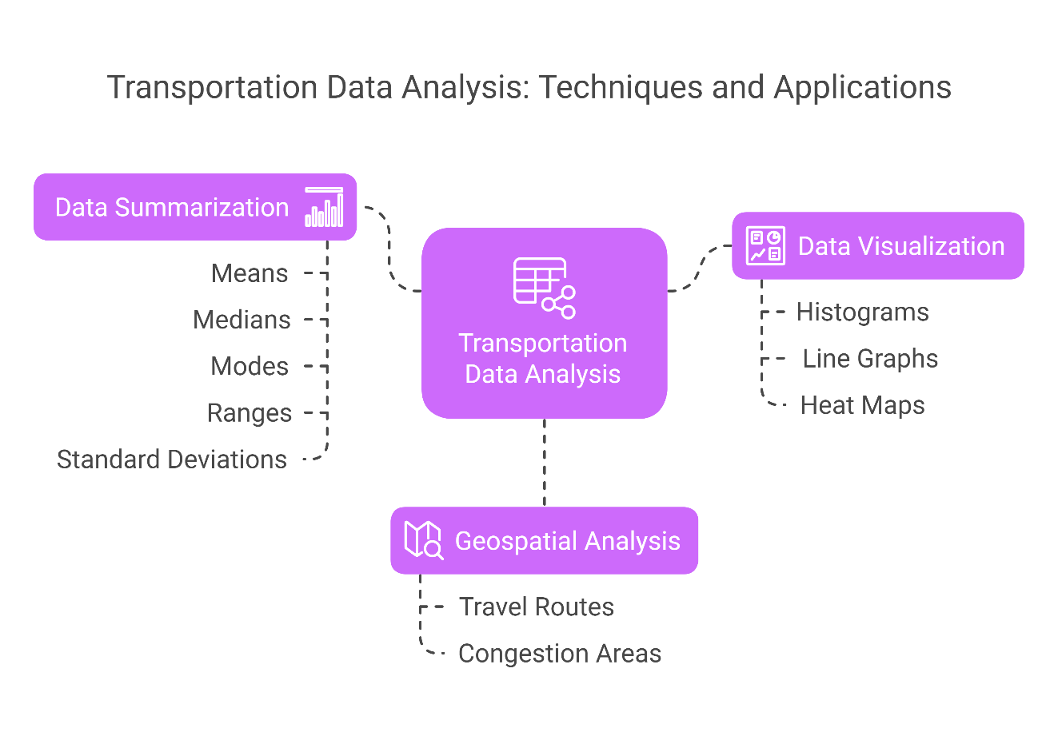
4. Descriptive Analysis
4.2 Key Techniques
Data Summarization: Utilizing statistical measures such as means, medians, modes, ranges, and standard deviations to summarize transportation data. For example, calculating the average daily traffic volume on a highway segment.
Data Visualization: Employing charts, graphs, and maps to represent data visually, making it easier to identify patterns and trends. Common visualizations include:
i. Histograms: Displaying the frequency distribution of variables like vehicle speeds.
ii. Line Graphs: Showing trends over time, such as monthly public transit ridership.
  iii. Heat Maps: Highlighting areas with high concentrations of events, like accident hotspots.
Geospatial Analysis: Analyzing spatial data to understand geographic patterns in transportation, such as mapping travel routes or identifying regions with high congestion.
17
Transport Analysis Techniques

Slide 22
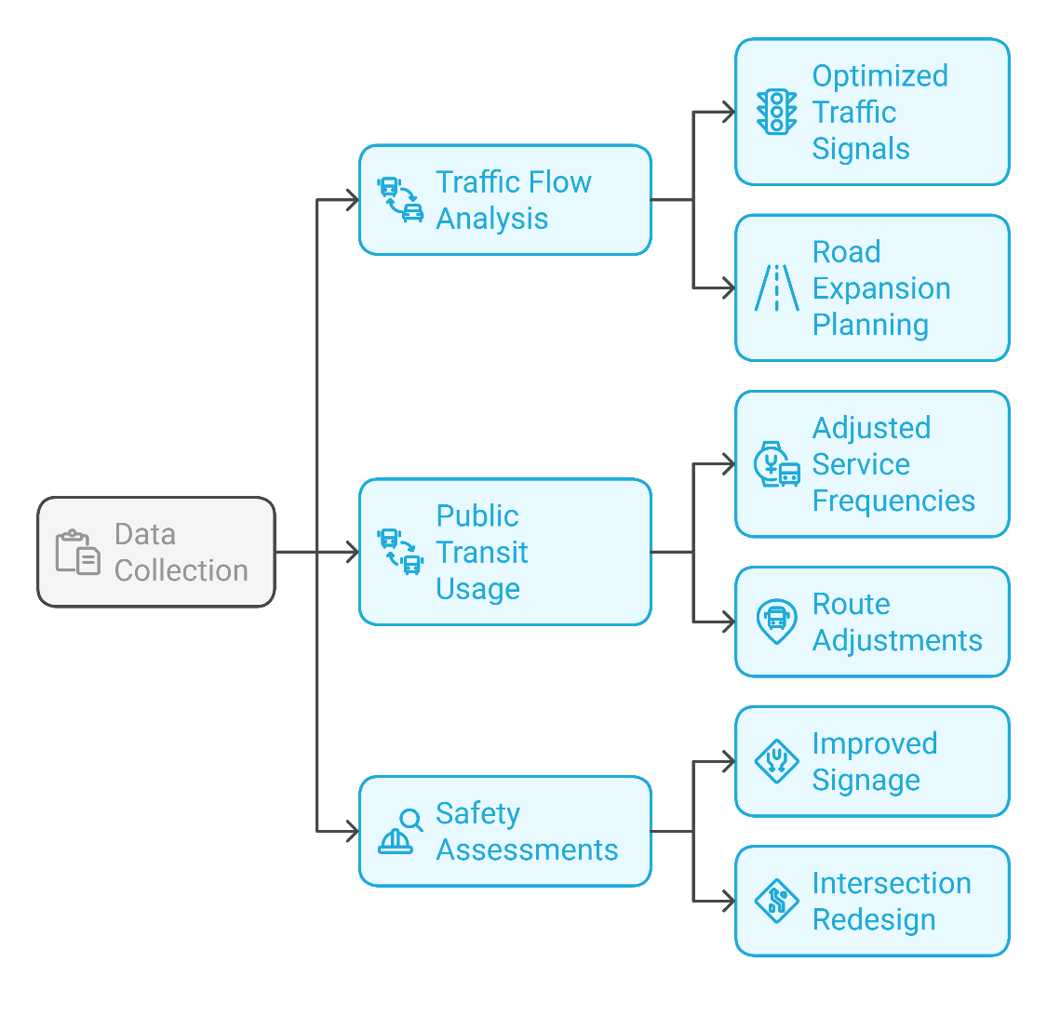
4. Descriptive Analysis
4.3 Real-World Examples in Transportation
Traffic Flow Analysis: Monitoring vehicle counts and speeds on roadways to assess congestion levels and identify peak travel times. This information helps in optimizing traffic signal timings and planning road expansions.​
Public Transit Usage: Analyzing data from automated fare collection systems to determine ridership patterns, which aids in adjusting service frequencies and routes to better meet passenger demand.​
Safety Assessments: Examining accident reports and incident logs to identify hazardous locations and common causes of accidents, leading to targeted safety improvements like adding signage or redesigning intersections.
18
Transport Analysis Techniques

Slide 23
Section 05:
Inferential Analysis
Transport Analysis Techniques

Slide 24
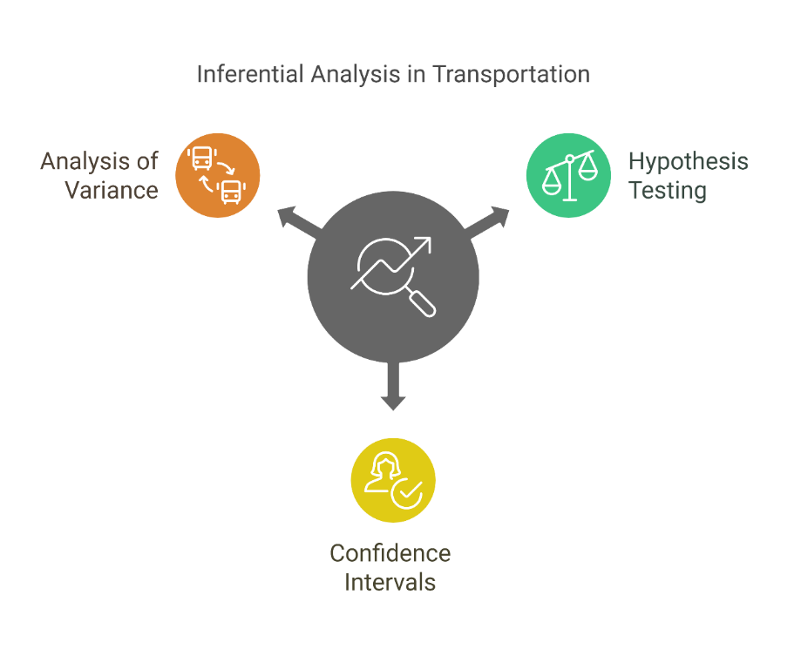
5. Inferential Analysis
5.1 Definition and Statistical Methods
Definition: Inferential analysis in transportation involves using statistical techniques to draw conclusions about a population or process based on sample data. It helps in understanding relationships between variables and making predictions or generalizations beyond the observed data.
Statistical Methods:
i. Hypothesis Testing: Determines if observed effects (e.g., changes in traffic patterns) are statistically significant or due to random chance.​
ii. Confidence Intervals: Provides a range of values within which a population parameter (e.g., average travel time) is likely to fall, offering a measure of estimation precision.​
iii. Analysis of Variance (ANOVA): Assesses differences between group means (e.g., travel times across different routes) to identify significant variations.
20
Transport Analysis Techniques

Slide 25
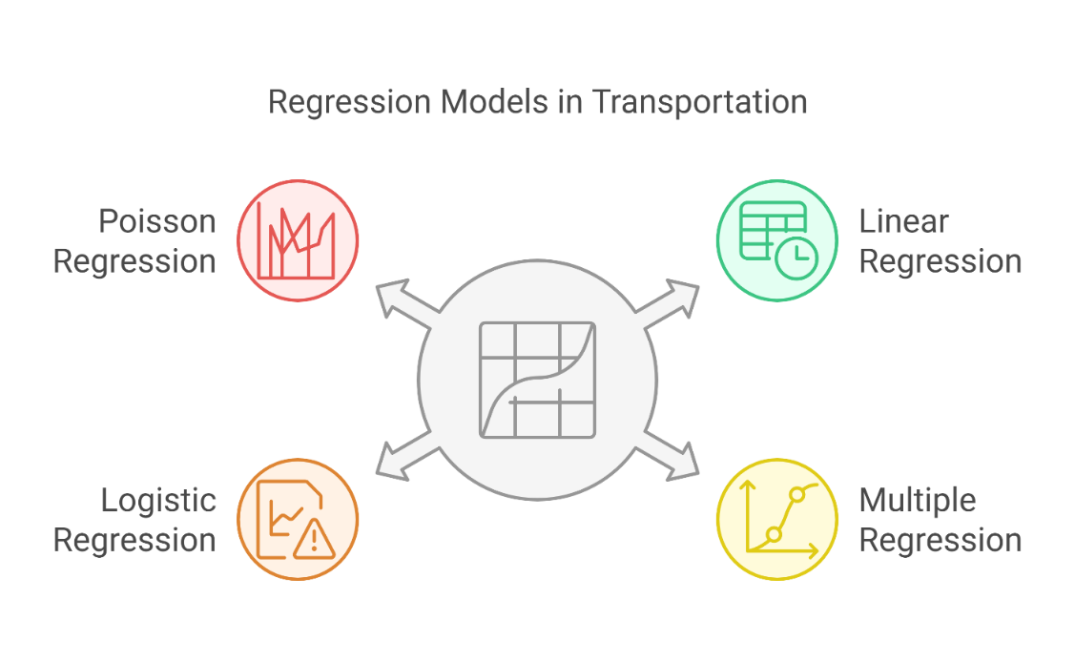
5. Inferential Analysis
5.2 Regression Models
Purpose: Regression models in transportation are used to quantify relationships between dependent variables (e.g., traffic volume) and one or more independent variables (e.g., time of day, weather conditions).​
Types of Regression Models:
  i. Linear Regression: Estimates the linear relationship between variables, such as predicting traffic flow based on time of day.​
  ii. Multiple Regression: Incorporates multiple independent variables to predict outcomes, like assessing how weather and economic factors together influence transit ridership.​
  iii. Logistic Regression: Models binary outcomes, such as the likelihood of an accident occurring under specific conditions.​
  iv. Poisson Regression: Suitable for modeling count data, like the number of accidents at an intersection over a period.
21
Transport Analysis Techniques

Slide 26
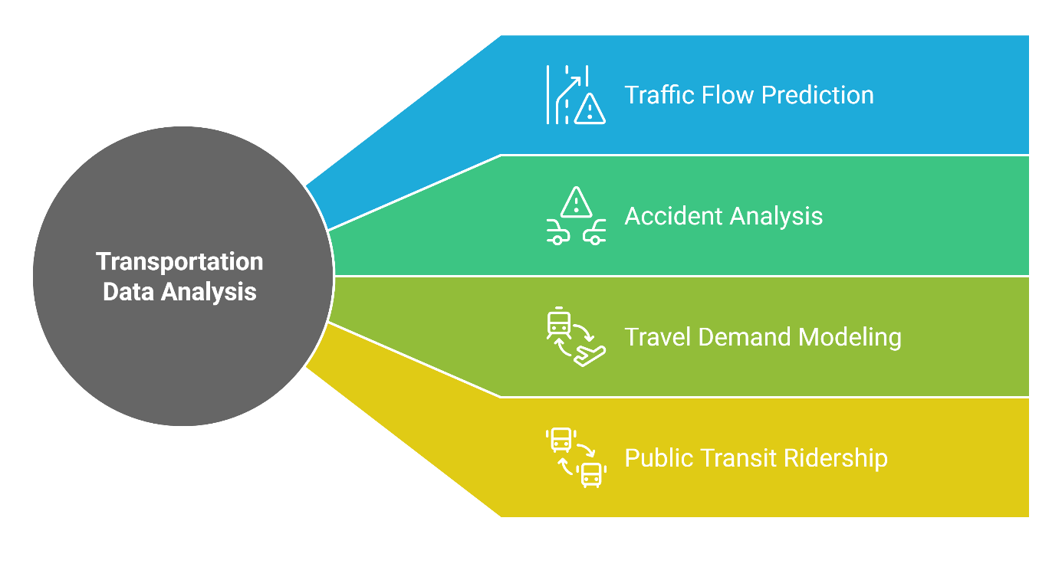
5. Inferential Analysis
5.3 Applications
Traffic Flow Prediction: Regression models help forecast traffic volumes based on variables like time, weather, and special events, aiding in congestion management.​
Accident Analysis: By examining factors contributing to accidents, such as road conditions and driver behavior, inferential analysis identifies high-risk areas and informs safety improvements.​
Travel Demand Modeling: Understanding how socio-economic factors influence travel choices enables planners to design effective transportation systems.​
Public Transit Ridership: Analyzing demographic and service quality factors helps predict and enhance public transit usage.
22
Transport Analysis Techniques

Slide 27
Section 06:
Predictive Analysis
Transport Research and Analysis
Transport Analysis Techniques

Slide 28
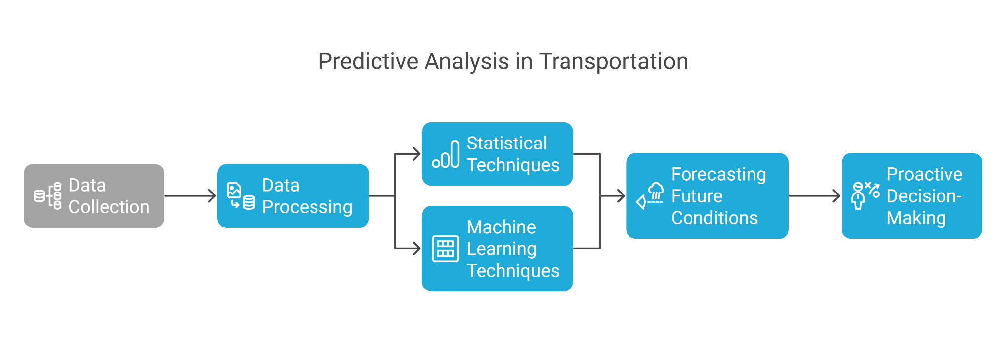
6. Predictive Analysis
6.1 Definition
Predictive Analysis: Utilizes historical and real-time data, along with statistical and machine learning techniques, to forecast future transportation conditions. This approach enables proactive decision-making by anticipating issues before they occur.
24
Transport Analysis Techniques

Slide 29
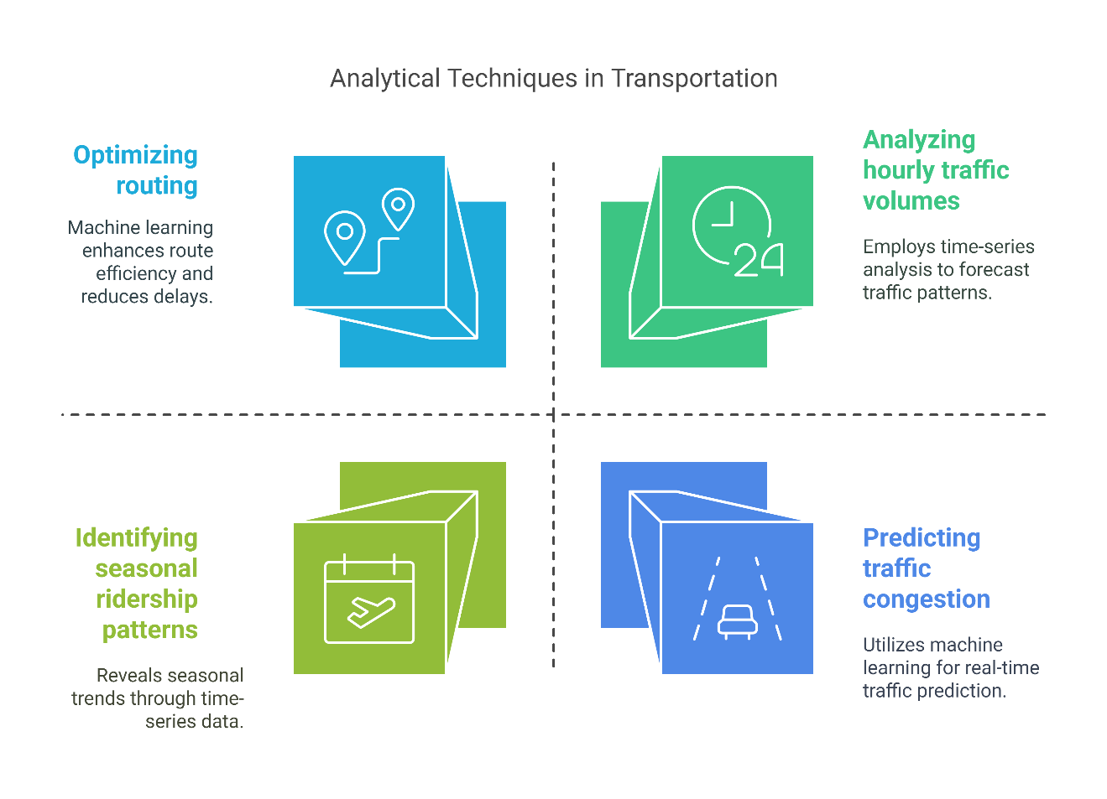
6. Predictive Analysis
6.2 Time-Series Analysis and Machine Learning Models
Time-Series Analysis: Involves examining data points collected or recorded at specific time intervals to identify trends, seasonal patterns, and cyclical behaviors. In transportation, this might include analyzing hourly traffic volumes or daily public transit ridership to predict future demand.​
Machine Learning Models: Employ algorithms that learn from data to make predictions or decisions without being explicitly programmed for each task. In transportation, machine learning can predict traffic congestion, optimize routing, and enhance safety measures by analyzing complex datasets.
25
Transport Analysis Techniques

Slide 30
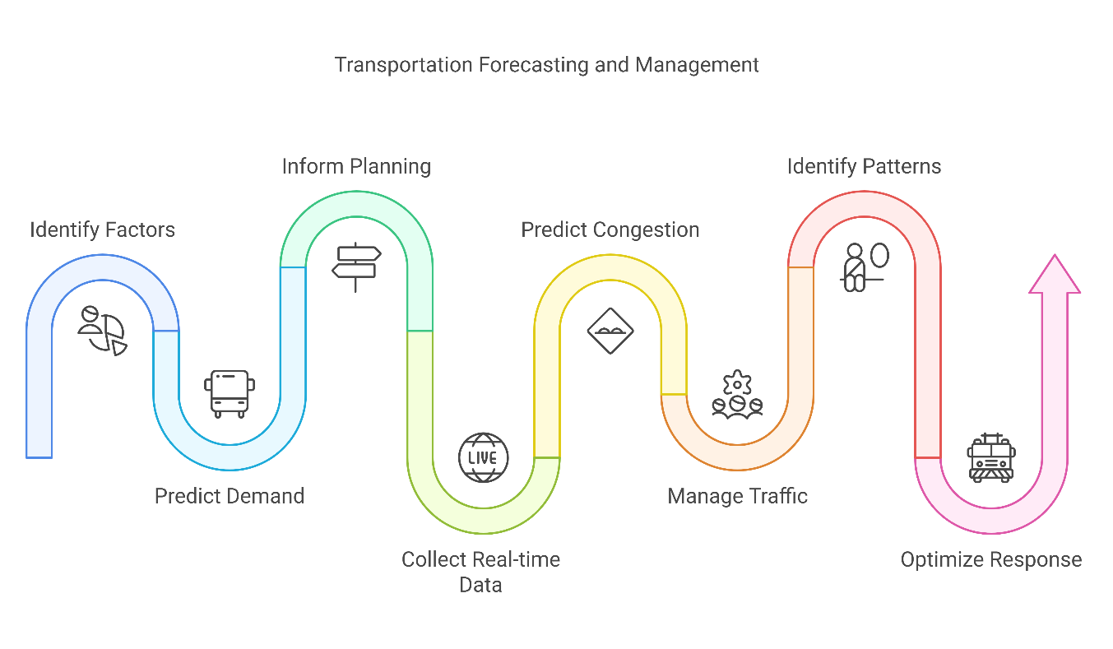
6. Predictive Analysis
6.3 Predicting Travel Demand, Traffic Congestion, and Incidents
Travel Demand Forecasting: Predicts future transportation needs based on factors like population growth, economic trends, and land use changes. Accurate forecasts inform infrastructure development and service planning.​
Traffic Congestion Prediction: Utilizes real-time data and predictive algorithms to anticipate congestion, allowing for dynamic traffic management strategies. For example, systems like Aimsun Live analyze live traffic data to forecast conditions and evaluate management strategies.
Incident Prediction and Management: Identifies patterns leading to accidents or incidents, enabling preventive measures. For instance, AI-driven tools like LYT have been implemented to reduce emergency vehicle response times by optimizing traffic signal timings, thereby enhancing overall traffic safety.
26
Transport Analysis Techniques

Slide 31
Section 07:
Quiz & Final Remarks
Transport Analysis Techniques

Slide 32
7. Quiz & Final Remarks
7.1 Quiz
Define transportation data and provide two examples.
What is the primary purpose of descriptive analysis in transportation?
Name two statistical methods used in inferential analysis.
How does time-series analysis benefit transportation forecasting?
Provide an example of how predictive analysis can improve traffic management.
28
Transport Analysis Techniques

Slide 33
7. Quiz & Final Remarks
7.2 Summary of Key Takeaways
Data's Integral Role: Data is foundational in understanding and enhancing transportation systems, influencing decision-making, planning, and policy development.
Analytical Approaches:
1. Descriptive Analysis: Offers insights into current and historical transportation trends.
2. Inferential Analysis: Utilizes statistical methods to draw conclusions and identify relationships within transportation data.
3. Predictive Analysis: Employs historical and real-time data to forecast future transportation conditions, enabling proactive management.
Applications: These analyses collectively contribute to optimizing traffic flow, enhancing safety, and improving overall transportation efficiency.
29
Transport Analysis Techniques

Slide 34
7. Quiz & Final Remarks
7.3 The Future of Data in Transportation
Autonomous Vehicles: The integration of driverless trucks and cars is set to revolutionize freight transport and personal mobility, offering potential solutions to driver shortages and operational efficiency.
Connected Infrastructure: The development of the Internet of Vehicles (IoV) and smart city initiatives will enable real-time data exchange between vehicles and infrastructure, enhancing traffic management and safety.
Advanced Predictive Analytics: The use of AI and machine learning will allow for more accurate predictions of travel demand, traffic congestion, and potential incidents, leading to more responsive and efficient transportation systems.
30
Transport Analysis Techniques
Notes:
1. Define transportation data and provide two examples.
Transportation data refers to information related to the movement of people, vehicles, and goods within a transport system. Examples include traffic flow data (e.g., vehicle counts, speeds) and transit ridership data (e.g., passenger counts on public transport).
2. What is the primary purpose of descriptive analysis in transportation?
To summarize and interpret historical data to understand past and current trends within transportation systems, aiding in informed decision-making.
3. Name two statistical methods used in inferential analysis.
Hypothesis testing and confidence intervals.​
4. How does time-series analysis benefit transportation forecasting?
By examining data points collected at specific time intervals, it helps identify trends and patterns, enabling accurate predictions of future transportation conditions.
5. Provide an example of how predictive analysis can improve traffic management.
Predictive analysis can forecast traffic congestion, allowing for dynamic traffic signal adjustments to reduce congestion and improve flow.

Slide 35
Thank you for your Attention!

