Slide 1
Transport Research and Analysis
Module 1: Introduction to Transport Research and Analysis
Lecture 1: Overview of Transport Systems and Research

Slide 3
Table of contents
Section 1 Introduction to Transportation ....................................... 5
What is a Transport System ........................................ 6
Importance of Transport Systems in Society ................ 7
Components of Transport System ............................... 8
Modes of Transport Systems ...................................... 9
Section 2 A Brief history of Transport ............................................ 10
Early History of Transport .......................................... 11
Industrial Revolution & Transport Growth ................... 12
From the 20th century to the 21st century .................... 13
Future of Transport ................................................... 14
Section 3 Definitions & Key Concepts ............................................ 15
Understanding Key Transport Terms ......................... 16
Scope & Coverage of Transport ................................ 18
Public vs Private Transport ....................................... 19
Policy changes & Integration ..................................... 20
Role of Economic & Policy Frameworks …….….……… 21
Section 4 Importance of Transport Research ................................. 22
Why is Transport Research Important ........................ 23
Key Areas of Transport Research .............................. 25
How is Transport Research Conducted ...................... 27
Case Studies ........................................................... 28
Technology in Transport Research ……………………... 31
Future Research Trends in Transport Research ……… 33
Section 5 Audience/Users of Transport Statistics ......................... 35
Who Uses Transport Data ......................................... 36
Common Sources and Collection Methods of
Transport Data ............................................................. 37
Example – Smart Transport Planning Using Data ....... 38
Importance of Data Analytics in Transport ................. 39
Challenges in Transport Data Collection ………………. 40
Section 6 Quiz & Group Discussion ................................................ 41
Quiz ........................................................................ 42
Group Discussion ..................................................... 43
Overview of Transport Systems and Research

Slide 4
0. Objectives
0.1. Lecture Overview
Introduce the concept of transport systems and their key components (modes, infrastructure, users, policies, regulations, technology).
Review the historical evolution of transport: from early inventions (wheel, steam power) to industrialisation, globalisation, and modern smart transport.
Clarify core transport concepts such as mobility, accessibility, scope of urban/regional/global transport, and public vs. private transport.
Explain the role of economic and policy frameworks, including externalities and cost–benefit analysis in transport planning.
Highlight the importance of transport research, key research areas (traffic management, public transport, safety, sustainable mobility) and typical methods (surveys, modelling, case studies, AI & big data).
Discuss transport statistics and data: who uses them, common data sources, and key challenges in data collection and analytics.
Overview of Transport Systems and Research

Slide 5
0. Objectives
0.2. Objectives
By the end of this lecture, students should be able to:
Define a transport system and describe its main components and modes.
Summarise the historical development of transport and relate it to today’s sustainability and smart mobility challenges.
Distinguish between mobility and accessibility, and between public and private transport, including their roles in cities and regions.
Explain how economic and policy frameworks (externalities, CBA, pricing policies) influence transport planning and operations.
Identify major areas and methods of transport research, including the use of technology, big data, and AI.
Recognise key users, sources, and challenges of transport data and reflect on current and future trends in transport systems and research.
Overview of Transport Systems and Research

Slide 6
Section 01:
Introduction to Transport Systems
Overview of Transport Systems and Research

Slide 7
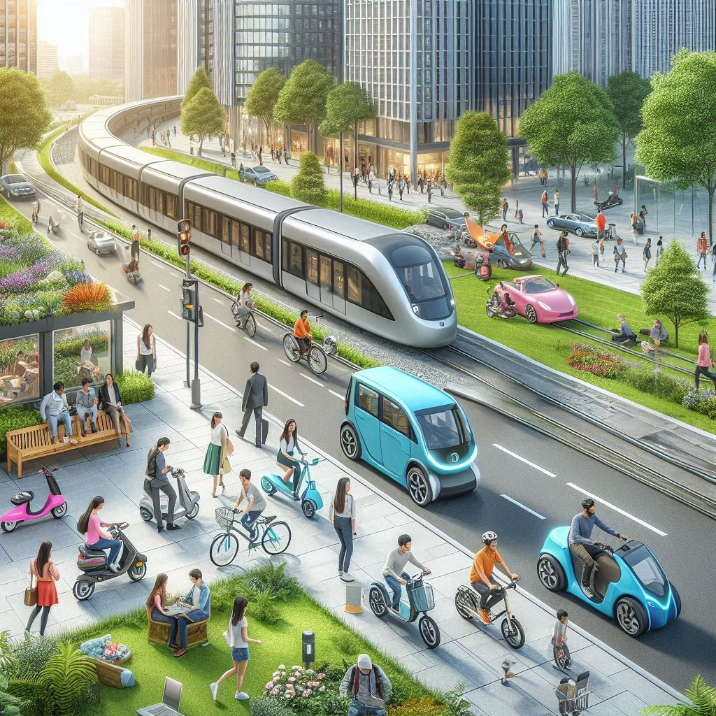
1.1 Introduction to Transport Systems
1.1. What is a Transport System?
Definition
A transport system is an interconnected network of transport modes, infrastructure, policies, and regulations designed to enable the movement of people and goods efficiently and safely.
Purpose
Facilitates movement of people and goods, supports economic growth, trade, social mobility, and ensures accessibility.
Overview of Transport Systems and Research

Slide 8
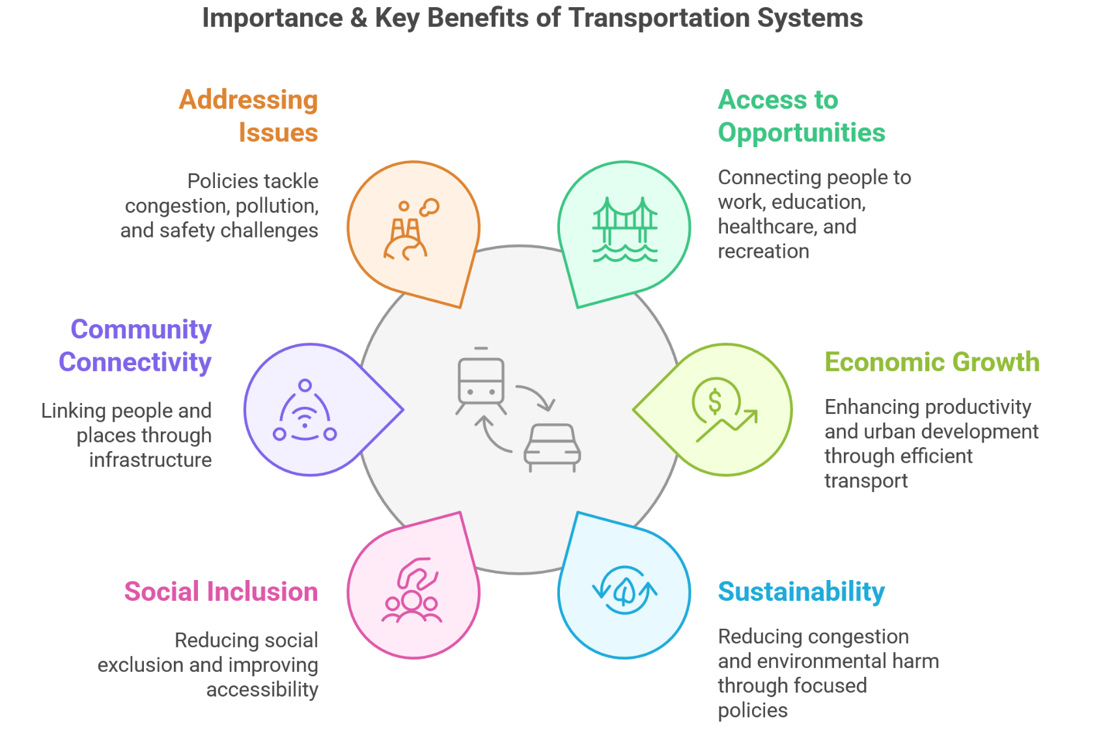
1. Introduction to Transport Systems
1.2. Importance of Transport Systems in Society
Overview of Transport Systems and Research

Slide 9
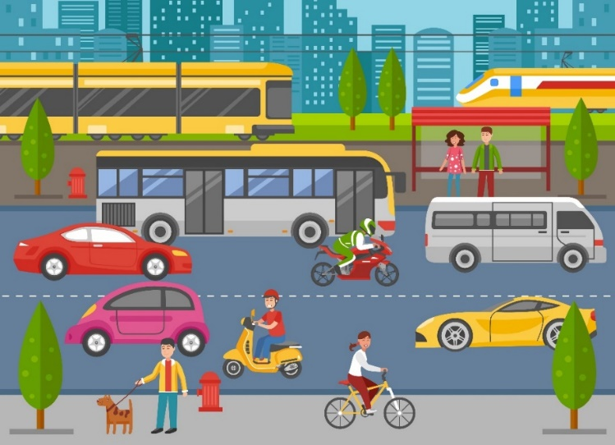
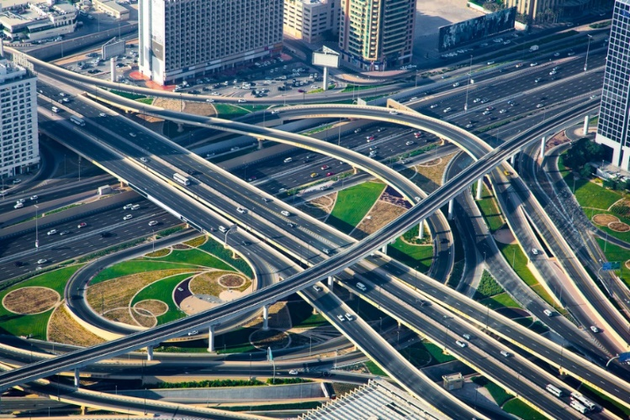
1. Introduction to Transport Systems
1.3. Components of a Transport System
Transportation systems are complex networks
They consist of multiple interconnected components
Key components include:
Modes - Various options like roads, rail, air, and even cycling and walking
Infrastructure - Physical elements such as roads, railways, and public transport facilities
Users - Passengers, businesses, logistics companies.
Policies - These shape the direction and development of transportation
Regulations - Guidelines and rules governing transportation activities
Technology - GPS tracking, AI-driven logistics, intelligent transport systems (ITS).
Overview of Transport Systems and Research

Slide 10
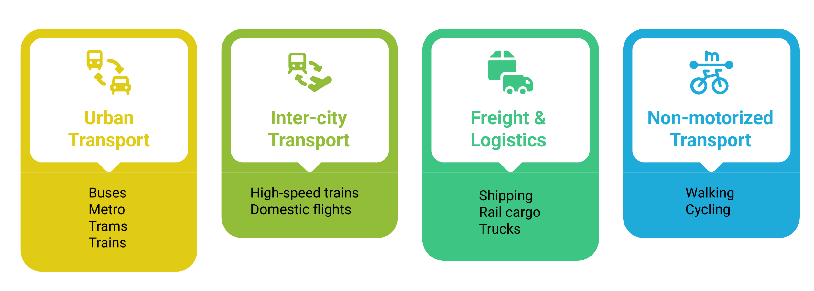
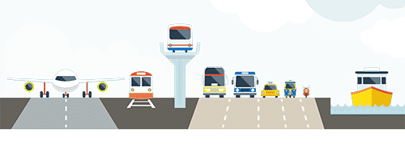
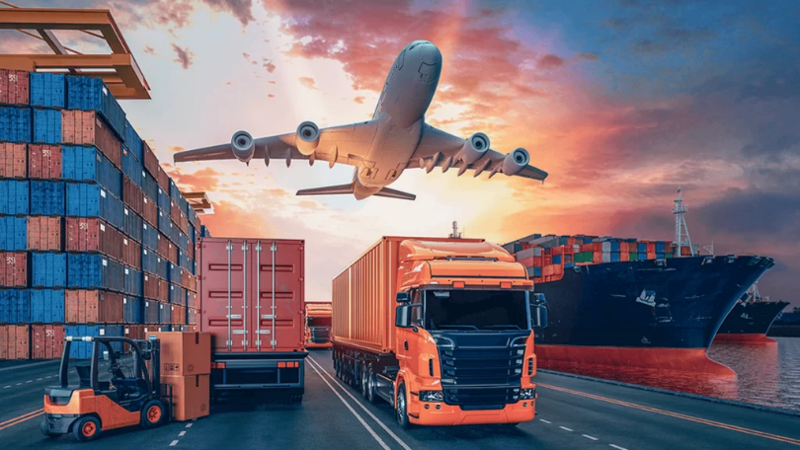
1. Introduction to Transport Systems
1.4. Modes of Transport Systems
Overview of Transport Systems and Research

Slide 11
Section 02:
A Brief history of Transport
Overview of Transport Systems and Research

Slide 12

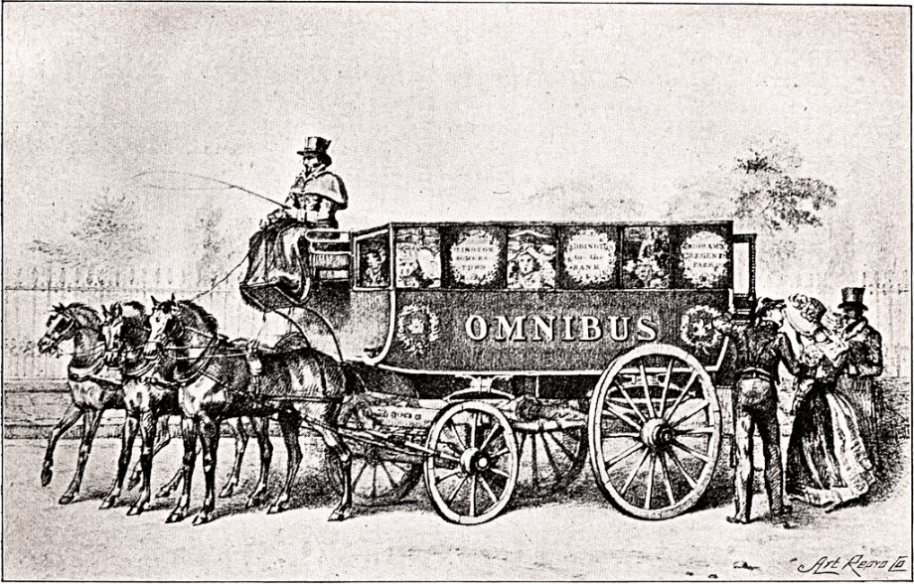
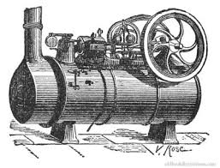
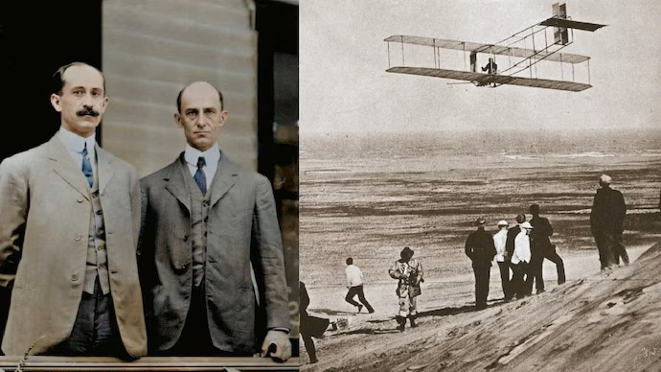
2. A Brief history of Transport
2.1. Early History of Transport
The Wheel: A Game Changer (3000 BC);
Invented in Mesopotamia for pottery, later adapted for transport.
The First Public Transit: The Omnibus (1662);
Invented by Blaise Pascal in France.
Steam Power Revolution (1800s);
Steamboats (1763) and hot air balloons began transforming transport.
The Wright Brothers and the Age of Flight (1903);
Orville & Wilbur Wright built and flew the first powered airplane.
Overview of Transport Systems and Research

Slide 13
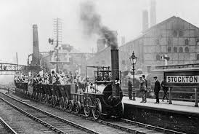
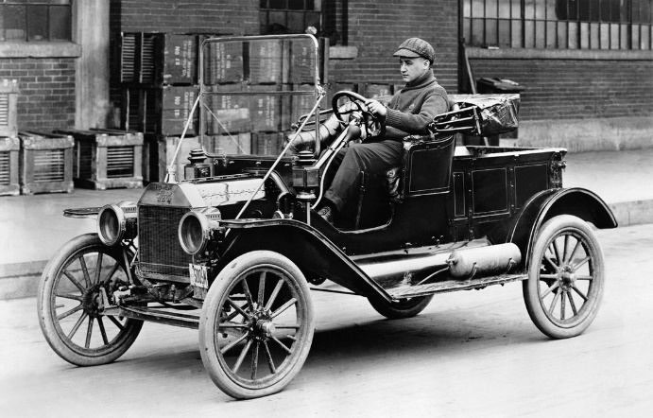
2. A Brief history of Transport
2.2. Industrial Revolution & Transport Growth
Railways & Urban Expansion;
The earliest transport transformation during the Industrial Revolution was the development of railways.
As trams, buses, and road-based vehicles emerged, major cities expanded outward, following railway corridors.
Automobile Revolution;
The motorcar revolutionized mobility, further fueling suburban expansion.
Cars and buses filled in gaps between rail lines, integrating small towns into larger urban areas.
Modern Highways;
Road-building improvements in the early 1800s, combined with automobiles, allowed for outstanding expansion between cities.
Overview of Transport Systems and Research

Slide 14

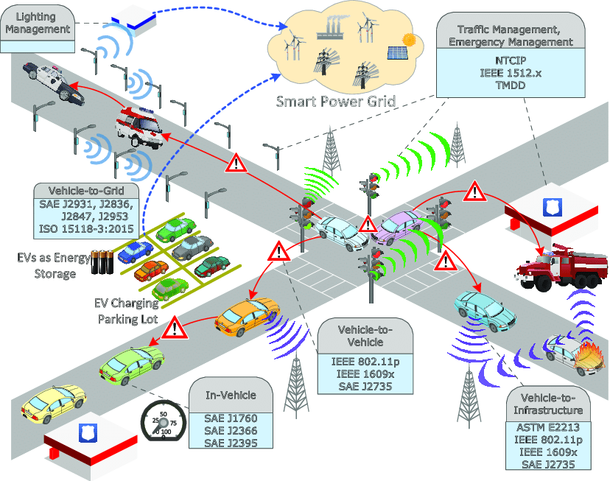
2. A Brief history of Transport
2.3. From the 20th Century to the 21st Century
20th Century: Globalization & Mass Transit Boom;
Trade & Freight Expansion: Globalization drove the need for efficient logistics; road freight outpaced economic growth.
Aviation & Urban Transit: Air travel revolutionized mobility; cities transitioned from trolleybuses to buses.
Technological Limits: Despite innovations, early automation (e.g., driverless vehicles) remained confined to airports.
21st Century: Sustainability & Smart Transport;
Electrification & Automation: Shift from fossil fuels to sustainable energy for efficiency and reduced emissions.
High-Speed Rail & Urban Mobility: Trains improve peak-time transit and promote environmental-friendly commuting.
Smart Transport Systems (ITS): AI-driven traffic management (e.g., SCATS) optimizes urban transport networks.
Overview of Transport Systems and Research

Slide 15
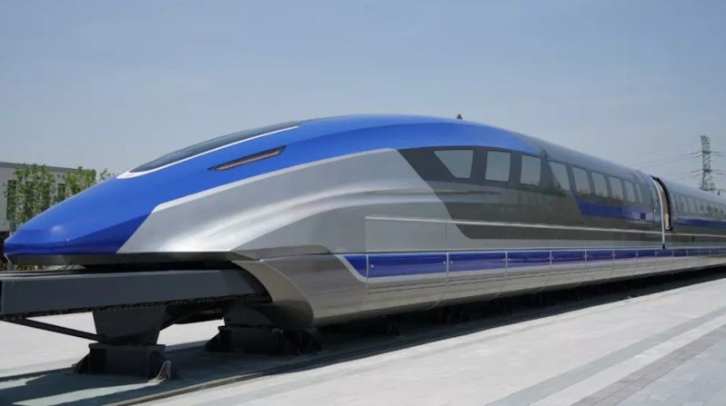
2. A Brief history of Transport
2.4. Future of Transport
Autonomous Vehicles;
Self-driving cars are set to change how we move, needing new rules and better infrastructure.
Understanding and making laws for these cars will be important for them to work well.
Hyperloop & Maglev Trains;
Shanghai introduced the first Maglev train in 2004, showing progress in fast transport.
Hyperloop, still being developed, could change long-distance travel by cutting travel time drastically.
Sustainable Urban Mobility;
There is an urgent need for eco-friendly transport to reduce fossil fuel use.
Future policies must focus on green and innovative ways to move people in cities.
Chinas new Maglev train 2024
Overview of Transport Systems and Research

Slide 16
Section 03:
Definitions of Key Concepts
Overview of Transport Systems and Research

Slide 17
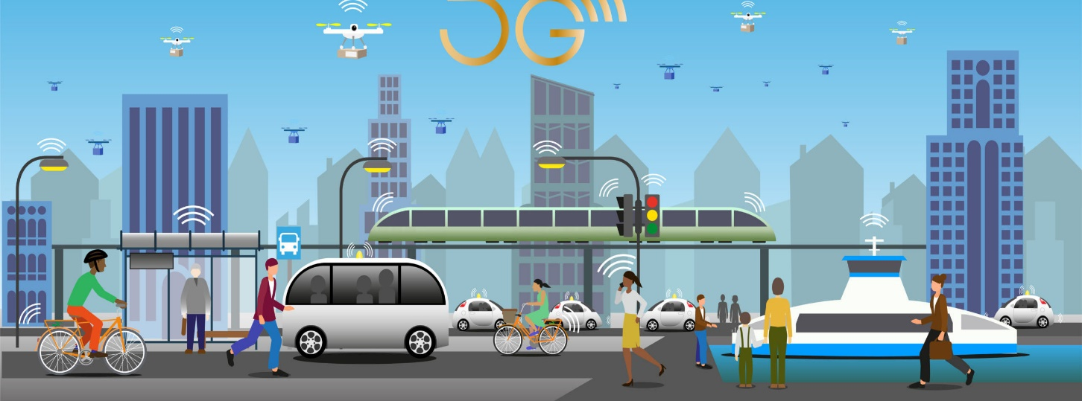
3. Definitions of Key Concepts
3.1. Understanding Key Transport Terms
Mobility
  Definition: Mobility refers to the ease of traveling from one place to another.
Key Factors: Mobility depends on the cost per kilometer, including:
  Monetary expenses
  Travel time
  Convenience
  Reliability
Example
    A person without a vehicle has limited mobility due to slower speeds and a smaller range.
    Using a wheeled vehicle (e.g., a bicycle or car) improves mobility by increasing speed and range.
Overview of Transport Systems and Research

Slide 18
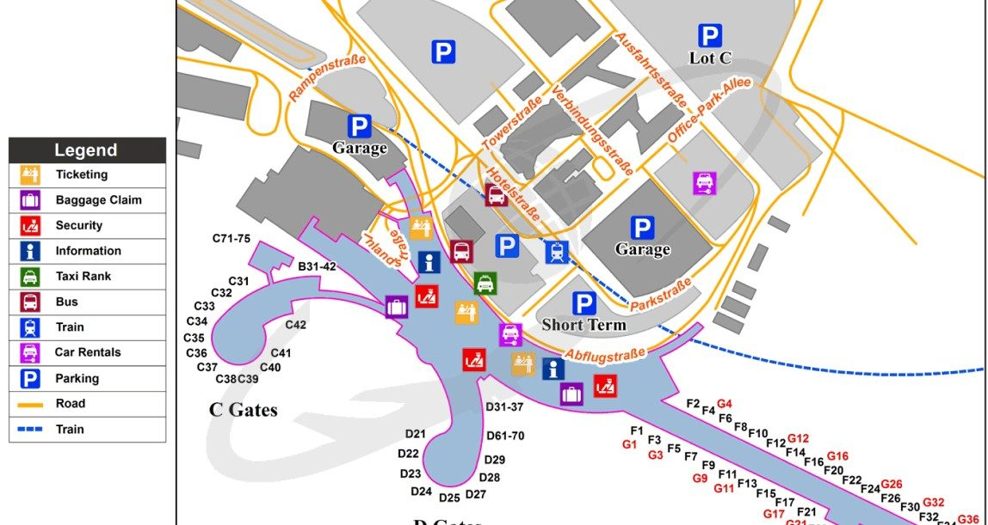
3. Definitions of Key Concepts
3.1. Understanding Key Transport Terms Cont.
Accessibility
  Definition: Accessibility is the ease of reaching specific destinations.
Key Factors: Accessibility is based on the cost per destination, which depends on:
  The efficiency of the transport system
  The locations of available destinations
Example
    A well-connected city with many transit options has higher accessibility.
    A rural area with fewer transportation options may have lower accessibility..
Overview of Transport Systems and Research

Slide 19
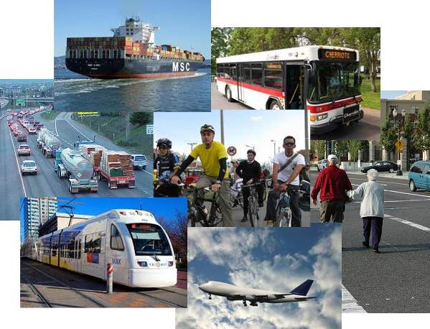
3. Definitions of Key Concepts
3.2. Scope & Coverage of Transport
Urban Transport
  Urban transport is a crucial aspect of city life, directly impacting how people move, work, and live.
  With over half the world’s population living in cities, even small improvements in transport systems can have massive benefits.
Regional Transport
  While urban transport is the main focus, it's also essential to consider how cities connect to surrounding regions.
  Regional and national transport policies help integrate cities into a larger network, ensuring smooth movement of people and goods.
Global Transport
  While international transport (like sea and air travel) isn’t the primary focus, it’s still acknowledged as an essential part of global connectivity.
  Ultimately, a well-planned transport system at all levels—urban, regional, and international—can enhance economic growth and improve quality of life.
Overview of Transport Systems and Research

Slide 20
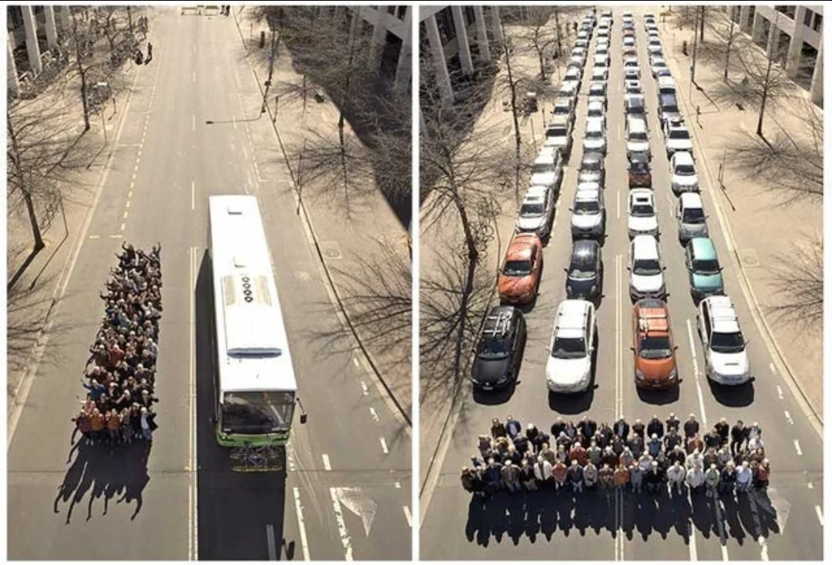
3. Definitions of Key Concepts
3.3. Public vs. Private Transport
Public Transport: The Backbone of Cities
  Public transport plays a key role in reducing road congestion, lowering pollution, and providing affordable mobility
    Examples include:
  Rail: Metros, trams, high-speed rail
  Buses: Regular buses, Bus Rapid Transit (BRT), minibuses
  Other modes: Ferries and taxis
The Role of Private Transport
While public transport is crucial, private vehicles—mainly cars—remain a dominant mode of travel.
Policies such as road pricing and congestion charges are used to manage road use and reduce traffic congestion.
Public vs. Private Ownership Debate
Some argue transport should be publicly funded for accessibility and affordability.
Others believe private investment can lead to better efficiency and service quality.
Although this debate continues, the focus is on balancing both systems to create an effective transport network.
Overview of Transport Systems and Research

Slide 21

3. Definitions of Key Concepts
3.4. Policy Challenges and Integration
Balancing Public and Private Transport
A key challenge is ensuring that both public and private transport work together, rather than competing inefficiently.
Sustainable transport requires a balance—too much reliance on private cars leads to congestion, while weak public transport leaves people with few options.
The Need for Integrated Planning
Instead of addressing transport problems separately, a "joined-up approach" is needed.
For example, land-use planning should align with transport development to avoid urban left alone and ensure accessibility.
Aligning Policies at Different Levels
City and national policies must work together.
A lack of coordination can lead to inefficiencies—for example, a city investing in a metro system while national policies prioritize highway expansion.
Overview of Transport Systems and Research

Slide 22
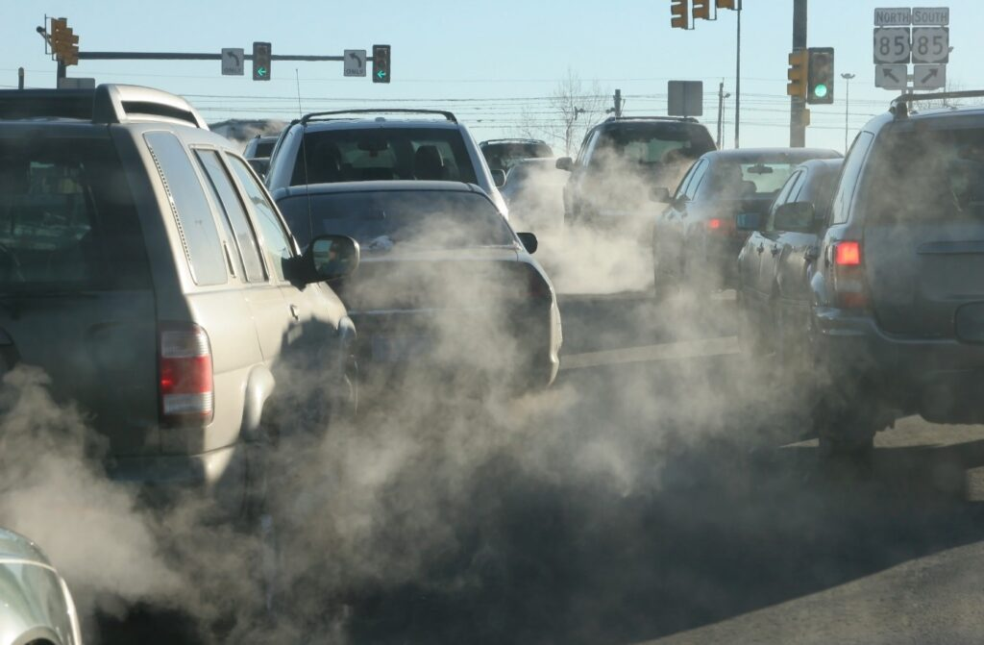
3. Definitions of Key Concepts
3.5. Role of Economic & Policy Frameworks
Role of Economic & Policy Frameworks
  Economic and policy frameworks shape transport planning and infrastructure development.
  Decisions impact sustainability, efficiency, and accessibility in transport systems.
Cost-Benefit Analysis (CBA) in Transport Planning
  CBA helps policymakers assess the financial and societal impact of transport projects.
  It includes monetary, physical, and qualitative measures to ensure well-informed decisions.
  Considers long-term sustainability by factoring in environmental and intergenerational concerns.
Externalities in Transport
  Negative Externalities: Air pollution, congestion, noise, and road safety risks.
  Positive Externalities: Economic growth (agglomeration effects), improved connectivity.
  Unregulated markets may oversupply goods with negative externalities and undersupply those with positive externalities.
Policy Solutions to Mitigate Externalities
  Policies should balance fairness and efficiency in addressing externalities.
Key Strategies:
        Promoting sustainable energy sources and fuel technologies.
        Road user charges to address congestion and pollution.
        Public transport improvements to reduce negative impacts.
        Assigning monetary value to social costs like emissions and noise.
Overview of Transport Systems and Research

Slide 23
Section 04:
Importance of Transport Research
Overview of Transport Systems and Research

Slide 24
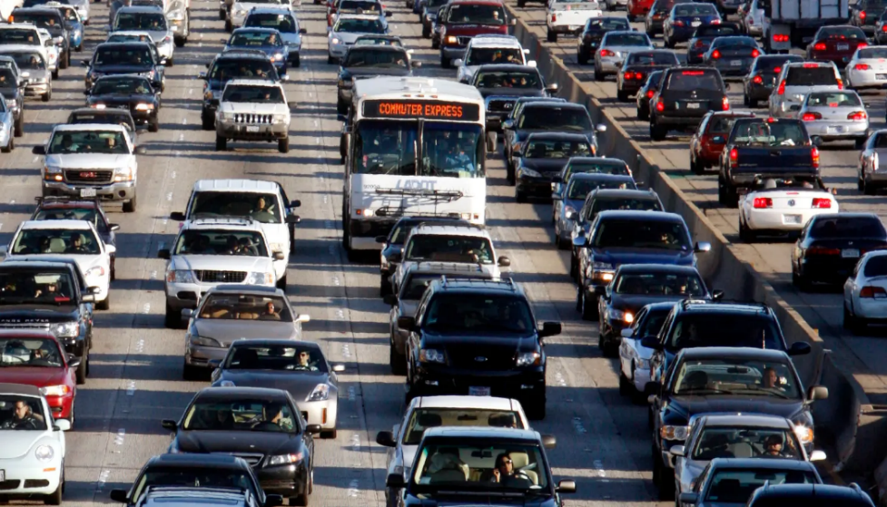
4. Importance of Transport Research
4.1. Why is Transportation Research Important?
Supports Policy-Making & Infrastructure Planning
Policy Development:
              Research helps design effective policies for congestion pricing, emission reduction, and public transport funding.
          Example: London Congestion Charge, implemented after in-depth feasibility studies.
Infrastructure Investment Decisions:
  Determines where new roads, highways, and transit networks are needed.
  Example: Smart Cities & Urban Transport Planning to integrate transit-oriented development
Identifies Problems & Develops Solutions
Understanding Transport Challenges:
  Congestion, emissions, accessibility, and safety concerns.
  Research helps measure and analyze these challenges.
Developing Evidence-Based Solutions:
  Alternative transport modes (public transit, shared mobility).
  Intelligent Transport Systems (ITS) for traffic flow optimization.
Overview of Transport Systems and Research

Slide 25
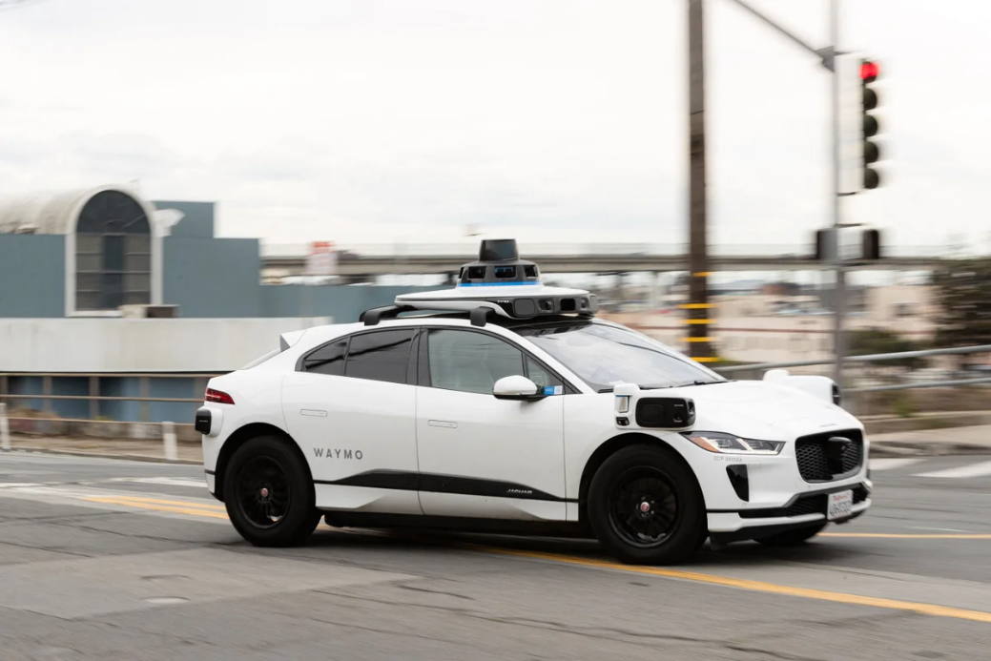
4. Importance of Transport Research
4.1. Why is Transportation research Important? Cont.
Helps in Technology Advancements (Autonomous Vehicles, EVs)
Electrification & Sustainable Transport:
  EV research helps optimize battery efficiency, charging infrastructure, and energy grid integration.
  Example: Governments incentivizing EV adoption based on lifecycle analysis of emissions.
Automation & AI in Transport:
  Autonomous vehicles (AVs) research focuses on safety regulations, sensor integration, and legal frameworks.
  Example: Pilot projects for self-driving cars in controlled urban areas like Singapore.
Overview of Transport Systems and Research

Slide 26
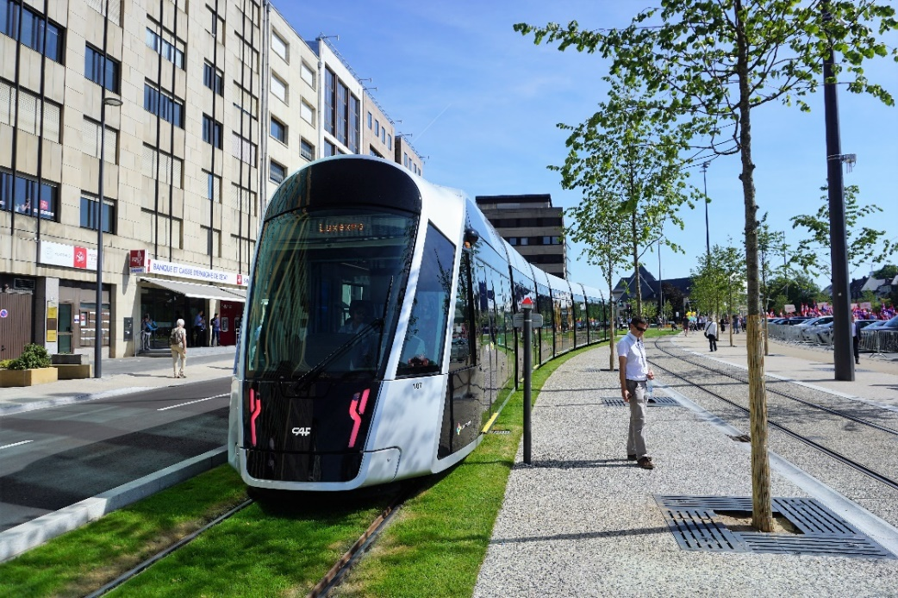
4. Importance of Transport Research
4.2. Key Areas of Transport Research
Traffic Management & Congestion Reduction
Explores congestion causes and management strategies.
Compares how traffic engineers and economists define congestion.
Covers recurring vs. incident-related congestion and road pricing as a solution.
Emphasizes mitigation over elimination, focusing on reducing negative impacts like pollution.
Public Transport Efficiency
Highlights public transport’s role in reducing car-related externalities.
Examines different modes (bus, rail, BRT, etc.) and their best-use scenarios.
Discusses efficiency, cost structures, and service delivery for urban areas.
Overview of Transport Systems and Research

Slide 27
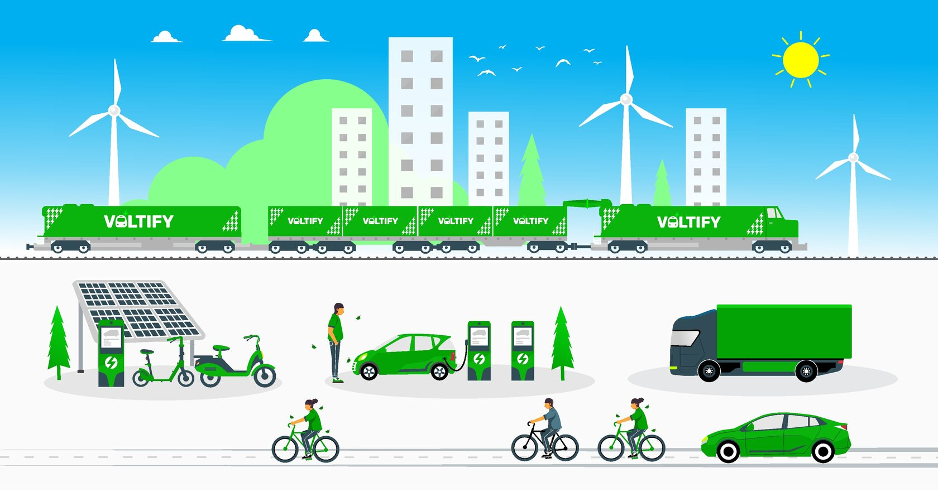
4. Importance of Transport Research
4.2. Key Areas of Transport Research
Road Safety & Accident Analysis
Identifies causes: driver behavior, vehicle condition, and road environment.
Highlights speed as a major risk factor in accidents.
Examines personal safety concerns and policy measures to improve safety.
Sustainable Mobility Solutions
Discusses alternative fuels & technologies to reduce fossil fuel dependence.
Explores low-capital strategies like TSM (Transport System Management) and TDM (Travel Demand Management).
Emphasizes integrating land use & transport for long-term sustainability.
Overview of Transport Systems and Research

Slide 28
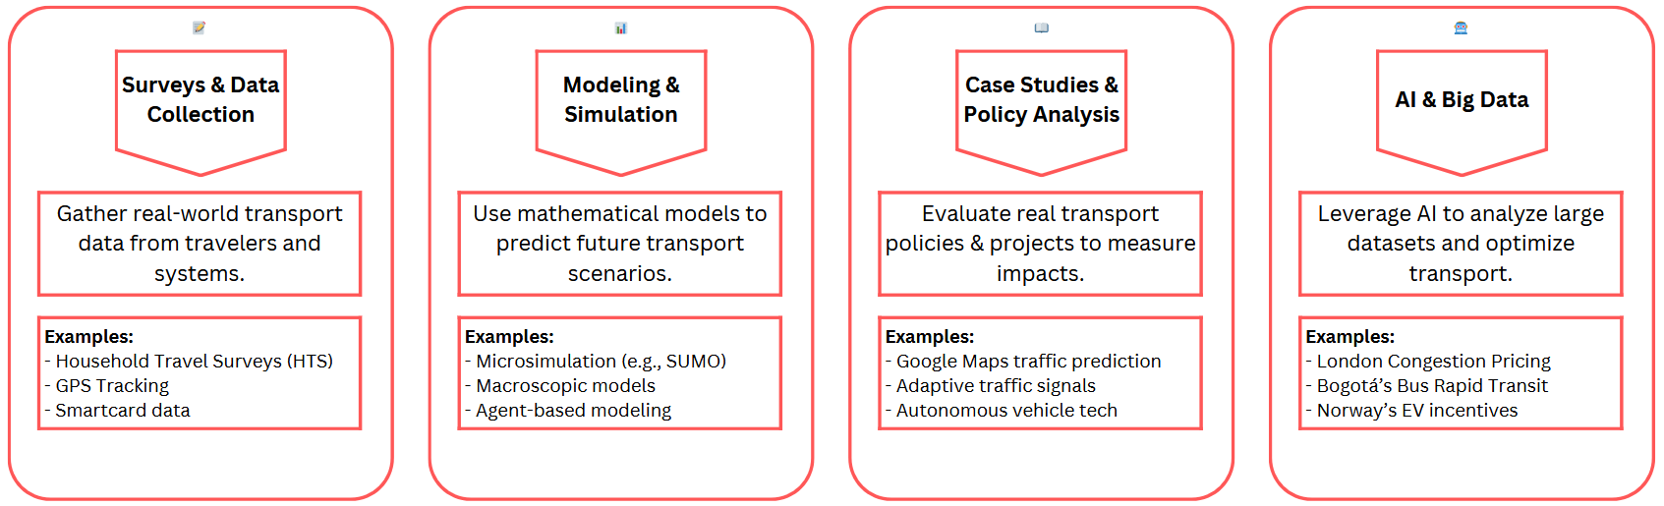
4. Importance of Transport Research
4.3. How is Transport Research Conducted
Overview of Transport Systems and Research

Slide 29
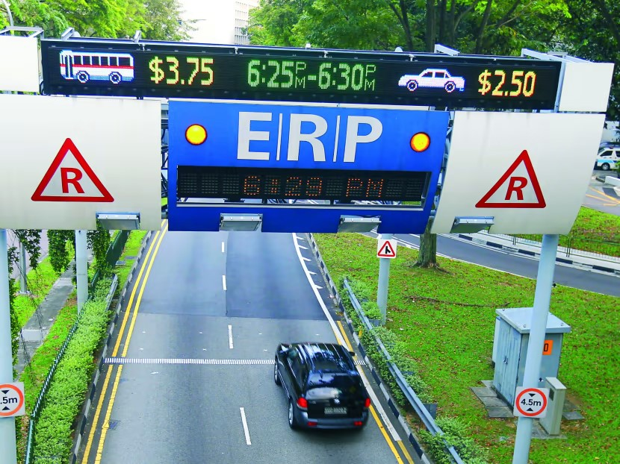
4. Importance of Transport Research
4.5. Case Studies – Congestion Pricing
London’s Congestion Charge
Area-based scheme implemented in 2003 to reduce traffic in central London.
Led to reduced traffic, increased travel speeds, and improved air quality.
Accompanied by a major increase in bus services, ensuring viable alternatives.
Singapore’s ERP (Electronic Road Pricing) System
Uses both cordon-based and link-based pricing for congestion management.
Charges vary by time of day and congestion levels to manage demand.
The system is highly adaptive, with real-time pricing adjustments.
Distance-based charging is noted as the most economically efficient approach.
Overview of Transport Systems and Research

Slide 30
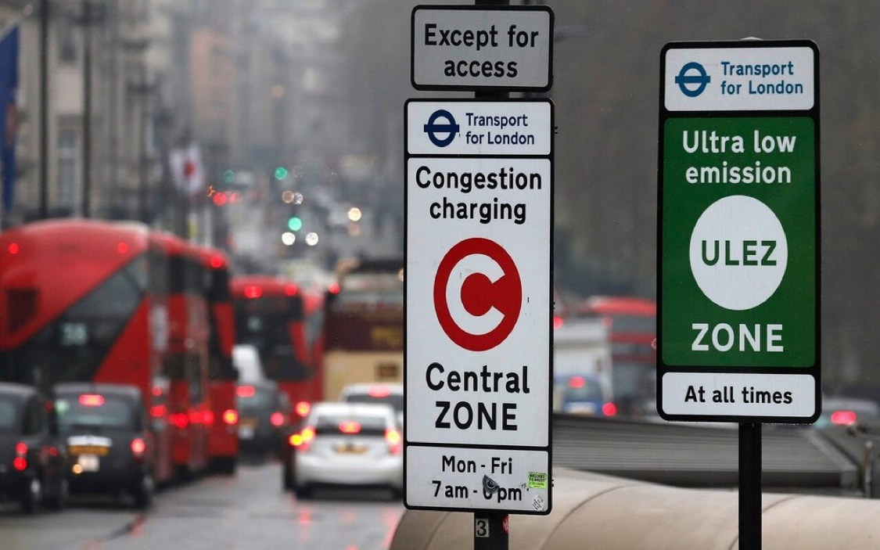
4. Importance of Transport Research
4.5. Understanding Congestion Pricing
Effectiveness of Congestion Pricing
Fast and sustained traffic reduction – the most effective method for managing congestion.
Helps prevent traffic from rebounding, keeping roads consistently decongested.
Effectiveness grows over time as people adapt travel behaviors.
Types of Congestion Pricing
Area-Based – Charges for entering a defined zone (e.g., London).
Cordon-Based – Charges applied at boundary points (e.g., Singapore).
Facility/Link-Based – Tolls for specific roads, tunnels, or bridges.
Distance-Based – Charges based on total distance traveled.
Impacts of Congestion Pricing
Reduced congestion & improved travel speeds.
Lower emissions due to decreased traffic volumes.
Encourages use of public transport & alternative mobility solutions.
Overview of Transport Systems and Research

Slide 31
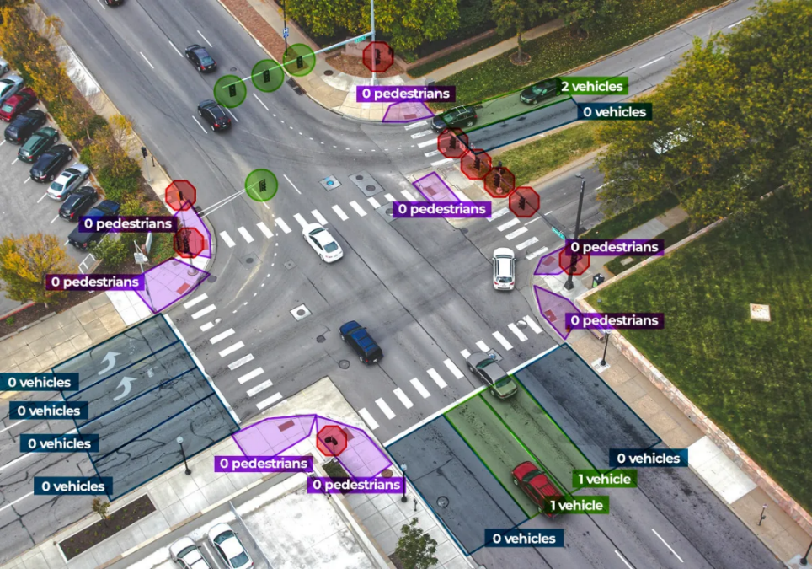
4. Importance of Transport Research
4.6. Technology in Transport Research
How Technology is Transforming Modern Transport Systems
Big Data & AI in Traffic Prediction
What it is:
  Big Data aggregates real-time traffic feeds, GPS signals, and sensor data to predict traffic congestion.
  AI analyzes patterns and optimizes traffic flow through predictive analytics.
Example:
  Google Maps & Waze use machine learning to suggest fastest routes based on live congestion updates.
  AI-driven adaptive traffic lights reduce congestion by adjusting signals based on real-time traffic volume.
Overview of Transport Systems and Research

Slide 32
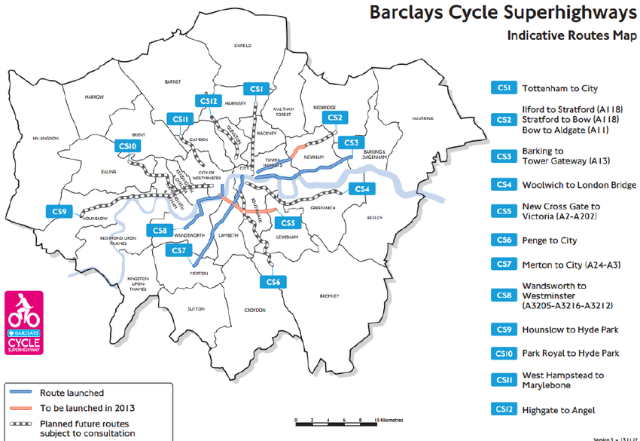
4. Importance of Transport Research
4.6. Technology in Transport Research
GIS & Mapping for Urban Planning
What it is:
  Geographic Information Systems (GIS) provide spatial analysis for urban transport planning.
  Planners use GIS to map traffic density, transport accessibility, and future infrastructure development.
Example:
  Cities use GIS to design bus routes, metro lines, and pedestrian zones based on population flow.
  London’s Cycle Superhighway was planned using GIS data on cyclist density.
Overview of Transport Systems and Research

Slide 33
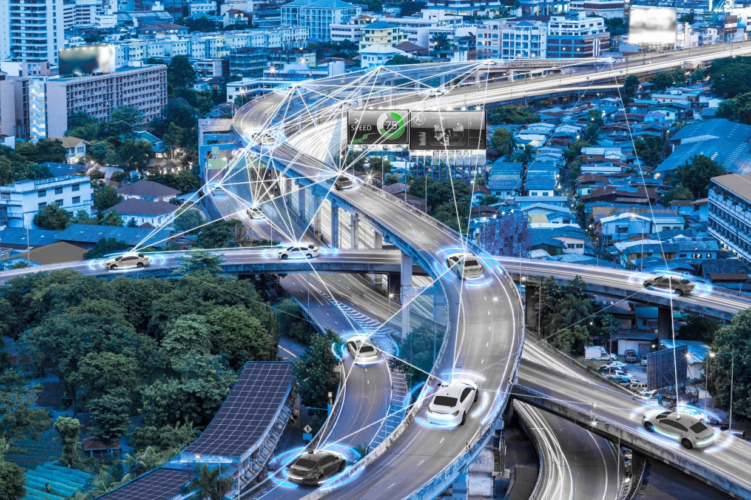
4. Importance of Transport Research
4.6. Technology in Transport Research
Autonomous Vehicles & Smart Mobility Research
What it is:
  Research into self-driving cars, connected vehicles, and Mobility-as-a-Service (MaaS).
  Uses AI & sensor fusion (LIDAR, cameras, radar) to enable autonomous navigation.
Example:
  Tesla & Waymo testing Level 4 autonomy in urban settings.
  Singapore’s self-driving taxis aim to replace private car ownership in dense urban areas.
Overview of Transport Systems and Research

Slide 34

4. Importance of Transport Research
4.7. Future Research Trends in Transport
Sustainable Transport - EVs and Alternative Fuels
Shift from petroleum-based fuels to sustainable energy sources.
Alternative fuels enhance sustainability, energy security, and reduce pollution.
Potential for technological advancements to replace fossil fuel engines.
  Case study: Australian road transport GHG reduction through tech & behavior change.
High-Speed Rail Innovations
What it is:
Research on ultra-fast transport solutions reducing travel time significantly.
Hyperloop systems using vacuum tubes to reach speeds over 1000 km/h.
Example:
  Elon Musk’s Hyperloop proposal: LA to San Francisco in 35 minutes.
  China’s High-Speed Rail network is already the world's largest and continues to expand.
Future development: linking land use/transport models with economic models.
Overview of Transport Systems and Research

Slide 35
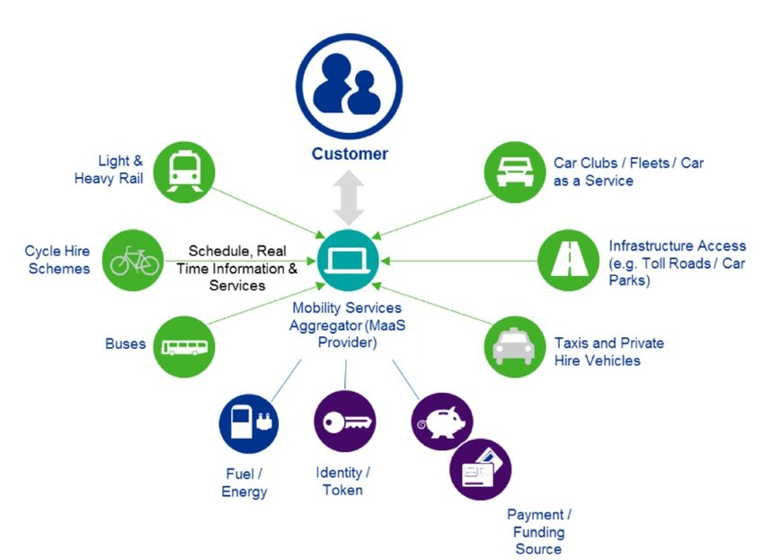
4. Importance of Transport Research
4.7. Future Research Trends in Transport
AI, Automation & Connected Vehicles
What it is:
  Use of AI in autonomous driving, intelligent traffic control, and predictive maintenance.
Example:
  Tesla, Waymo, and Mercedes-Benz working on full self-driving cars.
  AI-based smart traffic signals reducing urban congestion in Singapore & Amsterdam.
Shared Mobility & Mobility-as-a-Service (MaaS)
What it is:
Integrating various transport services (buses, metro, ride-hailing, car-sharing, bikes) into a single digital platform.
Encouraging public transport use through Travel Demand Management (TDM).
Integrated, "joined-up" approach to solving transport challenges.
Promoting Voluntary Travel Behavior Change (VTBC) to shift towards eco-friendly modes.
Example:
  Helsinki’s Whim App, allowing seamless booking & payment across multiple transport modes.
  Uber, Lyft, and Bolt integrating micro-mobility (e-scooters, bikes) into apps.
Overview of Transport Systems and Research

Slide 36
Section 05:
Audience/Users of Transport Statistics
Overview of Transport Systems and Research

Slide 37
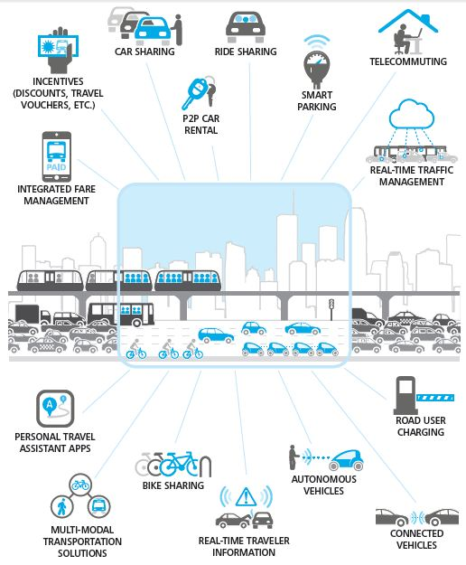
5. Audience/Users of Transport Statistics
5.1. Who uses transport data?
  Policymakers
    Transport data is essential for designing effective transport policies
    This data helps policymakers understand current transport network situations
    It also helps them predict future situations
    By using transport data, policy makers are able to develop transport policies that align to high-level goals.
Businesses
    Transport data enables effective logistics and supply chain management
    Freight industry stakeholders can use transport data to improve efficiency
  Academics & Researchers
    Academics and researchers use transport data to study trends
    Researchers use transport data to understand relationships between transport policy and society
    Transport data further enables them to predict future needs
Overview of Transport Systems and Research

Slide 38
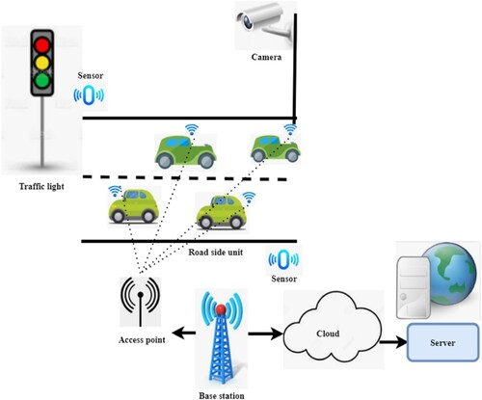
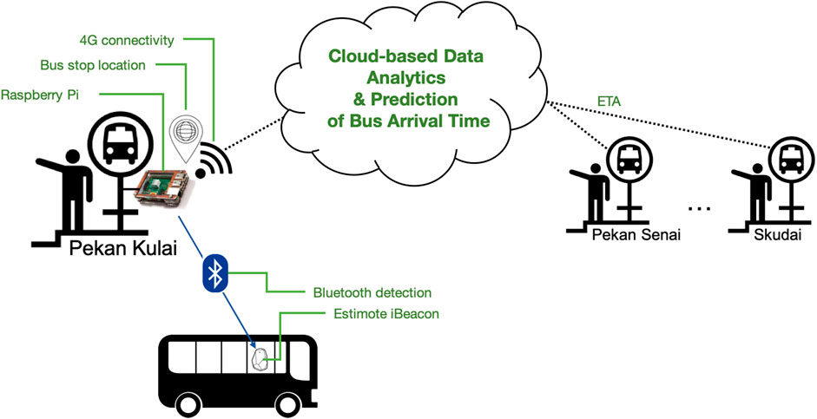
5. Audience/Users of Transport Statistics
5.2. Common Sources and collection methods of Transport Data
Government Transport Surveys
  National or regional Household Travel Surveys (HTS) that collect data on how people move daily.
  Typically includes trip purpose, travel mode, journey time, and frequency.
Big Data: Mobile Phones, GPS & IoT Sensors
  Real-time tracking data collected from smartphones, navigation apps, and connected vehicles.
  IoT-enabled infrastructure (smart traffic lights, toll gates, and highway sensors) providing live transport analytics.
Public Transport Ridership Data
  Data from metro turnstiles, bus ticketing systems, and ride-sharing platforms.
  Tracks passenger volumes, peak travel times, and route efficiency.
Overview of Transport Systems and Research

Slide 39
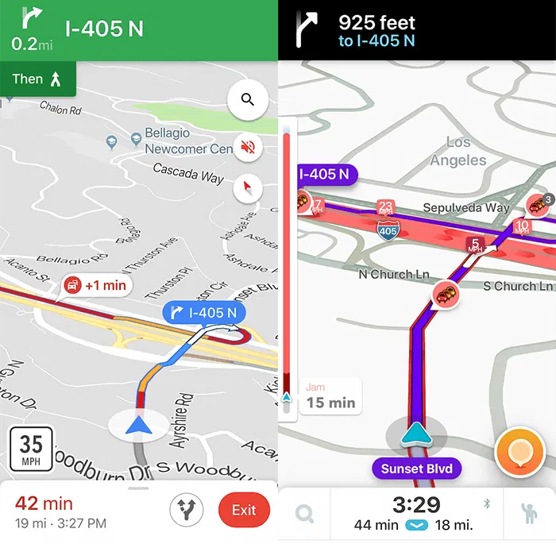
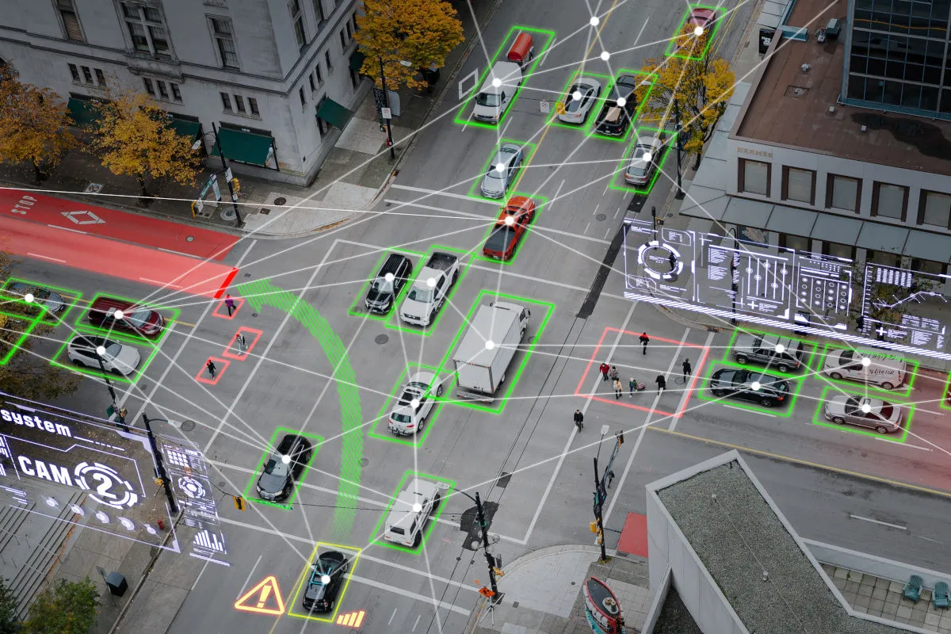
5. Audience/Users of Transport Statistics
5.3. Example – Smart Transport Planning Using Data
Google Maps & Waze: Traffic congestion tracking.
City Traffic Management: ITS - Intelligent Transport Systems
Overview of Transport Systems and Research

Slide 40
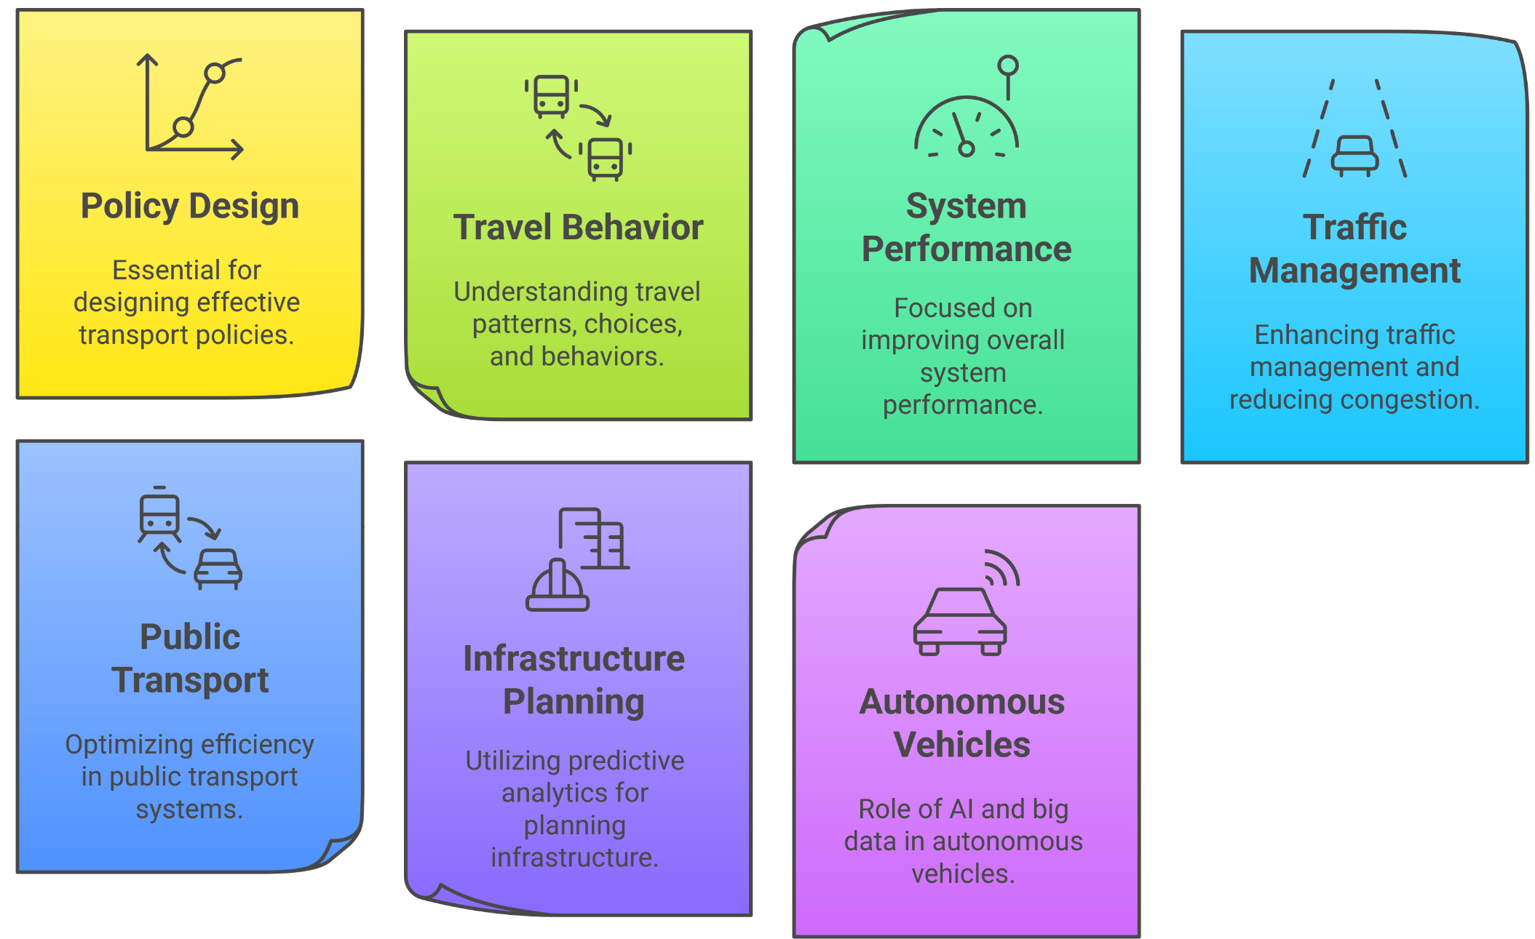
5. Audience/Users of Transport Statistics
5.4. Importance of Data Analytics in Transport
Overview of Transport Systems and Research

Slide 41
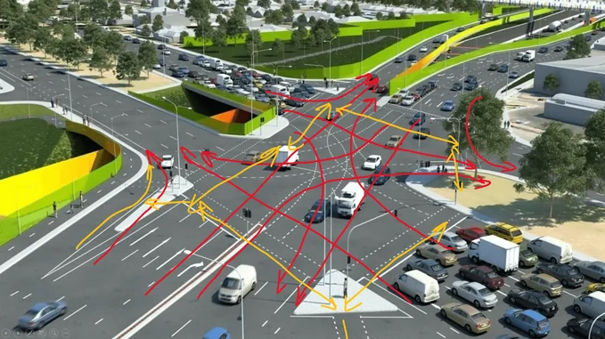
5. Audience/Users of Transport Statistics
5.5. Challenges in Transport Data Collection
Data Privacy & Security Concerns
  Transport data from GPS, mobile apps, and ride-sharing platforms contains sensitive personal location data.
  Risk of data breaches, unauthorized access, and misuse
Data Accuracy & Reliability
  Inconsistent data sources (manual surveys vs. real-time IoT data) can cause inaccuracies.
  Data gaps in rural areas where smart infrastructure & GPS tracking are limited.
Integration of Different Data Formats
  Transport data is collected from multiple sources (government surveys, GPS tracking, ride-sharing apps, IoT sensors).
  Different formats & data standards make integration difficult for smart city planning.
High Cost of Data Collection
  Deploying IoT-based transport data collection systems (sensors, AI cameras, GPS tracking) requires heavy investment.
  Governments may lack funding for continuous data collection & analytics.
Overview of Transport Systems and Research

Slide 42
Section 06:
Quiz & Discussion
Overview of Transport Systems and Research

Slide 43

6. Quiz & Discussion
6.1. Quiz Time
Question 1: Define the key components of a transport system.
Question 2: Why is transport research important?
Question 3: Explain the difference between mobility and accessibility.
Question 4: Name two applications of transport statistics.
Question 5: What is a major challenge in transport data collection?
Question 6: What is the main advantage of public transport ridership data?
Overview of Transport Systems and Research

Slide 44

6. Quiz & Discussion
6.2. Group Discussions
What are the biggest transport challenges in your city?
    What are the major transportation issues in urban areas?
    How can research solve these problems?
    What are some future trends in transport (e.g., automation, sustainability)
Overview of Transport Systems and Research

Slide 45
Thank you for your Attention!

