Slide 1
Transport Research and Analysis
Module 2: Transport Data Collection and Management
Lecture 8: Big Data in Transport

Slide 3
Table of Contents
Lecture 8: Big Data in Transport
1. Introduction to Big Data | 1
1.1 Definition of Big Data | 2
1.2 The 5 Vs of Big Data | 3
1.3 Why Big Data Matters in Transportation | 4
1.4 Emergence of Data-Driven Paradigms | 5
2. Applications of Big Data in Transport | 6
2.1 Real-Time Traffic Monitoring & Prediction | 7
2.2 Urban Mobility and Smart Cities | 8
2.3 Mobility-as-a-Service (MaaS) and Shared Transport | 9
2.4 Traveler Behavior and Activity Pattern Mining | 10
2.5 Infrastructure Management and Road Safety Analytics | 11
3. Opportunities of Big Data | 12
3.1 Role of Data in Decision-Making | 13
3.2 Data-Driven Transport Planning and Policy | 14
3.3 Challenges in Maintaining Confidentiality in Engineering Data | 15
3.4 Integration with Traditional Transport Models | 16
4. Opportunities of Big Data | 17
4.1 Enabling Personalized and Predictive Mobility Services | 18
4.2 Supporting Adaptive Traffic Control Systems | 19
4.3 Enhancing Equity and Accessibility in Transport | 20
4.4 Improving Resilience of Transport Networks | 21
i
Big Data in Transport

Slide 4
Table of contents
Lecture 8: Big Data in Transport
5. Benefits of Big Data | 22
5.1 Improved Efficiency and Optimization | 23
5.2 Better Policy-Making through Evidence-Based Insights | 24
5.3 Enhanced User Experience and Safety | 25
5.4 Real-Time Decision Support for Transport Authorities | 26
6. Future of Big Data in Transport | 27
6.1Integration with AI, IoT, and Edge Computing | 28
6.2 Autonomous Vehicles and Data Ecosystems | 29
6.3 Blockchain for Secure Mobility Data Sharing | 30
6.4 Data-Informed Transport Planning and Governance | 31
7. Quiz & Final Remarks | 32
7.1 Short Quiz | 33
7.2 Summary of Key Points | 35
7.3 Final Thoughts and Discussion | 36
ii
Big Data in Transport

Slide 5
Section 01:
Introduction to Big Data
Big Data in Transport

Slide 6
1. Introduction to Big Data
1.1 Definition of Big Data
Big Data refers to datasets that are too large, complex, and fast-changing to be processed using traditional data processing methods.
In the transport context, big data includes inputs from GPS devices, mobile apps, smartcards, traffic sensors, social media, and more.
It's not just about volume, but also about the value extracted for understanding and managing mobility systems.
“Big data in transportation is not just a question of size, but of diversity, speed, and integration into decision-making.”
(Antoniou et al., 2018)
2
Big Data in Transport

Slide 7
1. Introduction to Big Data
1.2 The 5 Vs of Big Data
Volume | Massive amounts of data generated from sources like GPS, sensors, and apps.
Velocity | Real-time or near-real-time data capture and processing.
Variety | Different data types: structured (databases), semi-structured (JSON/XML), and unstructured (videos, social media).
Veracity | Trustworthiness and accuracy of data—critical for reliable transport decisions.
Value | Insights gained from big data that support transport planning and operations.
3
Big Data in Transport

Slide 8
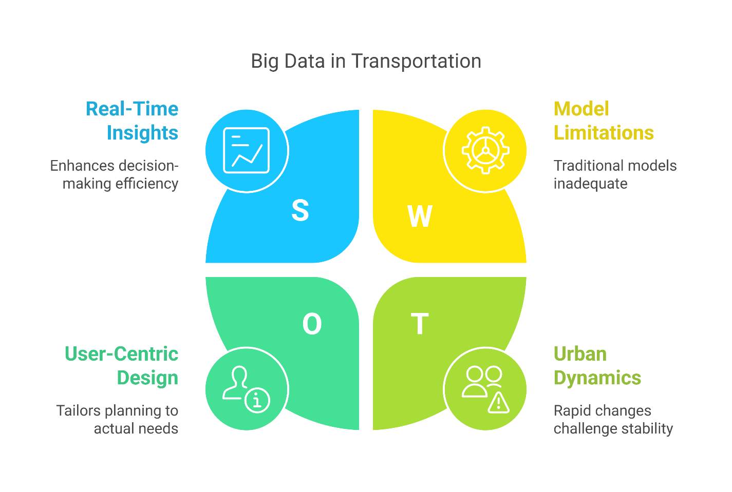
1. Introduction to Big Data
1.3 Why Big Data Matters in Transportation
      Increased Mobility Complexity: Urban systems are dynamic; traditional models struggle to keep up.
      Real-Time Decision-Making: Enables traffic management, public transport monitoring, and service optimization.
      User-Centric Planning: Big data reflects real travel behavior, helping planners design for actual needs.
      Integration with Smart Cities: Transport is one of the first domains impacted by data-driven urban governance.
4
Big Data in Transport

Slide 9
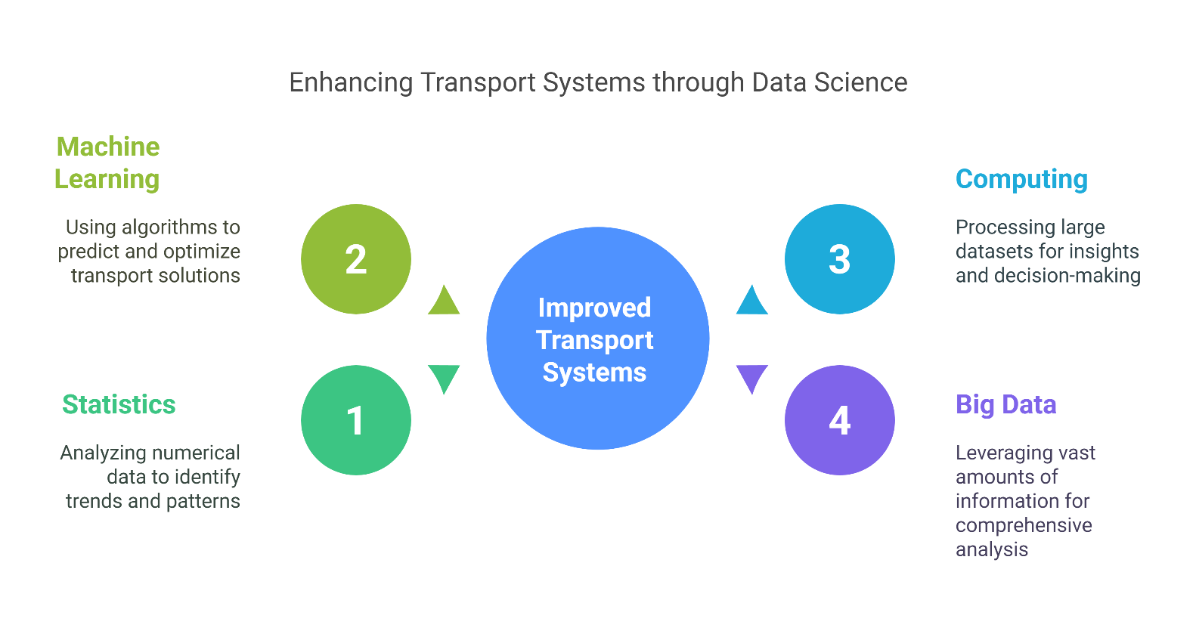
1. Introduction to Big Data
1.4 Emergence of Data-Driven Paradigms
Data Science in Transport:
Combines statistics, machine learning, and computing to uncover patterns from massive transport datasets
  Transport Analytics:​
  Uses big data to:
          i. Improve system efficiency
          ii. Model mobility demand
          iii. Understand activity-based behavior
5
Big Data in Transport

Slide 10
Section 02:
Applications of Big Data in Transport
Big Data in Transport

Slide 11
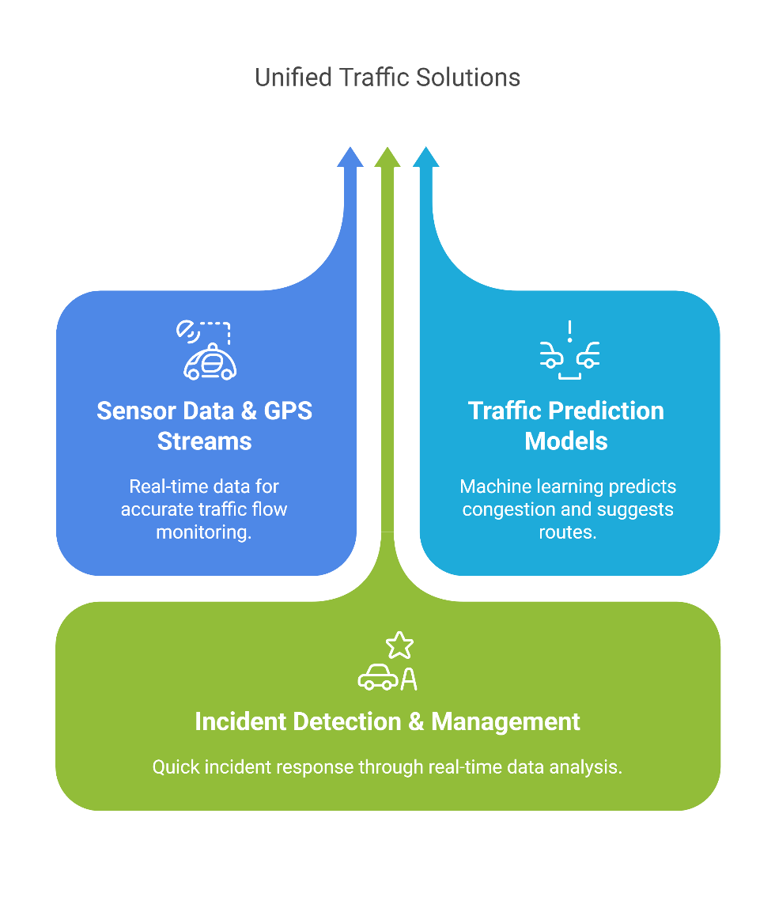
2. Applications of Big Data in Transport
2.1 Real-Time Traffic Monitoring & Prediction
Sensor Data & GPS Streams
Big data enables live tracking of traffic flow using GPS, cameras, loop detectors, and connected vehicle data.
Traffic Prediction Models
Machine learning algorithms analyze historical and live data to predict congestion and suggest alternative routes.
Incident Detection & Management
Real-time data allows faster detection of crashes or disruptions, enabling dynamic rerouting and response.
7
Big Data in Transport

Slide 12
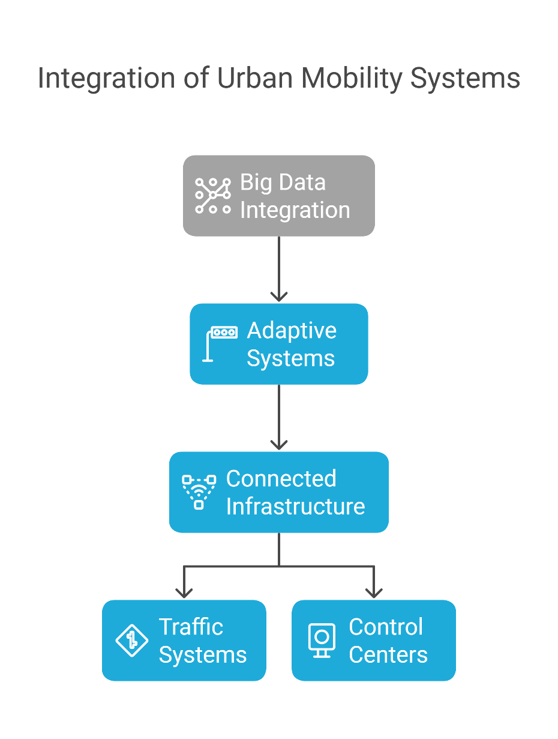
2. Applications of Big Data in Transport
2.2 Urban Mobility and Smart Cities
Integration of Systems
Smart cities use big data to integrate public transport, traffic control, energy use, and environmental data.
Adaptive Systems
Cities dynamically adjust signal timings, lane usage, and toll pricing based on live data.
Connected Infrastructure
Internet of Things (IoT) devices communicate in real-time with traffic systems and control centers.
8
Big Data in Transport

Slide 13
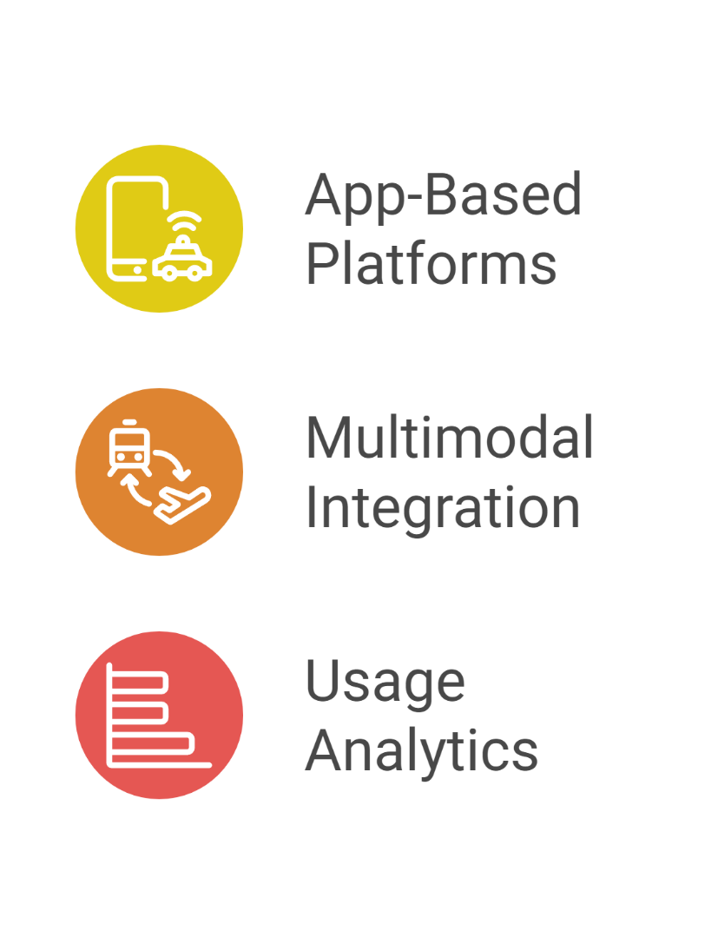
2. Applications of Big Data in Transport
2.3 Mobility-as-a-Service (MaaS) and Shared Transport
App-Based Platforms
Big data powers MaaS apps like Uber, Moovit, or Citymapper that aggregate multiple modes of transport.
Multimodal Integration
Combines ride-sharing, public transit, bike-sharing, and car rentals into seamless trip planning.
Usage Analytics
Analyzing trip data helps providers predict demand, optimize fleet distribution, and reduce waiting times.
9
Big Data in Transport

Slide 14
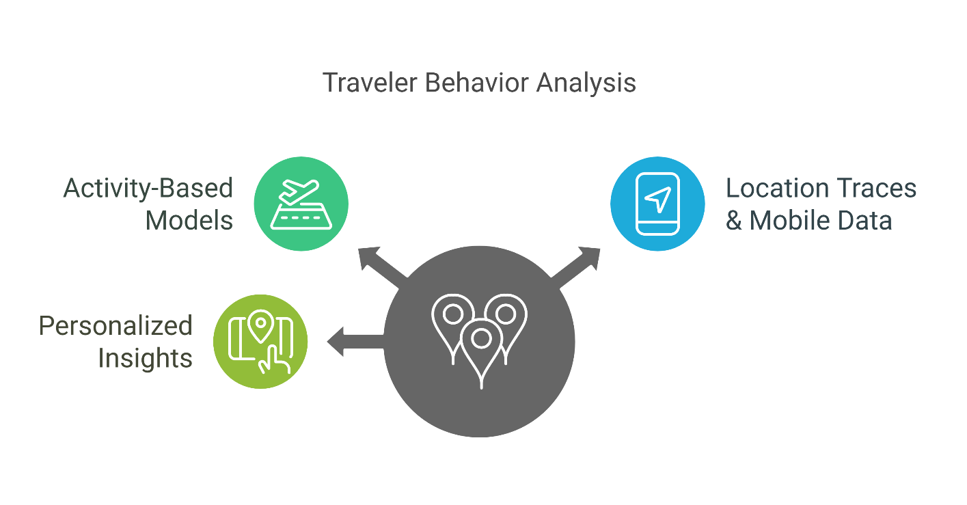
2. Applications of Big Data in Transport
2.4 Traveler Behavior and Activity Pattern Mining
Activity-Based Models
Moving beyond trips, these models analyze why, when, and how people move.
Location Traces & Mobile Data
GPS and mobile signal data reveal commuting routines, leisure travel, and peak hours.
Personalized Insights
Enables tailored mobility services, such as personalized notifications or routing.
10
Big Data in Transport

Slide 15
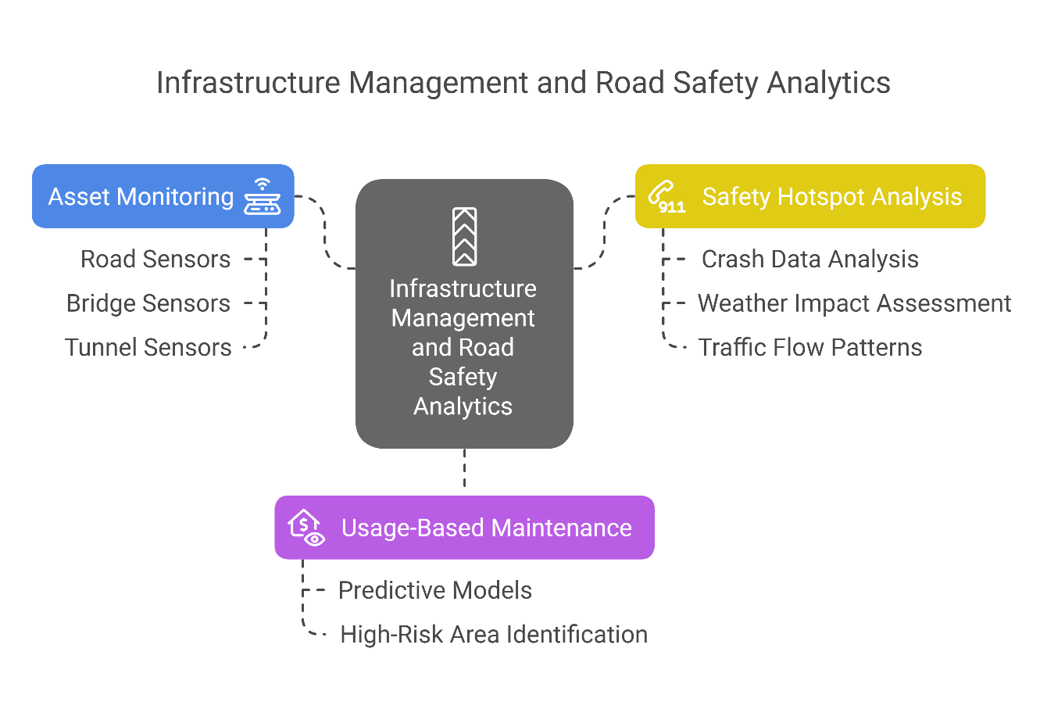
2. Applications of Big Data in Transport
2.5 Infrastructure Management and Road Safety Analytics
Asset Monitoring
Sensors embedded in roads, bridges, and tunnels collect data on wear, usage, and structural health.
Usage-Based Maintenance
Big data supports predictive maintenance by identifying high-risk or high-use areas.
Safety Hotspot Analysis
Crash data, weather, speed, and flow patterns are used to identify and prevent high-risk scenarios.
11
Big Data in Transport

Slide 16
Section 03:
Challenges of Big Data in Transport
Big Data in Transport

Slide 17
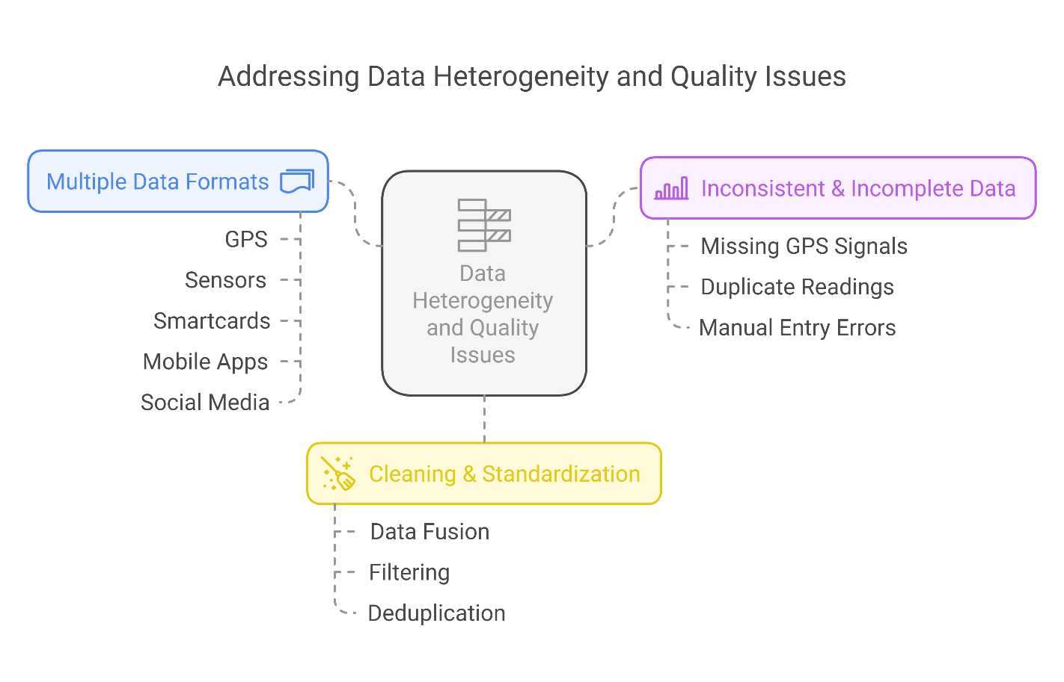
3. Challenges of Big Data in Transport
3.1 Data Heterogeneity and Quality Issues
Multiple Data Formats
Big data comes from diverse sources: GPS, sensors, smartcards, mobile apps, social media, etc.
Inconsistent & Incomplete Data
Missing GPS signals in tunnels
Duplicate or corrupted sensor readings
Manual data entry errors in surveys
Cleaning & Standardization
Preprocessing (e.g., data fusion, filtering, deduplication) becomes a major workload before any analysis can happen.
13
Big Data in Transport

Slide 18
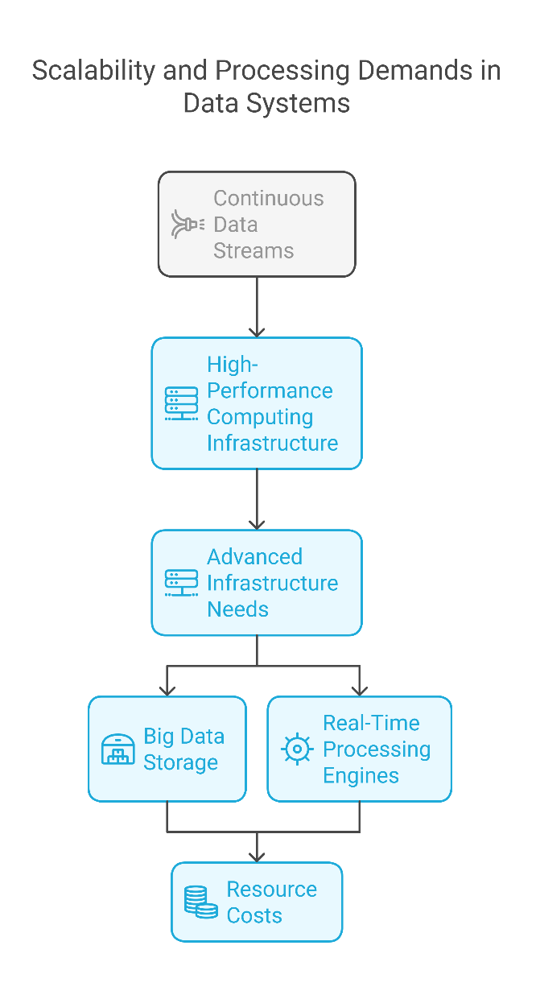
3. Challenges of Big Data in Transport
3.2 Scalability and Processing Demands
High Volume, High Velocity
Continuous data streams require high-performance computing infrastructure.
Example: City-wide sensor networks generating terabytes per day.
Advanced Infrastructure Needs
Big data storage (e.g., Hadoop, cloud storage)
Real-time processing engines (e.g., Apache Spark, Flink)
Resource Costs
These systems require specialized skills and budget investments, often lacking in public transport agencies.
14
Big Data in Transport

Slide 19
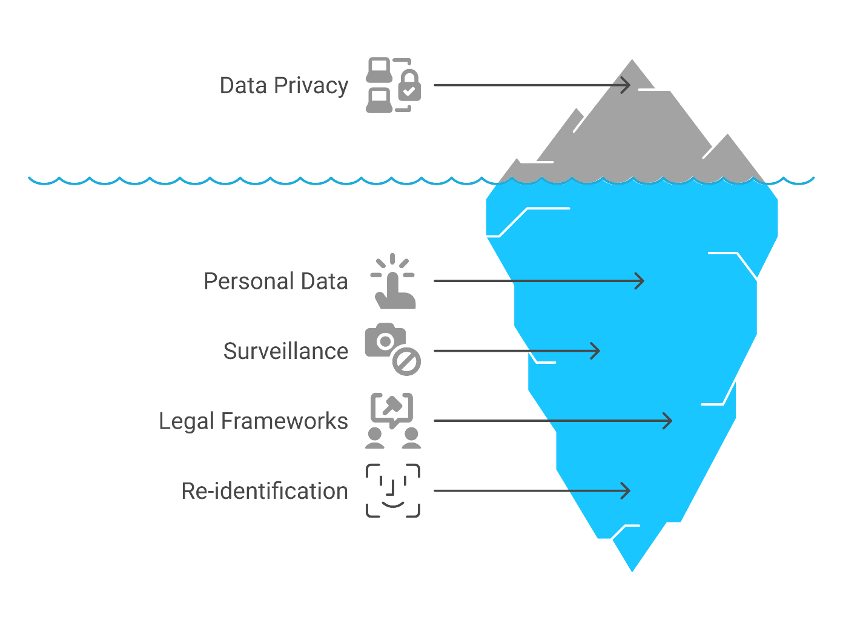
3. Challenges of Big Data in Transport
3.3 Privacy, Security, and Ethical Concerns
Personal Data Risks
Big data often includes personally identifiable information (PII): trip start/end, device ID, travel behavior.
Surveillance Worries
Public concern over being constantly tracked by smart city systems.
Legal & Ethical Frameworks
GDPR (Europe) & similar laws require user consent.
Data anonymization techniques must be implemented—but re-identification is still a risk.
15
Big Data in Transport

Slide 20
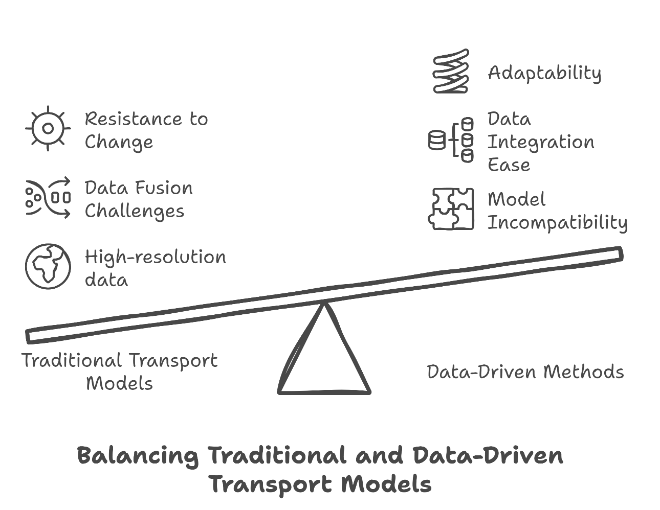
3. Challenges of Big Data in Transport
3.4 Integration with Traditional Transport Models
Model Incompatibility
Traditional models (e.g., 4-step models) are not designed for high-resolution, real-time data.
Data Fusion Challenges
Combining big data with historical or survey data is non-trivial.
Example: Matching floating car GPS data to OD matrices.
Resistance to Change
Legacy systems and outdated institutional frameworks slow down adoption of data-driven methods.
16
Big Data in Transport

Slide 21
Section 04:
Opportunities of Big Data in Transport
Big Data in Transport

Slide 22
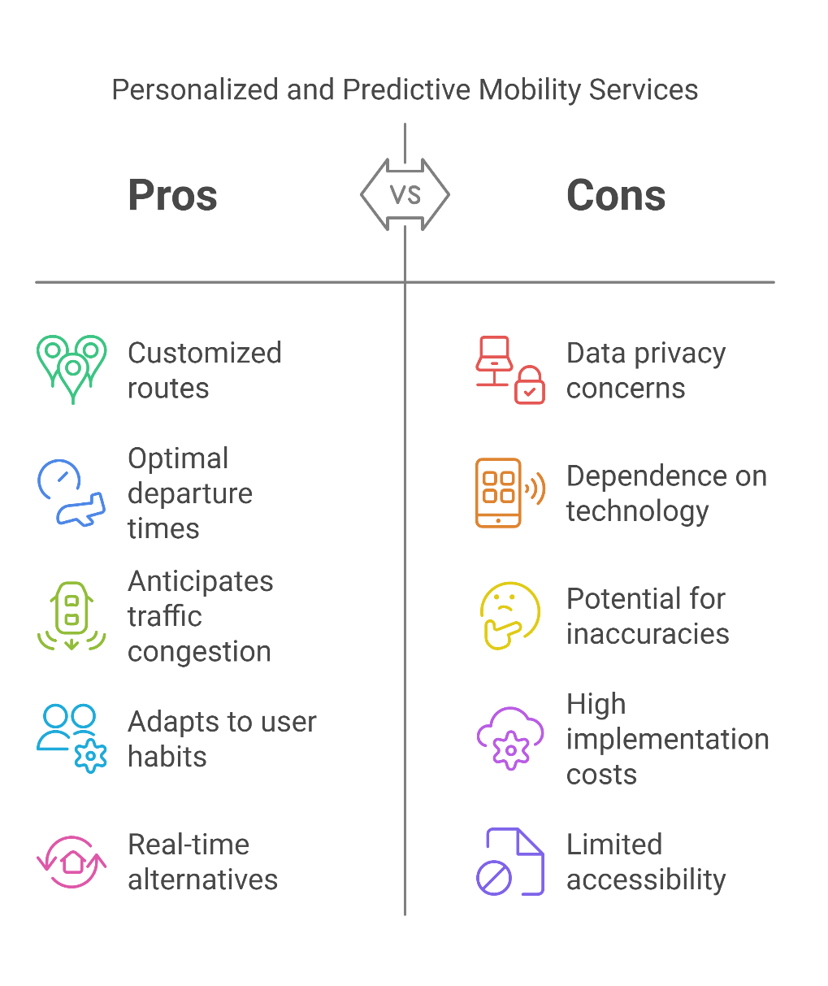
4. Opportunities of Big Data in Transport
4.1 Enabling Personalized and Predictive Mobility Services
Personalized Travel Experience
Big data allows platforms to recommend customized routes, departure times, or mode combinations based on user preferences and past behavior.
Predictive Capabilities
Machine learning models can anticipate:
i. Traffic congestion
ii. Ride-hailing demand surges
iii. Train/bus crowding patterns
Example: Apps like Google Maps or Transit suggest real-time alternatives when disruptions occur, adapting to individual habits.
18
Big Data in Transport

Slide 23
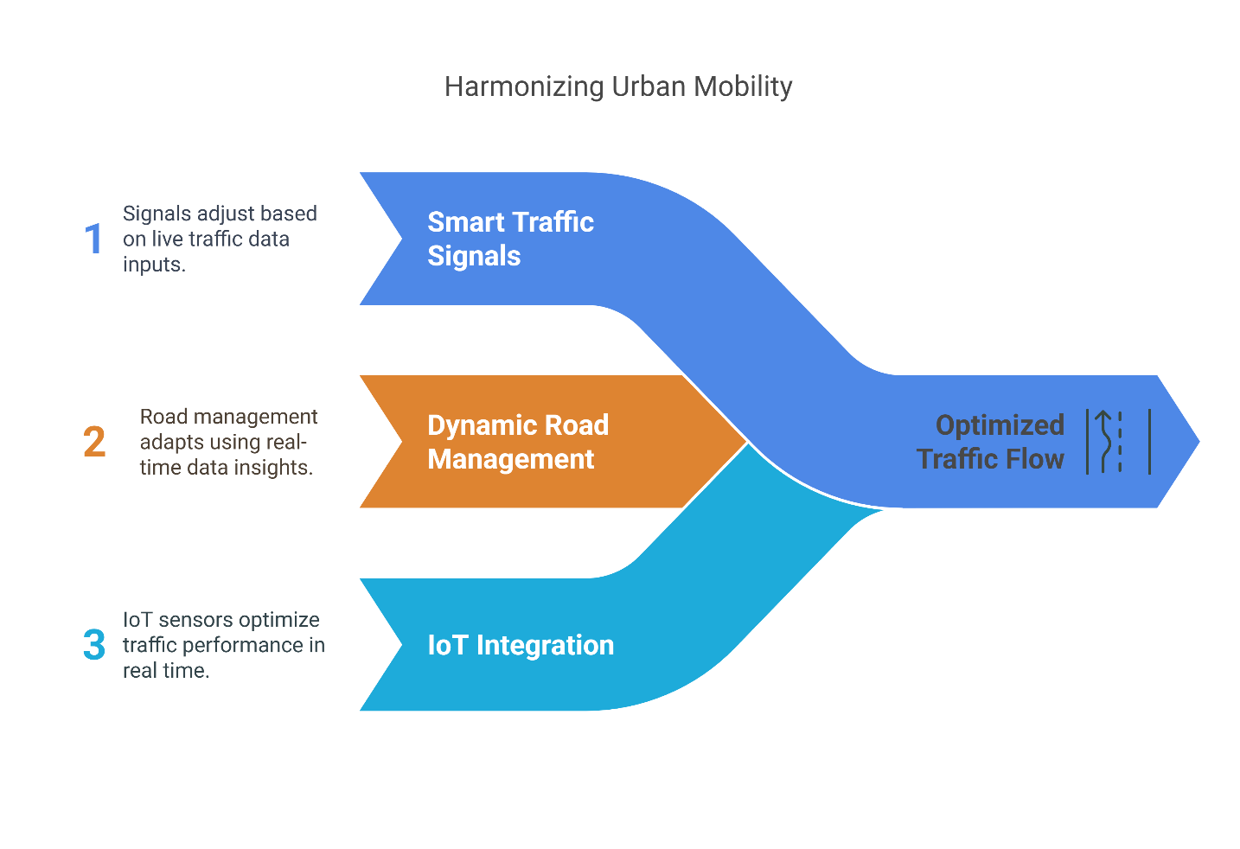
4. Opportunities of Big Data in Transport
4.2 Supporting Adaptive Traffic Control Systems
Smart Traffic Signals
Big data feeds real-time information into adaptive signal control systems that adjust based on live traffic volumes.
Dynamic Road Management
Lane reversals, dynamic tolling, and speed limit changes based on data insights improve flow and safety.
IoT Integration
Sensors embedded in roads, signals, and vehicles communicate to optimize performance in real time.
19
Big Data in Transport

Slide 24
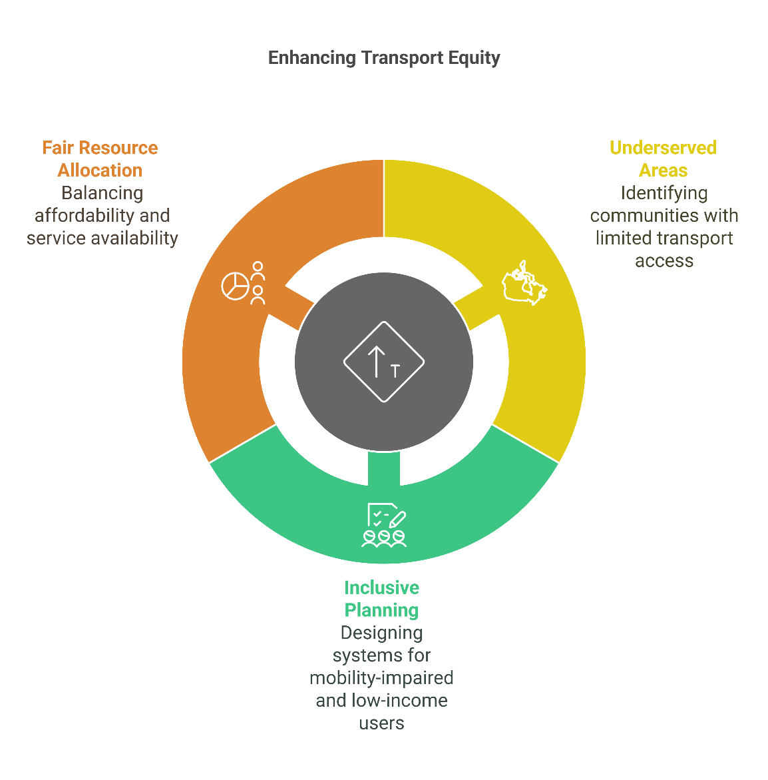
4. Opportunities of Big Data in Transport
4.3 Enhancing Equity and Accessibility in Transport
Identifying Underserved Areas
Analysis of travel behavior highlights communities with poor access to public transport, enabling targeted improvements.
Inclusive Planning
Data on mobility-impaired users or low-income households helps planners design more accessible and equitable systems.
Fair Resource Allocation
Dynamic pricing and service frequency can be adjusted to balance affordability and availability.
20
Big Data in Transport

Slide 25
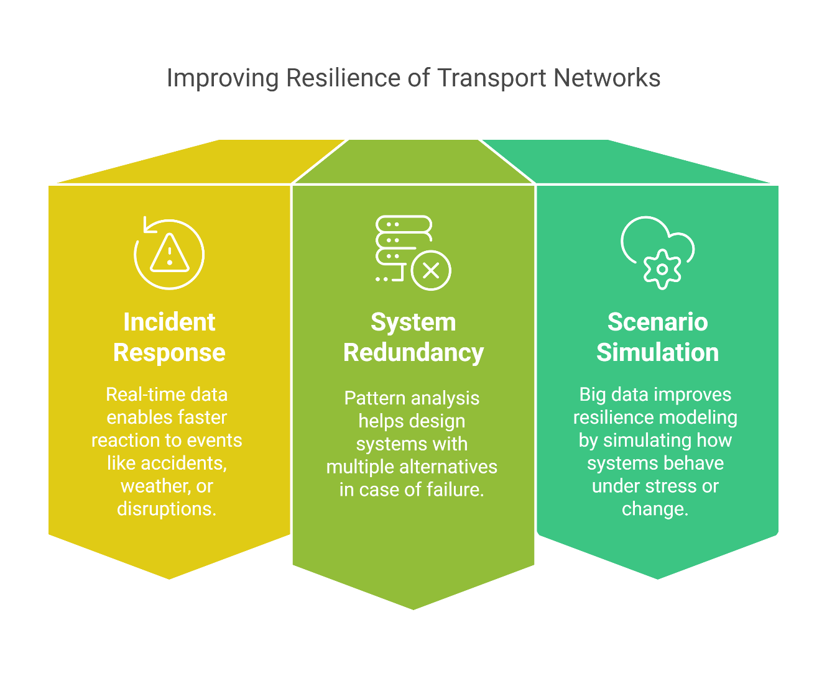
4. Opportunities of Big Data in Transport
4.4 Improving Resilience of Transport Networks
Incident Response & Recovery
Real-time data enables faster reaction to events like accidents, weather, or disruptions.
System Redundancy & Robustness
Pattern analysis helps design systems with multiple alternatives in case of failure.
Scenario Simulation
Big data improves resilience modeling by simulating how systems behave under stress or change.
21
Big Data in Transport

Slide 26
Section 05:
Benefits of Big Data in Transport
Big Data in Transport

Slide 27
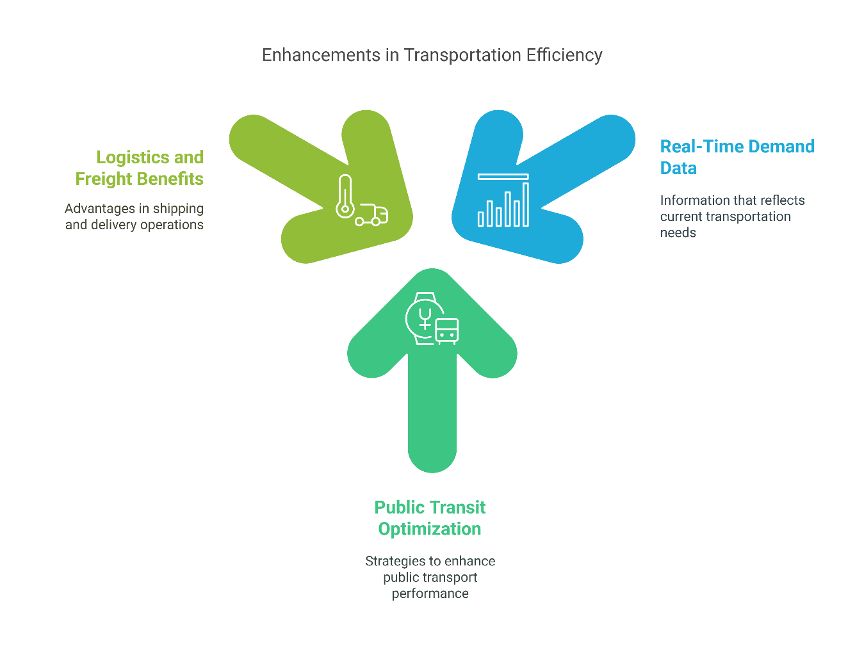
5. Benefits of Big Data in Transport
5.1 Improved Efficiency and Optimization
Data-Driven Operations
Transportation systems can dynamically adjust routes, frequencies, and resource allocation based on real-time demand.
Public Transit Optimization
Reduce idle times
Increase on-time performance
Optimize fleet usage
Logistics and Freight Benefits
Real-time routing minimizes fuel use and improves delivery timelines.
23
Big Data in Transport

Slide 28
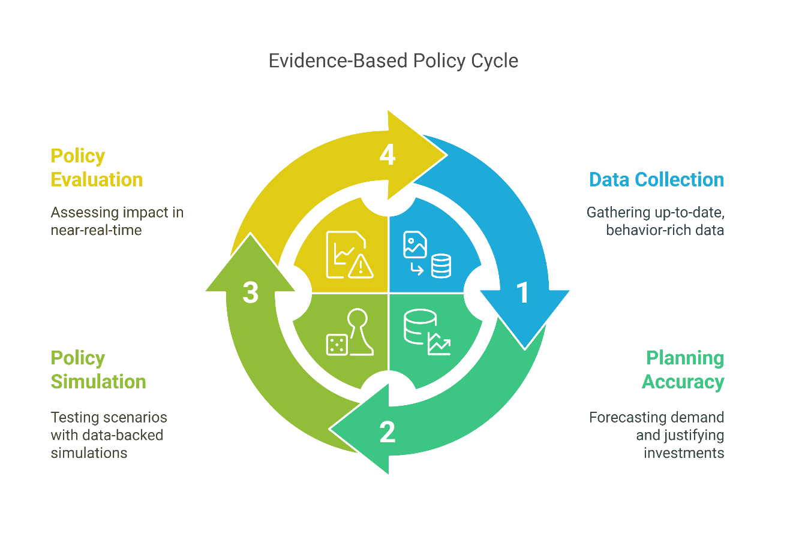
5. Benefits of Big Data in Transport
5.2 Better Policy-Making through Evidence-Based Insights
From Assumptions to Analytics
Traditional policy relied on surveys and historic trends—big data offers up-to-date, behavior-rich evidence.
Improves Planning Accuracy
Accurately forecast travel demand
Justify infrastructure investments
Evaluate the impact of policy changes in near-real-time
Policy Simulation & Evaluation
Test “what-if” scenarios using big data-backed simulations before actual implementation.
24
Big Data in Transport

Slide 29
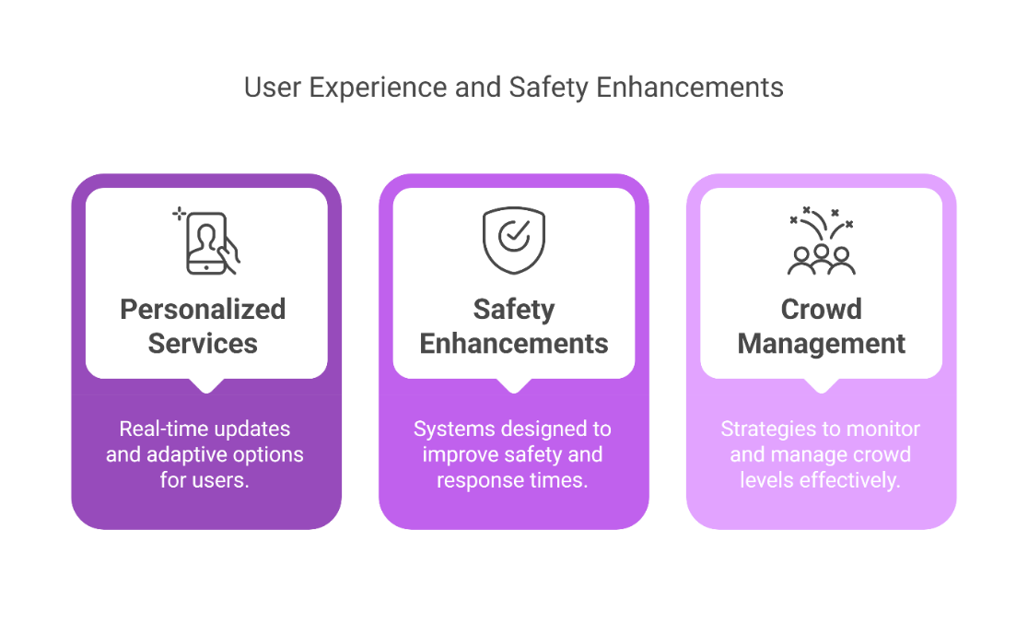
5. Benefits of Big Data in Transport
5.3 Enhanced User Experience and Safety
Personalized Services
Real-time updates on delays
Multimodal suggestions based on preferences
Adaptive ticketing options (e.g., daily fare caps)
Safety Enhancements
Predictive crash risk models
Early warning systems for driver fatigue or high-risk zones
Faster emergency response based on incident detection
Crowd Management
Monitor crowd levels at stations/events to reroute passengers and prevent dangerous congestion.
25
Big Data in Transport

Slide 30
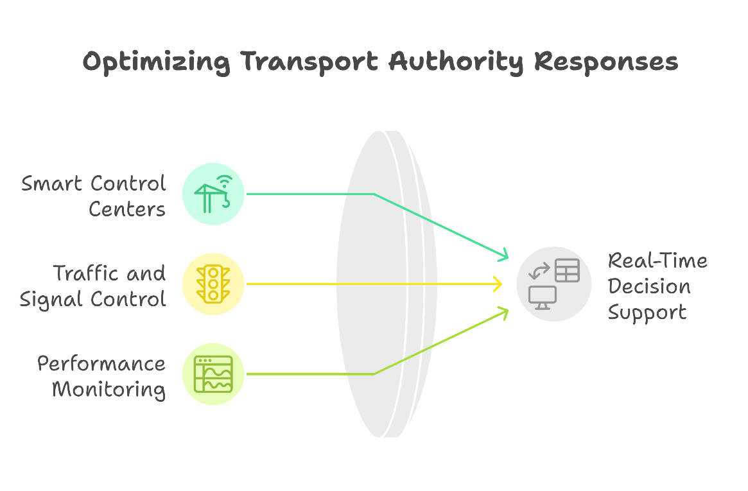
5. Benefits of Big Data in Transport
5.4 Real-Time Decision Support for Transport Authorities
Smart Control Centers
Centralized dashboards fed by live data streams empower rapid and informed responses to incidents.
Better Traffic and Signal Control
React instantly to congestion, traffic flow changes, and service delays.
Performance Monitoring
Authorities can benchmark and adjust operations across modes based on KPIs (Key Performance Indicators).
26
Big Data in Transport

Slide 31
Section 06:
Future of Big Data in Transport
Big Data in Transport

Slide 32
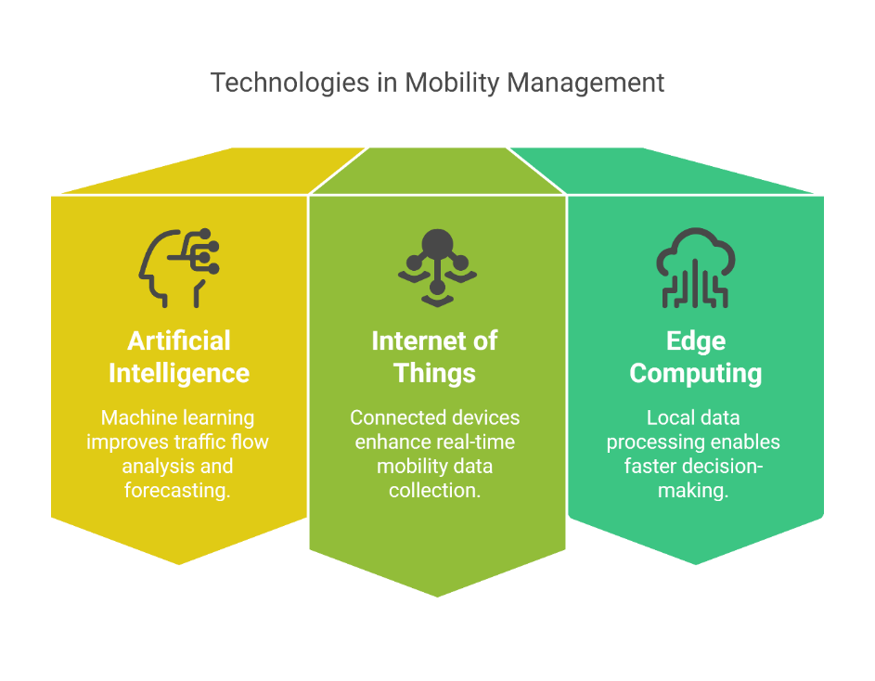
6. Future of Big Data in Transport
6.1 Definition
Artificial Intelligence (AI)
Machine learning enhances pattern recognition in traffic flows, anomaly detection, and demand forecasting.
Internet of Things (IoT)
Connected sensors on vehicles, infrastructure, and mobile devices create a rich data environment for real-time mobility management.
Edge Computing
Data is processed closer to the source (e.g., onboard vehicles or at traffic lights) to reduce latency and support ultra-fast decision-making.
28
Big Data in Transport

Slide 33
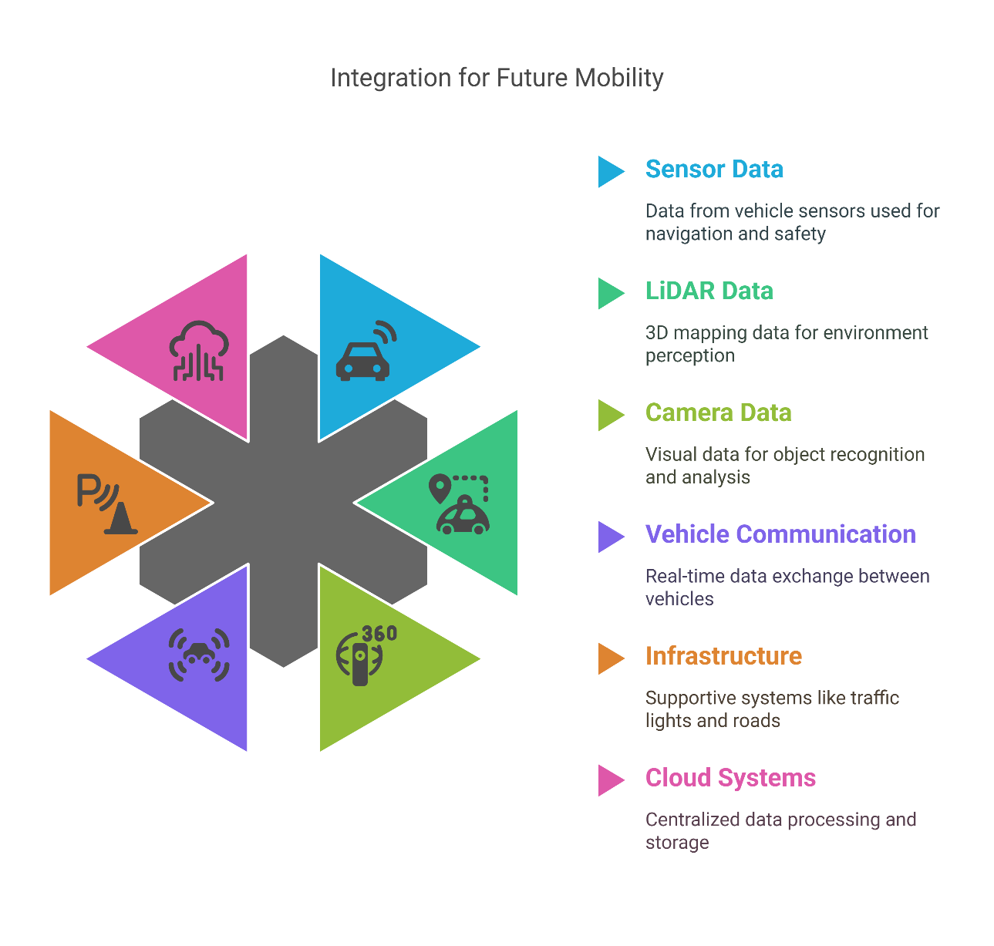
6. Future of Big Data in Transport
6.2 Autonomous Vehicles and Data Ecosystems
AVs as Data Generators
Self-driving cars produce massive streams of sensor, LiDAR, and camera data that feed into city-wide systems.
Vehicle-to-Everything (V2X)
AVs communicate with other vehicles, infrastructure, and the cloud for safer, coordinated mobility.
Ecosystem Collaboration
Future mobility depends on integration between OEMs, transport agencies, telecom providers, and tech companies.
29
Big Data in Transport

Slide 34
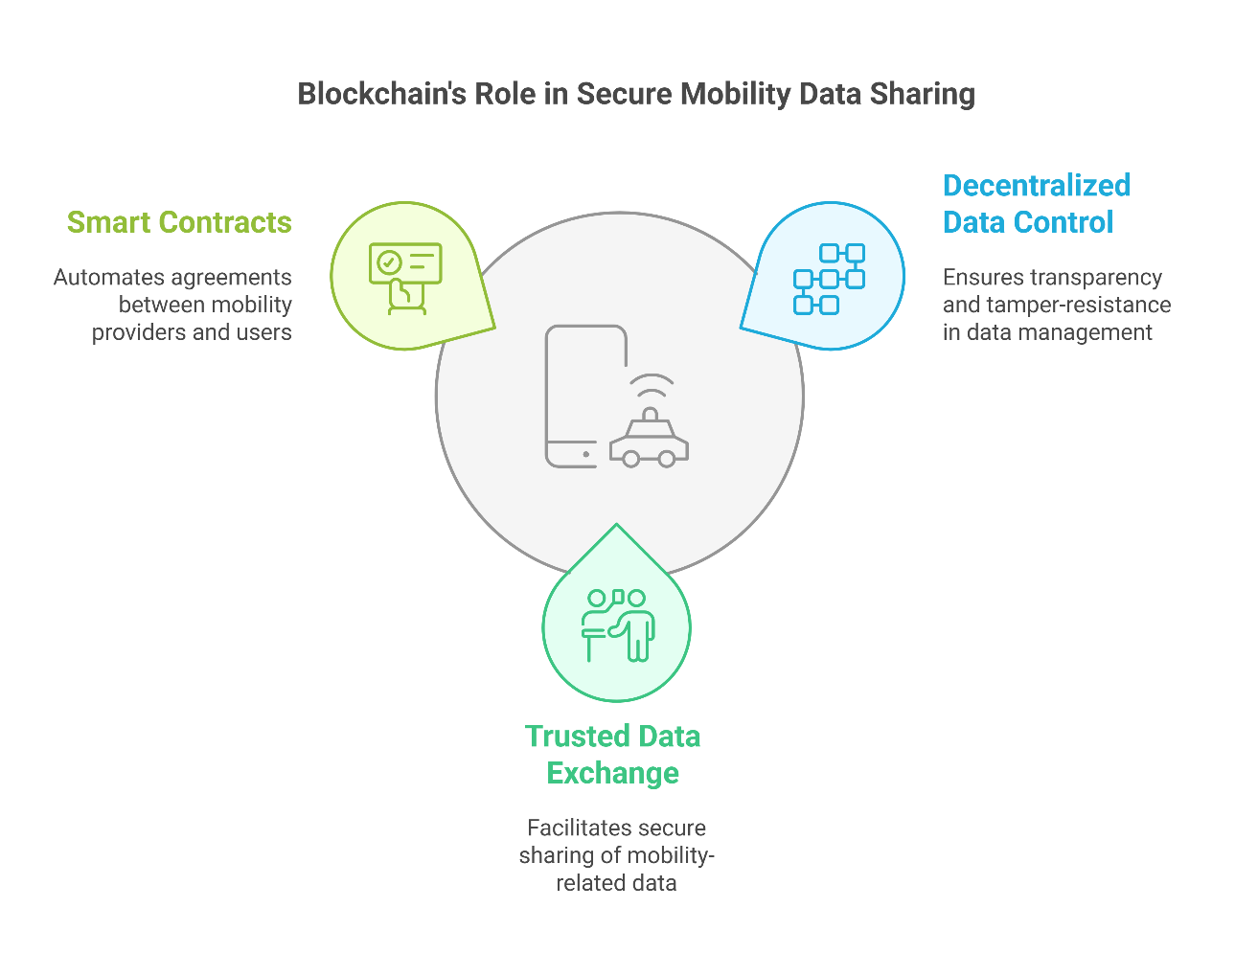
6. Future of Big Data in Transport
6.3 Predicting Travel Demand, Traffic Congestion, and Incidents
Decentralized Data Control
Blockchain offers a transparent and tamper-resistant system for managing mobility transactions and data ownership.
Trusted Data Exchange
Enables secure sharing of ridership, payment, and identity data across MaaS platforms and agencies.
Smart Contracts in Mobility
Automate service-level agreements between mobility providers and users.
30
Big Data in Transport

Slide 35
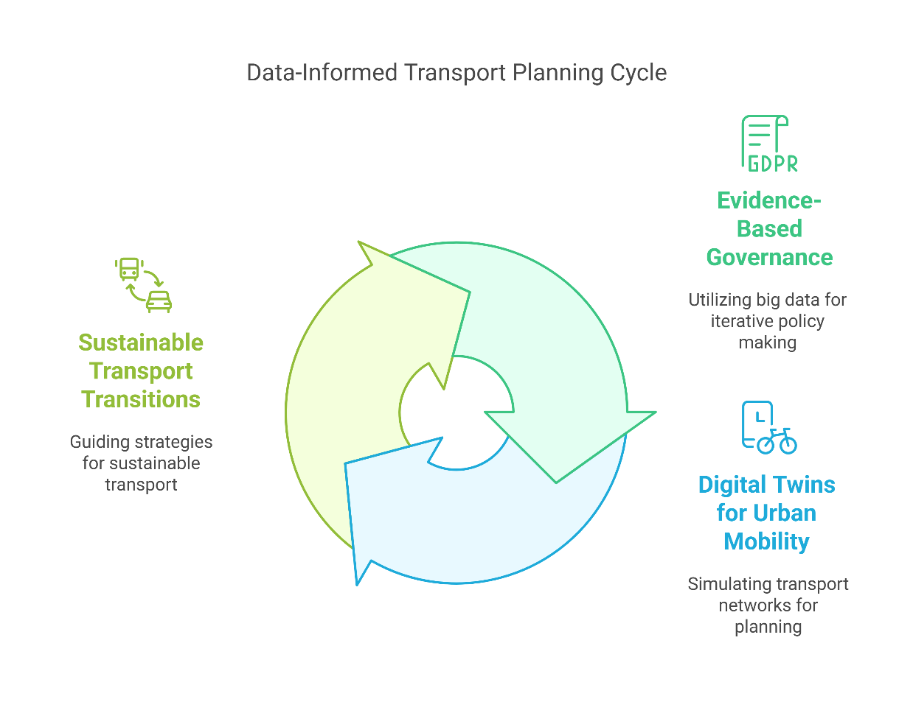
6. Future of Big Data in Transport
6.4 Data-Informed Transport Planning and Governance
Evidence-Based Governance
Big data enables iterative, data-driven policy making rather than one-off long-term plans.
Digital Twins for Urban Mobility
Simulate entire transport networks in real time using digital replicas for planning and experimentation.
Sustainable Transport Transitions
Data insights will guide equitable electrification, congestion pricing, and emissions reduction strategies.
31
Big Data in Transport

Slide 36
Section 07:
Quiz & Final Remarks
Big Data in Transport

Slide 37
7. Quiz & Final Remarks
7.1 Short Quiz
Question 1:
Which of the following is NOT one of the 5 Vs of Big Data?
a) Volume
b) Velocity
c) Variety
d) Validity
Question 2:
Name one application of big data in transport related to public safety.
Question 3:
True or False:
Big data eliminates the need for traditional transportation models.
Transport Data Collection and Management
33
Big Data in Transport
Notes:
Question 1:
Answer: d) Validity
Question 2:
Short Answer:
Real-time incident detection, crash hotspot analysis, predictive safety analytics, etc.
Question 3:
Answer: False
It complements but does not fully replace traditional models (yet).

Slide 38
7. Quiz & Final Remarks
7.1 Short Quiz
Question 4:
What technology enables data to be processed closer to the source (e.g., at traffic lights)?
Question 5:
Which of the following is a benefit of using big data in transportation planning?
a) Reduced service personalization
b) Slower response to incidents
c) Improved efficiency and real-time decision making
d) Higher congestion
Question 6:
List one ethical or privacy concern related to big data in transport.
Transport Data Collection and Management
34
Big Data in Transport
Notes:
Question 4:
Answer: Edge Computing
Question 5:
Answer: c) Improved efficiency and real-time decision making
Question 6:
Short Answer:
Location tracking without consent, risk of re-identifying anonymized data, data misuse, etc.

Slide 39
7. Quiz & Final Remarks
7.2 Summary of Key Points
Big Data is transforming transport systems with real-time, high-volume, high-variety data.
Applications span from traffic optimization to personalized mobility to resilient infrastructure.
Challenges include data quality, privacy, and integration with legacy systems.
The future is AI-driven, decentralized, and reliant on secure, scalable data platforms.
“Data is the new fuel – but how we refine and use it determines how far we go.”
Transport Data Collection and Management
35
Big Data in Transport

Slide 40
7. Quiz & Final Remarks
7.3 Final Thoughts and Discussion
💬 Class Discussion Prompt:
How should cities balance the benefits of big data with the need for individual privacy?
👥 Encourage 2–3 students to share thoughts or examples.
📌 Closing Note:
As future engineers and planners, your role isn’t just to use data—but to use it responsibly, intelligently, and equitably.
Transport Data Collection and Management
36
Big Data in Transport
Notes:
1. Define transportation data and provide two examples.
Transportation data refers to information related to the movement of people, vehicles, and goods within a transport system. Examples include traffic flow data (e.g., vehicle counts, speeds) and transit ridership data (e.g., passenger counts on public transport).
2. What is the primary purpose of descriptive analysis in transportation?
To summarize and interpret historical data to understand past and current trends within transportation systems, aiding in informed decision-making.
3. Name two statistical methods used in inferential analysis.
Hypothesis testing and confidence intervals.​
4. How does time-series analysis benefit transportation forecasting?
By examining data points collected at specific time intervals, it helps identify trends and patterns, enabling accurate predictions of future transportation conditions.
5. Provide an example of how predictive analysis can improve traffic management.
Predictive analysis can forecast traffic congestion, allowing for dynamic traffic signal adjustments to reduce congestion and improve flow.

