Slide 1
Transport Research and Analysis
Module 2: Transport Data Collection and Management
Lecture 7: Data Management and Cleaning in Transportation Research
Notes:
"Good morning, everyone. Welcome back. In our last lecture, we focused on the diverse methods of data collection. Today, in Lecture 7, we address the critical next step: Data Management and Cleaning. This is arguably one of the most important, yet often overlooked, stages in the research process. It's here that we transform raw, messy, and often untrustworthy data into a high-quality, reliable asset that can support robust analysis and lead to credible conclusions. What we do in this stage determines the validity of everything that follows. Over the next 135 minutes, we will cover the principles, strategies, and tools that are essential for this transformative process. Let's begin."

Slide 3
Table of contents
Data Management and Cleaning in Transportation Research
00: Introduction & Objectives……...................................4
0.0. Lecture Overview......................................................5
0.1. Connection to Previous Lecture................................6
0.2. Learning Objectives…………………………………....7
01 The Imperative for Data Management........................8
1.0. Defining Our Terms...................................................9
1.1. The "Dirty Data" Problem….....................................10
1.2. Why Data Management Matters..............................11
1.3. Sources of Complexity............................................12
1.4. The Impact of Raw Data Problems.........................13
1.5. Introduction to the Workflow....................................14
02 Preparing the Foundation.........................................15
2.0. Data Storage Solutions...........................................16
2.1. Key Storage Considerations……..……………..……17
2.2. Common Data Formats & Storage Systems.....…...18
2.3. Activity 1: Choosing a Storage Solution……...........19
2.4. Transition to Data Cleaning………………………….20
03 The Core Workflow..................................................21
3.0. The Data Cleaning Process...................................22
3.1. Common Data Issues in Detail………..……………23
3.2. A Strategic Approach to Cleaning............…………24
3.3. Method 1: Deduplication……….............................25
3.4. The Deduplication Process in Practice…………….26
3.5. Method 2: Format Standardization.........................27
3.6. Standardization in Practice....................................28
3.7. Method 3: Handling Outliers..................................30
3.8. Method 4: Ensuring Data Type Consistency..........31
3.9. Choosing the Right Tool: Excel vs. Code...............32
3.10. Automating the Process: Key Libraries................33
04 Ensuring Integrity....................................................34
4.0. Handling Missing Data……………………………....35
4.1. Types of Missing Data...........................................36
4.2. Strategies for Handling Missing Data……..……….37
4.3. A Decision-Making Process for Missing Data........38

Slide 4
Table of contents
Data Management and Cleaning in Transportation Research
4.4. Activity 2: Group Discussion on Missing Data.........39
4.5. Data Validation: The Final Quality Check................40
4.6. The Data Validation Cycle.......................................40
4.7. Common Validation Checks in Detail......................41
4.8. Case Study 1: Validating Traffic Sensor Data.........43
4.9. Case Study: Validation Flowchart...........................45
4.10. Tools for Automating Validation............................46
4.11. Example Validation Routine: Station IDs...............47
05: Synthesis, Application, and Conclusion................48
5.1. Reflective Q&A........................................................49
5.2. Quick Quiz..............................................................50
5.3. Quiz Answers & Discussion....................................51
5.4. Conclusion & Key Takeaways.................................52
5.5. Final Reflection.......................................................53
5.6. References & Further Reading………..………........54

Slide 5
Section 00:
Introduction and Objectives
Notes:
Section 00: Introduction and Objectives

Slide 6

00. Introduction & Objectives
0.0. Lecture Overview.
Lecture Roadmap
The Imperative for Data Management: Why "clean" data is the foundation of trustworthy research.
Preparing the Foundation: Correctly storing and structuring your data.
The Core Workflow: A step-by-step guide to the data cleaning process.
Ensuring Integrity: Handling missing data and performing data validation.
Synthesis & Application: Bringing it all together.
Notes:
"To give you a clear map of where we're going today, here is our agenda. We will begin by establishing the imperative for data management, answering the fundamental question of why this process is so critical in transportation research.
Next, we'll move into the first practical phase: preparing the foundation. Before we can clean, we must ensure our data is stored correctly and structured logically.
Then, we will dive into the core of the lecture: the data cleaning workflow. This will be a detailed, step-by-step guide to the techniques you'll use to identify and fix common data quality issues.
After that, we will cover two advanced but essential topics for ensuring data integrity: what to do when data is missing, and how to validate your final dataset to certify its accuracy.
Finally, we will conclude with a synthesis and application section, where we’ll reinforce these concepts with a few practical exercises and summarize our key takeaways. This structure is designed to build your skills logically, from the conceptual to the practical."

Slide 7
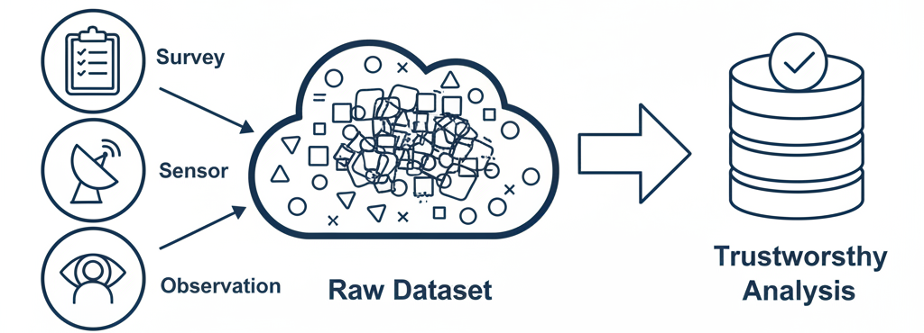
00. Introduction & Objectives
0.1. Connection to Previous Lecture.
Recap: Data Collection
  We examined various data collection methods (surveys, sensors/GPS, observational).
  These methods produce large, complex, and often "raw" datasets.
Today's Goal: From Raw Data to Reliable Insights
  Our focus now is to manage and clean these datasets to ensure our analysis is trustworthy and accurate.
Notes:
"Let's explicitly connect today's topic to our previous lecture. Last time, we explored the many ways we collect transportation data—from asking people in surveys, to passively tracking movement with GPS, to observing behavior at an intersection. The common result of all these methods is the generation of raw data.
And raw data, by its very nature, is rarely perfect. It contains errors, inconsistencies, and gaps. Therefore, our goal today is to bridge that critical gap between the raw data we collect and the reliable insights we need to generate. We are shifting our focus from the collection of information to the curation and preparation of that information for analysis. Without this step, even the best-collected data can lead to flawed conclusions."

Slide 8
00. Introduction & Objectives
0.2. Learning Objectives.
By the end of this lesson, you should be able to:
Recognize why data management is critical in transportation research.
Identify suitable data storage solutions and decide when to use each.
Apply basic data cleaning strategies to improve dataset quality.
Handle missing data responsibly using domain-appropriate techniques.
Validate data to ensure accuracy before in-depth analysis.
Notes:
"To be very clear about what we aim to accomplish, here are the key skills you should have by the end of this lecture.
First, you will be able to articulate why data management is a non-negotiable part of the research process.
Second, you will be able to evaluate different data storage options and make an informed choice based on a project's needs.
Third, and this is the core of our lecture, you will be able to apply fundamental data cleaning techniques to fix common errors.
Fourth, you will understand the different types of missing data and learn a framework for how to handle them responsibly.
And finally, you will be able to perform validation checks to certify that your data is accurate and ready for analysis. These objectives form a complete workflow, from storing the raw data to producing a final, validated dataset."

Slide 9
Section 01:
The Imperative for Data Management
Notes:
Section 01: The Imperative for Data Management

Slide 10
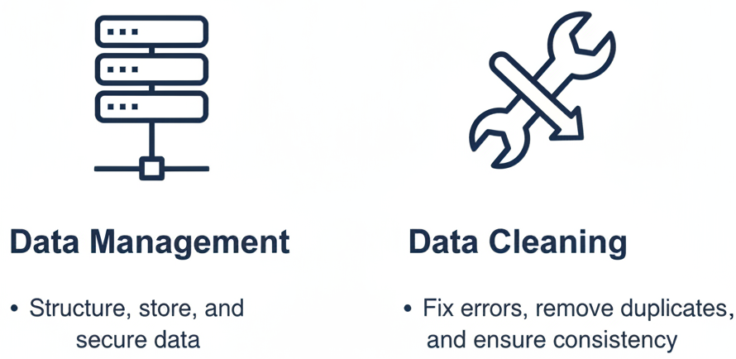
01. The Imperative for Data Management
1.0. Defining Our Terms.
Management vs. Cleaning:
Data Management:
  The systematic process of organizing, storing, securing, and documenting datasets to ensure their integrity, accessibility, and long-term reliability.
Data Cleaning:
  The process of detecting and correcting incomplete, inaccurate, or irrelevant data to ensure data quality and consistency.
Notes:
"Before we proceed, let's establish precise definitions for our two core topics, as they are related but distinct.
Data Management is the big picture. It's the high-level strategy and infrastructure you put in place for the entire lifecycle of your data. This includes how you organize your files, where you store them, what security measures you implement, and, critically, how you document everything so that someone else—or you, five years from now—can understand and use the data. Think of it as the architecture and library science of your research project.
Data Cleaning, on the other hand, is a specific, hands-on process that happens within the larger framework of data management. It's the technical work of going into a dataset and fixing what's wrong—correcting errors, filling in gaps, and removing inconsistencies. It is the janitorial work, the repair work, and the quality control that makes the data actually usable.
So, management is the overall system; cleaning is a key activity within that system."

Slide 11
01. The Imperative for Data Management
1.1. The "Dirty Data" Problem: Common Quality Issues
Raw data is rarely perfect. Some common issues include:
  Inconsistency: Variations in data formats, units, or naming conventions (e.g., "Street" vs. "St.").
  Missing Values: Gaps in the data resulting from sensor downtime or incomplete survey entries.
  Outliers & Anomalies: Implausible or erroneous values that skew analysis (e.g., a bus trip duration of -10 minutes).
  Duplicates: Repeated records that cause redundancy and inflate counts.
  Volume: The sheer size of modern datasets presents significant storage and processing challenges.
  Outliers and Anomalies: GPS glitches and unrealistic values can skew data analysis.
Notes:
"So why is this process so necessary? Because raw transportation data is inherently 'dirty.' Let's identify the usual suspects—the common data quality issues we are trying to fix.
Inconsistency is a major one. One dataset might record speed in miles per hour, while another uses kilometers per hour. One part of a database might use 'St.' for street, while another writes out the full word. These variations can break our analysis if not standardized.
Missing values are unavoidable. A traffic sensor might have a power outage, or a survey respondent might skip a question. These gaps can lead to biased models if not handled correctly.
We also frequently encounter Outliers and Anomalies. These are data points that are clearly errors, like a GPS glitch reporting a vehicle speed of 500 kilometers per hour, or a negative trip duration. These extreme values can dramatically skew statistical measures like averages.
Duplicates are also common, where the same trip or record is logged multiple times, which can artificially inflate our counts and lead to incorrect conclusions.
Finally, the sheer Volume of data from sensors and GPS is a challenge in itself, requiring powerful tools just to open and inspect the files, let alone clean them. Our job in data cleaning is to hunt down and resolve each of these issues systematically."

Slide 12
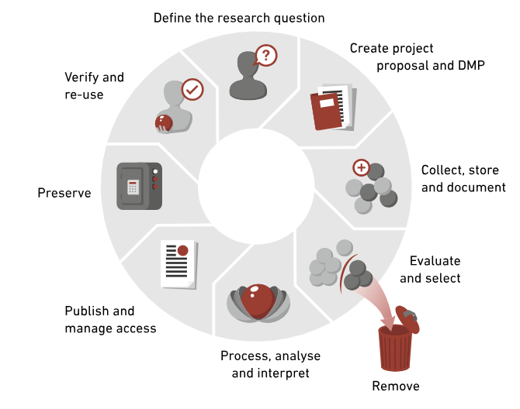
01. The Imperative for Data Management
1.2. Why Data Management Matters: The Lifecycle
Good data management is a continuous process, not a single step.
Key Benefits:
  Reduces errors and improves study reliability.
  Ensures data remains usable in the long term.
  Improves collaboration among team members.
  Prevents accidental and irreversible data loss.
Source: ETH Zurich Library, "The Research Data Life Cycle."
Notes:
"Given these challenges, effective data management becomes absolutely essential. It's not something you do once at the end of a project; it's a continuous process that adds value at every stage of the research lifecycle, as shown in this diagram.
By managing each stage carefully—from creating the project plan, to collecting and processing the data, to preserving it for the future—we gain several critical benefits. Most obviously, it reduces errors and dramatically improves the reliability of our study. It ensures that the data we collect today remains usable in the long term, so it can be re-analyzed or verified years from now. It makes collaboration easier, because a well-documented dataset can be understood and used by other team members or future researchers. And critically, it prevents accidental data loss through version control and proper backup procedures. In short, good data management is the professional standard that separates rigorous, reproducible research from unreliable, one-off analyses."

Slide 13

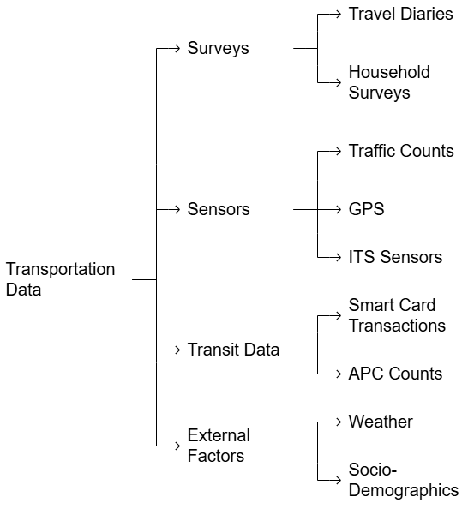
01. The Imperative for Data Management
1.3. Sources of Complexity.
Multiple data sources lead to varied formats, structures, and quality levels, which increases the complexity of data management and cleaning.
Notes:
"The challenges we've discussed are compounded by the sheer diversity of our data sources. As this diagram illustrates, a typical transportation study doesn't rely on a single dataset.
We might have survey data from travel diaries, sensor data from GPS and traffic counts, transit data from smart card transactions, and external factors like weather and socio-demographics.
Each of these sources comes with its own unique structure, format, and potential quality issues. The survey data is text-heavy, the GPS data is spatial, and the sensor data is a time-series. Integrating these disparate sources is a major challenge and is a primary reason why a systematic approach to data management is so crucial. The complexity of our data requires a corresponding sophistication in how we manage it."

Slide 14
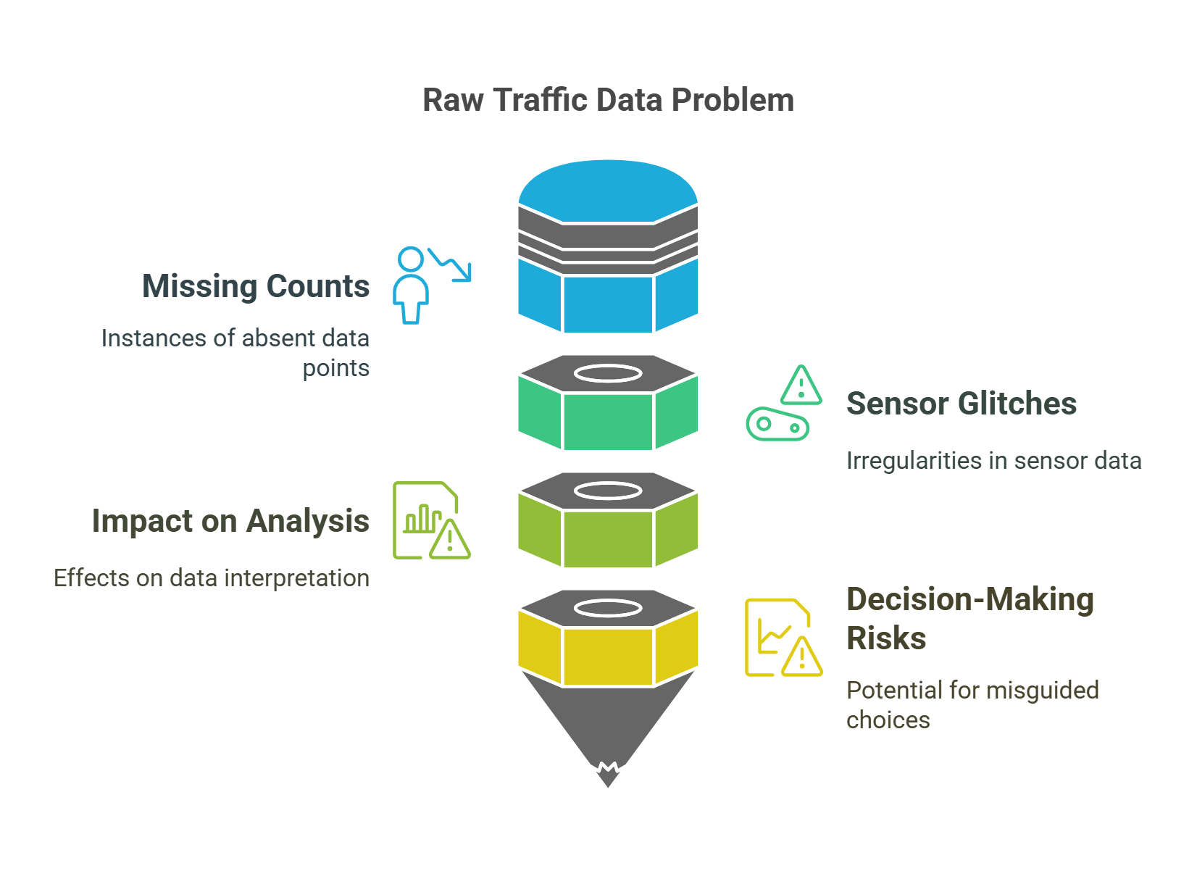
01. The Imperative for Data Management
1.4. The Impact of Raw Data Problems
Raw data is a liability. Using it directly leads to:
Resulting in an underestimation of demand or activity.
Introducing impossible values (outliers) that distort statistics.
Skewed results and flawed interpretations.
Potential for misguided, costly policy or investment choices.
Notes:
"So, let's put this all together with a concrete example to illustrate the real-world consequences of failing to clean our data.
Imagine you are analyzing traffic data from a set of road sensors. In its raw form, this data is a liability. Missing counts from a sensor that temporarily went offline will cause you to underestimate traffic volume, which could lead you to incorrectly conclude that a road is under-utilized. Sensor glitches might report a few cars traveling at impossible speeds, which would artificially inflate the average speed for the entire road segment, masking a real congestion problem.
The cumulative result is a significant negative impact on your analysis. Your summary statistics will be wrong, and your interpretations will be flawed.
This leads directly to severe decision-making risks. If you use this dirty data to make recommendations, you could end up advising against a needed road upgrade or investing in a solution that doesn't address the real problem. This is how small data errors can cascade into multi-million-dollar policy mistakes. This is why we clean our data."

Slide 15
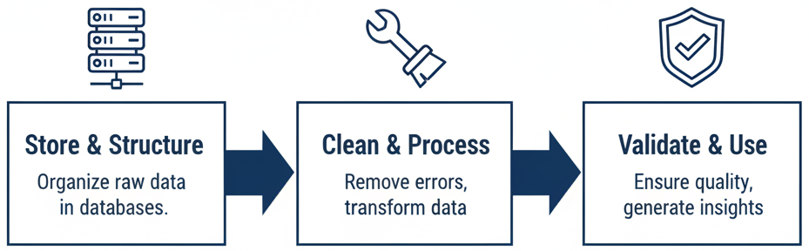
01. The Imperative for Data Management
1.5. Introduction to the Workflow
From Problem to Solution: A Three-Stage Workflow
  Stage 1: Store & Structure
    Choose the right storage solution and understand your data's format.
  Stage 2: Clean & Process
    Systematically identify and fix errors, inconsistencies, and duplicates.
  Stage 3: Validate & Use
    Perform final checks to ensure data integrity and prepare for analysis.
Notes:
"Now that we have firmly established the 'why,' we will spend the rest of the lecture focusing on the 'how.' We will approach this as a structured, three-stage workflow that will guide you from a raw, messy dataset to a clean, analysis-ready product.
Stage 1 is Store & Structure. This is the foundational phase where we make critical decisions about how to house our data, which will impact everything that follows.
Stage 2 is the core of the work: Clean & Process. Here, we will roll up our sleeves and execute the step-by-step techniques to fix the data quality issues we identified.
Stage 3 is the final gatekeeper: Validate & Use. In this last stage, we run a series of checks to certify the quality of our cleaned data before finally releasing it for in-depth analysis.
We will now proceed through this workflow stage by stage, beginning with the critical first step: data storage."

Slide 16
Section 02:
Preparing the Foundation: Data Storage & Structure
Notes:
Section 02: Preparing the Foundation: Data Storage & Structure

Slide 17
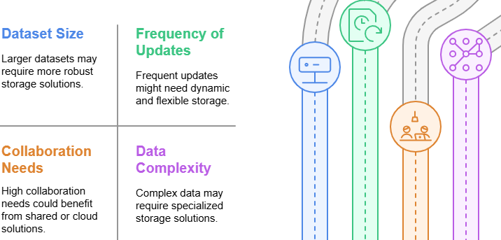
02. Preparing the Foundation: Data Storage & Structure
2.0. Data Storage Solutions
Choosing the right storage is the first critical decision in data management.
Key Factors Influencing Your Choice:
Dataset Size: Larger datasets require more robust, scalable solutions than simple spreadsheets.
Frequency of Updates: Datasets that are updated in real-time need more dynamic storage than static files.
Collaboration Needs: Projects with multiple users require shared, cloud-based, or server-based solutions.
Data Complexity: Complex, multi-table datasets are best handled by relational databases.
Notes:
"We now begin Stage 1 of our workflow: preparing the foundation. Before any cleaning can happen, we must decide where and how our data will live. This is not a trivial choice; the storage solution you select can either facilitate or frustrate your entire research process.
There are four key factors you must consider. First, Dataset Size. A small survey might fit comfortably in an Excel file, but terabytes of sensor data will overwhelm a personal computer and require a more powerful solution.
Second, the Frequency of Updates. Is this a one-time data dump, or is it a live feed of transit data that is constantly being appended? Real-time data requires a system, like a database, that can handle frequent writes efficiently.
Third, Collaboration Needs. Are you a solo researcher, or are you part of a team that needs simultaneous access to the data? Collaboration necessitates a shared environment, like a cloud storage platform or a centralized database.
Finally, Data Complexity. Is your data in a single, flat table, or is it a complex collection of related tables, like a set of transit schedules with linked tables for routes, stops, and trips? This level of complexity is where relational databases become essential.
Thinking through these four factors will guide you to the most appropriate storage solution for your project."

Slide 18
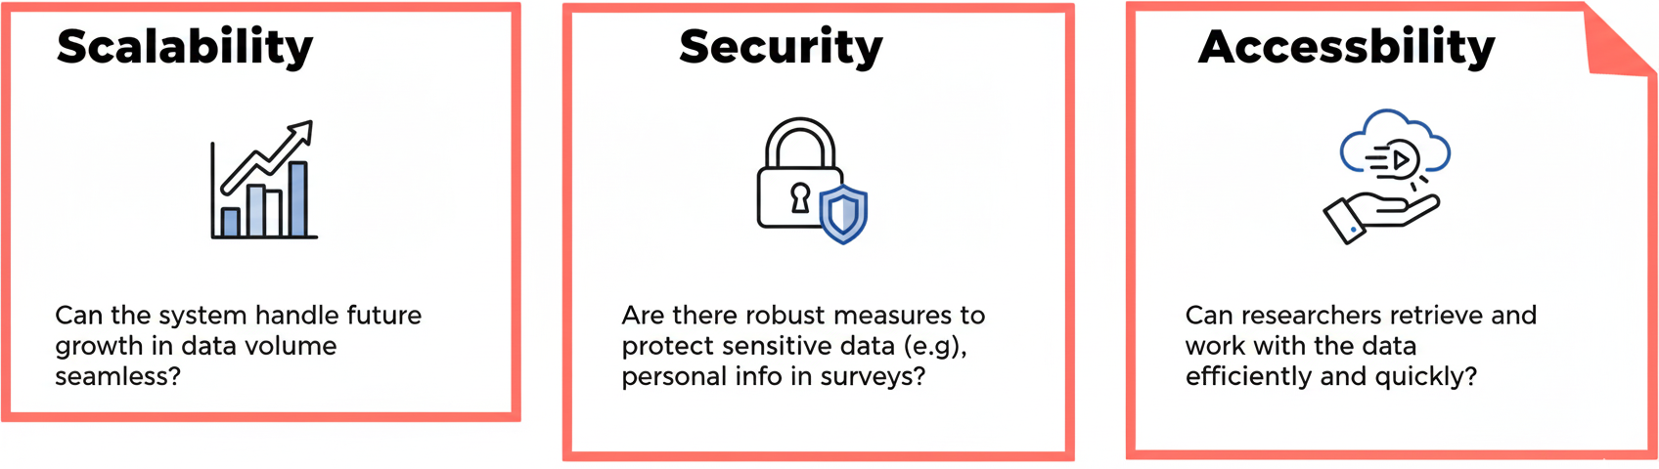
02. Preparing the Foundation: Data Storage & Structure
2.1. Key Storage Considerations
Three principles should guide your choice of a storage solution:
Accessibility
Can the system handle future growth in data seamlessly?
Notes:
"As you evaluate your options based on those four factors, three core principles should always be at the forefront of your mind: Scalability, Security, and Accessibility.
First, Scalability. Your chosen solution must be able to grow with your project. Transportation datasets rarely get smaller. A system that works for one year of data might fail when you try to add a second. Good solutions are scalable, meaning they can handle this increasing volume without a significant drop in performance.
Second, Security. This is non-negotiable, especially when dealing with data that contains personally identifiable information. Your storage system must have features to protect against unauthorized access, such as encryption and user access controls. This is a key part of our ethical responsibility as researchers.
Finally, Accessibility. A perfectly secure and scalable system is useless if researchers can't actually get the data they need in a timely manner. The system should allow for efficient querying and data retrieval. The goal is to make the data available to authorized users with minimal friction. A great storage solution balances these three principles effectively."

Slide 19
02. Preparing the Foundation: Data Storage & Structure
2.2. Common Data Formats & Storage Systems
Data Type | Pros | Cons
File-Based (Excel, CSV, JSON) | Simple, human-readable. | Not ideal for large datasets; poor for collaboration.
Relational Databases (SQL: MySQL, PostgreSQL) | Structured storage; efficient queries; ensures data integrity. | Requires database knowledge; less flexible schema.
NoSQL Databases (MongoDB, etc.) | Flexible with unstructured data. | Can be too unstructured; requires careful management.
Cloud Storage (AWS, Google, Azure) | Highly scalable; built for collaboration and real-time data. | Costs can escalate; potential privacy/security concerns.
Notes:
"So, what are the actual options? They generally fall into these four categories.
First, we have simple File-Based storage, like CSVs or Excel spreadsheets. These are great for small, simple datasets. They're easy to open, read, and understand. However, they struggle with large files and are very poor for collaboration, often leading to version control nightmares.
Next are Relational Databases, which use SQL (Structured Query Language). These are the workhorses of data management. They are excellent for storing structured data in related tables, and they have powerful features to enforce data integrity. The main drawback is that they require some specialized knowledge to set up and query.
A newer alternative is NoSQL Databases. These are much more flexible and are designed to handle unstructured or semi-structured data. However, this flexibility can be a double-edged sword, as it puts more responsibility on the user to manage consistency.
Finally, Cloud Storage platforms like Amazon Web Services or Microsoft Azure offer nearly infinite scalability and are designed for real-time data and collaboration. The main considerations here are managing costs and ensuring your data security and privacy policies align with storing data on a third-party server.
The progression from files to databases to the cloud generally follows the increasing scale and complexity of a project."

Slide 20
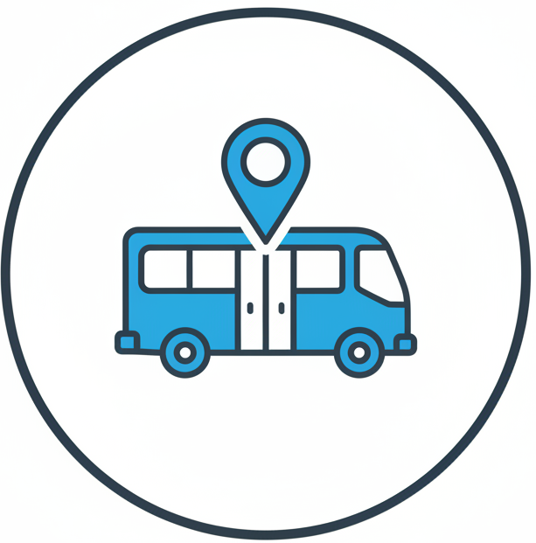
02. Preparing the Foundation: Data Storage & Structure
2.3. Activity 1: Choosing a Storage Solution
Scenario: You are part of a team collecting bus arrival data from GPS trackers at 1,000 bus stops. The data is collected daily, and the project will run for one year.
Prompt: Which storage solution fits best and why?
Instructions:
  Discuss in pairs (2 minutes).
  Consider: Data Volume, Collaboration Needs, and Cost.
  Be prepared to share your reasoning.
Notes:
"Alright, let's pause for a moment and apply this. I want you to get into pairs.
Here's the scenario: You're on a research team that is collecting daily GPS data on bus arrivals. You're tracking 1,000 bus stops, and the project will last for at least a year.
Based on what we've just discussed, which type of storage solution do you think would be most appropriate? Think about the factors we've covered: the sheer volume of data you'll accumulate, the fact that you're working in a team, and the potential costs.
Take two minutes to discuss this with your partner, and then I'll ask a few groups to share their conclusions and, more importantly, their reasoning."
(Facilitate the activity, then guide the class discussion. The ideal answer would lean towards a Relational Database (SQL) for its structure and query capabilities, likely hosted on a Cloud platform for scalability and collaboration, ruling out simple file-based storage due to the data volume and collaborative nature of the project.)

Slide 21
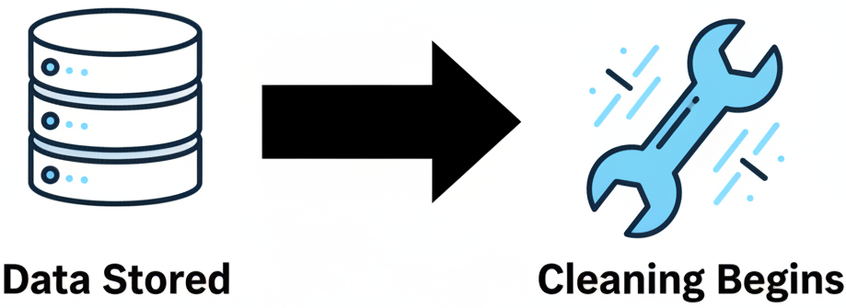
02. Preparing the Foundation: Data Storage & Structure
2.4. Transition to Data Cleaning
Stage 1 Complete: Data is Stored
Next: Stage 2 - The Core Cleaning Workflow
"Once data is properly stored and structured, the process of refining its quality can begin."
Notes:
"Excellent. That discussion shows you're already thinking like data managers. You've considered the scale and collaborative needs of a project to choose an appropriate storage foundation.
That completes Stage 1 of our workflow. We've successfully stored our data.
Now, we transition to Stage 2, which is the heart of today's lecture: the Core Cleaning Workflow. Having our data in a suitable system is a prerequisite, but it doesn't guarantee its quality. Now begins the detailed work of identifying and correcting the errors within the dataset to prepare it for analysis. Let's dive into the process."

Slide 22
Section 03:
The Core Workflow: A Step-by-Step Guide to Data Cleaning
Notes:
Section 03: The Core Workflow: A Step-by-Step Guide to Data Cleaning

Slide 23
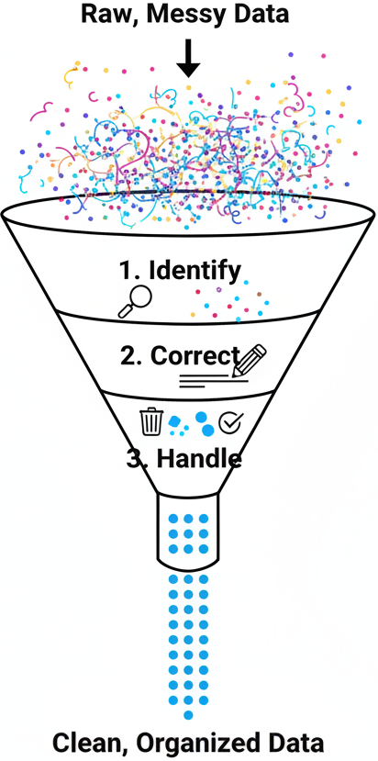
03. The Core Workflow: A Step-by-Step Guide to Data Cleaning
3.0. The Data Cleaning Process: An Overview
A systematic process for transforming raw data into a high-quality asset.
Key Stages:
  Identify Issues: Detect errors, anomalies, inconsistencies, and other data quality problems.
  Standardize & Correct: Fix identified inaccuracies and enforce consistent formats.
  Handle Outliers & Duplicates: Eliminate data points that skew results and remove redundant records.
Notes:
"We will approach data cleaning not as a random set of tasks, but as a systematic, multi-stage process. You can think of it like refining crude oil; we are taking a raw, unusable product and progressively purifying it.
The first stage is always to Identify the Issues. This is the diagnostic phase. We don't change anything yet; we simply run checks and perform exploratory analysis to find out what's wrong with our data. Where are the errors, the gaps, the inconsistencies?
The second stage is to Standardize and Correct. Once we have our diagnosis, we can begin the treatment. This is where we fix the problems we found—correcting typos, standardizing units and formats, and resolving contradictions in the data.
The final stage is to Handle Outliers and Duplicates. After the most obvious errors are fixed, we perform a final pass to remove extreme, implausible values (outliers) and any repeated records (duplicates) that could bias our analysis.
We will now walk through each of these stages in detail."

Slide 24
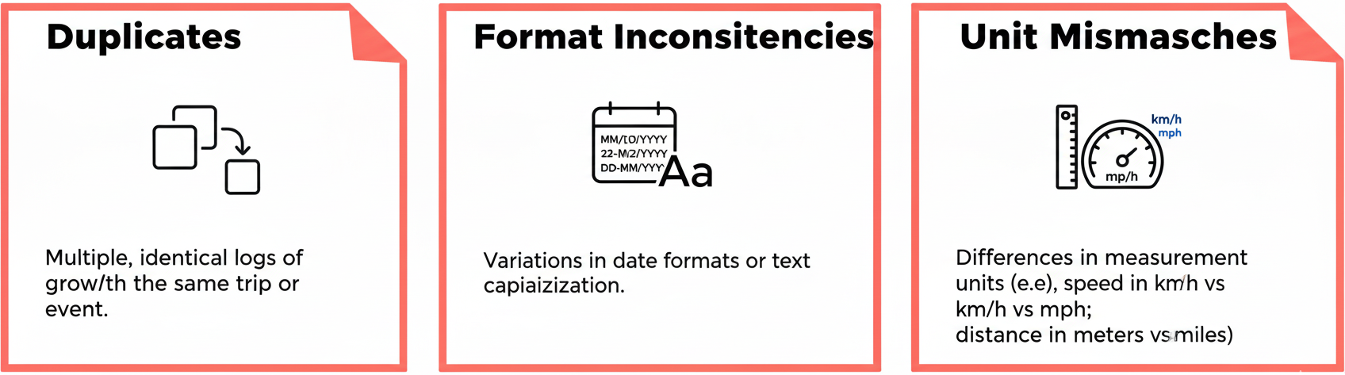
03. The Core Workflow: A Step-by-Step Guide to Data Cleaning
3.1. Common Data Issues in Detail
During the 'Identify' stage, we are looking for specific problems:
Unit Mismatches
Notes:
"So, in that first 'Identify' stage, what exactly are we looking for? Let's look at some very common examples you will encounter in transportation data.
Duplicates are a classic issue. A faulty sensor might log the same vehicle passage twice, or a user might accidentally submit a travel survey form more than once. If we don't remove these, we will overestimate our totals.
Format Inconsistencies are guaranteed to appear when you combine data from multiple sources. You'll find dates written in different ways, which will prevent chronological sorting. You might find categorical data, like vehicle type, entered as 'car', 'Car', and 'CAR', which a computer will treat as three different categories unless you standardize them.
Finally, Unit Mismatches are a subtle but dangerous problem. If one set of GPS data records speed in miles per hour and another records it in kilometers per hour, and you combine them without converting them to a standard unit, any calculation of average speed will be completely meaningless and wrong. This diagnostic phase is all about finding these specific types of errors before we attempt to fix them."

Slide 25
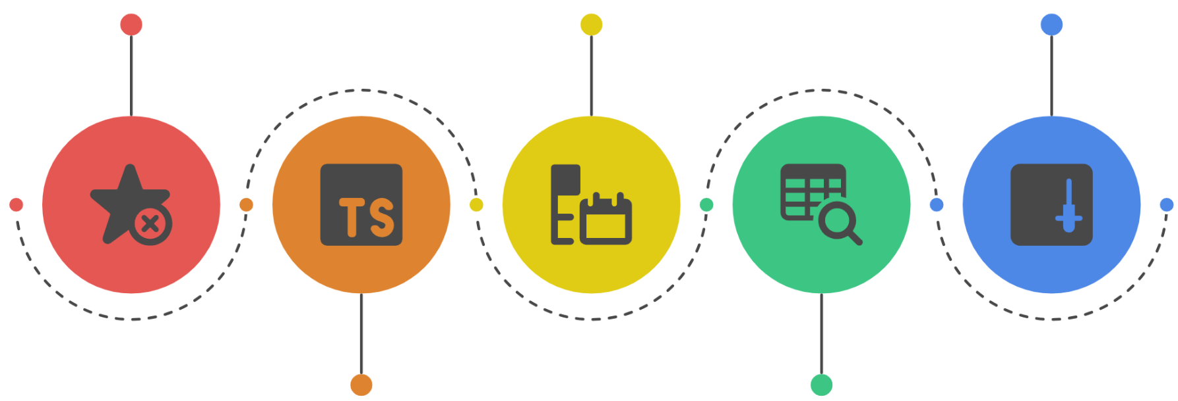
03. The Core Workflow: A Step-by-Step Guide to Data Cleaning
3.2. A Strategic Approach to Cleaning
Follow a logical order to avoid creating new problems.
A Recommended Workflow:
1. Check and Correct Data Types: Ensure numbers are numeric, dates are dates, etc.
3. Standardize Formats: Apply uniform formats for dates, text, and units.
5. Handle Missing Data:
2. Identify and Remove Duplicates: Eliminate redundant entries early.
4. Handle Outliers: Assess and remove or adjust extreme values.
Notes:
"Critically, data cleaning should not be a random process. The order in which you perform these tasks matters. For example, if you try to find outliers before you've standardized your units, you might incorrectly flag a value in kilometers as an outlier when compared to values in miles.
Therefore, we recommend a strategic workflow, as illustrated here.
First, always check and correct the data types. Make sure your numerical columns are actually stored as numbers and not text, and that dates are in a proper date format. Many errors stem from incorrect data types.
Second, remove duplicates. This is best done early to ensure you're not wasting time cleaning records that will just be deleted later.
Third, standardize your formats. This is the bulk of the work—making sure all dates, categories, and units are consistent across the entire dataset.
Fourth, once the data is standardized, you can then reliably handle outliers.
The final step, handling missing data, is a complex topic that we will address in its own section later. For now, we will focus on the first four steps of this workflow, starting with data types and duplicates."

Slide 26
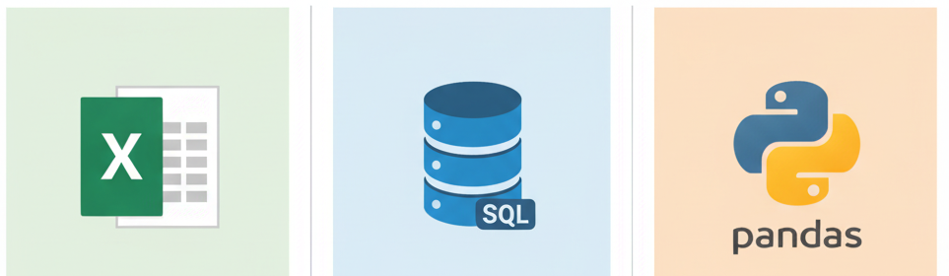
03. The Core Workflow: A Step-by-Step Guide to Data Cleaning
3.3. Method 1: Deduplication
Goal: To identify and remove repeated or redundant entries from the dataset.
Why it's important: Duplicates can artificially inflate counts and skew statistical results.
Common Tools for the Job:
  Excel: Use the built-in "Remove Duplicates" feature for simple, spreadsheet-based data.
  SQL: Use the SELECT DISTINCT command in relational databases to retrieve only unique records.
  Python (pandas): Use the .drop_duplicates() method for powerful and flexible deduplication in large datasets.
Notes:
"Let's begin with our first hands-on technique: Deduplication. The goal here is simple: find and remove any rows in our dataset that are identical copies of another row.
This is a critical first step because duplicates can severely bias our analysis. If 10% of our transit ridership records are duplicates, our estimate of total ridership will be 10% too high.
Fortunately, we have powerful tools to handle this efficiently. For those of you working with smaller datasets in Excel, there is a straightforward, built-in 'Remove Duplicates' button. For those working with large relational databases, the SQL query language has a fundamental command, SELECT DISTINCT, which instructs the database to return only the unique rows, effectively ignoring all duplicates. And for those of you who will be working programmatically, the pandas library in Python has a highly efficient and customizable method called drop_duplicates, which is the standard for handling this task in large-scale data analysis. The choice of tool depends on the scale and context of your data, but the principle is the same."

Slide 27
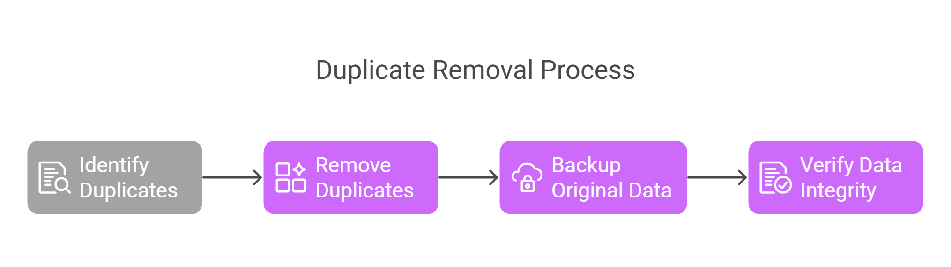
03. The Core Workflow: A Step-by-Step Guide to Data Cleaning
3.4. The Deduplication Process in Practice
A safe and reliable four-step process:
Notes:
"While the tools make removing duplicates easy, a professional researcher always follows a safe and reliable process to avoid mistakes. It consists of four steps.
Step 1 is to Identify. Before you delete anything, you must first confirm that duplicates actually exist and, more importantly, define what constitutes a duplicate. Is it a row where every single column is identical, or is it a row where a specific key, like a 'trip ID,' is repeated?
Step 2 is the most critical rule in data cleaning: Backup your original data. Before you make any changes—especially deletions—always, always save a copy of the raw, untouched file. This is your safety net. You must be able to undo any mistakes.
Step 3 is to actually Remove the duplicates using one of the tools we just discussed. As you can see in the example, the tool identifies and removes the repeated rows.
Step 4 is to Verify. After the removal, you must perform a sanity check. Does the new, lower row count make sense? Do a quick inspection of the cleaned data to ensure that no non-duplicate records were accidentally deleted.
Following this simple, careful process will protect you from irreversible errors."

Slide 28
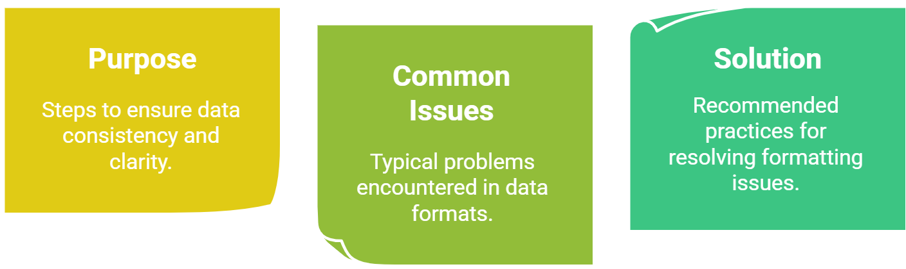
03. The Core Workflow: A Step-by-Step Guide to Data Cleaning
3.5. Method 2: Format Standardization
Goal: To ensure consistency in the format of data across the entire dataset.
Why it's important: Inconsistent formats prevent accurate sorting, filtering, and analysis. A computer treats "USA" and "usa" as two different countries.
Key Areas for Standardization:
  Dates: Enforce a single format (e.g., YYYY-MM-DD).
  Text (Categorical Data): Enforce consistent capitalization (e.g., lowercase) and remove leading/trailing whitespace.
  Units: Convert all measurements to a single, standard unit (e.g., all distances to kilometers).
Notes:
"After we've removed duplicate records, the next major task in our cleaning workflow is Format Standardization. This is the process of enforcing a single, consistent format for our data values, and it is absolutely essential for accurate analysis.
The reason it's so important is that computers are literal. Unlike a human, a computer does not understand that 'St.' and 'Street' mean the same thing. It will treat them as two distinct categories, which will fragment your data and invalidate your analysis.
We focus on three primary areas. First, Dates. You must choose one standard format, like the international standard YYYY-MM-DD, and convert all your date columns to match. This ensures you can sort chronologically and perform time-based calculations correctly. Second, Text, especially categorical data. You need to enforce consistent capitalization—a common practice is to convert everything to lowercase—and trim any accidental spaces before or after the text. And third, Units. As we've discussed, you must convert all measurements to a standard. If you're working with speed, choose either kilometers per hour or miles per hour and convert all values accordingly. This process of enforcing consistency is the backbone of data cleaning."

Slide 29
03. The Core Workflow: A Step-by-Step Guide to Data Cleaning
3.6. Standardization in Practice: Examples
Bad Data (Inconsistent):
  date: 2019-11-26, 26/11/2019
  direction: Left, left, lft
  speed: 15, "15 mph"
  location_id: 9, "N/A"
Good Data (Standardized):
  Street Abbreviations: Use consistently (e.g., "St." for Street).
  Time Format: Use ISO 8601 standard 24-hour format (e.g., HH:MM:SS). 2012-09-27T15:15 PM becomes 2012-09-27 15:15:00.
  Data Representation: Use None or a standard null value for missing data, not "N/A" or zero. Distinguish clearly between a zero count and missing information.
Notes:
"Let's make this concept very concrete. Here you can see a direct comparison between an inconsistent, 'dirty' dataset and a clean, standardized one.
In the bad data, look at the problems. The date column has multiple formats. The direction column has inconsistent capitalization and an abbreviation. The speed column has a mix of numbers and text. And the location_id column uses a string, "N/A", to represent a missing value, which will cause errors if you try to perform numerical calculations.
Now look at the good data. This is our goal. All street names and directions are standardized. The time format has been converted to the universal ISO 8601 standard, which is unambiguous and machine-readable. And most importantly, we've adopted a consistent rule for representing missing data—using a proper null value like None instead of a string or a zero. This is crucial: a traffic count of zero is real data meaning 'no cars', while a missing value means 'we don't know'. They are not the same, and our standardized data must reflect that distinction. This level of consistency is what makes a dataset ready for analysis."

Slide 30
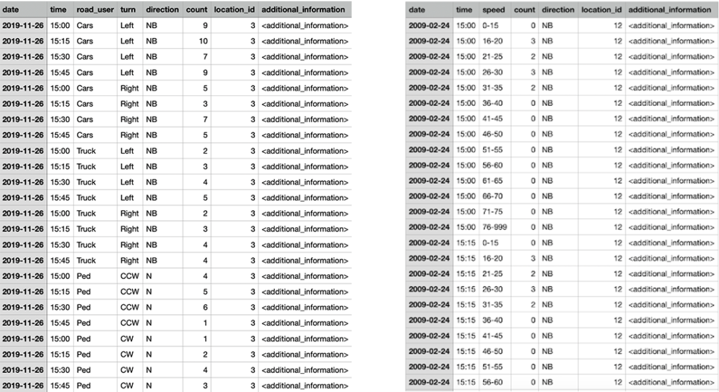
03. The Core Workflow: A Step-by-Step Guide to Data Cleaning
3.6. Standardization in Practice: Examples
The images below showcase spreadsheets that are appropriately formatted for easy processing
Notes:
"Let's make this concept very concrete. Here you can see a direct comparison between an inconsistent, 'dirty' dataset and a clean, standardized one.
In the bad data, look at the problems. The date column has multiple formats. The direction column has inconsistent capitalization and an abbreviation. The speed column has a mix of numbers and text. And the location_id column uses a string, "N/A", to represent a missing value, which will cause errors if you try to perform numerical calculations.
Now look at the good data. This is our goal. All street names and directions are standardized. The time format has been converted to the universal ISO 8601 standard, which is unambiguous and machine-readable. And most importantly, we've adopted a consistent rule for representing missing data—using a proper null value like None instead of a string or a zero. This is crucial: a traffic count of zero is real data meaning 'no cars', while a missing value means 'we don't know'. They are not the same, and our standardized data must reflect that distinction. This level of consistency is what makes a dataset ready for analysis."

Slide 31
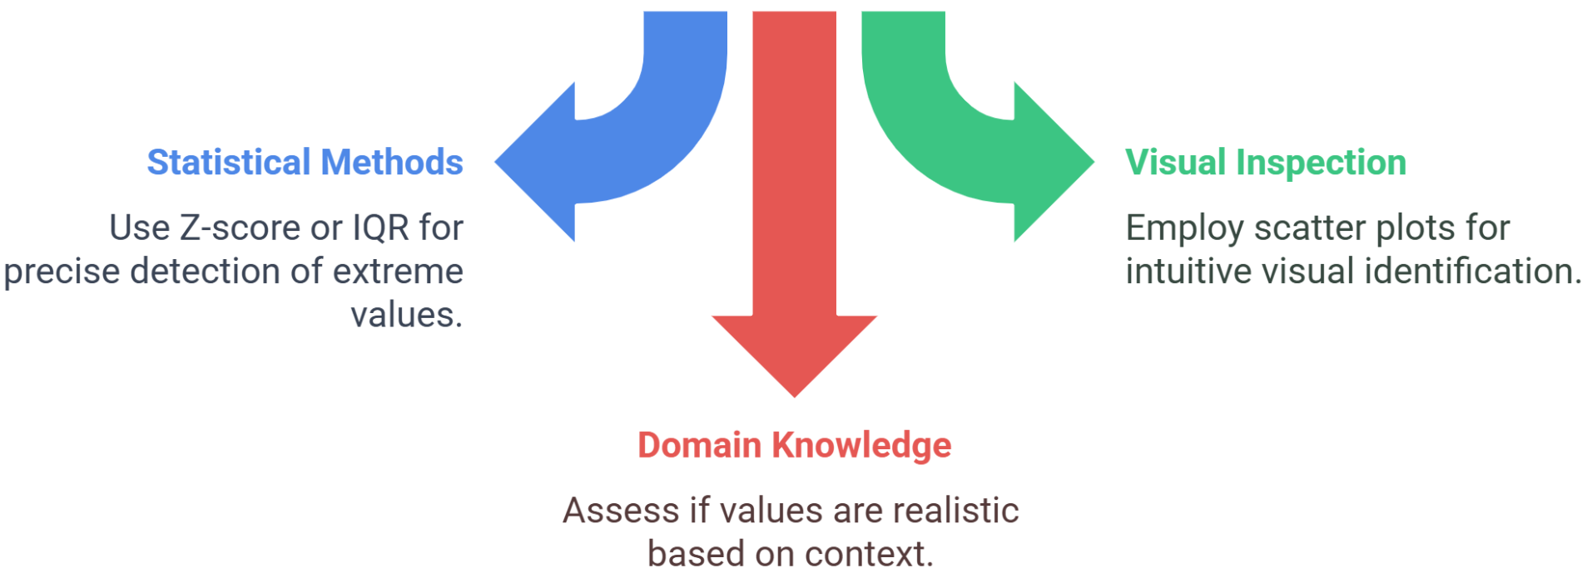
03. The Core Workflow: A Step-by-Step Guide to Data Cleaning
3.7. Method 3: Handling Outliers
What is an Outlier? A data point that is abnormally distant from other values in a dataset. It is often, but not always, an error.
A Three-Pronged Approach to Identification:
Statistical Methods: Use Z-scores or Interquartile Range (IQR) to mathematically identify extreme values.
Visual Inspection: Employ scatter plots and box plots to intuitively spot data points that fall far from the main cluster
Domain Knowledge: (Most Important) Assess if the value is realistic based on real-world context. Is a bus journey of 10 hours possible, even if it's statistically rare?
Notes:
"Once our data is consistently formatted, we can move on to handling outliers. An outlier is a data point that lies an abnormal distance from other values. Think of a GPS sensor on a bus reporting a speed of 200 kilometers per hour—that's a clear outlier and almost certainly an error.
However, not all outliers are errors, which is why we must use a careful, three-pronged approach to identify and assess them.
First, we can use Statistical Methods. We can calculate a Z-score for each data point to see how many standard deviations it is from the mean. A common rule of thumb is to flag anything beyond 3 standard deviations as a potential outlier.
Second, Visual Inspection is incredibly powerful. By creating a simple scatter plot or a box plot, outliers become immediately obvious to the human eye—they are the points that are far away from the main group of data.
But the third method is the most important: Domain Knowledge. This is your expertise as a transportation researcher. A value might be a statistical outlier, but your domain knowledge will tell you if it's actually plausible. For example, a travel survey might report a commute time of 4 hours. Statistically, this is a major outlier. But is it impossible? No. The person might live very far from their job. Conversely, a commute time of -10 minutes is a statistical outlier and is also impossible according to domain knowledge. It's the combination of these three methods, with a heavy reliance on your real-world expertise, that allows you to correctly identify and handle outliers."

Slide 32
03. The Core Workflow: A Step-by-Step Guide to Data Cleaning
3.8. Method 4: Ensuring Data Type Consistency
Goal: To ensure each column in a dataset is stored in the correct data type format (e.g., numeric, text, date).
Common Mismatches and How to Fix Them:
  Numeric Columns as Text: Often occurs when a number column contains non-numeric characters (e.g., "N/A").
    Fix: Identify and handle the non-numeric entries, then convert the column to a numeric format.
  Dates as Strings (Text): Prevents chronological sorting and time-based calculations.
    Fix: Use conversion functions to parse the string and convert it to a proper datetime format.
  Mixed Data in Columns: A single column contains multiple types of information (e.g., "Stop ID 123").
    Fix: Separate the different pieces of information into their own columns.
Notes:
"A final, fundamental cleaning task is ensuring Data Type Consistency. This means making sure that every column in your data table is stored in the correct format that reflects its content. Errors here are very common and can break your entire analysis.
One of the most frequent problems is having numeric columns stored as text. This usually happens if a column that should be all numbers, like 'passenger_count', contains a single text entry like 'missing' or 'N/A'. That one text entry will force the entire column to be treated as text, preventing you from calculating a sum or an average. The fix is to find and properly handle the non-numeric values, then convert the column type.
Similarly, you'll often find dates stored as strings, or plain text. You can look at '2023-10-27' and know it's a date, but until you convert it to a formal datetime data type, the computer can't sort it chronologically.
Finally, you may encounter mixed data in a single column. For example, a column might contain entries like 'Route 55'. This mixes text ('Route') and a number (55). The best practice here is to split this into two columns: one for the route prefix and one for the route number. Ensuring each column has a single, consistent data type is a prerequisite for almost any analysis."

Slide 33



03. The Core Workflow: A Step-by-Step Guide to Data Cleaning
3.9. Choosing the Right Tool: Excel vs. Code
The best tool depends on the scale and complexity of your task.
Excel / Spreadsheets:
  Best for: Simple, small-scale tasks on datasets that fit in memory.
  Features: User-friendly interface, built-in functions for simple cleaning.
Python / R (Programming):
  Best for: Large, complex, or repetitive cleaning tasks.
  Features: Powerful libraries (e.g., pandas, dplyr) for handling large data; allows for automation and creates a reproducible script.
Notes:
"We've now discussed several cleaning techniques, but which tool should you use to implement them? The choice generally comes down to a trade-off between ease of use and power.
For smaller datasets and simpler cleaning tasks, Microsoft Excel or other spreadsheet software can be a great choice. It has a visual, user-friendly interface, and you can perform many of the tasks we've discussed—like removing duplicates or finding and replacing inconsistent text—using built-in features. Its main limitation is that it struggles with very large datasets and it's difficult to document and reproduce your cleaning steps.
For larger, more complex, or repetitive tasks, the professional standard is to use a programming language like Python or R. These languages have specialized libraries—like pandas in Python or dplyr in R—that are specifically designed to handle and clean large datasets with incredible speed and efficiency. The biggest advantage of using code is reproducibility. Your code acts as a perfect record of every single cleaning step you took, which is essential for transparent and verifiable research. While there's a steeper learning curve, the power and reproducibility of code make it the go-to choice for serious data analysis."

Slide 34
03. The Core Workflow: A Step-by-Step Guide to Data Cleaning
3.10. Automating the Process: Key Libraries
For reproducible and scalable data cleaning, use programming libraries.
Python Libraries:
  Pandas: The essential library for data manipulation and analysis. Provides powerful tools for cleaning, transforming, and merging data.
  OpenRefine: A standalone tool that provides a graphical interface for powerful data cleaning and is particularly good for messy text data.
R Libraries:
  Tidyr & Dplyr: A suite of libraries (the "Tidyverse") that provide an intuitive and powerful grammar for data manipulation and cleaning.
Database Constraints:
  Define rules directly in a SQL database (e.g., NOT NULL, UNIQUE) to enforce data integrity at the source.
Notes:
"When you choose to work with code, you're really leveraging the power of specialized libraries that have been built for these exact tasks. Let's highlight the most important ones.
In the Python ecosystem, Pandas is absolutely fundamental. It is the workhorse for nearly all data manipulation and provides the functions you'll use for deduplication, standardization, handling missing values, and more. A related tool is OpenRefine, which is a powerful standalone application that lets you explore and clean your data using a graphical interface, but it can also export the steps as code for reproducibility.
In the R ecosystem, the 'Tidyverse' is a collection of libraries that work together seamlessly. Specifically, Tidyr helps you create 'tidy' data structures, and Dplyr provides a very powerful and intuitive set of verbs or commands for filtering, mutating, and summarizing your data.
Finally, it's worth noting that if you are using a SQL database, you can enforce many cleaning rules at the source by defining database constraints. For example, you can set a rule that a specific column cannot contain null values or that all entries in another column must be unique. This is a very robust way to maintain data integrity from the very beginning."

Slide 35
Section 04:
Ensuring Integrity: Handling Missing Data & Validation
Notes:
Section 04: Ensuring Integrity: Handling Missing Data & Validation

Slide 36
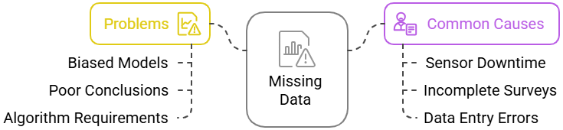
04. Ensuring Integrity: Handling Missing Data & Validation
4.0. Handling Missing Data: The Problem & Causes
The Problem of Missing Data:
  Can lead to biased models if the missingness is not random.
  Results in poor or weak conclusions due to reduced sample size.
  Can cause technical errors, as many algorithms cannot handle missing inputs.
Common Causes in Transportation:
  Sensor Downtime: A traffic loop detector loses power or malfunctions.
  Incomplete Surveys: A respondent chooses to skip a sensitive or difficult question.
  Data Entry Errors: A value is accidentally deleted during data processing.
Notes:
"Let's start with the pervasive problem of missing data. It's a rare and fortunate project that doesn't have any missing values. The presence of these gaps can cause serious problems.
First, and most dangerously, missing data can lead to biased models. If, for example, high-income individuals are less likely to answer a question about their travel costs, any analysis of that variable will be systematically biased. Second, it can lead to weaker conclusions simply because it reduces the amount of usable data you have. And third, from a purely technical standpoint, many statistical and machine learning algorithms simply cannot function when they encounter a missing value; they will throw an error.
The causes in our field are usually straightforward. We have Sensor Downtime due to power failures or maintenance. We have Incomplete Surveys, where participants intentionally or accidentally skip questions. And we have simple Data Entry Errors, where data is lost during transfer or processing. Understanding why data might be missing is the first step toward deciding how to handle it."

Slide 37
04. Ensuring Integrity: Handling Missing Data & Validation
4.1. Types of Missing Data
Understanding the pattern of missingness is key to choosing the right strategy.
MCAR (Missing Completely at Random):
  The missingness is pure chance and has no relationship to any other data.
  Example: A few random survey pages are lost in a fire.
  Implication: This is the least problematic type.
MAR (Missing at Random):
  The missingness can be explained by another variable in the dataset.
  Example: Men are less likely to answer a question about public transport satisfaction (the missingness is related to the 'gender' variable).
  Implication: We can use the other variables to help predict and fill in the missing values.
MNAR (Missing Not at Random):
  The missingness is related to the value of the missing data itself. This is systematic.
  Example: People with very high incomes are less likely to report their income.
  Implication: This is the most problematic type and can introduce significant bias.
Notes:
"Statisticians have a formal framework for classifying why data is missing, and understanding this is crucial because the reason determines the best way to handle it.
The first type is MCAR, or Missing Completely at Random. This is the ideal scenario. It means the fact that a data point is missing is completely random and has no connection to any other variable in your dataset. The classic example is a researcher accidentally dropping a few survey forms down a drain. It's pure bad luck. This is the least problematic because it doesn't introduce systematic bias.
The second type is MAR, or Missing at Random. This is a bit of a misnomer. It means the missingness isn't completely random, but it can be explained by other variables you have measured. The example here is key: if men are less likely to fill out a certain question than women, the 'missingness' is related to the 'gender' variable. This is good, because it means we can use the gender variable to help us intelligently account for the missing data.
The third and most difficult type is MNAR, or Missing Not at Random. This is when the reason a value is missing is related to the value itself. The classic example is income: people with very high or very low incomes are often the least likely to report it. The 'missingness' is dependent on the unobserved value. This is a major problem because it creates a systematic bias in your data that is very difficult to fix. Identifying which type of missingness you're dealing with is a critical diagnostic step."

Slide 38
04. Ensuring Integrity: Handling Missing Data & Validation
4.2. Strategies for Handling Missing Data
Once the type of missingness is understood, you can choose a strategy.
Simple Methods (Use with Caution):
  Listwise Deletion: Remove any row that contains a missing value.
    Use Case: Only acceptable for MCAR data when the number of missing rows is very small (<5%).
  Mean/Mode/Median Imputation: Replace the missing value with the average (for numeric data) or most frequent value (for categorical data) of the column.
    Use Case: Simple and fast but reduces data variability and can distort relationships between variables.
Advanced Methods (Often Preferred):
  Regression Imputation: Use a regression model to predict the missing value based on other variables in the dataset.
  Domain-Specific Methods: Use external data sources or expert knowledge to inform the imputation (e.g., using historical data from the same sensor).
Notes:
"Now that we can classify the type of missingness, let's look at the strategies for handling it. These range from simple but potentially problematic, to more advanced and robust.
Let's start with the simple methods, which you should always use with caution. Listwise Deletion is the most blunt approach: if a row has any missing data, you delete the entire row. This is only acceptable if the data is Missing Completely at Random (MCAR) and you are only losing a tiny fraction of your dataset—say, less than 5%. Otherwise, you are throwing away valuable information and potentially biasing your sample.
A slightly better, but still flawed, approach is Mean, Mode, or Median Imputation. Here, you replace the missing value with a calculated value from the rest of the column. For a numeric column like 'age', you might fill in the missing values with the average age. This is fast and easy, but it artificially reduces the variance of your data and can weaken correlations between variables.
That's why we often prefer more advanced methods. Regression Imputation is a powerful technique where you build a statistical model to predict the missing value based on the other variables you do have for that observation. This preserves the relationships between variables much more effectively. The most sophisticated approach is often Domain-Specific Methods. For example, if a traffic sensor's data is missing for an hour, you could use data from the same sensor on the same day of the week from the previous month to make a highly educated guess. This leverages your expert knowledge to make the most intelligent imputation possible."

Slide 39
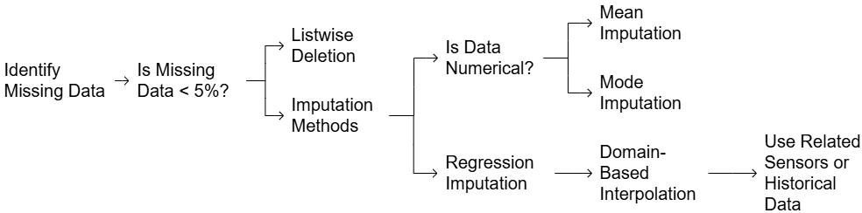
04. Ensuring Integrity: Handling Missing Data & Validation
4.3. A Decision-Making Process for Missing Data
Numerical: Consider Mean or Regression Imputation.
If Yes: Consider Listwise Deletion (if data is also MCAR).
Determine Data Type: Is the data numerical or categorical?
Categorical: Consider Mode Imputation.
First, locate all missing values in your dataset.
Assess Quantity: Is the percentage of missing data small (<5%)?
If No: Proceed to imputation methods.
Incorporate Domain Knowledge: Can you use related historical or sensor data to make a more accurate imputation?
Notes:
"This flowchart provides a practical, step-by-step process for deciding which of these strategies to apply.
First, you obviously need to identify the missing data in your dataset.
The very next question you should ask is about the quantity. Is the amount of missing data trivial—less than 5%? If the answer is yes, and you are confident the data is Missing Completely at Random, then the simple approach of listwise deletion might be an acceptable option.
If the amount of missing data is more significant, you must use an imputation method. Your next decision point is the data type. If the column is numerical, you could consider mean imputation for a simple fix, or regression imputation for a more sophisticated one. If the column is categorical, mode imputation (filling with the most frequent category) is the simple choice.
Finally, and this should overlay the entire process, always ask if you can incorporate domain knowledge. Do you have access to historical data or data from a nearby sensor that could provide a more accurate and context-aware imputation? Using related data is almost always superior to a simple statistical fill-in. This structured thinking will lead you to a more defensible and robust solution."

Slide 40
04. Ensuring Integrity: Handling Missing Data & Validation
4.4. Activity 2: Group Discussion on Missing Data
Prompt:
  "If 20% of the bus arrival time records are missing from your dataset, would you delete those rows or impute the missing values? Explain your reasoning."
Goal:
  Encourage critical thinking on the trade-off between data quantity and data accuracy/integrity.
Notes:
"Let's have a quick group discussion to grapple with the trade-offs here. I want you to consider this prompt:
You're analyzing a dataset of bus on-time performance, and you discover that a full 20% of your bus arrival time records are missing. What do you do? Do you delete those rows, or do you attempt to impute the values?
There isn't one single right answer. I want you to think about the pros and cons of each choice. What are the risks of deletion? What are the risks of imputation? What other information might you need to make the best decision?
Take a couple of minutes to discuss this in your groups, and then we'll share some perspectives as a class."
(Facilitate a discussion. Key points to guide towards: Deleting 20% of the data is a massive loss of information and could introduce bias if the missingness is not random. Imputing is better, but the method matters. A simple mean imputation might be inaccurate, whereas a more sophisticated model that uses the scheduled arrival time, the previous stop's arrival time, and the time of day could be quite powerful.)

Slide 41
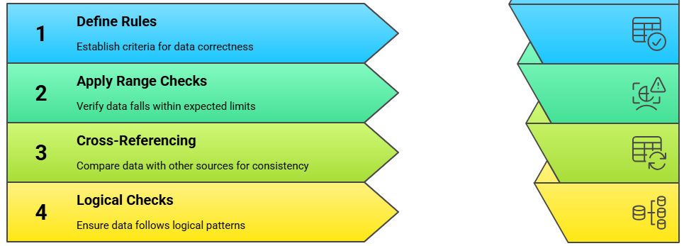
04. Ensuring Integrity: Handling Missing Data & Validation
4.5. Data Validation: The Final Quality Check
Data validation is the process of checking your cleaned data against a set of rules to ensure its correctness, logical consistency, and integrity before analysis.
A Four-Step Process:
Define Rules: Establish the criteria for what constitutes "correct" data (e.g., trip duration must be positive).
Apply Range Checks: Verify that data falls within expected, plausible limits (e.g., vehicle speed must be between 0 and 150 km/h).
Cross-Referencing: Compare data with other reliable sources for consistency (e.g., check your station IDs against an official master list).
Logical Checks: Ensure the data follows logical patterns (e.g., a trip's end time must be after its start time).
Notes:
"We now arrive at the final, crucial step in our workflow: Data Validation. You've stored your data, and you've gone through the intensive process of cleaning it. But before you begin your analysis, you must perform one last quality check. Validation is the process of confirming that your cleaned dataset is not only clean, but also correct and logical.
We can think of this as a four-step process. First, you must explicitly Define the Rules for your dataset. This is like creating a contract for your data. What are the criteria for correctness? For example, a rule might be that trip duration can never be negative.
Second, you Apply Range Checks. This involves checking your numerical values against plausible limits. For example, a recorded vehicle speed of 500 km/h might be a clean number, but it's not a valid one. You would set a rule to flag any speed outside a plausible range, say 0 to 150 km/h.
Third is Cross-Referencing. Here, you check your data against an external, authoritative source. For example, you would check all the transit stop IDs in your dataset to make sure they all exist in the official master list of stops provided by the transit agency.
Finally, you perform Logical Checks. This is about checking for internal consistency. The classic example is checking that a trip's end time is always after its start time. Data that violates these fundamental rules is not valid, and validation is the process of finding and flagging these issues."

Slide 42
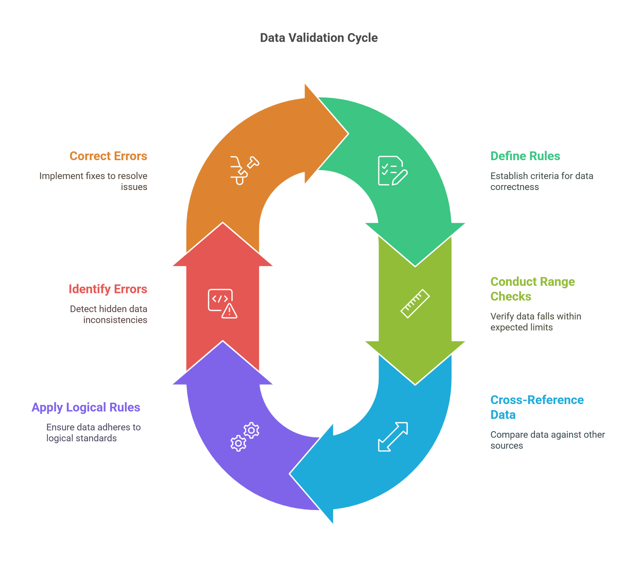
04. Ensuring Integrity: Handling Missing Data & Validation
4.6 The Data Validation Cycle
Correct Errors: Implement fixes to resolve issues
Define Rules: Establish criteria for data correctness
Identify Errors: Detect hidden data inconsistencies
Conduct Range Checks: Verify data falls within expected limits
Apply Logical Rules: Ensure data adheres to logical standards
Cross-Reference Data: Compare data against other sources
Notes:
"Much like the larger data lifecycle, validation itself is an iterative cycle. It's not always a linear process where you run your checks once and you're done.
As this diagram illustrates, you start by Defining your Rules and running your various checks. In doing so, you will inevitably Identify Errors—data that violates your rules. This then requires you to go back and Correct those Errors, which may in turn require you to refine your cleaning scripts or your initial assumptions. You might discover, for example, that what you thought was an outlier is actually a new, valid category of data that requires you to update your rules.
This loop of defining, checking, identifying, and correcting continues until your entire dataset passes all of your validation rules without raising any more flags. Only at that point can you certify the data as fully validated and ready for analysis. This cyclical approach ensures a much more robust and reliable final product."

Slide 43
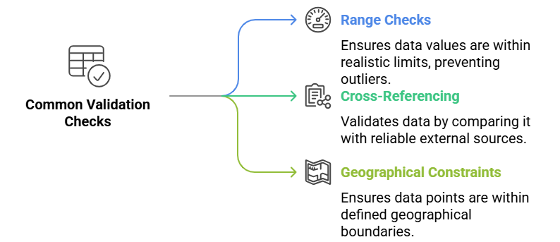
04. Ensuring Integrity: Handling Missing Data & Validation
4.7. Common Validation Checks in Detail
Range Checks: Ensures data values are within realistic, plausible limits, preventing the influence of extreme outliers.
Example: Flagging any bus passenger count on a single bus that is greater than 100.
Cross-Referencing: Validates data by comparing it with reliable external sources or other parts of your dataset. Example: Verifying that all airport codes in your dataset match the official IATA list of airport codes.
Geographical Constraints: Ensures that spatial data points are within defined geographical boundaries. Example: Flagging any bike-share trip that starts or ends in a location outside the official service area (e.g., in the middle of a lake).
Notes:
"Let's look a little closer at three of the most common and powerful validation checks you will use.
Range Checks are your first line of defense against implausible values that may have survived the initial outlier cleaning. You define a realistic minimum and maximum for a variable based on your domain knowledge. For example, a standard city bus has a maximum capacity of around 80-100 people. Any single trip record with a passenger count of 200 is clearly an error, and a range check will automatically flag it for investigation.
Cross-Referencing is about checking your data against a known 'source of truth.' This is extremely powerful for validating categorical or identifier data. If you have a dataset of flight records, you should validate the airport codes by cross-referencing them against the official list of IATA codes. Any code in your data that doesn't appear on the master list is an error.
Finally, for any spatial data, you must apply Geographical Constraints. This ensures that your latitude and longitude coordinates make sense. A common application in a bike-sharing system would be to check that all trip start and end points fall within the defined service area of the city. Any point that falls outside that boundary—for example, in a neighboring city or in the middle of a river—is clearly the result of a GPS error and must be flagged as invalid."

Slide 44
04. Ensuring Integrity: Handling Missing Data & Validation
4.8. Case Study 1: Validating Traffic Sensor Data
A real-world data validation workflow:
  Initial Report: A speed sensor reports an impossibly high speed (e.g., 250 km/h). This is flagged by a range check.
  Cross-Check: The system automatically cross-checks this reading with data from a nearby traffic camera that also estimates speed. The camera reports a normal speed.
  Identify Malfunction: The discrepancy between the sensor and the camera indicates a probable sensor malfunction.
  Implement Discard Rule: A rule is implemented to automatically discard any speed reading from that sensor above a set threshold (e.g., 150 km/h) until it can be physically repaired.
Notes:
"Let's walk through a case study to see how these checks work together in a real-world, automated system.
Imagine you have a network of traffic sensors. In step 1, a sensor on the highway reports a vehicle speed of 250 kilometers per hour. This immediately triggers a range check, because this value is outside the plausible limit you've defined.
In step 2, the system automatically performs a cross-check. It pulls data from a nearby video camera that is also monitoring the same stretch of road. The video analytics estimate the vehicle's speed was only 120 km/h.
In step 3, the system logs this discrepancy. Because the camera data contradicts the sensor data, it flags a probable sensor malfunction. One of the data sources is wrong.
Finally, in step 4, the system implements a business rule. It accepts the camera data as the more reliable source and automatically discards the erroneous sensor reading. Furthermore, it might place a temporary rule on that specific sensor to discard all future readings above 150 km/h and flag the unit for a maintenance check. This is a perfect example of a robust, multi-step validation process in action."

Slide 45
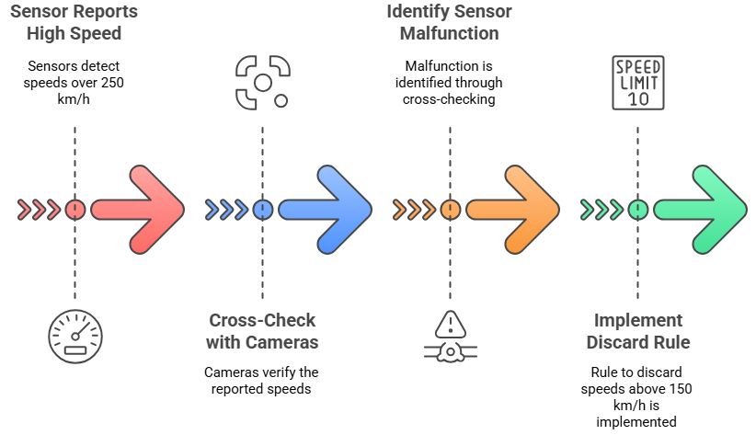
04. Ensuring Integrity: Handling Missing Data & Validation
4.8. Case Study: Validating Traffic Sensor Data
Notes:
"Let's walk through a case study to see how these checks work together in a real-world, automated system.
Imagine you have a network of traffic sensors. In step 1, a sensor on the highway reports a vehicle speed of 250 kilometers per hour. This immediately triggers a range check, because this value is outside the plausible limit you've defined.
In step 2, the system automatically performs a cross-check. It pulls data from a nearby video camera that is also monitoring the same stretch of road. The video analytics estimate the vehicle's speed was only 120 km/h.
In step 3, the system logs this discrepancy. Because the camera data contradicts the sensor data, it flags a probable sensor malfunction. One of the data sources is wrong.
Finally, in step 4, the system implements a business rule. It accepts the camera data as the more reliable source and automatically discards the erroneous sensor reading. Furthermore, it might place a temporary rule on that specific sensor to discard all future readings above 150 km/h and flag the unit for a maintenance check. This is a perfect example of a robust, multi-step validation process in action."

Slide 46
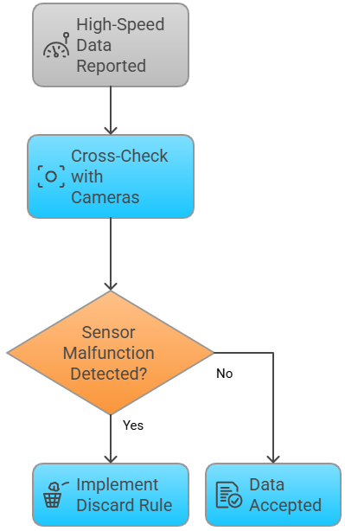
04. Ensuring Integrity: Handling Missing Data & Validation
4.9. Case Study: Validation Flowchart
The Logic of Automated Validation:
  High-speed data is reported by a sensor.
  The data is cross-checked with a second source (e.g., cameras).
  A decision point is reached: Is a sensor malfunction detected?
    If YES: Implement a discard rule and flag the data as invalid.
    If NO: The data is accepted as valid.
Notes:
"We can represent the logic of that case study using a simple flowchart, which is often how these validation rules are designed and programmed.
The process begins when high-speed data is reported. The first step is to cross-check it with our verification source, the cameras.
This brings us to a critical decision point. Based on the cross-check, do we detect a malfunction?
If the answer is YES—meaning the sensor and camera data do not agree—we follow the 'Yes' path. We implement our discard rule and reject the invalid sensor reading.
If the answer is NO—meaning both the sensor and the camera report a high, but consistent, speed (perhaps it was a high-performance vehicle on an empty road)—we follow the 'No' path, and the data is accepted as valid.
This flowchart logic is the foundation of building automated data quality pipelines. It's a series of checks and decisions that ensure only reliable data passes through to the final analysis stage."

Slide 47
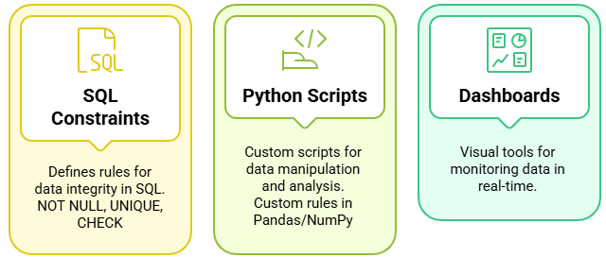
04. Ensuring Integrity: Handling Missing Data & Validation
4.10. Tools for Automating Validation
Validation checks can be built directly into your data pipeline using several tools.
e.g., Tableau, Power BI
Notes:
"Finally, how do we implement these validation routines in practice? We use a combination of tools to automate the process as much as possible.
If you are working with a SQL database, the most robust method is to define constraints directly in the database schema. You can create a CHECK constraint that, for example, physically prevents any record with a trip duration less than zero from being written to the table. This enforces data integrity at the point of entry.
For more complex, custom checks, you will typically write Python Scripts. Using libraries like Pandas, you can create a script that runs every night, loads the latest data, performs all the range, cross-referencing, and logical checks we've discussed, and outputs a detailed data quality report.
Finally, a very powerful tool for ongoing monitoring is Dashboards. Using a tool like Tableau or Power BI, you can create visual dashboards that are connected directly to your data source. You can build charts that track the number of missing values over time or flag outliers in real-time, providing a constant, visual pulse on the health of your data pipeline."

Slide 48
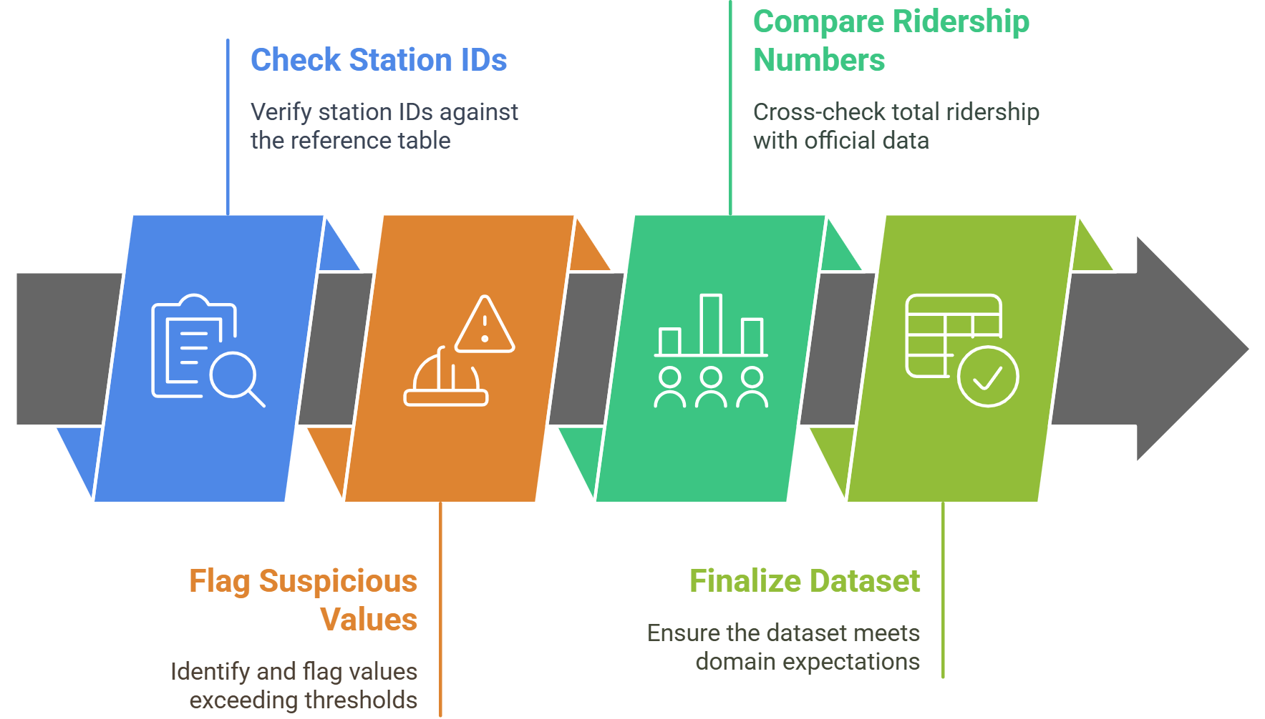
04. Ensuring Integrity: Handling Missing Data & Validation
4.11. Example Validation Routine: Station IDs
Notes:
"Let's walk through one final, concrete example of a validation routine, this time for a public transit dataset.
Step 1 is a classic cross-referencing check. You take all the station IDs from your daily ridership data and you check them against your official, master list of all valid station IDs. Any ID in your data that isn't on the master list is an error and must be investigated.
Step 2 is a more nuanced range check. Instead of a single rule for all stations, you would flag any daily ridership count for a specific station that is a major statistical outlier compared to its own historical data. A small station suddenly reporting 50,000 boardings is a suspicious value that needs to be flagged.
Step 3 is another cross-check, this time at an aggregate level. You would sum up the total ridership across all stations in your dataset for a given day and compare that number to the official total ridership number published by the transit agency for that same day. If the numbers don't closely match, there's a problem somewhere in your data.
Only after the data has passed all of these checks do you reach Step 4, where you can finally consider the dataset to be validated and ready for your analysis."

Slide 49
Section 05:
Synthesis, Application, and Conclusion
Notes:
Section 05: Synthesis, Application, and Conclusion

Slide 50

05. Synthesis, Application, and Conclusion
5.0. Reflective Q&A
Question:
  "Your analysis of a cleaned dataset shows the average daily ridership for a transit system is 10,000. However, official published records from the transit agency state the number is 20,000. What now?"
Answer / Next Steps:
  Do not assume the official record is wrong. The discrepancy is likely an error in your data or process.
  Systematically re-check your work:
    Re-examine your data cleaning steps. Did you accidentally filter out valid data?
    Re-examine your handling of missing data. Did your imputation method introduce a downward bias?
    Consult the external source's documentation. Are you defining "ridership" in the same way?
Notes:
"Let's do a quick reflective exercise to cap off our section on validation. Consider this scenario:
You have completed your cleaning and validation process. Your final, trusted dataset shows an average daily ridership of 10,000 passengers. But then you look at the transit agency's official annual report, and it claims the average is 20,000. What do you do?
(Pause for a moment to let students think.)
The first and most important rule is: do not immediately assume the official record is wrong. While it's possible, it is far more likely that the error is somewhere in your own data pipeline. Your first instinct must be to go back and critically re-examine your own work.
Go back and check your cleaning scripts. Is it possible you were too aggressive in removing outliers and accidentally deleted a large amount of valid data? Re-check your method for handling missing data. And critically, consult the documentation for the external source. Maybe the transit agency's definition of 'ridership' includes transfer passengers in a way that yours does not. This process of reconciling your data with an external source of truth is a core part of the validation process."

Slide 51

05. Synthesis, Application, and Conclusion
5.1. Quick Quiz
Let's check our understanding:
  Which storage solution (e.g., file-based, SQL) works best for large-scale, collaborative transport data projects?
  Name one preferred method to handle a significant amount of missing ridership counts and explain why simple deletion is problematic.
  Give a plausible, real-world example of an outlier in bus trip duration data.
Notes:
"Alright, let's do a very quick quiz to reinforce some of the key concepts we've covered today. I'll read three questions, just think about the answers.
First, which type of storage solution is most appropriate for a large, collaborative project?
Second, what is a good way to handle a lot of missing ridership data, and why is just deleting the rows a bad idea?
And third, give me a real-world example of what would be considered an outlier in a dataset of bus trip durations."

Slide 52
05. Synthesis, Application, and Conclusion
5.2. Quiz Answers & Discussion
Answer Highlights:
  Storage Solution: SQL or Cloud-based solutions, because they are scalable and built for collaboration.
  Missing Values: Use imputation (e.g., regression or domain-specific). Deletion is problematic because it reduces data quantity and can introduce significant bias if the data is not missing completely at random.
  Outlier Example: A negative trip duration (e.g., -600 seconds) due to a clock error, or an extremely long duration (e.g., 24 hours) due to a GPS tracker being left on overnight.
Core Takeaway: You must apply these cleaning and validation techniques to real datasets to move from raw data to reliable insights.
Notes:
"Okay, let's quickly review the answers.
For question one, the best storage solutions for large, collaborative projects are SQL databases or cloud platforms because of their scalability and support for multiple users.
For question two, a preferred method for handling significant missing data is imputation. Simple deletion is a bad idea because you lose a large amount of information and, more importantly, you will likely introduce bias into your results.
And for question three, a great example of an outlier in trip duration data would be a negative value, which is physically impossible, or an extremely long value of, say, 24 hours, which likely indicates a GPS device that was not turned off correctly.
The single most important takeaway from this entire lecture is that the systematic application of these techniques is what allows us to transform messy, raw data into the trustworthy, reliable insights that good policy and planning depend on."

Slide 53

05. Synthesis, Application, and Conclusion
5.3. Conclusion & Key Takeaways
In Summary:
  Data Management is the strategic framework that ensures data is usable and reliable in the long term.
  Data Cleaning is the technical process of fixing errors and preparing data for analysis.
  Handling Missing Data responsibly is critical for preventing biased or incomplete insights.
  Data Validation is the final check that confirms your cleaned data is logical, consistent, and correct.
Notes:
"To conclude our lecture, let's summarize the four core pillars we have discussed today.
First, we established that Data Management is the high-level, systematic framework that you must put in place to ensure your data assets are secure and usable for their entire lifecycle.
Second, we defined Data Cleaning as the hands-on, technical process of going into a dataset to fix errors, standardize formats, and remove inconsistencies.
Third, we covered the critical importance of Handling Missing Data with care, using methods that avoid introducing bias into our results.
And finally, we discussed Data Validation as the essential last step, a final quality gate that certifies our data is logical and correct before we commit to an analysis.
Mastering these four areas is a fundamental skill for any transportation researcher."

Slide 54
05. Synthesis, Application, and Conclusion
5.4. Final Reflection
A Final Question for You:
"How can these methods of cleaning and validation improve the quality and credibility of your next research project or lab assignment?"
Notes:
"I'd like to end with a final reflective question for you to take away.
As you approach your next project, whether it's a course assignment, a lab, or a thesis, I want you to think critically about this question: 'How can the systematic methods of cleaning and validation we discussed today improve the quality and, just as importantly, the credibility of your work?'
The answer is that by adopting these professional practices, you move from simply analyzing data to producing research that is robust, transparent, reproducible, and trustworthy. And that is the ultimate goal. Thank you."

Slide 55
05. Synthesis, Application, and Conclusion
5.5. References & Further Reading
Data Management & Lifecycle:
  ETH Zurich Library. "The Research Data Life Cycle." Retrieved from https://library.ethz.ch/en/researching-and-publishing/data-management-and-policies/research-data-management/research-data-life-cycle.html
Data Cleaning & Preparation:
  Wickham, H. (2014). Tidy Data. Journal of Statistical Software, 59(10).
  Dasu, T., & Johnson, T. (2003). Exploratory Data Mining and Data Cleaning. John Wiley & Sons.
Transportation Data Analysis:
  Ortúzar, J. de D., & Willumsen, L. G. (2011). Modeling Transport (4th ed.). John Wiley & Sons.
Practical Implementation:
  McKinney, W. (2017). Python for Data Analysis: Data Wrangling with Pandas, NumPy, and IPython (2nd ed.). O'Reilly Media.
Notes:
"And finally, for those who wish to go deeper, these resources are excellent starting points. Hadley Wickham's paper on 'Tidy Data' is a foundational text for how to structure data correctly. Dasu and Johnson provide a comprehensive overview of data cleaning. Ortúzar and Willumsen's textbook is a classic in our field. And for those of you who want to learn the practical implementation in Python, Wes McKinney's book is the definitive guide. Thank you again for your time and attention."

Slide 56
Thank you for your attention!
Notes:
Thank You

