Slide 1
Transport Research and Analysis
Lab 3: Field Data Collection
Digital and Manual Techniques

Slide 3
Table of contents
Lab 3: Field Data Collection
00: Introduction & Objectives.....…………………..….....4
0.0 Goal…....……………………...............................5
0.1 Objectives & Activities…………………...….........6
01: Pre Activity Briefing & Training...............................7
1.0 Activity 1.........................................................8
1.1 Activity 1: Key Metric……….….........................9
1.2 Activity 2.......................................................10
1.3 Activity 2: Key Metric......................................11
1.4 How Both Datasets Complement Each Other...12
1.5 Field Safety: Your Number 1 Priority...............13
1.6 The Pre-Field Safety Checklist.......................14
1.7 Your Digital Toolkit…......................................15
1.8 Step 1: Installation & First Launch..................16
1.9 Step 2: Configuring the App for Quality Data...17
1.10 Step 3: Recording a Track - Best Practices ....18
1.11 Step 4: Exporting the GPX Data File...............19
1.12 Common Issues & Troubleshooting…………....20
1.13 In-Class Activity 1: The Practice Track............21
1.14 Your Manual Toolkit........................................22
1.15 The Tally Sheet..............................................23
1.16 Field Execution..............................................24
1.17 Common Issues & Troubleshooting.................25
1.18 Defining Team Roles & Responsibilities..........26
1.19 Final Briefing & Time Synchronization.............27
02: Field Activity Execution……...............................…28
2.0 Field Activity Execution…………………………….29
03: Data Analysis & Reflection.…………………………30
3.0 Turning Data into Insights……………..………….31

Slide 4
Table of contents
Lab 3: Field Data Collection
3.1 Analysis Task 1: Visualizing the GPS Track…..32
3.2 Analysis Task 2: Digitizing Manual Count……..33
3.3 Data Quality Check........................................34
3.4 Analysis Task 4: Calculating Key Metrics……..35
3.5 Analysis Task 5: Creating Modal Split Chart….36
3.6 Group Discussion………………………….……...37
3.7 Summary & Key Takeaways………………….....38
3.8 Assignment & Submission………..……………..40
04: References…….......................................................41
4.0 References….……………………………………..42

Slide 5
Section 00:
Introduction & Objectives

Slide 6
00. Introduction & Objectives
0.0. Objectives & Activities
No | Activity | Tool(s) | Activity Type | Activity done by | Duration
1 | Activity Profile & Metrics | Slides | Presentation | Teacher | 15 min
2 | Field Safety Protocol & Checklist | Slides, Worksheet | Presentation + Individual Task | Teacher + Student | 10 min
3 | Digital Toolkit Training | Slides, Smartphone | Presentation + Practical | Teacher + Student | 30 min
4 | Manual Toolkit Training | Slides, Worksheet | Presentation + Group Work | Teacher + Student | 35 min
5 | Field Data Execution | GPS App, Tally Sheet | Field Work | Student | 45 min
6 | Data Processing & Quality Control | GPX Viewer, Spreadsheet | Practical | Student | 25 min
7 | Group Discussion & Homework | Slides | Discussion | Teacher + Student | 20 min
Total |  |  |  |  | 180 mins

Slide 7
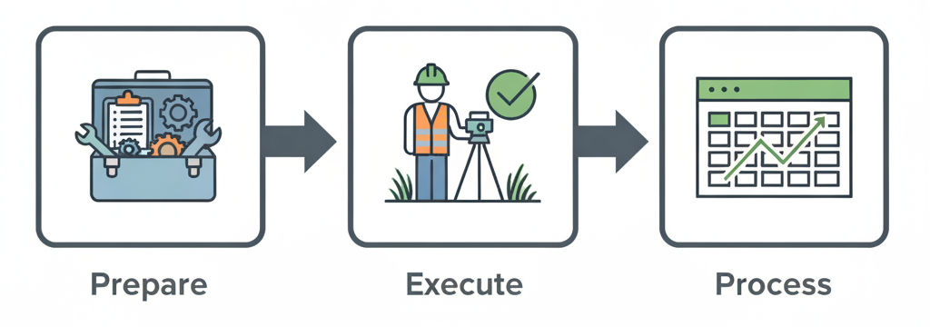
00. Introduction & Objectives
0.1. Goal: To execute a digital and manual data collection workflow
Three Step Action Plan
2. Execute safely and accurately in the field.
3. Process raw data into actionable insights.
1. Prepare tools and protocols.

Slide 8
Section 01:
Pre Activity Briefing & Training

Slide 9
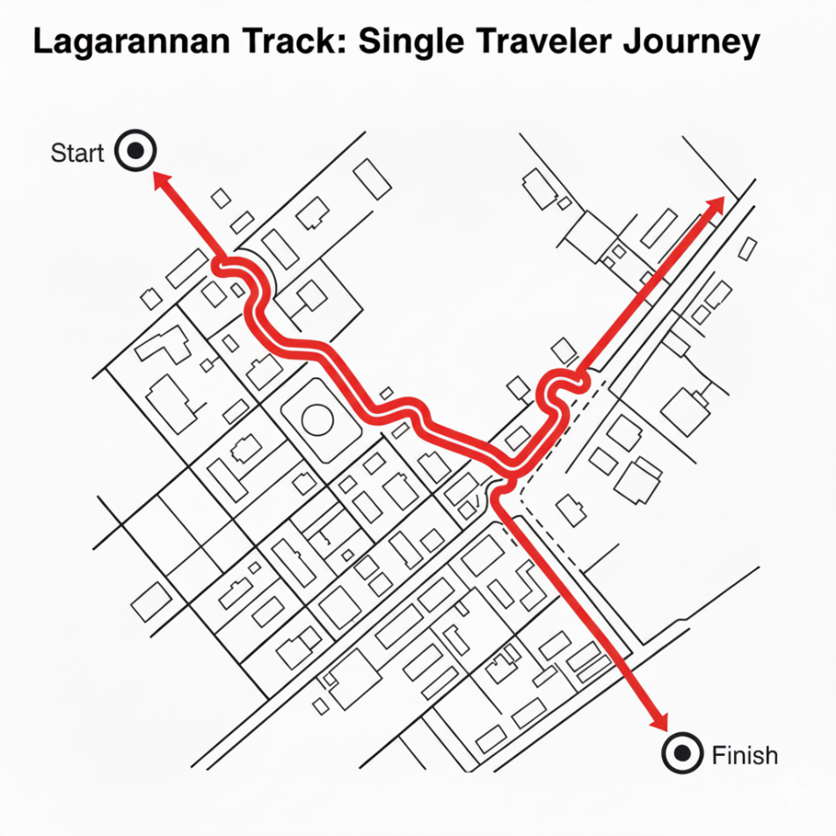
01. Pre Activity Briefing & Training
1.0. Activity 1: The traveler's-Eye View (Lagrangian Track)
The Task: Record the entire journey of a single traveler (a walker, in this case) from start to finish.
The Data: This is Lagrangian data; moving with an element to track its path.
Practical Use: This data reveals preferred paths, identifies specific bottleneck locations (where speed drops), and helps understand the real-world user experience.

Slide 10
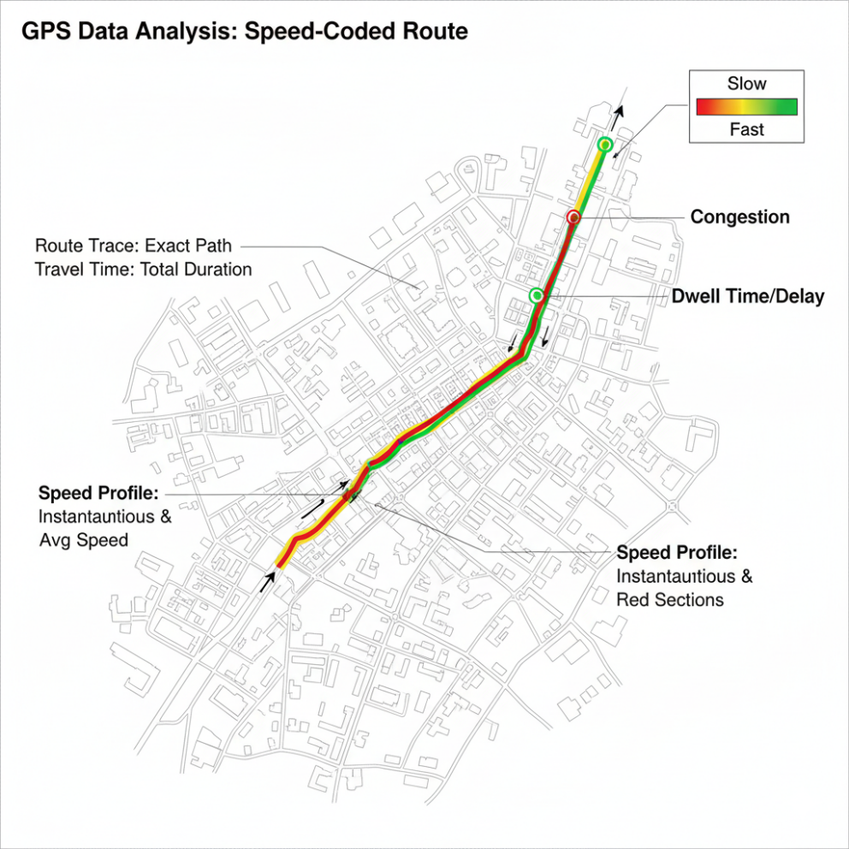
01. Pre Activity Briefing & Training
1.1. Activity 1: Key Metric
Key Metrics from GPS Data
Route Trace: The exact path taken, visualized on a map.
Travel Time: Total duration from start to stop.
Speed Profile: Instantaneous and average speed, calculated between track points.
Dwell Time/Delay: Time spent stationary or moving very slowly, indicating points of congestion or stops.

Slide 11
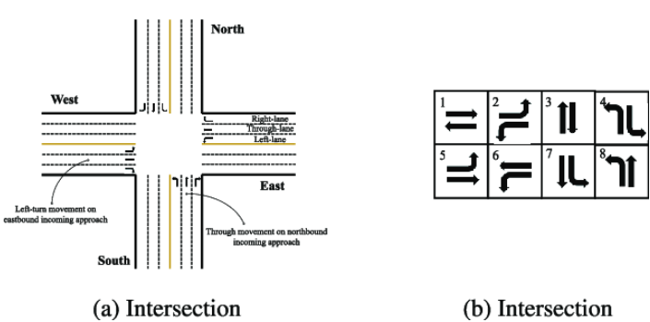
01. Pre Activity Briefing & Training
1.2. Activity 2: The Bird's-Eye View (Eulerian Count)
The Task: Measure the volume and mix of traffic passing through a fixed "gate“, i.e., your chosen intersection approach.
The Data: This is Eulerian data; observing flow at a stationary point.
Practical Use: This data is essential for justifying new transport infrastructure such as a new bike lane, retiming a traffic signal, or conducting a safety analysis.
Illustration of an intersection consisting of 4 approaches with corresponding lanes and 8 valid phases. Source: Zhang et al.

Slide 12
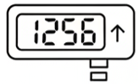
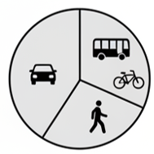
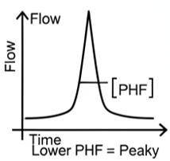
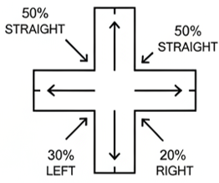

01. Pre Activity Briefing & Training
1.3. Key Metrics from Manual Counts
Volume: The total number of units (vehicles, people) passing a point.
Modal Split: The percentage breakdown of different travel modes (cars, buses, bikes, peds).
Turning Movement Percentages: The proportion of traffic turning left, straight, or right.
Peak Hour Factor (PHF): A measure of flow fluctuation. A lower PHF means traffic is more “peaky." (Source: UrbanLogiq, 2022)

Slide 13
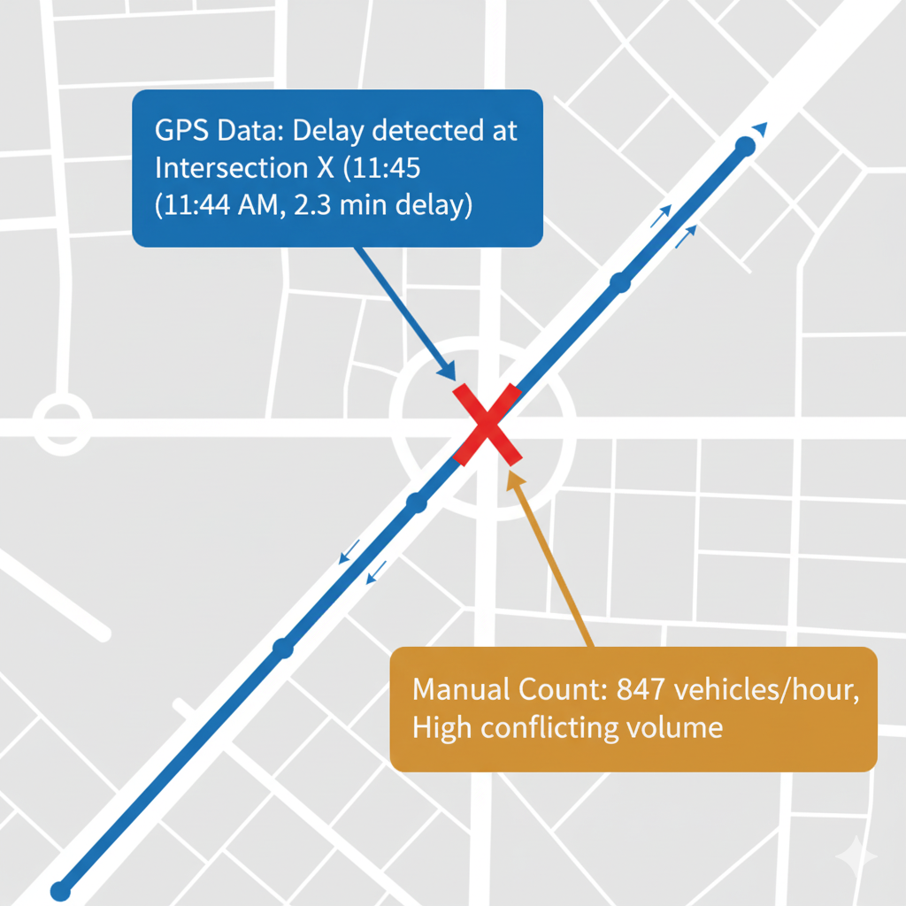
01. Pre Activity Briefing & Training
1.4. How Both Datasets Complement Each Other
Connecting the Datasets
Neither dataset tells the whole story alone.
The GPS track shows where a delay occurred (e.g., at Intersection X).
The manual count shows why the delay likely occurred (e.g., high conflicting traffic volume at Intersection X at that specific time).
Combining them allows for a much richer, more defensible analysis.

Slide 14

01. Pre Activity Briefing & Training
1.5. Field Safety: Your Number 1 Priority
Field Safety Protocol.
Fieldwork is a professional engineering task with real-world risks. Your safety is non-negotiable.
Primary Mandate: Always maintain situational awareness. The data is secondary to your safety.
You are responsible for yourself and for looking out for your teammates.

Slide 15
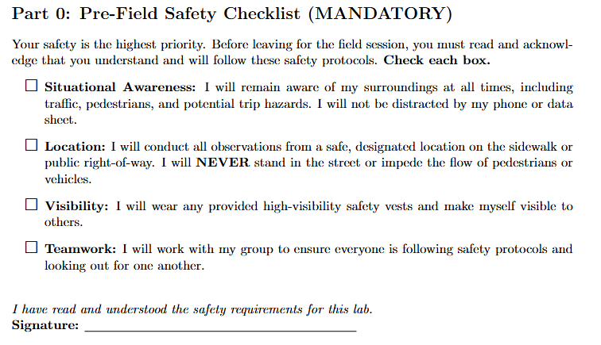
01. Pre Activity Briefing & Training
1.6. The Pre-Field Safety Checklist (Active Task)
Acknowledge the Protocol
Open your Student Worksheet to Part 0.
Individually, read and check off each item on the safety checklist.
This is your formal acknowledgement that you understand and will abide by these rules.
We will not proceed until everyone has completed this task.

Slide 16
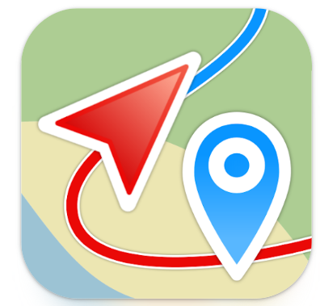
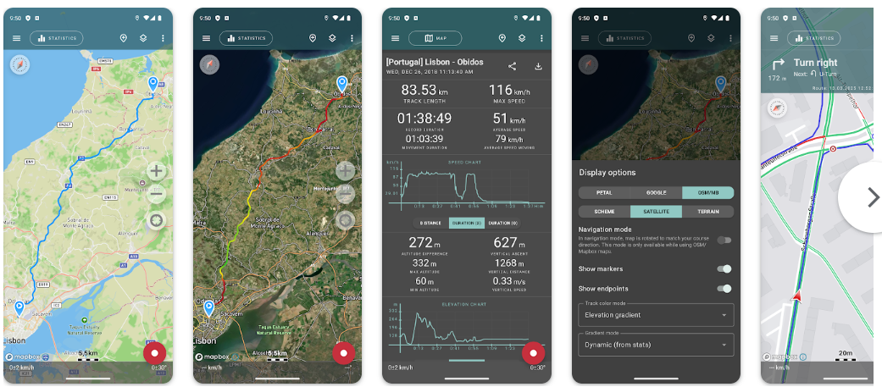
01. Pre Activity Briefing & Training
1.7. Your Digital Toolkit: The GPS Logger App
Digital Toolkit: The GPS Logger
We will use Geo Tracker, a free app that functions as a professional-grade GPS logger.
It records a series of timestamped geographic coordinates (latitude, longitude).
Its key function for the lab is clean, universal GPX data export.

Slide 17

01. Pre Activity Briefing & Training
1.8. Step 1: Installation & First Launch
Installation & First Launch
Task: Install "Geo Tracker - GPS tracker"" from your device's app store.
Critical: When you first open the app, it will ask for location permissions. You must select "Allow While Using App". If you deny this, the app will not work.
First Look: The app will open to a map view. Familiarize yourself with the main screen. You should see a large, red circular button at the bottom right; this is your main START/STOP button.

Slide 18
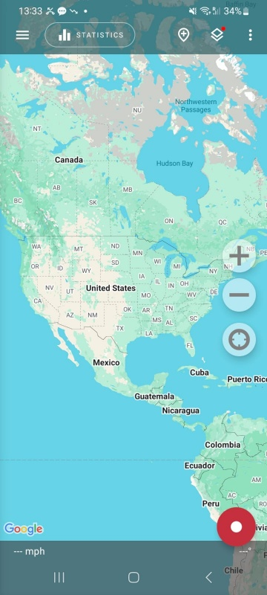
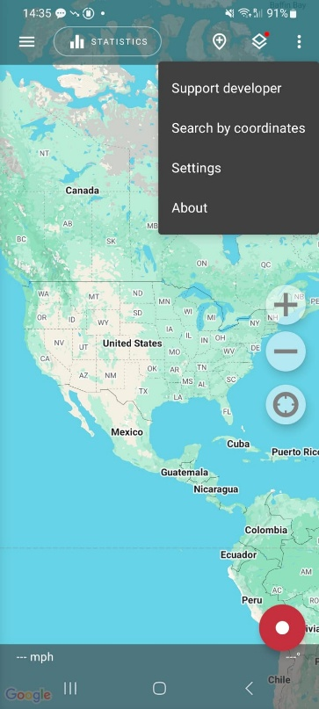
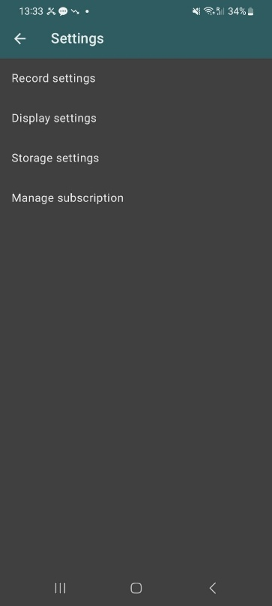
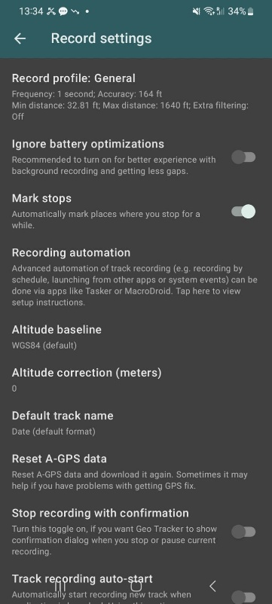
01. Pre Activity Briefing & Training
1.9. Step 2: Configuring the App for Quality Data
Poor settings = poor data. Let's configure for quality.
Goal: We will now verify the app's settings. Our goal is to understand the defaults, not change them. The default settings are excellent for our walk.
Navigate to Settings:
  Tap the Menu icon.
  Tap on Settings.
  Tap on Record settings.

Slide 19

01. Pre Activity Briefing & Training
1.10. Step 3: Recording a Track - Best Practices
Before You Start: Get a GPS Lock.
  Stand outside with a clear view of the sky.
  Watch the top of the app screen. Wait until the satellite icon has a stable number and the accuracy reading is less than 10m (33 ft). Do not start until you have a good lock.
To START Recording:
  When you are ready to begin your walk, tap the large, red circular START button once. It will likely change to indicate it's recording (e.g., a square "stop" icon).
To STOP Recording:
  When you have completed your route, tap the record button again to stop. The track will be automatically saved.
Tap here to START.

Slide 20
01. Pre Activity Briefing & Training
1.11. Step 4: Exporting the GPX Data File
Access Your Track: After you stop recording, your track is saved. To find it, tap the Menu icon (top-left) and select Track list (or a similar option like "History").
Share the Track:
  In the track list, find the track you just recorded (it will be named by date and time).
  Tap on it to open its details.
  Look for a Share or Export icon (often three connected dots).
  Crucial: When prompted for the format, select GPX.
Email the File: Share the GPX file via email to all your group members immediately. This creates a backup and distributes the data for analysis.
Menu Icon

Slide 21

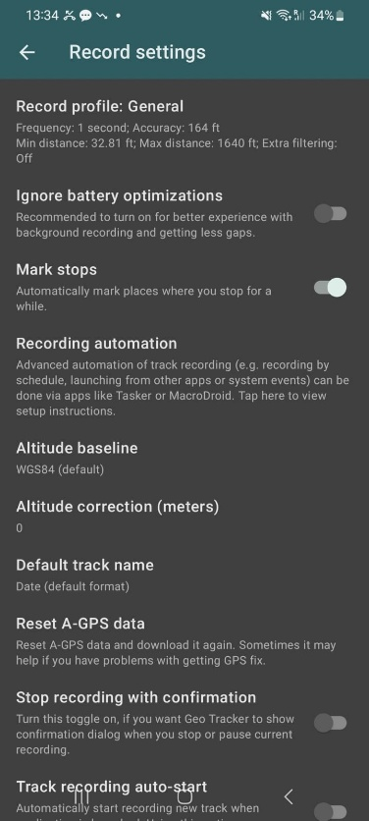
01. Pre Activity Briefing & Training
1.12. Common Issues & Troubleshooting
Problem: App stops recording in the background.
  Solution: In Record settings, turn ON the Ignore battery optimizations toggle. This tells your phone not to shut down the app to save power.
Problem: My GPS track is very inaccurate or won't lock.
  Solution 1: Always wait for a good signal lock before starting.
  Solution 2: In Record settings, use the Reset A-GPS data feature. This can help your phone find satellites faster.
Problem: The app created a lot of short, unwanted tracks.
  Cause: You may have accidentally enabled Track recording auto-start. In Record settings, ensure this toggle is OFF.

Slide 22
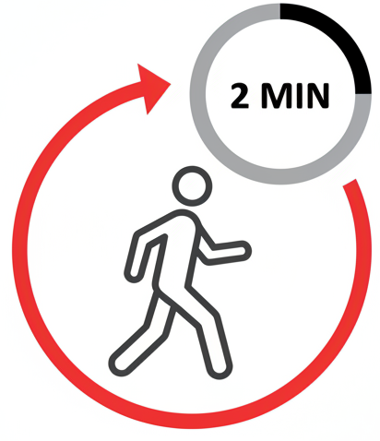
01. Pre Activity Briefing & Training
1.13. In-Class Activity 1: The Practice Track
In-Class Activity 1: Practice Run
To ensure the setup works before going outside.
Live Task (2 Mins):
  Students, START trackers.
  Walk out of the classroom, down the hall, and back to your seat.
  STOP the track.
  EXPORT the GPX file and email it to yourself.
Troubleshoot any issues now.

Slide 23




01. Pre Activity Briefing & Training
1.14. Your Manual Toolkit: The Tally Sheet & Timer
Manual Toolkit: Tally Sheet & Timer
Your primary tools are simple but require precision.
The Tally Sheet: A structured grid for capturing multimodal data in time intervals.
The Timer: A stopwatch or phone app is essential for marking intervals accurately.
The Clipboard & Pen: A stable writing surface for note taking.

Slide 24
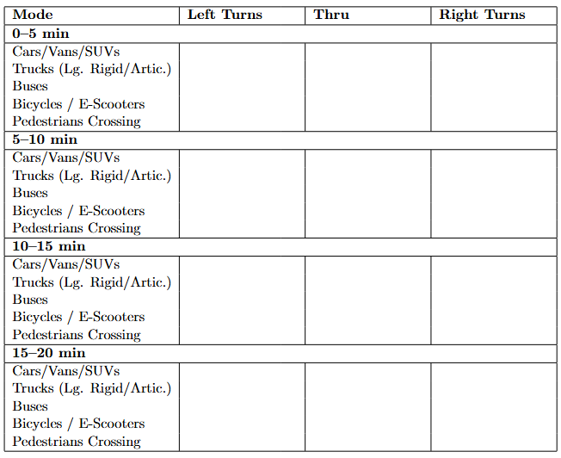
01. Pre Activity Briefing & Training
1.15. The Tally Sheet
Let's break down the tool. Refer to your worksheet.
Header: Location, Approach, Time, Weather. Fill this out completely before you start. Incomplete metadata makes data useless.
Columns: Turning Movements (Left, Thru, Right).
Rows: Travel Modes (Cars, Trucks, Buses, Bikes, Peds). Be precise with classification.
Time Blocks: Sections for each 5-minute interval.

Slide 25
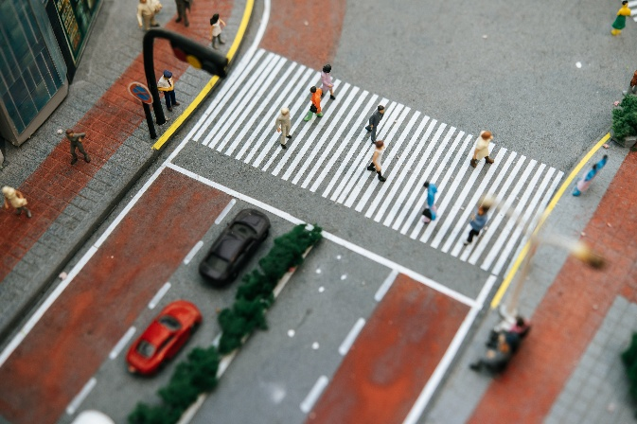
01. Pre Activity Briefing & Training
1.16. Field Execution
Field Execution Best Practices
Positioning:
  Assume a position with a clear and unobstructed view.
Use a Count Line:
  Mentally draw a line on the pavement (e.g., the stop bar).
  Count a vehicle only when its front axle crosses that line. This eliminates ambiguity.
Handling Occlusion:
  If a large truck blocks your view, do your best.
  If you are certain, you missed vehicles, make a note in your log; do not guess.
Handling Surges:
  If a large platoon arrives, focus on counting just one movement perfectly rather than all three poorly. Note the event.
Stop Bar

Slide 26
01. Pre Activity Briefing & Training
1.17. Common Problems in Manual Counts & How to Avoid Them
Problem | Description | Solution
Losing Count | A momentary distraction or a sudden surge of traffic causes you to lose your place in the tally. | Stop, make a note on your sheet (e.g., "lost count at 10:32"), and restart your tally fresh. Do not invent data.
Parallax Error | Counting from a sharp angle makes it difficult to accurately judge a vehicle's turning movement. | Position yourself as squarely to the approach as possible to get the clearest view.
Observer Drift | After 15 minutes of repetitive counting, natural focus begins to wane, increasing the risk of errors. | Stay engaged. If working in a pair, have one person count and one person record to help maintain focus.

Slide 27
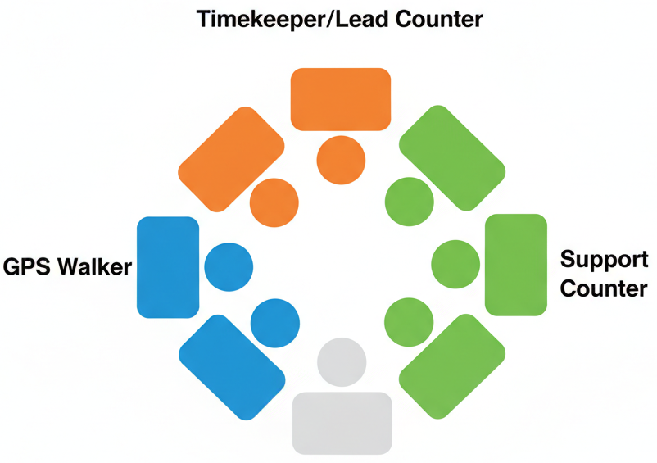
01. Pre Activity Briefing & Training
1.18. Defining Team Roles & Responsibilities for the Field
In-Class Activity 2: Define Your Team Plan
Form Groups and In your groups, decide:
  Who is the GPS Walker? (1 person)
  Who is the Lead Counter / Timekeeper? (1 person)
  Who are the Support Counters? (1-2 people, assigned to specific movements or modes).
Write these roles down in Part 1 of your worksheet.

Slide 28
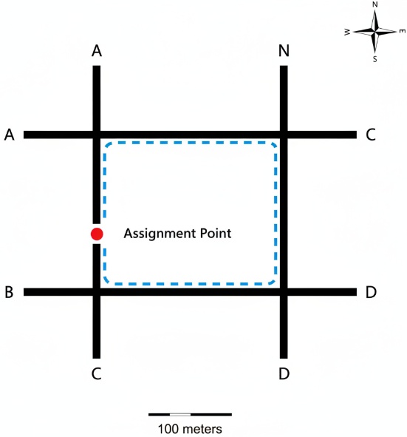
01. Pre Activity Briefing & Training
1.19. Final Briefing & Time Synchronization
Final Briefing
Location Assignments:
  Group 1: Intersection A, Northbound Approach...
Time Synchronization: Sync clocks. The field session begins and ends at the allocated time.
Plan: Travel to your site. The GPS Walker and Counters start their tasks at the exact same time. Both tasks run for 20 minutes. Return to class when done.

Slide 29
Section 02:
Field Activity Execution

Slide 30

02. Field Execution
2.0. Field Activity: Execute The Data Collection Plan
Field Activity: Execute
Final Checks:
  Worksheet, clipboard, pen?
  Timer ready?
  GPS phone charged and configured?
  Roles understood?
Remember your safety protocol. Be professional and aware
Refer to the Lab Manual

Slide 31
Section 03:
Data Analysis & Reflection

Slide 32
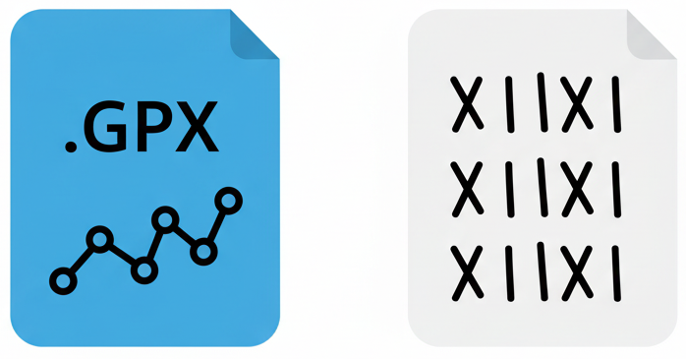
03. Data Analysis & Reflection
3.0. Turning Data into Insights
Data Processing Workflow
You should now have your two raw datasets:
  A GPX file from your walk.
  A completed Tally Sheet.
The next 25 minutes are a sprint to log, process, and visualize this data. Follow the steps outlined in the worksheet precisely.
A GPX file from your walk
A completed Tally Sheet

Slide 33
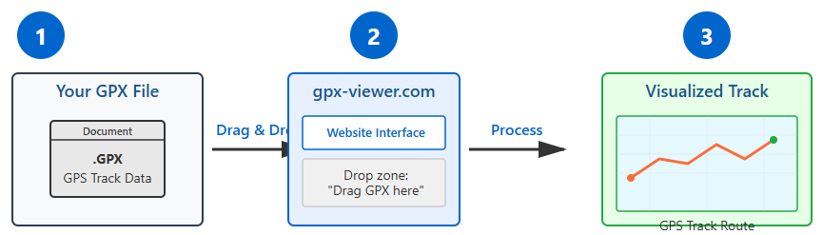
03. Data Analysis & Reflection
3.1. Analysis Task 1: Visualizing the GPS Track
Task 1: Visualize GPS Track
Tool: Use a free online viewer.
Action: Drag and drop your group's GPX file onto the website's map.
Goal: Visually inspect the track for quality and accuracy. Identify any areas with signal drift or error.
Deliverable: Submit your worksheet and results including final map with final analysis.
https://gpx-viewer.com/

Slide 34
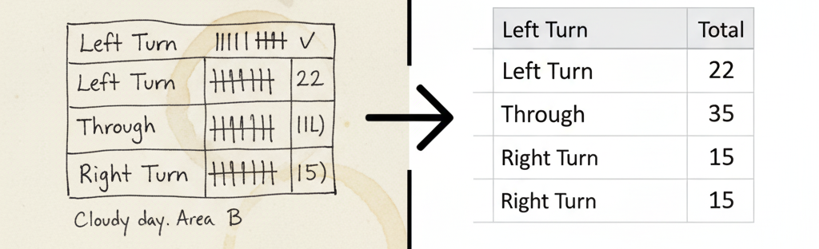
03. Data Analysis & Reflection
3.2. Analysis Task 2: Digitizing the Manual Count Data
Task 2: Digitize Manual Count
Tool: Google Sheets or Excel.
Action: Create a table that exactly mirrors your paper tally sheet. Sum your tallies and enter the final numbers into the cells.
Goal: Create a clean, error-free digital record of your observations.

Slide 35
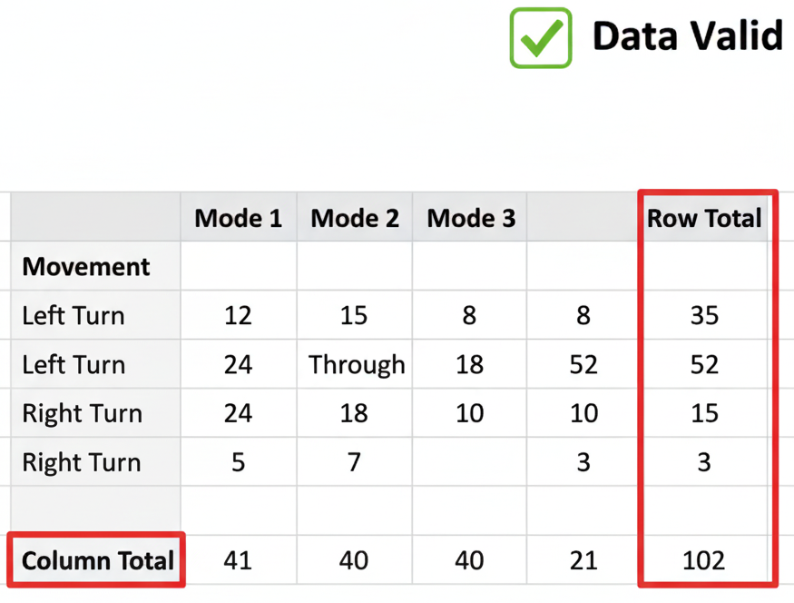
03. Data Analysis & Reflection
3.3. Data Quality Check
Task 3: Data Quality Check
Before you analyze, check your data for obvious errors.
In your spreadsheet, use the SUM() function.
Check 1: Does the sum of the four 5-minute interval totals equal the grand total you calculated?
Check 2: Does the sum of all modes for a given movement equal the total for that movement?
Fix any data entry errors before proceeding.

Slide 36

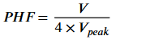
03. Data Analysis & Reflection
3.4. Analysis Task 4: Calculating Key Metrics
Modal Split (Percentage):
  This calculation shows the proportion of each travel mode you observed.
  Use the data from your spreadsheet's "Total" row.
  Formula:
  Where Count_i is the total count for a single mode (e.g., total cars).
Peak Hour Factor (PHF):
  This metric measures the "peakiness" of traffic flow within your count period.
  A PHF near 1.0 means traffic was steady; a lower value means it was very concentrated in one short burst.
Formula:
Where:
  V is the Total hourly traffic volume
  V_Peak is the Traffic volume during the busiest 15-minute interval within that hour.

Slide 37
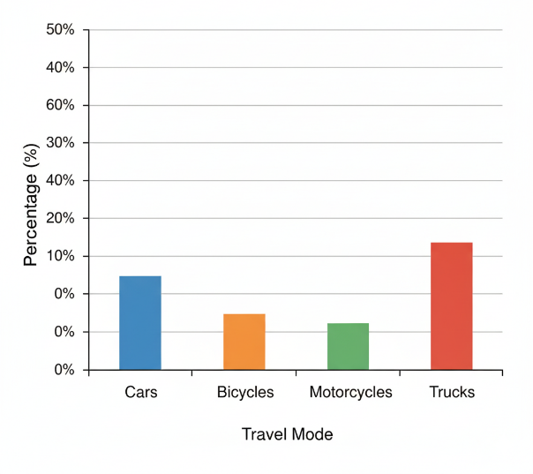
03. Data Analysis & Reflection
3.5. Analysis Task 5: Creating Modal Split Chart
Task 5: Create Modal Split Chart
Action:
  On Google Sheets or Excel, select your data for total volume per mode.
  Go to Insert > Chart and select a Column Chart.
Goal: Create a clear, professional visualization of the modal composition at your site.
Non-negotiable: Your chart MUST have a clear title (e.g., "Modal Split at [Intersection] on [Date]") and labeled X and Y axes.

Slide 38
03. Data Analysis & Reflection
3.6. Group Discussion: What Did Your GPS Track Reveal?
Group Debrief 3.2: GPS Track Insights
Question 1: Where did you see the most GPS error? Why do you think it happened there?
Question 2: Based on the speed profile of your track, where was the biggest delay for your walker? How could this tool be used to evaluate pedestrian Quality of Service?

Slide 39

03. Data Analysis & Reflection
3.7. Group Discussion: What Did Your Manual Count Reveal?
Group Debrief 3.2: Manual Count Insights
Question 1: What was the biggest practical challenge your group faced during the count? How did you solve it?
Question 2: Look at your modal split chart. Is this intersection dominated by cars, or is there a significant presence of other modes? What does this imply for future design?

Slide 40
03. Data Analysis & Reflection
3.8. Summary & Key Takeaways
Summary & Key Takeaways
Today's Achievement: You executed a professional-grade, multi-method data collection workflow.
Key Takeaway 1: Data quality is determined in the field. Good preparation and protocol prevent poor performance.
Key Takeaway 2: Different data types (Eulerian and Lagrangian) answer different questions but are most powerful when used together.

Slide 41
03. Data Analysis & Reflection
3.9. Assignment & Submission
Next Steps & Submission
Task: Complete all sections of the Student Worksheet, including the reflection questions.
Deliverables: Ensure your GPS screenshot, labelled map, modal split chart, and reflection answers are complete.
Submission: Submit the worksheet as a single PDF to the course portal in w weeks.

Slide 42
Section 08:
References

Slide 43
04: References
4.0. References
FHWA Traffic Monitoring Guide
NYSDOT, Turning Movement Collection Standards (2020)
UrbanLogiq, “What Is Peak Hour Factor (PHF)?” (2022)
Wikipedia, “Floating car data”
GPS Visualizer: Do-It-Yourself Mapping
Further Reading
"AI in Transportation and Education: Leveraging Predictive Maintenance, Adaptive Learning, and Automated Grading for Enhanced Efficiency," ResearchGate, Dec. 2022. doi: 10.13140/RG.2.2.13801.71528.

Slide 44
Thank you for your attention!

