Slide 1
Transport Research and Analysis
Module 3: Transport Modeling and Simulation
Lab 8: Travel Demand Forecasting

Slide 3
Table of contents
Travel Demand Forecasting
Section 1: Lab Overview and Required Tools ……………….…………………………………………. 4
1.1 Objectives …….……………………………………………………………………………………… 5
1.2 Lab Activities and Time Allocation ...…….……………………………………………………… 6
1.3 Tools Used in This Lab …………………….………………………………………………………… 7
Section 2: Introducing Travel Demand Forecasting ……………….…………………………………. 9
2.1 What is Travel Demand Forecasting? ………………………….…………………………………. 10
2.2 Key Approaches to Travel Demand Forecasting ……………..…………………………………. 11
2.3 Traditional vs Modern Demand Forecasting …………………….………………………………. 14
2.4 Types of Travel Demand Forecasting …………………………….………………………………. 15
2.5 Case Study ……………………………………………………………..………………………………. 16
Section 3: Class Activity 1: Four-Step Travel Demand Model ………………………………………. 17
3.1 Four-Step Travel Demand Model (Recap) ………………………………………………………. 18
3.2 Class Activity 1: Implement a Four-Step Travel Demand Model ………….…………………. 19
3.3 Class Activity 1: Task Instructions …………………………………………………………………. 21
3.4 Python code explanation ………………………………………………….…………………………. 22
Notes:
This lab is structured into five main sections. We’ll begin with techniques for cleaning and transforming data. Then, we’ll explore how to standardize transport data formats.

Slide 4
Table of contents
Travel Demand Forecasting
Section 4: Class Activity 2: Demand Estimation ………………..……………………………………. 30
4.1 Class Activity 2: Demand Estimation ………………………………...……………………………. 31
4.2 Class Activity 2: Dataset …………………………………………….………………………………. 32
4.3 Class Activity 2: Task Instructions …………………………………………………………………. 34
4.4 Python code explanation ………………………………………………….…………………………. 35
Section 5: Class Activity 3: Scenario Modeling ……………………….………………………………. 41
5.1 Class Activity 3: Scenario Modeling ……………………………….………………………………. 42
5.2 Class Activity 3: Dataset ………………………………………………..……………………………. 43
5.3 Class Activity 2: Task Instructions …………………………………………………………………. 45
5.4 Python code explanation ……………………………………………….……………………………. 46
Section 6: Homework Assignment ………………………………………..…………………………..…. 52
6.1 Homework: Travel Demand Forecasting ………………….……………………………………. 53
6.2 Homework: Dataset …………………………………………..……………………………………. 54
6.3 Homework: Task Instructions …………………………………….………………………………. 56
Section 7: References …………………………………………………….……………………………. 59
Notes:
This lab is structured into five main sections. We’ll begin with techniques for cleaning and transforming data. Then, we’ll explore how to standardize transport data formats.

Slide 5
Section 01:
Lab Overview and Required Tools
Notes:
# English
Now we are in Section 1: Overview and Tools.
Let’s quickly see what this lab is about and what tools we’ll use.
# French
Nous voici maintenant à la section 1 : Présentation et outils.
Voyons rapidement en quoi consiste cet atelier et quels outils nous utiliserons.

Slide 6
1. Lab Overview and Required Tools
1.1 Objectives: Travel Demand Forecasting
Travel demand forecasting helps us understand how many people will travel in the future, where they will travel, and which modes they will use. This lab introduces students to the practical side of forecasting by working with real datasets, performing basic demand estimation tasks, and exploring how changes in population or land use affect future travel patterns.
By the end of this lab, students will be able to:
✅ Understand the basic workflow of travel demand forecasting
✅ Prepare and analyze transportation datasets
✅ Perform simple demand estimation steps (trip generation & distribution recap)
✅ Apply forecasting concepts to evaluate future scenarios
✅ Visualize and interpret forecast results
✅ Compare impacts of population or land-use changes on network demand
✅ Connect travel demand forecasting with the Four-Step Model (brief recap)

Slide 7
1. Lab Overview and Required Tools
1.2 Lab Activities and Time Allocation
This lab guides students through simulating and analyzing traffic flow using PTV VISSIM. Activities include designing intersections, adjusting signals, and evaluating performance metrics. Hands-on tasks are combined with analysis to reinforce simulation skills.
Section | Topic | Tools | Activity Type | Activity Done By | Duration (min)
1 | Lab Overview and Required Tools | - | Presentation | Teacher | 10
2 | Introduction to Travel Demand Forecasting | - | Presentation | Teacher | 10
3 | Recap of Four-Step Model | - | Presentation | Teacher | 10
3 | Class Activity 1: Four-Step Travel Demand Model | Python | Practical | Teacher + Student | 20
4 | Class Activity 2: Scenario Modeling | Python | Practical | Teacher + Student | 55
5 | Class Activity 3: Demand Estimation | Python | Practical | Teacher + Student | 55
6 | Homework: Assignment 1 (at home 120-180min) | Python | Homework | Student | 20
Total |  |  |  |  | 180
Notes:
# English
In this lab, we will explore data preprocessing techniques that are essential for preparing raw transport or tabular datasets for analysis. You will learn how to clean, standardize, and visualize real-world datasets using Python and Google Colab.
We have 8 main sections in this lab, and altogether, it will take approximately 135 minutes to complete all the activities.
# French

Slide 8





1. Welcome & Objectives
1.2 Tools Used in Session
When following this lab, you will need to use the following tools:
✅ Python: A programming language widely used for data analysis, visualization, and machine learning.
✅ Anaconda: A distribution of Python that makes it easy to manage packages and environments for data science.
✅ Google Colab: A free cloud-based platform to write and run Python code directly in the browser, without installation.
✅ Jupyter Notebook: An interactive coding environment where you can mix code, text, and visualizations in one document.
✅ Excel: A spreadsheet tool for quick data exploration, simple cleaning, and visualization.
Notes:
# English
In this workshop, we’ll use a few simple tools to handle data.
Python is our main programming language for analysis and ML.
Anaconda helps manage packages.
Google Colab and Jupyter Notebook are used to write and run code easily.
Excel is for quick database checks.
There are many other tools in the industry, but in this session, we’ll only focus on Python, Colab, and Excel to keep things simple.

Slide 9

Travel Demand Forecasting - Video
How Is Travel Demand Forecasting Used In Disaster Planning?
In this informative video, they discussed the critical role of travel demand forecasting in disaster planning. This technique is essential for civil engineers as they prepare for emergencies such as hurricanes and floods.
Video Credits:
Civil Engineering Explained
Video link:
https://youtu.be/W9TJULKC1as
Notes:
# English
# French

Slide 10
Section 02:
Introducing Travel Demand Forecasting
Notes:
In this section, we are going to explore one of the most important data preprocessing steps in any data analysis project.
Whether you're working with transport data, business analytics, or health records, preprocessing helps turn messy raw data into something that machines — and humans — can understand.
Let’s go through the core techniques you’ll need to clean and prepare your data effectively.

Slide 11
2. Introducing Travel Demand Forecasting
2.1 What is Travel Demand Forecasting?
Travel demand forecasting is a method used to predict future travel patterns based on various factors such as population growth, land use, and transportation policies. It helps planners and decision-makers design efficient transport systems and infrastructure to meet future needs.
1. Infrastructure Planning
Helps determine where to build new roads, metro lines, and bus routes.
4. Policy Evaluation
Assesses the impact of policies like toll pricing, fuel taxes, or parking restrictions.
Why is Travel Demand Forecasting Important?
2. Congestion Reduction
Predicts traffic hotspots and suggests solutions to manage congestion.
5. Environmental Impact Analysis
Helps in reducing emissions by promoting sustainable transport.
3. Public Transport Development
Supports investment in buses, trains, and other mass transit options.

Slide 12
2. Introducing Travel Demand Forecasting
2.2 Key Approaches to Travel Demand Forecasting
There are several techniques used to predict travel demand:
1. Trend-Based Forecasting
✅ Uses historical travel data to predict future travel patterns.
✅ Assumes that past trends (ex: traffic growth rate) will continue.
✅ Ex: If a city’s traffic grows by 5% annually, this method will project a similar increase for future years.
✅ Limitations: Does not account for changes in policies, new transport options, or disruptions.
2. Regression Models
✅ Uses statistical techniques to find relationships between travel demand and influencing factors.
✅ Example: Travel demand = α(Population) + β(Income) + γ(Fuel Price) + ε
✅ Strengths: More accurate than trend-based forecasting as it considers multiple variables.
✅ Limitations: Requires extensive historical data and may not capture sudden changes in travel behavior.
3. Econometric Models
✅ Advanced version of regression models that account for economic factors (ex: GDP growth)
✅ Used for long-term strategic planning at regional or national levels

Slide 13
2. Introducing Travel Demand Forecasting
4. Machine Learning Models
✅ Uses AI algorithms like neural networks and random forests to analyze large datasets and predict travel demand.
✅ Can incorporate real-time traffic data and social behavior trends.
✅ Example: Google Maps and Uber use AI to predict demand surges.
✅ Strengths: Highly accurate for complex datasets.
✅ Limitations: Requires extensive computing power and large datasets.
5. Simulation-Based Models
✅ Uses computational simulations to model travel behavior under different scenarios.
✅ Example: Agent-Based Models (ABM) simulate individual travelers making decisions based on real-time conditions.
✅ Strengths: Captures complex interactions between travelers, network changes, and external factors (weather, policies, etc.).
✅ Limitations: Requires detailed input data and high computational power.

Slide 14
2. Introducing Travel Demand Forecasting
6. Land-Use and Transport Interaction Models
✅ Integrates land-use planning with transportation forecasting to understand how changes in urban development affect travel demand.
✅ Example: UrbanSim, TRANUS – Models how new residential or commercial zones influence traffic patterns.
✅ Strengths: Helps long-term strategic planning by linking transport investments with urban growth.
✅ Limitations: Requires extensive spatial and demographic data, and forecasts may be affected by unforeseen economic shifts.

Slide 15
2. Introducing Travel Demand Forecasting
2.3 Traditional vs. Modern Demand Forecasting Methods
Traditional travel demand forecasting methods rely on historical trends and statistical models to predict future travel patterns. These approaches, such as trend-based and regression models, are useful for stable environments but struggle to adapt to sudden changes (ex: new policies, emerging transport modes).
Modern methods integrate real-time data, AI, and simulation-based techniques to provide more dynamic and accurate predictions. These advanced models consider factors like real-time traffic conditions, land-use changes, and evolving commuter behavior.
Approach | Data Type | Accuracy | Use Case
Trend-Based | Historical | Low | Basic Forecasting
Regression | Statistical | Medium | Policy Planning
Econometric | Economic Data | Medium-High | Long-Term Planning
Machine Learning | Big Data | High | Real-Time Demand Forecasting

Slide 16

2. Introducing Travel Demand Forecasting
2.4 Types of Travel Demand Forecasting
1. Short-Term Forecasting (0-5 years)
Used for traffic management and immediate improvements.
Ex: Predicting traffic flow for an upcoming event.
2. Medium-Term Forecasting (5-15 years)
Supports infrastructure projects like road expansion and new transit routes.
Ex: Planning for a new metro line in a growing suburb.
3. Long-Term Forecasting (15+ years)
Used for strategic planning at the city or regional level.
Ex: Estimating transport demand for a new airport in 2040.

Slide 17

2. Introducing Travel Demand Forecasting
2.5 Case Study: New Metro Line
Demand Forecasting for a New Metro Line:
Scenario:
✅ A city is planning to introduce a new metro line to reduce road congestion.
✅ Travel demand forecasting predicts a 30% increase in metro users over the next 10 years.
✅ The model suggests adding more stations in high-density areas to maximize ridership.
✅ Outcome: The forecast helps in optimizing metro routes, reducing car dependency, and improving urban mobility.
Challenges in Travel Demand Forecasting:
✅ Uncertainty in Future Behavior: People’s travel habits can change due to unforeseen events (ex: COVID-19).
✅ Data Limitations: Inaccurate or outdated data can lead to incorrect predictions.
✅ Integration of New Transport Modes: Ride-sharing, e-scooters, and autonomous vehicles add complexity.
✅ Impact of Policy Changes: Fuel prices, taxation, and environmental laws influence travel demand.

Slide 18
Section 03:
Class Activity 1: Four-Step Travel Demand Model
Notes:
In this section, we are going to explore one of the most important data preprocessing steps in any data analysis project.
Whether you're working with transport data, business analytics, or health records, preprocessing helps turn messy raw data into something that machines — and humans — can understand.
Let’s go through the core techniques you’ll need to clean and prepare your data effectively.

Slide 19
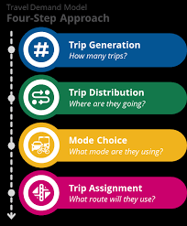
3. Four-Step Travel Demand Model
3.1 Four-Step Travel Demand Model
In this activity, you have to implement the Four-Step Travel Demand Model using Python to analyze trip generation, distribution, mode choice, and route assignment, providing insights into travel behavior and transportation planning.
Four-Step Travel Demand Model
Step 1: Trip Generation
Estimate how many trips start and end in each zone.
Step 2: Trip Distribution
Determine where these trips go by linking origins to destinations.
Step 3: Mode Choice
Identify which transport mode (car, bus, walk, etc.) travelers will use.
Step 4: Trip Assignment
Assign trips to actual routes in the network based on travel time and efficiency.

Slide 20
3. Four-Step Travel Demand Model
3.2 Class Activity 1: Implement Four-Step Travel Demand Model
In this activity, we will use a real raw dataset that contains common issues. The task is to explore, preprocess, and visualize the data using Python in order to transform it into a clean and structured dataset.
How to do?
We will provide a Python code in Google Colab notebook.
Open the provided Google Colab notebook.
Run each cell step by step.
Follow the inline comments to understand Trip Distribution, Mode Choice, and Route Assignment.
Link for the reference code: https://colab.research.google.com/drive/1qsiaIX7nK41iBjfKhiiCmPkJ3ExWg5rt
Save Your File:
ex: Class_Activity_Four_Step_Travel_Demand_Model.ipynb
Notes:
# English
To understand data preprocessing better, let’s do another real activity using Python. We’ll run code in Google Colab step by step, and see how issues like missing values, duplicates, and formatting errors are fixed. Then we’ll compare the raw data with the cleaned version using charts.

Slide 21
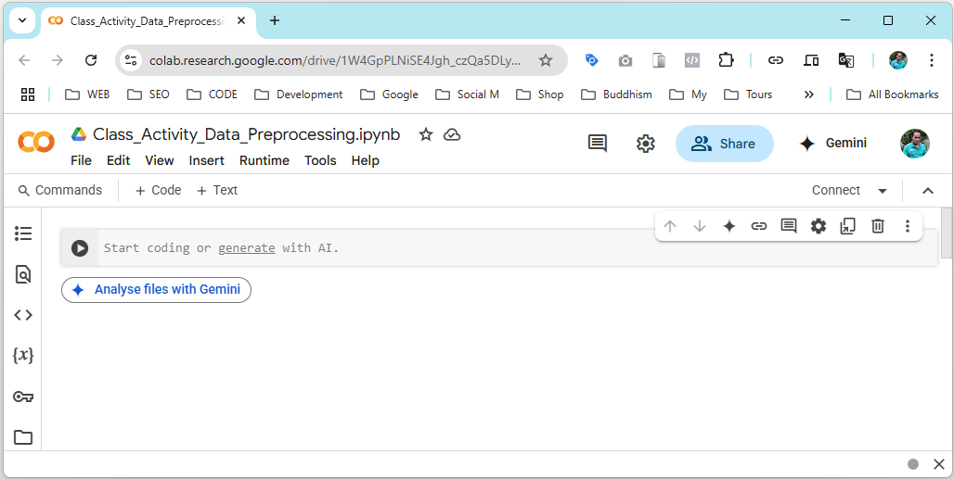
3. Four-Step Travel Demand Model
Instructions for Using Google Colab:
You need to implement the code for Data Preprocessing using Python on Google Colab. Use the provided sample code only as guidance. You are expected to write and run your own version for preprocessing with the class instructor.
Instructions:
How to Build with Google Colab?
Go to: https://colab.research.google.com/
Click “New Notebook”: This will create a blank Python (.ipynb) file in Colab.
Build the model: Use the provided sample code build the model.
Notes:
# English
In this activity, we’ll use Google Colab to run our Python code.

Slide 22
3. Four-Step Travel Demand Model
3.3 Class Activity 1: Task Instructions
Follow these steps using Python (preferably in Google Colab):
Step 1: Download the provided Python notebook.
Step 2: Upload the Python notebook to Google Colab.
Step 3: Import the necessary Python libraries.
Step 4: Import the dataset into Python.
Step 5: Implement Trip Distribution using the simplified Gravity Model dataset.
Step 6: Implement Mode Choice using a basic Logit formulation.
Step 7: Implement Route Assignment by computing shortest paths (Dijkstra’s Algorithm).
Step 8: Visualize and interpret all model outputs.
Step 9: Save and export the final .ipynb file.
Notes:
# English
Step 1 – Download the provided Python notebook
Students obtain the starter file that includes data loading blocks and basic structure.
Step 2 – Upload the notebook to Google Colab
They open the notebook in an environment with all required Python packages preinstalled.
Step 3 – Import Python libraries
Typical packages:
pandas, numpy, matplotlib, networkx, scipy, etc.
Step 4 – Implement Trip Distribution (Gravity Model)
Using the provided impedance matrix + productions/attractions:
Apply the formula
Generate Distributed OD Matrix
Validate row and column sums
Step 5 – Implement Mode Choice
Students use a simplified Logit model to estimate mode shares:
Car
Public Transport
Walk/Cycle
Using example utility values.
Step 6 – Implement Route Assignment (Shortest Path)
Using Dijkstra’s Algorithm via NetworkX:
Build graph from link data
Compute shortest paths
Assign OD trips to paths
Generate link volumes
Step 7 – Visualize and Analyze Results
Recommended visuals:
Distribution heatmap
Mode share bar chart
Network with assigned volumes
Difference between base and scenario (optional)
Step 8 – Save the final notebook
Students download/export .ipynb for submission.

Slide 23
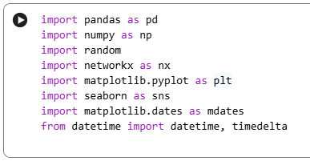
3. Four-Step Travel Demand Model
3.4 Python code explanation
Step 3: Import the necessary Python libraries.
This step imports the essential Python libraries for data analysis and visualization:
Pandas: used for handling and manipulating tabular data (DataFrames)
Numpy: used for numerical operations and mathematical calculations
Networkx: used to build transport networks and compute shortest paths (ex: Dijkstra)
Matplotlib: used for creating static plots and visualizations
Seaborn: used for creating more advanced and visually appealing statistical charts
Datetime: used to handle dates and time operations
Notes:
# English
Step 1 – Download the provided Python notebook
Students obtain the starter file that includes data loading blocks and basic structure.
Step 2 – Upload the notebook to Google Colab
They open the notebook in an environment with all required Python packages preinstalled.
Step 3 – Import Python libraries
Typical packages:
pandas, numpy, matplotlib, networkx, scipy, etc.
Step 4 – Implement Trip Distribution (Gravity Model)
Using the provided impedance matrix + productions/attractions:
Apply the formula
Generate Distributed OD Matrix
Validate row and column sums
Step 5 – Implement Mode Choice
Students use a simplified Logit model to estimate mode shares:
Car
Public Transport
Walk/Cycle
Using example utility values.
Step 6 – Implement Route Assignment (Shortest Path)
Using Dijkstra’s Algorithm via NetworkX:
Build graph from link data
Compute shortest paths
Assign OD trips to paths
Generate link volumes
Step 7 – Visualize and Analyze Results
Recommended visuals:
Distribution heatmap
Mode share bar chart
Network with assigned volumes
Difference between base and scenario (optional)
Step 8 – Save the final notebook
Students download/export .ipynb for submission.

Slide 24
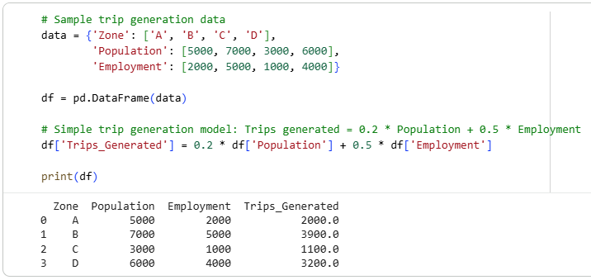
3. Four-Step Travel Demand Model
Step 4: Import the dataset into Python.
The notebook uses a sample hard-coded dataset for demonstration. You may replace it with a real dataset if available.
Notes:
# English
Step 1 – Download the provided Python notebook
Students obtain the starter file that includes data loading blocks and basic structure.
Step 2 – Upload the notebook to Google Colab
They open the notebook in an environment with all required Python packages preinstalled.
Step 3 – Import Python libraries
Typical packages:
pandas, numpy, matplotlib, networkx, scipy, etc.
Step 4 – Implement Trip Distribution (Gravity Model)
Using the provided impedance matrix + productions/attractions:
Apply the formula
Generate Distributed OD Matrix
Validate row and column sums
Step 5 – Implement Mode Choice
Students use a simplified Logit model to estimate mode shares:
Car
Public Transport
Walk/Cycle
Using example utility values.
Step 6 – Implement Route Assignment (Shortest Path)
Using Dijkstra’s Algorithm via NetworkX:
Build graph from link data
Compute shortest paths
Assign OD trips to paths
Generate link volumes
Step 7 – Visualize and Analyze Results
Recommended visuals:
Distribution heatmap
Mode share bar chart
Network with assigned volumes
Difference between base and scenario (optional)
Step 8 – Save the final notebook
Students download/export .ipynb for submission.

Slide 25
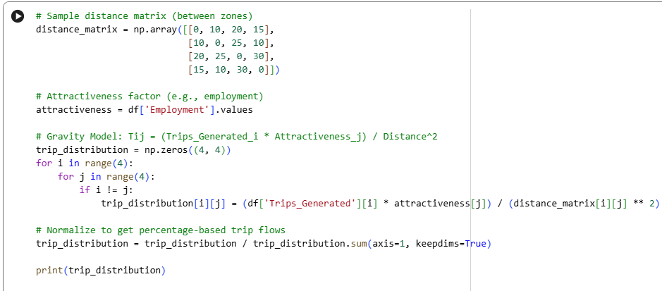
3. Four-Step Travel Demand Model
Step 5: Implement Trip Distribution using the simplified Gravity Model dataset.
Implement Trip Distribution using the simplified Gravity Model to estimate how trips are distributed between zones based on population, distance, and impedance.
Notes:
# English
Step 1 – Download the provided Python notebook
Students obtain the starter file that includes data loading blocks and basic structure.
Step 2 – Upload the notebook to Google Colab
They open the notebook in an environment with all required Python packages preinstalled.
Step 3 – Import Python libraries
Typical packages:
pandas, numpy, matplotlib, networkx, scipy, etc.
Step 4 – Implement Trip Distribution (Gravity Model)
Using the provided impedance matrix + productions/attractions:
Apply the formula
Generate Distributed OD Matrix
Validate row and column sums
Step 5 – Implement Mode Choice
Students use a simplified Logit model to estimate mode shares:
Car
Public Transport
Walk/Cycle
Using example utility values.
Step 6 – Implement Route Assignment (Shortest Path)
Using Dijkstra’s Algorithm via NetworkX:
Build graph from link data
Compute shortest paths
Assign OD trips to paths
Generate link volumes
Step 7 – Visualize and Analyze Results
Recommended visuals:
Distribution heatmap
Mode share bar chart
Network with assigned volumes
Difference between base and scenario (optional)
Step 8 – Save the final notebook
Students download/export .ipynb for submission.

Slide 26
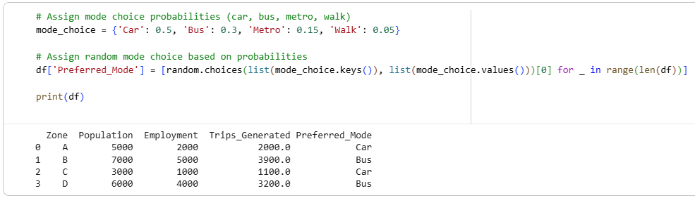
3. Four-Step Travel Demand Model
Step 6: Implement Mode Choice using a basic Logit formulation.
Apply a basic Logit model to calculate mode choice probabilities and estimate how many trips choose each mode (car, bus, walk, etc.).
Notes:
# English
Step 1 – Download the provided Python notebook
Students obtain the starter file that includes data loading blocks and basic structure.
Step 2 – Upload the notebook to Google Colab
They open the notebook in an environment with all required Python packages preinstalled.
Step 3 – Import Python libraries
Typical packages:
pandas, numpy, matplotlib, networkx, scipy, etc.
Step 4 – Implement Trip Distribution (Gravity Model)
Using the provided impedance matrix + productions/attractions:
Apply the formula
Generate Distributed OD Matrix
Validate row and column sums
Step 5 – Implement Mode Choice
Students use a simplified Logit model to estimate mode shares:
Car
Public Transport
Walk/Cycle
Using example utility values.
Step 6 – Implement Route Assignment (Shortest Path)
Using Dijkstra’s Algorithm via NetworkX:
Build graph from link data
Compute shortest paths
Assign OD trips to paths
Generate link volumes
Step 7 – Visualize and Analyze Results
Recommended visuals:
Distribution heatmap
Mode share bar chart
Network with assigned volumes
Difference between base and scenario (optional)
Step 8 – Save the final notebook
Students download/export .ipynb for submission.

Slide 27
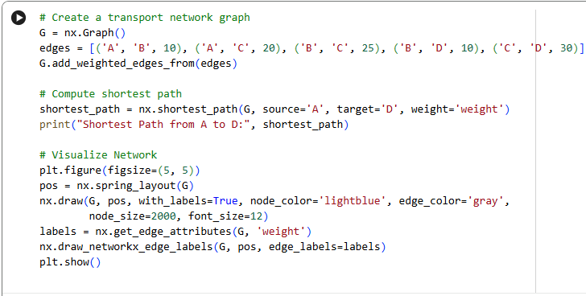
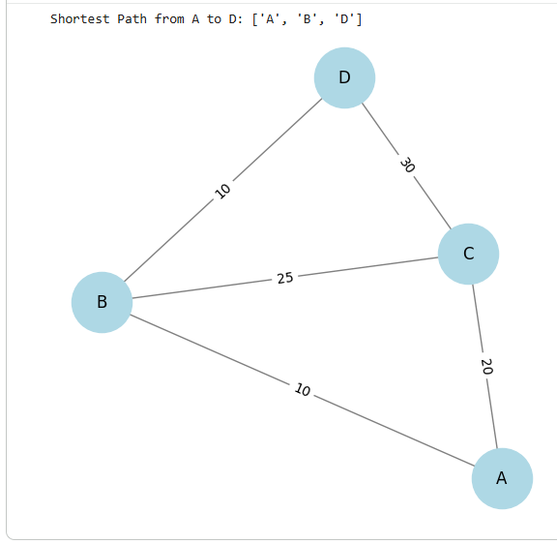
3. Four-Step Travel Demand Model
Step 7: Implement Route Assignment by computing shortest paths (Dijkstra’s Algorithm).
Use Dijkstra’s Algorithm to compute shortest paths on the network and assign trips to routes based on minimum travel time.
Notes:
# English
Step 1 – Download the provided Python notebook
Students obtain the starter file that includes data loading blocks and basic structure.
Step 2 – Upload the notebook to Google Colab
They open the notebook in an environment with all required Python packages preinstalled.
Step 3 – Import Python libraries
Typical packages:
pandas, numpy, matplotlib, networkx, scipy, etc.
Step 4 – Implement Trip Distribution (Gravity Model)
Using the provided impedance matrix + productions/attractions:
Apply the formula
Generate Distributed OD Matrix
Validate row and column sums
Step 5 – Implement Mode Choice
Students use a simplified Logit model to estimate mode shares:
Car
Public Transport
Walk/Cycle
Using example utility values.
Step 6 – Implement Route Assignment (Shortest Path)
Using Dijkstra’s Algorithm via NetworkX:
Build graph from link data
Compute shortest paths
Assign OD trips to paths
Generate link volumes
Step 7 – Visualize and Analyze Results
Recommended visuals:
Distribution heatmap
Mode share bar chart
Network with assigned volumes
Difference between base and scenario (optional)
Step 8 – Save the final notebook
Students download/export .ipynb for submission.

Slide 28
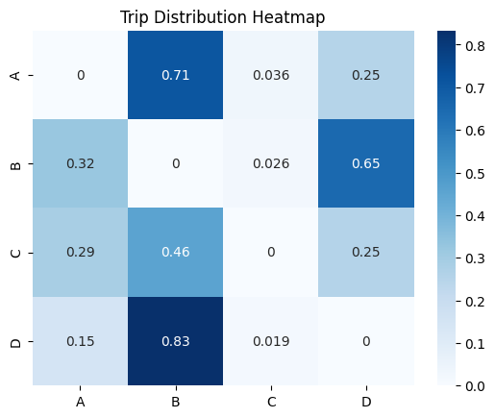
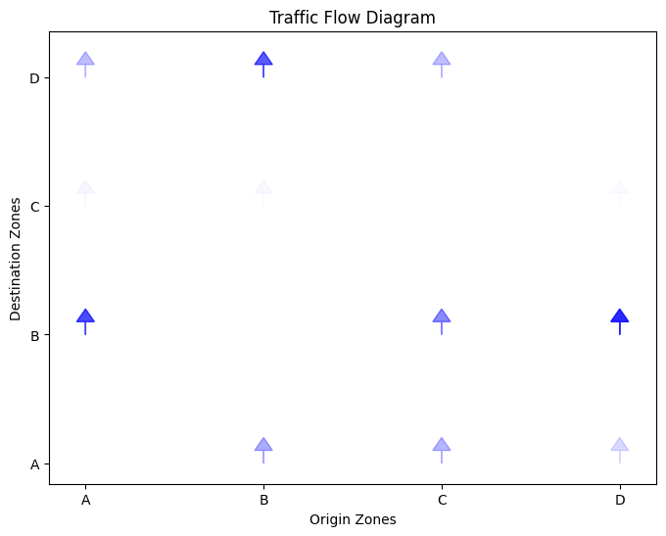
3. Four-Step Travel Demand Model
Step 8: Visualize and interpret all model outputs.
Create charts and visualizations to compare results from distribution, mode choice, and route assignment for clearer interpretation.
Notes:
# English
Step 1 – Download the provided Python notebook
Students obtain the starter file that includes data loading blocks and basic structure.
Step 2 – Upload the notebook to Google Colab
They open the notebook in an environment with all required Python packages preinstalled.
Step 3 – Import Python libraries
Typical packages:
pandas, numpy, matplotlib, networkx, scipy, etc.
Step 4 – Implement Trip Distribution (Gravity Model)
Using the provided impedance matrix + productions/attractions:
Apply the formula
Generate Distributed OD Matrix
Validate row and column sums
Step 5 – Implement Mode Choice
Students use a simplified Logit model to estimate mode shares:
Car
Public Transport
Walk/Cycle
Using example utility values.
Step 6 – Implement Route Assignment (Shortest Path)
Using Dijkstra’s Algorithm via NetworkX:
Build graph from link data
Compute shortest paths
Assign OD trips to paths
Generate link volumes
Step 7 – Visualize and Analyze Results
Recommended visuals:
Distribution heatmap
Mode share bar chart
Network with assigned volumes
Difference between base and scenario (optional)
Step 8 – Save the final notebook
Students download/export .ipynb for submission.

Slide 29
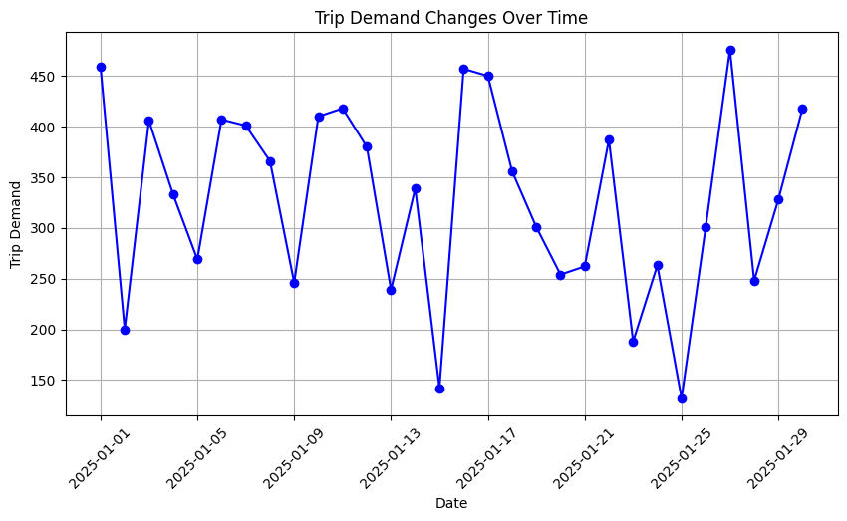
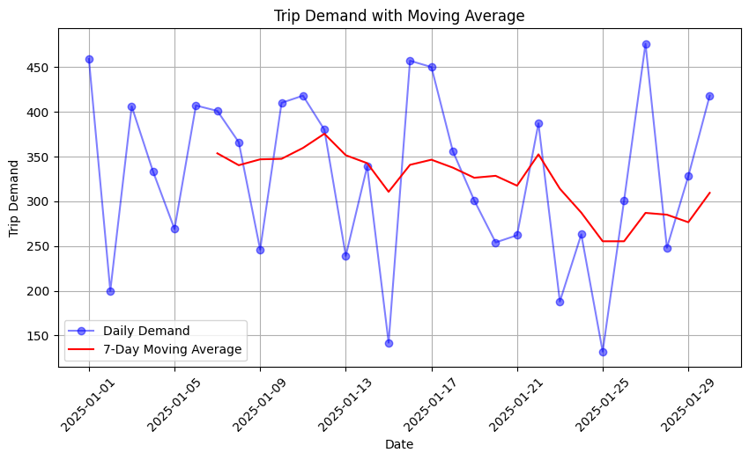
3. Four-Step Travel Demand Model
Notes:
# English
Step 1 – Download the provided Python notebook
Students obtain the starter file that includes data loading blocks and basic structure.
Step 2 – Upload the notebook to Google Colab
They open the notebook in an environment with all required Python packages preinstalled.
Step 3 – Import Python libraries
Typical packages:
pandas, numpy, matplotlib, networkx, scipy, etc.
Step 4 – Implement Trip Distribution (Gravity Model)
Using the provided impedance matrix + productions/attractions:
Apply the formula
Generate Distributed OD Matrix
Validate row and column sums
Step 5 – Implement Mode Choice
Students use a simplified Logit model to estimate mode shares:
Car
Public Transport
Walk/Cycle
Using example utility values.
Step 6 – Implement Route Assignment (Shortest Path)
Using Dijkstra’s Algorithm via NetworkX:
Build graph from link data
Compute shortest paths
Assign OD trips to paths
Generate link volumes
Step 7 – Visualize and Analyze Results
Recommended visuals:
Distribution heatmap
Mode share bar chart
Network with assigned volumes
Difference between base and scenario (optional)
Step 8 – Save the final notebook
Students download/export .ipynb for submission.

Slide 30
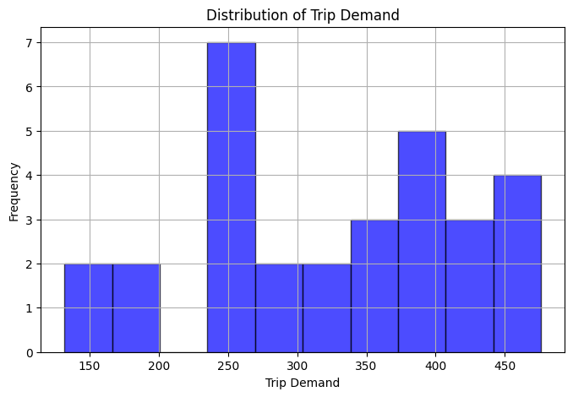
3. Four-Step Travel Demand Model
Notes:
# English
Step 1 – Download the provided Python notebook
Students obtain the starter file that includes data loading blocks and basic structure.
Step 2 – Upload the notebook to Google Colab
They open the notebook in an environment with all required Python packages preinstalled.
Step 3 – Import Python libraries
Typical packages:
pandas, numpy, matplotlib, networkx, scipy, etc.
Step 4 – Implement Trip Distribution (Gravity Model)
Using the provided impedance matrix + productions/attractions:
Apply the formula
Generate Distributed OD Matrix
Validate row and column sums
Step 5 – Implement Mode Choice
Students use a simplified Logit model to estimate mode shares:
Car
Public Transport
Walk/Cycle
Using example utility values.
Step 6 – Implement Route Assignment (Shortest Path)
Using Dijkstra’s Algorithm via NetworkX:
Build graph from link data
Compute shortest paths
Assign OD trips to paths
Generate link volumes
Step 7 – Visualize and Analyze Results
Recommended visuals:
Distribution heatmap
Mode share bar chart
Network with assigned volumes
Difference between base and scenario (optional)
Step 8 – Save the final notebook
Students download/export .ipynb for submission.

Slide 31
Section 04:
Class Activity 2: Demand Estimation
Notes:
In this section, we are going to explore one of the most important data preprocessing steps in any data analysis project.
Whether you're working with transport data, business analytics, or health records, preprocessing helps turn messy raw data into something that machines — and humans — can understand.
Let’s go through the core techniques you’ll need to clean and prepare your data effectively.

Slide 32
4. Class Activity 2: Demand Estimation
4.1 Class Activity 2: Demand Estimation
In this activity you will work with a real raw taxi dataset that contains typical data issues (missing values, mixed types, irregular timestamps). Your task is to explore, clean, preprocess, and visualise the data in Python to produce a clean, zone-level demand dataset ready for analysis.
How to do?
We will provide a Python code in Google Colab notebook.
Open the provided Google Colab notebook.
Run each cell step by step.
Follow the inline comments to understand Trip Distribution, Mode Choice, and Route Assignment.
Edit the scenario parameters as instructed.
Recompute zone-level demand and generate the “before vs after” visualisations.
Link for the reference code:
https://colab.research.google.com/drive/1htmgYcmKiomm-5t-WwUJTMjhUb9Skfgg
Save Your File:
ex: Class_Activity_Four_Step_Travel_Demand_Model.ipynb
Notes:
# English
To understand data preprocessing better, let’s do another real activity using Python. We’ll run code in Google Colab step by step, and see how issues like missing values, duplicates, and formatting errors are fixed. Then we’ll compare the raw data with the cleaned version using charts.

Slide 33
4. Class Activity 2: Demand Estimation
4.2 Class Activity 2: Dataset
For this activity, we use the NYC TLC Yellow Taxi Trip Records, provided in Apache Parquet format. The full TLC dataset is 29.58 GB, containing millions of trip-level records from multiple years. To keep processing fast and manageable in Colab, we use only the latest monthly file (October 2022).
About the Dataset:
The Yellow Taxi Trip Records include detailed information on each taxi trip, such as:
✅ Pick-up & drop-off timestamps
✅ Pick-up & drop-off TLC zone locations
✅ Trip distance
✅ Fare details (fare amount, tolls, surcharges)
✅ Rate type and payment type
✅ Passenger count reported by drivers
Notes:
# English
Step 1 – Download the provided Python notebook
Students obtain the starter file that includes data loading blocks and basic structure.
Step 2 – Upload the notebook to Google Colab
They open the notebook in an environment with all required Python packages preinstalled.
Step 3 – Import Python libraries
Typical packages:
pandas, numpy, matplotlib, networkx, scipy, etc.
Step 4 – Implement Trip Distribution (Gravity Model)
Using the provided impedance matrix + productions/attractions:
Apply the formula
Generate Distributed OD Matrix
Validate row and column sums
Step 5 – Implement Mode Choice
Students use a simplified Logit model to estimate mode shares:
Car
Public Transport
Walk/Cycle
Using example utility values.
Step 6 – Implement Route Assignment (Shortest Path)
Using Dijkstra’s Algorithm via NetworkX:
Build graph from link data
Compute shortest paths
Assign OD trips to paths
Generate link volumes
Step 7 – Visualize and Analyze Results
Recommended visuals:
Distribution heatmap
Mode share bar chart
Network with assigned volumes
Difference between base and scenario (optional)
Step 8 – Save the final notebook
Students download/export .ipynb for submission.

Slide 34
4. Class Activity 2: Demand Estimation
Dataset Information:
✅ Dataset Title: TLC Trip Record Data Yellow Taxi
✅ Source: Kaggle
✅ Link: https://www.kaggle.com/datasets/marcbrandner/tlc-trip-record-data-yellow-taxi
✅ CSV Database name: yellow_tripdata_2022-10.parquet
✅ File Size: 55.7 MB (single month extract)
✅ Format: Apache Parquet (efficient, compressed, fast loading)
✅ Contains: pickup time, dropoff time, zones, distance, fare, passengers
✅ Total Records: ~5.5 million
Notes:
# English
Step 1 – Download the provided Python notebook
Students obtain the starter file that includes data loading blocks and basic structure.
Step 2 – Upload the notebook to Google Colab
They open the notebook in an environment with all required Python packages preinstalled.
Step 3 – Import Python libraries
Typical packages:
pandas, numpy, matplotlib, networkx, scipy, etc.
Step 4 – Implement Trip Distribution (Gravity Model)
Using the provided impedance matrix + productions/attractions:
Apply the formula
Generate Distributed OD Matrix
Validate row and column sums
Step 5 – Implement Mode Choice
Students use a simplified Logit model to estimate mode shares:
Car
Public Transport
Walk/Cycle
Using example utility values.
Step 6 – Implement Route Assignment (Shortest Path)
Using Dijkstra’s Algorithm via NetworkX:
Build graph from link data
Compute shortest paths
Assign OD trips to paths
Generate link volumes
Step 7 – Visualize and Analyze Results
Recommended visuals:
Distribution heatmap
Mode share bar chart
Network with assigned volumes
Difference between base and scenario (optional)
Step 8 – Save the final notebook
Students download/export .ipynb for submission.

Slide 35
4. Class Activity 2: Demand Estimation
4.3 Class Activity 2: Task Instructions
Follow these steps using Python (preferably in Google Colab):
Step 1: Download the provided Python notebook.
Step 2: Upload the Python notebook to Google Colab.
Step 3: Import the necessary Python libraries.
Step 4: Import the dataset into Python (we use the Parquet file).
Step 5: Compute trip productions and trip attractions per zone using the simplified trip-rate rule.
Step 6: Build a simplified OD-style matrix representing zone-to-zone movement patterns.
Step 7: Generate visual outputs such as Choropleth or heatmap of trip volumes, Bar chart of top high-demand zones and Distribution plot of demand patterns
Step 8: Save and export the final .ipynb file.
Notes:
# English
Step 1 – Download the provided Python notebook
Students obtain the starter file that includes data loading blocks and basic structure.
Step 2 – Upload the notebook to Google Colab
They open the notebook in an environment with all required Python packages preinstalled.
Step 3 – Import Python libraries
Typical packages:
pandas, numpy, matplotlib, networkx, scipy, etc.
Step 4 – Implement Trip Distribution (Gravity Model)
Using the provided impedance matrix + productions/attractions:
Apply the formula
Generate Distributed OD Matrix
Validate row and column sums
Step 5 – Implement Mode Choice
Students use a simplified Logit model to estimate mode shares:
Car
Public Transport
Walk/Cycle
Using example utility values.
Step 6 – Implement Route Assignment (Shortest Path)
Using Dijkstra’s Algorithm via NetworkX:
Build graph from link data
Compute shortest paths
Assign OD trips to paths
Generate link volumes
Step 7 – Visualize and Analyze Results
Recommended visuals:
Distribution heatmap
Mode share bar chart
Network with assigned volumes
Difference between base and scenario (optional)
Step 8 – Save the final notebook
Students download/export .ipynb for submission.

Slide 36
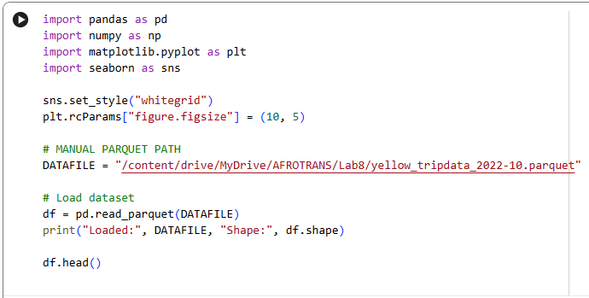
4. Class Activity 2: Demand Estimation
4.4 Python code explanation
Block 1: Import Libraries and Load the Dataset:
This step imports the essential Python libraries for data analysis and visualization.
We read the Parquet taxi dataset into a DataFrame so we can process and analyze the trip records.
Notes:
# English
Step 1 – Download the provided Python notebook
Students obtain the starter file that includes data loading blocks and basic structure.
Step 2 – Upload the notebook to Google Colab
They open the notebook in an environment with all required Python packages preinstalled.
Step 3 – Import Python libraries
Typical packages:
pandas, numpy, matplotlib, networkx, scipy, etc.
Step 4 – Implement Trip Distribution (Gravity Model)
Using the provided impedance matrix + productions/attractions:
Apply the formula
Generate Distributed OD Matrix
Validate row and column sums
Step 5 – Implement Mode Choice
Students use a simplified Logit model to estimate mode shares:
Car
Public Transport
Walk/Cycle
Using example utility values.
Step 6 – Implement Route Assignment (Shortest Path)
Using Dijkstra’s Algorithm via NetworkX:
Build graph from link data
Compute shortest paths
Assign OD trips to paths
Generate link volumes
Step 7 – Visualize and Analyze Results
Recommended visuals:
Distribution heatmap
Mode share bar chart
Network with assigned volumes
Difference between base and scenario (optional)
Step 8 – Save the final notebook
Students download/export .ipynb for submission.

Slide 37
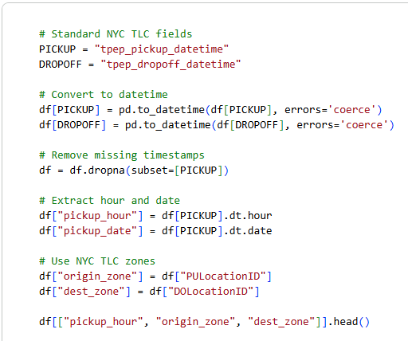
4. Class Activity 2: Demand Estimation
Block 2: Basic Cleaning & Preparing Fields
We now extract the fields required for demand estimation:
Convert pickup datetime
Extract hour & date
Keep useful columns only
Handle missing values
Prepare zone information
(PULocationID / DOLocationID)
Notes:
# English
Step 1 – Download the provided Python notebook
Students obtain the starter file that includes data loading blocks and basic structure.
Step 2 – Upload the notebook to Google Colab
They open the notebook in an environment with all required Python packages preinstalled.
Step 3 – Import Python libraries
Typical packages:
pandas, numpy, matplotlib, networkx, scipy, etc.
Step 4 – Implement Trip Distribution (Gravity Model)
Using the provided impedance matrix + productions/attractions:
Apply the formula
Generate Distributed OD Matrix
Validate row and column sums
Step 5 – Implement Mode Choice
Students use a simplified Logit model to estimate mode shares:
Car
Public Transport
Walk/Cycle
Using example utility values.
Step 6 – Implement Route Assignment (Shortest Path)
Using Dijkstra’s Algorithm via NetworkX:
Build graph from link data
Compute shortest paths
Assign OD trips to paths
Generate link volumes
Step 7 – Visualize and Analyze Results
Recommended visuals:
Distribution heatmap
Mode share bar chart
Network with assigned volumes
Difference between base and scenario (optional)
Step 8 – Save the final notebook
Students download/export .ipynb for submission.

Slide 38
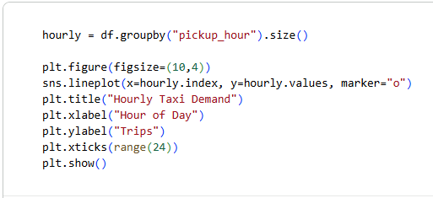
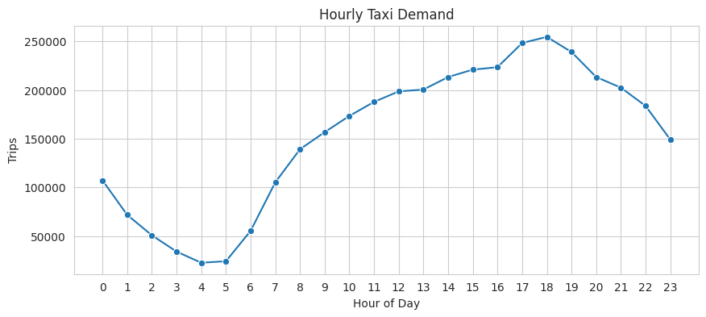
4. Class Activity 2: Demand Estimation
Block 3: Advanced Demand Estimation & Visualization
Hourly Demand Profile: This visualization helps understand how demand varies across different times of the day.
Notes:
# English
Step 1 – Download the provided Python notebook
Students obtain the starter file that includes data loading blocks and basic structure.
Step 2 – Upload the notebook to Google Colab
They open the notebook in an environment with all required Python packages preinstalled.
Step 3 – Import Python libraries
Typical packages:
pandas, numpy, matplotlib, networkx, scipy, etc.
Step 4 – Implement Trip Distribution (Gravity Model)
Using the provided impedance matrix + productions/attractions:
Apply the formula
Generate Distributed OD Matrix
Validate row and column sums
Step 5 – Implement Mode Choice
Students use a simplified Logit model to estimate mode shares:
Car
Public Transport
Walk/Cycle
Using example utility values.
Step 6 – Implement Route Assignment (Shortest Path)
Using Dijkstra’s Algorithm via NetworkX:
Build graph from link data
Compute shortest paths
Assign OD trips to paths
Generate link volumes
Step 7 – Visualize and Analyze Results
Recommended visuals:
Distribution heatmap
Mode share bar chart
Network with assigned volumes
Difference between base and scenario (optional)
Step 8 – Save the final notebook
Students download/export .ipynb for submission.

Slide 39
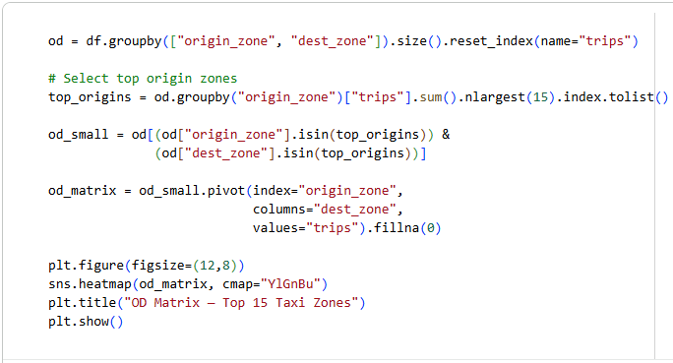
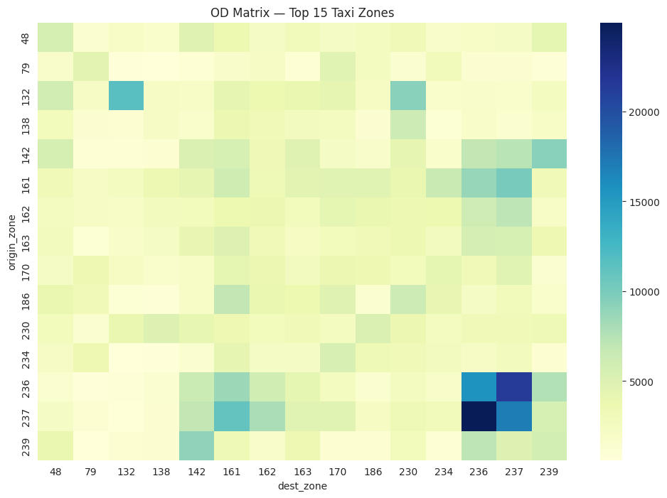
4. Class Activity 2: Demand Estimation
Block 4: OD Matrix (Using TLC Zone IDs)
We compute the Origin–Destination matrix by aggregating trips between NYC TLC zone IDs.
To keep the matrix readable, we limit it to the top 15 busiest origins.
Notes:
# English
Step 1 – Download the provided Python notebook
Students obtain the starter file that includes data loading blocks and basic structure.
Step 2 – Upload the notebook to Google Colab
They open the notebook in an environment with all required Python packages preinstalled.
Step 3 – Import Python libraries
Typical packages:
pandas, numpy, matplotlib, networkx, scipy, etc.
Step 4 – Implement Trip Distribution (Gravity Model)
Using the provided impedance matrix + productions/attractions:
Apply the formula
Generate Distributed OD Matrix
Validate row and column sums
Step 5 – Implement Mode Choice
Students use a simplified Logit model to estimate mode shares:
Car
Public Transport
Walk/Cycle
Using example utility values.
Step 6 – Implement Route Assignment (Shortest Path)
Using Dijkstra’s Algorithm via NetworkX:
Build graph from link data
Compute shortest paths
Assign OD trips to paths
Generate link volumes
Step 7 – Visualize and Analyze Results
Recommended visuals:
Distribution heatmap
Mode share bar chart
Network with assigned volumes
Difference between base and scenario (optional)
Step 8 – Save the final notebook
Students download/export .ipynb for submission.

Slide 40
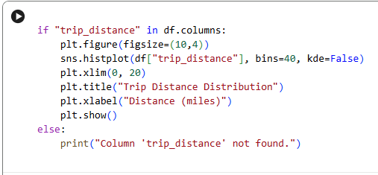
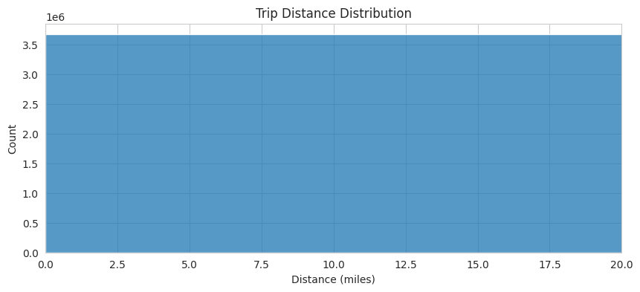
4. Class Activity 2: Demand Estimation
Block 5: Trip Distance Distribution
We visualize the distribution of trip distances to understand how far most passengers travel.
Notes:
# English
Step 1 – Download the provided Python notebook
Students obtain the starter file that includes data loading blocks and basic structure.
Step 2 – Upload the notebook to Google Colab
They open the notebook in an environment with all required Python packages preinstalled.
Step 3 – Import Python libraries
Typical packages:
pandas, numpy, matplotlib, networkx, scipy, etc.
Step 4 – Implement Trip Distribution (Gravity Model)
Using the provided impedance matrix + productions/attractions:
Apply the formula
Generate Distributed OD Matrix
Validate row and column sums
Step 5 – Implement Mode Choice
Students use a simplified Logit model to estimate mode shares:
Car
Public Transport
Walk/Cycle
Using example utility values.
Step 6 – Implement Route Assignment (Shortest Path)
Using Dijkstra’s Algorithm via NetworkX:
Build graph from link data
Compute shortest paths
Assign OD trips to paths
Generate link volumes
Step 7 – Visualize and Analyze Results
Recommended visuals:
Distribution heatmap
Mode share bar chart
Network with assigned volumes
Difference between base and scenario (optional)
Step 8 – Save the final notebook
Students download/export .ipynb for submission.

Slide 41
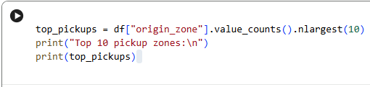
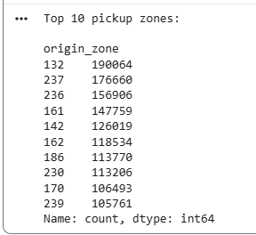
4. Class Activity 2: Demand Estimation
Block 5: Top Pickup Zones Analysis
This code counts how many trips start in each zone, selects the top 10 busiest pickup zones, and prints them.
Notes:
# English
Step 1 – Download the provided Python notebook
Students obtain the starter file that includes data loading blocks and basic structure.
Step 2 – Upload the notebook to Google Colab
They open the notebook in an environment with all required Python packages preinstalled.
Step 3 – Import Python libraries
Typical packages:
pandas, numpy, matplotlib, networkx, scipy, etc.
Step 4 – Implement Trip Distribution (Gravity Model)
Using the provided impedance matrix + productions/attractions:
Apply the formula
Generate Distributed OD Matrix
Validate row and column sums
Step 5 – Implement Mode Choice
Students use a simplified Logit model to estimate mode shares:
Car
Public Transport
Walk/Cycle
Using example utility values.
Step 6 – Implement Route Assignment (Shortest Path)
Using Dijkstra’s Algorithm via NetworkX:
Build graph from link data
Compute shortest paths
Assign OD trips to paths
Generate link volumes
Step 7 – Visualize and Analyze Results
Recommended visuals:
Distribution heatmap
Mode share bar chart
Network with assigned volumes
Difference between base and scenario (optional)
Step 8 – Save the final notebook
Students download/export .ipynb for submission.

Slide 42
Section 05:
Class Activity 3: Scenario Modeling
Notes:
In this section, we are going to explore one of the most important data preprocessing steps in any data analysis project.
Whether you're working with transport data, business analytics, or health records, preprocessing helps turn messy raw data into something that machines — and humans — can understand.
Let’s go through the core techniques you’ll need to clean and prepare your data effectively.

Slide 43
5. Class Activity 3: Scenario Modeling
5.1 Class Activity 3: Scenario Modeling
In this activity, students will learn how to modify real demand patterns using simple "what-if" scenarios.
By adjusting inputs (ex: fuel price, congestion, policy), we can observe how travel demand changes and visualize the effects.
How to do?
Load the cleaned taxi dataset.
Apply a scenario-based rule (e.g., increase demand, reduce trips, shift mode).
Recalculate zone-level demand.
Visualize the before–after change.
Interpret results.
Link for the reference code:
https://colab.research.google.com/drive/1mjwlhjU-qdKjQ-TgIPqljOTgy3ipyf8O
Save Your File:
ex: Lab8_Class_Activity_3_Advanced_Demand_Estimation.ipynb
Notes:
# English
To understand data preprocessing better, let’s do another real activity using Python. We’ll run code in Google Colab step by step, and see how issues like missing values, duplicates, and formatting errors are fixed. Then we’ll compare the raw data with the cleaned version using charts.

Slide 44
5. Class Activity 3: Scenario Modeling
5.2 Class Activity 3: Dataset
For this activity, we use the NYC TLC Yellow Taxi Trip Records, provided in Apache Parquet format. The full TLC dataset is 29.58 GB, containing millions of trip-level records from multiple years. To keep processing fast and manageable in Colab, we use only the latest monthly file (October 2022).
About the Dataset:
The Yellow Taxi Trip Records include detailed information on each taxi trip, such as:
✅ Pick-up & drop-off timestamps
✅ Pick-up & drop-off TLC zone locations
✅ Trip distance
✅ Fare details (fare amount, tolls, surcharges)
✅ Rate type and payment type
✅ Passenger count reported by drivers
Notes:
# English
Step 1 – Download the provided Python notebook
Students obtain the starter file that includes data loading blocks and basic structure.
Step 2 – Upload the notebook to Google Colab
They open the notebook in an environment with all required Python packages preinstalled.
Step 3 – Import Python libraries
Typical packages:
pandas, numpy, matplotlib, networkx, scipy, etc.
Step 4 – Implement Trip Distribution (Gravity Model)
Using the provided impedance matrix + productions/attractions:
Apply the formula
Generate Distributed OD Matrix
Validate row and column sums
Step 5 – Implement Mode Choice
Students use a simplified Logit model to estimate mode shares:
Car
Public Transport
Walk/Cycle
Using example utility values.
Step 6 – Implement Route Assignment (Shortest Path)
Using Dijkstra’s Algorithm via NetworkX:
Build graph from link data
Compute shortest paths
Assign OD trips to paths
Generate link volumes
Step 7 – Visualize and Analyze Results
Recommended visuals:
Distribution heatmap
Mode share bar chart
Network with assigned volumes
Difference between base and scenario (optional)
Step 8 – Save the final notebook
Students download/export .ipynb for submission.

Slide 45
5. Class Activity 3: Scenario Modeling
Dataset Information:
✅ Dataset Title: TLC Trip Record Data Yellow Taxi
✅ Source: Kaggle
✅ Link: https://www.kaggle.com/datasets/marcbrandner/tlc-trip-record-data-yellow-taxi
✅ CSV Database name: yellow_tripdata_2022-10.parquet
✅ File Size: 55.7 MB (single month extract)
✅ Format: Apache Parquet (efficient, compressed, fast loading)
✅ Contains: pickup time, dropoff time, zones, distance, fare, passengers
✅ Total Records: ~5.5 million
Notes:
# English
Step 1 – Download the provided Python notebook
Students obtain the starter file that includes data loading blocks and basic structure.
Step 2 – Upload the notebook to Google Colab
They open the notebook in an environment with all required Python packages preinstalled.
Step 3 – Import Python libraries
Typical packages:
pandas, numpy, matplotlib, networkx, scipy, etc.
Step 4 – Implement Trip Distribution (Gravity Model)
Using the provided impedance matrix + productions/attractions:
Apply the formula
Generate Distributed OD Matrix
Validate row and column sums
Step 5 – Implement Mode Choice
Students use a simplified Logit model to estimate mode shares:
Car
Public Transport
Walk/Cycle
Using example utility values.
Step 6 – Implement Route Assignment (Shortest Path)
Using Dijkstra’s Algorithm via NetworkX:
Build graph from link data
Compute shortest paths
Assign OD trips to paths
Generate link volumes
Step 7 – Visualize and Analyze Results
Recommended visuals:
Distribution heatmap
Mode share bar chart
Network with assigned volumes
Difference between base and scenario (optional)
Step 8 – Save the final notebook
Students download/export .ipynb for submission.

Slide 46
5. Class Activity 2: Scenario Modeling
5.3 Class Activity 3: Task Instructions
Follow these steps using Python (preferably in Google Colab):
Step 1: Download the provided scenario-modeling Python notebook.
Step 2: Upload it to Google Colab.
Step 3: Import the necessary Python libraries.
Step 4: Load the trip dataset (Parquet format).
Step 5: Define a scenario rule (e.g., +20% increase in demand, -30% reduction, peak-hour boost).
Step 6: Apply the scenario to zone-level trip counts.
Step 7: Visualize “Before vs After” using bar charts & heatmaps.
Step 8: Save and export the final .ipynb file.
Notes:
# English
Step 1 – Download the provided Python notebook
Students obtain the starter file that includes data loading blocks and basic structure.
Step 2 – Upload the notebook to Google Colab
They open the notebook in an environment with all required Python packages preinstalled.
Step 3 – Import Python libraries
Typical packages:
pandas, numpy, matplotlib, networkx, scipy, etc.
Step 4 – Implement Trip Distribution (Gravity Model)
Using the provided impedance matrix + productions/attractions:
Apply the formula
Generate Distributed OD Matrix
Validate row and column sums
Step 5 – Implement Mode Choice
Students use a simplified Logit model to estimate mode shares:
Car
Public Transport
Walk/Cycle
Using example utility values.
Step 6 – Implement Route Assignment (Shortest Path)
Using Dijkstra’s Algorithm via NetworkX:
Build graph from link data
Compute shortest paths
Assign OD trips to paths
Generate link volumes
Step 7 – Visualize and Analyze Results
Recommended visuals:
Distribution heatmap
Mode share bar chart
Network with assigned volumes
Difference between base and scenario (optional)
Step 8 – Save the final notebook
Students download/export .ipynb for submission.

Slide 47
5. Class Activity 2: Scenario Modeling
5.4 Python code explanation:
Block 1: Import Libraries and Load the Dataset:
This step imports the essential Python libraries for data analysis and visualization.
We read the Parquet taxi dataset into a DataFrame so we can process and analyze the trip records.
Notes:
# English
Step 1 – Download the provided Python notebook
Students obtain the starter file that includes data loading blocks and basic structure.
Step 2 – Upload the notebook to Google Colab
They open the notebook in an environment with all required Python packages preinstalled.
Step 3 – Import Python libraries
Typical packages:
pandas, numpy, matplotlib, networkx, scipy, etc.
Step 4 – Implement Trip Distribution (Gravity Model)
Using the provided impedance matrix + productions/attractions:
Apply the formula
Generate Distributed OD Matrix
Validate row and column sums
Step 5 – Implement Mode Choice
Students use a simplified Logit model to estimate mode shares:
Car
Public Transport
Walk/Cycle
Using example utility values.
Step 6 – Implement Route Assignment (Shortest Path)
Using Dijkstra’s Algorithm via NetworkX:
Build graph from link data
Compute shortest paths
Assign OD trips to paths
Generate link volumes
Step 7 – Visualize and Analyze Results
Recommended visuals:
Distribution heatmap
Mode share bar chart
Network with assigned volumes
Difference between base and scenario (optional)
Step 8 – Save the final notebook
Students download/export .ipynb for submission.

Slide 48
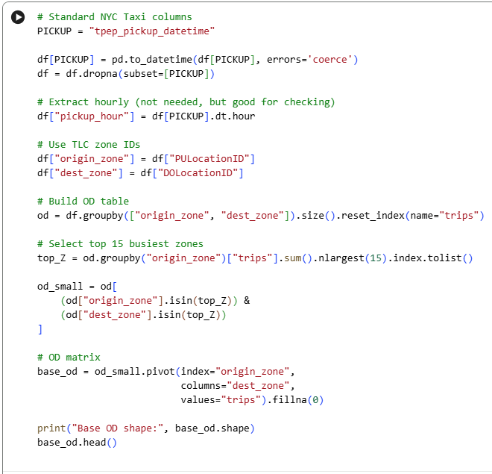
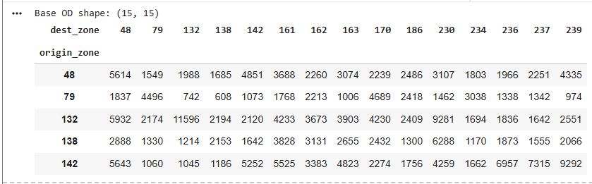
5. Class Activity 2: Scenario Modeling
Block 2: Clean & Prepare OD Data
Convert trip records into a structured origin–destination table by filtering, grouping, and counting trips between zones. This creates the foundation for scenario analysis.
Notes:
# English
Step 1 – Download the provided Python notebook
Students obtain the starter file that includes data loading blocks and basic structure.
Step 2 – Upload the notebook to Google Colab
They open the notebook in an environment with all required Python packages preinstalled.
Step 3 – Import Python libraries
Typical packages:
pandas, numpy, matplotlib, networkx, scipy, etc.
Step 4 – Implement Trip Distribution (Gravity Model)
Using the provided impedance matrix + productions/attractions:
Apply the formula
Generate Distributed OD Matrix
Validate row and column sums
Step 5 – Implement Mode Choice
Students use a simplified Logit model to estimate mode shares:
Car
Public Transport
Walk/Cycle
Using example utility values.
Step 6 – Implement Route Assignment (Shortest Path)
Using Dijkstra’s Algorithm via NetworkX:
Build graph from link data
Compute shortest paths
Assign OD trips to paths
Generate link volumes
Step 7 – Visualize and Analyze Results
Recommended visuals:
Distribution heatmap
Mode share bar chart
Network with assigned volumes
Difference between base and scenario (optional)
Step 8 – Save the final notebook
Students download/export .ipynb for submission.

Slide 49
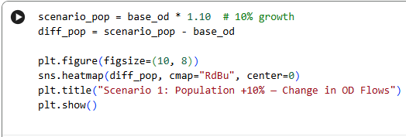
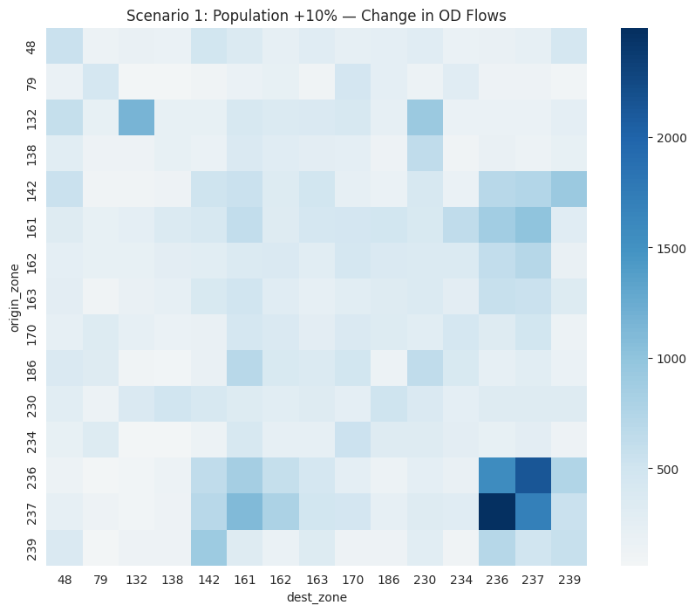
5. Class Activity 2: Scenario Modeling
Block 3: Scenario A: Population Growth +10%
Apply a uniform 10% increase to OD flows.
This simulates demand growth due to increased population or economic activity.
Notes:
# English
Step 1 – Download the provided Python notebook
Students obtain the starter file that includes data loading blocks and basic structure.
Step 2 – Upload the notebook to Google Colab
They open the notebook in an environment with all required Python packages preinstalled.
Step 3 – Import Python libraries
Typical packages:
pandas, numpy, matplotlib, networkx, scipy, etc.
Step 4 – Implement Trip Distribution (Gravity Model)
Using the provided impedance matrix + productions/attractions:
Apply the formula
Generate Distributed OD Matrix
Validate row and column sums
Step 5 – Implement Mode Choice
Students use a simplified Logit model to estimate mode shares:
Car
Public Transport
Walk/Cycle
Using example utility values.
Step 6 – Implement Route Assignment (Shortest Path)
Using Dijkstra’s Algorithm via NetworkX:
Build graph from link data
Compute shortest paths
Assign OD trips to paths
Generate link volumes
Step 7 – Visualize and Analyze Results
Recommended visuals:
Distribution heatmap
Mode share bar chart
Network with assigned volumes
Difference between base and scenario (optional)
Step 8 – Save the final notebook
Students download/export .ipynb for submission.

Slide 50
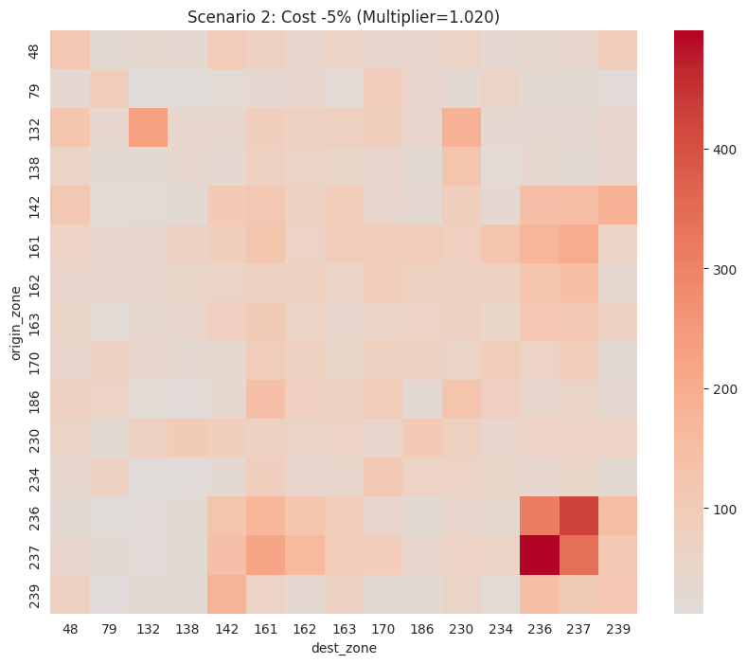
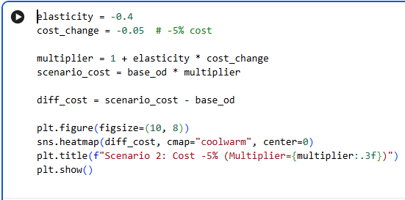
5. Class Activity 2: Scenario Modeling
Block 4: cenario B: Travel Cost –5% (Elasticity Model)
Using elasticity = –0.4, a 5% reduction in travel cost results in demand change:
Demand_new = Demand_old × (1 + elasticity × %change_in_cost)
Notes:
# English
Step 1 – Download the provided Python notebook
Students obtain the starter file that includes data loading blocks and basic structure.
Step 2 – Upload the notebook to Google Colab
They open the notebook in an environment with all required Python packages preinstalled.
Step 3 – Import Python libraries
Typical packages:
pandas, numpy, matplotlib, networkx, scipy, etc.
Step 4 – Implement Trip Distribution (Gravity Model)
Using the provided impedance matrix + productions/attractions:
Apply the formula
Generate Distributed OD Matrix
Validate row and column sums
Step 5 – Implement Mode Choice
Students use a simplified Logit model to estimate mode shares:
Car
Public Transport
Walk/Cycle
Using example utility values.
Step 6 – Implement Route Assignment (Shortest Path)
Using Dijkstra’s Algorithm via NetworkX:
Build graph from link data
Compute shortest paths
Assign OD trips to paths
Generate link volumes
Step 7 – Visualize and Analyze Results
Recommended visuals:
Distribution heatmap
Mode share bar chart
Network with assigned volumes
Difference between base and scenario (optional)
Step 8 – Save the final notebook
Students download/export .ipynb for submission.

Slide 51
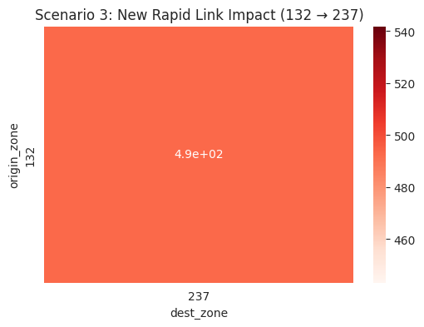
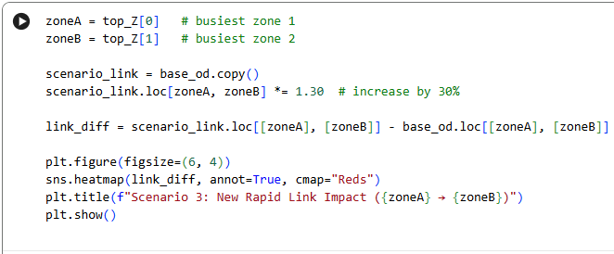
5. Class Activity 2: Scenario Modeling
Block 5: Scenario C: New Rapid Link Boost (30% Increase)
Simulate a new rapid connection between two high-demand zones.
Notes:
# English
Step 1 – Download the provided Python notebook
Students obtain the starter file that includes data loading blocks and basic structure.
Step 2 – Upload the notebook to Google Colab
They open the notebook in an environment with all required Python packages preinstalled.
Step 3 – Import Python libraries
Typical packages:
pandas, numpy, matplotlib, networkx, scipy, etc.
Step 4 – Implement Trip Distribution (Gravity Model)
Using the provided impedance matrix + productions/attractions:
Apply the formula
Generate Distributed OD Matrix
Validate row and column sums
Step 5 – Implement Mode Choice
Students use a simplified Logit model to estimate mode shares:
Car
Public Transport
Walk/Cycle
Using example utility values.
Step 6 – Implement Route Assignment (Shortest Path)
Using Dijkstra’s Algorithm via NetworkX:
Build graph from link data
Compute shortest paths
Assign OD trips to paths
Generate link volumes
Step 7 – Visualize and Analyze Results
Recommended visuals:
Distribution heatmap
Mode share bar chart
Network with assigned volumes
Difference between base and scenario (optional)
Step 8 – Save the final notebook
Students download/export .ipynb for submission.

Slide 52
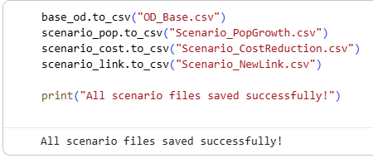
5. Class Activity 2: Scenario Modeling
Block 5: Save Outputs
Save your OD matrices and scenario outputs for reporting.
Notes:
# English
Step 1 – Download the provided Python notebook
Students obtain the starter file that includes data loading blocks and basic structure.
Step 2 – Upload the notebook to Google Colab
They open the notebook in an environment with all required Python packages preinstalled.
Step 3 – Import Python libraries
Typical packages:
pandas, numpy, matplotlib, networkx, scipy, etc.
Step 4 – Implement Trip Distribution (Gravity Model)
Using the provided impedance matrix + productions/attractions:
Apply the formula
Generate Distributed OD Matrix
Validate row and column sums
Step 5 – Implement Mode Choice
Students use a simplified Logit model to estimate mode shares:
Car
Public Transport
Walk/Cycle
Using example utility values.
Step 6 – Implement Route Assignment (Shortest Path)
Using Dijkstra’s Algorithm via NetworkX:
Build graph from link data
Compute shortest paths
Assign OD trips to paths
Generate link volumes
Step 7 – Visualize and Analyze Results
Recommended visuals:
Distribution heatmap
Mode share bar chart
Network with assigned volumes
Difference between base and scenario (optional)
Step 8 – Save the final notebook
Students download/export .ipynb for submission.

Slide 53
Section 06:
Homework: Travel Demand Forecasting
Notes:
In this section, we are going to explore one of the most important data preprocessing steps in any data analysis project.
Whether you're working with transport data, business analytics, or health records, preprocessing helps turn messy raw data into something that machines — and humans — can understand.
Let’s go through the core techniques you’ll need to clean and prepare your data effectively.

Slide 54
6. Homework: Travel Demand Forecasting
6.1 Homework: Travel Demand Forecasting
In this homework, you will work with a real-world transport dataset (NYC Yellow Taxi Parquet file). Your task is to clean the data, estimate travel demand, create visualizations, and implement a simple next-day demand forecasting function.
How to do?
Use the provided Python notebook, follow the steps in order, and run each cell to load the dataset, clean it, analyze demand, generate visualizations, and produce the next-day forecast.
Link for the reference code:
https://colab.research.google.com/drive/1U60jRK-qo80PrgTgSZ_7hHXrEUkAvyu4
Save Your File:
ex: Lab8_Homework_Travel Demand Forecasting.ipynb
Notes:
# English
To understand data preprocessing better, let’s do another real activity using Python. We’ll run code in Google Colab step by step, and see how issues like missing values, duplicates, and formatting errors are fixed. Then we’ll compare the raw data with the cleaned version using charts.

Slide 55
6. Homework: Travel Demand Forecasting
6.2 Homework: Dataset
For this activity, we use the NYC TLC Yellow Taxi Trip Records, provided in Apache Parquet format. The full TLC dataset is 29.58 GB, containing millions of trip-level records from multiple years. To keep processing fast and manageable in Colab, we use only the latest monthly file (October 2022).
About the Dataset:
The Yellow Taxi Trip Records include detailed information on each taxi trip, such as:
✅ Pick-up & drop-off timestamps
✅ Pick-up & drop-off TLC zone locations
✅ Trip distance
✅ Fare details (fare amount, tolls, surcharges)
✅ Rate type and payment type
✅ Passenger count reported by drivers
Notes:
# English
Step 1 – Download the provided Python notebook
Students obtain the starter file that includes data loading blocks and basic structure.
Step 2 – Upload the notebook to Google Colab
They open the notebook in an environment with all required Python packages preinstalled.
Step 3 – Import Python libraries
Typical packages:
pandas, numpy, matplotlib, networkx, scipy, etc.
Step 4 – Implement Trip Distribution (Gravity Model)
Using the provided impedance matrix + productions/attractions:
Apply the formula
Generate Distributed OD Matrix
Validate row and column sums
Step 5 – Implement Mode Choice
Students use a simplified Logit model to estimate mode shares:
Car
Public Transport
Walk/Cycle
Using example utility values.
Step 6 – Implement Route Assignment (Shortest Path)
Using Dijkstra’s Algorithm via NetworkX:
Build graph from link data
Compute shortest paths
Assign OD trips to paths
Generate link volumes
Step 7 – Visualize and Analyze Results
Recommended visuals:
Distribution heatmap
Mode share bar chart
Network with assigned volumes
Difference between base and scenario (optional)
Step 8 – Save the final notebook
Students download/export .ipynb for submission.

Slide 56
6. Homework: Travel Demand Forecasting
Dataset Information:
✅ Dataset Title: TLC Trip Record Data Yellow Taxi
✅ Source: Kaggle
✅ Link: https://www.kaggle.com/datasets/marcbrandner/tlc-trip-record-data-yellow-taxi
✅ CSV Database name: yellow_tripdata_2022-10.parquet
✅ File Size: 55.7 MB (single month extract)
✅ Format: Apache Parquet (efficient, compressed, fast loading)
✅ Contains: pickup time, dropoff time, zones, distance, fare, passengers
✅ Total Records: ~5.5 million
Notes:
# English
Step 1 – Download the provided Python notebook
Students obtain the starter file that includes data loading blocks and basic structure.
Step 2 – Upload the notebook to Google Colab
They open the notebook in an environment with all required Python packages preinstalled.
Step 3 – Import Python libraries
Typical packages:
pandas, numpy, matplotlib, networkx, scipy, etc.
Step 4 – Implement Trip Distribution (Gravity Model)
Using the provided impedance matrix + productions/attractions:
Apply the formula
Generate Distributed OD Matrix
Validate row and column sums
Step 5 – Implement Mode Choice
Students use a simplified Logit model to estimate mode shares:
Car
Public Transport
Walk/Cycle
Using example utility values.
Step 6 – Implement Route Assignment (Shortest Path)
Using Dijkstra’s Algorithm via NetworkX:
Build graph from link data
Compute shortest paths
Assign OD trips to paths
Generate link volumes
Step 7 – Visualize and Analyze Results
Recommended visuals:
Distribution heatmap
Mode share bar chart
Network with assigned volumes
Difference between base and scenario (optional)
Step 8 – Save the final notebook
Students download/export .ipynb for submission.

Slide 57
6. Homework: Travel Demand Forecasting
6.3 Homework: Task Instructions
Follow these steps using Python (preferably in Google Colab):
Step 1: Download the provided scenario-modeling Python notebook.
Step 2: Upload it to Google Colab.
Step 3: Import the necessary Python libraries.
Step 4: Load & Clean Data the trip dataset (Parquet format).
Step 5: Basic Demand Estimation
Trips per hour, Trips per day, Trips per pickup zone
Step 6: Visualisation Dashboard.
Line chart (daily demand), Bar chart (top pickup zones), Heatmap (hourly trends)
Step 7: Simple Demand Forecasting - Moving Average OR Linear Trend
Step 8: Save and export the final .ipynb file.
Notes:
# English
Step 1 – Download the provided Python notebook
Students obtain the starter file that includes data loading blocks and basic structure.
Step 2 – Upload the notebook to Google Colab
They open the notebook in an environment with all required Python packages preinstalled.
Step 3 – Import Python libraries
Typical packages:
pandas, numpy, matplotlib, networkx, scipy, etc.
Step 4 – Implement Trip Distribution (Gravity Model)
Using the provided impedance matrix + productions/attractions:
Apply the formula
Generate Distributed OD Matrix
Validate row and column sums
Step 5 – Implement Mode Choice
Students use a simplified Logit model to estimate mode shares:
Car
Public Transport
Walk/Cycle
Using example utility values.
Step 6 – Implement Route Assignment (Shortest Path)
Using Dijkstra’s Algorithm via NetworkX:
Build graph from link data
Compute shortest paths
Assign OD trips to paths
Generate link volumes
Step 7 – Visualize and Analyze Results
Recommended visuals:
Distribution heatmap
Mode share bar chart
Network with assigned volumes
Difference between base and scenario (optional)
Step 8 – Save the final notebook
Students download/export .ipynb for submission.

Slide 58
6. Homework: Travel Demand Forecasting
6.4 Class Activity 2: Submission Guidelines
Submit the cleaned dataset analysis, visual outputs, and forecast results as instructed below.
A brief PDF report
Graphs in png/jpeg
Python code file (.ipynb or .py format)
Report Structure: Your report must include below sections.
Title Page with your name, course, and date
Introduction to the dataset and its source
Summary of Key Cleaning Steps
Visual Outputs (screenshots or images of plots)
Conclusion: What was improved through preprocessing
Appendix: Python code snippets for main functions
Notes:
# English
Step 1 – Download the provided Python notebook
Students obtain the starter file that includes data loading blocks and basic structure.
Step 2 – Upload the notebook to Google Colab
They open the notebook in an environment with all required Python packages preinstalled.
Step 3 – Import Python libraries
Typical packages:
pandas, numpy, matplotlib, networkx, scipy, etc.
Step 4 – Implement Trip Distribution (Gravity Model)
Using the provided impedance matrix + productions/attractions:
Apply the formula
Generate Distributed OD Matrix
Validate row and column sums
Step 5 – Implement Mode Choice
Students use a simplified Logit model to estimate mode shares:
Car
Public Transport
Walk/Cycle
Using example utility values.
Step 6 – Implement Route Assignment (Shortest Path)
Using Dijkstra’s Algorithm via NetworkX:
Build graph from link data
Compute shortest paths
Assign OD trips to paths
Generate link volumes
Step 7 – Visualize and Analyze Results
Recommended visuals:
Distribution heatmap
Mode share bar chart
Network with assigned volumes
Difference between base and scenario (optional)
Step 8 – Save the final notebook
Students download/export .ipynb for submission.

Slide 59
6. Homework: Travel Demand Forecasting
6.5 Class Activity 2: Deadline & Notes
Deadline: Submit all files before … / … / … (1week after the Lab 4)
Note: This assignment will be graded based on clarity, correctness of processing steps, code quality, and data visualization.
Notes:
# English
Step 1 – Download the provided Python notebook
Students obtain the starter file that includes data loading blocks and basic structure.
Step 2 – Upload the notebook to Google Colab
They open the notebook in an environment with all required Python packages preinstalled.
Step 3 – Import Python libraries
Typical packages:
pandas, numpy, matplotlib, networkx, scipy, etc.
Step 4 – Implement Trip Distribution (Gravity Model)
Using the provided impedance matrix + productions/attractions:
Apply the formula
Generate Distributed OD Matrix
Validate row and column sums
Step 5 – Implement Mode Choice
Students use a simplified Logit model to estimate mode shares:
Car
Public Transport
Walk/Cycle
Using example utility values.
Step 6 – Implement Route Assignment (Shortest Path)
Using Dijkstra’s Algorithm via NetworkX:
Build graph from link data
Compute shortest paths
Assign OD trips to paths
Generate link volumes
Step 7 – Visualize and Analyze Results
Recommended visuals:
Distribution heatmap
Mode share bar chart
Network with assigned volumes
Difference between base and scenario (optional)
Step 8 – Save the final notebook
Students download/export .ipynb for submission.

Slide 60
Section 07:
References

Slide 61
7. References
References:
  “Transportation Engineering and Planning” by C.S. Papacostas and P.D. Prevedouros (Covers basics of transport systems, data, planning, and policy)
  “Introduction to Transportation Systems” by Joseph Sussman
  “Data Science for Transport: A Self-Study Guide with Computer Exercises” by Charles Fox
  “Modeling Transport” by Juan de Dios Ortúzar and Luis G. Willumsen
  (Travel demand modeling)
  “Transportation Systems Planning: Methods and Applications” by Konstadinos G. Goulias

Slide 62
Thank you for your attention!

